Slide 1
“From waste feedstock to low-carbon, sustainable, high-value chemicals.”

Slide 2
The Chemicals Industry Must Change
99%
16%
60%
Key chemicals found to be unsustainable*
Global GHG emissions (2nd largest)
Account for 60% of oil demand in next decade**
* Green Chemistry, 2021 (https://doi.org/10.1039/D1GC02623B); ** World Energy Outlook 2020 (International Energy Agency)

Slide 3
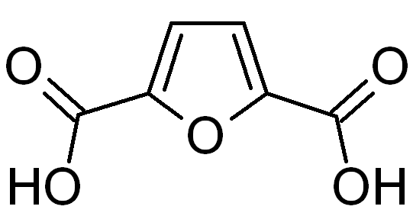
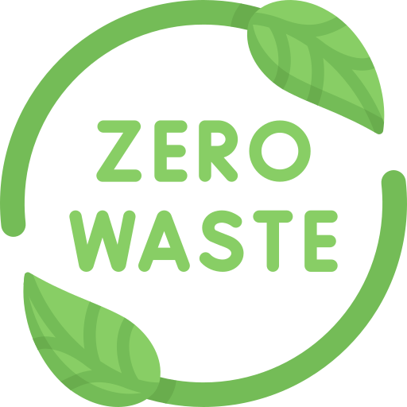
Carbon-negative,
green hydrogen
Saves millions of tonnes of CO₂ per year
Gateway to green chemicals for plastics, textiles and more
Reduces weight and improves strength of plastics
FDCA
Biorefinery approach: zero waste
Improves biodegradability of plastics

Slide 4
Why Should Shell Care?
Supplier of chemicals
Products include building blocks for polymers, solvents and adhesives
We offer a unique entry point in bio-based chemicals and hydrogen

Slide 5
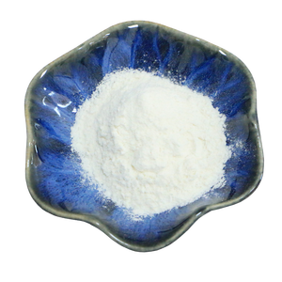
Market: $324 billion (2030)
Total Available Market (bioplastics) - 17% CAGR
Drink Bottle
Food Packaging
Textiles
Wrapping Films
$2,500 / tonne Thin-film, flexible electronics
$1,500 / tonne Biopolymers and films for packaging.

Slide 6
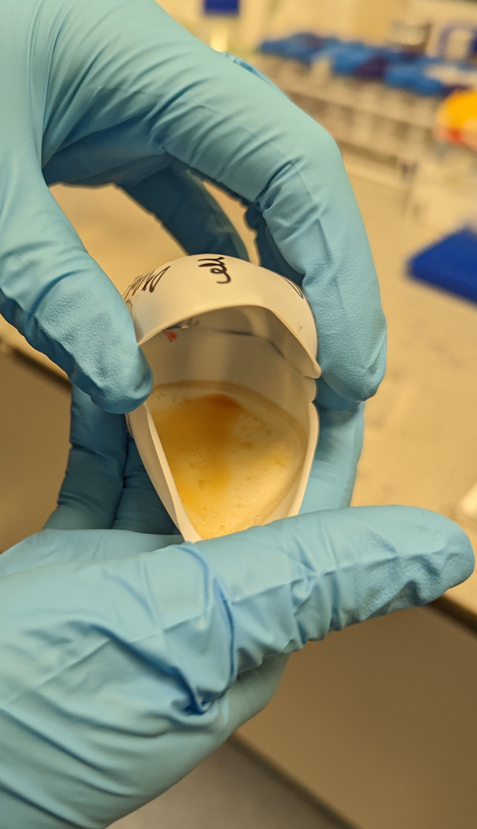
Competition
Feedstock Agnostic
No handling intermediates (incl. HMF)
No difficult-to-remove by-products
FDCA directly from biomass
Consumes plastic waste

Slide 7
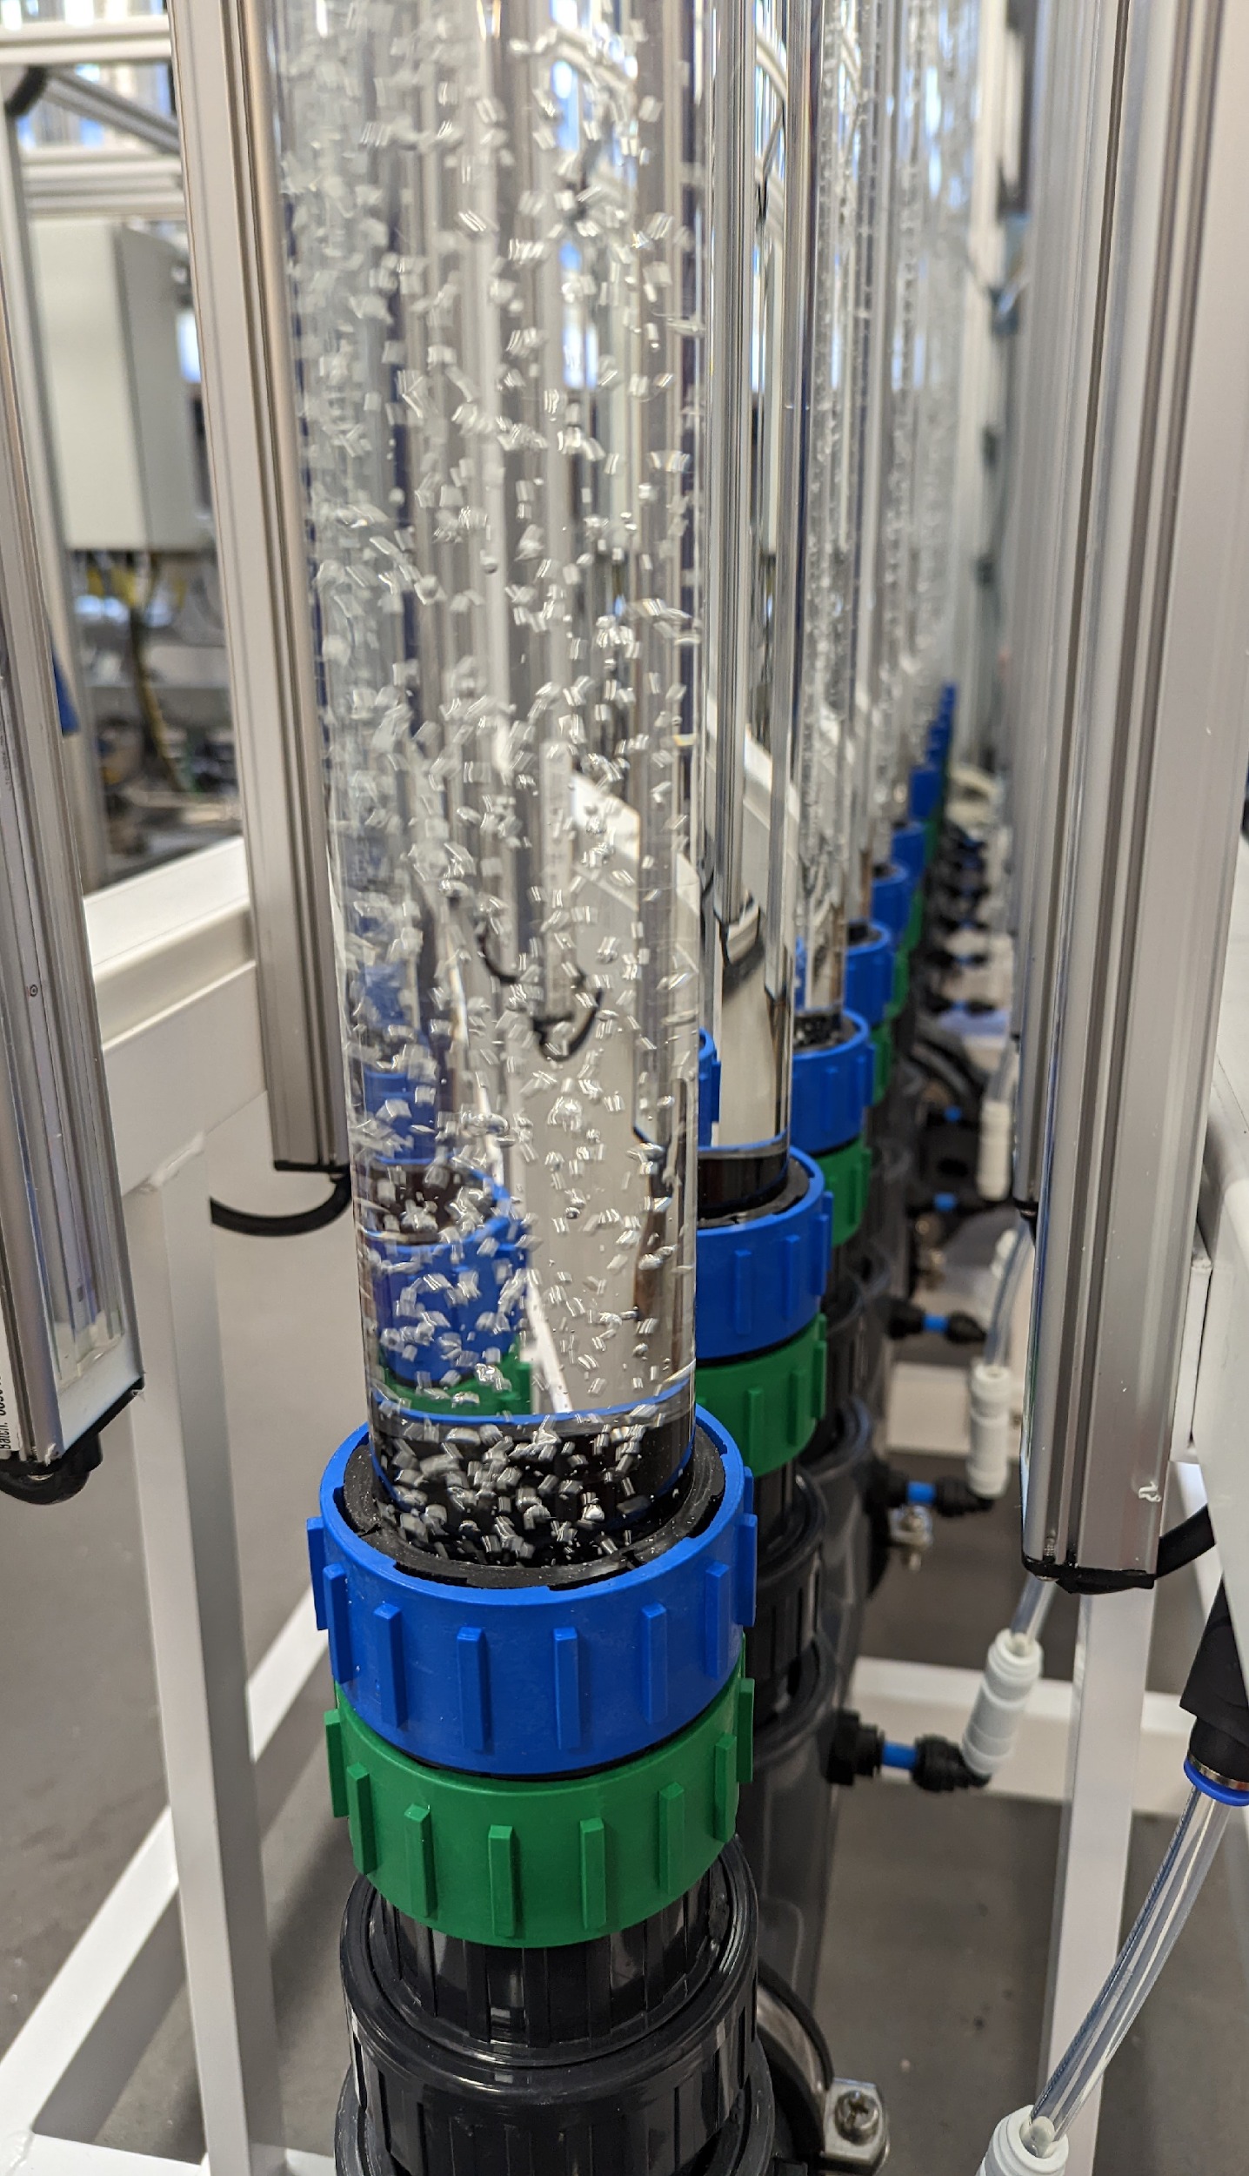
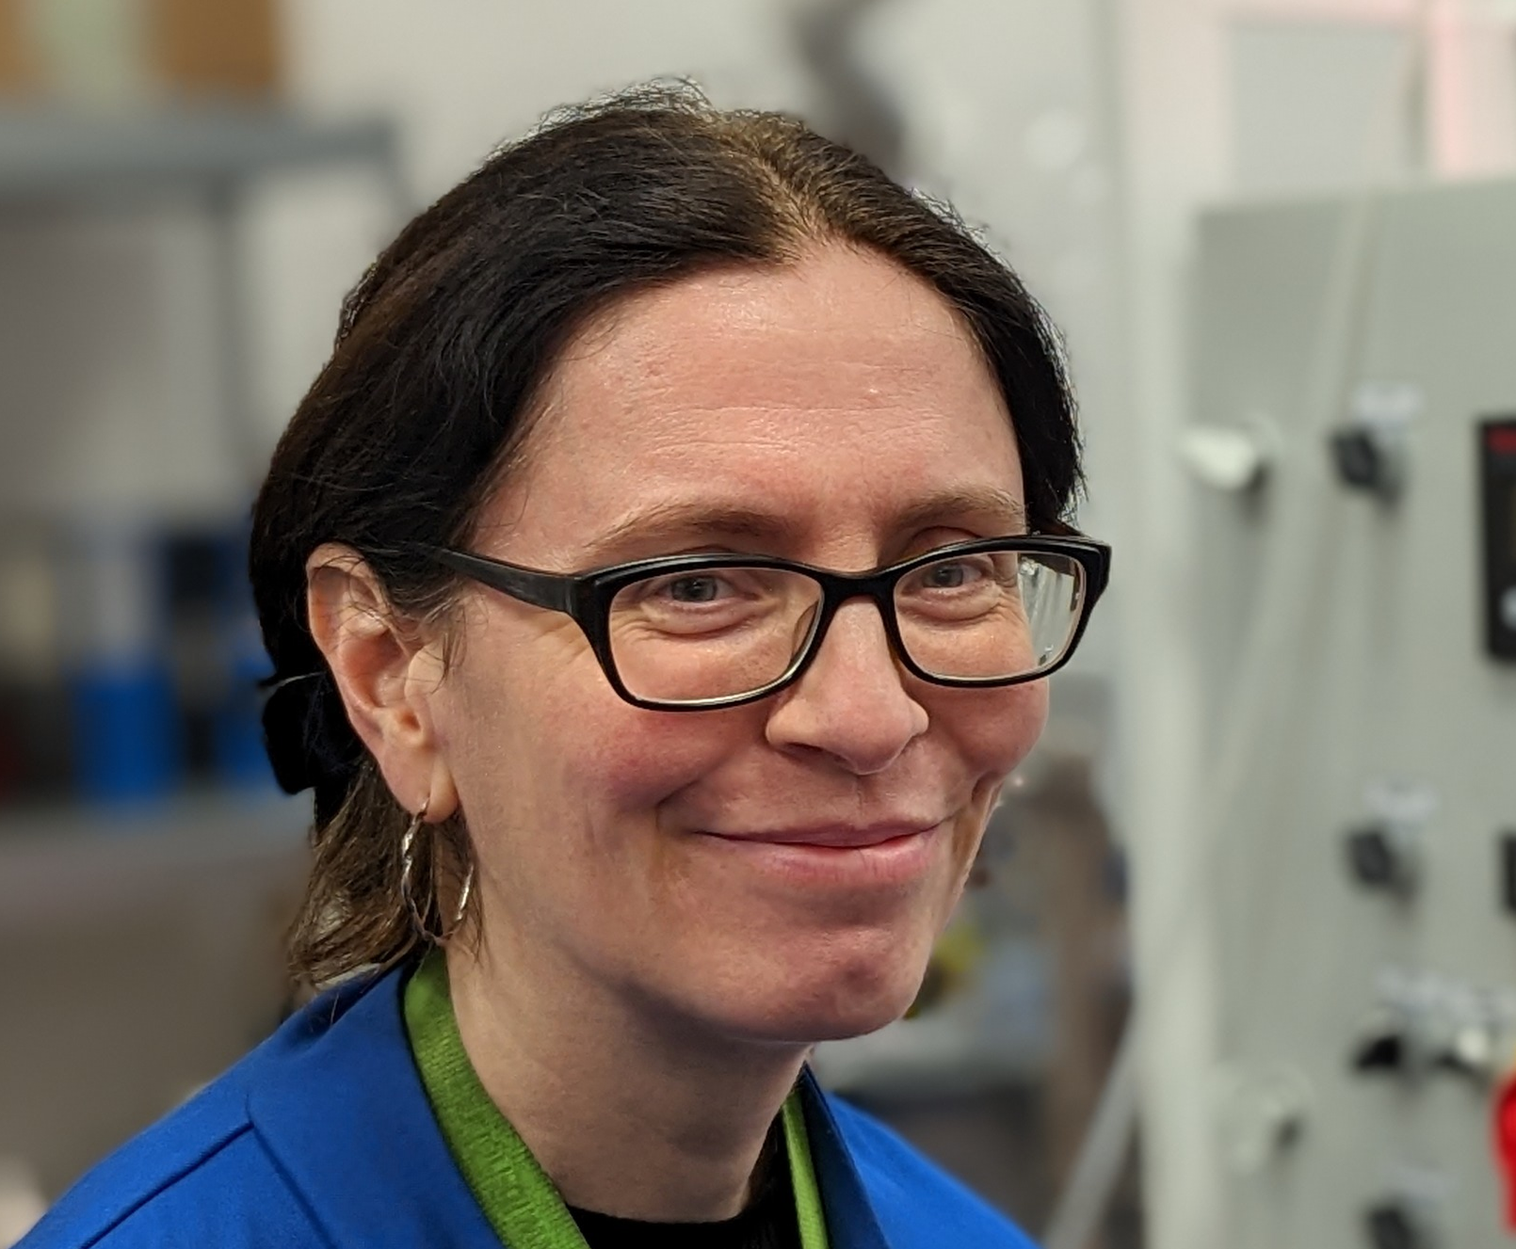
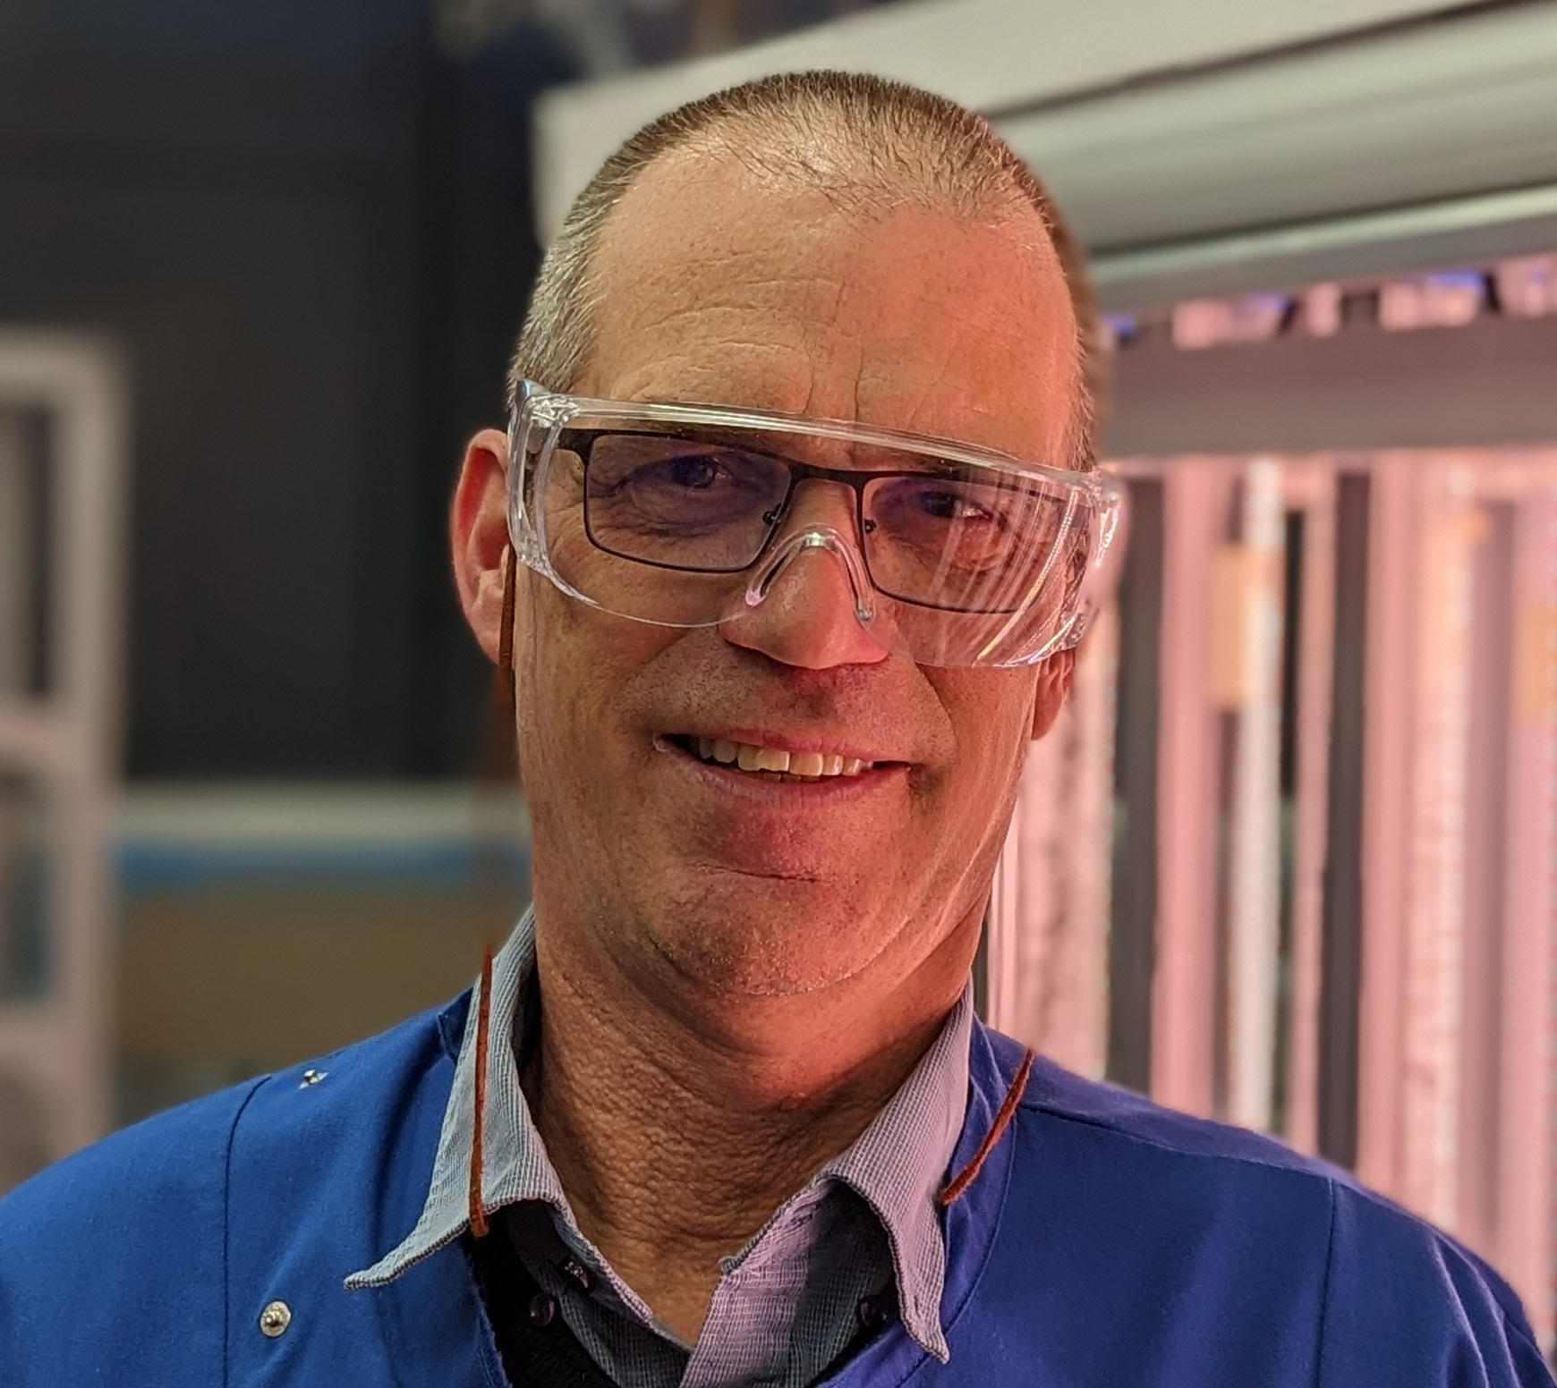
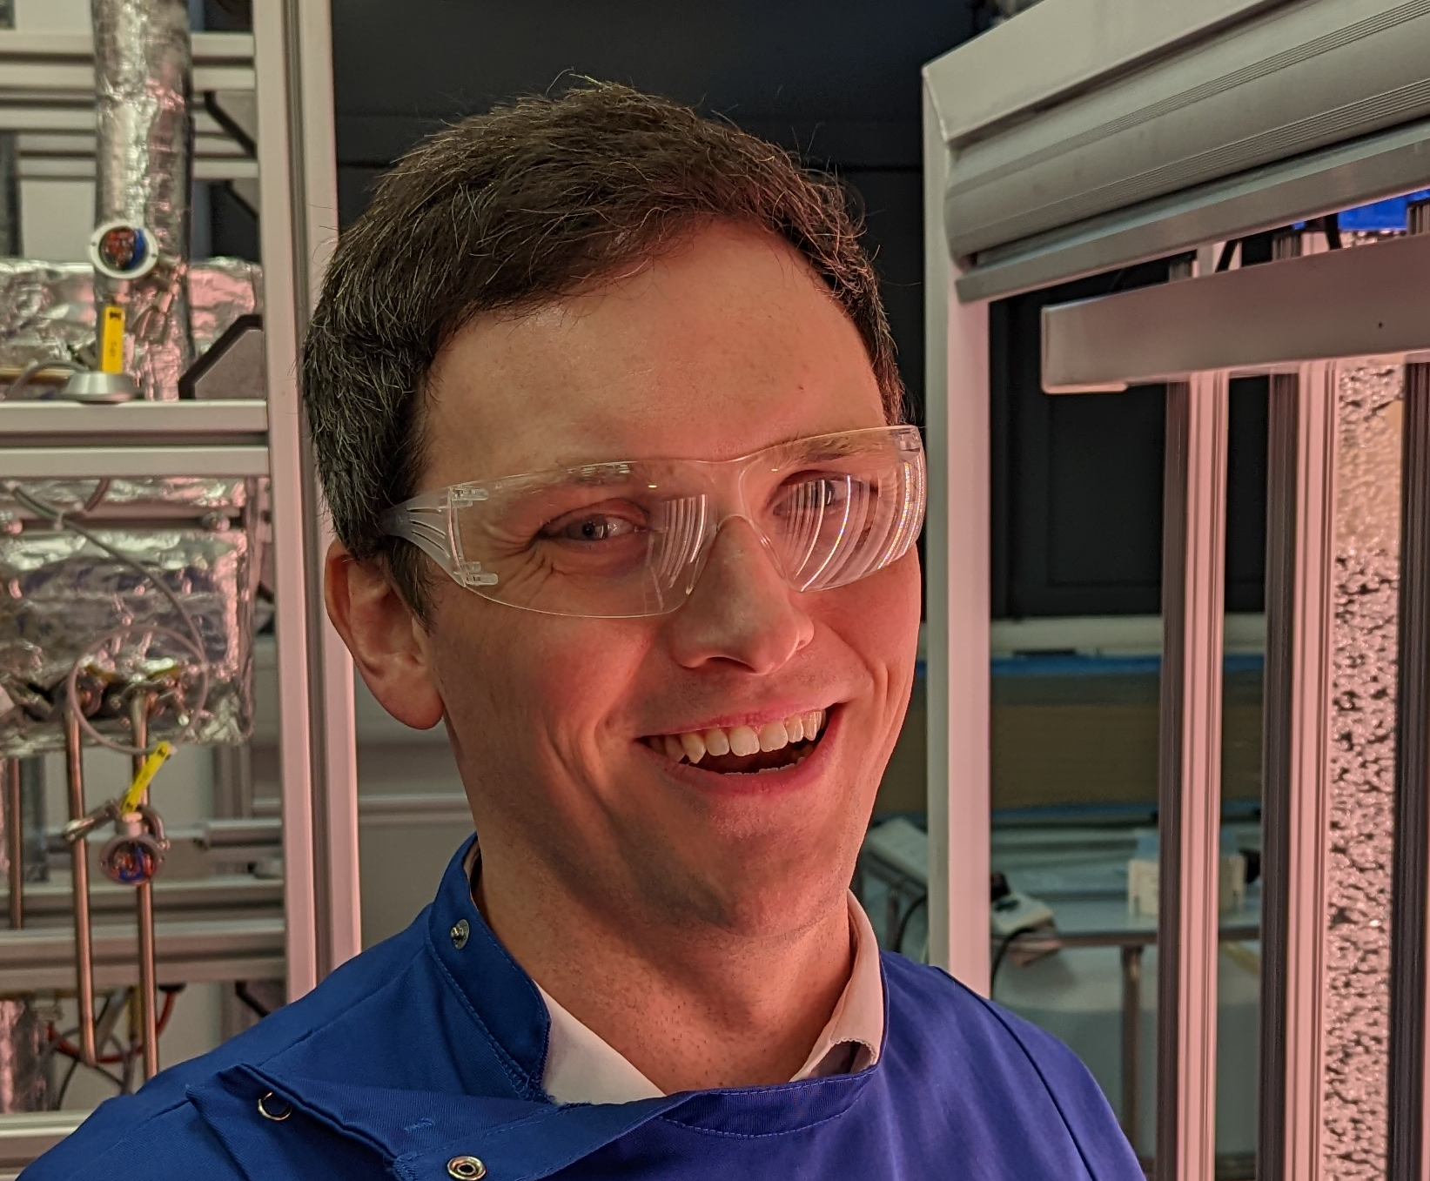
Dr Samantha Bryan CTO
Assistant Professor (Nottingham)
20+ years in microbiology
Dr Athan Fox CEO
PhD in Chemistry (Cambridge)
15+ years in polymers, start-ups, patents
Dr Peter Knight COO
PhD in Biochemistry (Cambridge)
10+ years in biotechnology and scale-up
Andrew Rogan CCO
MBA (Cass Business School, London)
15+ years in finance, accounting, private equity

Slide 8
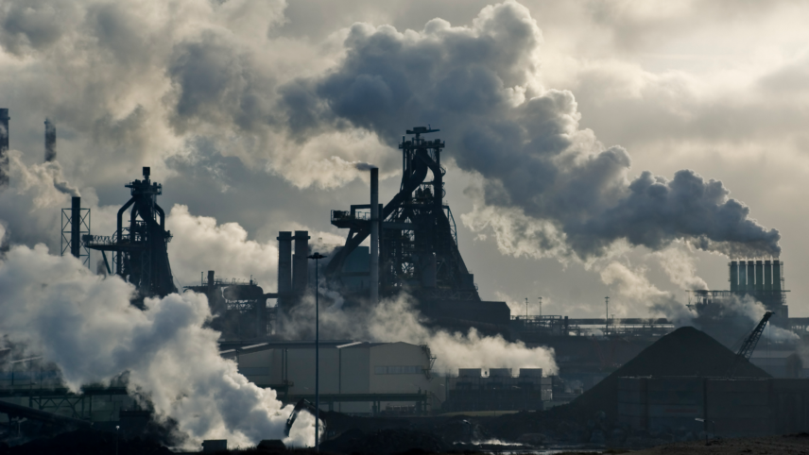
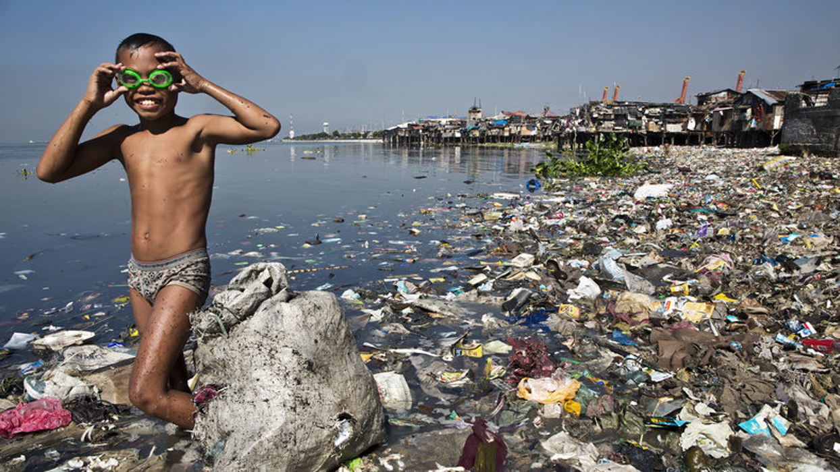
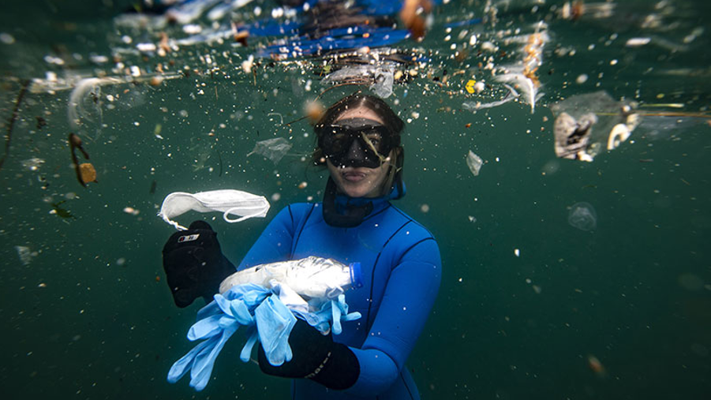
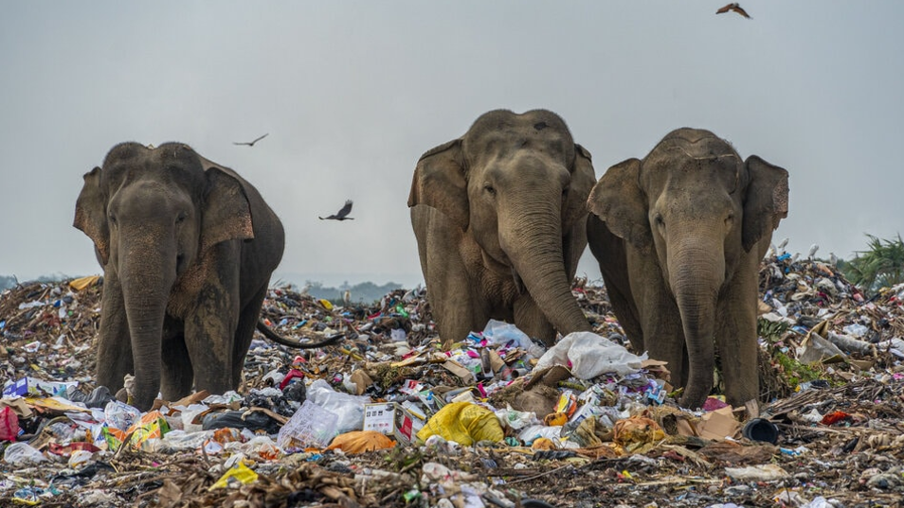
LET’S RETHINK CHEMICALS

