Slide 1
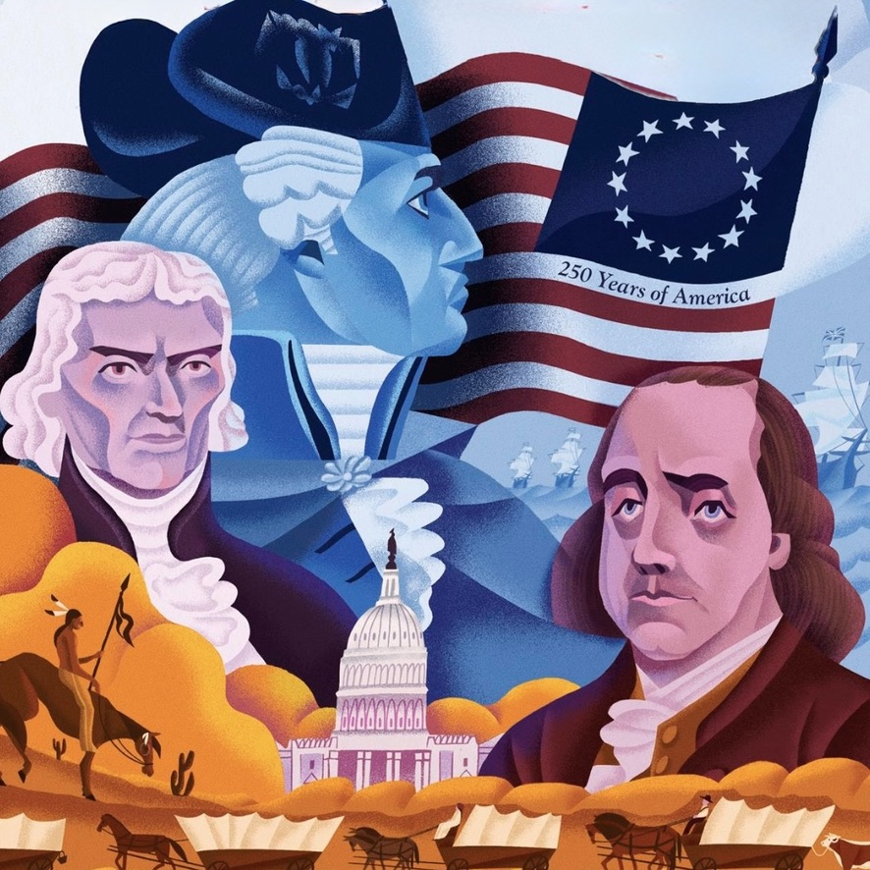

America’s 250th and Parish’s 20th

Slide 2


Slide 3

“We will not hide the truth from our children but will tell the coming generation the glorious deeds of the Lord and His might, the wonders that He has done.” Psalm 78: 4
“Wonders cannot be known in the midst of darkness and righteousness cannot be done in a land of forgetfulness.” Psalm 88:12

Slide 4

July 1: Magnalia Christi Americana
July 8: Semper Reformanda
July 15: Great Awakening
July 22: The Sword of the Lord
July 29: The Last Stand Film

Slide 5
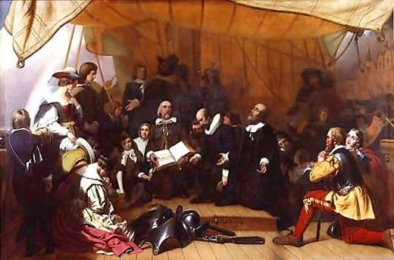
Massachusetts Bay Company

Slide 6
“It cannot be emphasized too strongly or too often that this great nation was founded, not by religionists, but by Christians, not by religions, but by the Gospel of Jesus Christ.” Patrick Henry

Slide 7
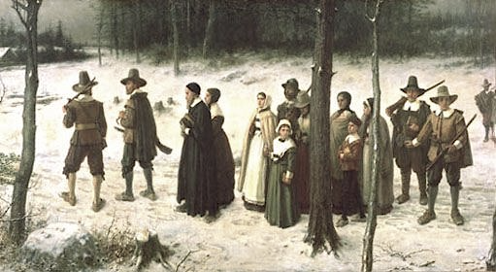
A New England Sabbath

Slide 8
“No human society has ever been able to maintain both order and freedom, both cohesiveness and liberty apart from the moral precepts of the Christian Religion applied and accepted by all the classes. Should our Republic ever forget this fundamental precept of governance, men are certain to shed their responsibilities for licentiousness, and this great experiment will then surely be doomed.” John Jay

Slide 9
“The highest glory of the American War for Independence was this; it connected in one indissoluble bond, the principles of the civil government with the principles of Christianity. From the day of the Declaration the American people were bound by the Laws of God and by the standards of the Gospel, which they all acknowledged as the rules of their conduct.” John Quincy Adams

Slide 10
“At a time when liberty is under attack, decency is under assault, the family is under siege, and life itself is threatened, the good will arise in Truth; they will arise in Truth with the very essence and substance of their lives; they will arise in Truth though they face opposition by fierce subverters; they will arise in Truth never shying from the Standard of Truth, never shirking from the Author of Truth.” Henry Laurens

Slide 11
“The foundations of our society and our government rest so much on the teachings of the Bible that it would be difficult to support them if faith in these teachings would cease to be practically universal in our country.” Calvin Coolidge

Slide 12
“Under the conditions of 21st century Modernity, the cultural authority of American beliefs, ideals, and traditions is dissolving. Tradition is softening into a selective nostalgia for the past and the transcendent faith of Christianity is melting into a suburbanesque sentiment that is vulnerable to the changing fashions of the therapeutic revolution. Thus, with the gravitas of their cultural authority collapsing inward like the critical mass of an exploding star, parts of American society are beginning to flare out with the dazzling but empty brilliance of a great culture in a critical phase. The result is a grand loss of confidence and dynamism. As a result of much leveling, even more unraveling, and no little reveling in both, American beliefs, ideals, and traditions are fast becoming a lost continent to many Americans.” Os Guinness

Slide 13
Providential History
“The only responsible way to retell the American story is through the lens of Providential History.” D. James Kennedy

Slide 14
The American Colonies
“Despite the diverse backgrounds in all of the American colonies, the Christian faith played a significant, if not dominant, role in their founding and settling. Whether in the Puritan holy commonwealths of New England, in the Cavalier commercial establishments of the Middle Colonies, or in the revivalist utopias of the South, each of the colonies were distinctly Christian in purpose, vision, and culture. Their charters, legal systems, social structures, commercial compacts, and political covenants were indisputably and unhesitatingly Christian. America was founded on zeal for Christ and His Kingdom.” G. Grant, Experiment

Slide 15
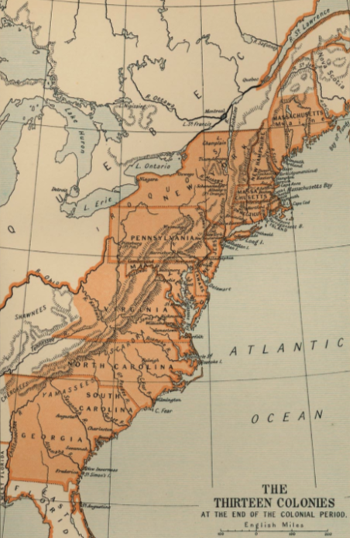
The Scramble for Colonies
“The scramble for American colonies by the great European powers throughout the sixteenth and seventeenth centuries not only defined the history of the Americas, it defined the history of the entire world. Indeed, it continues to define our world today. It is the one great movement that straddles the feudal and the modern worlds.”
Barbara Tuchman

Slide 16
Essential Differences
English, Dutch, Swede, Huguenot, and Scot | Settlers, Farmers, and Tradesmen
 | Commercial Trading Companies
 | Autonomy and Salutary Neglect
 | Economic Liberalism
 | Families and Communities
French, Portuguese, and Hapsburg Spanish | Adventurers, Soldiers, and Traders
 | State-Owned Monopolies
 | Imperial Governance
 | Economic Mercantilism
 | Privateers and Plantations

Slide 17
Why They Came
Faith | Reformation and Counter-Reformation
 | Pogroms and Persecutions
 | The Thirty Years War
Economics | Primogenitor and a Hierarchical Society
 | Collapse of Craft and Trade Guilds
 | Mercantilist Trade Policies
Politics | Bourbon and Hapsburg Wars of Succession
 | Dispossession: Scots, Huguenots, Swedes
 | The English Civil War
 | The Glorious Revolution

Slide 18
Cotton Mather
“The stunning achievement of Cotton Mather and his Magnalia Christi Americana is unmatched in all of history.” Henry Cabot Lodge

Slide 19
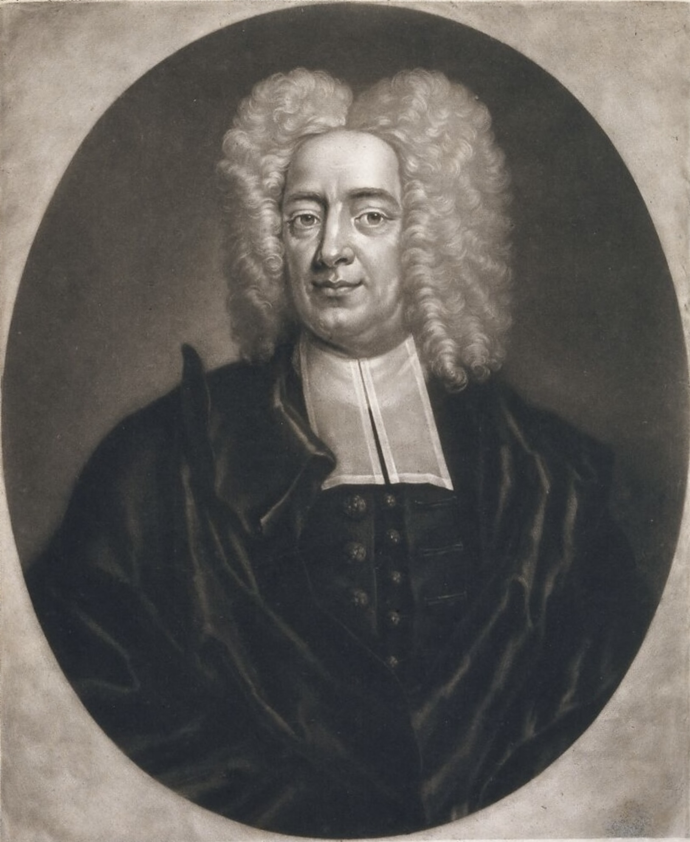

Slide 20
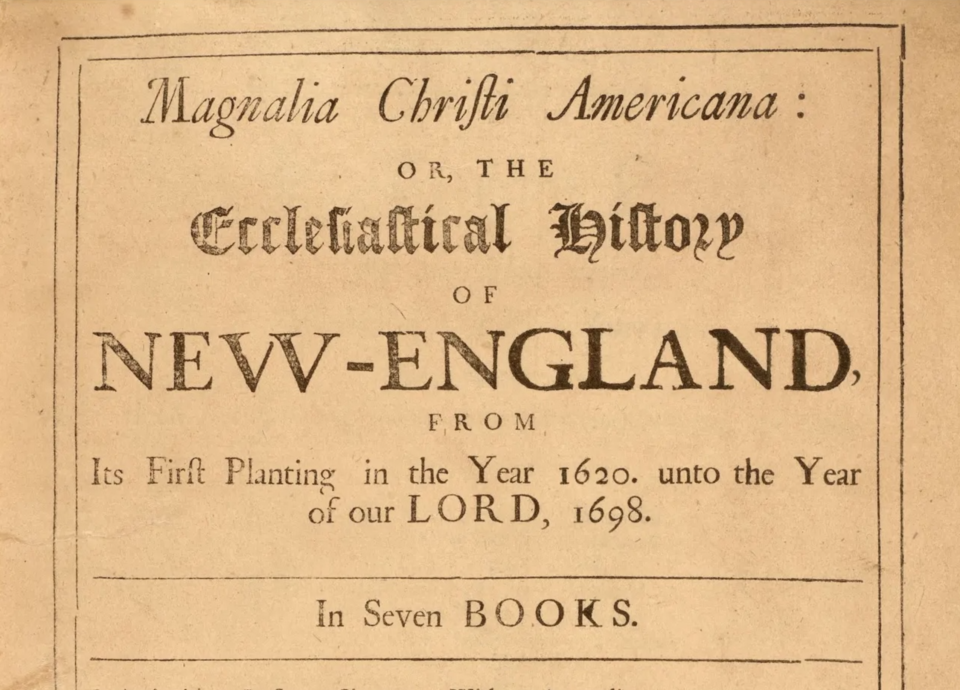

Slide 21
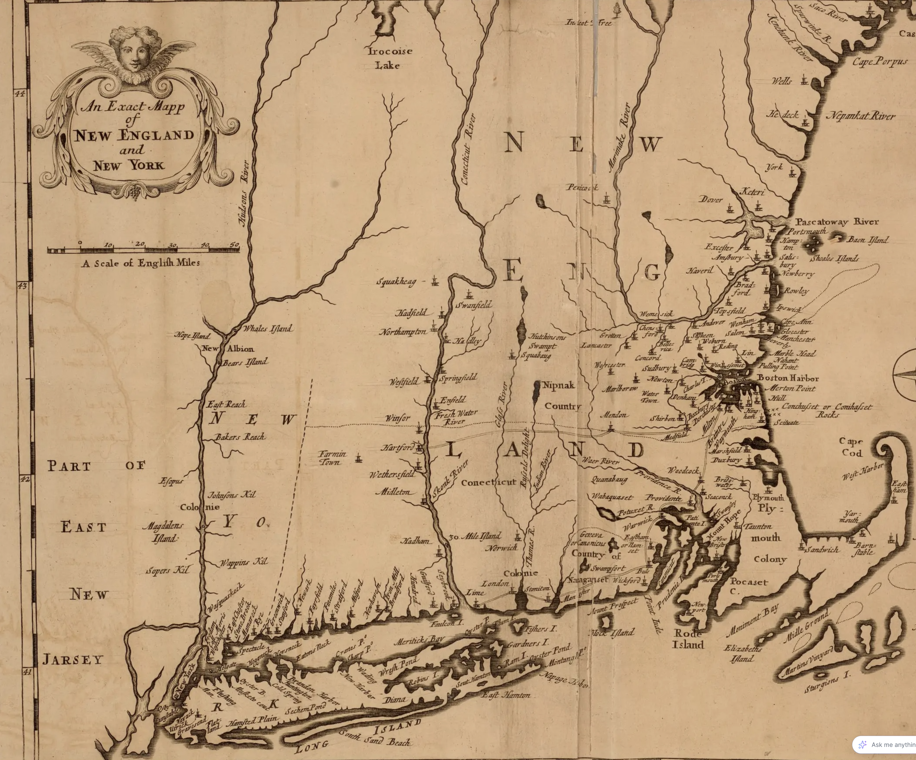

Slide 22
How Should We then Live?
“History must be our deliverer not only from the undue influence of other times, but from the undue influence of our own, from the tyranny of environment and the pressure of the air we breathe.” John Emerich Edward Dalberg, Lord Acton

Slide 23
1. God, the Supreme Lord and King of all the world, hath ordained civil magistrates to be under Him, over the people, for His own glory and the public good, and to this end hath armed them with the power of the sword, for the defense and encouragement of them that are good, and for the punishment of evil-doers.

Slide 24
2. It is lawful for Christians to accept and execute the office of a magistrate when called thereunto; in the managing whereof, as they ought especially to maintain piety, justice, and peace, according to the wholesome laws of each commonwealth, so, for that end, they may lawfully, now under the New Testament, wage war upon just and necessary occasion.

Slide 25
3. The civil magistrate may not assume to himself the administration of the Word and sacraments; or the power of the keys of the kingdom of heaven: yet he hath authority, and it is his duty, to take order, that unity and peace be preserved in the Church, that the truth of God be kept pure and entire; that all blasphemies and heresies be suppressed; all corruptions and abuses in worship and discipline prevented or reformed; and all the ordinances of God duly settled, administered, and observed. For the better effecting whereof, he hath power to call synods, to be present at them, and to provide that whatsoever is transacted in them be according to the mind of God.

Slide 26
4. It is the duty of people to pray for magistrates, to honor their persons, to pay them tribute and other dues, to obey their lawful commands, and to be subject to their authority, for conscience’ sake. Infidelity or difference in religion doth not make void the magistrate’s just and legal authority, nor free the people from their due obedience to him: from which ecclesiastical persons are not exempted; much less hath the Pope any power or jurisdiction over them in their dominions, or over any of their people; and least of all to deprive them of their dominions or lives, if he shall judge them to be heretics, or upon any other pretense whatsoever.

Slide 27
“Whatever makes a man a good Christian also makes a good citizen.” Daniel Webster

Slide 28
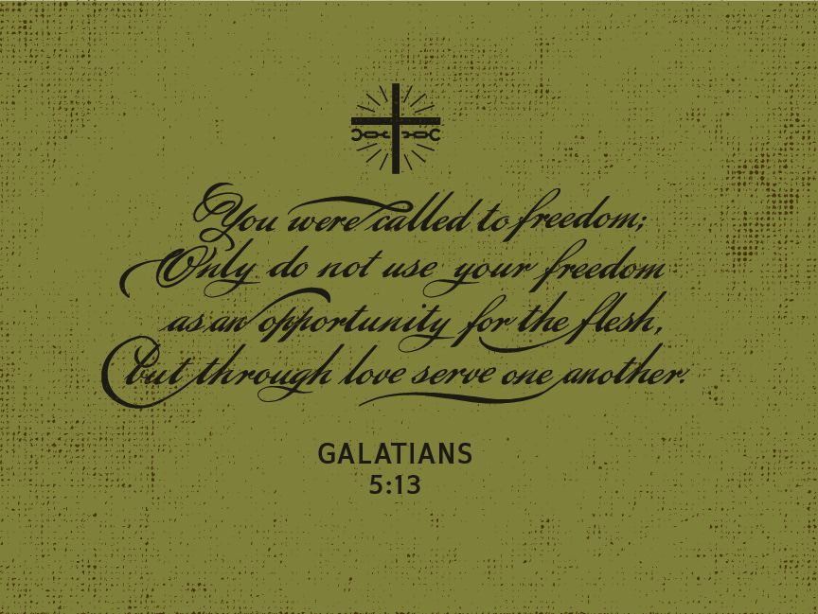

Slide 29
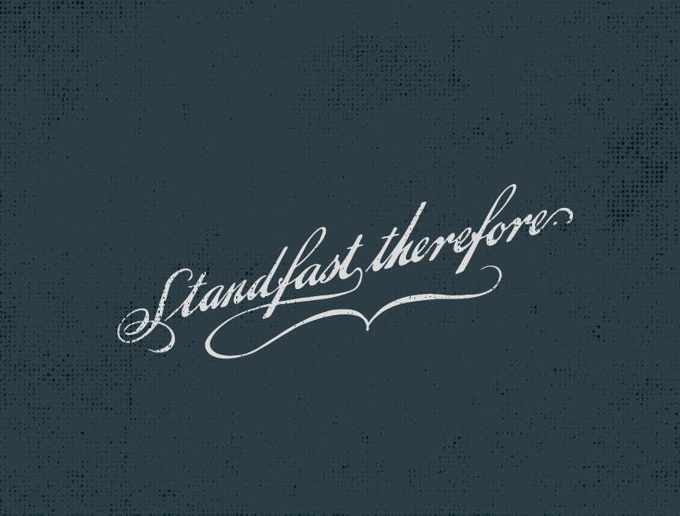

Slide 30
July 1: Magnalia Christi Americana
July 8: Semper Reformanda
July 15: Great Awakening
July 22: The Sword of the Lord
July 29: The Last Stand Film

Slide 31

Resources
This Civilizational Moment
America Agonistes
Experiment in Liberty
Foundations of Freedom
Hero Tales
Patriot’s Handbook

Slide 32


