Slide 1
Making the Grade:
Treating ADHD without Drugs
September, 2025
NBX Webinar
Nancy Hofreuter O’Hara, MD, MPH, FAAP
www.drohara.com

Slide 2
MAKING THE GRADE: ADHD
What is ADD/ADHD?
Statistics
Pharmaceuticals
Changing our perceptions
Differential Diagnosis
Environmental Impacts
Immune, Gastrointestinal and Metabolic Changes
Nutritional Biochemistry
Behavioral Interventions and more…

Slide 3
Making the Grade: ADHD
  > 400% increase over the last 20 years
  > 7 fold increase in use of stimulant medications
  Approximately 11% of children 4-17 years of age (6.4 million) diagnosed with ADHD as of 2011.
  The percentage of children with an ADHD diagnosis continues to increase, from 7.8% in 2003 to 9.5% in 2007 and to 11.0% in 2011.
  Rates of ADHD diagnosis changed in 2016 data due to change in age (2-17 years old)

Slide 4
Making the Grade: What is ADD/ADHD?
Inattention - Six or more symptoms of inattention for children up to age 16, or five or more for adolescents 17 and older and adults; symptoms of inattention have been present for at least 6 months, inappropriate for developmental level (DSMV criteria):
  Often fails to give close attention to details or makes careless mistakes in schoolwork, at work, or with other activities; trouble holding attention on tasks or play activities.
  Often does not seem to listen when spoken to directly; often easily distracted
  Often does not follow through on instructions and fails to finish schoolwork, chores, or duties in the workplace (e.g., loses focus, side-tracked); often forgetful
  Often has trouble organizing tasks and activities; often avoids, dislikes, or is reluctant to do tasks that require mental effort over a long period of time
  Often loses things necessary for tasks and activities (e.g. school materials, pencils, books, tools, wallets, keys, paperwork, eyeglasses, mobile telephones).
Hyperactivity and Impulsivity - Six or more symptoms of hyperactivity- impulsivity for children up to age 16, or five or more for adolescents 17 and older and adults; symptoms of hyperactivity-impulsivity have been present for at least 6 months to an extent that is disruptive and inappropriate for the person’s developmental level (DSM V criteria):
  Often fidgets with or taps hands or feet, or squirms in seat.
  Often leaves seat in situations when remaining seated is expected.
  Often runs about or climbs in situations where it is not appropriate (adolescents or adults may be limited to feeling restless).
  Often unable to play or take part in leisure activities quietly.
  Is often "on the go" acting as if "driven by a motor".
  Often talks excessively.
  Often blurts out an answer before a question has been completed.
  Often has trouble waiting his/her turn.
  Often interrupts or intrudes on others (e.g., butts into conversations or games)

Slide 5

Making the Grade: ADHD: Why it Matters The Ways it Affects a Child’s Life
More trouble making friends and maintaining friendships (Strine et al. Prev Chronic Dis. 2006)
More injuries requiring ER visits and hospitalizations (JAMA. 2001)
ADHD Medications can have significant and sometimes life-altering side effects
ADHD will continue into adulthood for ~50% of children
More likely to be involved in car crashes, drinking and driving and traffic violations (Woodward et al. J Am Acad Child Adolesc Psych. 2000)
Adults with ADHD can have poor personal and professional relationships and loss of work productivity (De Graaf R, et al. Occup Environ Med. 2008)

Slide 6
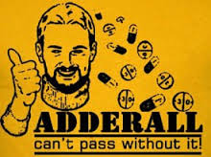
Making the Grade: What Do We Do?
Age specific guidelines per AAP
4 -5 year old
  behavioral therapy is first line
  methylphenidate if needed for moderate to severe dysfunction
6-11 years old
  Rx FDA approved medications
  evidence based parent and teacher behavioral therapies
  preferably both
12-18 years old
  Rx FDA approved medications
  may prescribe behavior therapy
  preferably both
http://pediatrics.aappublications.org/content/128/5/1007.full

Slide 7
Making the Grade: Medications for ADHD
DRUG | COMMON SIDE EFFECTS | CONS
METHYLPHENIDATES (increase dopamine) | Trouble sleeping; ⇓ appetite; headache; stomach ache | ⇑ risk of tics, anxiety, and abnormal movements; ⇑ abuse risk; psychotic symptoms,⇑ risk fast heart rate, blood pressure, sudden death
AMPHETAMINES (increase dopamine) | Trouble sleeping; ⇓ appetite; headache; stomach ache | ⇑ risk of tics, anxiety, and abnormal movements; ⇑ abuse risk; psychotic symptoms,⇑ risk fast heart rate, blood pressure, sudden death
ATOMOXETINE (increases adrenaline; non-stimulant) | Trouble sleeping; ⇓ appetite; headache; stomach ache – but overall less common than with other categories of meds | ⇑ risk of fast heart rate, high blood pressure, arrhythmia, stroke and sudden death
ALPHA-2-AGONISTS (non-stimulants) |  | Lower blood pressure; ⇑ risk of rebound HTN if stopped too quickly (especially clonidine)

Slide 8
Evidence of Long-Term Benefit of ADHD Medications Lacking (Michael V. Bloom, letter to Pediatrics Dec. 20, 2011)
The MTA Cooperative Group A 14-month randomized clinical trial of treatment strategies for attention-deficit/hyperactivity disorder (Arch Gen Psychiatry. 1999)
The MTA Cooperative Group Moderators and mediators of treatment response for children with attention-deficit/hyperactivity disorder (Arch Gen Psychiatry. 1999)
The MTA Cooperative Group National Institute of Mental Health Multimodal Treatment Study of ADHD follow-up: 24-month outcomes of treatment strategies for attention-deficit/hyperactivity disorder. (Pediatrics. 2004)

Slide 9
Bloom critique-Pediatrics ADHD Practice Guidelines
…many RCTs that show benefits of stimulant medication for school age children in the short term (most studies were under 12 weeks)…there is only one notable study that follows the children long- term. .. the MTA study..
The benefits of stimulant medication seen at 14 and 24 months were no longer present at 36 months. The guidelines made no reference to the eight year follow-up of the study which demonstrated sustained lack of benefit for children in the intensive pharmacological intervention arm compared to the behavioral intervention arm.
The authors of the eight year study summarize their findings on the NIMH website as, "The eight-year follow-up revealed no differences in symptoms or functioning among the youths assigned to the different treatment groups as children. This result suggests that the type or intensity of a one-year treatment for ADHD in childhood does not predict future functioning." They conclude, "Children who were no longer taking medication at the eight-year follow-up were generally functioning as well as children who were still medicated, raising questions about whether medication treatment beyond two years continues to be beneficial or is needed at all” Pediatrics Conclusion - 14 month and 24 months MTA studies which showed benefit are referenced in the bibliography, the three and eight year follow-up data are not.

Slide 10
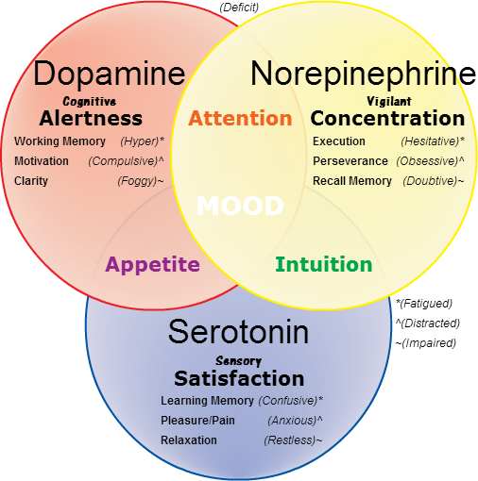
Making the Grade: ADHD: Why Medications?
Improve Attention/focus
Improve working memory
Improve motivation
Improve concentration
Increase satisfaction
Increase relaxation
Help our children
Pharmaceuticals – Making a Difference? Or a Patch? Masking Underlying Issues and Other Symptoms?

Slide 11


Making the Grade: ADHD: Why Medications?
Marketing direct to consumer… Stimulant sales quintupled since 2002

Slide 12

Making the Grade: Changing our Thinking
Auditory Processing, Visual Processing, Executive Function & Sensory Integration or Processing Disorders
Anxiety/Depression/Bipolar disorders
Substance Abuse
Environmental toxins
Allergies and Immune dysregulation
Gut dysbiosis
PANS/PANDAS
Sleep disorders
Mitochondrial dysfunction
Metabolic disorders (thyroid & adrenal dysfunction)
Nutritional deficiencies

Slide 13
Making The Grade: Neuropsychological Testing
Executive Function Differences
  Visuomotor problems (hard to copy words/drawings & to write neatly)
  Slow processing speed
  Problems with organizing and paying attention
Auditory Processing Disorder
  Trouble understanding what they hear
  Trouble shutting out background noise making it difficult to concentrate
Visual Processing Disorder
  Not recognize differences between shapes or letters or see them backwards
  Dyslexia and/or dyscalculus.
Sensory Integration or Sensory Processing Disorders (SPDs)
  See, feel, taste, hear, sense their environment differently
  Underreact or over react to sensory stimuli
Ben-Sasson et al. J Abn Child Psychol 2009

Slide 14
Making the Grade: A Functional Medicine Approach
ADHD
Toxins
Diet & Nutritional Deficiencies
Metabolic & mitochondrial Dysfunction (thyroid)
Sleep
disorders
Gut Dysbiosis
Allergies

Slide 15
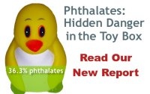
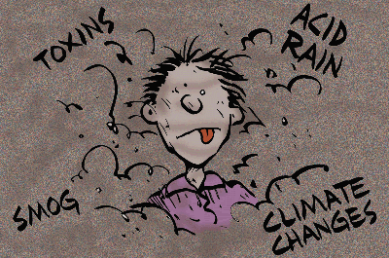
Making the Grade:
Environmental Toxins & ADHD
Mt Sinai Children’s Environmental Health Study
Third-trimester maternal urines analyzed for phthalate metabolites.
Children (188) assessed for cognitive & behavioral development (4-9 yrs)
Evaluated aggression, attention, depression, conduct & behavior.
Behavioral domains & ADHD adversely associated with prenatal exposure to phthalates (Environ Health Perspct. 2010)
Cincinnati Childhood Allergy and Air Pollution Study (CCAAPS)
Birth cohort exposure to ECAT (elemental carbon attributed to traffic) during infancy and behavioral scores at 7 years of age.
Exposure to the highest tertile of ECAT during the first year of life was significantly associated with Hyperactivity (Newman, Environ Health Perspect. 2013)
In utero smoking exposure
linked to higher levels of ADHD
Moore S, Paalanen L, Melymuk L, Katsonouri A, Kolossa-Gehring M, Tolonen H. The Association between ADHD and Environmental Chemicals-A Scoping Review. Int J Environ Res Public Health. 2022 Mar 1;19(5):2849. doi: 10.3390/ijerph19052849. PMID: 35270544

Slide 16
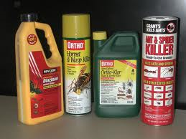

Making the Grade:
Environmental Toxins & ADHD
Organophosphates
Children (1139) – tested levels of organophosphates
Higher organophosphate pesticide levels in urine
More likely to develop ADHD (Pediatrics 2010)
Pieronyl Butoxide and Permethrin
Prenatal exposure to PBO was negatively associated with 36 month neurodevelopment
    (Horton, et al. Pediatrics, 2011)
Inhibition of Methionine Synthase
By ethanol, lead, mercury, aluminum
Target of neurodevelopmental toxins
Marcello Dala Bernardina Dalla, et al. Environmental pollution and attention deficit hyperactivity disorder: A meta-analysis of cohort studies, Environmental Pollution, Volume 315, 2022, ISSN 0269-7491, https://doi.org/10.1016/j.envpol.2022.120351.

Slide 17
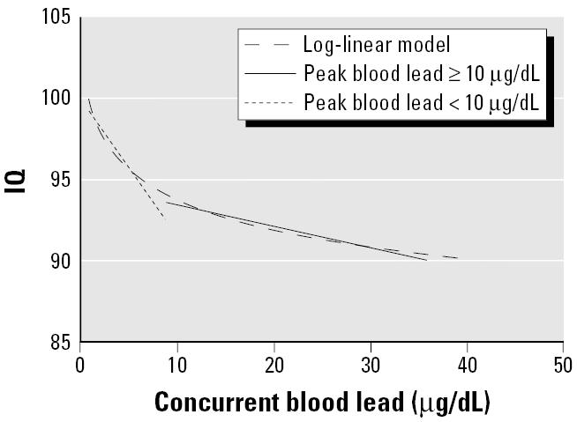
Making the Grade:
Lead and ADHD
  Decreases IQ
  Reduces GABA
  Increases glutamates
  Increases ammonia
  Associated with protein deficiencies and malnutrition
  Ca, Zinc, Se, Fe, or Vitamin E deficiencies can cause increased lead absorption
  Fluoride increases lead absorption
  Lead causes poor heme synthesis, decreased reduced glutathione, increased oxidative stress, and increased lipid peroxidation
  Reduces glutamine synthase and glutamic acid dehydrogenase
  Interferes with active Vitamin D formation
  May cause microcytic anemia and iron deficiency
    Farmani, R., Mehrpour, O., Kooshki, A. et al. Exploring the link between toxic metal exposure and ADHD: a systematic review of pb and hg. J Neurodevelop Disord 16, 44 (2024). https://doi.org/10.1186/s11689-024-09555-8
.

Slide 18

Making the Grade: ADHD and Lead
Lead measured in South Korean population
1001 children ages 8-11
Blood lead associated with lower IG and higher impulsivity
(Hong et al. Environ Health Perspect. 2015)
Childhood lead exposure & ADHD
Contributes to hyperactivity and impulsivity
Increase high school dropout rates
Reduces vocabulary and class standing
Increases antisocial & delinquent behaviors
(J Dev Behav Ped. 2002)

Slide 19
Making the Grade: Allergy & ADHD
Pollen Exposure as a Cause for the Deterioration of Neurobehavioral Function in Children with Autism and Attention Deficit Hyperactive Disorder: Nasal Pollen Challenge
Authors: Boris, Marvin1; Goldblatt, Allan1
Source: Journal of Nutritional & Environmental Medicine, Volume 14, Number 1, March 2004, pp. 47-54(8)
Publisher:Routledge, part of the Taylor & Francis Group

Slide 20
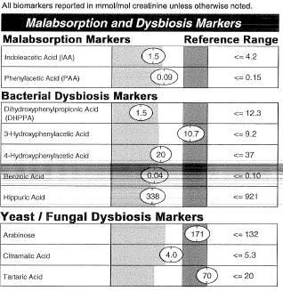

Making the Grade:
ADHD & The Gut
Lack of beneficial flora
Overgrowth of pathogenic flora
  Yeast
  Clostridia
  Bacteria
    Checa-Ros A, Jeréz-Calero A, Molina-Carballo A, Campoy C, Muñoz-Hoyos A. Current Evidence on the Role of the Gut Microbiome in ADHD Pathophysiology and Therapeutic Implications. Nutrients. 2021 Jan 16;13(1):249. doi: 10.3390/nu13010249. PMID: 33467150
Infection-induced Autoimmune encephalitis
PANS/PANDAS
  Acute-onset
    ADHD/ADD
    Learning differences
    (Swedo et al. Ped Ther. 2012)

Slide 22

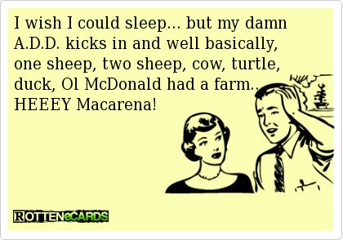
Making the Grade:
ADHD & Sleep
ADHD associated with impaired sleep
One key driver of sleep/wake cycles is the circadian system, which at the molecular level consists of a series of transcriptional feedback loops of clock genes, which in turn produce endocrine, physiological and behavioral outputs with a near 24 hr periodicity
Significant diurnal and nocturnal hyperactivity in the ADHD group, as well as a significant shorter period of best fit for the locomotor circadian rhythm in ADHD
          Baird, A. Mol. Psych 2012
Melatonin in ADHD
  Sleep improved
  Behavior and mood improved
  71 & 61% at Long-term follow-up
  Hoebert, M. Journal of Pineal Research 2009
  Wajszilber D, Santiseban JA, Gruber R. Sleep disorders in patients with ADHD: impact and management challenges. Nat Sci Sleep. 2018 Dec 14;10:453-480. doi: 10.2147/NSS.S163074. PMID: 30588139

Slide 23
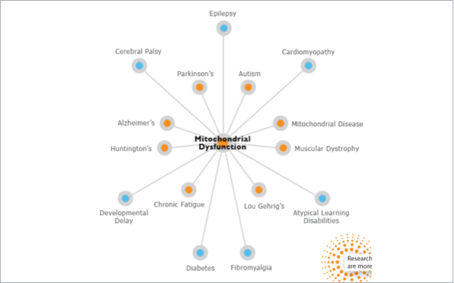
Making the Grade: Mitochondrial Dysfunction

Slide 24
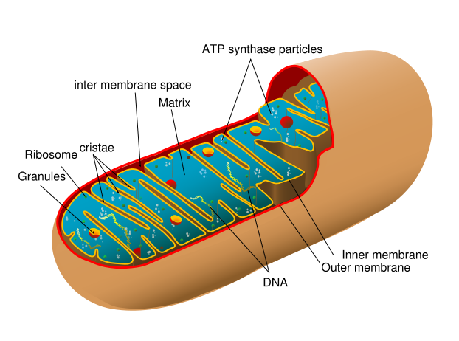
Making the Grade: Mitochondrial Dysfunction & ADD
Drugs: risperidol
acetominophen
Genetic factors:
SNPs affecting
Mito function
B6 B12 deficiency
Glutathione
Allergies & Ongoing systemic immune activation
Toxins:
Mercury
Lead
Aluminum
High sugar diet & Nutritional Deficiencies
Notes:
High sugar poison for energy via mitochondria
Food as information vs food as calories (Bland)

Slide 25
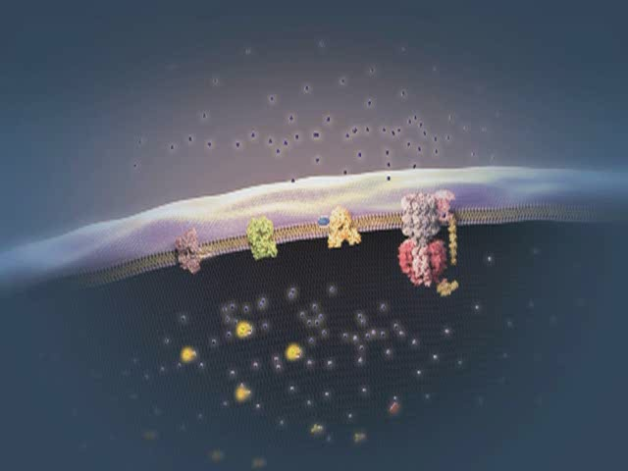
Making the Grade: Symptoms of Mitochondrial Dysfunction
“Any symptom in any organ at any age”
• Developmental or growth delay
• Motor delay, clumsiness, fatigue and lethargy
• Developmental regression & slow processing
• Seizures
• Hypotonia (low muscle tone)
• Migraines
GI Abnormalities (diarrhea, constipation)
• Myopathies
• Disturbances to vision/hearing

Slide 26
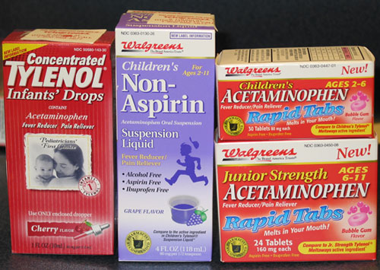
Making the Grade: Suspicious Labs for Mitochondrial Dysfunction in a child with ADD/ADHD
Lab Findings:
  Isolated elevation of AST or ALT
  Low glucose
  Low blood counts
  Low BUN
  Low B12 (MMA) and folate (RBC)
        Haas et al, Pediatrics, 2007
HISTORY and PHYSICAL EXAM!!!
Additional Labs for confirmation
Serum lactate and pyruvate
Ammonia Ji, Y, et al. Association of cord plasma biomarkers of in utero acetaminophen exposure with risk of attention deficit/hyperactivity disorder and autism spectrum disorder in childhood. JAMA Psychiatry.2019.
Carnitine and acylcarnitine (Decrease in hyperactivity and improve attention and social behavior, and decrease aggression (Arnold, et al. J Child Adolesc Psychopharmacol. 2007)
Amino acids, plasma
  Elevated alanine, as well as glycine, proline, sarcosine, tyrosine
Organic acids, urine
  Elevation of TCS cycle intermediates, ethylmalonate, 3-methyl-gluconate and dicarboxylic acids
        Haas et al, Molecular Genetics & Metab, 2008

Slide 27
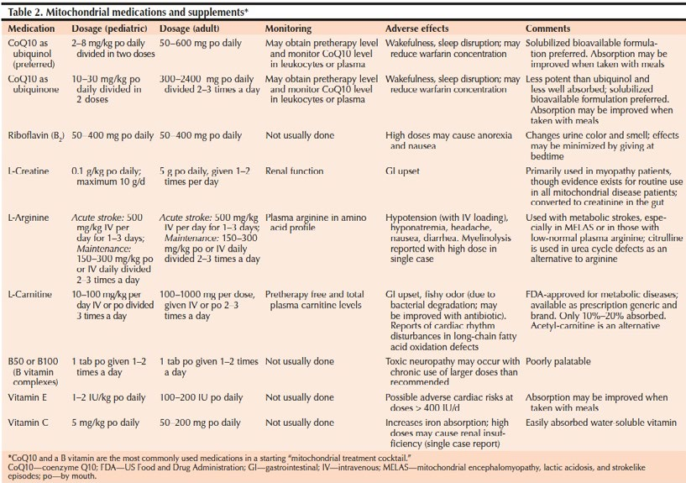
Making The Grade: Mitochondrial Supplementation

Slide 28
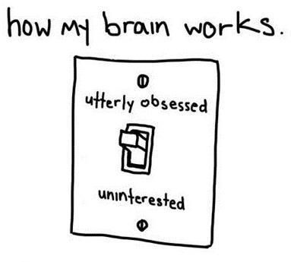
Making the Grade: Thyroid and Adrenal Dysfunction
Adrenal Stress
Anxiety
Hyperactivity
Impulsivity
Thyroid – Hypothyroid
Fatigue and hard to awaken
Daydreaming and inattention
Constipation
Cold intolerance
Measure Chen, G., Gao, W., Xu, Y., Chen, H., & Cai, H. (2023). Serum TSH Levels are Associated with Hyperactivity Behaviors in Children with Attention Deficit/Hyperactivity Disorder. Neuropsychiatric Disease and Treatment, 19, 557–564. https://doi.org/10.2147/NDT.S402530
24 hour cortisol (saliva); fasting morning cortisol (blood)
TSH, T4 (free and total), T3 and reverse T3, Thyroid antibodies

Slide 29
Making the Grade: ADHD and Nutrition
What affects behavior and cognition? FOOD!
Improvement in hyperactivity and learning issues with elimination diet
              Shannon WR. 1922 Am J Child Dis. 1922
Feingold suggested up to 50% of hyperactive kids were sensitive to artificial food colors, flavorings, preservatives, and salicylates
              Feingold BF. Introduction to Clinical Allergy, 1973
Feingold’s hypothesis actually showed 50% of kids on Feingold Diet had decrease in hyperactivity
              Murray et al. Encyclopedia of Natural Medicine. 1998
Relationship found between dietary peptides and neurologic function and behavior (Increased IgA and IgG gliadin and casein antibodies)
              Cade et al. Nutritional Neurosciences. 2000
Malnutrition associated with decreased cognition
  Prospective, longitudinal study of 1559 children with early malnutrition
  Age 3: poorer cognition -> Age 11: Still poor cognition (15.3 point IQ deficit)(
              Liu et al. Arch Ped Adol Med 2003
132 with Celiac Disease & ADHD – ADHD sx improved with GF after 6 mths
              Niederhofer H et al. J Atten Disord. 2006

Slide 30


Making the Grade: ADHD and Nutrition
What affects behavior and cognition? FOOD!
Elimination Diet & Challenge
  Randomized, controlled trial
  ADHD rating scales got worse after the challenge
          Pelsser et al. Lancet. 2011
Physical and sleep complaints in ADHD
  Improved with elimination diet
  Randomized controlled pilot study
          Pelsser et al. Eur J Ped. 2010
When rats were given the choice between artificially sweetened water or IV cocaine, 94% chose the sweetened water
          Lenoir, PLos One

Slide 31

Making the Grade: ADHD & Diet
WHAT DO WE DO?
Exercise/Activity - Improves Behavioral, Neurocognitive, and Scholastic Performance in Children with ADHD (J Ped. 2013); (Halperin. Neuroscience & Biobehavioral Reviews. 2011)
Basic Nutritional Changes
  Fresh, unprocessed, unrefined, organic, whole foods
  Varied and rotational
  Non allergenic (crave that which most sensitive to)
  Protein (every 4-5 hours)
  Avoid excitotoxins (caffeine, MSG, dyes); phenolics (grapes, strawberries)
  Juicing; raw foods; fermented foods (kefir); good fats
  Organic (especially chicken, rice, pears, apples, peppers, celery, strawberries, cherries, grapes, spinach, lettuce, potatoes – Dirty Dozen (www.ewg.org)

Slide 32
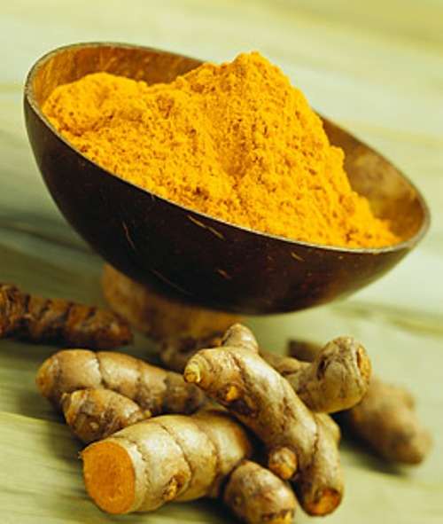
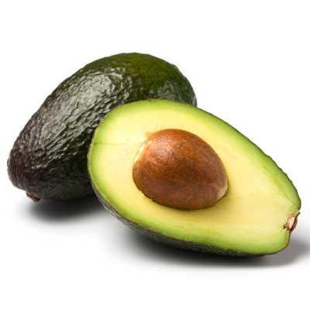
Making the Grade: What to Get?
Add foods that reduce inflammation and
heal the gut
  Avocado, Fish oil, flax seeds, nuts and other omega-3 fatty acids can reduce inflammation.
  Ginger and turmeric are spices that can be added to food to reduce inflammation
  Improve good bacteria with asparagus, beans, leeks, garlic

Slide 33
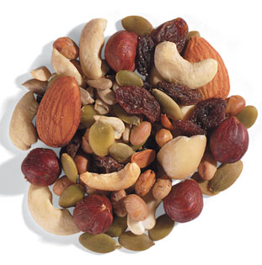
Making the Grade: ADHD & Healthy School Snacks
Snacks/ Desserts Options
  Fresh fruit
  Vegetables and dip
  Fun sauces/mixes
  Rice crackers with almond butter or hummus
  Nuts
  GF Fruit bars (Lara)
  Trail mix (nuts and dried fruit mix)
  Almond/coconut milk yogurt

Slide 34
Making the Grade: ADHD & What to Avoid?
Avoid Additives & Preservatives such as sodium benzoate, tartrazine, Blue#2 and Red#40.
  The American Academy of Pediatrics now agrees that eliminating preservatives and food colorings from the diet is a reasonable therapeutic option for children with ADHD [www.AAP.org].
Avoid MSG
Avoid High Fructose Corn Syrup (HFCS) – increases shelf life
  Found to have mercury (9/20 samples had detectable Hg)
  Fructose interferes with brain’s communication with leptin
  After eating fructose, 100 %of the metabolic burden rests on your liver (20% with glucose)
  Every cell in your body, including your brain, utilizes glucose. Therefore, much of it is “burned up” immediately after you consume it.
  By contrast, fructose is turned into free fatty acids (FFAs), VLDL (the damaging form of cholesterol), and triglycerides, which get stored as fat. Dufault R, et al. Environmental Health. 2009

Slide 35
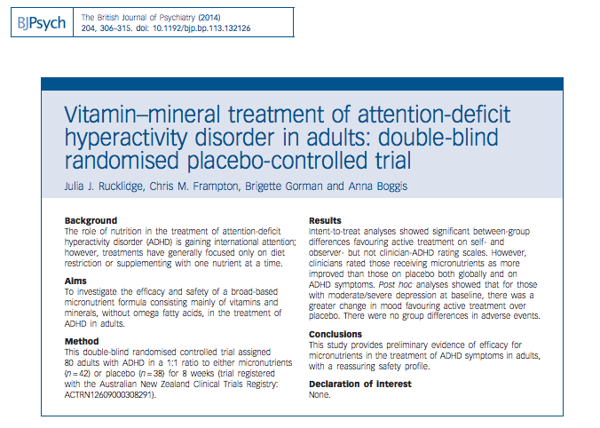
Making the Grade: ADHD & Nutrients
Vitamins & minerals essential to cognitive function
Low levels often found in children with neurodevelopmental disorders
Cognition and test scores improve with vitamin and mineral supplementation
Benton et al. Lancet.1988;
Schoenthaler et al. J Altern Complement Med. 2000.
Ryu SA, Choi YJ, An H, Kwon HJ, Ha M, Hong YC, Hong SJ, Hwang HJ. Associations between Dietary Intake and Attention Deficit Hyperactivity Disorder (ADHD) Scores by Repeated Measurements in School-Age Children. Nutrients. 2022 Jul 16;14(14):2919. doi: 10.3390/nu14142919. PMID: 35889876

Slide 36
Making the Grade: ADHD & Vitamin D
Low levels of vitamin D - Linked to depression, fatigue, myalgia
            Jorde, 2005
Improving Vitamin D significantly improves mood and vitality
            Landsdowne, 1998
Vitamin D supports immune function
Downregulates autoimmune processes
          Rolf et al. Ann N Y Acad Sci. 2014
Those more at risk for vitamin D deficiency
    Dark skinned children
    Children living farther away from the equator
    Children who spend most of their time indoors
    Children who have genetic differences (VDR)

Slide 37
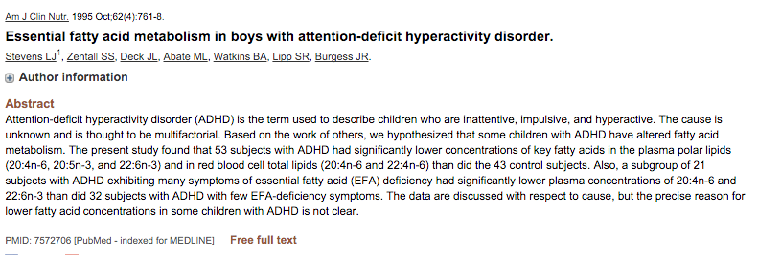
Making the Grade: ADHD & EFAs
EFAs are
  An essential part of our cell membranes
  Anti-inflammatory
  We can’t make them ourselves
  Lacking in our typical American diets
  Animals are fed diets full of omega-6s
    promoting inflammation
A combination of EFAs (EPA & DHA) are essential for tx of ADHD, mood, and behavior
        Richardson AJ. Int Rev Psychiatry. 2006
Children with hyperactivity have significantly lower levels of some good EFAs (DHA, AA)
        Mitchell et al. 1987
Children with lower levels of Omega 3 EFAs have more ADHD symptoms, sleep problems and temper tantrums
        Stevens et al. Physiol Behav. 1996
Children with dyslexia, dyspraxia, processing and learning problems improve when given DHA and GLA
        Stordy J. J Clin Nutr. 2000
        Derbyshire E. Do Omega-3/6 Fatty Acids Have a Therapeutic Role in Children and Young People with ADHD? J Lipids. 2017;2017:6285218. doi: 10.1155/2017/6285218. Epub 2017 Aug 30. PMID: 28951787

Slide 38
Making the Grade: ADHD & EFAs
Oxford-Durham Study:
  A randomized, controlled trial of supplementation with fatty acids in children
  Lack of polyunsaturated fatty acids (PUFA) may contribute to dyslexia and ADHD
          PEDIATRICS 2005
Some studies have used very high doses with no negative results
          Sorgi et al. Nutrition Journal, 2007
Doses of 1500 mg of EPA and DHA are very safe and effective in decreasing hyperactivity
          Amminger GP. Biol Psychiatry. 2007
FDA considers doses up to 3000 mg safe with minor and rare side effects (stomach upset, loose stools, fishy aftertaste; freezing the capsules to get rid of the “fish burps”)
          Newmark. ADHD Without Drugs, 2010
For vegetarians, you can use flax oil or flaxseeds, walnuts and other sources of ALA which can be converted to EPA and DHA by our bodies. You can also use algae based supplements.

Slide 39
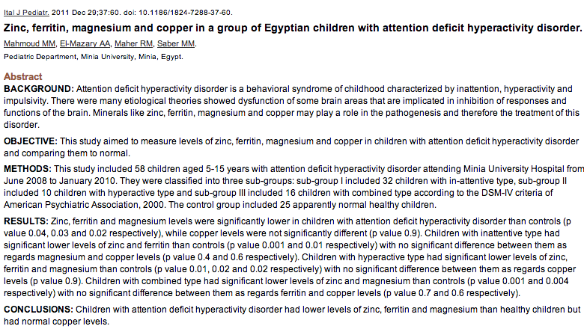
Making the Grade: ADHD & Minerals

Slide 40
Making the Grade: ADHD & Iron
Children who had moderately severe iron-deficiency anemia as infants had lower scores on tests at school entry than the rest of the children
            Lozoff et al. NEJM. 1991
Children with ADHD had lower levels of iron stores (ferritin) and the lower the level the more severe the learning problems
            Konofal et al. Arch Pediatr Adolesc Med. 2004
Treating children with iron improves their performance on verbal learning, memory (73 girls with low ferritin randomly assigned 650 mg 2x/day ferrous sulfate or placebo x 8 wks)
            Bruner AB et al. Lancet. 1996
Treating children with iron improves their ADHD symptoms (23 children with ADHD; ages 5 to 8; ferritin < 30 ng/ml -> 18 given Fe-sulfate 80 mg/d x 12 wks; 5 placebo)
            Konofal et al. Pediatr Neurol. 2008
Check iron and iron stores (ferritin). Dose at 3 mg/kg and then retest after 3 months (watch for constipation). It can take 6 months or more for the iron stores to build up.
Good food sources for iron include meats, liver, beans, leafy green vegetables.
Giving iron supplements with milk or dairy products can interfere with absorption. Giving iron supplements with citrus & vitamin C can help absorption.

Slide 41
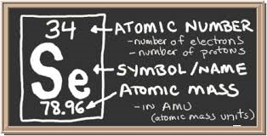
Making the Grade: ADHD & Selenium
Selenium deficiency
  Increases susceptibility to
    Glutamate induced seizures
    Defects in neuronal plasticity
Inter-connected to thyroid
  3 types of selenoproteins:
    GPx (glutathione peroxidases) – anti-oxidants
    TRx (thioredoxin reductases) – cell structure & growth
    Dis (iodothyronine deiodinases) - convert T4 to T3
Trace mineral in foods & soil (geographic variability)
    Pacific Northwest
    Great Lakes region to the New England states
    Eastern seaboard of Florida
    Australia

Slide 42
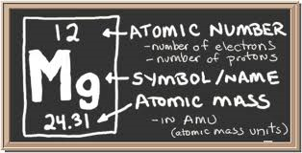
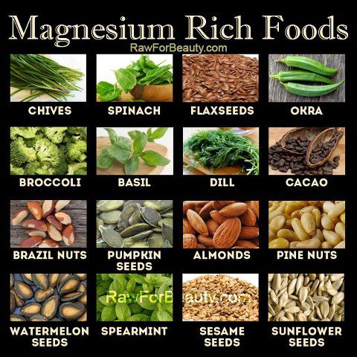
Making the Grade: ADHD & Magnesium
Deficiencies in magnesium have been found in children with hyperactivity, distractibility and disruptive behavior
        Kozielec et al.Magnes Res. 1997
Magnesium can decrease hyperactivity in a child with ADHD
        Starobrat-Hermelin et al. Magnes Res. 1997
    > 300 enzymatic functions; neuromuscular, BP, osmotic laxative
    Deficiency causes hyperactivity, anxiety, twitches, insomnia
    Sighing/salt craving/constipation
    Forms – citrate, glycinate, oxide; Epsom salt baths
Check RBC magnesium levels
Magnesium is found in many foods
Refined and processed food products are drained of their magnesium content and thus many children are deficient.

Slide 43
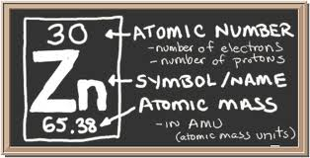
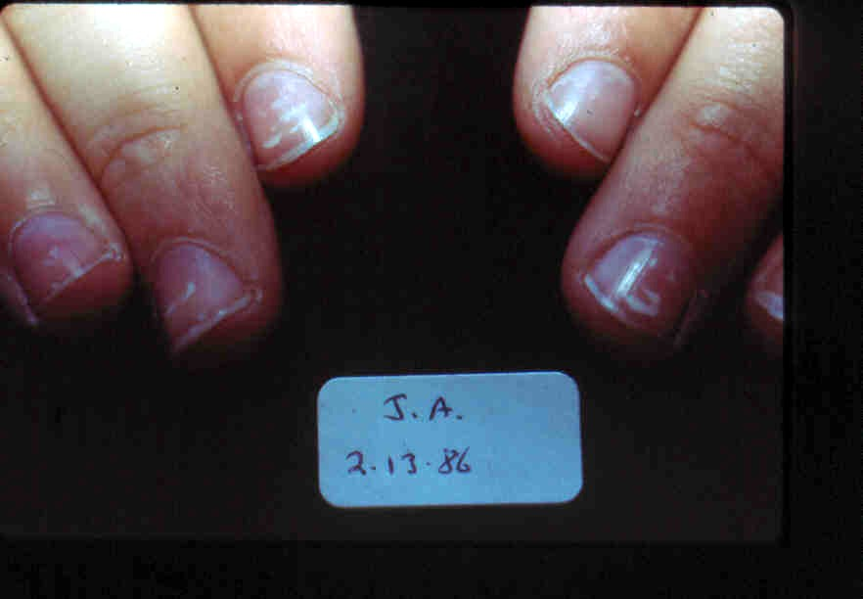
Making the Grade: ADHD & Zinc
Zinc
  Often low in ADHD
      Yorbik et al.Prog Neuropsychopharmacol Biol Psychiatry. 2008
  May be related to low free FA levels
              Bekaroglu et al. J Child Psychol Psychiatry. 1996
  Low zinc may predict poor response to amphetamines & stimulant medications
              Arnold et al. Int J Neurosci. 1990
    > 200 enzymatic functions; in energy metabolism, protein, immunity, detox
    Acne, mouth sores,nail spots/lines, pica, loss of smell, taste
    Best given alone, at night (piccolinate, acetate, carnosine )

Slide 44
Making the Grade: ADHD & Zinc
Zinc deficiency may affect cognitive development by alterations in attention, activity, neuropsychological behavior and motor development.
Zinc is essential for neurogenesis, neuronal migration, synaptogenesis and its deficiency could interfere with neurotransmission and subsequent neuropsychological behavior.
Studies in animals show that zinc deficiency during the time of rapid brain growth, or during the juvenile and adolescent period affects cognitive development by decreasing activity, increasing emotional behavior, impairing memory and the capacity to learn.
Low maternal intakes of zinc during pregnancy and lactation were found to be associated with less focused attention in neonates and decreased motor functions at 6 months of age.
Zinc supplementation resulted in better motor development and more playfulness in low birth weight infants and increased vigorous and functional activity in infants and toddlers.
In older school going children the data is controversial but there is some evidence of improved neuropsychological functions with zinc supplementation.
Additional research is required to determine the exact biological mechanisms, the critical periods, the threshold of severity and the long-term effects of zinc deprivation on cognitive development.
          Bhatnagar, S. Br J Nutr. 1985

Slide 45
Making the Grade:
What competes with Zinc?
Phylates and oxalates from foods such as grains and legumes
Caffeine and tannins from tea and coffee
Oral contraceptives.
Analgesic drugs such as Aspirin and Salicylates.
Lange KW, Lange KM, Nakamura Y, Reissmann A. Nutrition in the Management of ADHD: A Review of Recent Research. Curr Nutr Rep. 2023 Sep;12(3):383-394. doi: 10.1007/s13668-023-00487-8. Epub 2023 Jul 28. PMID: 37505402
Prolonged periods of diarrhea
High fiber diet as this binds to zinc through as it travels through the gut.
Alcohol - reduces absorption and increases excretion of zinc.
Gumma, S.D., Elotla, S.F., Ibrahim, O.Y. et al. Nutrients patterns and attention deficit hyperactivity disorder among Egyptian children: a sibling and community matched case-control study. Eur J Clin Nutr 78, 64–71 (2024). https://doi.org/10.1038/s41430-023-01345-0

Slide 46
Making the Grade:
Treatment of High Cu/Zinc Ratios
Treat Zinc deficiency until Zinc level optimized (100mcg/dl)
Induce Metallothionein production (Selenium, Glutathione, N-acetyl Cysteine)
Add Molybdenum and provide adequate amounts of vitamin B6/Magnesium
Optimize Vitamin C dose
Avoid Sources of Copper
    Tap water (Cu pipes)
    Swimming pools and hot tubs (Cu algaecide)
    Chocolate, Carob, Soy, Shellfish, Liver
Avoid Red/ Yellow dyes, HFCS, and MSG (deplete Zinc)

Slide 47
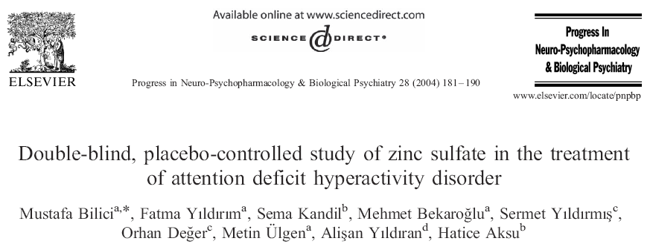
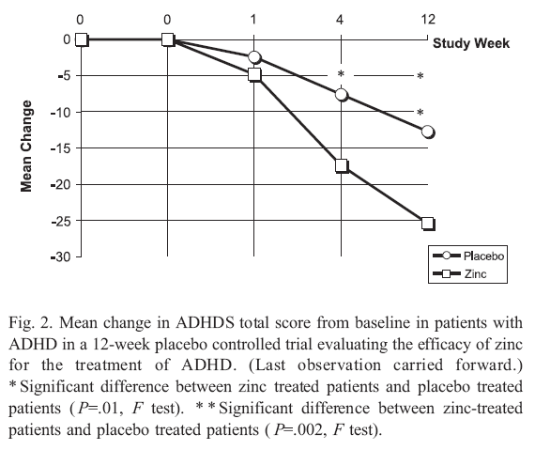

Slide 48
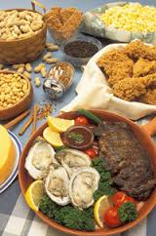
Making the Grade: ADHD & Zinc
Zinc supplementation
  Decreases hyperactive, impulsive and poor socialization symptoms
    Bilici et al.Prog Neuropsychopharmacol Biol Psychiatry. 2004
Zinc supplementation
  May improve ADHD symptoms when added to a stimulant medication
    Ghanizadeh. Eur J Clin Nutr. 2013
Check plasma or RBC (red blood cell) zinc levels
If the levels are low, supplement with at least 15 mg of elemental zinc given separately from meals; recheck levels
    Akhandzadeh et al.BMC Psychiatry. 2004
Good food sources of zinc include red and white meats, oysters, beans, nuts and whole grains.

Slide 49
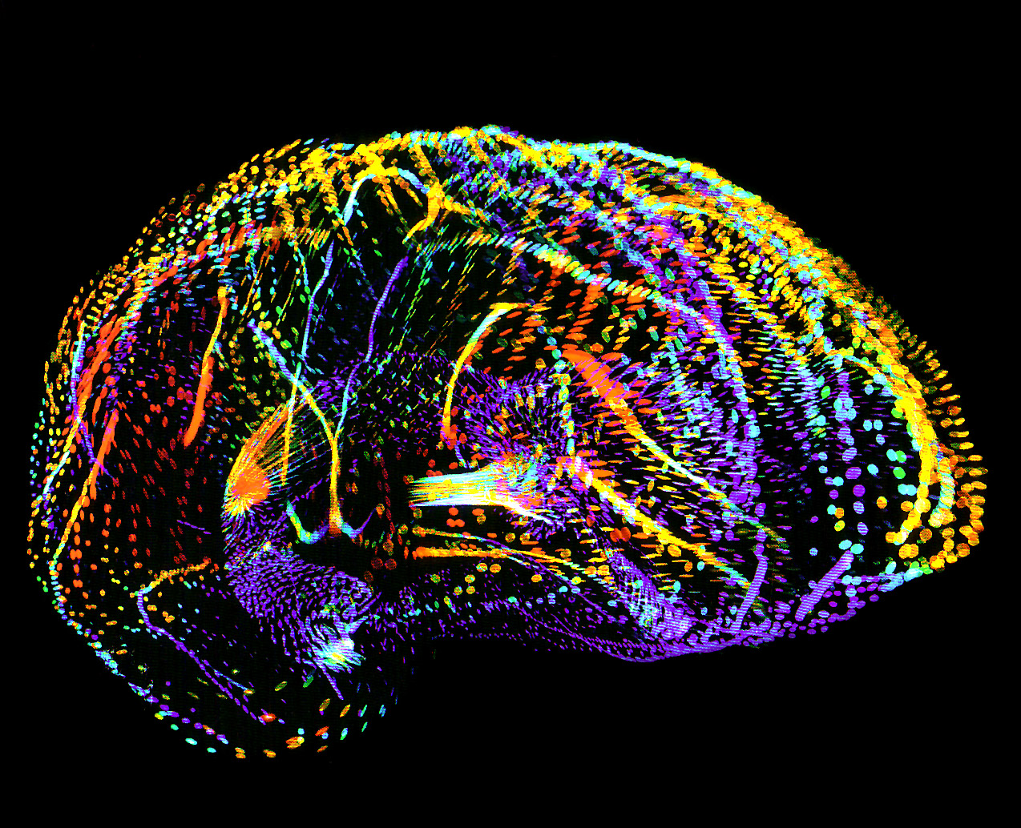
Making the Grade: ADHD and EEG/qEEG Abnormalities
qEEG and Neurofeedback
  Measures the electrical activity in each region of the brain
  Provides a blueprint for the treatment of Neurofeedback
In a study of 18 children with ADHD, theta, alpha and beta waves patterns and behavioral scores improved with Neurofeedback
            Hillard etal. Clin EEG Neurosci. 2013
More Theta wave activity and increased theta:beta ratio in the frontal cortex in comparison to children without ADHD
Theta waves are prevalent when drowsy or day dreaming
Beta waves in the frontal cortex
  Associated with sustained attention
  Associated with thinking
          Steiner. 2014
  “In- School Neurofeedback Training for ADHD:;
  Sustained Improvements from a Randomized Control Trial.”
          Pediatrics 2014

Slide 50
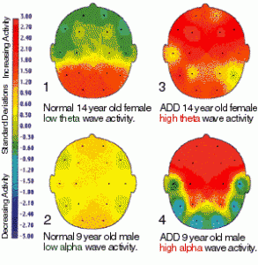
High theta
High alpha in ADD
Left:14 year old female and 9 year old male.
Right: (3&4) age matched ADD individuals:
Notice how the two ADD individuals (3&4) demonstrate high (more red) Theta and Alpha activity in their maps than do the normal individuals, respectively.
High Theta: drowsiness
High Alpha: idleness.
ADD (3&4): non-attentiveness and too little stimulation of the reticular activating system

Slide 51

Making the Grade: ADHD and Behavioral Interventions at Home
Support Self-esteem
Praise and define good behaviors while ignoring bad behaviors
Encourage an activity your child loves
Provide a quiet study area
Allow frequent breaks
Set clearly defined rules and directions
Limit the use of electronics
Encourage exercise
Provide adequate sleep and good nutrition
      Smith, Melinda, and Robert Segal.
      "ADD/ADHD Parenting Tips." :
      Helping Children with Attention Deficit Disorder. 2014

Slide 52

Making the Grade: ADHD and Behavioral Interventions at School
  Sit near teacher or positive role model
  Avoid distractions near student (ex, air conditioners, high traffic areas)
  Write key points on board (visual aides)
  Reinforce directions (written directions home, tape recorded or computer aides)
  Teach through many modes and variety of activities (sight, touch, sound)
  Give extra time for tests, quizzes, and in-class assignments
  Break down directions and assignments into smaller parts
  Provide outlines, study guides, organizational packets, peer tutoring
  Allow computer printed assignments; do not deduct for handwriting
  Avoid time pressured/competitive exams/activities
  Allow student to have extra set of books or notes
    One at home (decreases risk of losing or misplacing)
    Provide assignment notebook
  Develop reward system for school and homework
            Grohol. ADHD Behavioral Interventions. 2009

Slide 53

Making the Grade: ADHD & Social and Behavioral Interventions
Find a social skills class or lunch bunch group (www.chadd.org)
Find a cognitive training program such as Cognitive Behavioral Therapy (CBT), or Social Cognition Training (www.nacbt.org)
Consider qEEG and Neurofeedback
Consider AIT (Auditory Integration Therapy) – may improve attention, anxiety
      Brocket et al. Hearing Equals Behavior: Updated and Expanded. 2011

Slide 54
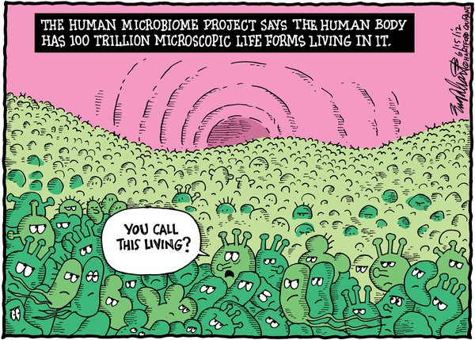
Making the Grade: What do we do to decrease risk of ADHD?
First 1000 days
Starts in preconception with the health of mom
Continues through pregnancy and early infancy
Includes treating microbiome (probiotics and prebiotics), inflammation (vitamin D, EFAs), nutritional deficiencies (iron, zinc, magnesium, selenium, Bs)
Breastfeeding and first foods

Slide 55

complexity
integration
individuality
synergy

Slide 57
Making the Grade: ADHD Labs
CMP – Chemistry panel
CBC with differential and platelets
Vitamin D 25 OH
Mitochondrial markers – carnitine, acylcarntine, ammonia, lactate, Amino acids
Iron and ferritin (iron stores)
Zinc (plasma or RBC levels)
Magnesium (RBC levels)
Selenium
Lead, mercury, arsenic, aluminum
Celiac panel (HLA DQB1)
Urine Organic Acid Test
Others as warranted by history and PE (ionized calcium, strep and mycoplasma titers, vitamin A, inflammatory markers, stool testing, mold sensitivities)

Slide 58
Making the Grade: What’s the Diagnosis?
ADHD
Restricted appetite
Severe acne
Chronic diarrhea
Episodic anger
Alpha Agonist or Nutritional
Biochemistry?
ZINC
Notes:
People who are live streaming
March birthdays
zinc

Slide 59
Making the Grade: What’s the Diagnosis?
ADHD Sx
Anxiety
Lots of sighing
Salt craving
No veggies
Antianxiety Med or Nutritional Biochemistry
Magnesium
Notes:
April birthdays
mag

Slide 60
Making the Grade: What’s the Diagnosis?
ADHD Sx
Fatigue
Constipation
Dry, brittle hair
Sydney, Australia
Hypothyroid
Antidepressant Or Nutritional
biochemistry?
Notes:
May birthdays
hypothyroid

Slide 61
Making the Grade: What’s the Diagnosis?
ADHD?
Allergic shiners/Dark circles
Restless
Falls asleep in class
Food sensitivities
Snores
Notes:
Shout out from audience
Immune dysregulation, obstructive sleep apnea

Slide 62
Making the Grade: Basic functional medicine interventions for ADHD
HEAL THE GUT
  Treat constipation
  Treat germ overgrowth
  Treat inflammation
Avoid what harms
  Gluten? Casein?
  Additives? Toxins?
Give what heals
  Nutrient dense diet
  Probiotics
  Omega 3 EFAs
FIX METABOLIC PROBLEMS
  Additional Minerals
    Magnesium
    Iron
    Zinc
  Antioxidants
    Vitamins A, C, D, E
  Treat metabolic, mitochondrial and/or sleep problems
  Behavioral Therapy
  Detoxification
    Sweat
    Exercise!

Slide 63
