Slide 1

Join the Norwegian National Pavilion
China International Import Expo (CIIE) 2026
Shanghai, 5th – 10th November 2026

Slide 2
WHY CIIE
CIIE Highlights
The World’s largest import-themed exhibition
Over 400 000 professional visitors
A recorde USD 83.49 billion in intended deals within one year
Representation from over 138 countries and regions
Over 4 100 participating enterprices
430 000 sqm of dedicated exhibition space
Why join the Norwegian National Pavilion
Innovation Norway and Team Norway in China joint collaboration
Direct access to China’s high growth market
Presence of senior Norwegian government and industry leaders
Enhanced public, media and brand visibility
Proven track record with strong endorsements from 2024 & 2025 exhibitors

Slide 3
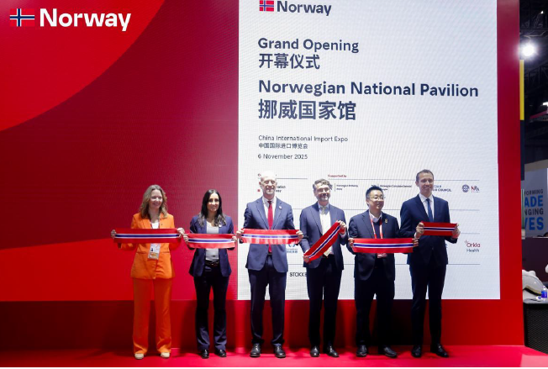
The Norwegian Pavillion was one of the most popular country pavillions
Highlights of the pavillion
Opening Ceremony: Attended by senior officials and Team Norway representatives.
Business Events: Curated programmes to support sponsors and showcase leading Norwegian business solutions
Interactive Activities: Food tastings and immersive experiences highlighting Norwegian culture and lifestyle
Media Coverage: Widespread exposure across major Chinese media outlets and social media channels

Slide 4
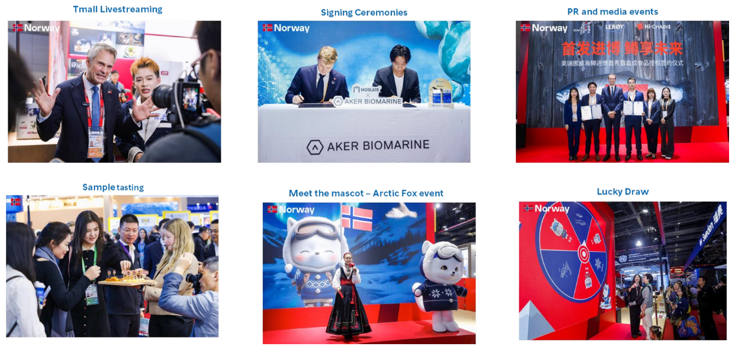
Dynamic Stand Activities at Norwegian National Pavillion
CIIE 2025

Slide 5
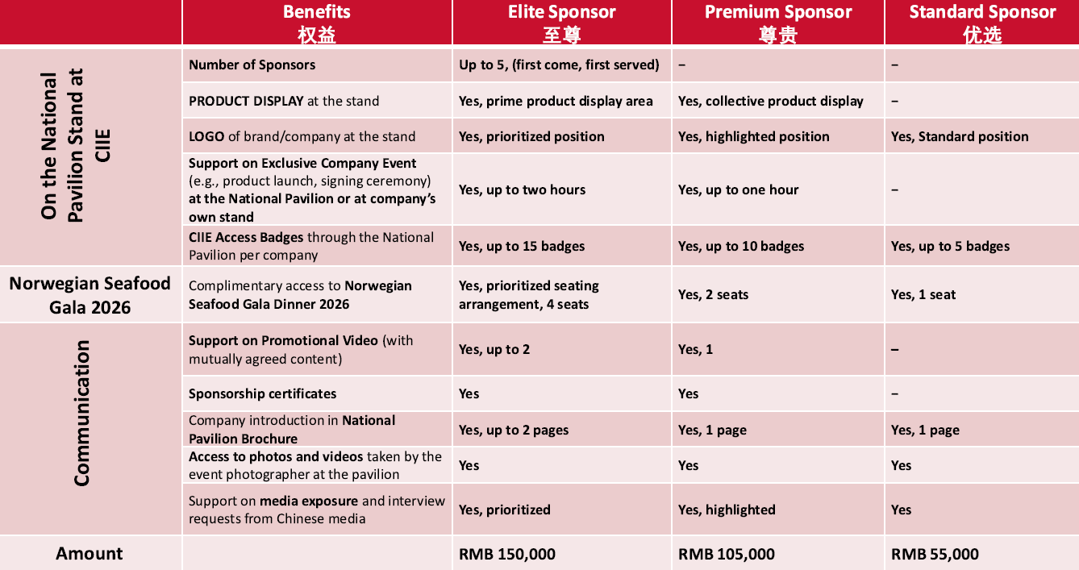
Packages available for the Norwegian Pavillion
CIIE 2026 participation

Slide 6
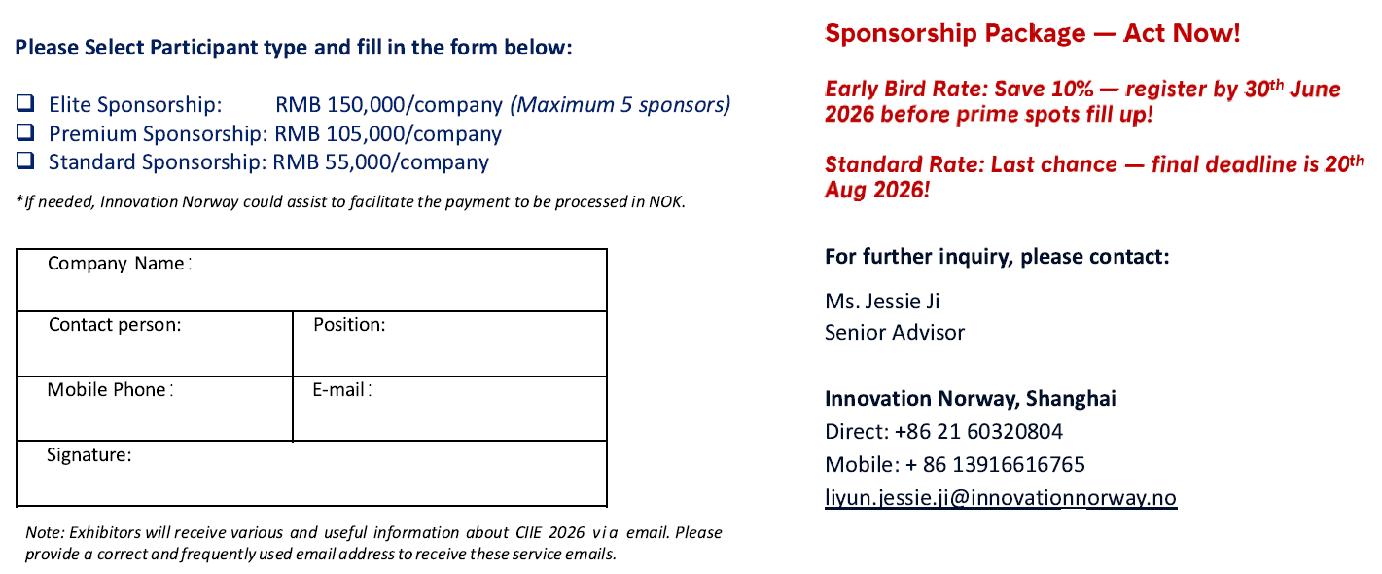
Invitation to participate @Norwegian National Pavilion 2026
CIIE, Shanghai, 5th – 10th November 2026

