Slide 1
Experience with Romanian-Norwegian research cooperation: A Norwegian perspective
Cristina Mihai
Research Council of Norway

Slide 2
1. Our role as DPP
2. Who we are?
3. Energy research in Norway

Slide 3
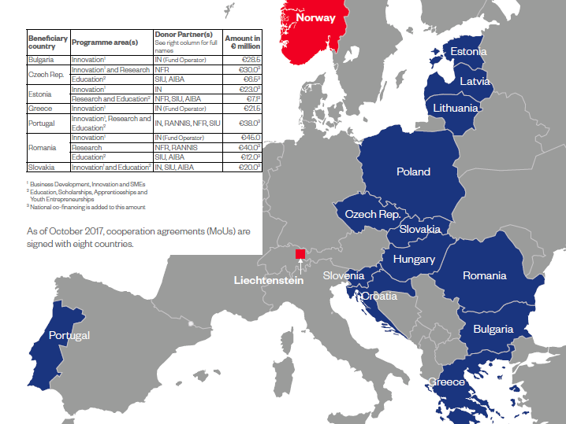
EEA and Norway Grants for research
2004-2009: projects, pilot programme in Poland (2006-2011)
2009-2014: 5 bilateral programmes (2012-2017)
2014-2021: 5 programmes with 7 countries ongoing (2018-2024)

Slide 4
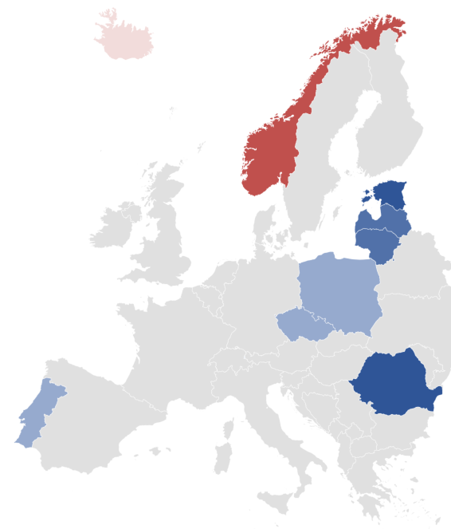
Forskning i EØS-midlene
Notes:
Norge bidrar med betydelige midler til å løfte forskningskapasitet i nye medlemsland i EU. Vi gjør det gjennom forskningssamarbeid og erfaringsutveksling.
Gode resultater fra forskningssamarbeidet mellom Norge og partnerlandene frem til 2017 har gitt videreføring og økning av støtte til forskning.
Stolpediagramet:
Tall for Portugal viser Blå vekst programmet (2018-2024) der forskning inngår med 7 millioner euro – bevilgningsmøte snart (juli)
Felles baltisk forskningsprogram for Estland, Latvia og Litauen fra 2018, før dette egne program med Latvia og Estland.
145 forskningsprosjekter med norske partnere ble gjennomført 2012-2017, det blir over 200 prosjekter i denne runden

Slide 5
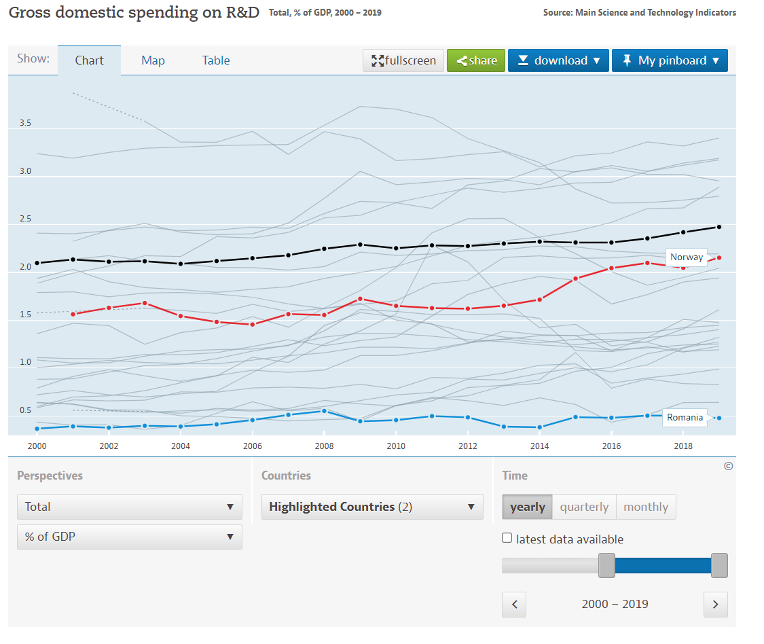
Norway is not just about the fjords…

Slide 6
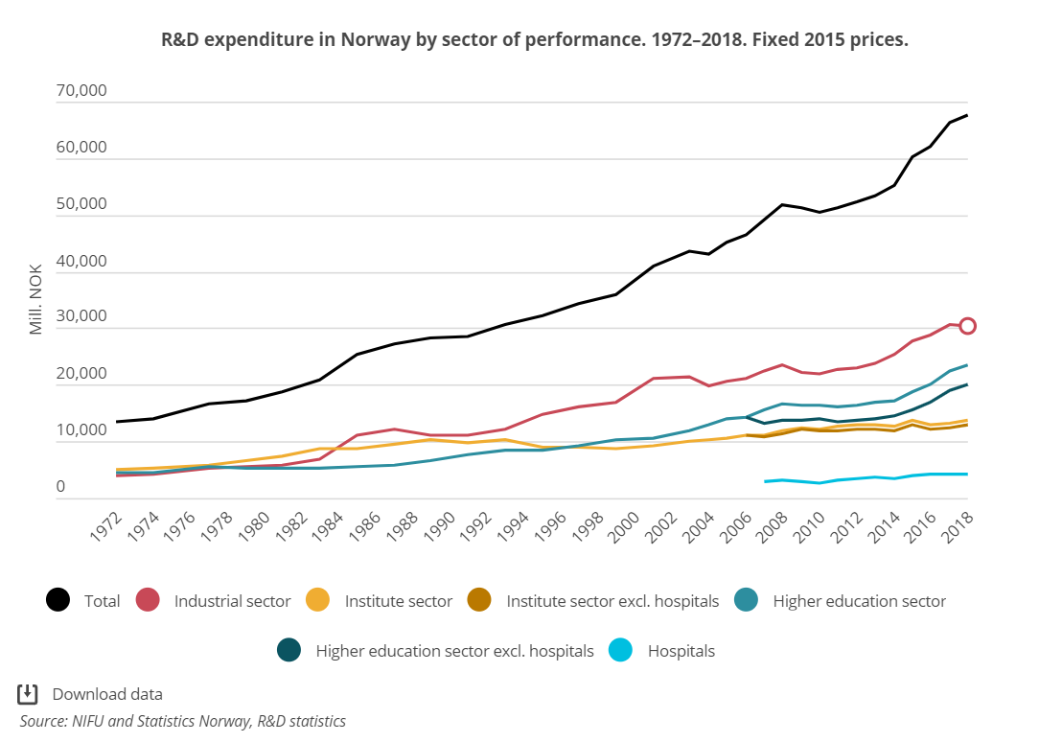
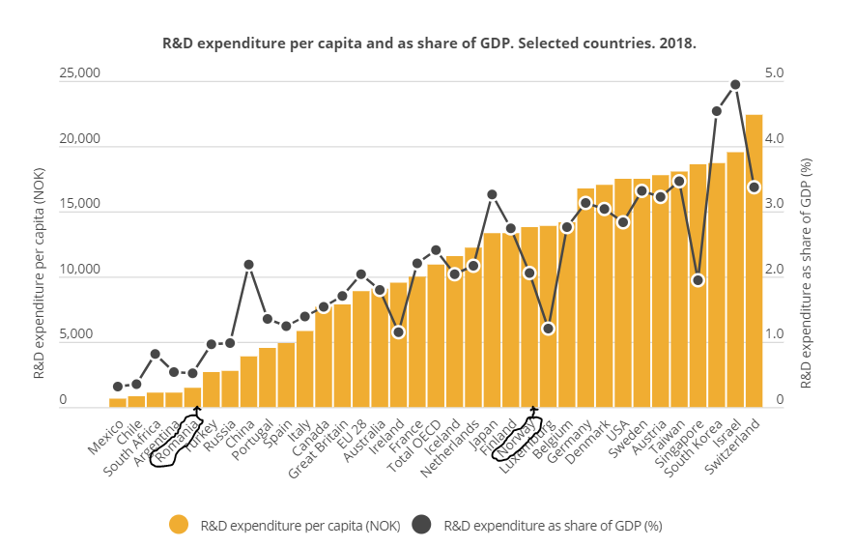
Norwegian Research ​– strong fields
7,7 billion Euros in 2019
Renewable energy ​
Geology​
Petroleum technology​
Climate change​
Marine sciences​
Maritime​
Clinical medicine​
Public administration
45%
35%
20%
Notes:
R&D expenditure in Norway reached nearly 73 billion NOK in 2018. In real prices, this was a 1.7 per cent increase from the previous year, far lower than the 7 per cent increase in 2017.
The industrial sector constituted 45 per cent of Norway’s R&D expenditure in 2018, the higher education sector 35 per cent and the institute sector 20 per cent. The health trusts, which are part of the higher education and institute sectors, respectively, constituted 6 per cent of the R&D expenditure.
The industrial sector spent 6.2 billion NOK on R&D within the thematic area energy in 2018. The institute sector spent nearly 2 billion NOK on energy R&D, and 2.1 billion on R&D within health and care. Data on thematic R&D for 2018 is not available for the higher education sector.

Slide 7
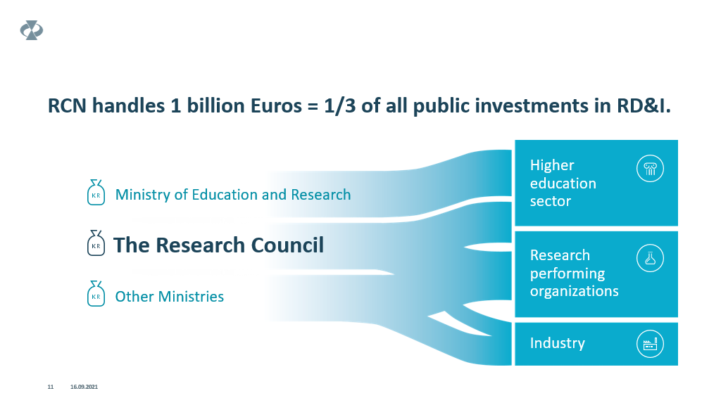
37%
40%
17%

Slide 8
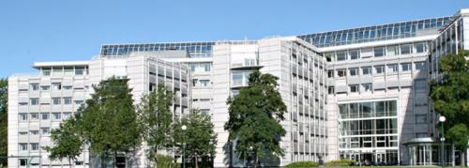
The Research Council is a focal point in the research and innovation landscape
15 ministries give 1,1 billion Euros
Europe and the world
Society (users)
Norges forskningsråd
R&I institutions
Business sector (ca 17%)
Institutes (40%)
Universities and university colleges (37%)
Notes:
The Research Council is a focal point between policy makers, R&I actors as well as Europe and the world.
The annual budget for 2018 is approximately 1 billion Euro, or 1,3 billion USD
RCN is also a policy adviser to the government and the ministries
RCN gives advice and proposals to the ministries on research priorities and funding.

Slide 9
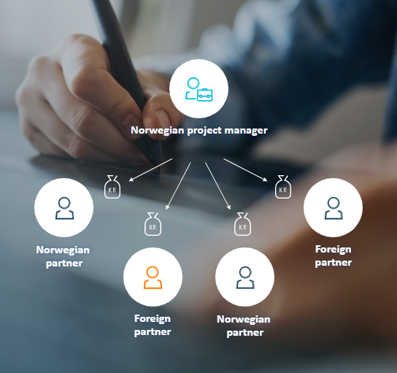
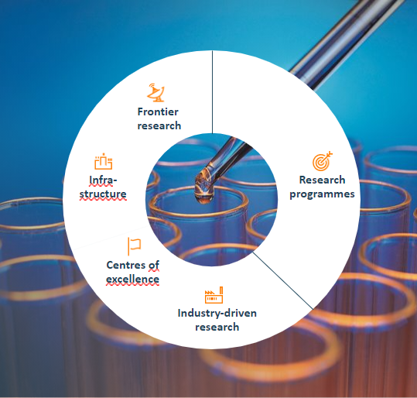
RCN finances international cooperation in our national schemes

Slide 10
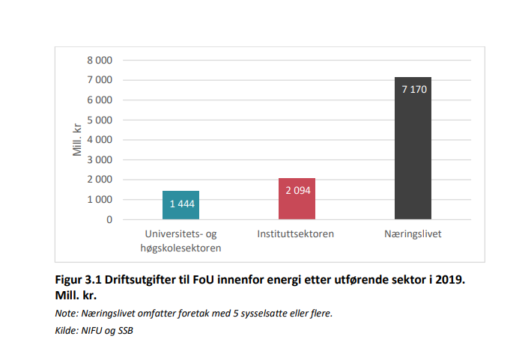
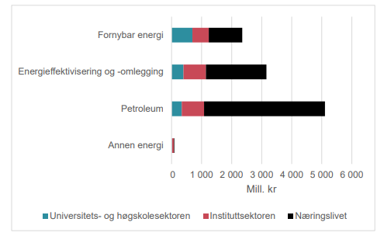
Energy research
76%
20%
14%
10,7 billion NOK expenditure in 2019
15% financed by RCN, 62% industry

Slide 11
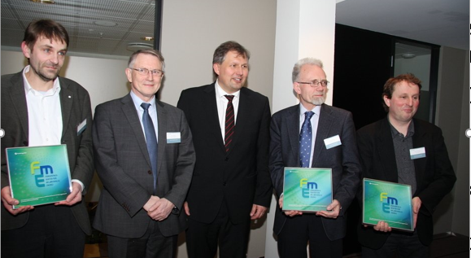
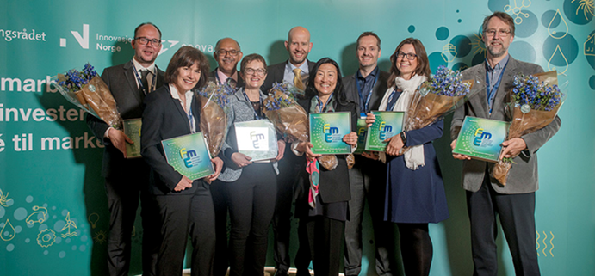
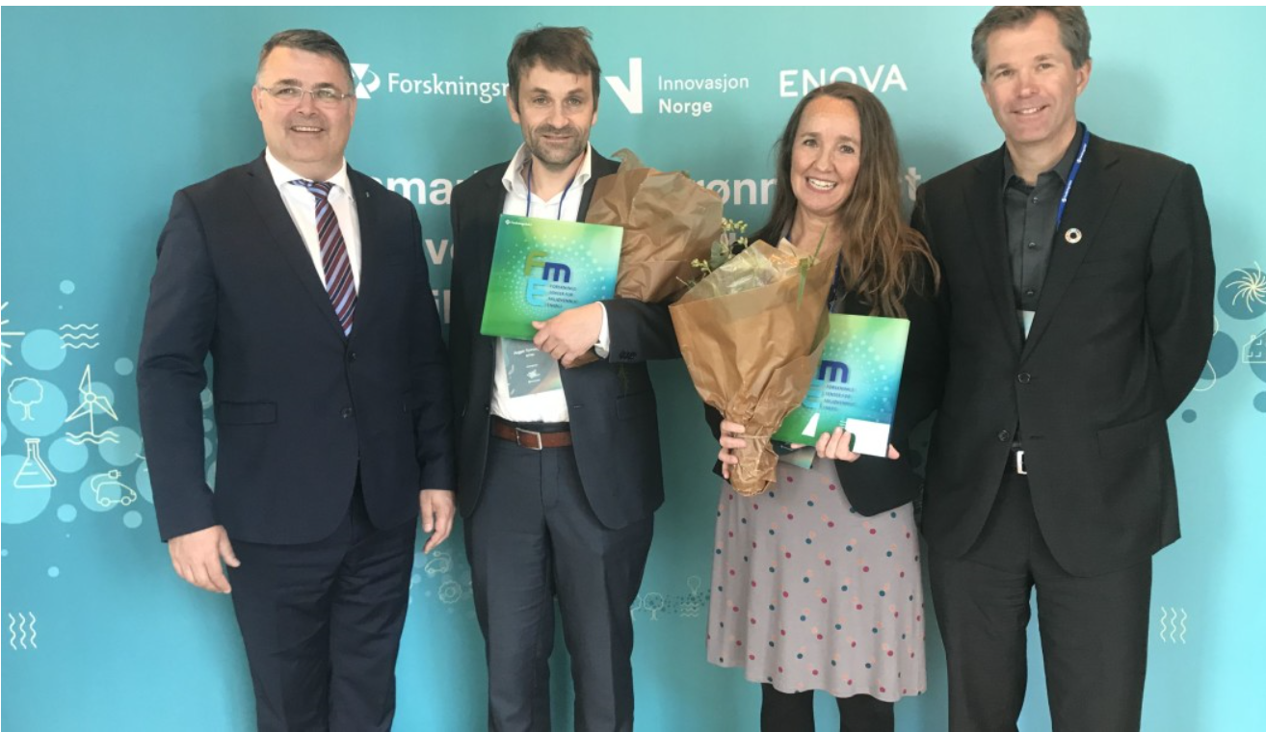
Centres for Environment-friendly Energy Research - FME
  2009 – 2017: Eight centres within technological energy research
  2011 – 2019: Three centres within social science related energy research
  2016 – 2024: Eight centres mainly within technological energy research
  2019 – 2027: Two centres within social science related energy research
  2021 – 2029: One centre within wind energy
  2022 – 2030: One centre within hydrogen and hydrogen based energy carriers

Slide 12









Centres for Environment-friendly Energy Research 2016 - 2024
Centre for intelligent electricity distribution
Centre for an Energy Efficient and Competitive Industry for the Future
Mobility Zero Emission Energy Systems
Research Centre for Sustainable
Solar Cell Technology
Norwegian CCS
Research Centre
Norwegian Research Centre for Hydropower Technology
Norwegian Centre for Sustainable
Bio-based Fuels and Energy
The Research Centre on Zero Emissions Neighbourhoods in Smart Cities

Slide 13
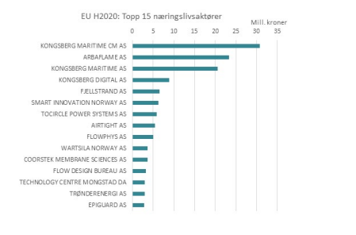
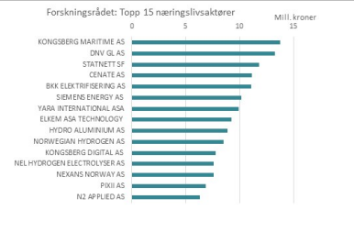
Norwegian companies by results in H2020

Slide 14
Why to apply to the Energy call?
The call is quite open thematically - allow to build on your strenghts
Bilateral teams do research together – more than networking
Equal partnerships offer benefits to all participants – also in Norway
International coordinator experience towards more complex project Horizon Europe applications
Potential for upscaling and replication in different climate and socio-economic conditions and with respect to energy supply

Slide 15
Bafta multa!
Cristina Mihai
cmi@rcn.no

