Slide 1
Norway Grants and Innovation Norway
Konrad Konieczny, Programme Officer

Slide 2
Innovation Norway Innovation Norway is the Norwegian Government and regional authorities' main instrument for realising value-creating industrial and commercial development throughout the country
Innovation Norway aims to stimulate commercially and socio-economically profitable business development, and realise the commercial potential of the regions
Foto: Unsplash
Notes:
Given the challenges and opportunities we have been talking about, we have a new strategy. Our goal and our vision remain firm!
Our purpose:
Innovation Norway is the Government and regional authorities' main instrument for realising value-creating industrial and commercial development throughout the country.
Main objectives
Innovation Norway aims to stimulate commercially and socio-economically profitable business development, and realise the commercial potential of the regions

Slide 3
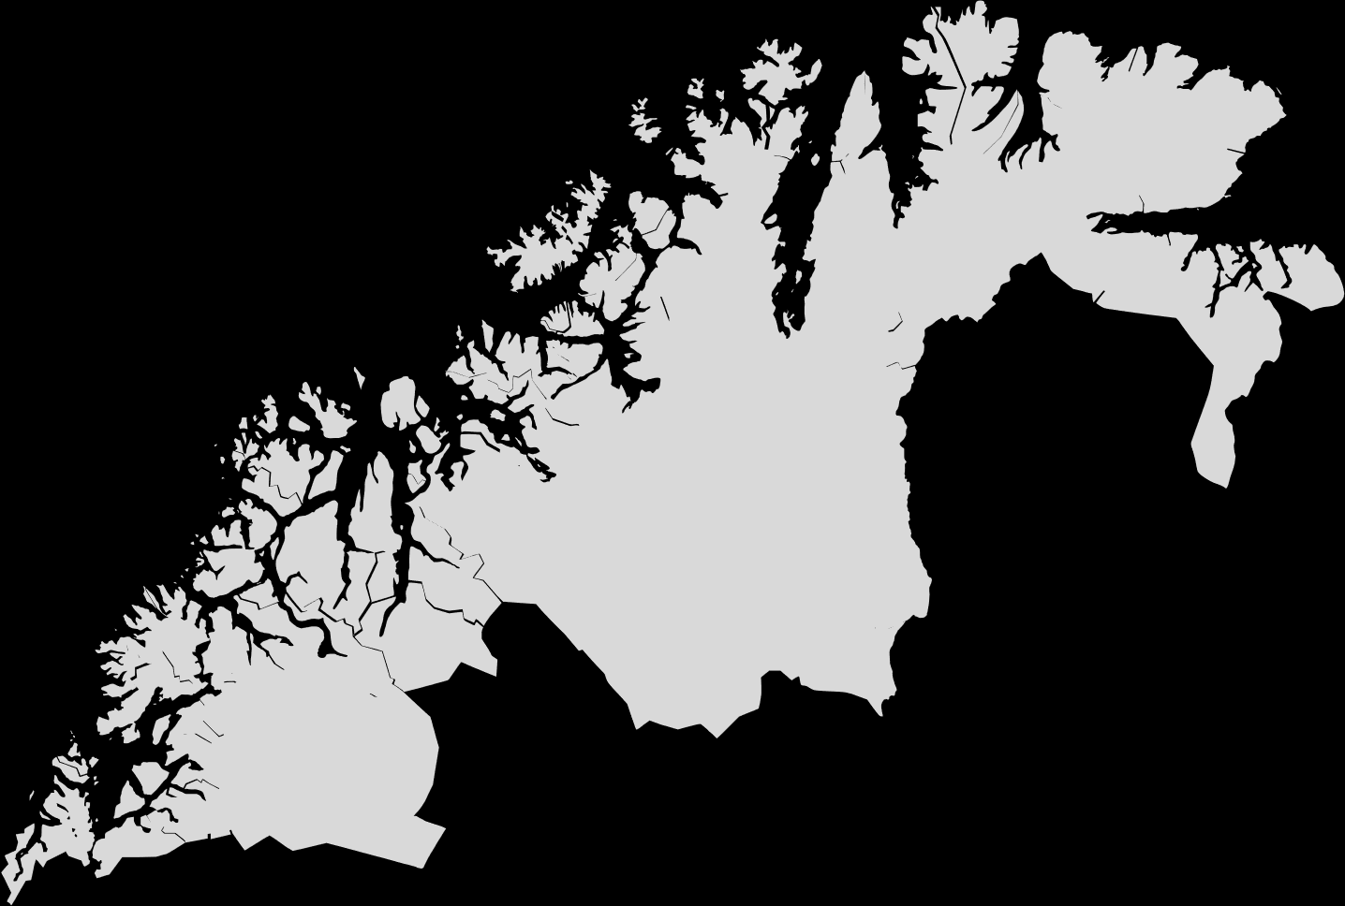
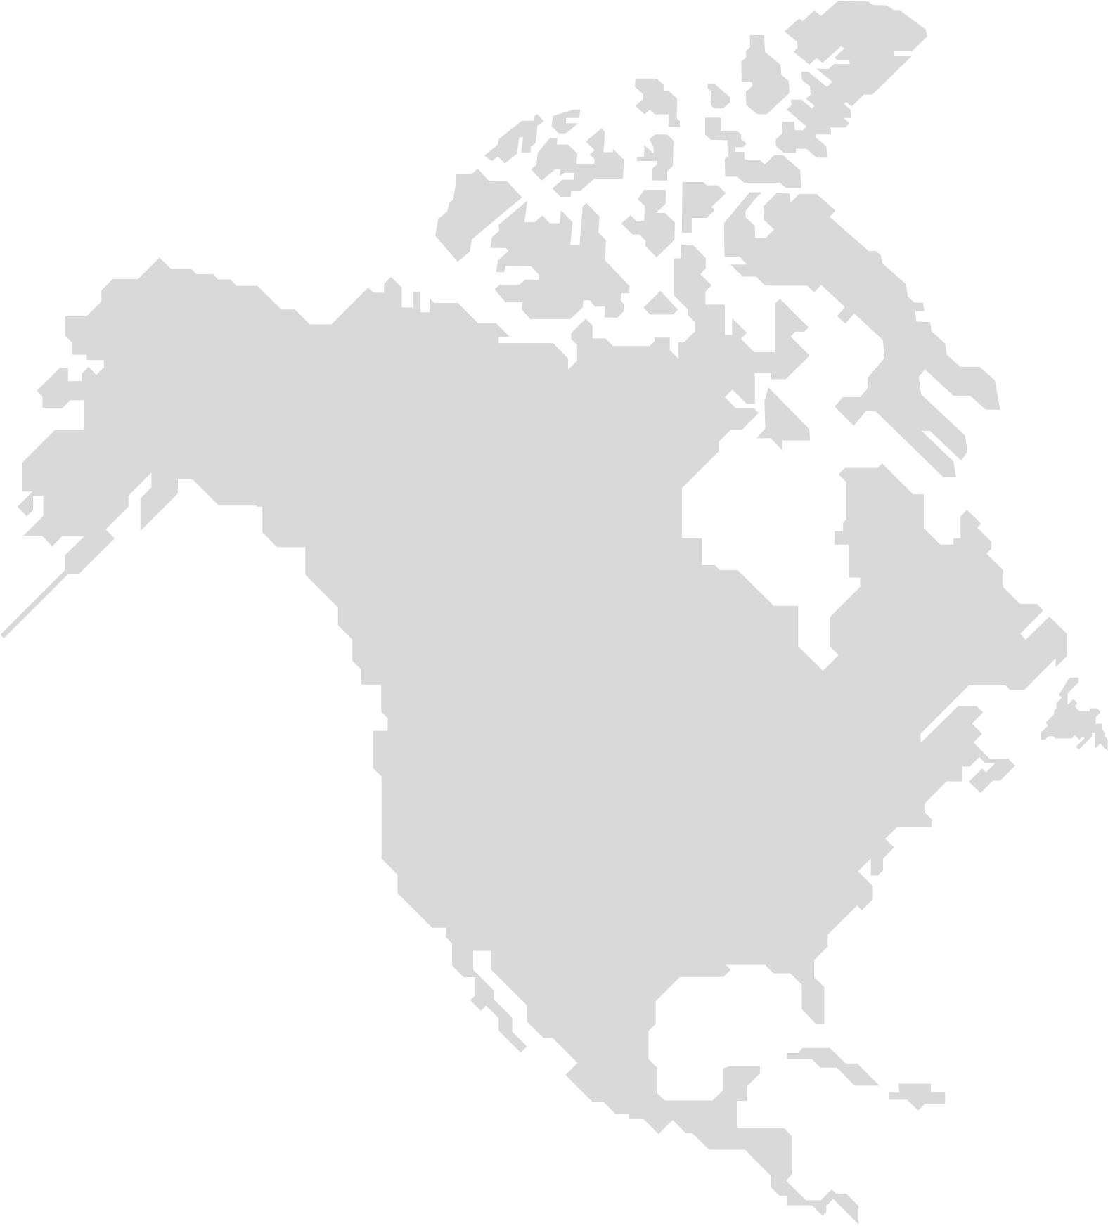
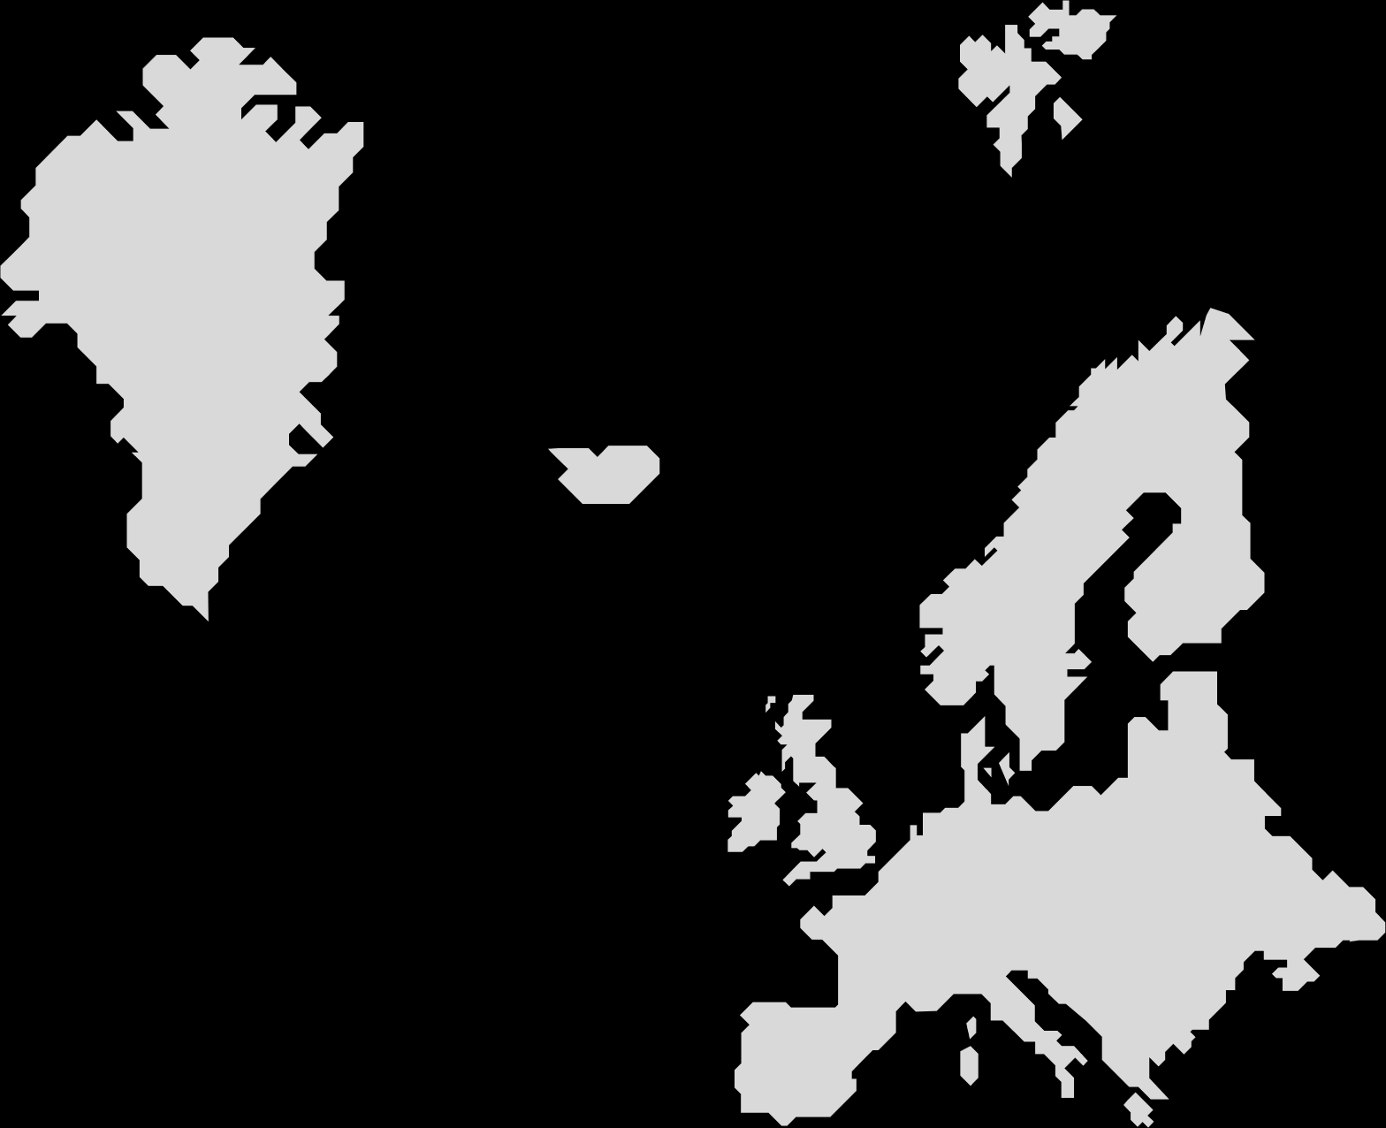
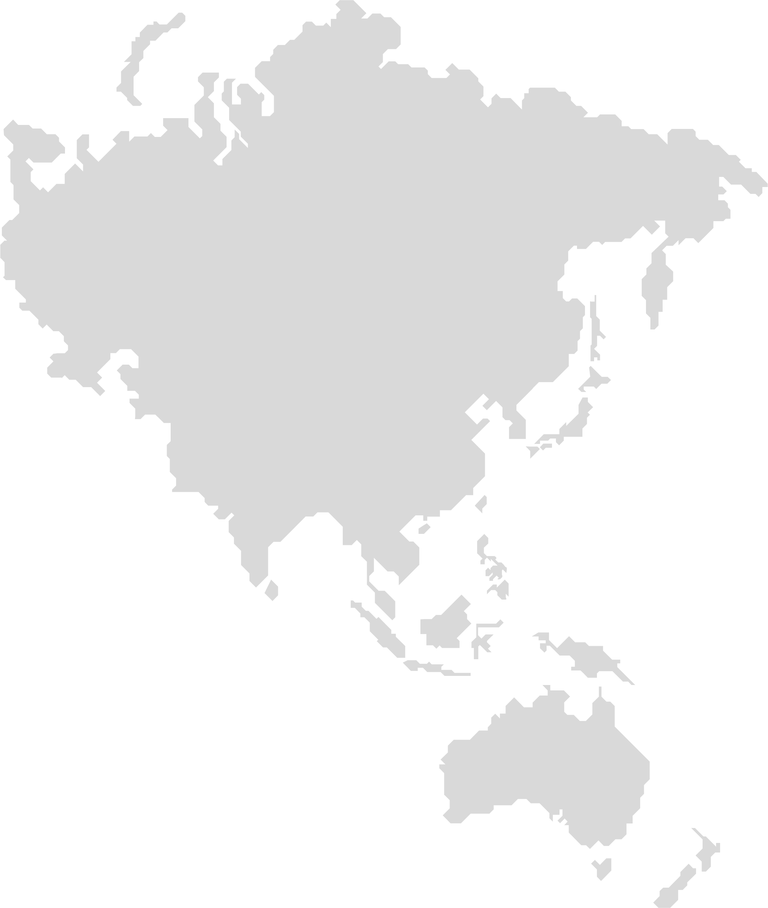
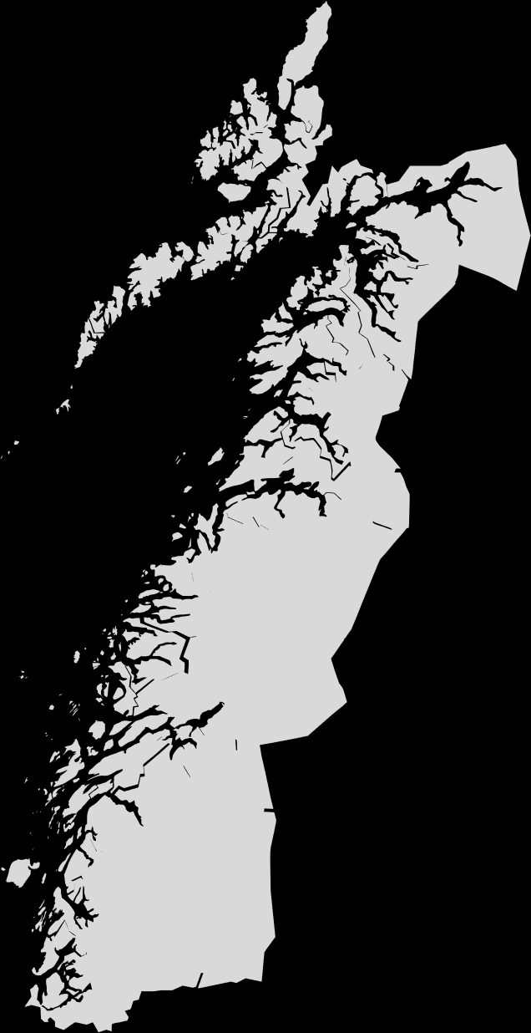
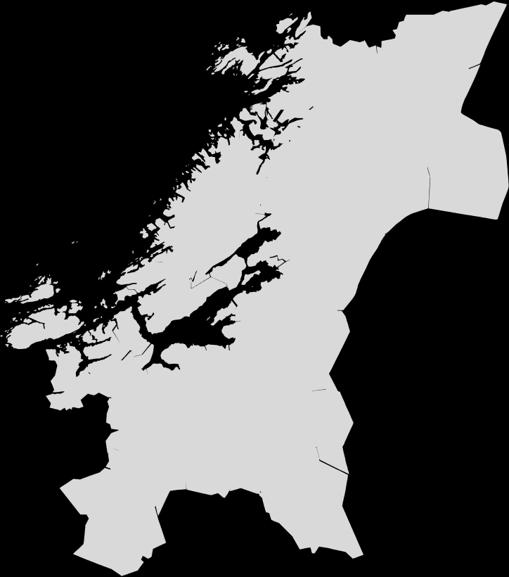
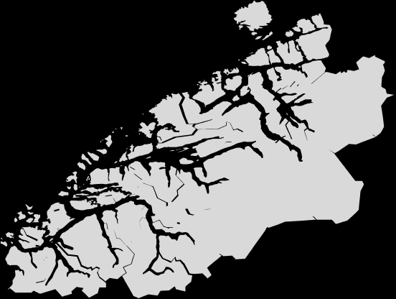
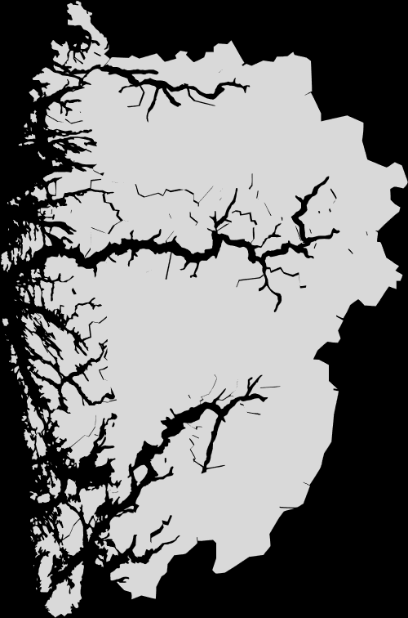
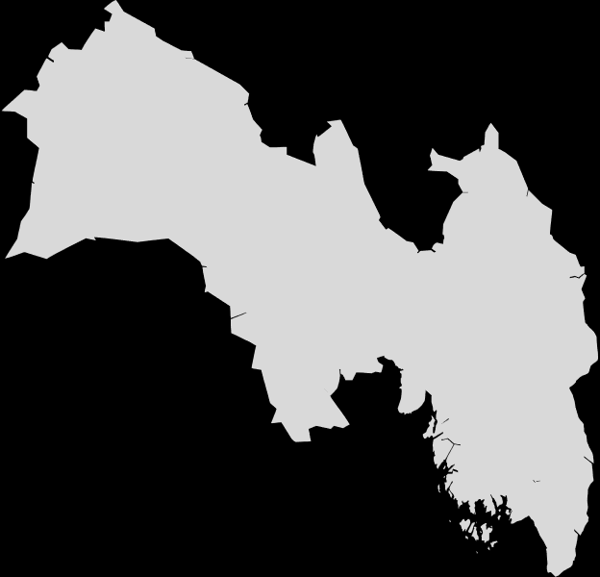
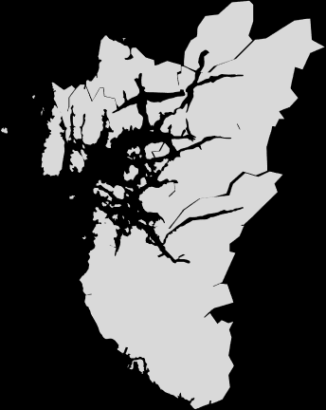
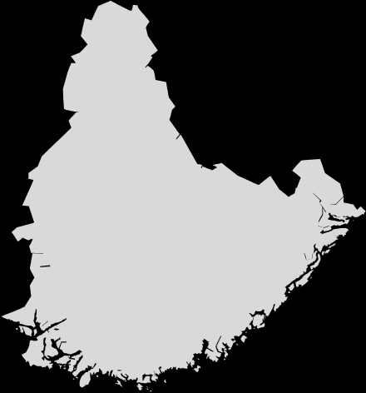
We give local ideas global opportunities
We connect people, businesses and environments with ideas, knowledge and capital across borders
Alta
Vadsø
Tromsø
Bodø
Steinkjer
Molde
Trondheim
Ålesund
Vekst- og gründersenteret i Førde
Brumunddal
Sogndal
Bergen
Oslo
Drammen
Stavanger
Sarpsborg
Borre
Skien
Grimstad

Slide 4
Our goals
More successful entrepreneurs
More companies with growth potential
More innovative business clusters
Our regional offices are actively involved in building stronger structures for innovation and entrepreneurship in the different regions in Norway.
Norwegian economic restructuring depends on more companies growing and scaling successfully.
Companies that participate in networks and clusters experience more growth, are better at collaborating and utilize more instruments compared to other companies that don’t use Innovation Norway’s services.
Notes:
More successful entrepreneurs
It is important for Innovation Norway to contribute to a healthy entrepreneurial culture and a thriving ecosystem throughout the whole country.
More companies with growth potential
Innovation Norway’s contribution is to provide funding to these companies and link them up with expertise and networks in Norway and in the export markets.
More innovative business clusters
This takes place through three types of instruments; the Norwegian Innovation Clusters programme, the Business Network service and the Centre of Expertise for Regional Restructuring.

Slide 5
High Potential Innovation
A holistic service offering that supports companies through the entire customer journey
Financing
Competence
Network
Positioning
High
Quality Investments
High
Potential Opportunities

Slide 6
Our results
Financial contributions to 8.100 innovation and transition projects in 2020
9/10 customers state that support from IN was decisive for realizing their project

Slide 7
The EEA & Norway Grants

Slide 8
Objectives of the EEA and Norway Grants
Contributing to reducing social and economical disparities in the European Economic Area
Strengthening relations between Norway, Iceland, Liechtenstein and the beneficiary countries
2017-2024: 2.8 billion EUR to programmes in 15 countries
Notes:
This strengthens the internal market, leading to a more prosperous Europe.

Slide 9
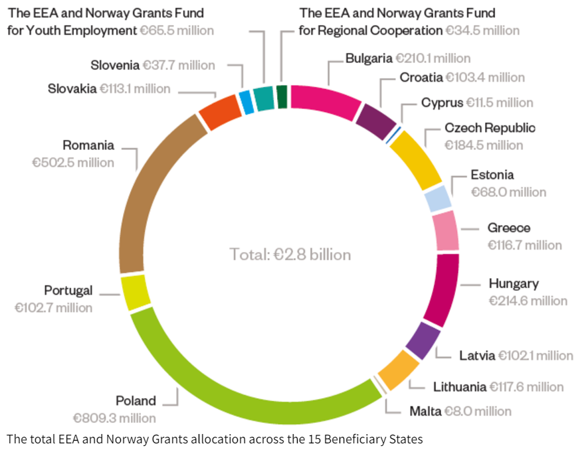

Slide 10
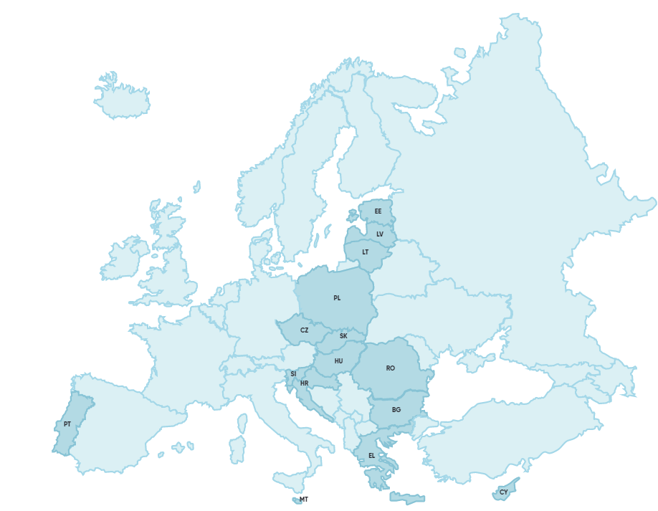
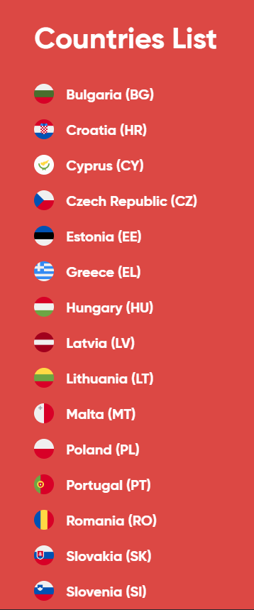
Notes:
EØS-midlene er norges skatt for å ha tilgang til eu’s indre marked
Det skal gå til sos øk utvikling i eu-land og til å styrke bilaterale forhold
Vi går nå inn i en ny periode – og her har det vært en kraftig skatteøkning fra 1,8 til 2,8 milliarder euro.
Disse pengene fordeles på 15 mottakerland og 11 av disse vil ha nærings og innovasjonsprogram hvor IN enten forvalter programmene eller som partner til mottakerlandene
Så hva har IN med dette å gjøre
Svaret er at EØS-midlene er et fantastisk eksportvirkemiddel for norske bedrifter

Slide 11
IN roles under the EEA and Norway Grants
In the framework of EEA and Norway Grants, we provide financing, partner search and advice Innovation Norway participates in business programs in 10 countries and in the decent work program in 12 countries In the current period, we are responsible for the implementation of programmes totalling around EUR 190 million, and involved in partner role in programmes amounting another EUR 225 million.

Slide 12
Innovation Norway as Programme Operator
IN operator
Bulgaria
IN operator
IN operator
Croatia
IN operator
Business and innovation, 28,5 mill. EUR
Business and innovation, 45 mill. EUR
Romania
Greece
Business and innovation – Green
Industry, blue growth, ICT, 21,5 mill. EUR
Business and innovation 22 mill. EUR
Energy 62,8 mill. EUR

Slide 13
Foto: Pixabay

Slide 14
Innovation Norway as Programme Partner
IN program partner
Slovakia
IN program partner
Business innovation and education, 20 mill. EUR
Portugal
Poland
Business and innovation, 95 mill. EUR
Estonia
IN program partner
Business and innovation, 23 mill. EUR
Latvia
IN program partner
Business and innovation, 12,5 mill. EUR
IN program partner
Business and innovation, research and education, 38 mill.
Lithuania
IN program partner
Business and innovation 14 mill. EUR
EURclimate and energy 24 mill. EUR

Slide 15
Foto: Pixabay

Slide 16
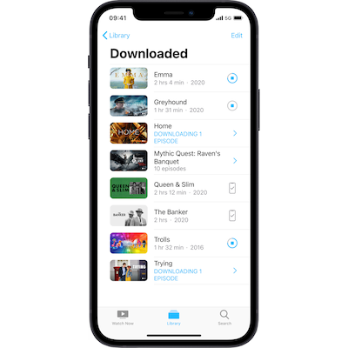
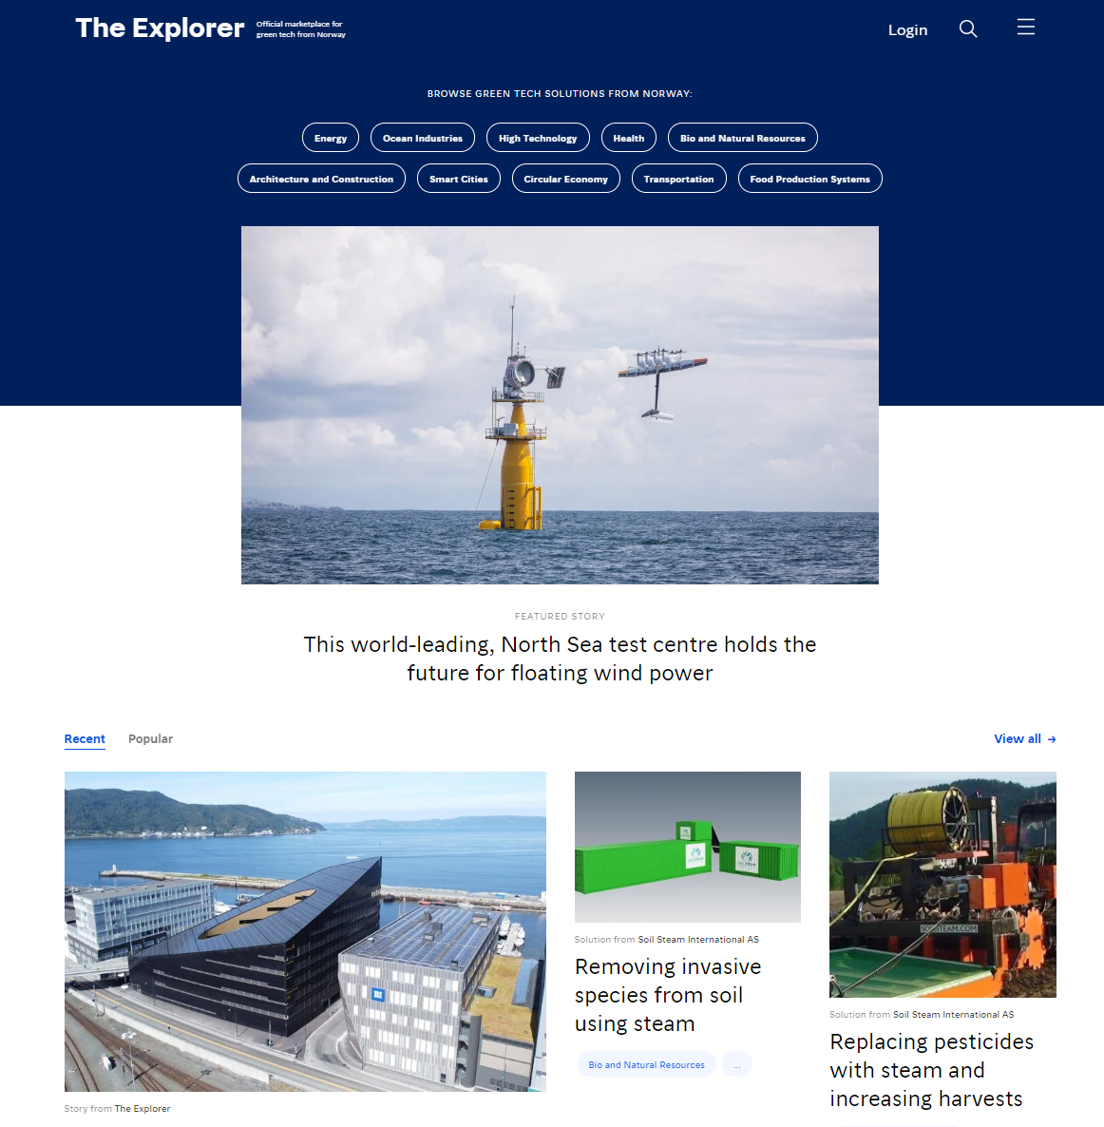
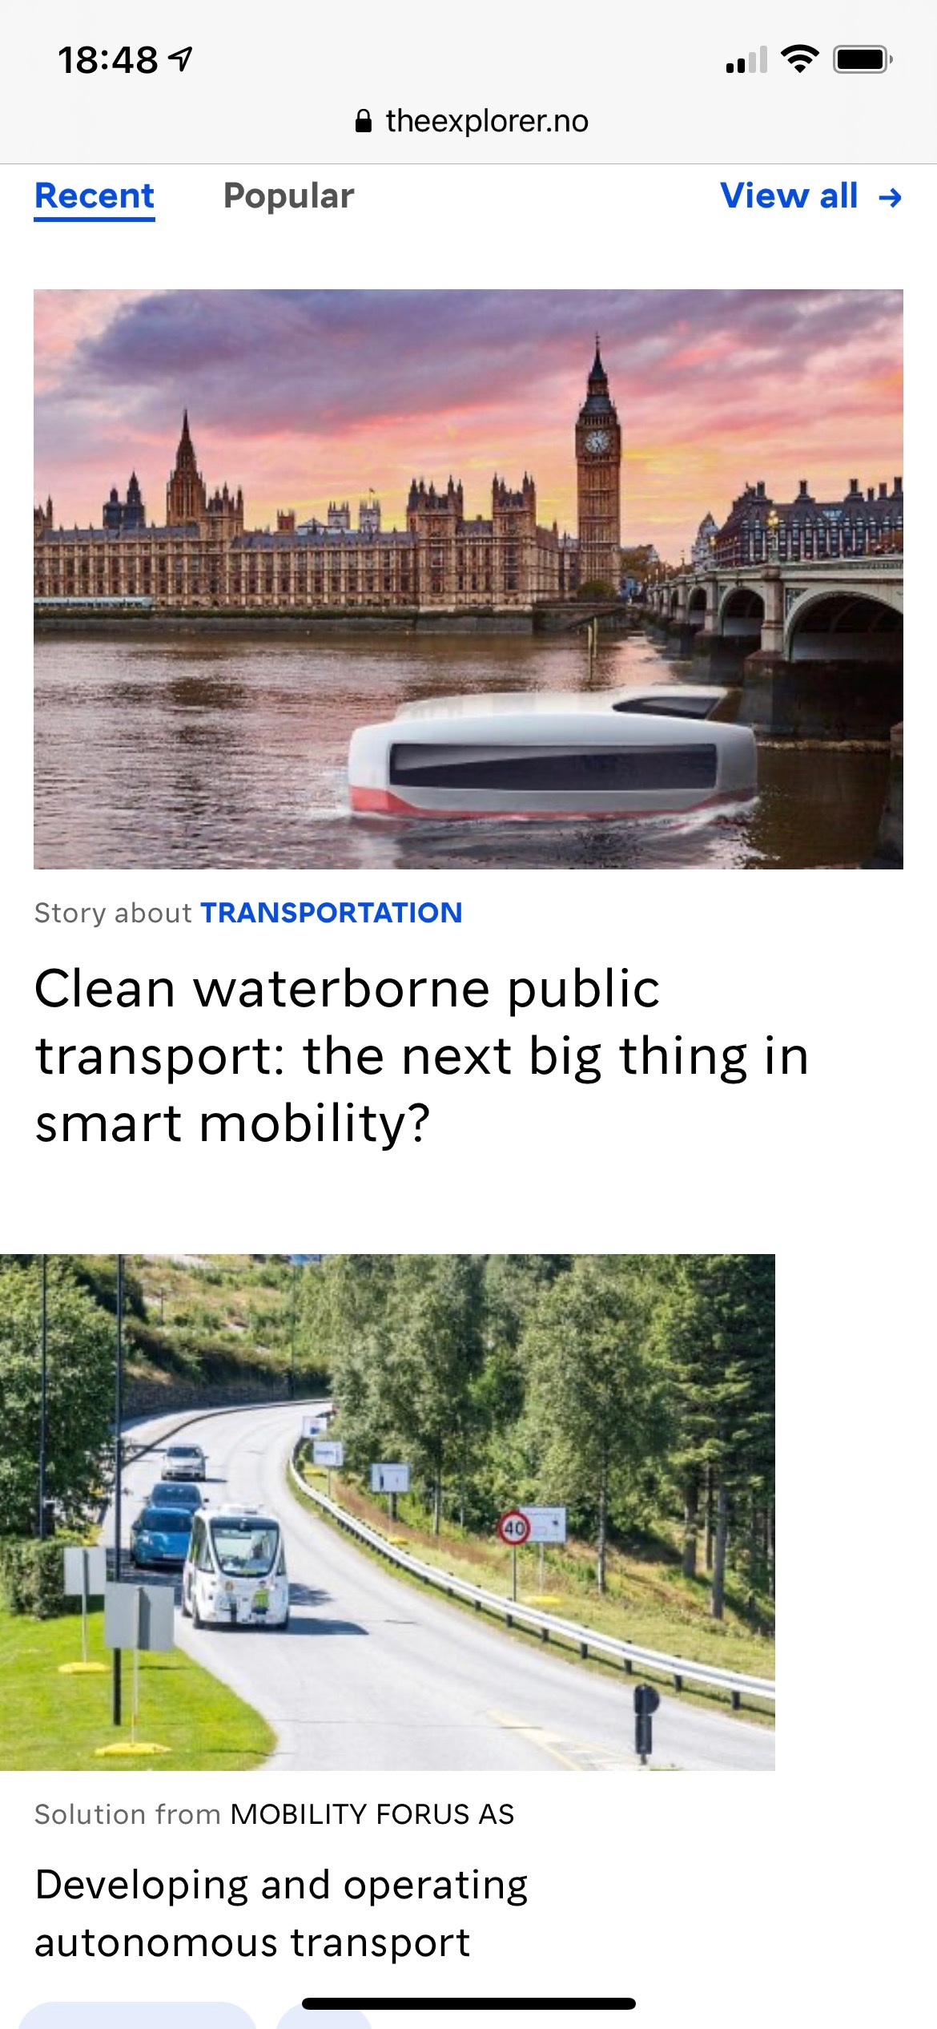
The Explorer is Norways official platform showcasing green and sustainable solutions with the goal to match international businesses with Norwegian companies
.
Norges offisielle plattform for grønn teknologi, der målet er å koble internasjonale bedrifter med norske innovative løsninger. Plattformen inneholder ca 430 godkjente bærekraftige løsninger «pioneered in Norway»
Ca 100 000 gjennomsnittlig besøkende per mnd, og 1 av 4 bedrifter sier de har fått nye kontakter.
Notes:
The Explorer is funded by the Ministry of Climate and Environment and run by Innovation Norway.
The platform contains over 460 approved solutions within a range of sectors like green shipping, clean energy, offshore wind, zero emission mobility, smart cities and many more. And the platform has more than 100,000 international visitors per month.
For companies to be approved for visibility on the platform, they must meet some criteria 1) the solution has to be green and / or sustainable within given categories, 2) contribute to solving at least one of the sustainable developement goals, and 3) the company must be ready for international growth - and of course operates within good business practice. So if the solution is approved for The Explorer, it is also part of our "national team" - these solutions are the best solutions that Norway has to offer.
The Explorer has its own editorial staff that assists Norwegian companies in tailoring an English sales pitch for their solutions. In addition to solutions, the team also develops articles (more than 140) and films that are used in our targeted digital campaigns.

Slide 17
