Slide 1
Energy and Innovation: Research and development webinar and matchmaking
Energy Programme in Romania
17 September 2021
www.innovationnorway.no/RoEnergy ro.energy@innovationnorway.no
Notes:
Magnar - intro

Slide 2
Energy Programme in Romania
Fund Operator:
Innovation Norway
Donor Programme Partners:
Norwegian Water Resources and Energy Directorate (NVE), Norway
National Energy Authority (OS), Iceland
Beneficiary State Programme Partners:
Ministry of Energy, Romania
Ministry of Environment, Romania
Programme Objective:
Less carbon intensive energy and increased security of supply
Bilateral Objective:
Strengthen bilateral relations between Romania and the Donor States (Iceland, Liechtenstein and Norway)
Programme allocation: EUR 62,8 mil.
Photo source: https://unsplash.com/photos/6Y88yhsNId8
Notes:
Inger

Slide 3
Energy Programme in Romania Working together for a green and competitive Europe!
The programme objective is to achieve less carbon intensive energy and increased security of supply. The Programme seeks to stimulate and develop long‐term cooperation between Iceland, Liechtenstein, Norway (“the Donor States”) and Romania (“Beneficiary State”).
The Energy Programme in Romania consists of five focus areas. The expected long term programme impact is less carbon intensive energy and increased security of supply in Romania. The programme will also enable the establishment of new businesses and jobs in energy field, which will lead to positive social benefits for local communities.
The Energy Programme focus areas are Renewable Energy, Energy Efficiency, Research and Development, Training and Awareness, and Electrification of Households.
There are 41 projects in total under the implementation phase (20 projects under Renewable Energy and 21 projects under Energy Efficiency), out of which 1 project has been successfully completed under Call 3 - Other Renewable Energy Source.
Photo source: https://unsplash.com/photos/6Y88yhsNId8
Notes:
Inger

Slide 4
Programme activities in the coming period - New Calls
Relaunched:
Calls 5 Research and Development (launched: 02 Jun 2021; deadline: 14 October 2021, 14:00 (Romanian time); budget: €4,1 mil. )
Call 2.1 Geothermal (relaunched: 12 May 2021; deadline: 30 Sept. 2021 budget: €3,25 mil.)
Call SGS-1.1 RES for SMEs and NGOs (budget: €1,9 mil.)
Under preparation:
SGS-4 Training and Awareness (budget: €3 mil.)
Notes:
Inger

Slide 5
Energy Programme in Romania
Travel Support available
Development of Donor Project Partnerships
Budget: EUR 100.000 (until depletion of funds)
Lump sum: EUR 1.000 per entity (Liechtenstein-Romania/RO-LI travel)
EUR 1.200 per entity (Norway-Romania/RO-NO travel),
EUR 1.500 per entity (Iceland-Romania/RO-IS travel)
Notes:
Mihai -Lucian
If COVID-19 safe to travel!
TS available for Programme focus areas:
Renewable Energy
Energy Efficiency
R&D
Electrification of households
EXCLUDED (in the current Call): Training and awareness

Slide 6
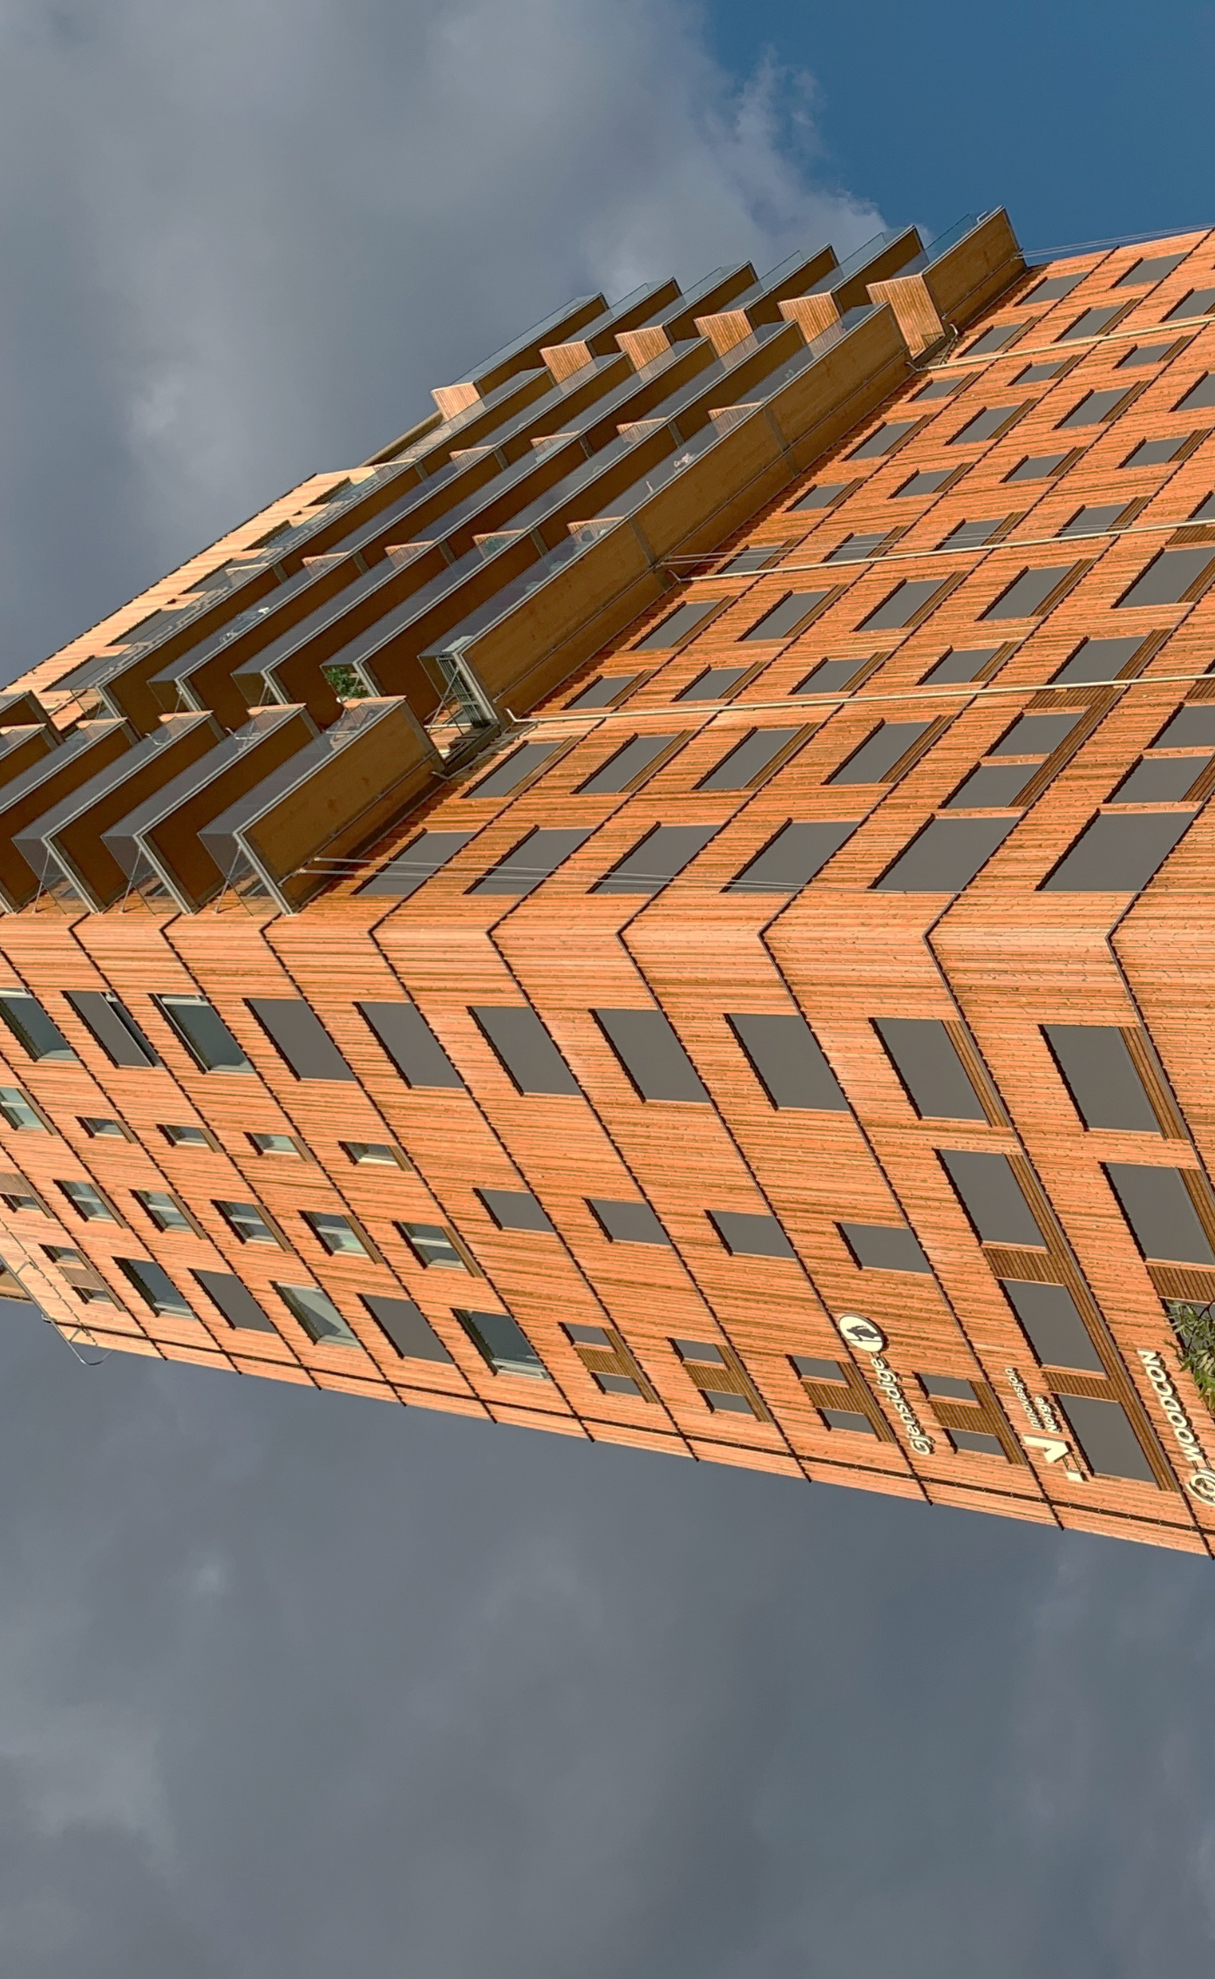
Enhanced research and development capacity on renewable energy, energy efficiency and energy security Calls 5.a, 5.b, SGS -5 These calls are “first time launches” and we went through consultation process with relevant actors in the field.
Consulting meetings have been held with the Research, Development Innovation Funding in Romania (UEFISCDI), the Research Council of Norway (RCN) and our Programme Partners.
Notes:
Gabi

Slide 7
Research and Development – New Calls 5.a, 5.b, SGS -5
a. Main Elements
Research, Development and Innovation (R&D&I) in the energy sector: "Enhanced research and development capacity on renewable energy, energy efficiency and energy security"​
​
Contribution will be made towards increased cooperation between research institutions and enterprises. Industrial and experimental research projects that deliver impact during the programme lifetime will be targeted.​
R&D Financial Mechanism and budget:
Individual projects – budget of € 3 mil:
Call 5(a) - EEA Grants, budget: €1,5 mil. and
Call 5(b) - Norway Grants, budget: €1,5 mil
SGS-5 - Norway Grants, budget: €1,1 mil.
Proposal for minimum and maximum grant:
Individual projects: €200.000 – € 500 000
SGS: € 50 000 – € 200 000
Call/Scheme: | Eligible Applicants: | Eligible Partners:
Call 5(a) Enhanced research and development capacity​ | Any entity, private or public, commercial or non-commercial, and non-governmental organizations, established as legal person in Romania. | Any private or public entity, commercial or non-commercial, established as a legal person in Norway, Iceland, Liechtenstein or in Romania
Call 5(b) Enhanced research and development capacity​ | Any entity, private or public, commercial or non-commercial, and non-governmental organizations, established as legal person in Romania. | Any private or public entity, commercial or non-commercial, established as a legal person in Norway or in Romania
SGS | Any entity, private or public, commercial or non-commercial, and non-governmental organizations, established as legal person in Romania. | Any private or public entity, commercial or non-commercial, established as a legal person in Norway, Iceland, Liechtenstein or in Romania
Notes:
Gabi

Slide 8
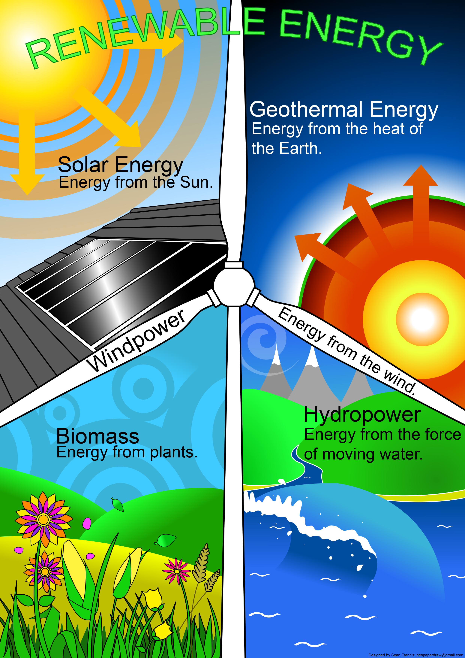
b. Areas of Support and Eligible Activities
This Scheme can provide support for projects that will develop and implement activities aiming to enhance research and development capacity on renewable energy, energy efficiency and energy security:
I. Renewable energy, energy efficiency and energy security:
Novel technologies for challenges in Energy transitions from fossils based to less Carbon emissions.
Research and Development related to technologies, equipment, tools, solutions, materials etc. for the energy transition.
Smart grid technologies,
Energy valorisation of waste.
Pre-feasibility/ Feasibility studies etc. for Carbon Capture and Storage (CCS); - if they are part of an integrated project.
II. Renewable - Hydropower:
Energy generation in Non-Powered Dams originally built for water supply, cooling water for industry or irrigation.
Safety of classical hydro power stations operated for designed conditions.
Safety of old hydro power stations against the effect of natural hazards.
d) Pump storage plants.
This Photo by Unknown author is licensed under CC BY-NC-ND.
Notes:
Gabi

Slide 9
Outcomes and Outputs
Projects on Research and Development must contribute directly to these:
Outcome indicators:
Enhanced research and development capacity on renewable energy, energy:
a. Number of renewable energy, energy efficiency and energy security technologies/solutions/services developed
b. Number of successful joint applications for Intellectual Property protection (copyrights, industrial design, trademarks, patents) by research institutions and enterprises
Output indicators:
Increased support to renewable energy, energy efficiency and Installed capacity for production of hydropower electricity (in MW);
a. Number of research and development on renewable energy, energy efficiency and energy security projects supported
b. Number of signed collaborative agreements between research institutions and enterprises involved in the programme
Optionally, projects may contribute to this outcome indicator:
Number of jobs created.
This Photo by Unknown author is licensed under CC BY-NC-ND.
Notes:
Gabi

Slide 10
Specific documents on Research and Development area, which are relevant for the present Calls
Technology Readiness Level: Guidance Principles for Renewable Energy technologies Technology readiness level - Publications Office of the EU (europa.eu): https://op.europa.eu/en/publication-detail/-/publication/1da3324e-e6d0-11e7-9749-01aa75ed71a1/language-en
Frascati Manual 2015: Guidelines for Collecting and Reporting Data on Research and Experimental Development (oecd-ilibrary.org): https://www.oecd-ilibrary.org/docserver/9789264239012-en.pdf
UNSPLASH
Notes:
Gabi

Slide 11
Donor Partnership Projects
Not mandatory, but Donor Partnership Projects are strongly encouraged and will be awarded extra points during the project assessment process.
Unique bilateral partnership opportunity.
Access to expertise, technologies and solutions from Donor States entities (Norway, Iceland, Liechtenstein).
The Romanian Applicant is in the driver seat (submits the project application, signs the financing contract with Innovation Norway, submits Interim & Final Reports).
Division of roles is in the Partnership Agreement.
This Photo by Unknown Author is licensed under CC BY-ND
Notes:
Gabi

Slide 12
Detailed Activity Budget
Mihaela Piroi, Innovation Norway – Bucharest Office
September 17, 2021
Notes:
Mihaela

Slide 13
Introduction
Business Plan
Structure & Role of the Detailed Activity
Budget (DAB) into the Application Package
Project Application
- Detailed budget (Eligible costs per Activity) (Sheet 1);
Balance sheet (Sheet 2);
Profit & Loss sheet (Sheet 3);
Read carefully
Financial Statements
Other doc (price offers, cost references, bank & commitment letters, etc.)
the Guideline for the Detailed Budget and Financial Forecast
Notes:
Mihaela

Slide 14
Read before filling in the form…
Mihaela
Notes:
Mihaela

Slide 15
Detailed Budget
The management, publicity, legal services, audit services should correspond to the complexity of the project framework and the activities setup;
The costs of staff assigned to the project (actual salaries plus social security charges and other statutory costs) should correspond to the usual policy on remuneration of the organization
VAT eligibility – include VAT in the budget only if it is not recoverable
Do not include in the budget costs that are 100% covered by the promoter or costs that are not eligible to be financed under the respective call.
Pay attention to the applicable state aid category and the applicable state aid grant rate
Notes:
Mihaela

Slide 16
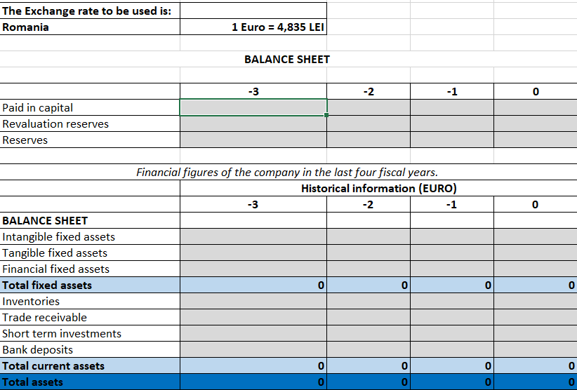
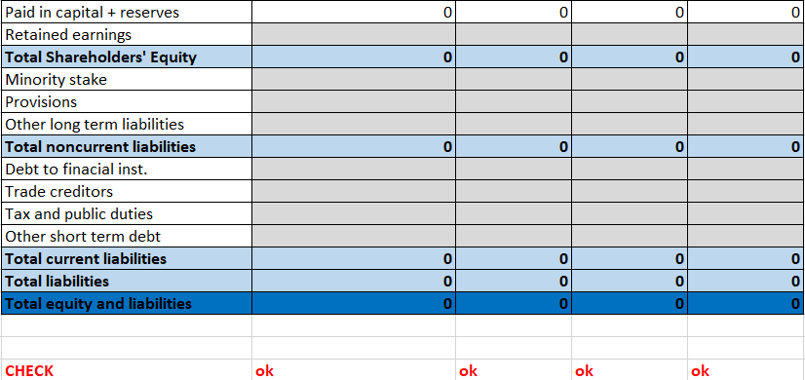
Balance Sheet – Historical Data
Total Assets should be equal to Total equity and liabilities
Notes:
Mihaela

Slide 17
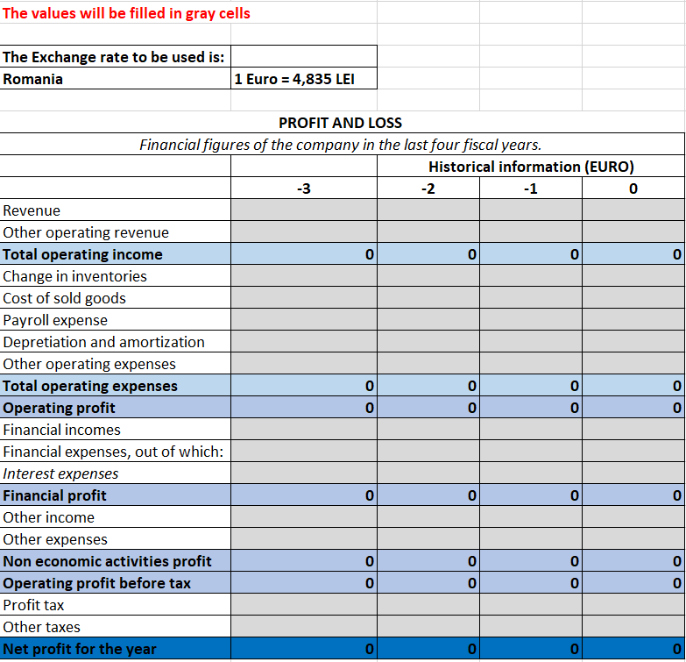
P&L_historic
Notes:
Mihaela

Slide 18
Balance Sheet and Profit and Loss – Historical data
Exchange rate – use the one indicated in the generic document;
Check the Guideline for correspondence with Annual Balance Sheet and Profit and Loss
The whole figures should be filled-in, avoid using decimals.
Recommendation: try to use formulas
For calls with deadline till the end of 2021 the N-year is 2020;
The amounts filled-in in DAB should correspond to the amounts in the Balance sheet and Profit&Loss submitted to the national authorities.
Notes:
Mihaela

Slide 19
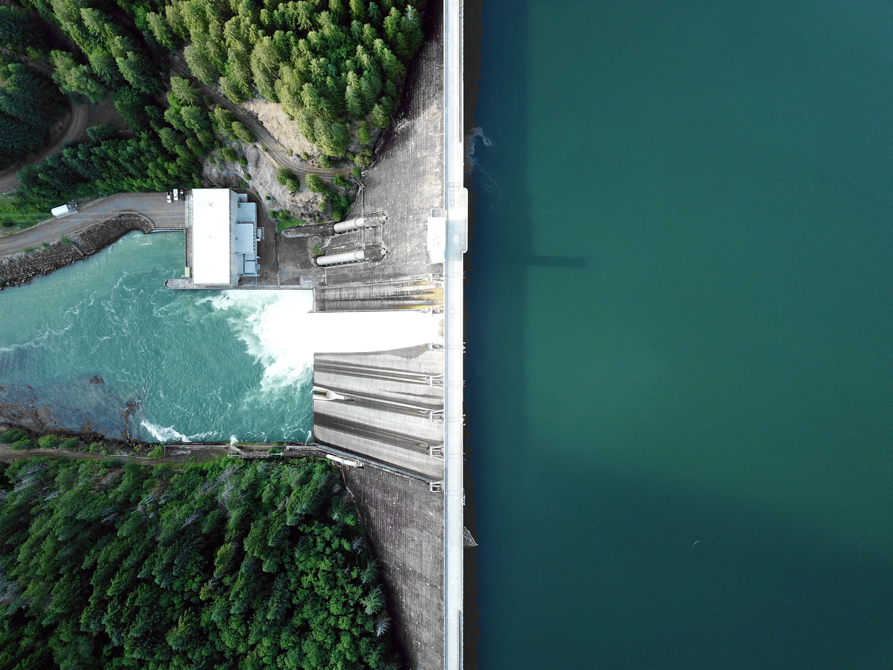
More info about the Calls of Proposals
Energy Programme in Romania: Energy Programme in Romania (innovasjonnorge.no)
List of currently opened Calls under the Energy Programme in Romania:
There are three open calls for project proposals:
The Call for Proposals on Geothermal Energy with deadline 30 September 2021, 14:00 (Romanian time)
The Call for Proposals on Research and Development with deadline 14 October 2021, 14:00 (Romanian time)
The Call or Proposals on Hydropower, Geothermal and Other Renewable Energy Sources for SMEs and NGOs with deadline 3 December 2021, 14:00 (Romanian time)
Photo source: https://unsplash.com/photos/w6X7XaolqA0
Notes:
Rannveig
- Mention that more information about the Programme and Calls for Proposals is available at the listed links.

Slide 20
Q&A Session
Please also read:
Frequently Asked Questions
Romania, Energy, Research and Development (innovasjonnorge.no)
Photo source: FEDERICO BECCARI
Notes:
Magnar, Gabi, Mihai - Lucian

Slide 21
Energy Programme in Romania
Working together for a green and competitive Europe!
Tusen takk! Takk fyrir! Vă mulțumim!
www.innovationnorway.no/RoEnergy
ro.energy@innovationnorway.no
Notes:
Rannveig
- Thank you
- Contact e-mail for the Energy Programme in Romania

