Slide 1
EEA and Norway Grants – relevant Calls for Proposals
Magnar Ødelien, Programme Director, Innovation Norway

Slide 2
Objectives of the EEA and Norway Grants
Contributing to reducing economic and social disparities in the European Economic Area
Strengthening relations between Norway, Iceland, Liechtenstein and the beneficiary countries
2017-2024: 2.8 billion EUR to programmes in 15 countries
Approx 350 mill. EUR to business programmes

Slide 3
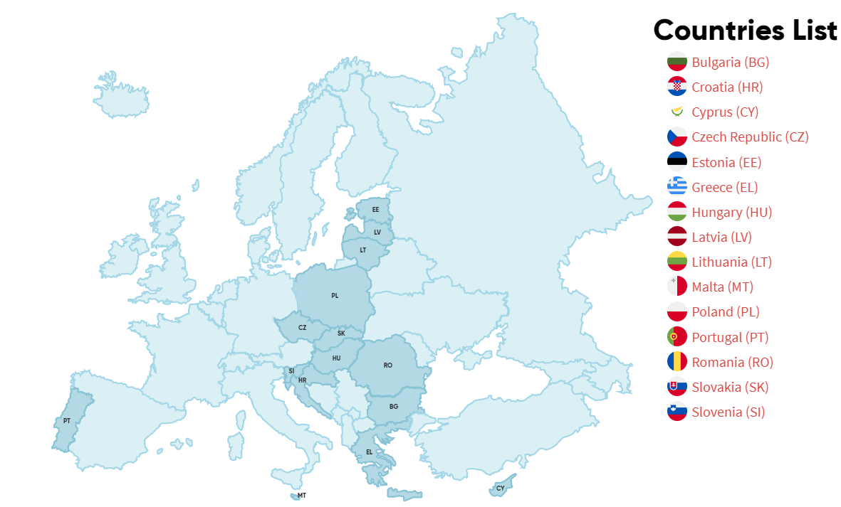
Business programmes - which countries?
Forpliktelse som følge av EØS-avtalen siden 1994
Økonomisk og sosial utjevning i Europa
Styrke de bilaterale forbindelser mellom giverlandene Island, Liechtenstein, Norge og 15 mottakerland
Norges andel utgjør totalt i underkant av 98 prosent

Slide 4
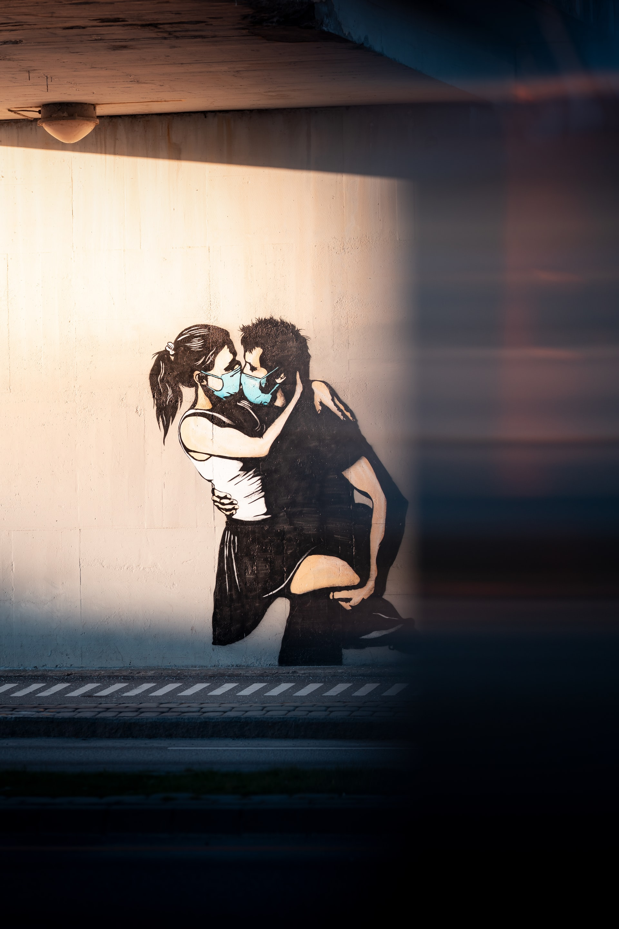
«These times» - status for programmes
The objectives of the programmes remain unchanged: Increased value creation and sustainable growth
Implementation of projects delayed
Finally back to physical events
Deadlines of some calls have been extended
Digital first: the partner search continues!
Photo by Daniel Tafjord on Unsplash

Slide 5
Currently open and upcoming calls
Regular calls
2. Soft measures/bilateral cooperation
Bilateral funds at national level and
programme level
Photo by Ramiro Mendes on Unsplash

Slide 6
www.innovasjonnorge.no/en/start-page/eea-norway-grants/calls-for-proposals/

Slide 7
Third call in Croatia – To be published in November
Overall Call Budget: EUR 5 – 6 million Euro
Focus area: Green Industry Innovation
Focus area: Blue Growth
Grant support Thresholds:
Minimum grant amount: EUR 50 000
Maximum grant amount: EUR 1 500 000
Types of projects:
Innovation – research and development
Investment projects – regional development aid
Applicants and partners:
Companies in Croatia, focus on SMEs
Entities in Croatia and Norway (companies, research institutes etc.)
Partnerships with Norway
Partnership with Norwegian entities encouraged
Travel grants available

Slide 8
Soft measures schemes - Who can apply?
- Companies
Non-profit organisations

Slide 9
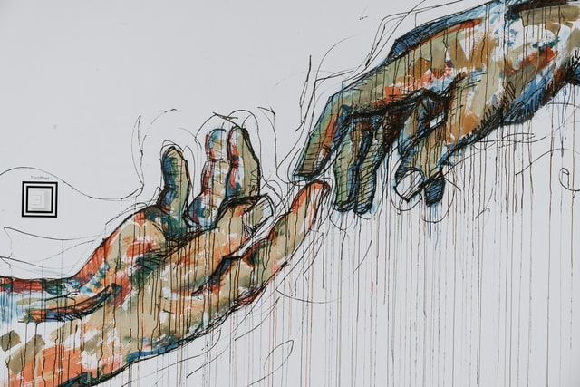
Who can become project partner?
Any public or private entity, commercial or non-commercial and non-governmental organisations, established as a legal person in the Beneficiary States or in one of the donor states (Norway, Iceland, Liechtenstein)
Photo by 🇨🇭 Claudio Schwarz | @purzlbaum on Unsplash

Slide 10
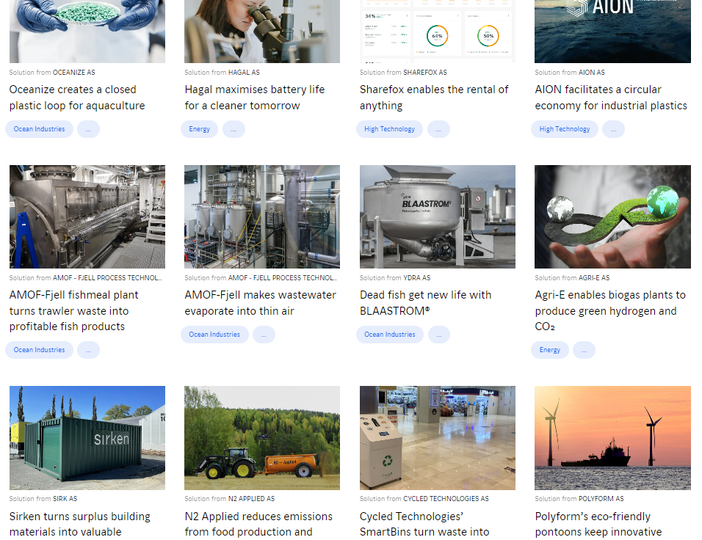
How to find a partner in Norway?
Make use of the matchmaking possibilities – physical events and online platforms
Check for instance theexplorer.no/ for Norwegian companies with business models related to circular economy, blue growth, health / welfare…

Slide 11
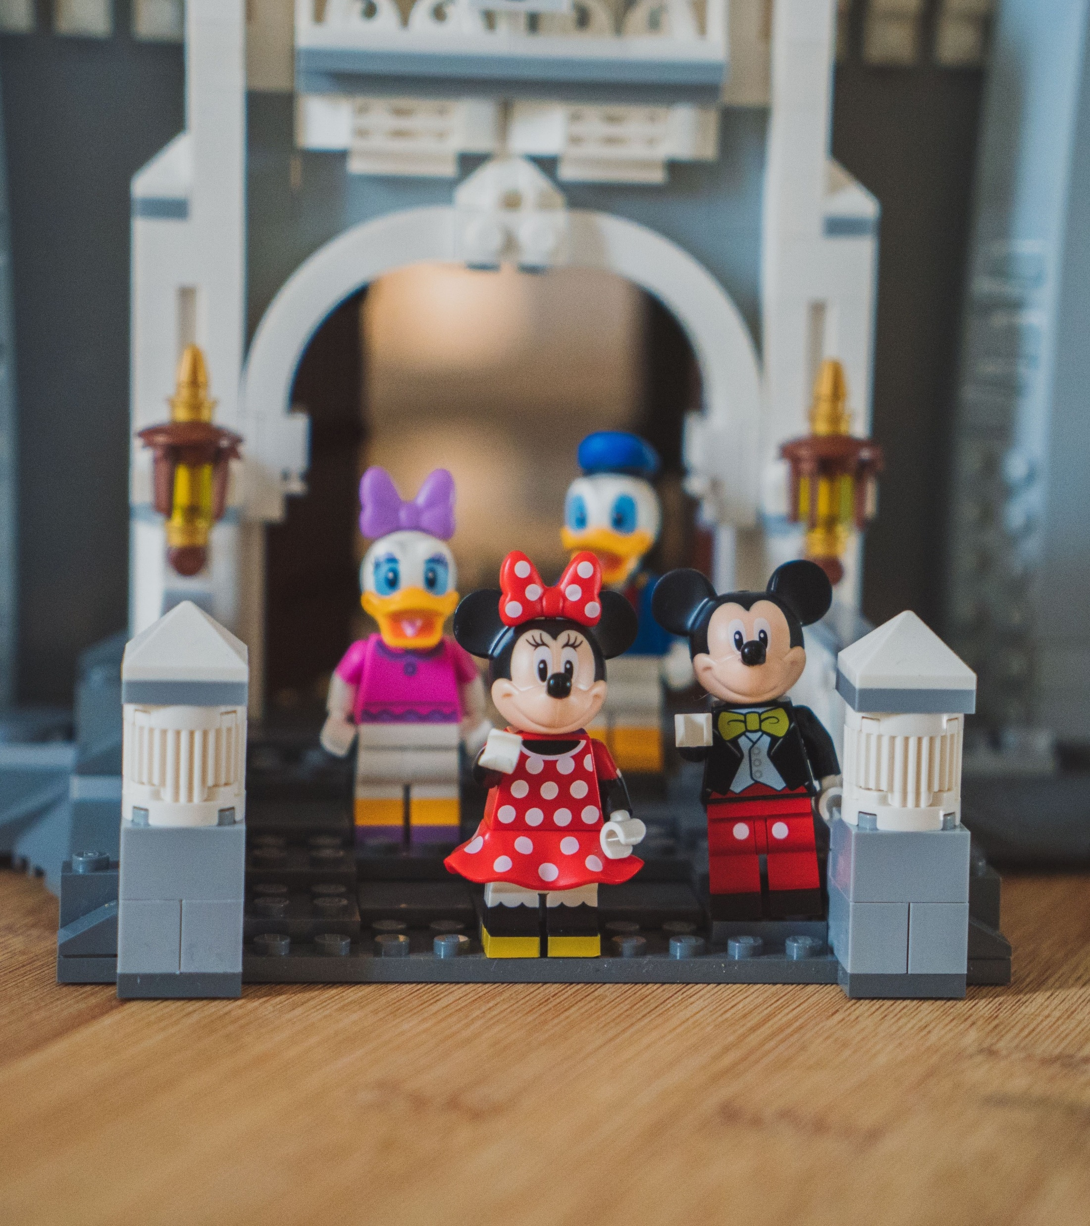
Examples of eligible activities:
business organizations/clusters that support SMEs to increase their knowledge about topics in fields such as business models, eco-innovation, circular economy, internationalization, Corporate Social Responsibility (CSR)
large enterprises that receive business skills support (training, coaching, mentoring etc.)
SMEs that receive business skills support (training, coaching, mentoring etc.)
Start-ups that receive business skills support (training, coaching, mentoring etc.)
Grant rate: up to 90 %
Photo by Rod Long on Unsplash

Slide 12
Example activities for donor partners
Contribute as mentors / experts to training modules organized by cluster organisations, with the aim of developing green business models
Participate in physical study trips with the aim of analysing the sustainability of businesses, and providing good practice advice on an improved model for circular economy
Inviting businesses to centers / sites in Norway, Iceland, Liechtenstein with the aim of showing sustainable business practice
…
Photo by Carl Heyerdahl on Unsplash
Notes:
Eligible partners:

Slide 13
Bulgaria
Overall Call Budget: EUR 1 350 000
Romania
Overall Call Budget: EUR 1 000 000
Focus area: Green Industry Innovation
Grant support Thresholds:
Minimum grant amount: EUR 5 000
Maximum grant amount: EUR 100 000
Focus area: Green Industry Innovation
Focus area: Blue Growth
Grant support Thresholds:
Minimum grant amount: EUR 10 000
Maximum grant amount: EUR 200 000
Focus area: ICT
Donor partnership:
Norway
Donor partnership:
Iceland, Liechtenstein, and Norway
Focus area: Welfare Technology
Deadline:
17 November
Deadline:
20 October

Slide 14
Greece
Overall Call Budget: EUR 695 000
Croatia
Overall Call Budget: EUR 695 852
Focus area: Green Industry Innovation
Grant support Thresholds:
Minimum grant amount: EUR 10 000
Maximum grant amount: EUR 200 000
Focus area: Green Industry Innovation
Focus area: Blue Growth
Grant support Thresholds:
Minimum grant amount: EUR 10 000
Maximum grant amount: EUR 200 000
Donor partnership:
Iceland, Liechtenstein and Norway
Donor partnership:
Norway
Focus area: Blue Growth
ICT
Deadline: to be publsihed
Deadline: To be published

Slide 15
Bilateral funds – National level and programme level
Poland – bilateral cooperation on Green transition
- Available amount: 2,5 mill, EUR
- Deadline: 15 November
- size of projects: 50.000 – 250.000
- Broad scope of applicants and activities
The call particularly aims at the following areas: renewable energy and other forms of clean energy solutions, zero-emission transport including green shipping, smart/sustainable city solutions, carbon capture and storage, circular economy
Possible that other countries will follow, both at national level and the programme level

