Slide 1
Disrupting the legal services market
THE RIGHT LAWYER AT YOUR FINGERTIPS
A new way to access legal services

Slide 2
Individuals & SMEs
Lawyers & law firms
Expensive legal services
Lack of legal information
Problem
Legal restrictions on advertising
Lack of networking forums

Slide 3
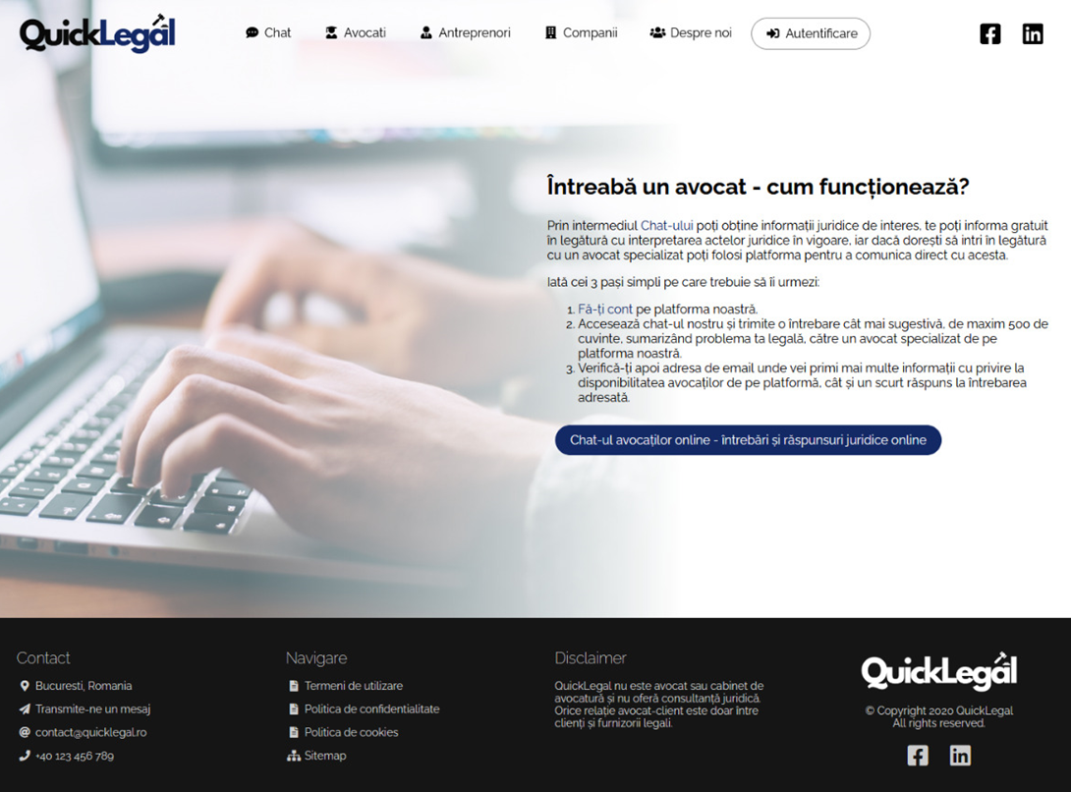
Solution
QuickLegal is the legal matchmaking platform that instantly connects you with the RIGHT lawyer
and let’s you chat for FREE, all in a virtual office
www.quicklegal.ro

Slide 4
Our Competition
Our Competitive Advantage
In-house matching with specialized lawyers | ✔ | 🗶 | 🗶 | 🗶
Specialized legal assistance | ✔ | ✔ | 🗶 | 🗶
Free chat with a lawyer of choice | ✔ | 🗶 | 🗶 | 🗶
Virtual Office for attorney-client interactions | ✔ | ✔ | 🗶 | 🗶
First to market

Slide 5
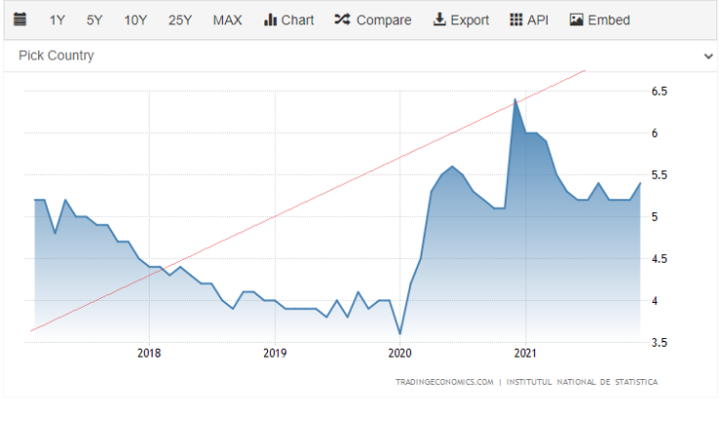
WHY NOW?
2020 - 2021 - EU and RO regulations approving online intermediation attorney-client platforms
Opportunity
WHY LABOUR LAW?
Unemployment rate skyrocketed to 6.5 in 2021
Covid-19
429,000 employment contracts were terminated
600,000 deferred
* Romanian Labor Market 2018-2022 – INS

Slide 6
Total Addressable Market
Romania as a beachhead market
€366M
€100M
€3M
TAM
SAM
SOM
5.6M employees
500K SMEs
27K lawyers
1.8 M employees
165K SMEs
15K lawyers
2K employees
10K SMEs
9K lawyers

Slide 7
Our Revenue Model
Lawyers
Clients
€28
Freemium
Basic
Subscription per month
Limited edition

Slide 8
Traction
Trusted by
With less than €500, in 5 months…
CUSTOMERS
PROJECTIONS 5Y
200 enrolled
1250 community
€3M revenue
21K customers
25 key partners
REVENUE
EXPANSION
€500
20 cases
3 attorney-client contract
3 new territories (France, EE, Nordic countries)

Slide 9
Our Amazing Team
Luminita Busuricu
Iulia Caizer
CEO
Experienced Litigation Lawyer
LL.M graduate in International Arbitration BU Romania
Attorney at law at Leroy si Asociatii
COO
Experienced Corporate Lawyer
LL.M graduate from GSU, the US and Heidelberg Uni Germany
Legal Counsel at UiPath
Bianca Florea
CMO
Competition Lawyer at De Pardieu Brocas Maffei
Science Po Paris, Sorbonne Law School Graduate
Dan Giuriciu
CTO
Founder Dahl Development and Consulting
Co-Founder
Edgefront Technologies

Slide 10
Our Request
€235K
identify partners to improve the go-to-market strategy & to invest in marketing and sales (>23K customers in 5Y; 33% RGR)
identify partners for R&D investment - enabling key technologies; add new features & reshape platform’s functions; improve customer experience
expand areas of expertise & legal services
team expansion & international partnerships
explore markets for scaling up the product in other EU countries

Slide 11
Thank You.
Register on Quick Legal
NOW!
Quick Legal
Fast, reliable, and easy!
Quick Legal SRL
(+40) 736 355 780
contact@quicklegal.ro
https://quicklegal.ro/home

