Slide 1
EcoCube – Fully electric waste management island
By Marservis d.o.o

Slide 2
Marservis d.o.o. - founded in 1994. - 19 people - nautical service in Marina Novigrad - FRP boatbuilding in Kaštelir since 2002. - Electric boats (Aquabus) since 2005. - 600m² production hall + 400m² addition in 2022.

Slide 3
EcoCube
Part of PROEco ecological maritime projects
Growing need for maritime waste disposal
Abt. 1 000 000 litres daily only in Croatia’s summer season

Slide 4
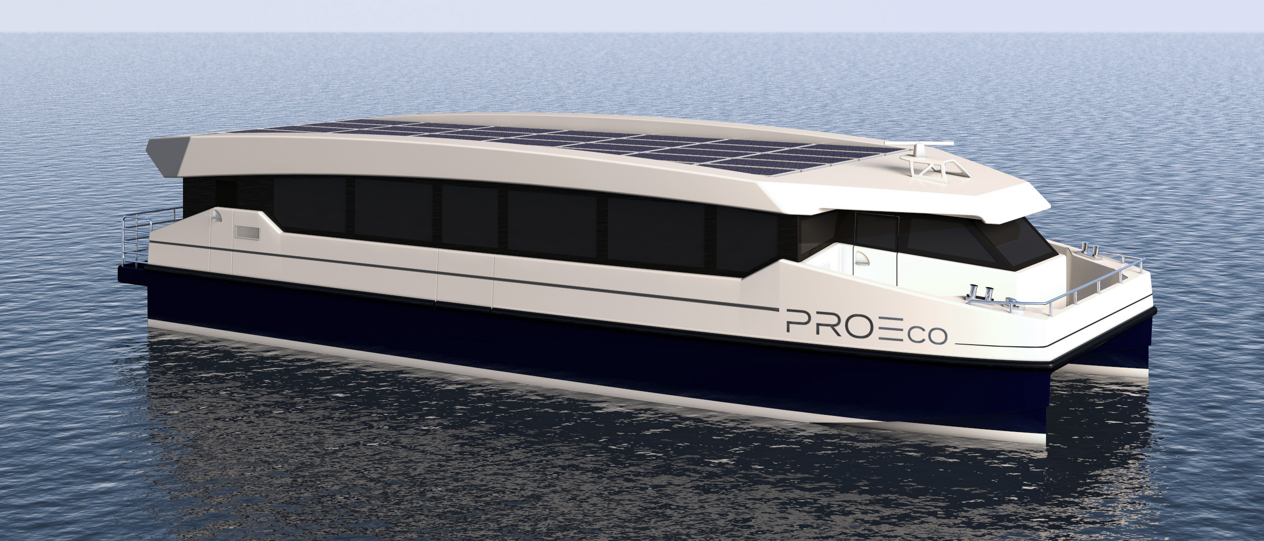
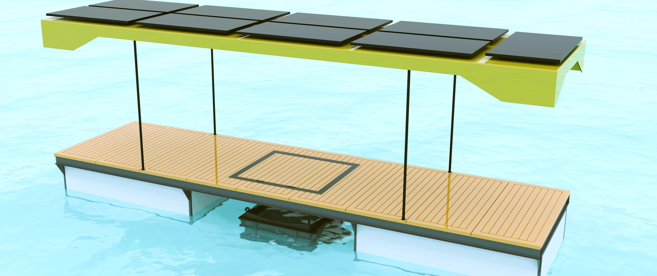
ProEco60 – fully electric passenger catamaran
LOA – 19m
Pax – 100
Batteries – 180kWh
AquaPOD – solar powered surface water cleaning pontoon
Solar panels – 3,8 kW
Next step – autonomous movement

Slide 5
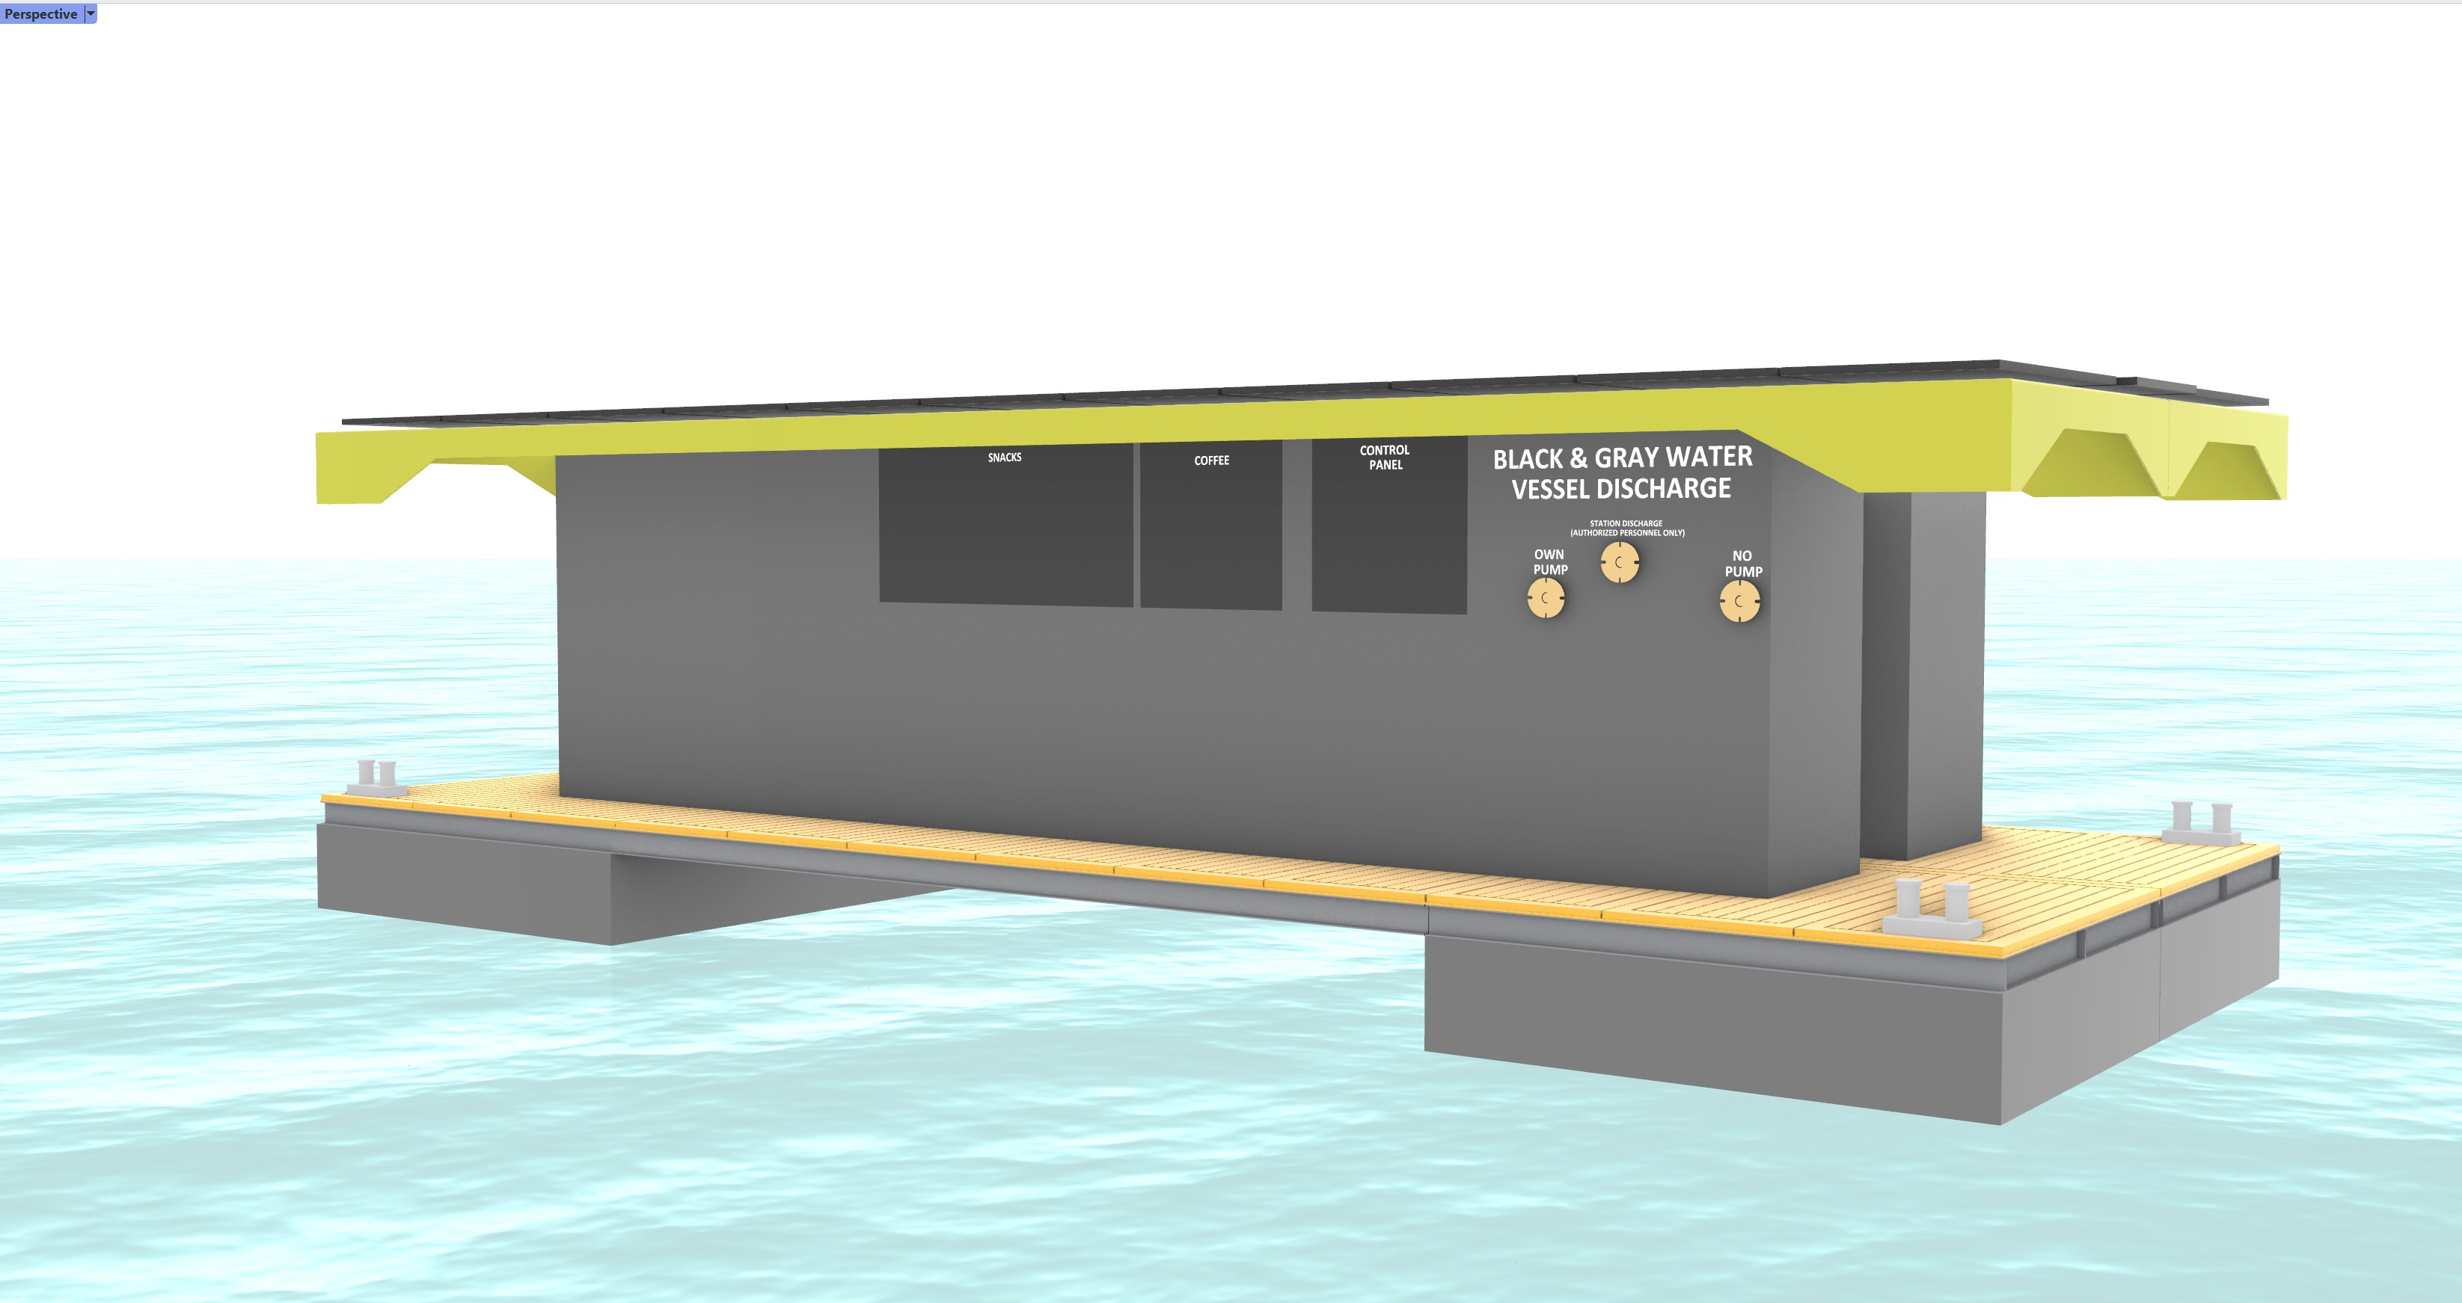
Length – 12,0m
Breadth – 4,8m
Design draft – 1,00m
Solar – 13,7kW
Batteries – 25,0kWh
Vessels up to 20m

Slide 6
B&G water discharge (8,5m³)
Solid waste disposal (5 x 1m³)
Coffee machine
Snack machine
Fresh water maker (420lit/h)

Slide 7
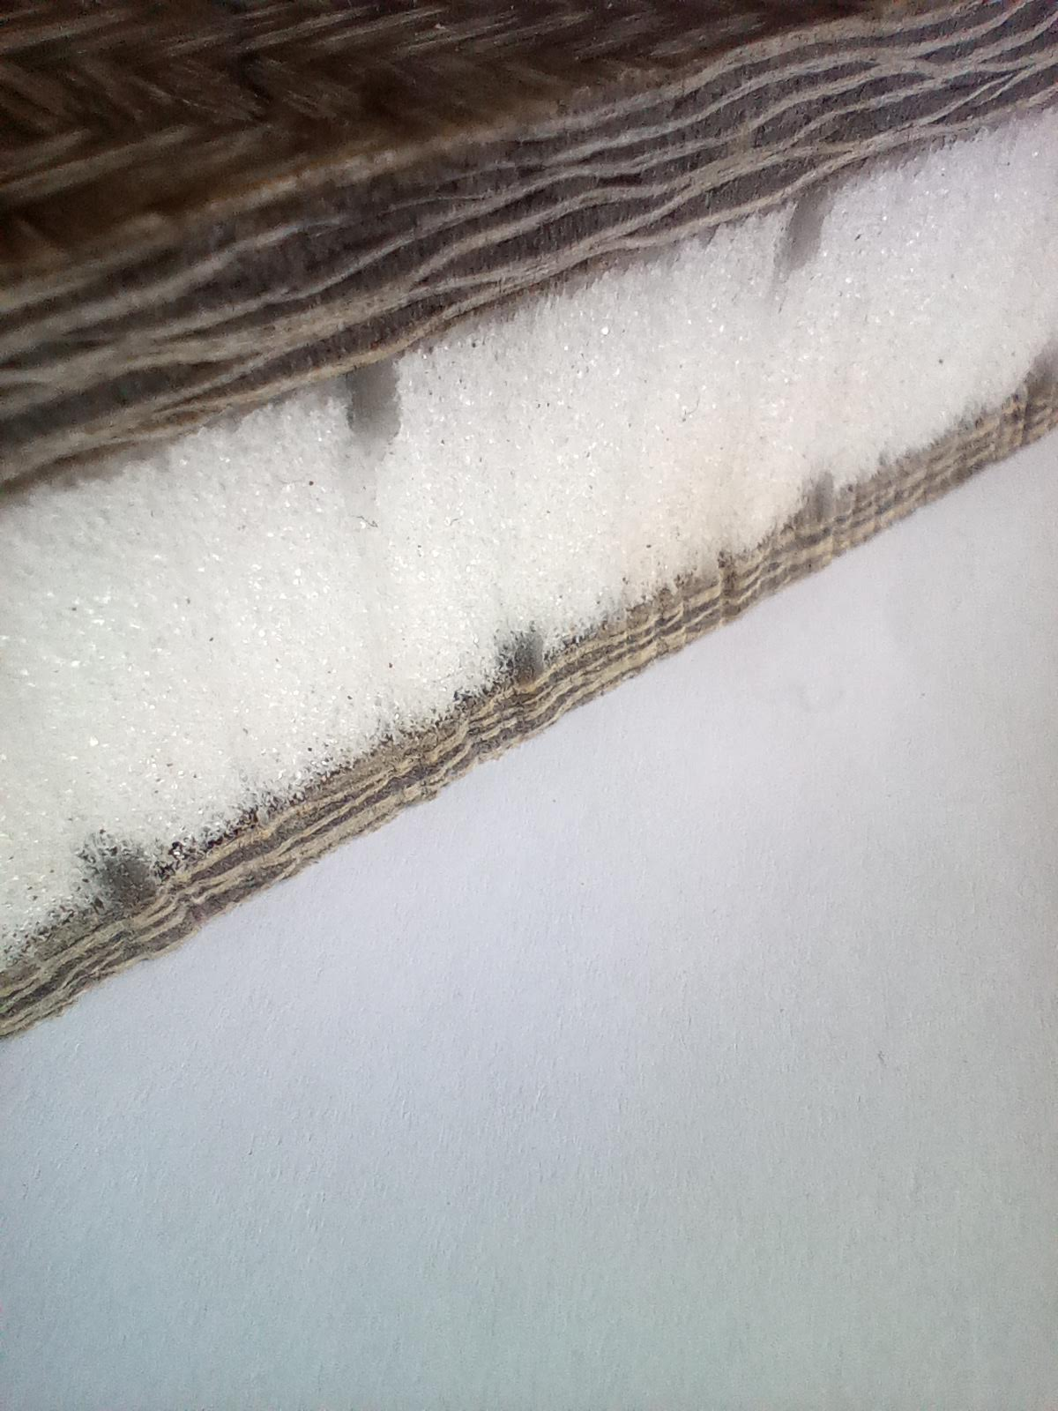
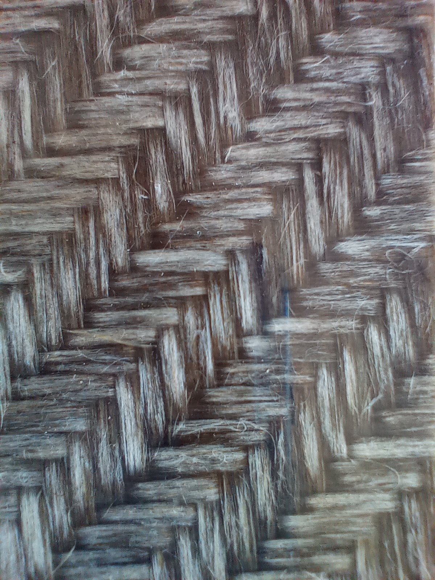
Completely made of Flax fibres infused with Bio epoxy resin
0,7 tons of CO₂ per ton of flax compared to 2,2 tons of CO₂ in production of glass fibres
35% less energy consuming than production of common glass fibres (17 MJ/kg compared to 26 MJ/kg)
All lights will be LED since they use about 75% less energy than old fashioned incandescent light

Slide 8
Scalable (1 pontoon 12m x 2,4m)
- more pontoons → more solar power
Adjustable (different services can be implemented depending on Customer’s demands)
AIS visible
Mobile app monitoring and alarm system

Slide 9
GOALS
Increasing capacity of B&G water disposal
Eliminating the need to sail to marina when at sea
Creating a network of EcoCubes and service vessels in Europe
EcoCube is a business opportunity

Slide 10
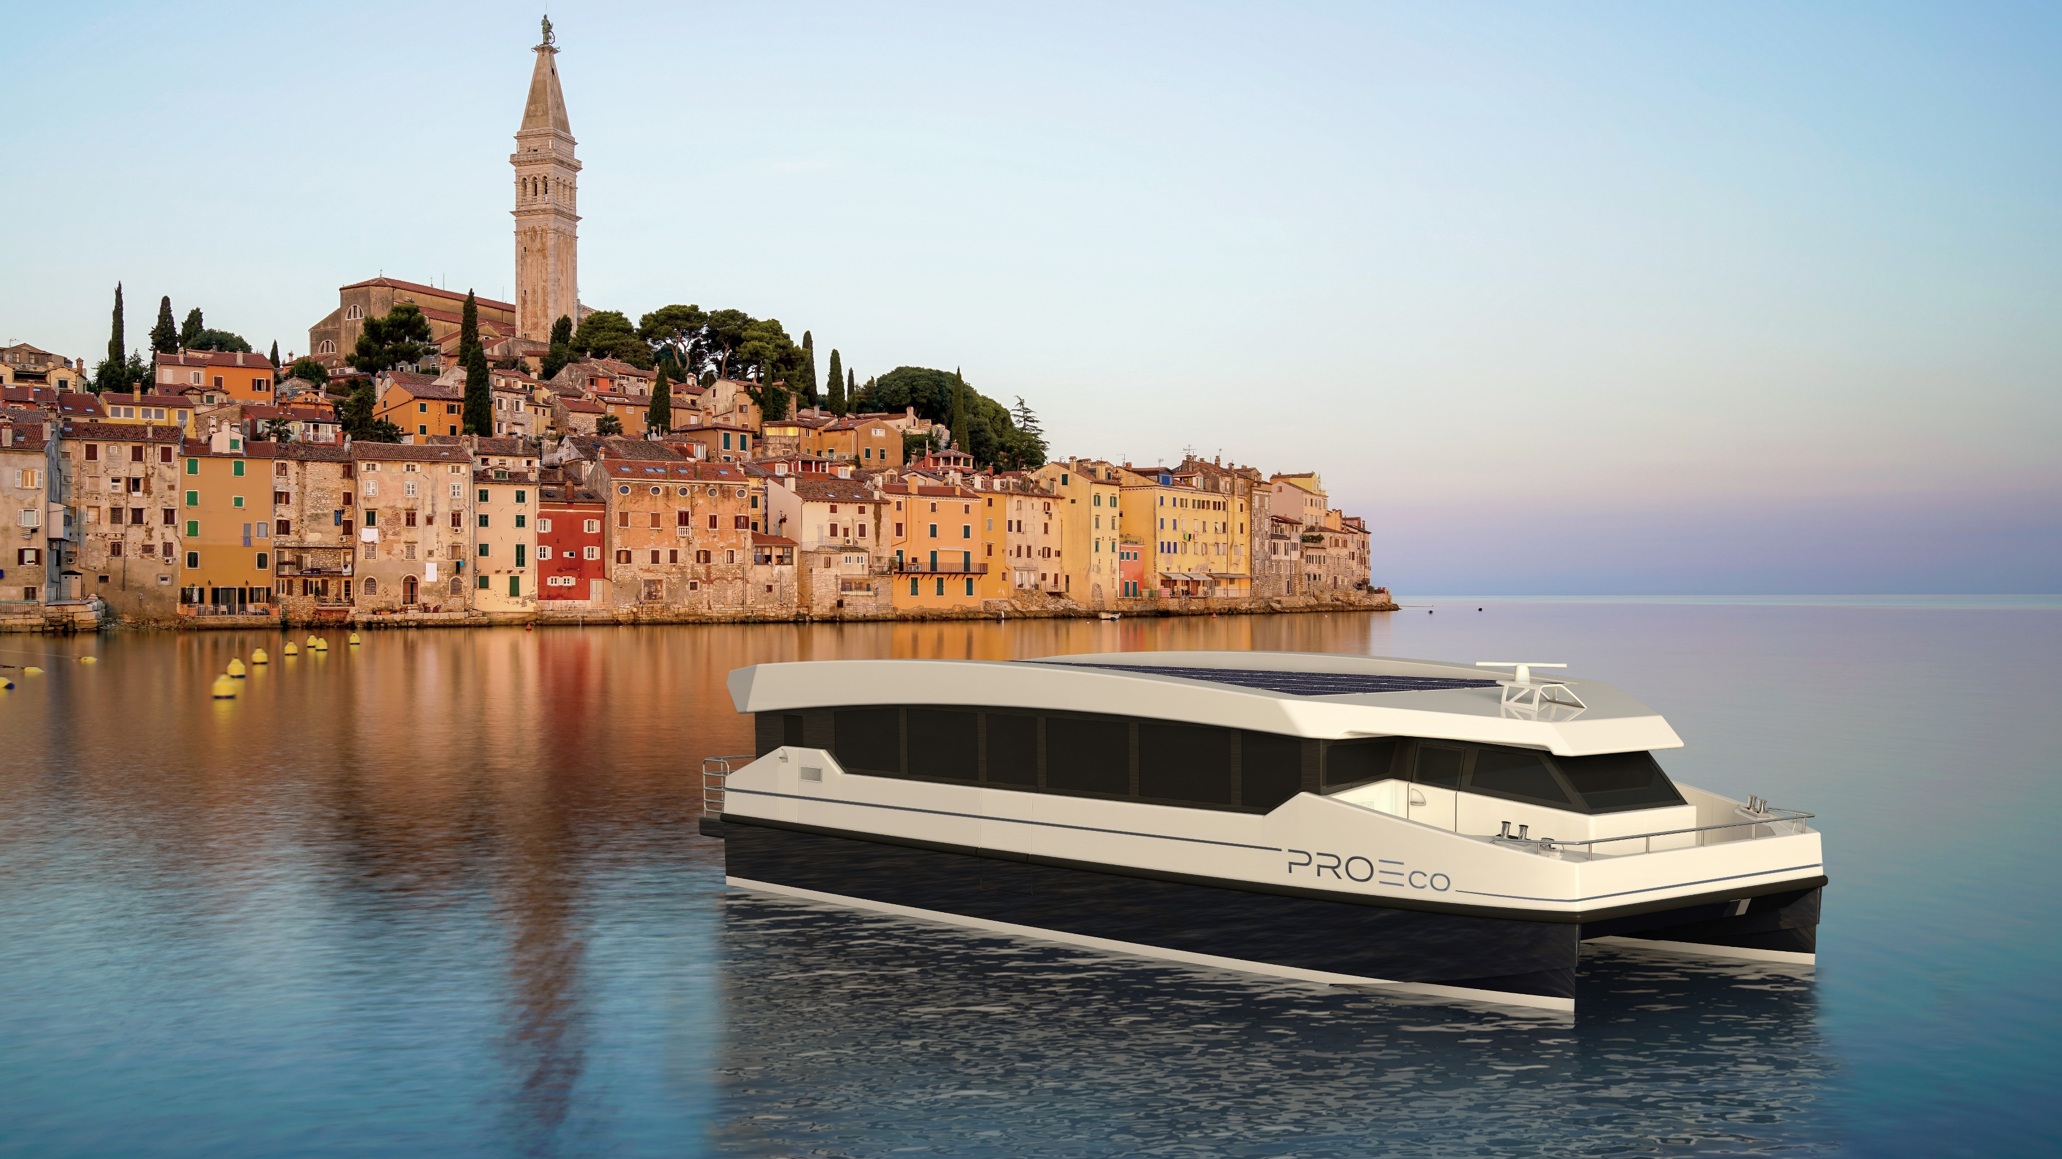
THANK YOU FOR YOUR ATTENTION
Dinko Salopek, Nav.Arch
dinko.salopek@marservis.hr
www.marservis.hr

