Slide 1
VI. Detailed Activity Budget

Slide 2
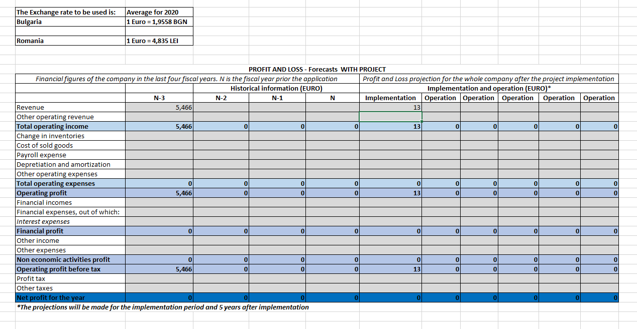
VI. Detailed Activity Budget

Slide 3
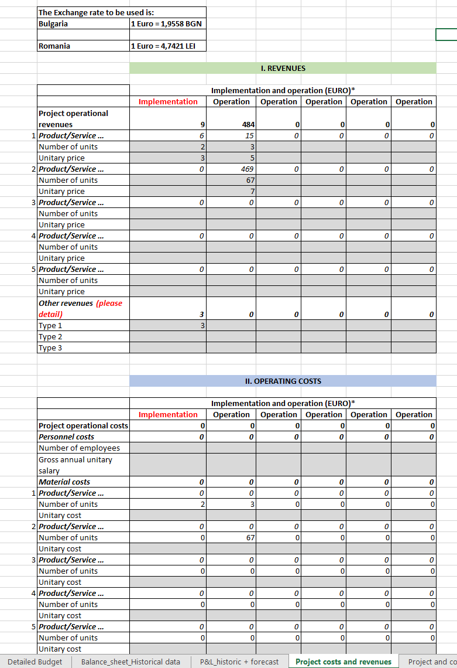
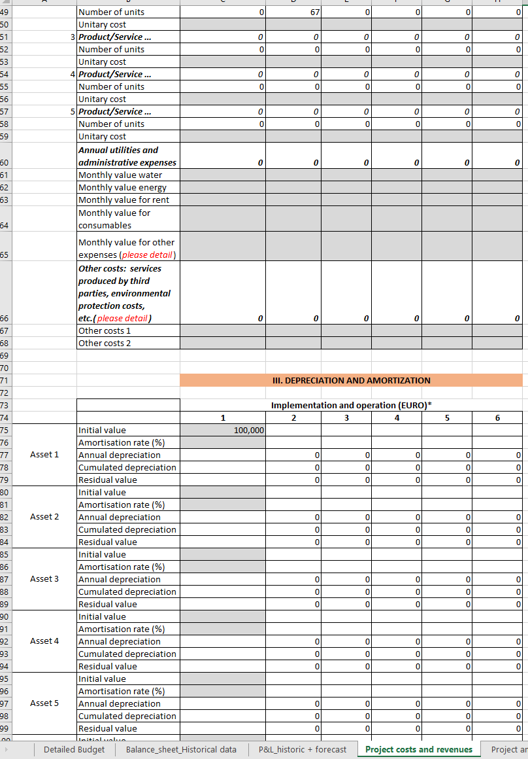
VI. Detailed Activity Budget

Slide 4
VI. Detailed Activity Budget

Slide 5
All questions are welcome at:
ro.innovation@innovationnorway.no
Thank you!

