Slide 1
Energy and Innovation: Green Opportunities with the EEA and Norway Grants in Romania and Bulgaria
Energy Programme in Romania
19 of May 2021
www.innovationnorway.no/RoEnergy ro.energy@innovationnorway.no

Slide 2
Energy Programme in Romania
Fund Operator:
Innovation Norway
Donor Programme Partners:
Norwegian Water Resources and Energy Directorate (NVE), Norway
National Energy Authority (OS), Iceland
Beneficiary State Programme Partners:
Ministry of Energy, Romania
Ministry of Environment, Romania
Programme Objective:
Less carbon intensive energy and increased security of supply
Bilateral Objective:
Strengthen bilateral relations between Romania and the Donor States (Iceland, Liechtenstein and Norway)
Programme allocation: EUR 62,8 mil.
Photo source: https://unsplash.com/photos/6Y88yhsNId8

Slide 3
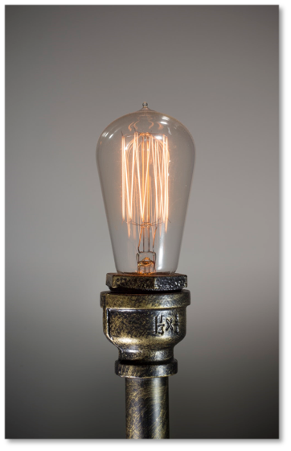
Energy Programme in Romania Working together for a green and competitive Europe!
The programme objective is to achieve less carbon intensive energy and increased security of supply. The Programme seeks to stimulate and develop long‐term cooperation between Iceland, Liechtenstein, Norway (“the Donor States”) and Romania (“Beneficiary State”).
The Energy Programme in Romania consists of five focus areas. The expected long term programme impact is less carbon intensive energy and increased security of supply in Romania. The programme will also enable the establishment of new businesses and jobs in energy field, which will lead to positive social benefits for local communities.
The Energy Programme focus areas are Renewable Energy, Energy Efficiency, Research and Development, Training and Awareness, and Electrification of Households.
There are 41 projects in total under the implementation phase (20 projects under Renewable Energy and 21 projects under Energy Efficiency), out of which 1 project has been successfully completed under Call 3 - Other Renewable Energy Source.
Photo source: https://unsplash.com/photos/6Y88yhsNId8

Slide 4
Programme activities in the coming period - New Calls
Relaunched:
Call 1.1 Hydropower (relaunched: 25 Nov. 2020; extended deadline: 31 May 2021; budget: €7,2 mil.)
Calls 6.1a and 6.1b Electrification of households (relaunched: 25 Nov. 2020; extended deadline: 30 June 2021; budget: € 10 mil.)
Call 3.1 Other RES (relaunched: 26 Apr. 2021; deadline: 8 Sept. 2021; budget: €4,6 mil.)
Call 2.1 Geothermal (relaunched: 12 May 2021; deadline: 30 Sept. 2021 budget: €3,25 mil.)
Under preparation:
Call SGS-1.1 RES for SMEs and NGOs (budget: €1,9 mil.)
Calls 5 Research and Development (budget: €4,1 mil.)
SGS-4 Training and Awareness (budget: €3 mil.)

Slide 5
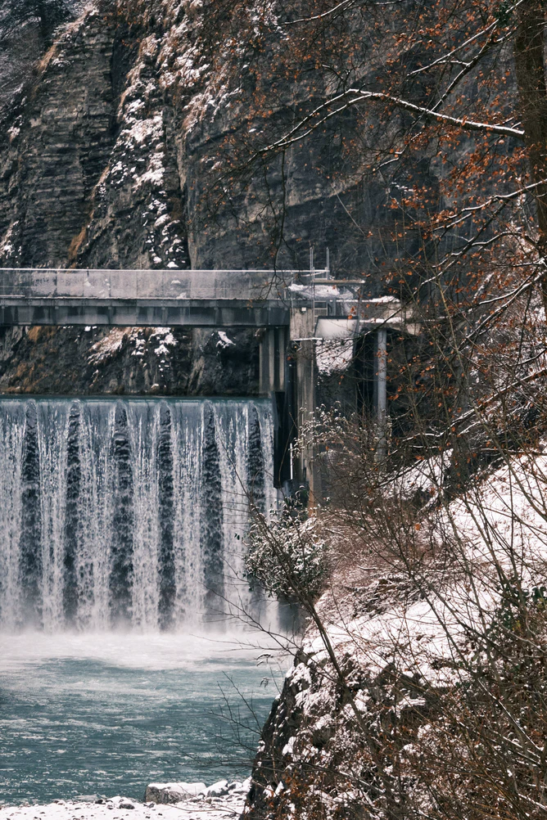
Call 1.1 ‘Increased capacity to deliver renewable energy’ – Hydropower
Expected outcome: Increased renewable energy production
Available budget: EUR 7,2 mil. (EEA Grants)
Eligible applicants: Any entity, private or public, commercial or non-commercial, and non-governmental organizations, established as legal person in Romania. Established for at least 3 years by the Call deadline.
Eligible partners: Any private or public entity, commercial or non-commercial, established as a legal person in Iceland, Liechtenstein, Norway or in Romania. Donor partnership projects are very much encouraged. Established for at least 1 year by the Call deadline.
Call deadline (extended): 31 May 2021, 14:00 Romanian time
Electronic applications, submitted via Innovation Norway’s Application Portal.
Photo source: https://unsplash.com/photos/kPsBGvnVwnU

Slide 6
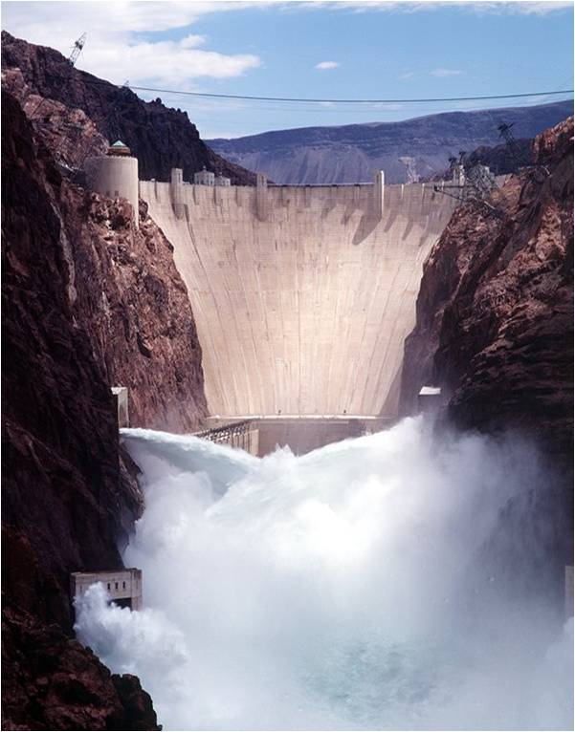
Areas of support and eligible activities
Call 1.1 ‘Increased capacity to deliver renewable energy’ – Hydropower
Grant amount: EUR 200.000 - 2.000.000
Support for projects that will develop and implement activities within the hydropower field:
refurbishment or renewal of existing, small or large, Hydro Power Plants (HPP) to increase the power generation capacity and production efficiency;
construction of new Small Scale Hydro Power Plants (SSHPP) (<10MW installed capacity);
Mandatory that all permits and concessions are in place by the time the project application is submitted to Innovation Norway.
activities to increase reservoir capacity for hydropower generation, as a secondary activity in a project;
training of staff on using and maintenance of the equipment, provided by the supplier of the equipment, as an integrated part of an investment project (secondary activity in the investment project).
Photo source: https://unsplash.com/photos/kPsBGvnVwnU
6
Notes:
6

Slide 7
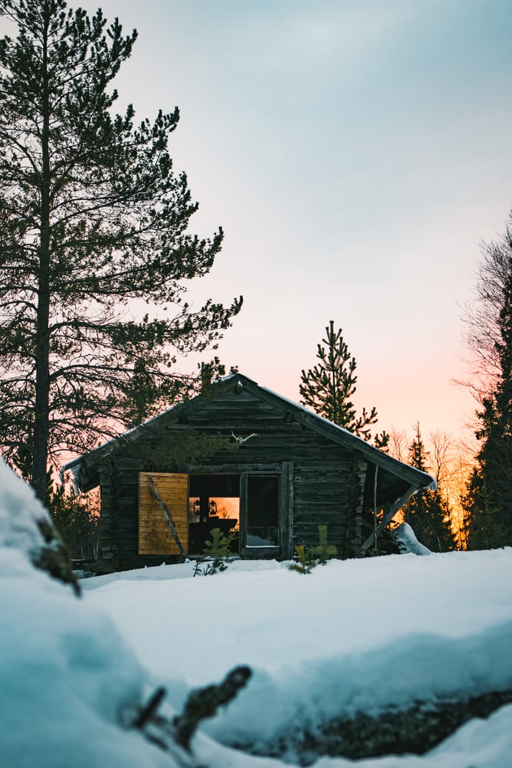
SGS-6.1(a) & Call 6.1(b): Electrification of households
Expected outcome: Electrification of households in areas where connection to the electricity network is not economically feasible.
Available budget: SGS-6.1(a): EUR 5 mil. (EEA Grants) Call 6.1(b): EUR 5 mil. (Norway Grants)
Eligible applicants: Any entity, private or public, commercial or non‐commercial, and non‐governmental organisations, established as legal person in Romania.
The Applicant must have been established for at least 3 years at the date of the deadline of the Calls.
Eligible partners: Any private or public entity, commercial or non‐commercial, established as a legal person in Iceland, Liechtenstein, Norway or in Romania.
The Project Partner must have been established for at least 1 year at the date of the deadline of the Calls.
Call deadline (extended): 31 June 2021, 14:00 Romanian time
Submission of applications: in English: use the Electronic Application Portal,
in Romanian: by email at RO.Electrificare@innovationnorway.no
Photo source: https://unsplash.com/photos/KdIcF1vSUVc

Slide 8
SGS-6.1(a) & Call 6.1(b): Electrification of households
Grant amount: SGS-6.1(a): 30.000 - 200.000 Euro, Call 6.1(b): 200.000 - 2.000.000 Euro
Priority (additional score) given to isolated households (>2 km from accessible grid).
New unelectrified households and residential development do not qualify for support, unless they are inhabited by vulnerable residents (Law no. 292/2011).
Only households with permanent residents are eligible (inhabited > 6 months per year).
Examples of eligible activities:
purchase and installation of Renewable Energy solutions, including associated equipment, cables, support structures for the photovoltaic panels etc.;
extension of the existing electricity grid, but the funding shall not cover the obligation of the Distribution System Operators (DSOs).
Grid connection is not eligible – it is the legal obligation of the DSOs as per ANRE Order no. 17/2021 - see the Call Frequently Asked Questions doc.
project management and technical staff;
training of households’ permanent residents on how to use the Renewable Energy electrification solutions; insurance of equipment & audit costs.
Photo source: https://unsplash.com/photos/_kdTyfnUFAc

Slide 9
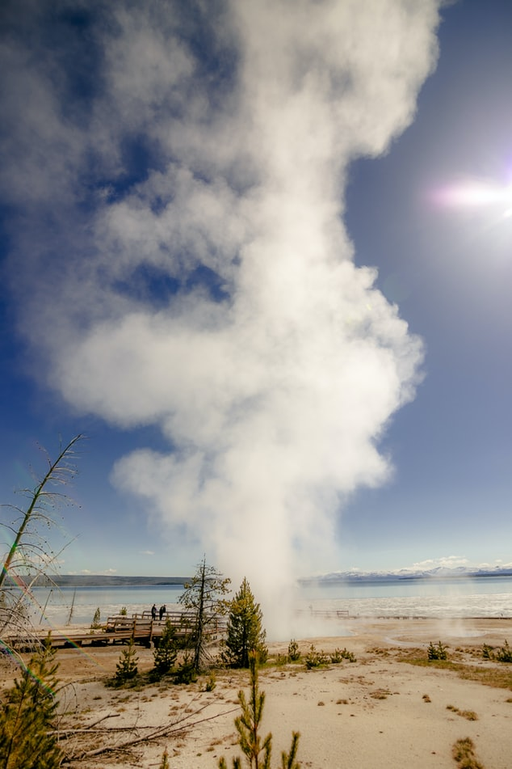
Call 2.1: ‘Increased capacity to deliver renewable energy’ – Geothermal
Available budget: EUR 3,25 mil. (EEA Grants)
Eligible applicants: Any entity, private or public, commercial or non-commercial, and non-governmental organizations, established as legal person in Romania. Established for at least 3 years by the Call deadline.
Eligible partners: Any private or public entity, commercial or non-commercial, established as a legal person in Iceland, Norway, Liechtenstein or in Romania. Established for at least 1 year by the Call deadline.
Donor partnership projects are very much encouraged.
Call deadline: 30 September 2021, 14:00 Romanian time
Electronic applications, submitted via Innovation Norway’s Application Portal.
Photo source: https://unsplash.com/photos/Fce_4_CHlwk

Slide 10
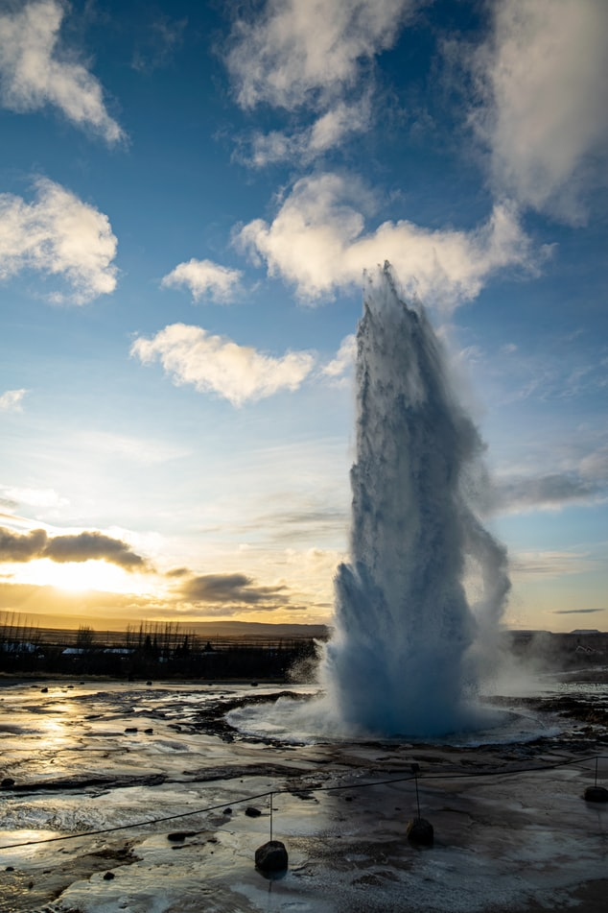
Call 2.1: ‘Increased capacity to deliver renewable energy’ – Geothermal
Grant amount: EUR 200.000 – 2.000.000
Grant rate: For entities involved in economic activities: the grant rate will be determined based on the applicable provisions of Commission Regulation 651/2014. 10% - max. 90% (applicants should not expect to receive the maximum grant rates – as per the state aid rules/articles).
For non-economic operators & not falling under state aid provisions: public entities (max. 85%), NGOs (max. 90%).
An Applicant shall submit only one project proposal under this Call.
Photo source: https://unsplash.com/photos/anwTHbI1qnQ

Slide 11
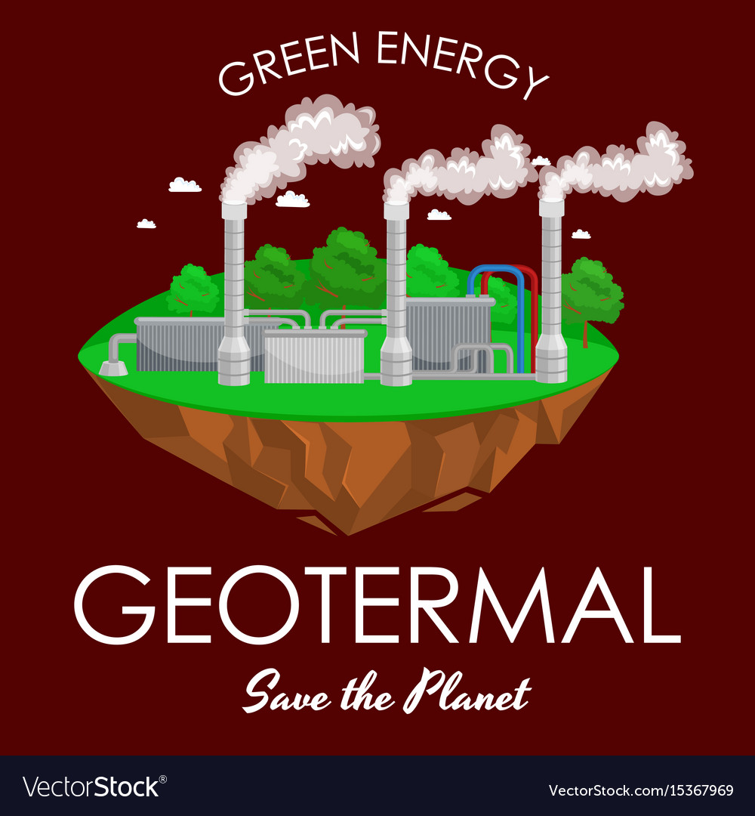
Call 2.1: ‘Increased capacity to deliver renewable energy’ – Geothermal Areas of support and eligible activities
Support for projects that will develop and implement activities within the geothermal field:
development and investments in geothermal energy supplying public buildings, office buildings, malls, industrial sites and buildings, and private homes as end-beneficiaries;
activities to increase production capacity for geothermal energy;
training of staff on utilization and maintenance of the equipment, provided by the supplier of the equipment, as an integrated part of an investment project (secondary activity in the investment project);
renewal/refurbishment of geothermal distribution system (secondary activity);

Slide 12
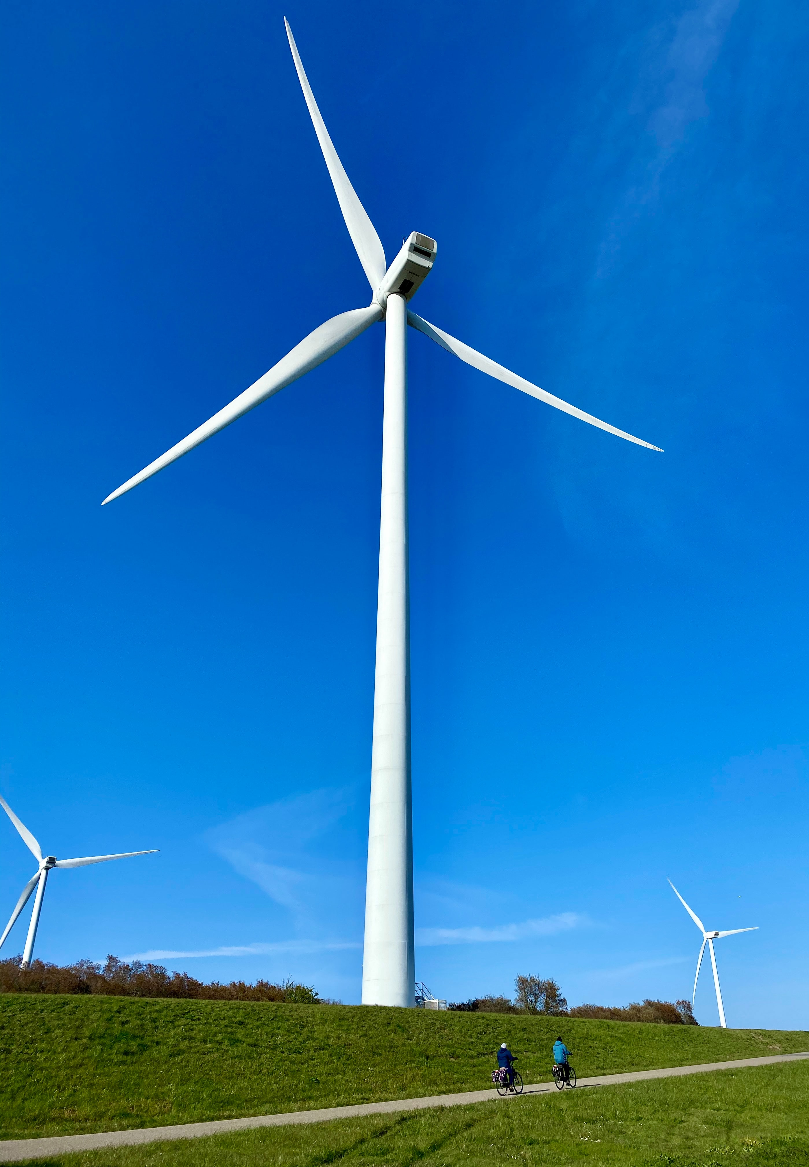
Call 3.1 ‘Increased capacity to deliver renewable energy’ – Other Renewable energy Sources (Other RES)
Expected outcome: Increased renewable energy production
Available budget: ~ EUR 4,6 mil. (Norway Grants)
Eligible applicants: Any entity, private or public, commercial or non-commercial, and non-governmental organizations, established as legal person in Romania.
Established for at least 3 years by the Call deadline.
Eligible partners: Any private or public entity, commercial or non-commercial, established as a legal person in Norway or in Romania.
Established for at least 1 year by the Call deadline.
Donor Partnership Projects are very much encouraged.
Call deadline: 8 September 2021, 14:00 Romanian time
Electronic applications, submitted via Innovation Norway’s Application Portal.
Photo source:
https://unsplash.com/photos/XibPRd3XXQE

Slide 13
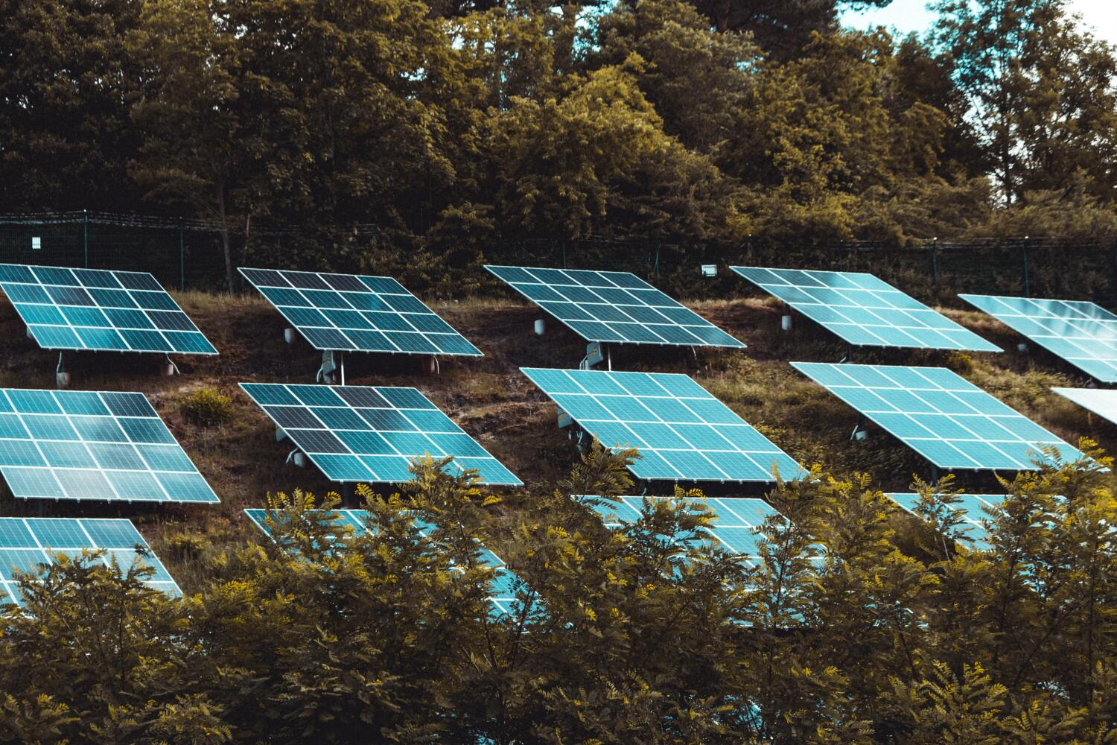
Call 3.1 ‘Increased capacity to deliver renewable energy’ – Other RES
Grant amount: EUR 200.000 – 2.000.000
Grant rate: For entities involved in economic activities: the grant rate will be determined based on the applicable provisions of Commission Regulation 651/2014. 10% - max. 90% (applicants should not expect to receive the maximum grant rates – as per the state aid rules/articles).
For non-economic operators & not falling under state aid provisions: public entities (max. 85%), NGOs (max. 90%).
An Applicant shall submit only one project proposal under this Call.
Photo credit: MORITZ KINDLER

Slide 14
Areas of support and eligible activities
Call 3.1 ‘Increased capacity to deliver renewable energy’ – Other RES
Support for projects that will develop and implement activities aiming at energy/electricity production from other Renewable Energy Sources:
projects that utilise bio‐based substrates (manure, waste from food, sludge, slaughter waste, energetic crops, wood waste etc.) for production of electricity and heating/cooling in local communities;
development and investment in private industrial facilities for waste to energy projects;
solar or wind energy: new small‐scale projects (up to 1.000 kW installed capacity) and production of electricity for Applicant’s own consumption (i.e. not for selling for profit purposes);
Note: - such projects do not exclude a connection to the utility grid (in order to inject in the grid the excess hourly/daily electricity production), provided that at least the equivalent electricity amount is consumed from the utility grid) - current level of electricity consumption needs to be indicated in the project application its (e.g. electricity invoices for the last 12 months).
training of staff on using and maintenance of the equipment, provided by the supplier of the equipment, as an integrated part of an investment project (secondary activity in the investment project).
14
Notes:
14

Slide 15
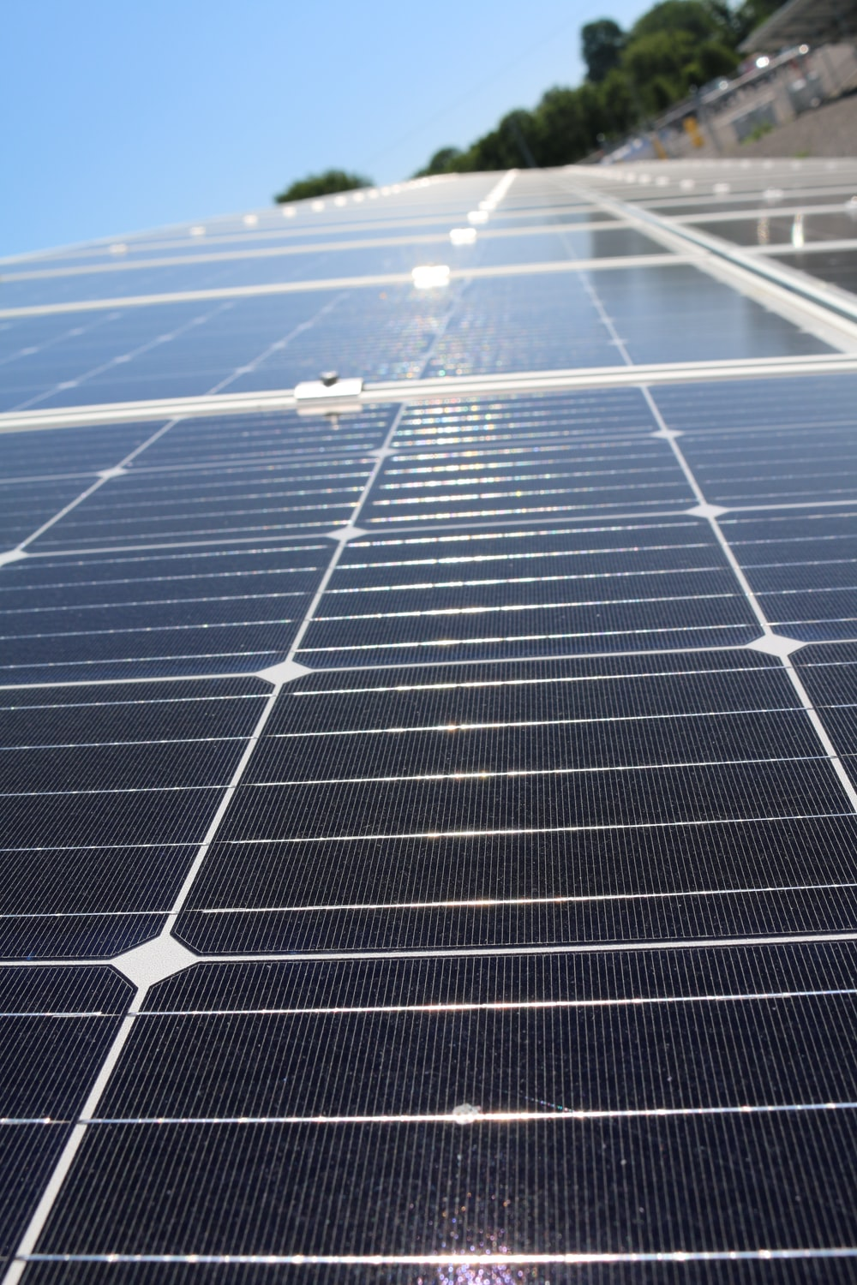
Call 3.1 ‘Increased capacity to deliver renewable energy’ – Other RES
Projects must contribute directly to these:
outcome indicators:
Estimated annual CO₂ emissions reductions (in tonnes CO₂ eq./year);
Electric energy produced from other renewable sources including wind, solar, biomass/biogas (in MWh/year).
Optionally, projects may contribute to “Number of jobs created”.
output indicators:
Installed capacity for production of energy/electricity from other RES (in MW);
Number of new installations for production of renewable energy/electricity from biomass/biogas, wind, photovoltaic or other renewable sources.
Language: English - all applications and supporting documents, shall be submitted in English. Official certificates and certified annual accounts can be submitted in Romanian.
Photo source:
https://unsplash.com/photos/jld4MmOc4Uk

Slide 16
Energy Programme in Romania
Travel Support available
Development of Donor Project Partnerships
Budget: EUR 100.000 (until depletion of funds)
Lump sum: EUR 1.000 per entity (Liechtenstein-Romania/RO-LI travel)
EUR 1.200 per entity (Norway-Romania/RO-NO travel),
EUR 1.500 per entity (Iceland-Romania/RO-IS travel)

Slide 17
Call SGS-1.1: ‘Hydropower, geothermal and other RES for SMEs and NGOs’
(under preparation)
Available budget: 1,9 mil EUR (Norway Grants)
Grant amount: 50.000 – 200.000 EUR
Eligible applicants: SMEs and NGOs (including social enterprises with economic activities) Any private or public entity, commercial or non-commercial, established as a legal person in Norway or in Romania
Eligible partners: Any private or public entity, commercial or non-commercial, established as a legal
person in Norway or in Romania
Eligible activities: The content of the eligible activities are expected to be similar with Calls 1.1 Hydropower, 2.1 Geothermal, 3.1 Other RES
Final information will be available when the Call is published!
Follow us on the web-site and Social Media.

Slide 18
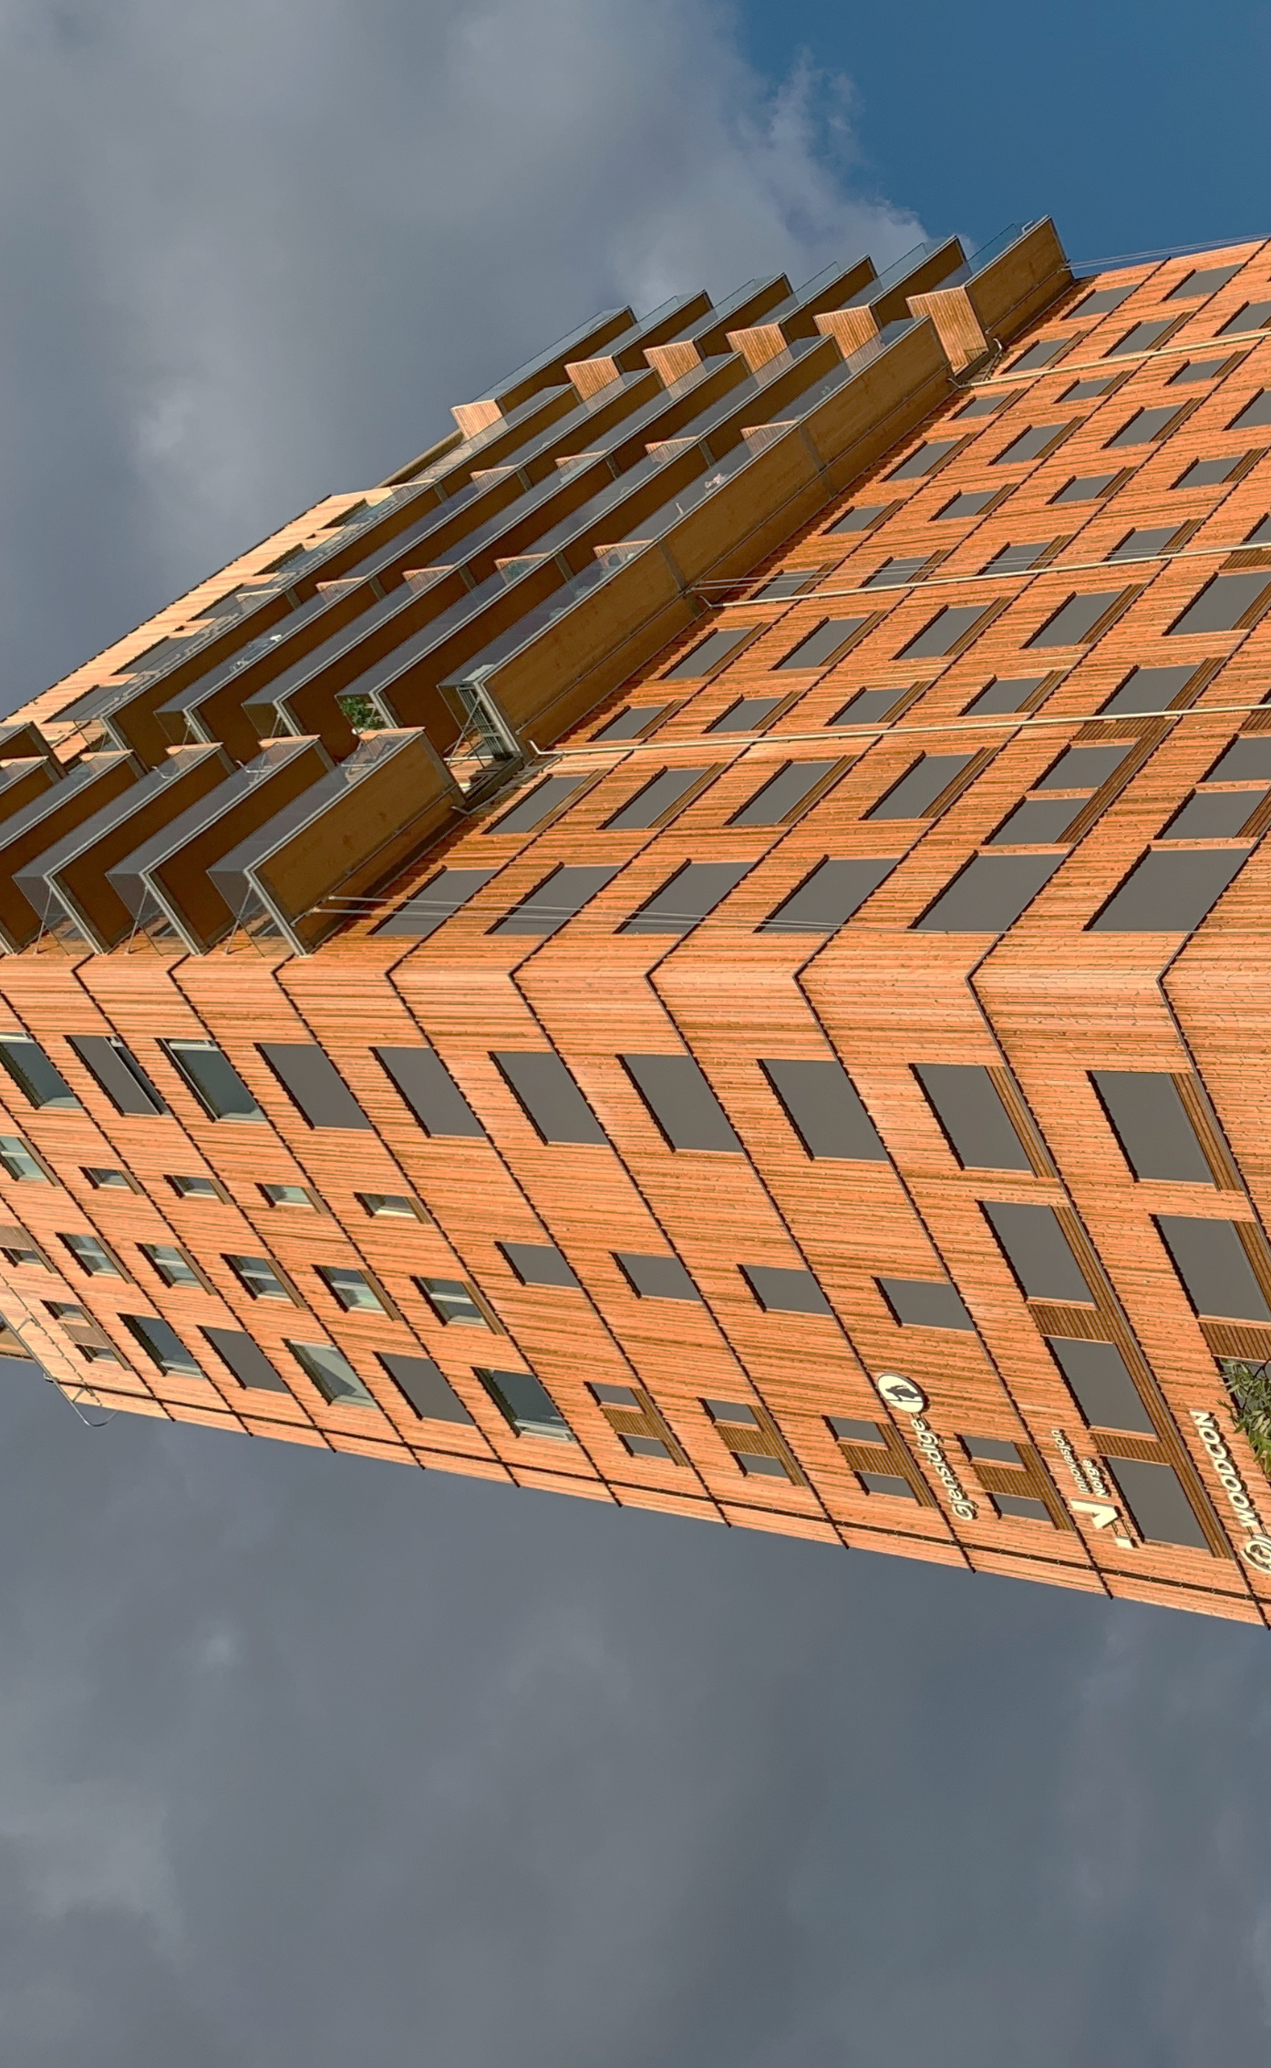
Enhanced research and development capacity on renewable energy, energy efficiency and energy security Calls 5.a, 5.b, SGS -5 These calls are “first time launches” and we went through consultation process with relevant actors in the field.
Consulting meetings have been held with the Research, Development Innovation Funding in Romania (UEFISCDI), the Research Council of Norway (RCN) and our Programme Partners.
Launch (tentative): May 2021

Slide 19
Research and Development – New Calls 5.a, 5.b, SGS -5
a. Main Elements
Research, Development and Innovation (R&D&I) in the energy sector: "Enhanced research and development capacity on renewable energy, energy efficiency and energy security"​
​
Contribution will be made towards increased cooperation between research institutions and enterprises. Industrial and experimental research projects that deliver impact during the programme lifetime will be targeted.​
R&D Financial Mechanism and budget:
Individual projects – budget of € 3 mil:
Call 5(a) - EEA Grants, budget: €1,5 mil. and
Call 5(b) - Norway Grants, budget: €1,5 mil
SGS-5 - Norway Grants, budget: €1,1 mil.
Proposal for minimum and maximum grant:
Individual projects: €200.000 – € 500 000
SGS: € 50 000 – € 200 000
Call/Scheme: | Eligible Applicants: | Eligible Partners:
Call 5(a) Enhanced research and development capacity​ | Any entity, private or public, commercial or non-commercial, and non-governmental organizations, established as legal person in Romania. | Any private or public entity, commercial or non-commercial, established as a legal person in Norway, Iceland, Liechtenstein or in Romania
Call 5(b) Enhanced research and development capacity​ | Any entity, private or public, commercial or non-commercial, and non-governmental organizations, established as legal person in Romania. | Any private or public entity, commercial or non-commercial, established as a legal person in Norway or in Romania
SGS | Any entity, private or public, commercial or non-commercial, and non-governmental organizations, established as legal person in Romania. | Any private or public entity, commercial or non-commercial, established as a legal person in Norway, Iceland, Liechtenstein or in Romania

Slide 20
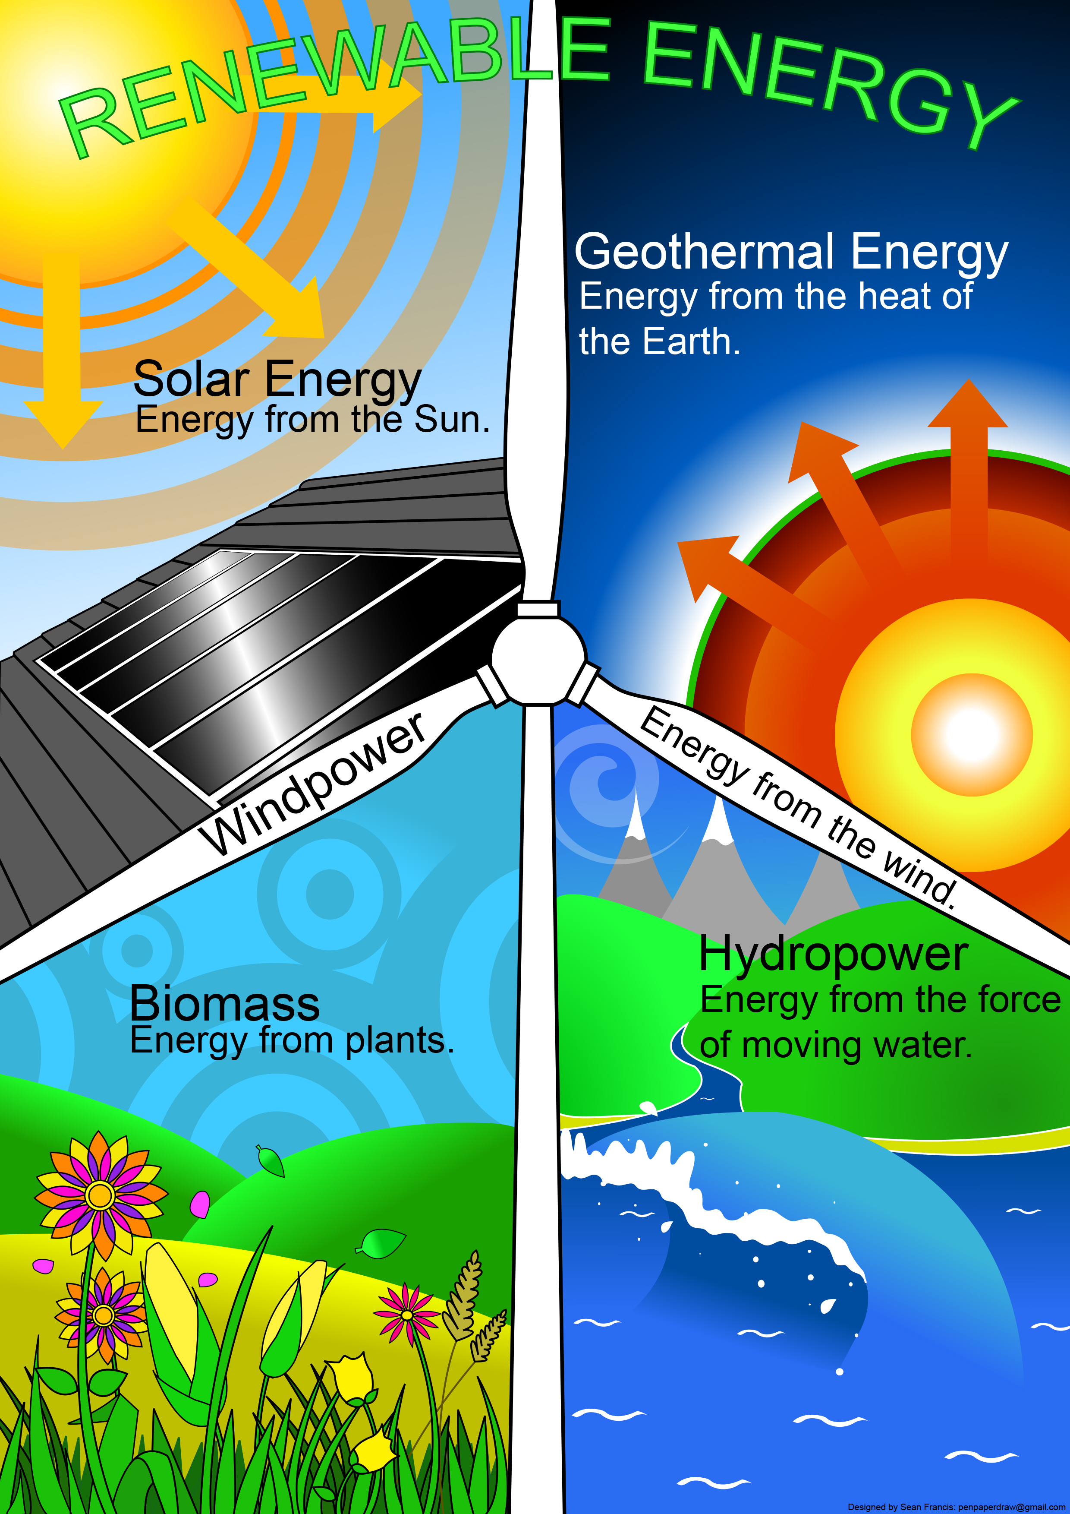
b. Areas of Support and Eligible Activities
This Scheme can provide support for projects that will develop and implement activities aiming to enhance research and development capacity on renewable energy, energy efficiency and energy security:
I. Renewable energy, energy efficiency and energy security:
Novel technologies for challenges in Energy transitions from fossils based to less Carbon emissions.
Research and Development related to technologies, equipment, tools, solutions, materials etc. for the energy transition.
Smart grid technologies,
Energy valorisation of waste.
Pre-feasibility/ Feasibility studies etc. for Carbon Capture and Storage (CCS); - if they are part of an integrated project.
II. Renewable - Hydropower:
Energy generation in Non-Powered Dams originally built for water supply, cooling water for industry or irrigation.
Safety of classical hydro power stations operated for designed conditions.
Safety of old hydro power stations against the effect of natural hazards.
d) Pump storage plants.
This Photo by Unknown author is licensed under CC BY-NC-ND.

Slide 21
Outcomes and Outputs
Projects on Research and Development must contribute directly to these:
Outcome indicators:
Enhanced research and development capacity on renewable energy, energy:
a. Number of renewable energy, energy efficiency and energy security technologies/solutions/services developed
b. Number of successful joint applications for Intellectual Property protection (copyrights, industrial design, trademarks, patents) by research institutions and enterprises
Output indicators:
Increased support to renewable energy, energy efficiency and Installed capacity for production of hydropower electricity (in MW);
a. Number of research and development on renewable energy, energy efficiency and energy security projects supported
b. Number of signed collaborative agreements between research institutions and enterprises involved in the programme
Optionally, projects may contribute to this outcome indicator:
Number of jobs created.
This Photo by Unknown author is licensed under CC BY-NC-ND.

Slide 22
Donor Partnership Projects
Not mandatory, but Donor Partnership Projects are strongly encouraged and will be awarded extra points during the project assessment process.
Unique bilateral partnership opportunity.
Access to expertise, technologies and solutions from Donor States entities (Norway, Iceland, Liechtenstein).
The Romanian Applicant is in the driver seat (submits the project application, signs the financing contract with Innovation Norway, submits Interim & Final Reports).
Division of roles is in the Partnership Agreement.
This Photo by Unknown Author is licensed under CC BY-ND

Slide 23
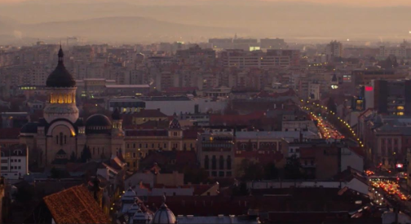
Project examples
We have the pleasure to present some of the projects under implementation financed from EEA and Norway Grants and managed by Innovation Norway in Romania under the umbrella of Energy Programme.
Welcome and thank you to our Project Promoters for their availability and participation in this event - Cluj-Napoca Municipality Hall.
Photos source: Project: Smart and low GHG emission Lighting System in Cluj Napoca, Project: Production of Simex furniture with green energyS.C. SIMEX S.A.

Slide 24
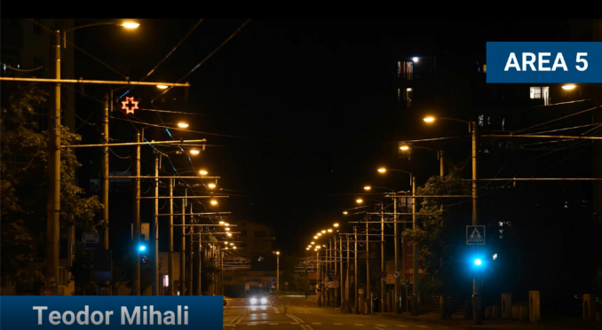
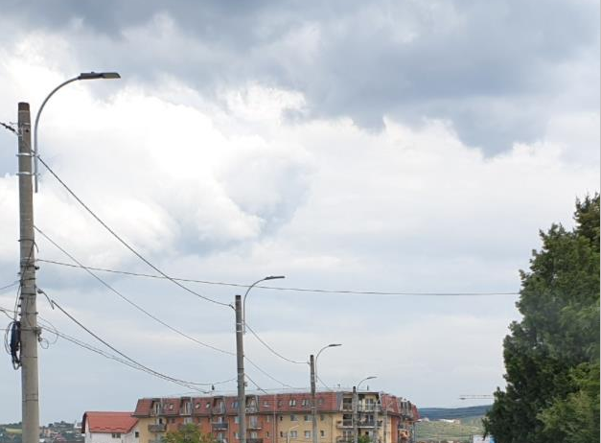
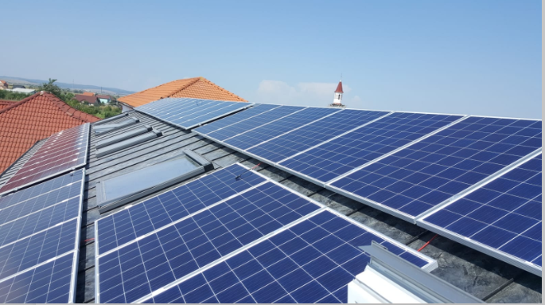
"Public lighting system with green energy" and "Photovoltaic panels on 8 public buildings which belongs to Municipality of Cluj - Napoca"
Project Promoter: CLUJ - NAPOCA Municipality Hall
Total eligible budget: 761 771 Euro, Total grant amount: 647 500 Euro
Short description: Replacement of 1 376 lighting points by using LED sources.
The use of the new LED technology will provide to Cluj – Napoca Municipality the opportunity to transform the current conventional lighting sources into a smart solution by combining efficient electricity consumption management, integrated lighting sources via internet into an adaptive smart control of the lighting level.
Expected outcomes
- Reduction of energy consumption by 532 MWh/year.
- CO2 equivalent emission reduction per year: 452 tonnes CO2 equivalent / year.
The Project Promoter has previously implemented a project with a Grant of 10,000 EUR from Norway Grants to perform Energy Audit Report for the public lighting network and is also implementing a project for installing photovoltaic panels on 8 public buildings which belongs to Municipality of Cluj - Napoca with a Grand amount of 697,300 EUR EEA&Norway Grants.
Mr. Emil Boc Mayor of Cluj-Napoca Municipality testimony: https://youtu.be/jvj21bZCYK0
Photos source: Public lighting system with green energy Cluj Napoca Municipality
Photos source: Photovoltaic panels on public buildings which belongs to Municipality of Cluj - Napoca

Slide 25
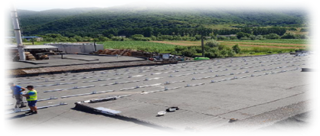
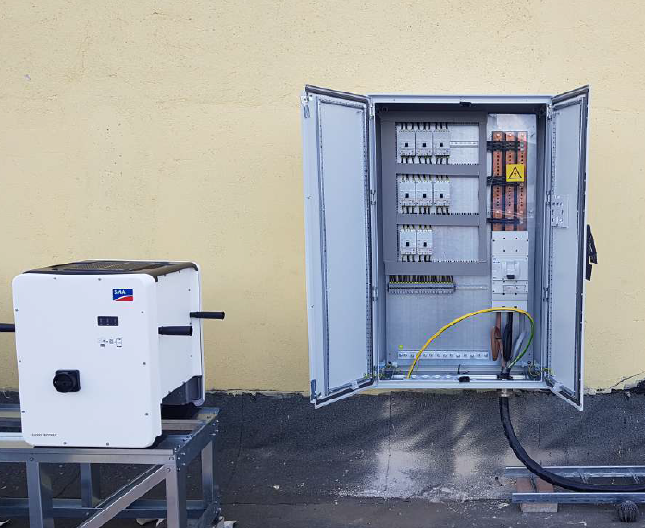
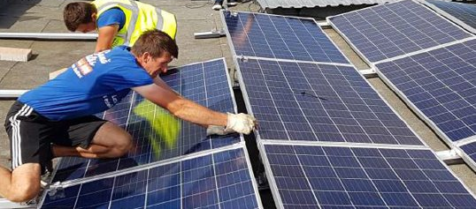
*Successful Story
Completion of the project
„Production of Simex furniture with green energy”
S.C. SIMEX S.A., headquartered in Șimleul Silvaniei, has implemented the project „Production of Simex furniture with green energy”, in the frame of the
„Energy Programme in Romania”.
Eligible project budget: 477.600 Euro
Grant: 237.000 Euro (co-financing: 240.600 Euro)
The main objective of the project is to provide alternative energy resources from renewable sources for the furniture production process.
Outcomes of the project:
Estimated annual CO2 emissions reductions: 364 tons of CO2 eq./year
Estimated annual production of energy from other renewable sources (photovoltaic pannels): 520 MWh/year
3 new jobs created for unemployed or disadvantaged people;
Mr. Dumitru Blaga, CEO Simex S.A. testimony: Simex project – YouTube
Photos source: Project implementation Simex S.A.
Photos source: Final monitoring visit at Simex – December 2020​

Slide 26
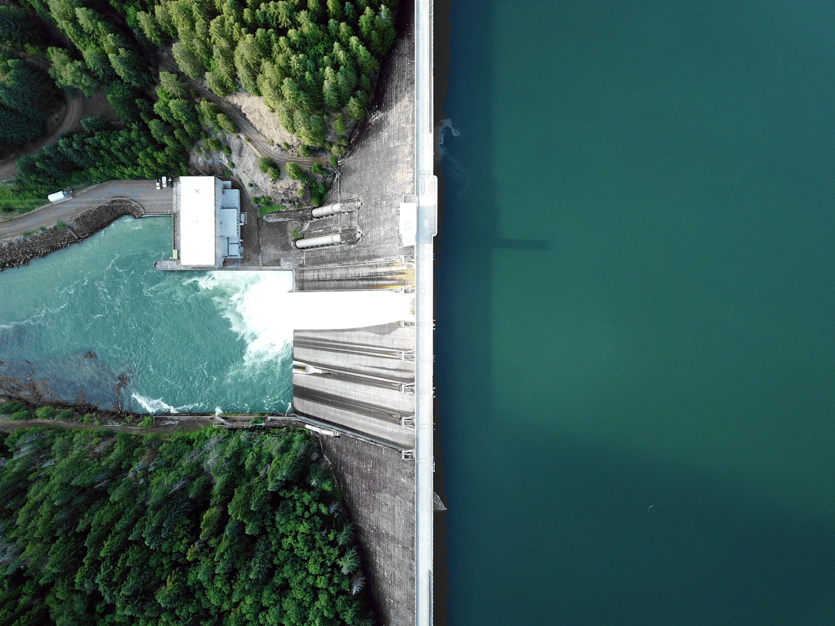
More info about the Calls of Proposals
Energy Programme in Romania: www.innovationnorway.no/RoEnergy
List of currently opened Calls under the Energy Programme in Romania:
Call for Proposals 1.1 – Hydropower. Extended deadline: Monday, 31 May 2021;
Calls for Proposals 6.1a and 6.1b – Electrification of households. Extended deadline: Wednesday, 30 June 2021;
Call for Proposals 3.1 – Other Renewable Energy Sources. Deadline: Wednesday, 8 September 2021;
Call for Proposals 2.1 – Geothermal Energy. Deadline: Thursday, 30 September 2021.
Calls Timeline (opened, planned and closed Calls): Timeline for launching Calls. (Updated on 17.05.2021)
Photo source: https://unsplash.com/photos/w6X7XaolqA0

Slide 27
Energy Programme in Romania
Working together for a green and competitive Europe!
Tusen takk! Takk fyrir! Vă mulțumim!
www.innovationnorway.no/RoEnergy
ro.energy@innovationnorway.no

