Slide 1
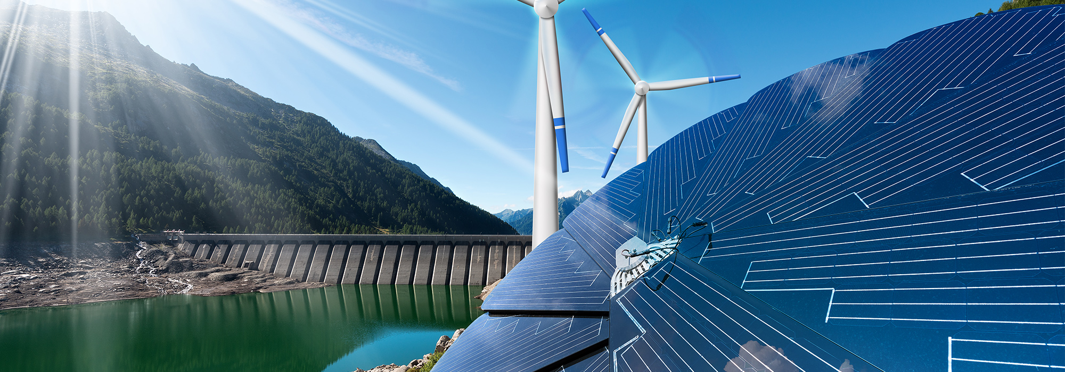
Energy Programme in Romania – Working together for a green and competitive Europe!
Hydrogen Webinar,
9 March 2022
www.innovationnorway.no/RoEnergy ro.energy@innovationnorway.no
This Photo by Unknown Author is licensed under CC BY-ND

Slide 2
Objectives of the EEA and Norway Grants
Contributing to reducing economic and social disparities in the European Economic Area
Strengthening relations between Norway, Iceland, Liechtenstein and the beneficiary countries
2014-2021: 2.8 billion EUR to programmes in 15 countries
Many Beneficiary States, including Romania, have included Energy programmes

Slide 3
Notes:
Innovation Norway is s state owned agency with an objective is to contribute to the growth of Norwegian industry and commerce by offering capital and expertise

Slide 4
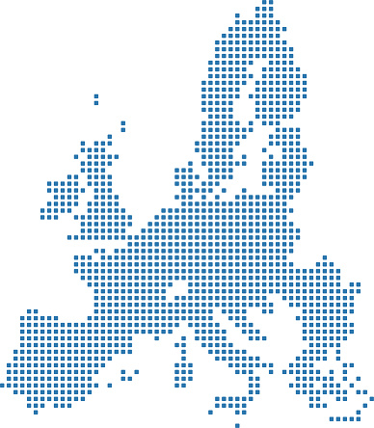
Innovation Norway - Business Development, Energy and Decent Work – Fund operator and Donor Programme partner
Romania Romania Energy Bulgaria Greece Croatia Social Dialogue /Decent Work Estonia Latvia Lithuania Poland Slovakia Portugal Blue Portugal Green

Slide 5
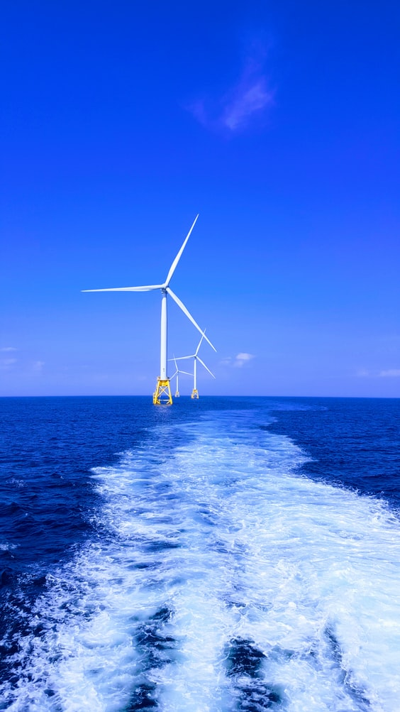
Energy Programme in Romania
Fund Operator:
Innovation Norway
Donor Programme Partners:
Norwegian Water Resources and Energy Directorate (NVE), Norway
National Energy Authority (OS), Iceland
Beneficiary State Programme Partners:
Ministry of Energy, Romania
Ministry of Environment, Romania
Programme Objective:
Less carbon intensive energy and increased security of supply
Bilateral Objective:
Strengthen bilateral relations between Romania and the Donor States (Iceland, Liechtenstein and Norway)
Programme allocation: EUR 62,8 mil.
Photo source: https://unsplash.com/photos/6Y88yhsNId8

Slide 6
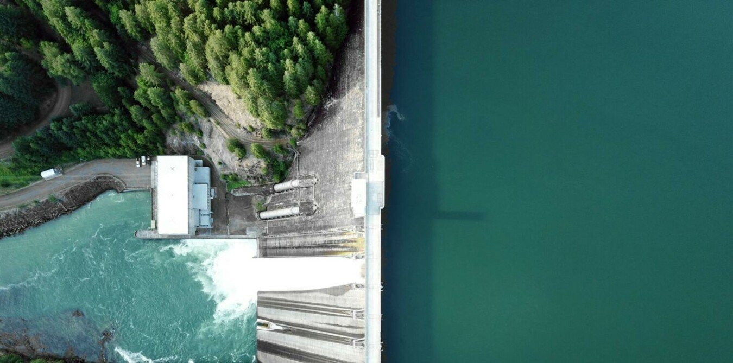
Energy Programme in Romania
The programme objective is to achieve less carbon intensive energy and increased security of supply. The Programme seeks to stimulate and develop long‐term cooperation between Iceland, Liechtenstein, Norway (“the Donor States”) and Romania (“Beneficiary State”).
The Energy Programme in Romania consists of five focus areas. The expected long term programme impact is less carbon intensive energy and increased security of supply in Romania. The programme will also enable the establishment of new businesses and jobs in energy field, which will lead to positive social benefits for local communities.
The Energy Programme focus areas are Renewable Energy, Energy Efficiency, Research and Development, Training and Awareness, and Electrification of Households.
Photo source: https://unsplash.com/photos/6Y88yhsNId8

Slide 7
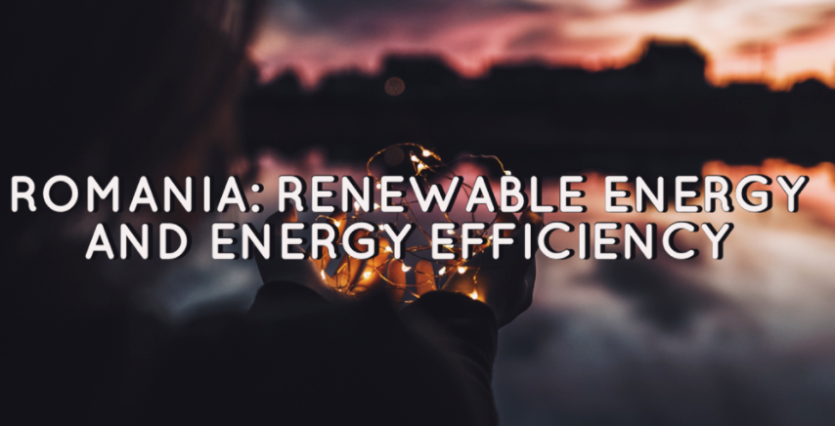
Deadline
Tuesday, 31 May 2022, 14.00 (Romanian time)
The call aims to support awareness-raising, training and competence-building on renewable energy, energy efficiency and energy security (soft measures).

Slide 8
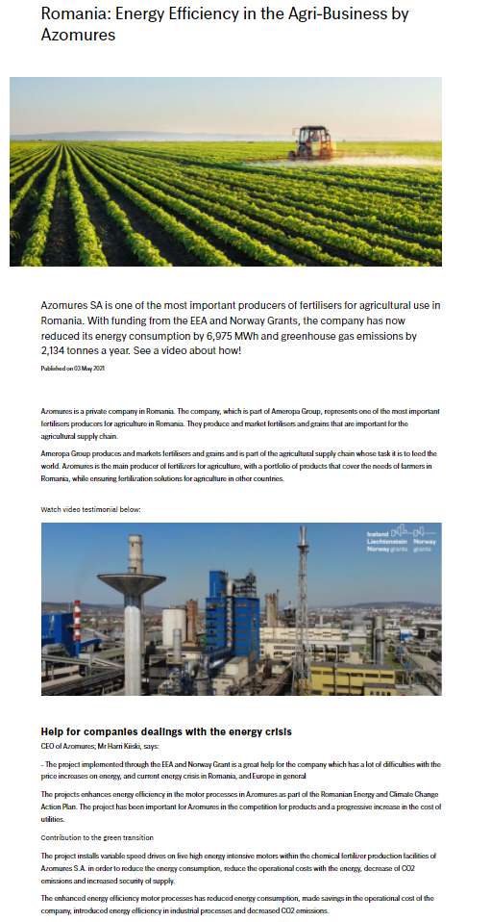
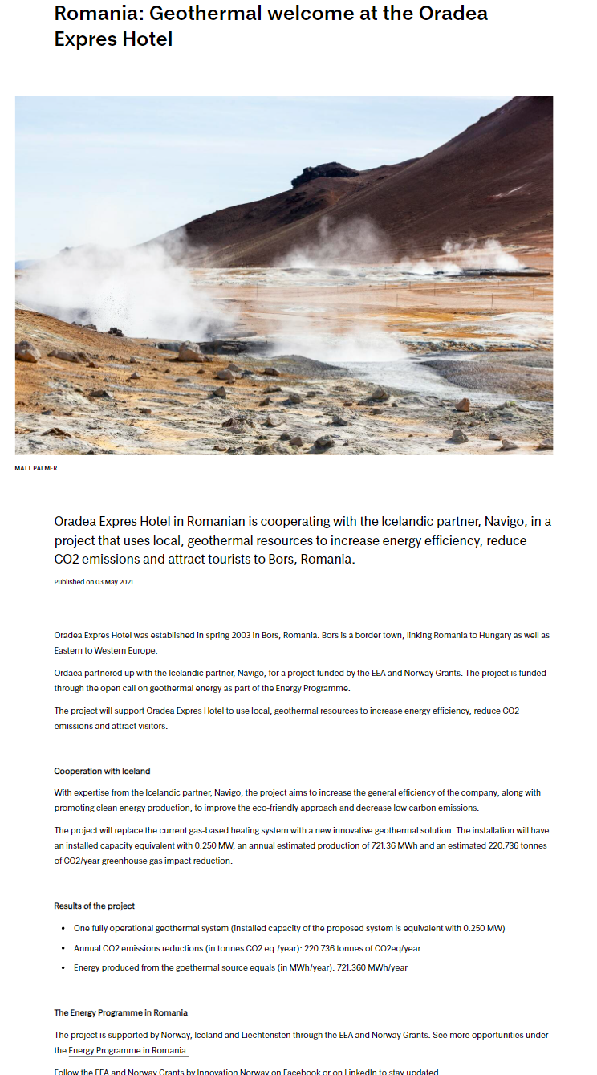
Project Examples

Slide 9
Energy Programme in Romania
Working together for a green and competitive Europe!
Tusen takk! Takk fyrir! Vă mulțumim!
www.innovationnorway.no/RoEnergy
ro.energy@innovationnorway.no

