Slide 1
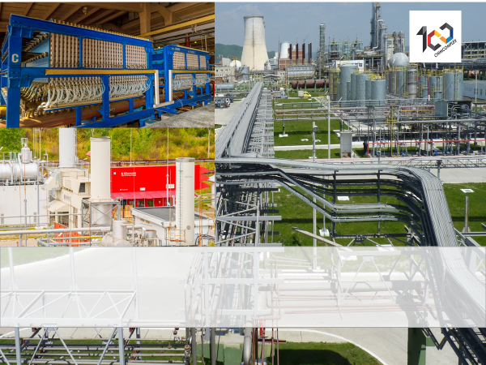
CHEMISTRY AND HYDROGEN ENERGY INTEGRATED WITH INDUSTRIAL DECARBONIZATION
Dumitru Coman
CTO CHIMCOMPLEX

Slide 2
CHEMISTRY AND HYDROGEN ENERGY INTEGRATED WITH INDUSTRIAL DECARBONIZATION
YES, CHIMCOMPLEX IS READY FOR INNOVATION THROUGH INTEGRATION!

Slide 3
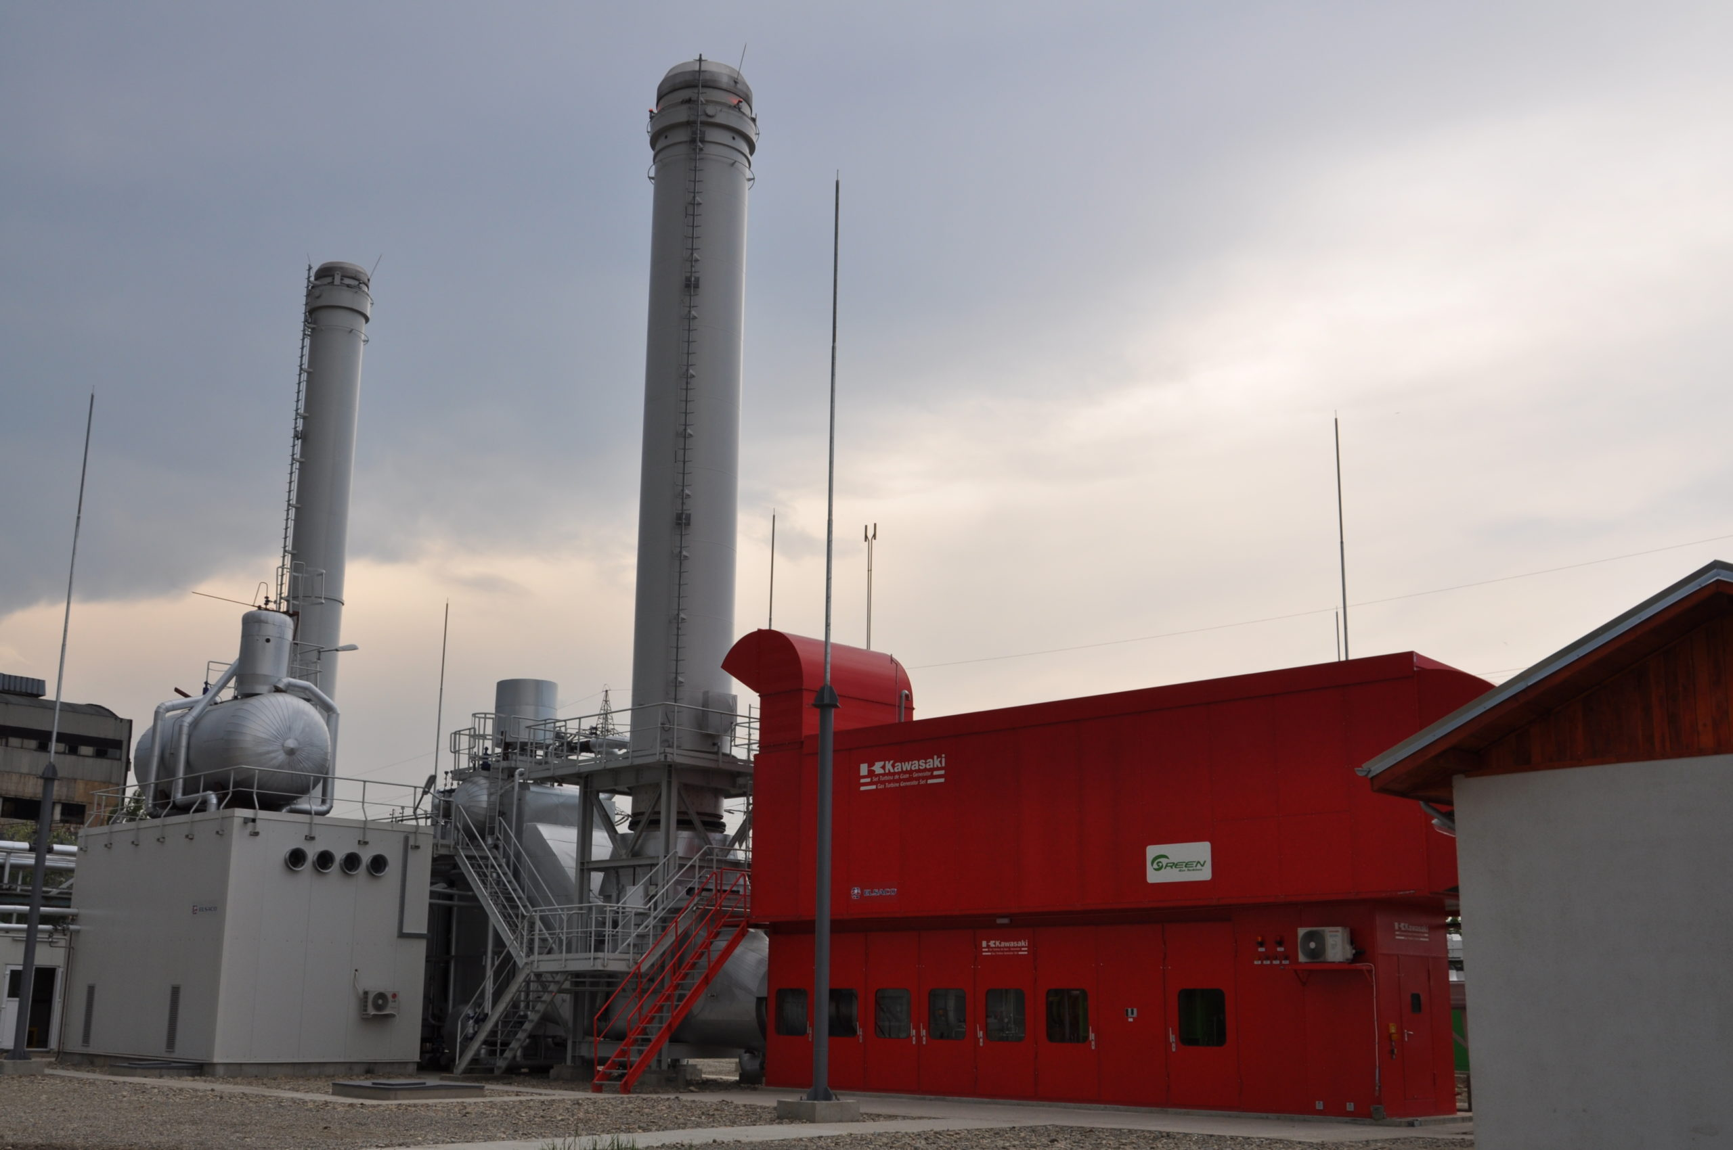
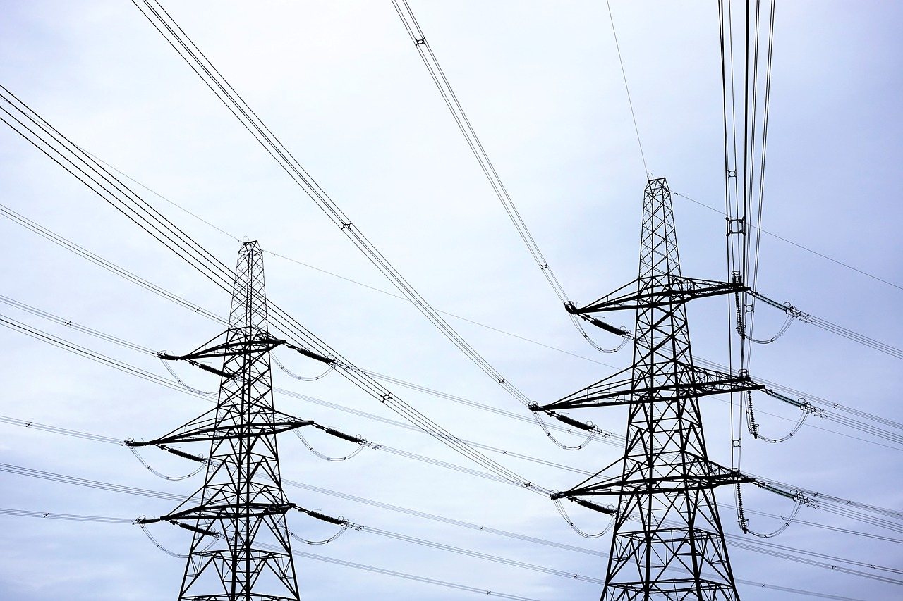
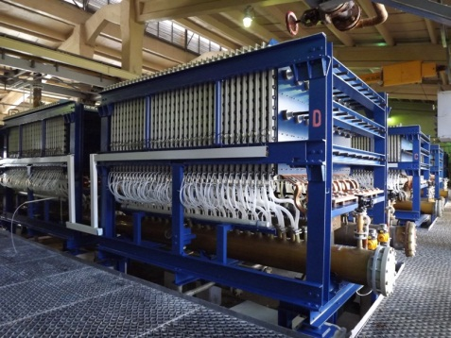
CHEMISTRY AND HYDROGEN ENERGY INTEGRATED WITH INDUSTRIAL DECARBONIZATION
Cogeneration
Purification
Natural Gas
CO₂
Green Energy
INTEGRATION OF HYDROGEN CHEMISTRY AND ENERGY
Brine Electrolysis (MSI)
H₂
H₂
Chemical Synthesis
Cl₂
NaOH

Slide 4
CHEMISTRY AND HYDROGEN ENERGY INTEGRATED WITH INDUSTRIAL DECARBONIZATION
CHIMCOMPLEX has the possibility to use emitted CO₂ and hydrogen produced from green energy for integrated and sustainable production!
CHIMCOMPLEX has been producing hydrogen from water for over 60 years (today approx. 5400 t/year), captures and uses CO2 for over 50 years, obtains hydrogen energy for over 10 years.
CHIMCOMPLEX has the necessary infrastructure for the construction of hydrogen projects in chemistry and energy.

Slide 5
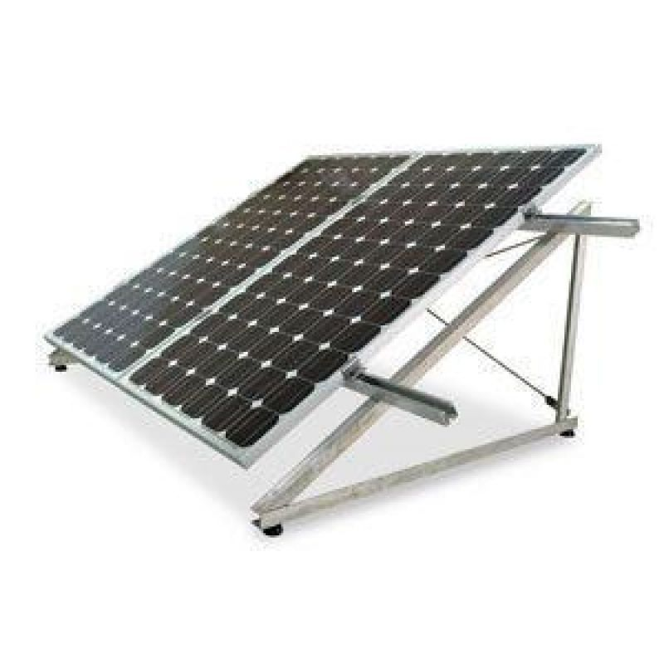
CHEMISTRY AND HYDROGEN ENERGY INTEGRATED WITH INDUSTRIAL DECARBONIZATION
Natural Gas
Cogeneration
CO_{2 Purification}
CO₂
_{Chemical Synthesis}
Carbonated products
S
Y
N
G
A
S
Green Energy
CO₂
Methanol synthesis
MTO-olefines
INTEGRATION OF HYDROGEN CHEMISTRY AND ENERGY
Oxo alcohols synthesis
H₂
H₂
Plasticizer
Water Electrolysis
H₂
O₂
Increasing production capacity Soda M
H₂
Chemical Synthesis
O₂
Inorganic products
Cl₂
Organic products
and POLYOLS
Brine Electrolysis (MSI)
NaOH
Green energy production

Slide 6
CHEMISTRY AND HYDROGEN ENERGY INTEGRATED WITH INDUSTRIAL DECARBONIZATION
Chimcomplex provides the space to efficiently integrate CCU and green hydrogen.
The lowest specific electricity consumption for hydrogen produced from water
Total or partial decarbonization
Chain of highly processed chemicals (polyols, oxo alcohols, plasticizers)
Electrolysis of brine with ion exchange membrane(1,3kWh/kg H₂)
40 times lower consumption than in the case of water electrolysis
Integrated flow of energy and hydrogen chemistry through CCU capture and use of CO₂
Chemistry synthesis (through technologies already validated) using hydrogen and CO₂

Slide 7
CHEMISTRY AND HYDROGEN ENERGY INTEGRATED WITH INDUSTRIAL DECARBONISATION
Advantages of implementing green hydrogen production and consumption integration projects:
Capitalization of traditional natural resources resulting in the highest added value
Developing horizontal connections between multiple industrial sectors
Integration of Romanian research on projects with direct applicability
Increasing the competitiveness of products by reducing the carbon footprint
High efficiency portfolio investments
DECARBONIZATION
COGENERATION / CO₂ CAPTURE/ CO₂ UTILIZATION
Natural Gas
S
Y
N
G
A
S
INTEGRATED CHEMISTRY AND
GREEN HYDROGEN ENERGY

Slide 8
The target model for the industry aims at adopting a circular economy model and use of renewable resources
Circular economy model of hydrocarbons
To survive, the industry is reconfiguring from a linear business model to a circular one
The circular model involves the use of renewable resources in chemical production, thus having an impact in the entire value chain
Using these products as raw material in the manufacturing industry results in recyclable goods, thus reducing landfilling
At the time of decommissioning, these products can be recycled and re-enter the production circuit exemplified in the image
Energy input
CO₂
Landfill
Carbon Capture
Industry manufacturing
Recycling
H₂
CO₂
Mechanical
C_{n}H_{n}
Chemical Production
Bio Feed
Chemical
C_{n}H_{n}
Refinery
Pyrolysis
CO + H₂
CO₂
Oil & Gas
Energy
CO₂
Value creation
Linear value creation
Circular value creation
Synthetic hydrocarbons

Slide 9
Investing in green technologies can support the safeguarding of existing assets and the economics of the main products
New feedstock
New Operations
Alternative Feedstock
New material and energy resources (e.g. captured CO₂)
Alternative processing of current resources (e.g. natural gas)
Circular Economy
Formation of a closed-loop value chain
Application of different stages of recycling (e.g. chemical recycling)
Power-to-X
Production of chemicals and fuels from renewable electric energy
Carbon Capture Utilization (CCU)
Utilization of captured CO₂-emissions in the value chain of various products
Circular
Power-to-X
CCU
GENERIC VALUE CHAIN
PVC
Industry park CO₂
Polyolefins
Carbon
Capture
MeOH
Olefines
Natural gas
Cogeneration
Flue
gases
CO₂
Recycling
MTO
Electrolysis
H₂
Renewable energy
Recycled Waste
Plasticizer
Olefines
Chlorine Alkali Electrolysis
Chlorine
Epoxide
Brine
Pyrolysis
Phosgene
Amines
MDI, TDI
Polyols
Oxo alcohols
DOTP
PU
PU Recycling
PET Recycling

