Slide 3
Energy Programme in Romania – Working together for a green and competitive Europe!
Inger Karni, Programme Director, Energy programme in Romania
31 March 2022
www.innovationnorway.no/RoEnergy ro.energy@innovationnorway.no
This Photo by Unknown Author is licensed under CC BY-ND

Slide 4
Objectives of the EEA and Norway Grants
Contributing to reducing economic and social disparities in the European Economic Area
Strengthening relations between Norway, Iceland, Liechtenstein and the beneficiary countries
2014-2021: 2.8 billion EUR to programmes in 15 countries
Many Beneficiary States, including Romania, have included Energy programmes

Slide 5
Notes:
Innovation Norway is s state owned agency with an objective is to contribute to the growth of Norwegian industry and commerce by offering capital and expertise

Slide 6
Energy Programme in Romania
Fund Operator:
Innovation Norway
Donor Programme Partners:
Norwegian Water Resources and Energy Directorate (NVE), Norway
National Energy Authority (OS), Iceland
Beneficiary State Programme Partners:
Ministry of Energy, Romania
Ministry of Environment, Romania
Programme Objective:
Less carbon intensive energy and increased security of supply
Bilateral Objective:
Strengthen bilateral relations between Romania and the Donor States (Iceland, Liechtenstein and Norway)
Programme allocation: EUR 62,8 mil.
Photo source: https://unsplash.com/photos/6Y88yhsNId8

Slide 7
Energy Programme in Romania
The programme objective is to achieve less carbon intensive energy and increased security of supply. The Programme seeks to stimulate and develop long‐term cooperation between Iceland, Liechtenstein, Norway (“the Donor States”) and Romania (“Beneficiary State”).
The Energy Programme in Romania consists of five focus areas. The expected long term programme impact is less carbon intensive energy and increased security of supply in Romania. The programme will also enable the establishment of new businesses and jobs in energy field, which will lead to positive social benefits for local communities.
The Energy Programme focus areas are Renewable Energy, Energy Efficiency, Research and Development, Training and Awareness, and Electrification of Households.
Photo source: https://unsplash.com/photos/6Y88yhsNId8

Slide 8
Energy Programme in Romania
Working together for a green and competitive Europe!
Tusen takk! Takk fyrir! Vă mulțumim!
www.innovationnorway.no/RoEnergy
ro.energy@innovationnorway.no

Slide 9
Norway Grants for the Energy Programme in Romania ​ ​
The Energy Programme in Romania launches its final call for project proposals!
Call SGS-4: Increased knowledge on renewable energy, energy efficiency ​ – Awareness raising general public and Training​
​ 31 March 2022
Gabriela Constantin, Innovation Norway
Notes:
Thank you for participating today webinar and matchmaking Event regarding awareness-raising, training and competence-building on renewable energy, energy efficiency and energy security.
Our goal today is to present you new financing opportunities in energy field and help you understand our new call SGS-4: Increased knowledge on renewable energy, energy efficiency
– Awareness raising general public and Training under Energy Programme in Romania.
The purpose of these Calls is to SUPPORT AWARENESS-RAISING, TRAINING AND COMPETENCE-BUILDING ON RENEWABLE ENERGY, ENERGY EFFICIENCY AND ENERGY SECURITY.

Slide 10
Deadline​
Tuesday, 30 June 2022, 14.00 (Romanian time)
THE CALL AIMS TO SUPPORT AWARENESS-RAISING, TRAINING AND COMPETENCE-BUILDING ON RENEWABLE ENERGY, ENERGY EFFICIENCY AND ENERGY SECURITY
(SOFT MEASURES).
This Photo by Unknown author is licensed under CC BY-SA.
Notes:
This Call for Proposals will finance projects proposed by Romanian entities in the Programme focus area: Increased knowledge on renewable energy, energy efficiency - Awareness raising general public and Training.
The expected outcome of the projects is increased knowledge on renewable energy, energy efficiency and energy security.
We have extended the deadline from 31 May 14:00 Romanian time until 30 June 14:00 Romanian time to give this Call and the ongoing planning of projects and a bit more time to find and create partnerships.

Slide 11
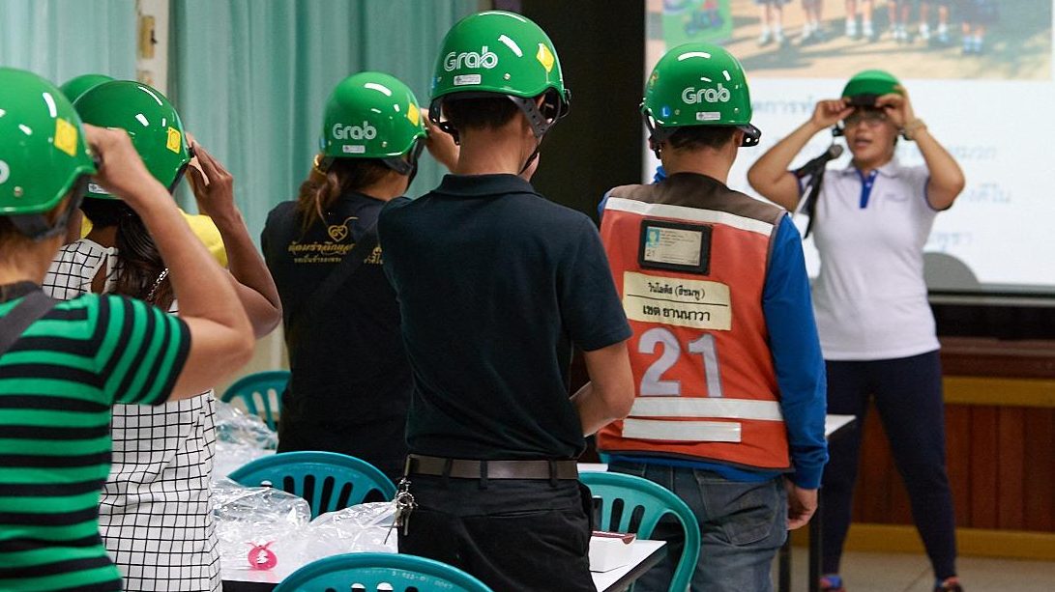
CALL SGS 4: INCREASED KNOWLEDGE ON RENEWABLE ENERGY, ENERGY EFFICIENCY AND ENERGY SECURITY
Total available amount: €3,000,000
Minimum grant: €50,000
Maximum grant: €200,000
Eligible Applicants (Project Promoters)
Any entity, public or private, commercial or non-commercial and non-governmental organizations, established as a legal person in Romania
This Photo by Unknown author is licensed under CC BY.​
Notes:
The total available amount for this Call is €3,000,000 .
The minimum amount of grant assistance applied for shall be EUR 50.000.
The maximum amount of grant assistance applied for shall be EUR 200.000.
The target group for this Programme is entities legally registered in Romania.
The Applicant must have been established for at least 3 years at the date of the deadline of the present Call.

Slide 12
Donor Partnership Projects
Donor Partnership Projects are strongly encouraged and will be awarded extra points during the project assessment process.
Unique bilateral partnership opportunity.
Access to expertise, technologies and solutions from Donor States entities (Norway, applicable for this Call).
The Applicant is in the driver seat (submits the project application, signs the financing contract with Innovation Norway, submits Interim & Final Reports).
Division of roles is in the Partnership Agreement.
This Photo by Unknown Author is licensed under CC BY-ND
Notes:
It is not mandatory to have Project Partners in the projects, but Partnership Projects are encouraged and will be awarded additional points during assessment. Most points will be awarded to cooperation with entities from the Donor States in Donor Partnership Projects.
Is important to mention that the partnership quality will be assessed - the extent to which the Partnership Agreement includes clear division of roles, tasks responsibilities and cash flow has been agreed upon; assessment of Partner(s) involvement in the preparation, implementation and sharing of the project results; each partner has a significant contribution to the project activities.
To qualify for such points, the Donor State Partner (from Norway) and/ or from Romania should be actively involved in, and effectively contributing to, the implementation of the project, and it should share with the Project Promoter a common economic or social goal which is to be realized through the implementation of the project. The simple provision of services does not qualify as a partnership project
The Partnership Agreement should include clear division of roles, tasks, responsibilities and cash flow.

Slide 13
WHO CAN BE PARTNER?
Any public or private entity, commercial or non-commercial, established as a legal person in Norway or in Romania.
Projects that include Norwegian partners are encouraged.
Eligible partners are any public or private entity, commercial or non-commercial, established as a legal person in Norway or in Romania.
This Photo by Unknown Author is licensed under CC BY-SA
Notes:
The Partner must have been established for at least 1 year at the date of the deadline of the present Call.
If the Applicant has one or more Partners, a draft Partnership Agreement defining the roles and responsibilities of the different partners, is attached to the application.
A template for the Partnership Agreement is published on the Programme website together with the present Calls, please read the List of mandatory documents: point 4 - 4.Draft Partnership Agreement (if relevant) (template)

Slide 14
Matchmaking event: It promotes Norwegian companies and connects them with international partners.
The matchmaking provides a platform to make a profile, browse the profiles of other participants and book meetings: Digital matchmaking “Soft Measures: Awareness-raising, Training and Mentorship” - Home (b2match.io)
Participants can sign up and book meeting all throughout April.
This Photo by Unknown Author is licensed under CC BY-NC-ND
Notes:
Please join the digital matchmaking Soft Measures: Awareness-raising, Training and Mentorship!
You can register, browse the other profiles, and book meetings with partners here.
Who can participate?
For this particular Call , the Participants are entities from Romania and Norway.
Participants from Romania, can meet with partners in Norway.
Participants from Norway can meet with partners in Romania.
The Norway Grants aims to reduce social and economic differences in Europe and to strengthen cooperation with Norway.
The matchmaking will therefore be open from 30 March and remain open all of April. Participants are encouraged to register with profiles in B2Match and book meetings as early as possible. However, registration and the opportunity to book meetings will be open all of April until 30 April.
Why join the matchmaking?
By making a profile in this platform, you will find a list of partners who are willing, able and ready to cooperate in projects. Signing up with a profile will:
Allow you to book short B2B meetings before, during or after the event, and make a network
Give you visibility so that other participants can contact you with ideas for cooperation
Give you an overview of participants so that you can contact them with ideas for cooperation

Slide 15
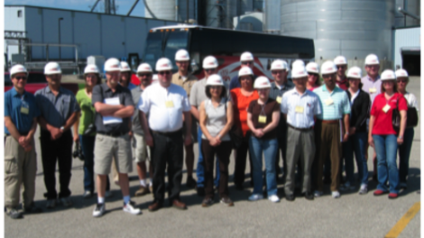
Areas of support and eligible activities
An Applicant shall submit only one project proposal under this Call for Proposals.
This Scheme can provide support for projects that will develop and implement activities aiming to increased knowledge on renewable energy, energy efficiency – Awareness raising general public and training/ competence
This Photo by Unknown Author is licensed under CC BY
Notes:
An Applicant shall submit only one project proposal under this Call for Proposals.
This Scheme can provide support for projects that will develop and implement activities aiming to increased knowledge on renewable energy, energy efficiency – Awareness raising general public and training/ competence

Slide 16
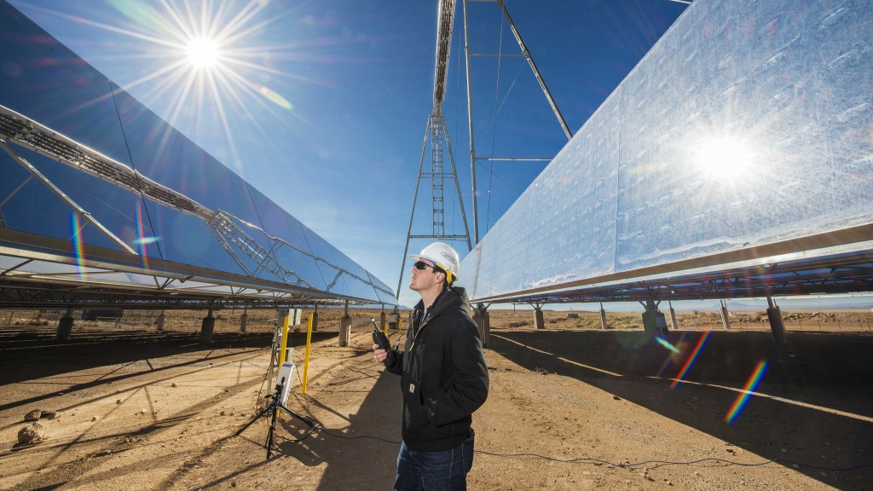
ELIGIBLE ACTIVITIES
Trainings, seminars, mentoring, media campaigns, etc., provided to general public by business organisations (SMEs, large companies, incubators, accelerators etc.), public sector (public organisations, local, regional or central public entities), public educational institutions, academia, in fields like renewable energy, energy efficiency – awareness raising general public and training/ competence.
Conferences/workshops in the field of renewable energy, energy efficiency – awareness raising to general public and /or public authorities.
Credit giving education at tertiary level on renewable energy, energy efficiency and energy security (supply) to general public.
Training staff in energy advice (e.g., City/Commune and Guilds’ Energy Awareness course) so that they are better able to address the needs of customers.
Training on general public about ways to use energy more efficiently (e.g., explaining how to use timers, controls, heaters etc. effectively).
Support for the trainings in implementation of Energy Management systems, which includes energy efficiency, local renewable generation, energy sufficiency/security, the creation of an energy management team in industries, local public authorities, universities, except for the requirements imposed by the law.
Support skills regarding the preliminary evaluation, preparation (including risk mitigation) and development of an energy investment, including knowledge related to how to sell and how to buy energy efficiency.
Support for trainings to overcome internal / external barriers for the energy efficiency to be implemented (trainings for the decision makers to understand the projects in terms of MWh savings, in terms of increased profitability, release of cashflow, difficulties in obtaining licenses, etc.).
Support for trainings of the local public authorities in relation with the associations of households/blocks of apartments, to make the residential owners and landlords to be more aware of the benefits of renewable energy and/or energy efficiency measures (deep renovation, PV installation on the rooftops, etc..).
Notes:
Eligible activities:
• Trainings, seminars, mentoring, media campaigns, etc., provided to general public by business organisations (SMEs, large companies, incubators, accelerators etc.), public sector (public organisations, local, regional or central public entities), public educational institutions, academia, in fields like renewable energy, energy efficiency – awareness raising general public and training/ competence.
• Conferences/workshops in the field of renewable energy, energy efficiency – awareness raising to general public and /or public authorities.
• Credit giving education at tertiary level on renewable energy, energy efficiency and energy security (supply) to general public.
• Training staff in energy advice (e.g., City/Commune and Guilds’ Energy Awareness course) so that they are better able to address the needs of customers.
• Training on general public about ways to use energy more efficiently (e.g., explaining how to use timers, controls, heaters etc. effectively).
• Support for the trainings in implementation of Energy Management systems, which includes energy efficiency, local renewable generation, energy sufficiency/security, the creation of an energy management team in industries, local public authorities, universities, except for the requirements imposed by the law.
• Support skills regarding the preliminary evaluation, preparation (including risk mitigation) and development of an energy investment, including knowledge related to how to sell and how to buy energy efficiency.
• Support for trainings to overcome internal / external barriers for the energy efficiency to be implemented (trainings for the decision makers to understand the projects in terms of MWh savings, in terms of increased profitability, release of cashflow, difficulties in obtaining licenses, etc.).
• Support for trainings of the local public authorities in relation with the associations of households/blocks of apartments, to make the residential owners and landlords to be more aware of the benefits of renewable energy and/or energy efficiency measures (deep renovation, PV installation on the rooftops, etc..).
NOTE: As a support activity the applicant may purchase materials and consumables necessary for the project implementation, but it’s relation to the main objectives of the project proposal should be clearly justified and with strong implications on the expected outcomes. Purchasing of equipment for purely administrative functions will not be supported.

Slide 17
EXPECTED RESULTS
Outcomes:​
Level of self‐reported desirability for renewable energy, energy efficiency and energy security - Target value 5​
Number of people self‐reporting enhanced capacity/skills related to renewable energy, energy efficiency and energy security – Target value 355​
Number of people self‐reporting on improved knowledge related to renewable energy, energy efficiency and energy security – Target value 2000​
Outputs:
Number of people completing comprehensive (more than 2 days) trainings on renewable energy, energy efficiency and energy security implemented –Target value 124
Number of people completing credit giving education at university level – Target value 10
Number of people completing short (less than 2 days) trainings on renewable energy, energy efficiency and energy security implemented – Target value 320
Number of people reached by the awareness‐raising on renewable energy, energy efficiency and energy security – Target value 2500
This Photo by Unknown author is licensed under CC BY-SA.
Notes:
Projects on Calls for Proposals, focus area: Increased knowledge on renewable energy, energy efficiency – Awareness raising general public and Training/ Competence must contribute directly to these:
➢ outcome indicators:
- Increased knowledge on renewable energy, energy efficiency and energy security:
a. Level of self‐reported desirability / knowledge for renewable energy, energy efficiency and energy security - 5
c. Number of people self‐reporting enhanced capacity/skills related to renewable energy, energy efficiency and energy security. - target value 355
d. Number of people self‐reporting on improved knowledge related to renewable energy, energy efficiency and energy security – target value 2000.
➢ output indicators:
- Knowledge‐enhancing measures implemented for all sectors of society:
a. Number of awareness raising campaigns.
b. Number of people completing comprehensive (more than 2 days) trainings on renewable energy, energy efficiency and energy security implemented. - target value 124
c. Number of people completing credit giving education at tertiary level - target value 10
d. Number of people completing short (less than 2 days) trainings on renewable energy, energy efficiency and energy security implemented. - target value 320
e. Number of people reached by the awareness‐raising on renewable energy, energy efficiency and energy security. - target value 2 500
Important to be mention: Please note, that it is not necessary that a project contributes to all indicators, but only to the relevant indicators associated with the eligible activity (activities) for which financing is requested.

Slide 18
Grant rates and co-financing
The financial contribution from this Programme shall be determined on a case-by-case basis. The applicable rules on public procurement and on state aid, procedural and substantive, shall be complied with.
The Applicant (Project Promoter) shall secure the full financing of the project. The Project Promoter (and/or the Project Partner(s)) shall provide or obtain the remaining co-financing in the form of cash.
All eligible expenditures of a project can form the basis of the required co-financing.
In-kind contribution is not accepted as co-financing.
Notes:
The financial contribution from this Programme shall be determined on a case-by-case basis, taking all relevant factors into account, including the profitability of the project and the general financial standing of the Applicant.
The applicable rules on public procurement and on state aid, procedural and substantive, shall be complied with.
The Applicant (Project Promoter) shall secure the full financing of the project.
The Project Promoter (and/or the Project Partner(s)) shall provide or obtain the remaining co-financing in the form of cash. All eligible expenditures of a project can form the basis of the required co-financing.
In-kind contribution is not accepted as co-financing.

Slide 19
Grant rate for non-economic operators
For public entities, proposing projects which do not fall under state aid provisions (i.e., Regulation 651/2014), the grant rate will be maximum 85% of the total eligible expenses for the project, without exceeding the maximum amount that may be granted to a project.
For NGOs, proposing projects which do not fall under state aid provisions (i.e., Regulation 651/2014), the grant rate will be maximum 90% of the total eligible expenses for the project, without exceeding the maximum amount that may be granted to a project.
Notes:
For public entities, proposing projects which do not fall under state aid provisions (i.e., Regulation 651/2014), the grant rate will be maximum 85% of the total eligible expenses for the project, without exceeding the maximum amount that may be granted to a project.
For NGOs, proposing projects which do not fall under state aid provisions (i.e., Regulation 651/2014), the grant rate will be maximum 90% of the total eligible expenses for the project, without exceeding the maximum amount that may be granted to a project.

Slide 20
Grant rate for entities involved in economic activities
For entities involved in economic activities, the grant rate will be determined based on the applicable provisions of Commission Regulation 651/20141 declaring certain categories of aid as compatible with the Internal market in application of Articles 107 and 108 of the Treaty, as amended by Commission Regulation 2017/1084:
https://eur-lex.europa.eu/legal-content/EN/TXT/PDF/?uri=CELEX:32014R0651&from=EN
The grant rate may vary, depending on the type of state aid awarded, size of the Applicant and other elements included in the provisions of the Regulation which are relevant for the respective project.
Notes:
For entities involved in economic activities, the grant rate will be determined based on the applicable provisions of Commission Regulation 651/20141 declaring certain categories of aid as compatible with the Internal market in application of Articles 107 and 108 of the Treaty, as amended by Commission Regulation 2017/1084.
The grant rate may vary from 30% to maximum 90%, depending on the type of state aid awarded, size of the Applicant and other elements included in the provisions of the Regulation which are relevant for the respective project. Applicants should not expect to receive the maximum grant rates possible according to the state aid rules.
The Applicant should provide reasoning on how the envisaged project activities and the corresponding costs fulfil the criteria for each of the relevant state aid categories.

Slide 21
For this Call the following categories of state aid will be applicable
1. De minimis support
Financial support to economic operators could be awarded as de minimis support in line with the Commission Regulation (EC) No 1407/2013 (max. EUR 200.000 over three fiscal years). The maximum grant rate applied will be 90%.
2. art. 31 Training aid
Increased knowledge on renewable energy,
energy efficiency – Awareness raising general public and Training/ Competence
3. Aid to SMEs - art. 18 Aid for consultancy in favor of SMEs

Slide 22
Energy Programme in Romania
Working together for a green and competitive Europe!
Tusen takk! Thank you!
www.innovationnorway.no/RoEnergy
ro.energy@innovationnorway.no

Slide 23
Detailed Activity Budget
Ramona Costut, Innovation Norway – Bucharest Office
March 31, 2022

Slide 24
Introduction
Project Document
Structure & Role of the Detailed Activity
Budget (DAB) into the Application Package
Project Application
- Detailed budget (Eligible costs per Activity) (Sheet 1);
Balance sheet (Sheet 2);
Profit & Loss sheet (Sheet 3);
Read carefully
Financial Statements
Other doc (price offers, cost references, bank & commitment letters, etc.)
the Guideline for the Detailed Budget and Financial Forecast

Slide 25
Read before filling in the form…

Slide 26
Detailed Budget
The management, publicity, audit services should correspond to the complexity of the project framework and the activities setup;
The costs of staff assigned to the project (actual salaries plus social security charges and other statutory costs) should correspond to the usual policy on remuneration of the organization
VAT eligibility – include VAT in the budget only if it is not recoverable
Do not include in the budget costs that are 100% covered by the promoter or costs that are not eligible to be financed under the respective call.
Pay attention to the applicable state aid category and the applicable state aid grant rate

Slide 27
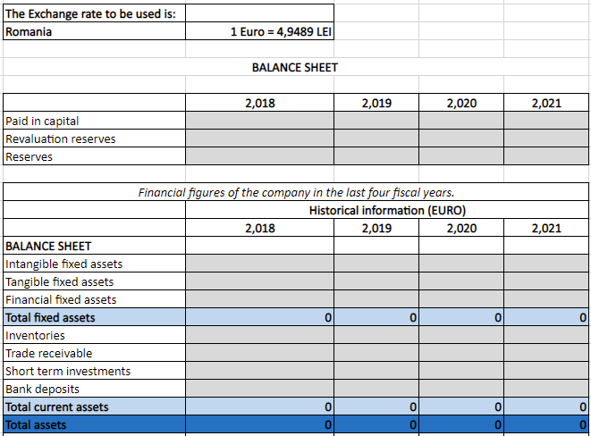
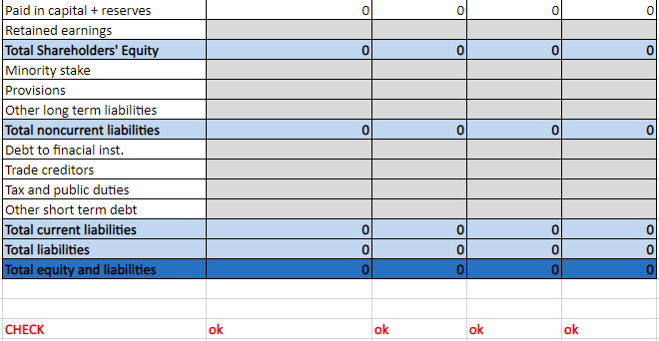
Balance Sheet – Historical Data
Total Assets should be equal to Total equity and liabilities

Slide 28
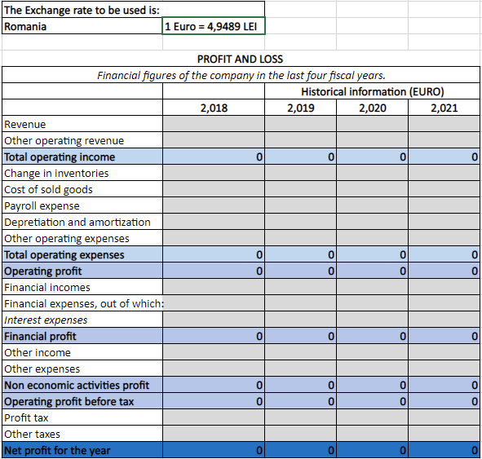
P&L_historic

Slide 29
Balance Sheet and Profit and Loss – Historical data
Exchange rate – use the one indicated in the generic document;
Check the Guideline for correspondence with Annual Balance Sheet and Profit and Loss
The whole figures should be filled-in, avoid using decimals.
Recommendation: try to use formulas
The amounts filled-in in DAB should correspond to the amounts in the Balance sheet and Profit&Loss submitted to the national authorities.

Slide 30
Good luck with your application! Thank you!

