Slide 1
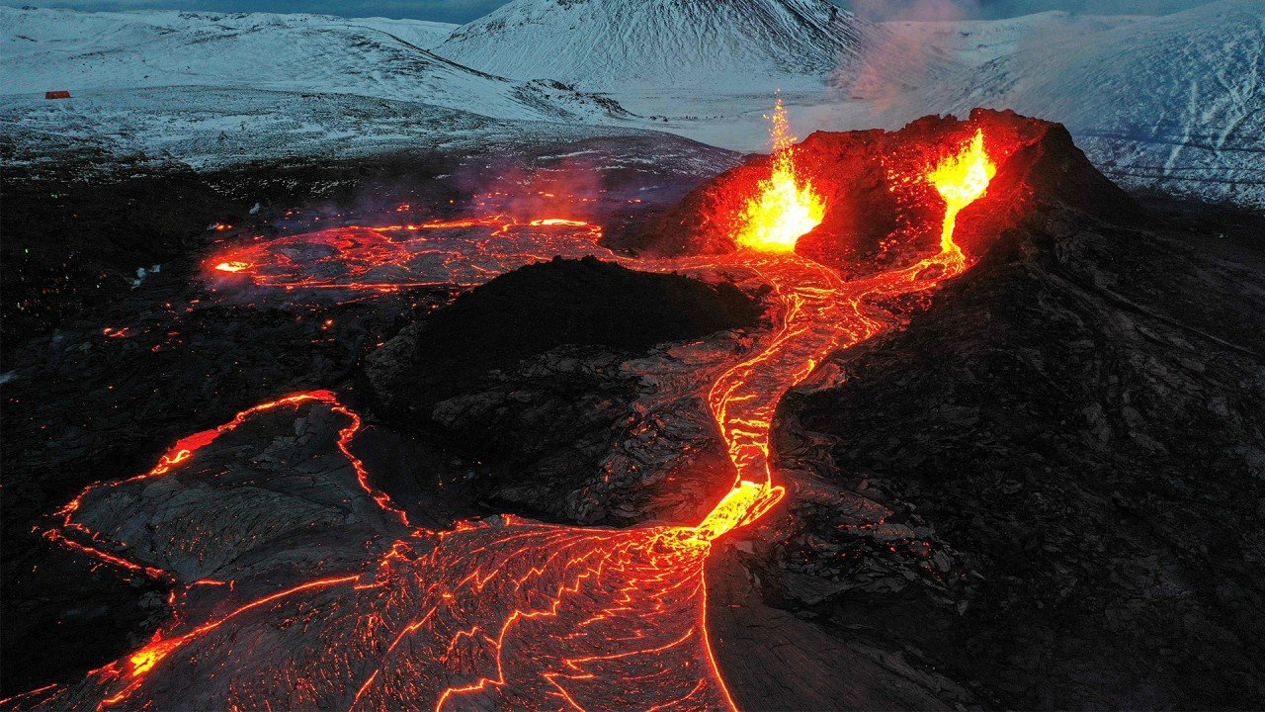
Highlights of Energy Research and Innovation in Iceland
Jónas Ketilsson <jonas.ketilsson@os.is>

Slide 2

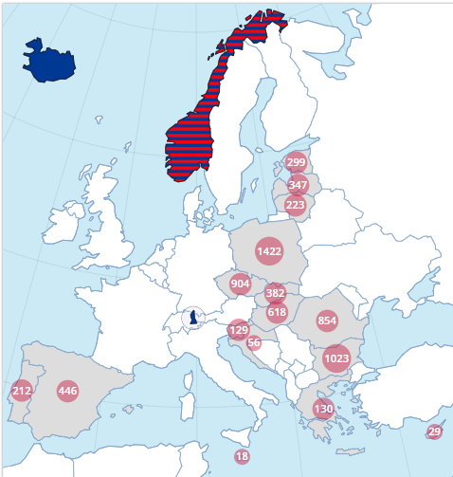
EEA Grants
Orkustofnun became involved as DPP in the previous period (2009-2014).
Focus on geothermal energy and district heating.
2009-2014: DPP in Hungary, Portugal (Azores) and Romania.
Current programme: DPP in energy programmes in Poland, Bulgaria, Romania and Hungary.

Slide 3
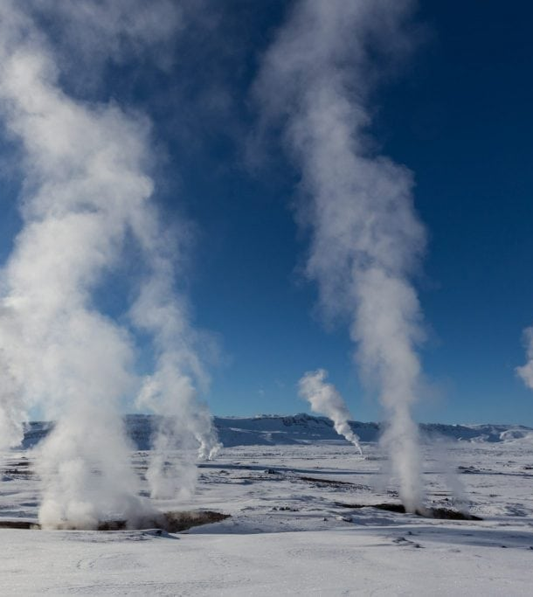
Research and innovation topics in Iceland
Geothermal
  Deep geothermal – super critical
  Better utilisation of Resources – Resource parks
Transition to zero-carbon society and increased energy efficiency
  Off-grid solutions
  Heat pumps
  Hydrogen
CO₂ capture and storage

Slide 4
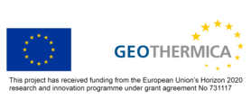
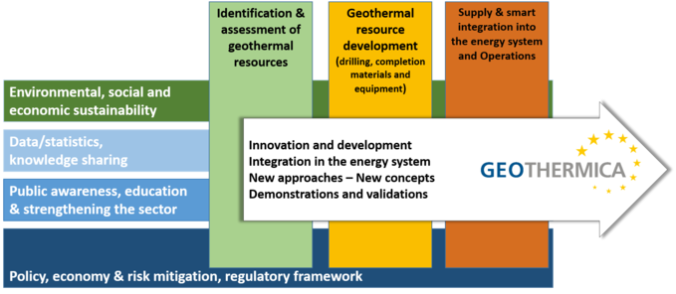
Geothermica
GEOTHERMICA targets innovation in the way geothermal energy supply and integrates into Europe's future energy system. GEOTHERMICA focuses on three technological themes, which cover all stages in the development cycle of a secure, sustainable, competitive and affordable geothermal installation:
  Identification and assessment of geothermal resources suitable for direct use and power generation
  Geothermal resource development (drilling, completion, materials and equipment)
  Supply and smart integration into the energy system and operations
GEOTHERMICA combines the financial resources and know-how of 20 geothermal energy research and innovation programme owners and managers from 16 countries and their regions.

Slide 5
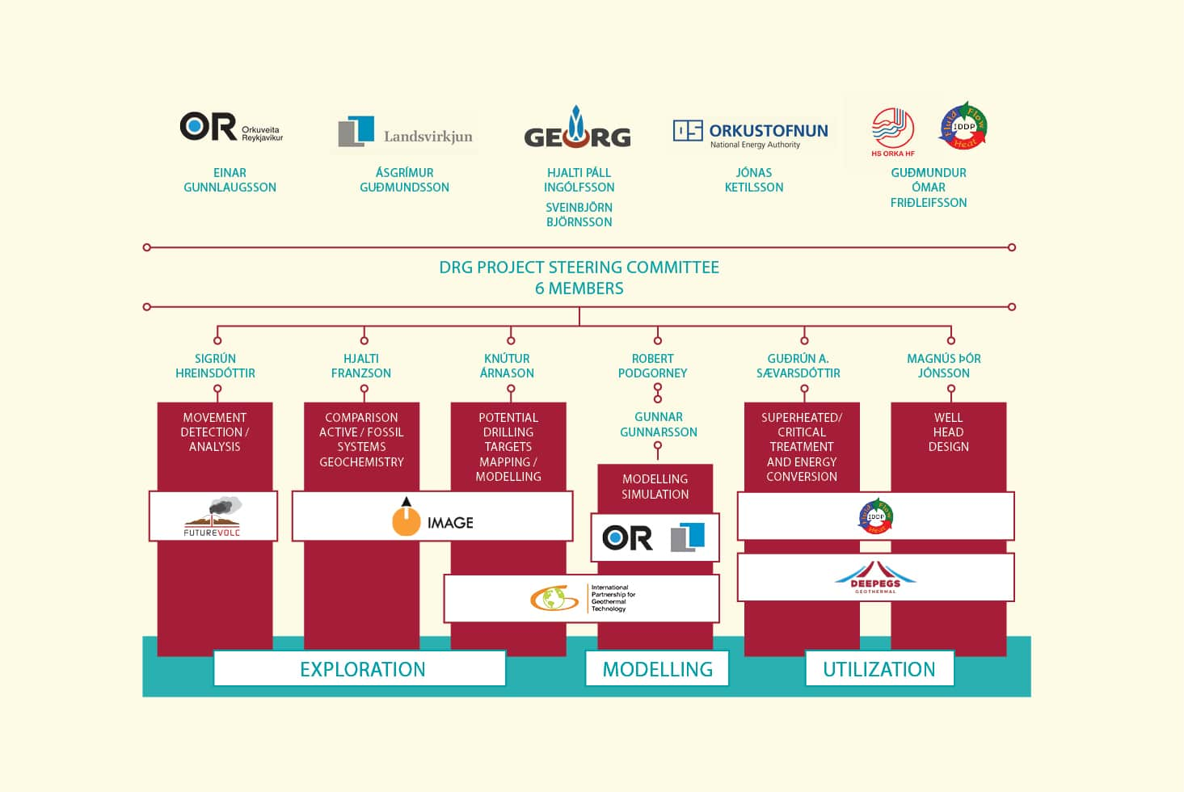
Deep Roots of Geothermal - DRG
The aim of the DRG project is to understand the relationship between water and magma in the roots of volcanoes and how heat is transferred into geothermal systems to maintain their energy.
Furthermore, the design of wells and wellheads for high temperatures will be a focus of the project, as will methods for utilizing superheated steam from greater depths.

Slide 6
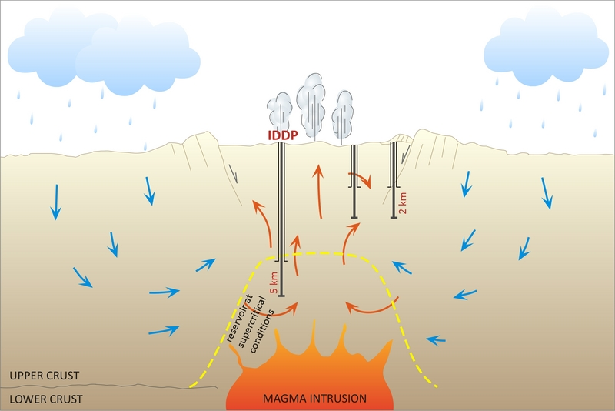
Iceland Deep Drilling Project - IDDP
IDDP was founded in 2000 by the three largest energy companies in Iceland and Orkustofnun.
Goal was to drill 4-6 km into a geothermal system and reach supercritical conditions.
IDDP - 1 in Krafla: abandoned in 2009 after drilling into molten rock.
IDDP – 2 in Reykjanes, completed in 2017. Reached supercritical conditions of 427°C and 340 bars.
Pilot plant in preparation
Made international headlines.
IDDP – 3 planned in Hengill area.

Slide 7
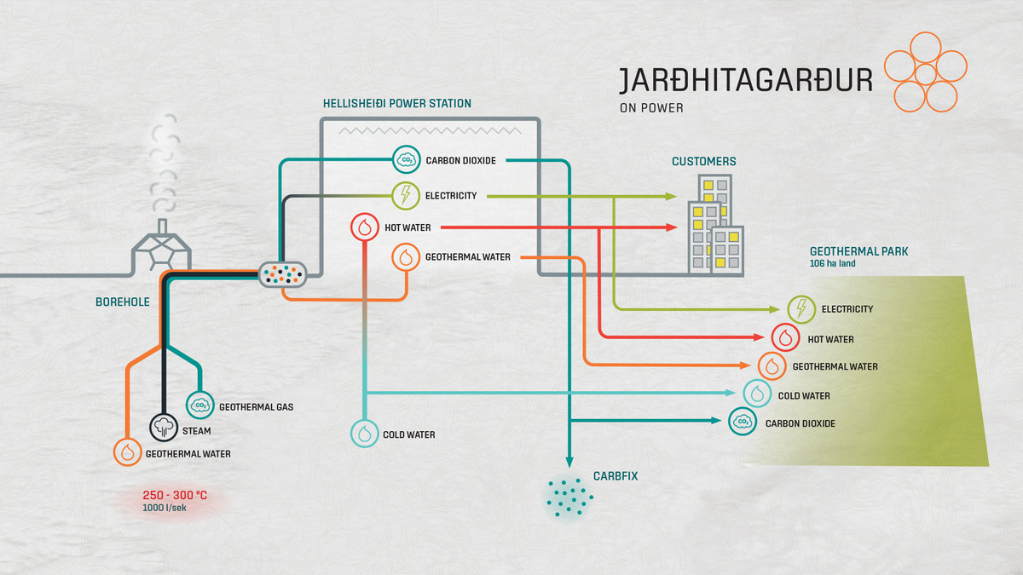
Better utilisation of Resources – Resource Parks
Reykjanes Resource Park at
Svartsengi and Reykjanes Geothermal Power plants
Blue Lagoon Spa
Companies using waste steam and heat for their processes, e.g. fish farming, greenhouses.
Methanol Production using excess CO₂
Generates more income and jobs than the power plants by themselves.
Hellisheiði Geothermal Park
Silica from waste water used for production of supplements and other products.
Hydrogen Production.
CO₂ capture and storage.

Slide 8
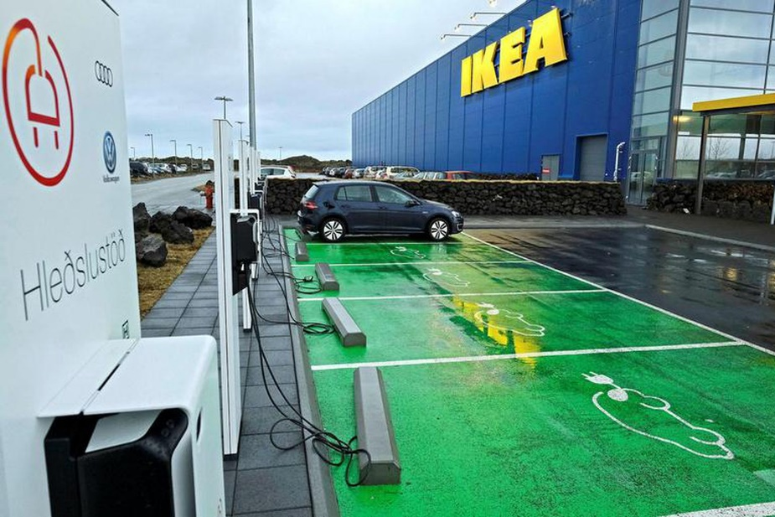
Transition to Zero-Carbon Society - Challenges
The majority of the energy used in Iceland is renewable.
Transport is the major exception, currently around 12% of energy use in that sector is renewable.
Off-grid areas also use fossil fuels for electricity production and heat.
District heating in areas with no access to geothermal energy use curtailable electricity supplemented with fossil fuels.
Back up power is also mostly fossil fuel based.

Slide 9
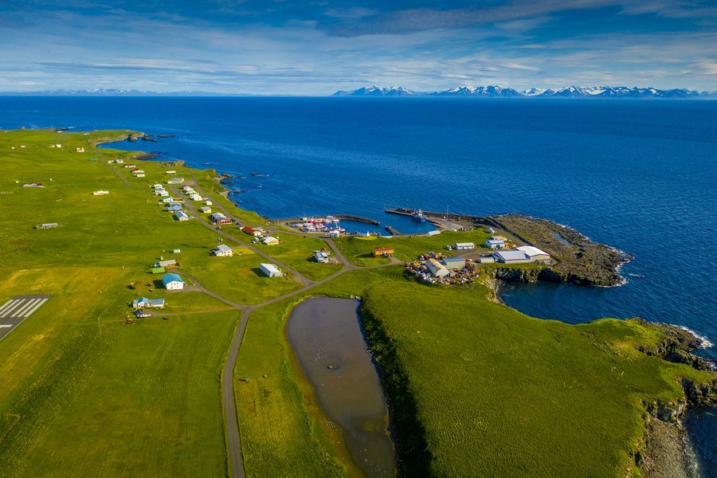
Off-Grid Solutions – Replacing fossil fuels
Energy transition in Grímsey
Island north of the mainland (three hours by ferry). Population ~60.
Use fossil fuels for all their needs.
New project supported by the Energy Fund (managed by OS) will build wind and solar infrastructure on the island.
Heat pumps to be installed for every house.
Grímsey is at the arctic circle, so plenty of sunshine in the summer!

Slide 10
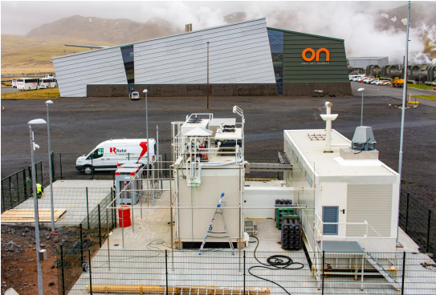
Hydrogen production – Replacing fossil fuels
Energy transition in transport
Iceland is one of the fastest adopters of EVs.
Scientists have looked to hydrogen to replace fossil fuels in heavy and long distance transport.
Iceland has plenty of both water and electricity for electrolysis production of hydrogen.
Pilot plant at Hellisheiði Power Plant uses off-peak power to produce hydrogen for vehicles.
Scale-up can be easily implemented.

Slide 11
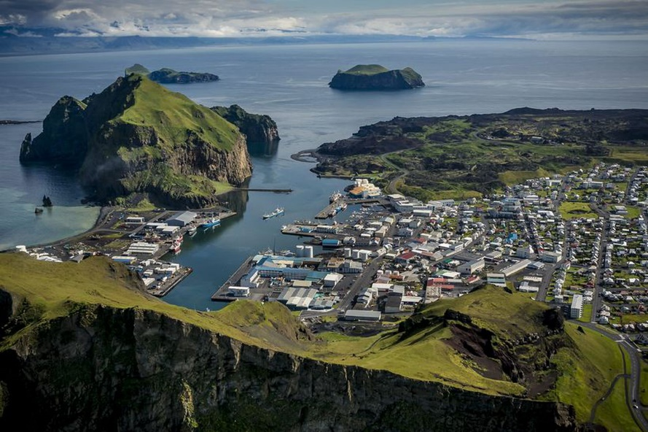
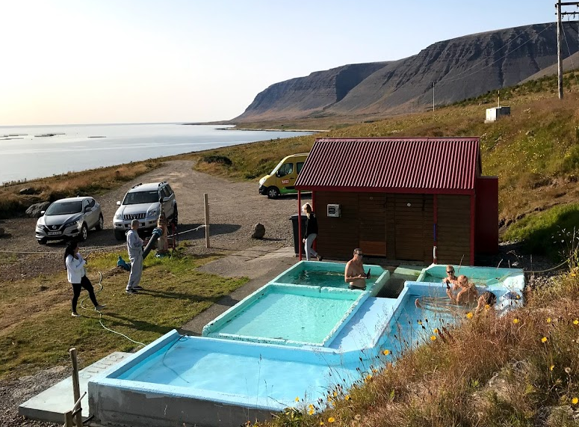
Large scale heat pumps – Energy Efficiency
Vestmannaeyjar
  Isolated heating system on an island (pop. 4500).
  Electrical boiler using curtailable electricity from the mainland, supplemented by oil when electricity was curtailed.
  A 10 MW heat pump that uses 7°C sea water has replaced the old system. Built using public grants in part. 75% decrease in electricity use.
Tálknafjörður
  Existing geothermal well providing plentiful water at 40°C in an otherwise “cold” area.
  Heat pump to be installed to raise the temperature to use for district heating in town (pop. 200).
  Will use 1/6 electricity compared to direct electrical heating.

Slide 12
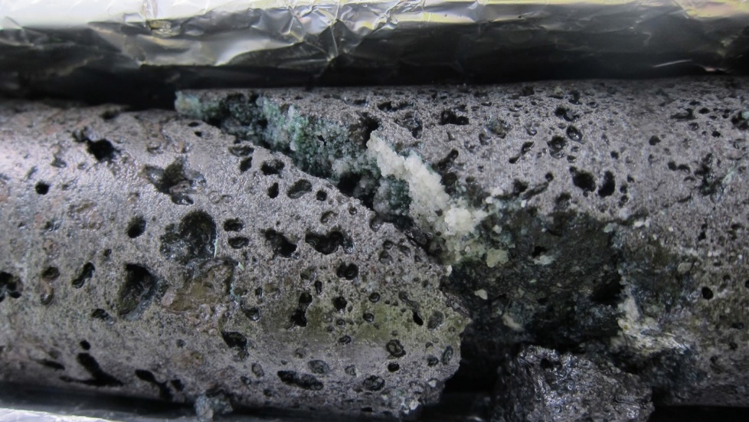
CO₂ Capture and Storage
CarbFix – Turning CO₂ to Stone
Started as a research project in 2006 as a collaboration between Reykjavík Energy, University of Iceland and others.
CO₂ is reinjected with wastewater from Hellisheiði Power Station.
CO₂ is mineralised and permanently stored in bedrock via natural processes in about 2 years.
Faster and less expensive than most CCS technologies on the market.
Requires basaltic bedrock.
CarbFix has been incorporated in 2021 and has plans for a rapid scale up of the technology

Slide 13
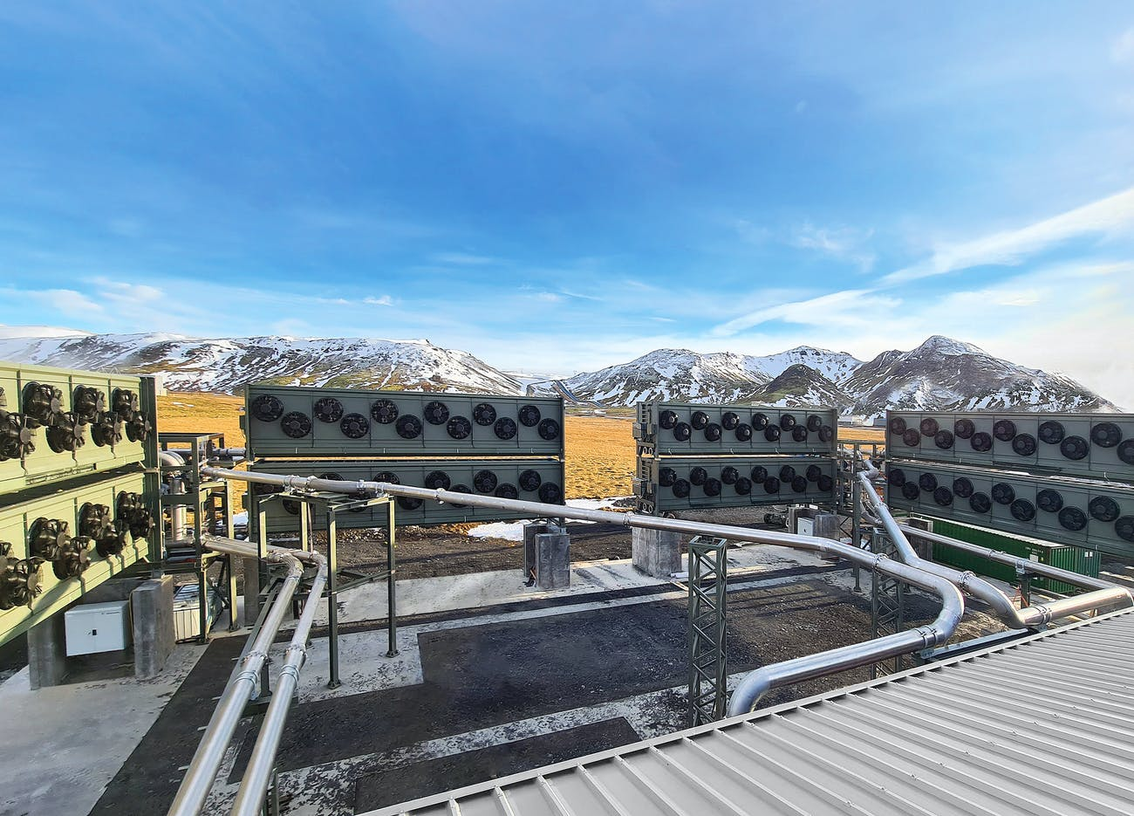
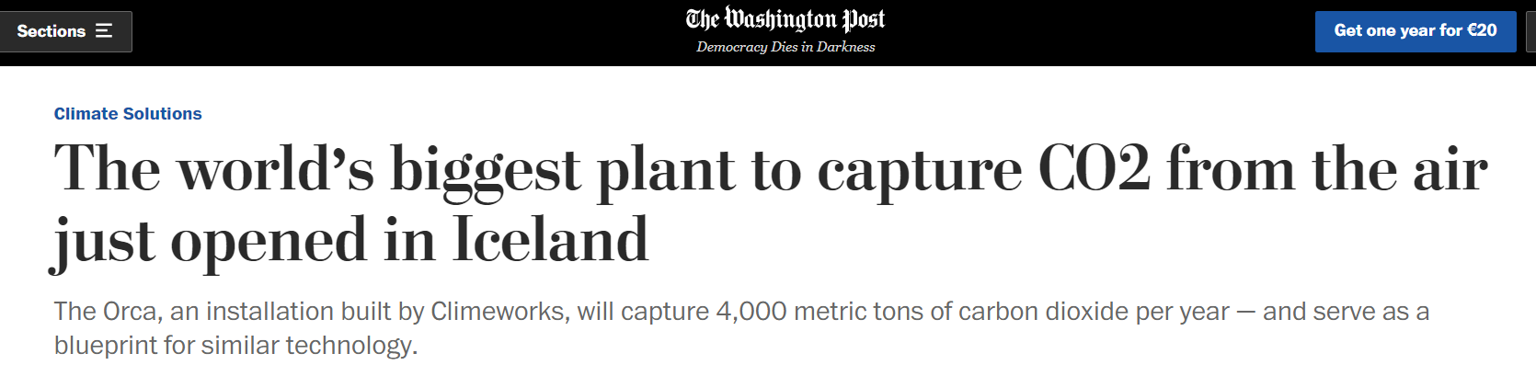
CO₂ Capture and Storage
Capturing Carbon from the atmosphere
Climeworks has installed pilot carbon collectors at Hellisheiði.
Captured carbon is reinjected using the CarbFix method.

Slide 14

How to find partners in Iceland?
Energy Programme: Orkustofnun - National Energy Authority of Iceland
www.nea.is
Research Programme:
Rannís – Icelandic Centre for Research
en.rannis.is
Find a partner in the Foreign Ministry database
https://www.government.is/topics/foreign-affairs/iceland-in-europe/eea-grants/

Slide 15

Thank you
Notes:
Fish farming senegalese sole

