Slide 1
Romanian Research Programme
EEA & Norwegian Financial Mechanism 2014-2021
Monica Cruceru
RO Research Programme Coordinator
17.09.2021 – Energy Programme event – Publishing information

Slide 2
UEFISCDI - PO
RO Research Programme (EEA & NO Grants)
Budget:
€ 55,529,412 (85% grant rate & 15% co-financing)
Call for EEA grants in 2018
Call for NO grants in 2019
2 calls organized
Enhanced performance of Romanian research internationally
Eligible applicants (PPs):
Research organizations established in RO, as defined in the Community Framework for State Aid for RDI (2014/C 198/01)
Eligible partners:
Research organizations and companies
established in RO, NO, IS and LI (in case of EEA Grants call) /
established in RO and NO (in case of NO Grants call)

Slide 3
basic research
Eligible
activities
experimental
development
industrial
research
No of peer-reviewed scientific publications submitted
No of joint to peer-reviewed scientific publications submitted
No of joint applications for further funding
No of jobs created
No of bilateral institutional partnerships between DS and RO entities
No of researchers supported
No of DS research groups involved in projects
No of joint registered applications for IPP
Indicators

Slide 4
Energy
Environment
Health
Social Sciences and humanities
ICT
Biotechnology
Thematic areas
Innovative materials and technologies for energy storage
Energy efficiency within the process of generation, transmission, smart grids distribution and at the consumer/end user
Eco-friendly-environmental technologies for energy production/generation
Energy sources – diversification/balance
Carbon capture and storage (CCS)
KEY TOPICS
42 projects - EEA & NO grants (€ 51,572,636)
(out of 553 eligible proposals submitted)
5 projects funded under ENERGY thematic area (€ 6,145,652)
(out of 64 eligible proposals submitted)
Funded projects

Slide 5
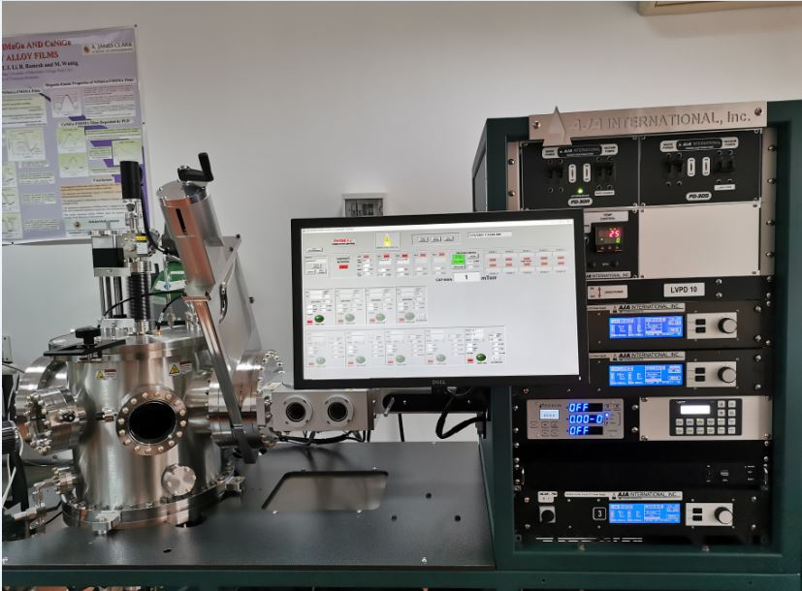
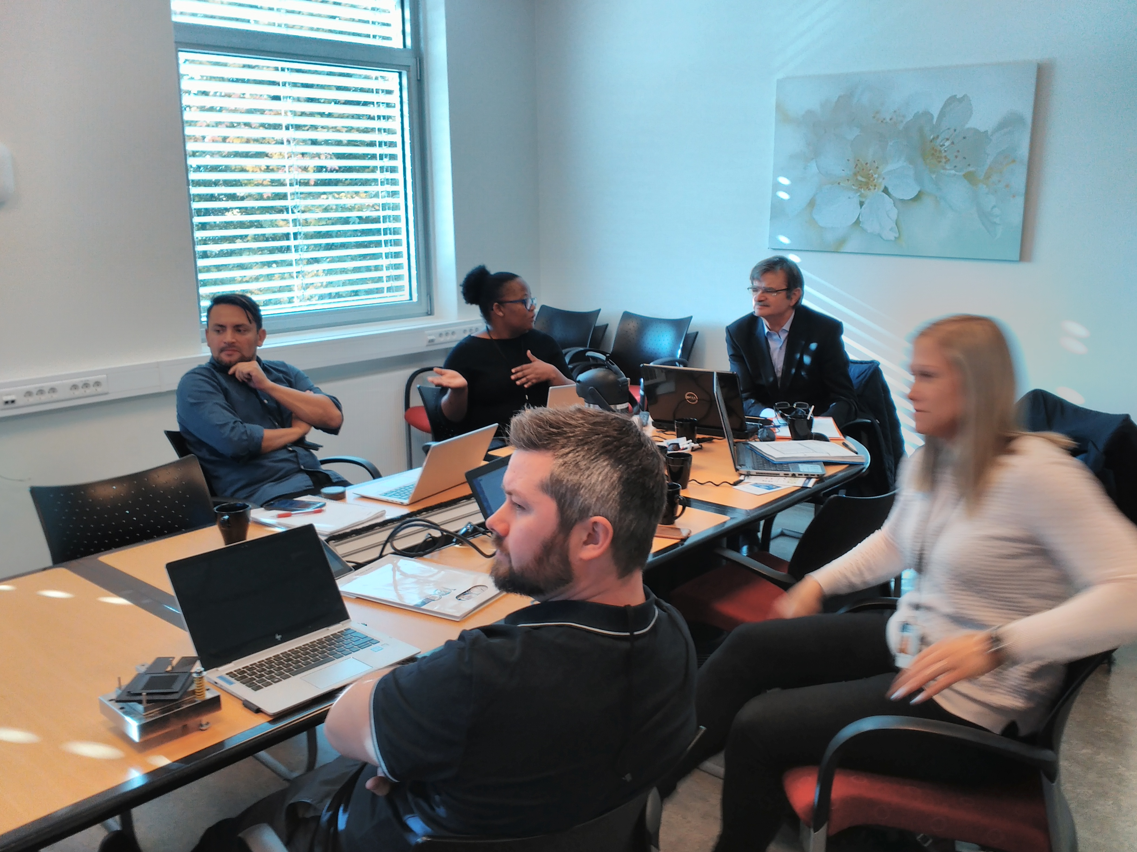
Call for EEA grants in 2018
Combinatorial Design of Novel Bipolar Plate Coatings for Proton Exchange Membrane Electrolyzers
budget: 1.495.151 € (48 m)
PP: Politehnica University Timisoara
Partner: SINTEF AS (NO)
Key topic: Innovative materials and technologies for energy storage
https://www.sintef.no/projectweb/codepem
The Code-PEM project aims to contribute to the development of electrochemical reactors for hydrogen generation, through novel design and implementation solutions, optimized in terms of cost and weight, respectively with an improved reliability of the main component - the bipolar plate of electrolyzers with proton-exchanging membranes.
What is the social impact of the project?
“The development of optimized components for hydrogen generation proposed in the project contributes to the promotion of sustainable, environmentally friendly solutions that allow the replacement of combustion systems with fuell cells based on chemical reactions, which produce only water and heat as reaction products.”

Slide 6
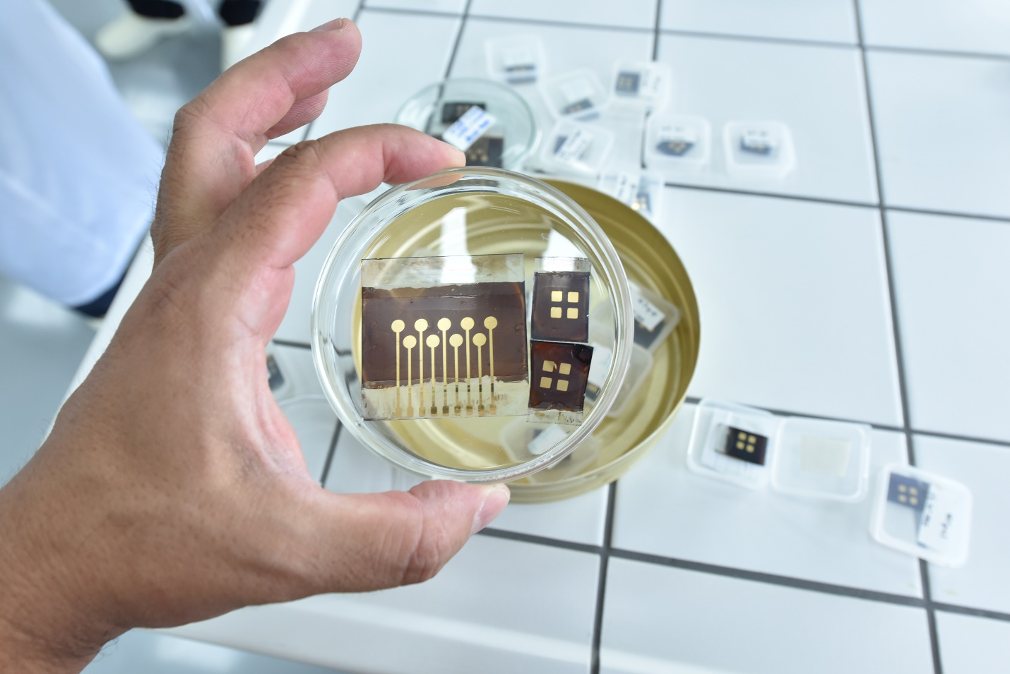
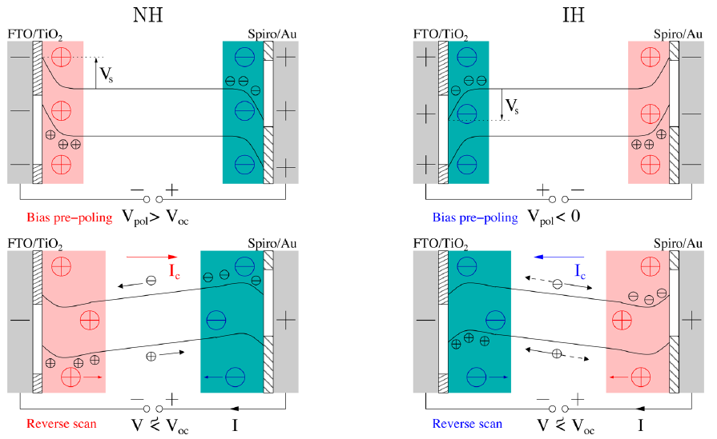
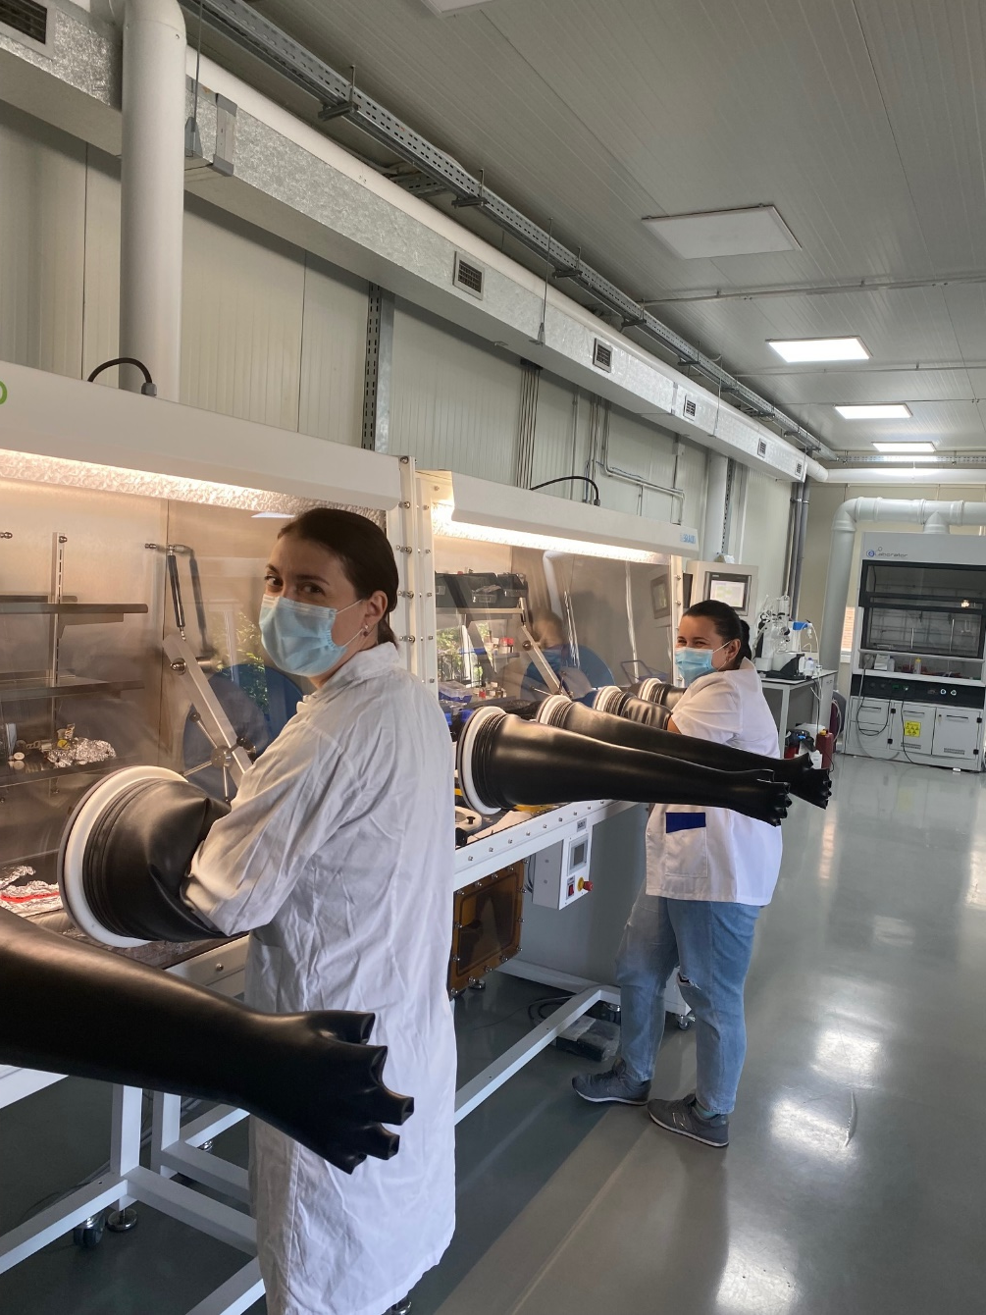
Call for EEA grants in 2018
Towards perovskite large area photovoltaics
budget: 1.164.000 € (36 m)
PP: National Institute of Materials Physics
Partners: University of Oslo (NO)
Reykjavík University (IS)
IFIN – HH (RO)
Tritech Group SRL (WATTROM) (RO)
Key topic: Eco-friendly-environmental technologies for energy production/generation
http://perla-pv.ro
The overall aims/objectives of the project are:
to develop efficient, stable, reproducible standard and inverted perovskite solar cells (PSC) and photovoltaic modules fabricated with affordable large area and environmental friendly technologies, reducing to minimum the pollutants during fabrication process;
to strengthen the knowledge base concerning the application of environmental technology; new knowledge will be acquired regarding how PSCs can be optimized for large scale applications and how can they be fabricated using environmentally friendly technologies with low carbon footprint.
What is the social impact of the project?
"It is expected that by developing stable, low-cost, optimized efficiency photovoltaic panels, the use of these devices in public and private buildings (such as offices, supermarkets, homes, schools, etc.) will be boosted, thus contributing to the increase of the share of renewable energy in the energy balance in Romania and donor states.”

Slide 7
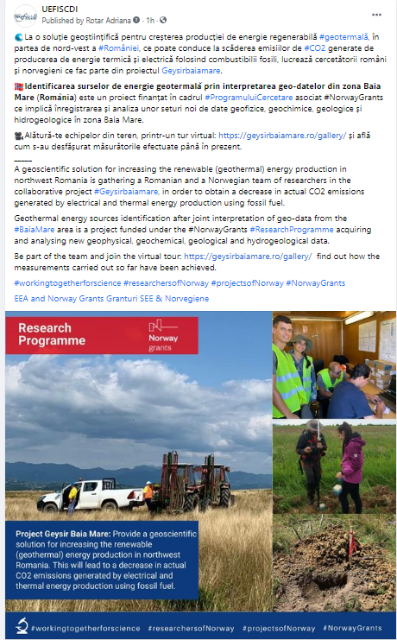
Call for NO grants in 2019
Geothermal energy sources identification after joint interpretation of geo-data from the Baia Mare area
budget: 1.159.956 € (36 m)
PP: University of Bucharest
Partner: University of Oslo (NO)
Key topic: Energy sources – diversification/balance
http://www.geysirbaiamare.ro
The main objective of this project is to provide a geoscientific solution for increasing the renewable (geothermal) energy production in northwest Romania. This will lead to a decrease in actual CO2 emissions generated by electrical and thermal energy production using fossil fuel.
What is the social impact of the project?
“In order to achieve the project goals, new geophysical, geochemical, geological and hydrogeological data have to be acquired and analysed. To do this, we signed research agreements with the local public administration authorities and the landholders located in our study area. The population from the Baia Mare area showed a great interest and support for our research project and for the continuation of geothermal exploration studies in nearby areas.”

Slide 8
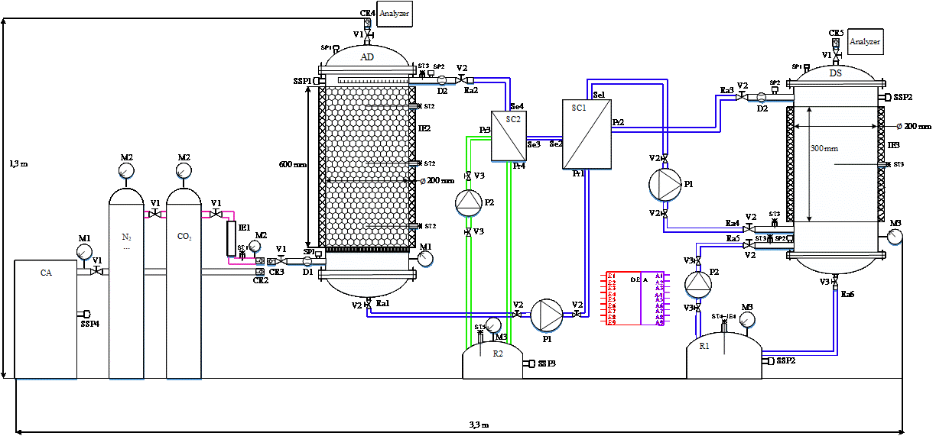
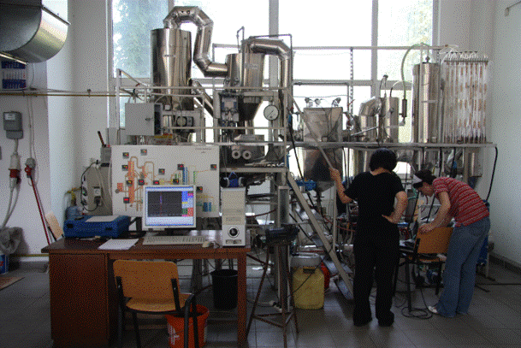
Call for NO grants in 2019
Hybrid Solvent – Membrane for post-combustion CO2 capture and utilization
budget: 1.164.000 € (36 m)
PP: University POLITEHNICA of Bucharest
Partners: Babes Bolyai University (RO)
SINTEF AS (NO)
INCDTIM (RO)
GEOECOMAR (RO)
Key topic: Carbon capture and storage
http://co2hybrid.upb.ro
The aim of the project is to develop a hybrid technology based on CO2 capture using processes based on chemical absorption as well as the use of polymeric or ceramic membranes. Such technology will allow carbon dioxide capture without having a negative impact on the cost of producing electricity or any other product (clinker, cast iron, glass, etc.).
What is the social impact of the project?
“The technology developed under the project can be implemented in energy-intensive industries that generate significant carbon emissions such as the energy, cement, glass or pig iron industries. This will help to reduce the carbon footprint of electricity, clinker, glass or pig iron, etc.”

Slide 9
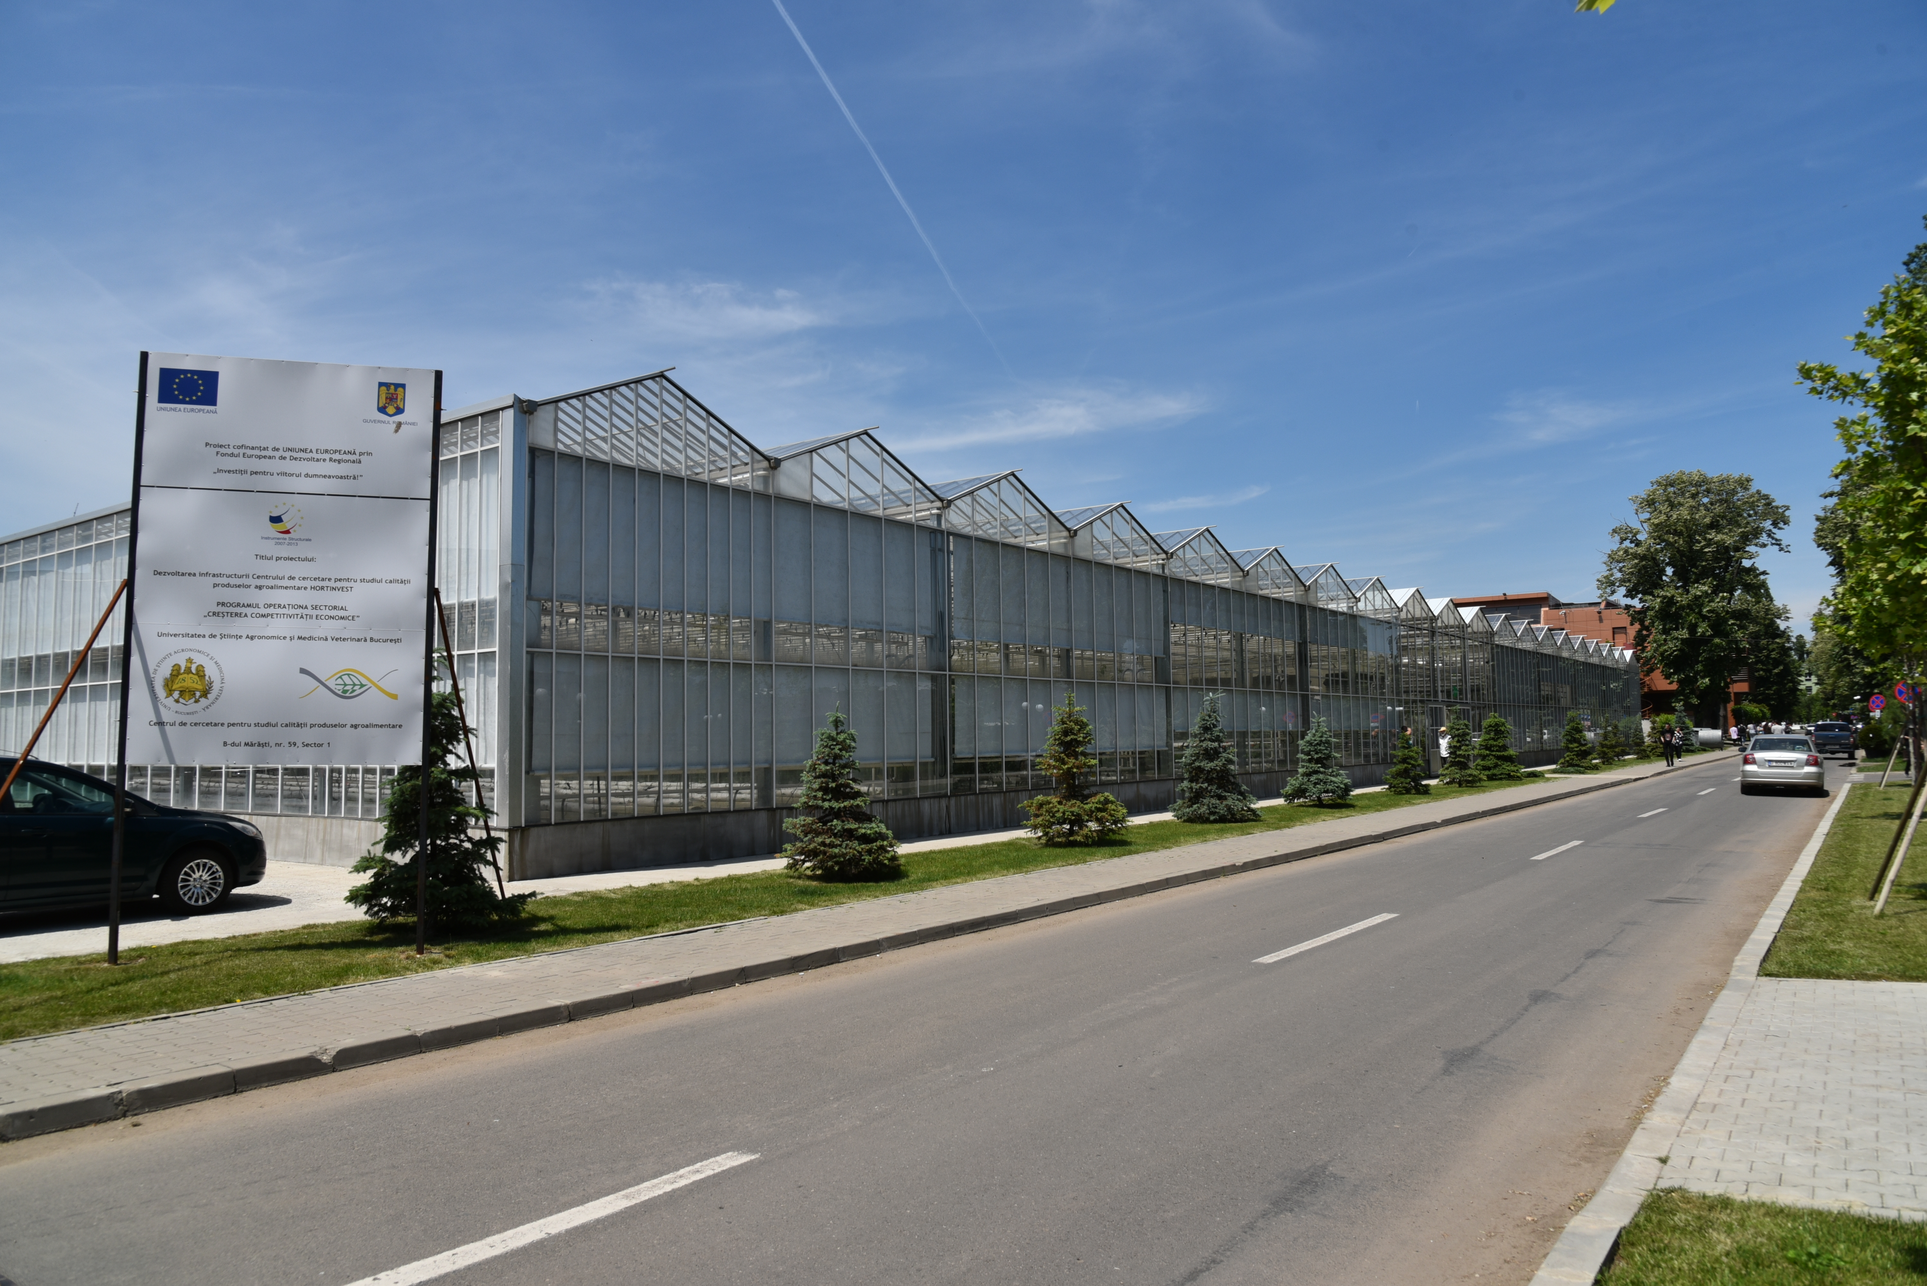
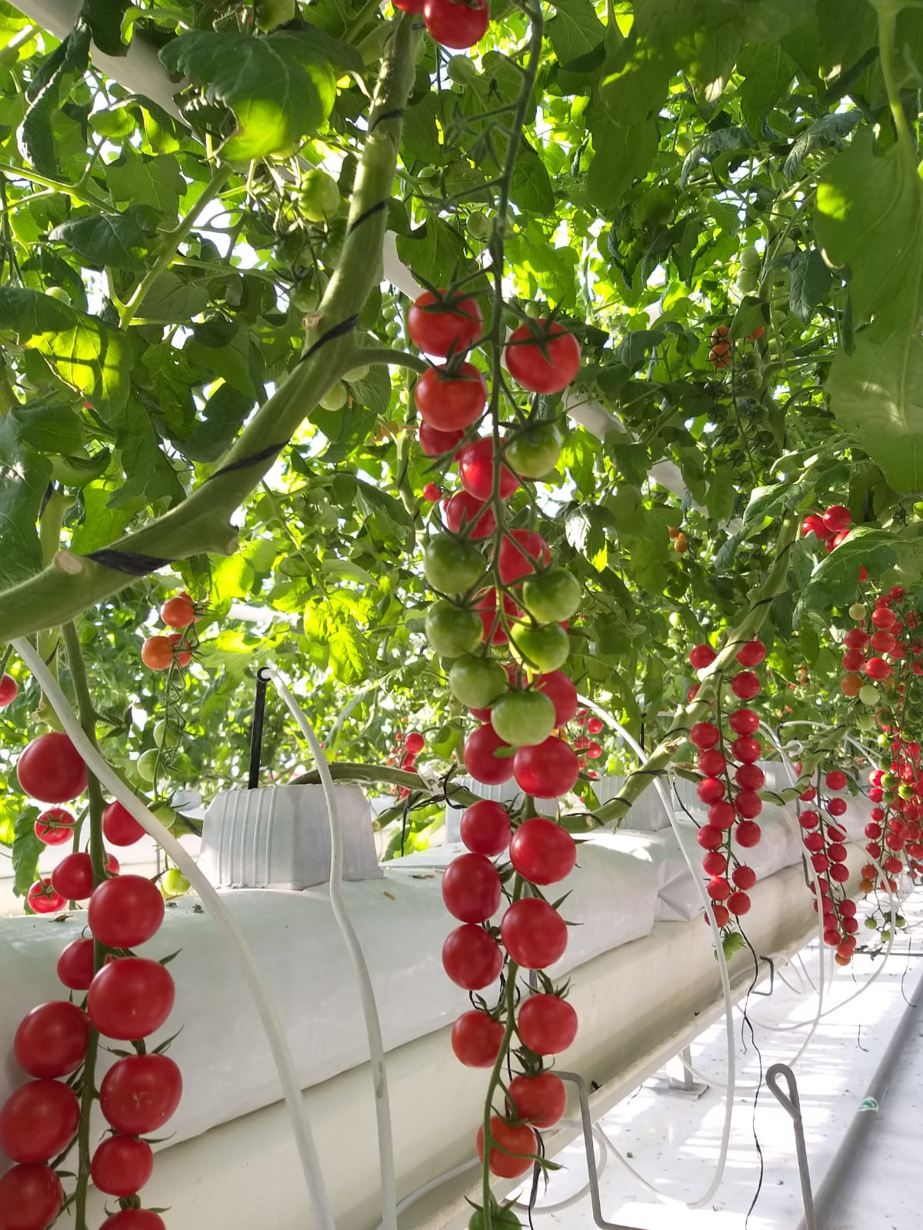
Call for NO grants in 2019
Energy-efficient climate control of a greenhouse for increased productivity
budget: 1.162.545 € (36 m)
PP: University of Agronomic Sciences and Veterinary Medicine of Bucharest (USAMV)
Partners: SINTEF Energy Research (NO)
Gether AS (NO)
Key topic: Energy efficiency within the process of generation, transmission, smart grids distribution and at the consumer/end user
https://www.climagreen.eu
The project goal is to optimize the climatic conditions in glasshouses, minimize the energy usage and demonstrate the potential for heightening the overall productivity of greenhouses in general. The basic idea is that integrated heat pumps provides both heating and cooling to the greenhouse, while controlling the relative humidity. Excess heat from the summer season will be thermally stored for winter usage.
What is the social impact of the project?
“ClimaGreen focuses on building social awareness related to the challenges of clean and energy-efficient operations in food production area. The project will develop and demonstrate a sustainable production system and use it further to improve the educational materials, at different levels. Currently the system of cooling/heating with heat pump system are not used in Romania and by the implementation of this project we expect that the system will become more widely known, available and used, bringing economic and environmental benefits to the farmers.”

Slide 10
Thank you and Good luck!
Info call under Research and Development (2nd of June 2021) – dissemination
Facebook: https://www.facebook.com/uefiscdi
Linkedin: https://www.linkedin.com/feed/update/urn:li:activity:6843783356958720000
Twitter: https://twitter.com/uefiscdi/status/1438018227158802433/photo/1

