Slide 1
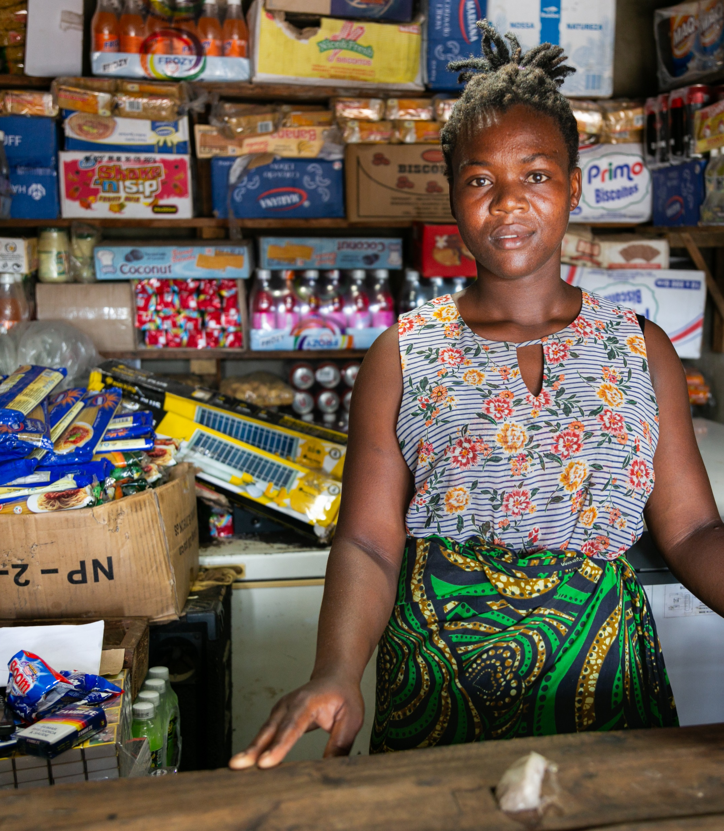
Making Circular Economy Business Models Work in Humanitarian Action
Husk å fylle inn credit

Slide 2
How to use this guidance
This guidance and the supporting tools are an accompaniment to the Innovation Norway report ‘Making Circular Economy Business Models Work in Humanitarian Action’.
This guidance is not intended to be read from start to finish. There are likely to be sections with specific content that you may find relevant. They are designed to be used as standalone content as required. Wherever you start, this guidance will hep you to create better, more effective action in humanitarian context – and critically, with the concept of circularity.
The guidance is designed to be extensible. This means it can be added to and is not considered to be complete. This is a growing knowledge domain, with new case studies emerging every year.
There are four key parts, with sub-sections of content within them. Within each of these, you will find an introductory slide which sets out what you will get from the section and any practical resources included.

Slide 3
Contents
1: Circular Economies: The Basics & Why They Matter
2: Opportunities and Challenges in Humanitarian Contexts
4: Putting Circular Economies into Action
1.1: What is a Circular Economy Business Model?
3: Circular Economy Business Model Strategies
3.1: A range of CE business model strategies
4.2: Design for Sustainably Funded CE Programs
1.4: Revenue Generation and a Summary of Terms
1.3: Value of Circular Economy in Humanitarian Contexts
1.2: A Complete System of Working Parts
2.1: CE Opportunities & Challenges in Humanitarian Contexts
2.2: Assess Circular Economy Needs and Opportunities in Humanitarian Contexts
3.2: Understanding the CE Business Model Diagrams
4.1: Identify and Motivate Collaborative Participants
4.3: Create a Big Picture View of a CE Business Model

Slide 4

1
Circular Economies: The Basics & Why They Matter

Slide 5

This section lays out the basic concept of Circular Economy and describes the three elements you need to put in place to have a successful business model.
Complete System of Working Parts
Ways to Deliver Value
Sources of Revenue
Complete System of Working Parts
Ways to Deliver Value
Sources of Revenue

Slide 6
1.1 – What is a Circular Economy Business Model?
In this section:
You’ll understand the definition of a Circular Economy Business Model
The key elements that make up a CE Business Model will be laid out, providing a framework for the rest of this section

Slide 7

What does circular economy mean?
Circularity economy is about the creative reuse of resources.
It’s a way of getting more out of materials and products that are already in use. This minimizes waste and maximizes value, and reduces the need to extract and use ever-more resources.
What is a circular economy business model?
A circular economy business model is a system that delivers circularity. It’s like an engine that allows you to reuse resources in a way that is sustainable and effective over time. It figures out how to make your circular economy function out in the real world.

Slide 8

Knowledge about Circular Economies is growing around the world. A wide range of new programs are being driven by the need to make resources go further and by urgent challenges like climate and ecological crises. This video is an example of how people are making a case for Circular Economies:

Slide 9
The Three Essential Parts of a Circular Economy Business Model
A System of Working Parts – A complete Circular Economy program is a system with multiple interconnected parts. It’s a lot like a car. All the parts must be put in place and work together for the system to operate.
Creating Value – For people and organizations to embrace this system it will be necessary to create meaningful value. This is what ‘sells’ the CE program.
Revenue Generation – There needs to be a way to pay the bills. Even a truly valuable CE program can’t survive without a source of revenue.
A working Circular Economy Business model has three key elements.
You must find a way to put each of these in place to have a sustainable and effective program.

Slide 10
1.2 – A Complete System of Working Parts
In this section:
You’ll see how working Circular Economy programs are ‘systems’ with many interconnected parts
This illustrates the kind of complete system you will need to create when setting up a CE business model

Slide 11
Putting Together All the Parts for a Working System
A business model combines people, resources, and tools to create value. Let’s look at a simple example, a street corner tea cart to see how this works.
Our tea cart creates value by consistently offering quality tea to customers, in exchange for payment.
The business model system (right*) shows how multiple pieces must together to deliver that hot tea to customers: people, equipment, location, resources, and money. Each part needs to be connected and work together.
For the tea cart operation to work, all the parts must be in place. Not even one part can be omitted. For example, if one morning the vendor finds they are out of fuel, there won’t be any tea to serve.
*See the annex slide for an explanation of how to read and use the diagrams in this toolkit

Slide 12
A Real-World Example of a Complete CE System
Here is an example of a real-world Circular Economy system that collects plastic from a large refugee camp, processes the material, and then sells it to a bulk plastic buyer.

Slide 13
1.3 – Value of Circular Economy in Humanitarian Contexts
In this section:
You’ll see ways to make the case for why circular economies are particularly relevant to humanitarian contexts.
You can use these sources of value to convince others to support and participate in a circular economy program*

Slide 14
Four ways to make the general case for circular economies
Regulatory compliance
Income-generation
Around the world, policies that promote CE practices are becoming increasingly common. For example, there are bans on single-use plastic items, incentives which promote sustainable design, and rules that extend the producer’s responsibility to enable the repair or disposal of their products.
Adopting CE practices can be an important way of complying with regulations, benefit from incentives, and build an organization’s reputation as a responsible world actor.
CE can support local economic opportunities – it can provide a basis for jobs and skills training, as well as income-generating opportunities.
Common CE practices such as product repair, refurbishment, recycling and improving waste management create jobs within local communities.
A single CE program can deliver value in all four of
these areas. So, CE can be Win-Win-Win-Win.

Slide 15
Making the case for CE in a humanitarian crisis context
CE strategies are a growing part of the Humanitarian actors’ toolkit for dealing with complex crises. Humanitarian crisis contexts present complex challenges which can be addressed with CE strategies. Here are five ways that you can make the case for CE in humanitarian action:
1) Livelihoods / economic empowerment: Those living in refugee camps and other crisis contexts often face limited economic opportunities and difficulty developing their economic resilience.
CE strategies can create opportunities for crisis-affected people to build new skills, gain employment or create small businesses or undertake activities that generate income.
2) Community resilience: Humanitarian responses to crises often implement global approaches that are not led by the local community. Aid actors may bring in supplies that undermine local capacity.
CE strategies can build on local capacity by creating systems that are less reliant on new international inputs, and that help communities to become build resilience and act with greater agency.

Slide 16
1.4 – Revenue Generation and a Summary of Terms
In this section:
You’ll see the need for revenue generation and the range of options.
We summarize the key terms related to business models.

Slide 17
Revenue Generation - Funding Needs, Strategies, and Sources
Revenue generation is needed to implement and operate a working CE business model. Each source of revenue has three key elements.
1. Funding Need – This is why you need the funding. The to main reasons are capital investment and operating funds.
Funding Strategy - This is how you plan to obtain the funding. For example, you may sell products to a customer, or you might receive grants from donors
Funding Source(s) – These are the people or organizations that support the business model with money or resource
Many organizations have multiple combinations of funding needs, strategies, and sources. Sometimes this is because they are supporting different business activities (e.g. piloting a new innovation or operating a tested service). In other cases, a single CE business model might be supported by several different financial strategies (for instance, a social enterprise might supplement commercial sales with donor grants).

Slide 18
CE Revenue Generation – Multiple Needs
It is common for Circular Economy programs working in complex humanitarian contexts to have multiple needs for revenue. Here’s a high-level diagram of a circular economy business model that turns waste into energy. Note that the purple boxes that show multiple spots in the system where revenue is required.

Slide 19
CE Business Model - Key Terms
Here’s a summary of the concepts that are key to creating a successful Circular Economy Business Models.
Revenue Generation | This how you pay the bills. You will need funding for both up front ‘capital’ expenses to buy things like equipment. You will also need to have consistent operational funding to pay for things like salaries and supplies. Different types of funding strategies and funding sources may be used in a single CE program to cover these costs.
Business model | A business model is a system that makes a CE strategy work. You develop it so that you can set up and operate a complex CE program in the real world. Your business model provides a plan that shows how all the elements come together to successfully create value and pay the bills in a consistent and sustainable way.
Complete System | Your business model will have multiple people, organizations, resources, and equipment that all come together to make the CE system work from start to finish. Your job is to design and implement this complete system, so that all the parts work together over time.
Value | Refers to the benefit that is created and delivered for stakeholders. Creating value is why you set up a circular economy program. This is how you convince people to support and participate in your CE program. In the context of CE there are a many potential sources of value: economic, environmental, and social worth.

Slide 20
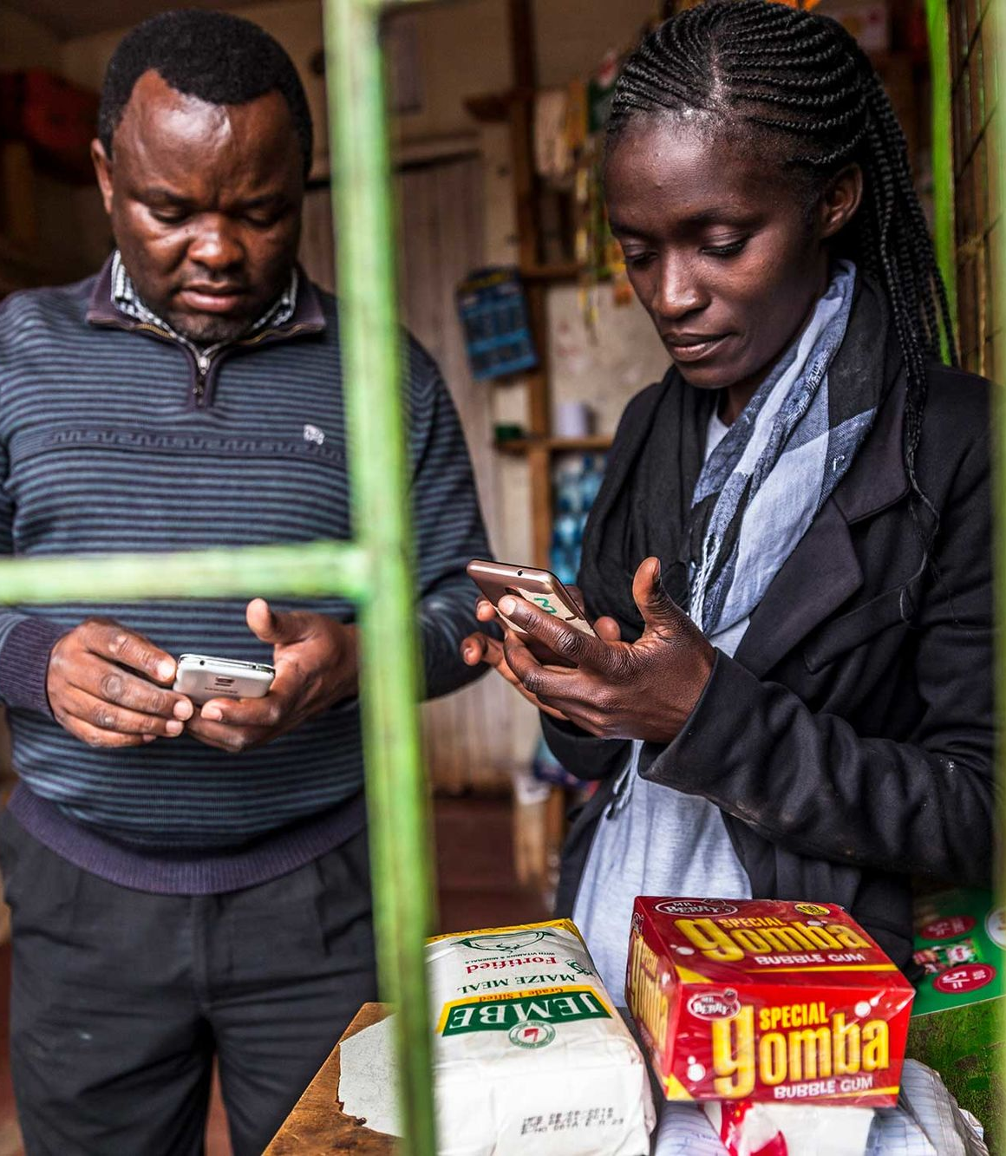
2
Circular Economies: The Basics & Why They Matter

Slide 21
Assess Circular Economy Needs and Opportunities in Humanitarian Contexts
Circular economy business models bring together a variety of different elements. For example, they require:
Important Problems: To justify a circular economy system there must be an important problems that can be addressed.
Capacity to Act: Organizations and people are needed to perform CE tasks. Who is available to be developed and trained to do the needed work?
Available Resources: The types of resources (e.g. type of waste) will also drive the type of CE system you build.
Motivations: What kind of motivations and reasons for action do people have?
Begin work by assessing both needs and opportunities to guide your Circular Business Model design.
Refer to TOOL 2.1 – CE ASSESSMENT KICKOFF
This tool provides an initial list of questions to explore when assessing a humanitarian or development context for Circular Economy needs and opportunities.
Don’t stop here! As you learn more about your context and begin to consider specific CE strategies (see the next section), continue to engage with local actors and communities to build out a more complete picture.

Slide 22
2 – Assess Circular Economy Needs and Opportunities in Humanitarian Contexts
In this section:
You’ll use the Humanitarian Project Cycle to breakdown ways to think about applying circular economy strategies
You’ll access a tool to uses the Humanitarian Project Cycle to think stage by stage about how to integrate CE possibilities into an existing program.

Slide 23
Integrating CE Strategies into Humanitarian Programming
Needs assessment & analysis
Strategic planning
Resource mobilisation
Implementation & monitoring
Review and evaluation
Circular Economy programs don’t have to sit outside of the rest of humanitarian planning and delivery.
CE should be seen as a strategic capability that can be integrated with the planning and delivery of other support to affected people.
The familiar “Humanitarian Program Cycle” can be used as a starting framework to consider ways to integrate Circular Economy initiatives into planning and delivery of services.
Use TOOL 2.2 – INTEGRATING CE to start exploring these integration possibilities.
Humanitarian Program Cycle

Slide 24
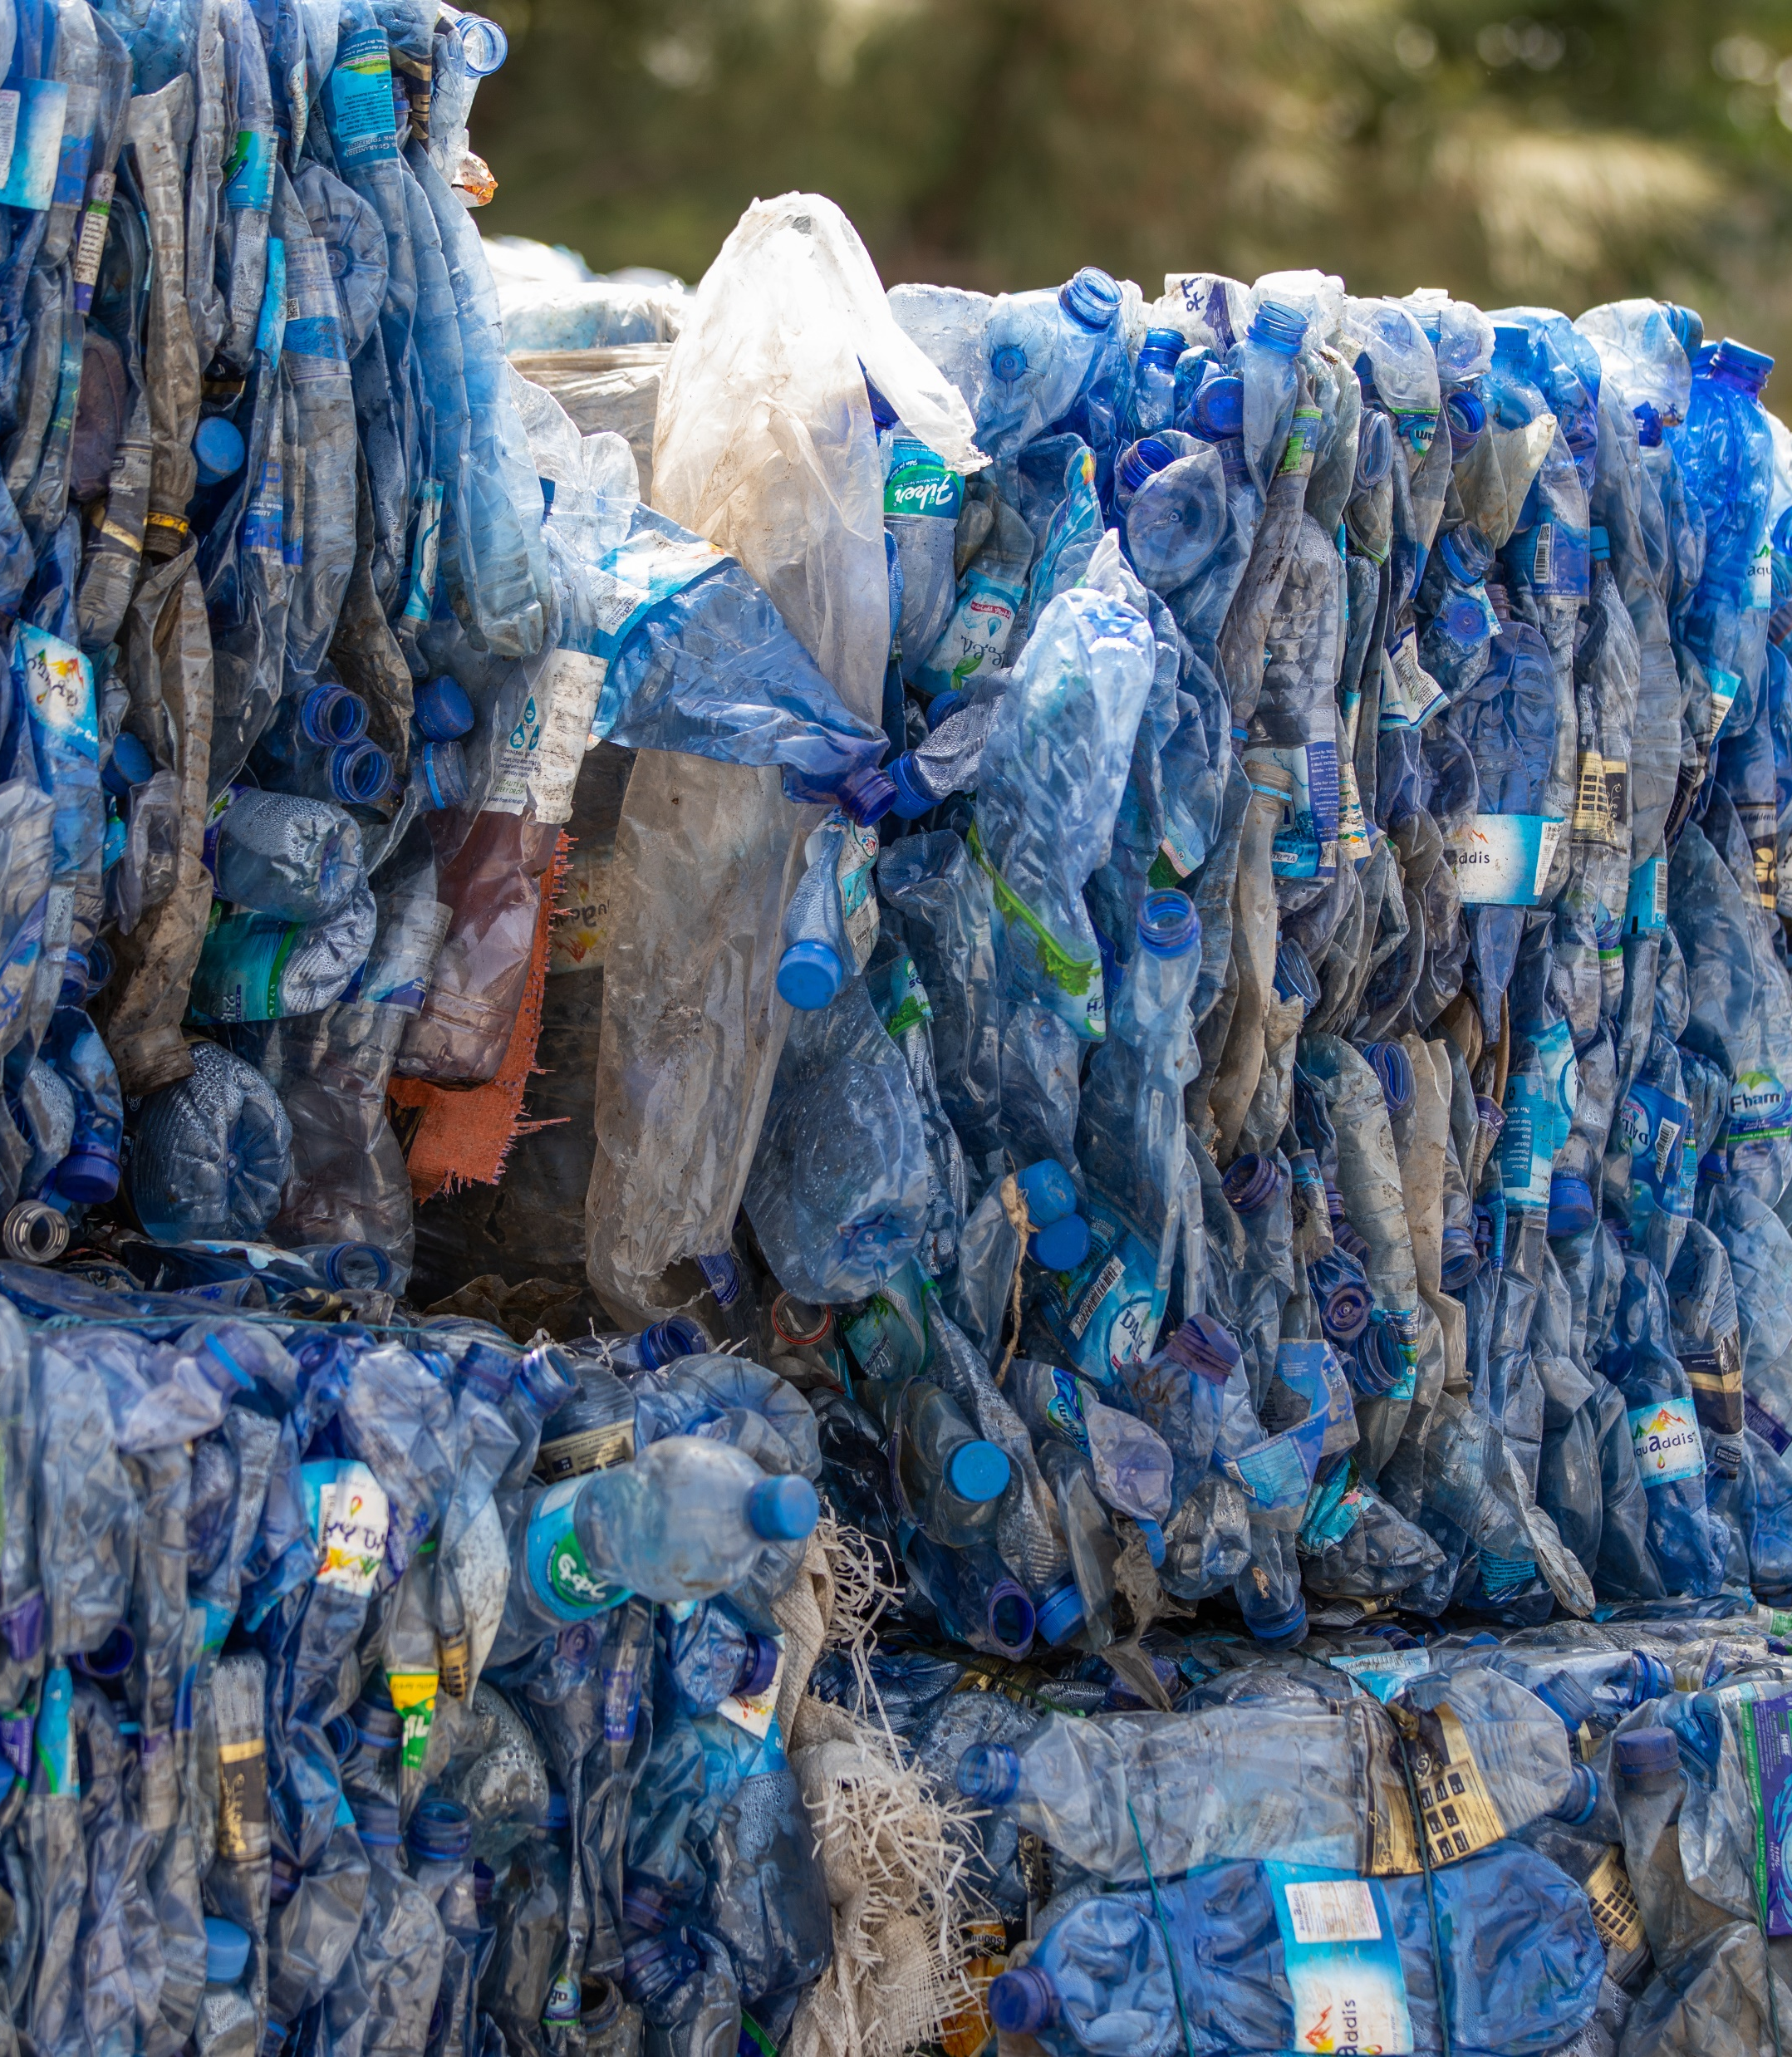
3
Approaches to Circular Economy Business Models

Slide 25
3 – Assess Circular Economy Needs and Opportunities in Humanitarian Contexts
In this section:
You’ll learn about five major types of CE business models.
You’ll see a big picture view of how each of these systems works.
You will get additional information on each business model strategy that can help guide your choice.

Slide 26

A Range of CE Business Models
While there are many variations of CE Business Models, there are five major business model strategies that are common and most relevant to humanitarian contexts.
Each CE Business Model requires the creation of a system with a variety of different parts. For the business model to be successful, all the parts of the system must come together to deliver one or more sources of value.
The business models are not mutually exclusive. In a single context, more than one strategy can be implemented and connected together. You can find summaries of each of the five business model strategies in TOOL 3.1 Business Model Overviews.
You can find summaries of each of the five business model strategies in TOOL 3.1 Business Model Overviews.

Slide 27
Overview of Five Major CE Business Models
Business Model System | Goal
1) Effective waste disposal | Handle waste that is produced in such a way as to minimize environmental impact and removal of materials from potential future use.
2) Directly using local waste | Transform waste into a standard form that can be directly used as a resource by local families, communities, or others.
3) Recycling industrial feedstocks | Generate value from collected waste by recycling it into industrial feedstock.
4) Upcycling with product entrepreneurship | Creating valuable new products that ‘upcycle’ the waste materials.
5) Reducing Waste through durability, reuse, repair | Reduce waste production by improving product durability and repairability.

Slide 28
3.2 – Understanding the CE Business Model Diagrams
In this section:
You’ll learn how to understand CE business model diagrams – all the component elements and their connections.

Slide 29
Understanding the CE Business Model Diagrams
The blueprint diagrams in this section of the toolkit use a consistent color coding to identify the different parts of the system:
Actions and Actors (Yellow Boxes) – These are the main steps and activities in the CE process.
Waste and Outputs (Gray Boxes) – The waste input into the process and the materials produced.
Other Resource Inputs (Green Boxes) – Other resources that must be input into the CE process (e.g. fuel).
Funding (Purple Boxes) – Funding for either capital purchases or ongoing operations.
Additional Benefits (Orange Boxes) – Additional benefits such as providing livelihoods, reducing health risks, or delivering environmental benefits.
Value Created (Black Boxes) – These are the points where the system delivers value.

Slide 30
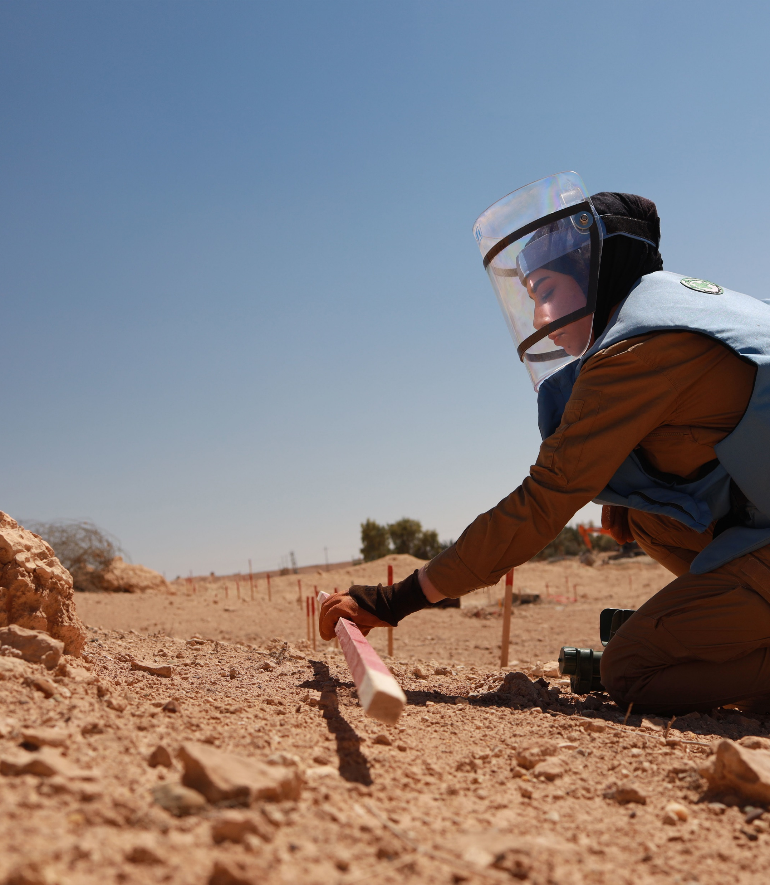
4
Putting Circular Economies into Action

Slide 31
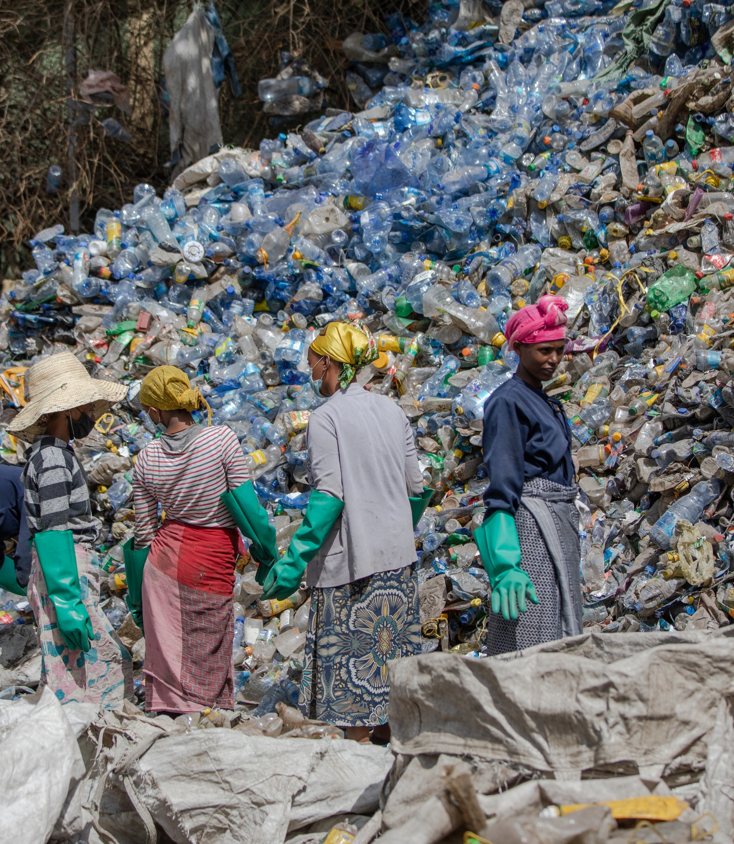
Circular Economy Business Models: Putting Into Action
This section lays out the basic concept of a Circular Economy and describes the three elements you need to put in place to have a successful business model.
Complete System of Working Parts
Ways to Deliver Value
Sources of Revenue
Innovation Norway

Slide 32
4.1 – Identify and Motivate Collaborative Participants
In this section:
You will learn about the importance of collaboration and broad participation in CE business models.
You’ll identify the needs and motivations that will enable you to engage your key participants.

Slide 33
Identifying Participants in a Collaborative CE Program
All CE business models operate as systems, with different actors connected together, carrying out different roles.
Your program may have a variety of different participants. It’s important to identify who these actors are and the roles you want them to play. The table in TOOL 4.1 – Participant Inventory and Insights can help you record a complete list.
Here are some examples of potential participants:
Participants | Role in Program | Needed Actions / Skills / Resources | Motivations for Participation
Informal waste pickers | Labour to collect and sort waste | Need to identify individuals currently in this role and provide training. | Direct payment for labour / Reliable income Training for skills development
Local government authority | Local subsidies License granting | Need to qualify for subsidies and licensing | Formal governmental role Improved local environment and waste management
Truck manufacturer / distributer | Provides specialized trucks and purchase finance arrangements | Need to determine type of trucks and qualify for financing | Direct payment for trucks / loans Opportunities for expansion / new markets Reputational gains
Product customer | Purchases household products made from recycled plastics | Need for marketing and persuasion that the product is functional and good value | Want the value created by the product (it solves an important problem) and the product is easy to use & affordable.

Slide 34
4.1 – Identify and Motivate Collaborative Participants
In this section:
You will explore different types of funding requirements and types of funding sources.
You will develop a high-level view of the costs and revenue sources associated with your program.

Slide 35
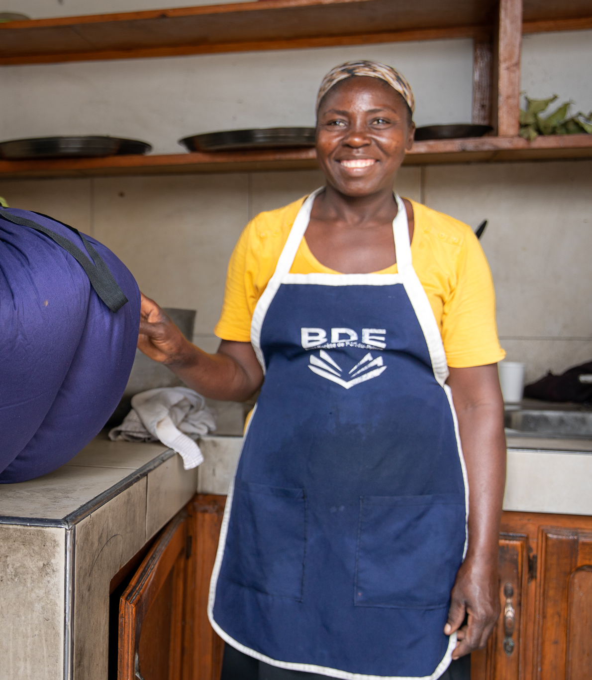
Two Types of Funding Requirements
A successful Circular Economy Business Model must be able to fund its varied participants, equipment, and operational activities. Your funding requirements will come in two forms.
Capital costs: These are one-time charges that pay for equipment and other investments needed to create a working CE program. Capital funding might be required for a single elements (such as a repair center, a waste collection truck or a biogas unit) or multiple elements (such as home-based energy production units).
Operating Costs: These are the ongoing costs of implementing the business model system. These costs may include paying workers, rent, fuel, storage and and repayments on loans if they were used to cover capital costs.

Slide 36
Varied Options for Funding Capital Costs
Grants
Funding that is normally provided by a governments or donors as an upfront resource and can be used to cover core capital costs.
Funding is not typically required to be repaid.
Aid funders are increasingly investing in initiatives which offer positive environmental impact.
Competition for funding can be intense and comes with conditions relating to how it should be used.
Funding can be unpredictable and not relied upon to be continued.
Loans
Funding typically from a financial institution but with the expectation that the loan will be repaid over time, with a level of interest charged.
Projects may offer potential to generate revenue and attract lenders.
Blended finance arrangements whereby a third organization guarantees a loan by co-funding a project can de-risk and increase attractiveness to a lender.
The complexities and instability of humanitarian contexts can make profit-generating challenging.
Investments
Funding from an investor but with the expectation that the they will receive future benefits from their investment.
Investors who are looking for non-financial returns (e.g. addressing social challenges) may be attracted by CE strategies.
Investors looking for a financial return may be put-off by the challenging risks and economics of humanitarian contexts.

Slide 37
Varied Options for Ongoing Operational Funding
Humanitarian ownership of waste as a ‘core cost’
Look at international and markets outside the aid context
Long-term Government service funding contracts
Customer demand for products
Encouraging humanitarian program managers to consider waste management as a necessary cost.
If waste isn’t seen as ‘free’, then the funds can be used to help fund CE initiatives.
It may be possible to look beyond the local humanitarian context for buyers or markets which are willing to pay for ethical, sustainable products.
Some CE services may attract long-term contracts to deliver government mandates and policy – and receive long term funding. Comes with substantial requirements: strong evidence of impact and performance.
One of the most effective funding models is selling a valued product.
If CE system have customers willing to purchase the products or services, they may be able to operate independently of other institutional funding sources.

Slide 38
4.3 - Create a Big Picture View of Your CE Business Model
In this section:
You will create a ‘big picture’ diagram of your business model system that shows all the parts and participants.
You will consider ways to use the business model diagram to help design and implement your program

Slide 39
Big Picture View of Your CE Business Model
How to Apply Your Visual Model
Lists of participants, activities, and costs help generate ideas for your CE business model.
However, visualizing how these elements connect is crucial for building a complete and successful system
A big-picture view allows you to see all components in one place and understand their relationships.
This visual approach supports key activities and helps communicate your model effectively.
Check Your Business Model: A visual diagram can help you check for gaps in your strategy and see places where parts don’t fit together.
Tell Your Story: When collaborators, donors or new staff ask how your CE program works, you can show them the diagram. Use it to show how all the pieces work together to deliver value. It helps make something complex seem easier to understand.
Show Where People Fit In: A visual picture can also help people and organizations see where they fit into the overall approach.

Slide 40
How to Draw a Picture of Your CE Business Model
Boxes for Things: A simple picture of your CE Business Model can be drawn by putting each key person/role, organization, resource, piece of equipment, and source of funding into a box.
Connect with Lines: Use lines to show how the pieces connect and interact with each other.
Follow the Flow: Circular economy business models have a natural flow of steps. For example, waste materials enter at the beginning, are processed, and finally sold at the end. Draw your diagram to follow the flow.
Some Model Drawing Tips
Fit to One Page: It can be tempting to try and capture every bit of detail in a huge complex diagram. Aim instead for a model that fits comfortably on one page. That will be more effective as a working tool.
Make It Easy to Update: Plan to update your diagram as your strategy evolves. Don’t invest too much in fancy visual design or graphics.
Use Available Tools: You can draw the model by hand on a piece of paper, on white board, or using a software package like Miro, Mural, Visio, or Omnigraffle. Use tools when you can, but don’t let them stand in your way.

Slide 41
A sample CE business model diagram
See more sample business model diagrams in the business model summaries in Part 3.

Slide 42
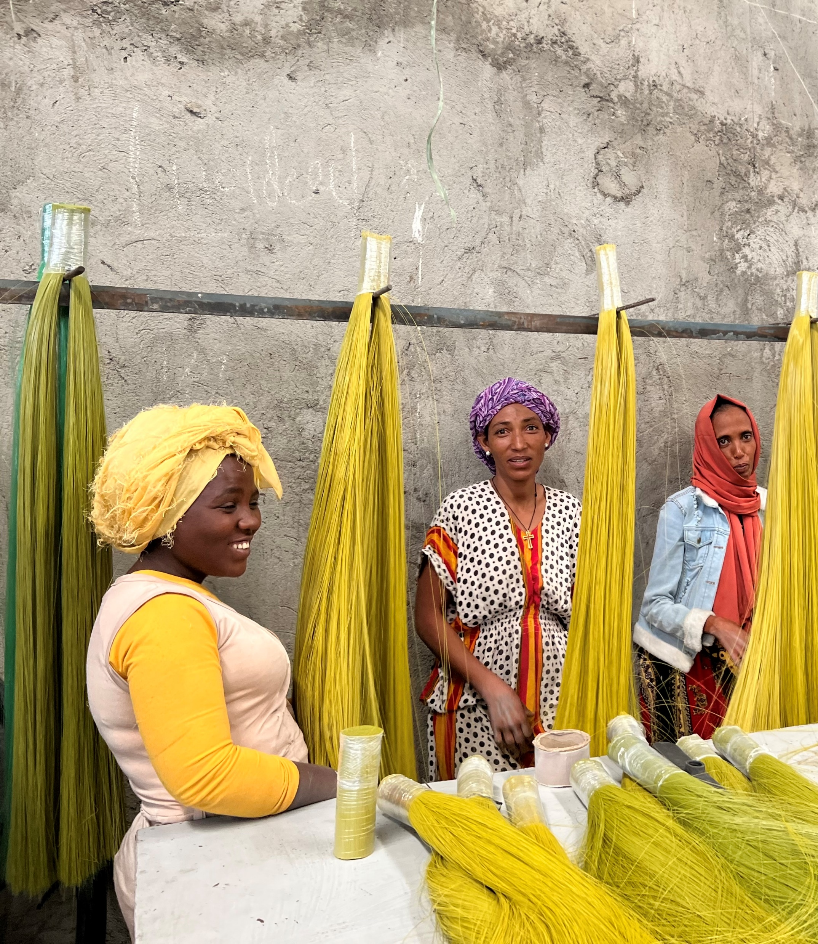
This guidance is a flexible, evolving resource designed to support innovation in humanitarian action. Use it as a practical tool to develop and refine circular economy business models. Explore, adapt, and contribute—circularity is a journey, not a destination.
Thank you!

