Slide 1









Scaling E-Waste and Energy Access
Circular Models project
Uganda, Bidibidi Refugee Settlement
Organization:
International Organization for Migration (IOM)
Project Partners:

Slide 2
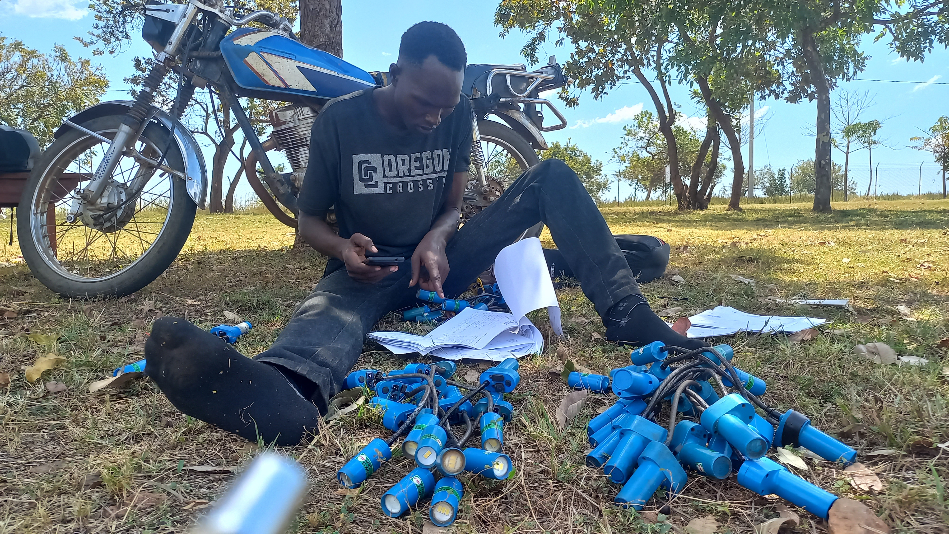






The problem we are solving
The solution:
Community-led e-waste
handling circular
eco-system
75.5 hazardous disposal
57% Dump in bushes, 18.5 Burn it
Trained youths to work
as technicians
81.7% solar waste
Concentrated in lanterns
42% failed repairs
Lack of tools and training
Formal community-led
enterprise established
to manage e-waste

Slide 3






Value Proposition
Users, institutions, and funders/investors
USERS: Refugees And Hosts
System Impact &
Sustainability
Innovation & Shared Value
New skills & jobs:
Training in repair and maintenance
Access to energy
Repair, Second-life products
Cleaner communities
Less toxic pollution
Value for money
Quality repairs and products
SDGS 7, 8, 12, 13, & 17
Affordable Energy,
Decent Work, Responsible Consumption and Production, Climate Action, Partnership for Goals.
Solution adoption
Co-designing and user-feedback
Knowledge sharing
Toolkits, Assesments etc
EPR
Design, Take back, Recycling. Packaging
Access to markets
Customer base, raw materials, supply systems
Research & Design
End-user feedback on product’s quality, usage and recommendations

Slide 4
Evidence & Traction
Impact data, behavioural shifts, system change signals.
Impact & Operational Traction
Behavioral Shifts & Adoption
Systemic Change & Formalization
Transitioned to fee-based repair services entirely managed by the community.
Reduced dumping/burning; increased repair and formal disposal.
Legally registered, community-owned enterprise (30 members).
7,893 solar lanterns repaired and 300 battery packs assembled
Increased women’s participation; 59% of service users female.
Unified refugee and host governance structure.
Generated $1,996; projected $12,968 after certification.
Manufacturer design improvements driven by field feedback.
Integrated informal actors into regulated structure.

Slide 5
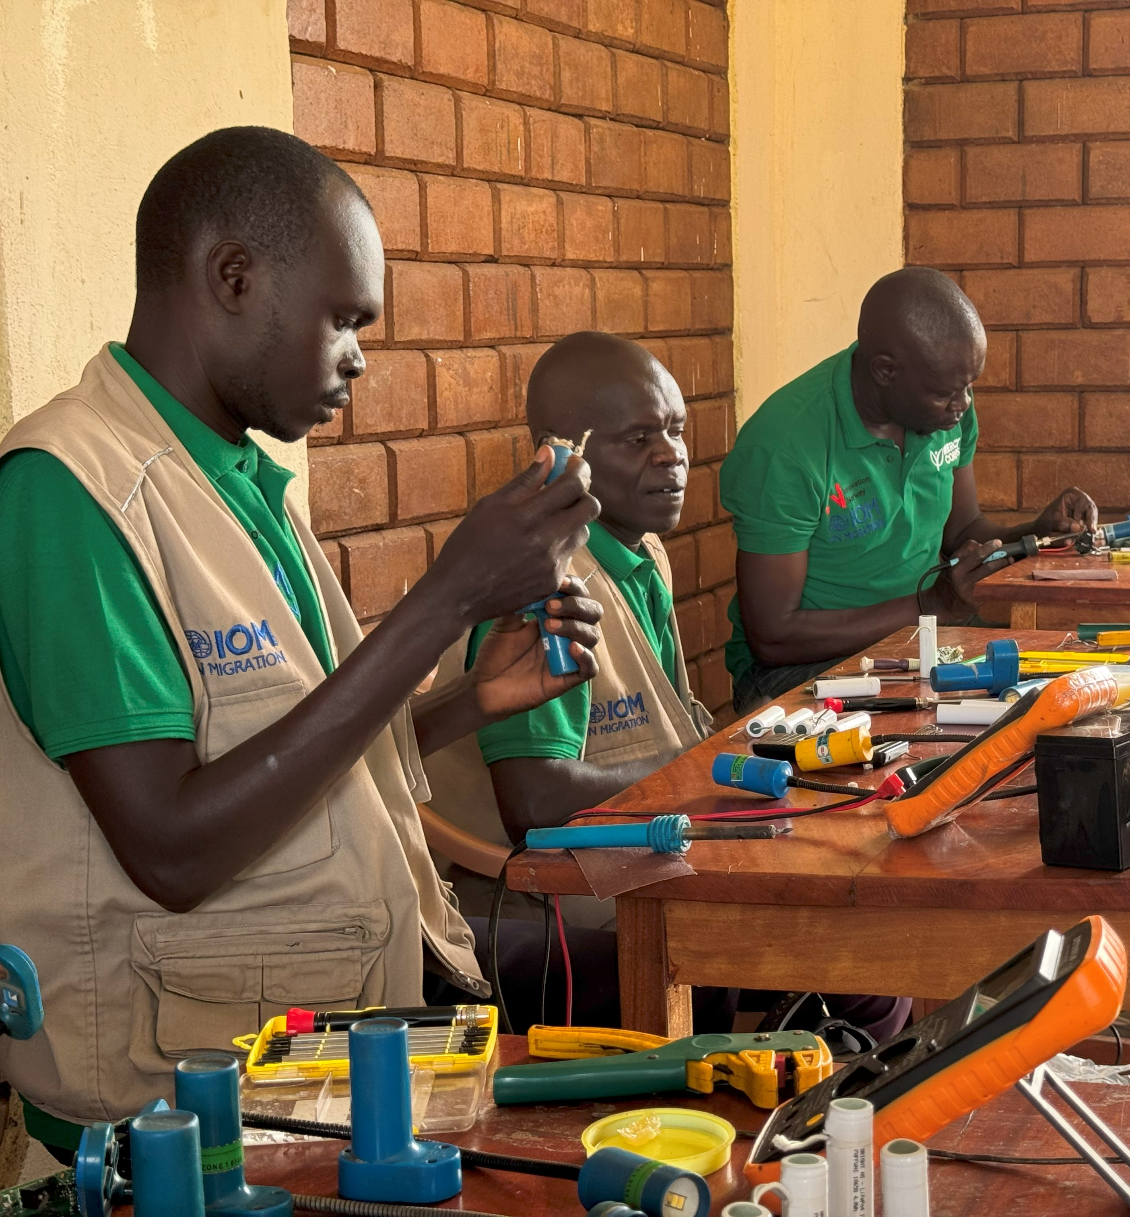


Lessons from the ecosystem
Emerging Insight
Governance must be bottom-up to be durable.
Core Lesson
Legal formalization is the primary de-risking mechanism for private sector engagement in displacement settings.
Community ownership
Structured governance
Business modelling
Management model
Informal Sector Integration
Sustainability

Slide 6
Pathway to Sustainability
Capital stack, blended finance logic, revenue pathway.
Capital Stack
Blended Finance
Why Blended Finance?
Grant Capital
Matched Private Sector Contributions
Enterprise Revenue
Innovation/Bridge Financing
Grants absorb early-stage uncertainty.
Legal formalisation reduces institutional risk.
Revenue streams gradually replace grant dependency.
Humanitarian grant funding
Private sector in-kind
Community enterprise revenue
Device repair fees.
Second-life battery pack sales
E-waste collection service fees.
Solar system maintenance services.
Refurbishment and resale of electronics.
Material recovery (metals, components).
Spare parts resale and local distribution.
Local assembly of SUNLITE lamps.
Carbon finance potential.
Charging station services (static and mobile).
Revenue Pathway

Slide 7






The Ecosystem Fit
Stakeholder Map
Private Sector Partners (The Technical Experts)
Supply technology, parts, financing and technical processes.
Communities
National Government & Policy Actors
Deliver frontline services (repair, refurbishment, assembly)
Set standards and align with national frameworks
Scaling E-Waste
Circular Models
Academic & Innovation Institutions (The Validators)
UN Agencies & INGOs
(The Ecosystem Facilitators)
Supply technology, parts, financing and technical processes.
Coordinate, fund, and ensure protection.
Local Governments
Deliver frontline services (repair, refurbishment, assembly)

Slide 8
Key Capital Constraints to Scale
Financial Gaps Hindering the E-Waste Circular Economy
Grant Dependency
Working Capital
Infrustructure Gap
Transitioning from HIP/IOM funded operations to community-led self-sustaining models
Lack of upfront cash to set up systems, i.e., informal collectors’ integration and pay for logistics.
Funds needed to build/maintain repair kiosks, bins, and tricycles (land is provided, assets are not).
Cost of Compliance
Innovation Funding
Innovation Funding
High expense of safety testing,shipping and certification to legally second-life products.
Capital to fund R&D, technical assessments with universities and think-tanks
Capital to fund R&D, technical assessments with universities and think-tanks

Slide 9
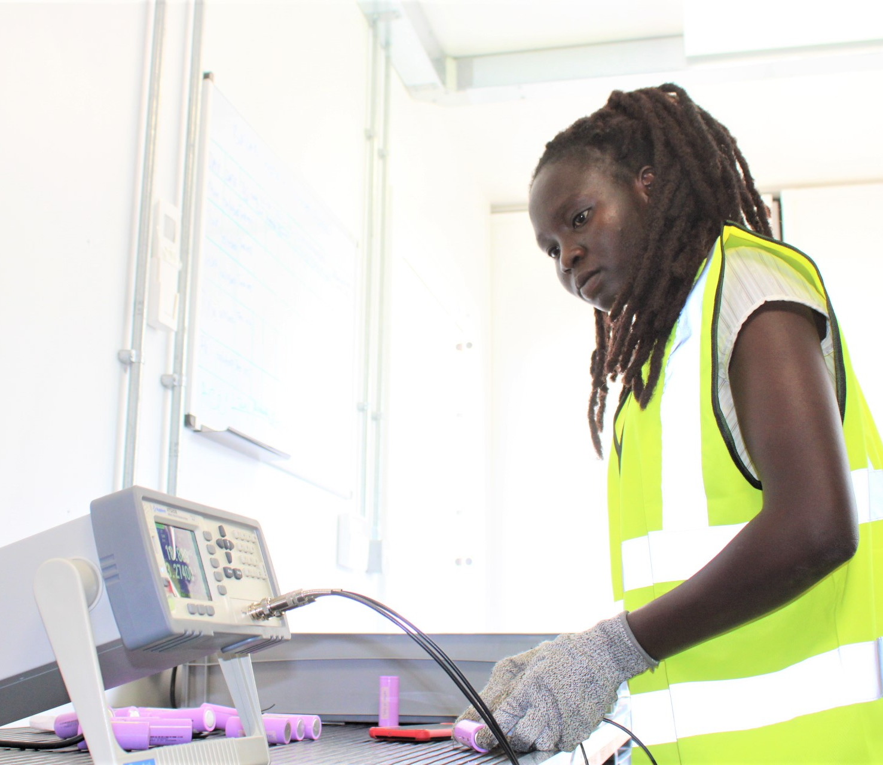





The Ask:
Bridging Capital to Unlock Scale
Microfinance & Impact Investors
Supporting micro-enterprise growth.
Infrastructure scaling.
De-risking the model for private sector entry.
Financing certification and compliance.

Slide 10
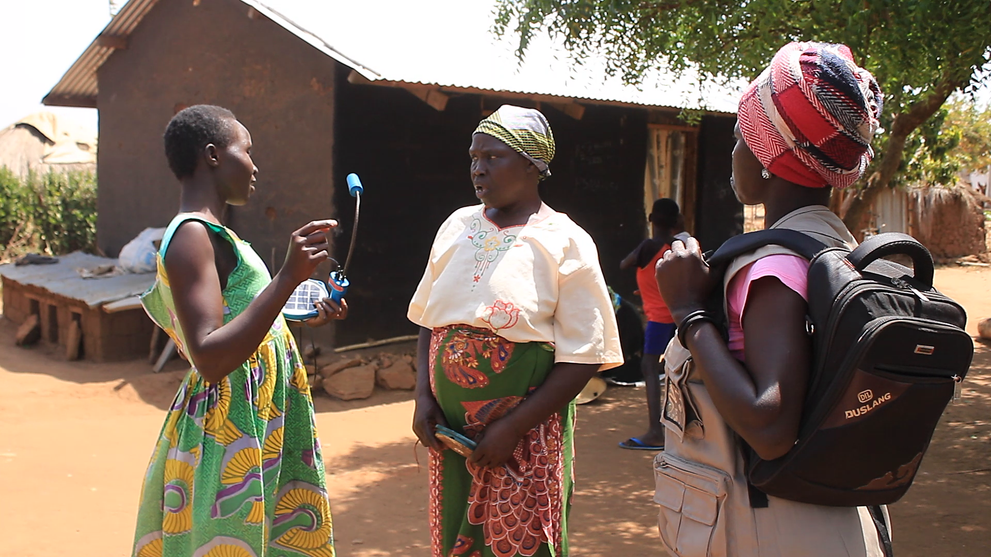

Toolkit for developing the e-waste circular economy
Abubaker Mayemba
Senior Project Associate (MECR)
amayemba@iom.int

