Slide 1
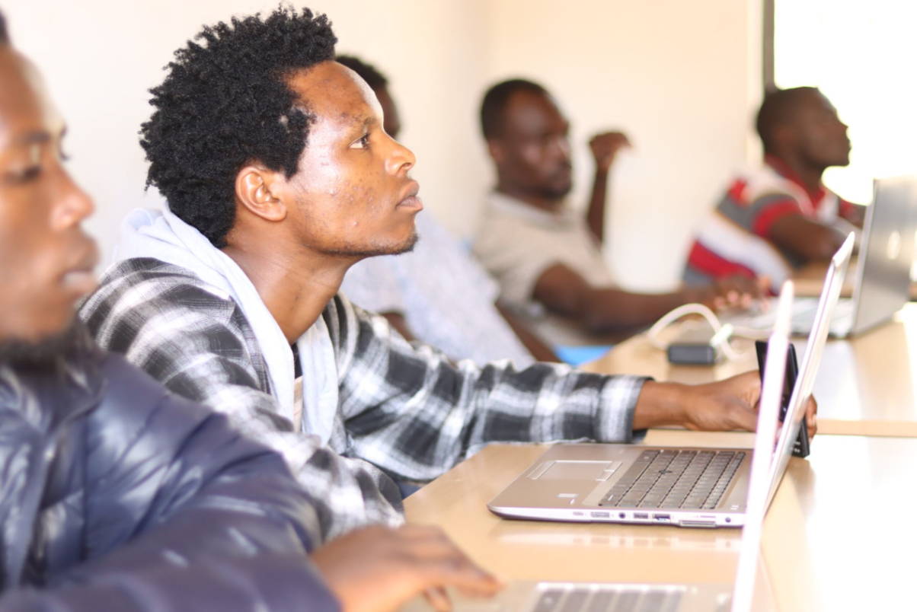

Bridging the Digital Divide

Slide 2
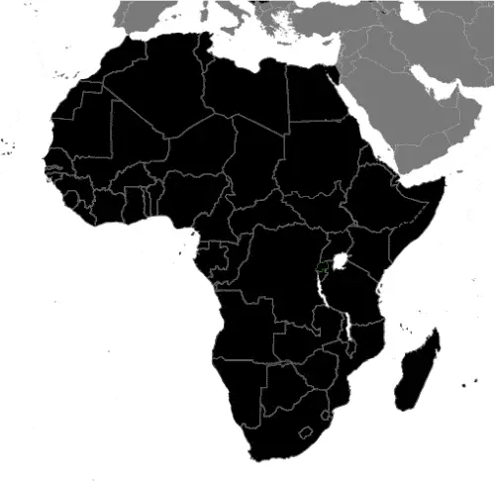
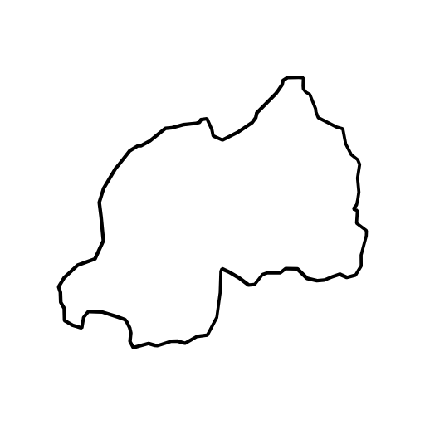


Mahama: 73,000 refugees
13%

Slide 3









Pain journey

Slide 4



Design

Slide 5




Prototypes in Mahama
1
2
3
4
Internet Cafe
Digital Training
Blanket Wi-Fi
Device financing

Slide 6
Can refugees lead and finance their own internet connectivity?

Slide 7

How does Kumwe Hub do this?
Idea → Refugee-led Solution → Self-reliant
Partner with refugee entrepreneur
Access to catalytic finance
Track impact
Refugee entrepreneur sets up low-cost business
Training

Slide 8
Impact Results

Slide 9
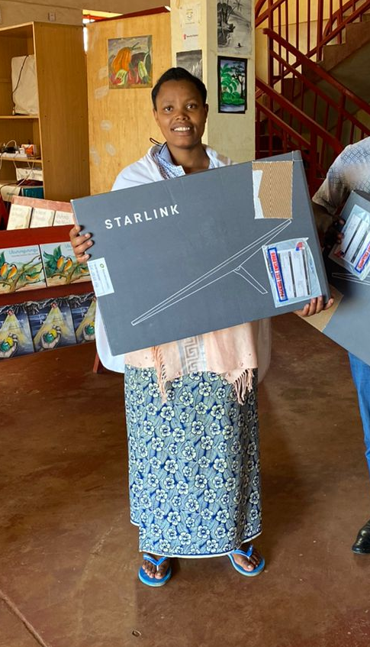




Impact results
Refugee-led Internet Cafe
Digital Training business
Blanket Wi-Fi
Device financing
1,400 clients/month paying 300 RWF/hour
$550 USD/month
49% women
9 new jobs

Slide 10
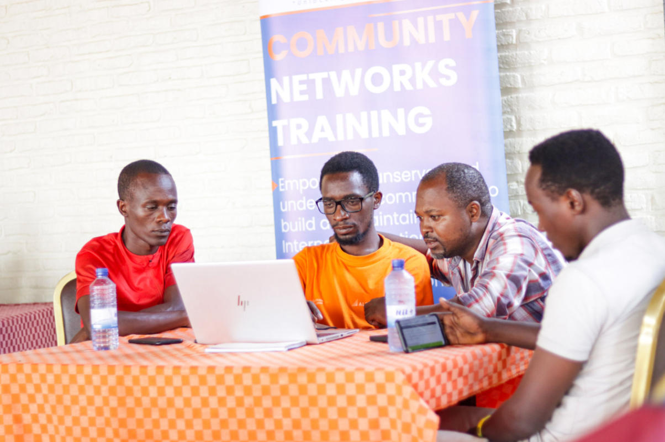


Impact results
Refugee-led Internet Cafe
Digital Training business
Blanket Wi-Fi
Device financing
1,400 clients/month paying 300 RWF/hour
5,000 paid for training in 6 months
$550 USD/month
5-10k RWF per training
49% women
200USD/month
9 new jobs

Slide 11
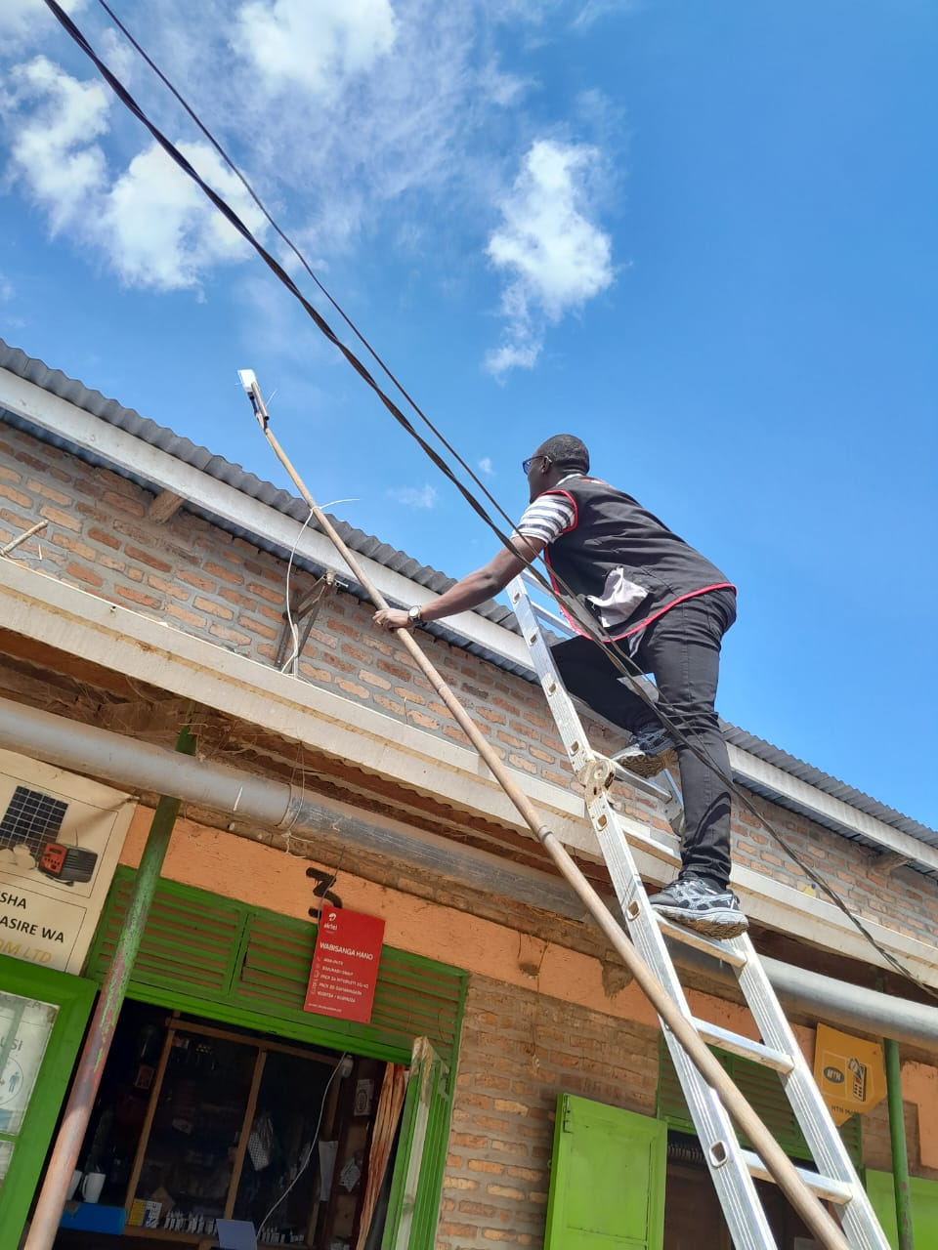


Impact results
Refugee-led Internet Cafe
Digital Training business
Blanket Wi-Fi
Device financing
1,400 clients/month paying 300 RWF/hour
5,000 paid for training in 6 months
3 new Wi-Fi spots in villages
$550 USD/month
600 paying 10k RWF/month
5-10k RWF per training
49% women
100 USD/month
200USD/month
9 new jobs
6 new jobs

Slide 12
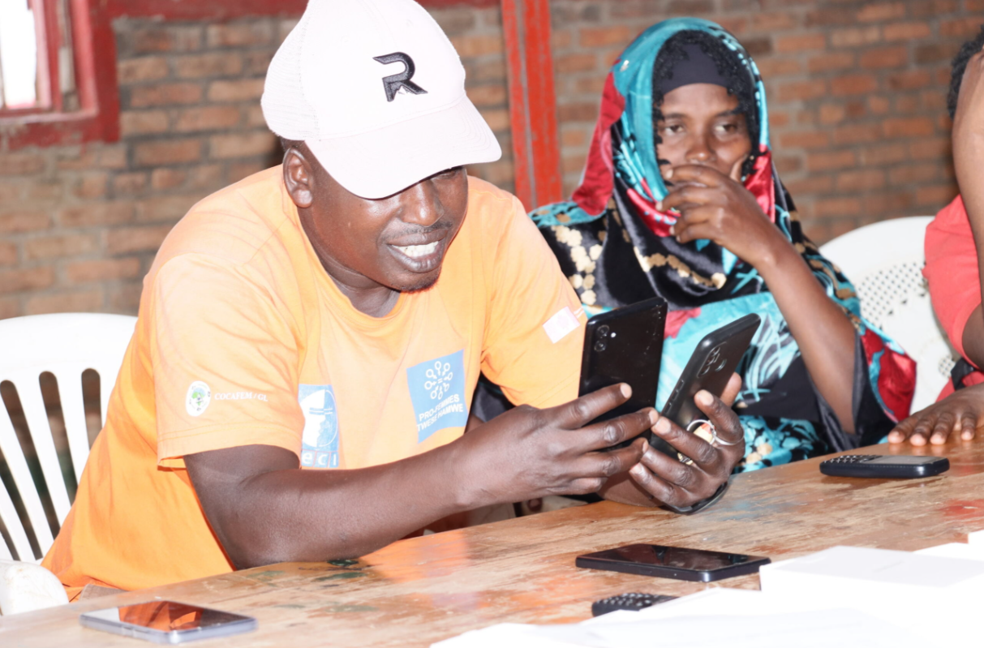

Impact results
Refugee-led Internet Cafe
Digital Training business
Blanket Wi-Fi
Device financing
1,400 clients/month paying 300 RWF/hour
5,000 paid for training in 6 months
3 new Wi-Fi spots in villages
180 smartphones sold over 1 year: Low-cost and patient
3 new jobs
$550 USD/month
600 paying 10k RWF/month
5-10k RWF per training
49% women
100 USD/month
200USD/month
9 new jobs
6 new jobs

Slide 13
Can refugees lead and finance their own internet connectivity?
…What have we learned?
Notes:
Refugees are innovative and powerful, but lack capital, trust and infrastructure to set up solutions to their connectivity problems.

Slide 14

Designed for scale: Scale-up in Rwanda & Kenya
306,000
135,000

Slide 15



Seeking catalytic philanthropic capital
Internet to refugees in Rwanda & Kenya
45 businesses
280 new jobs
150,000 refugee sessions
24,000 children safely navigating the internet

Slide 16

Want to partner?
www.kumwehub.com

