Slide 1
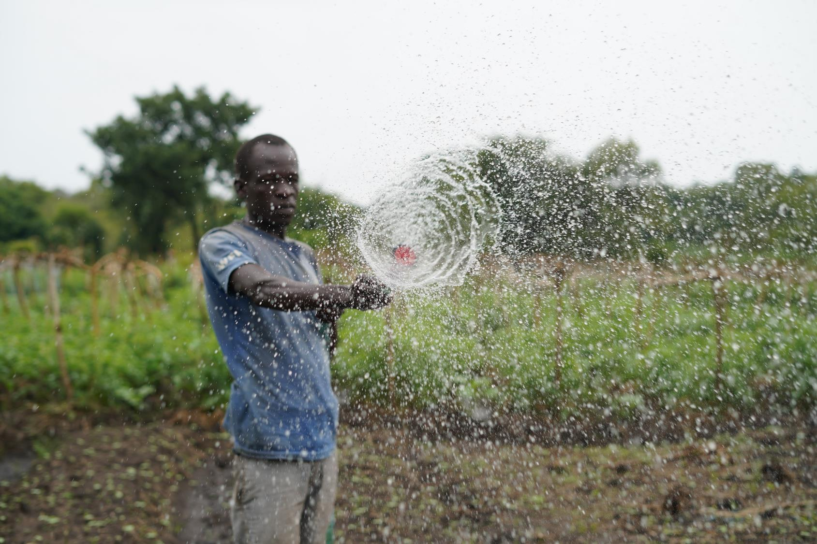




SOLAR: Solarizing Livelihood Activities with Refugees

Slide 2
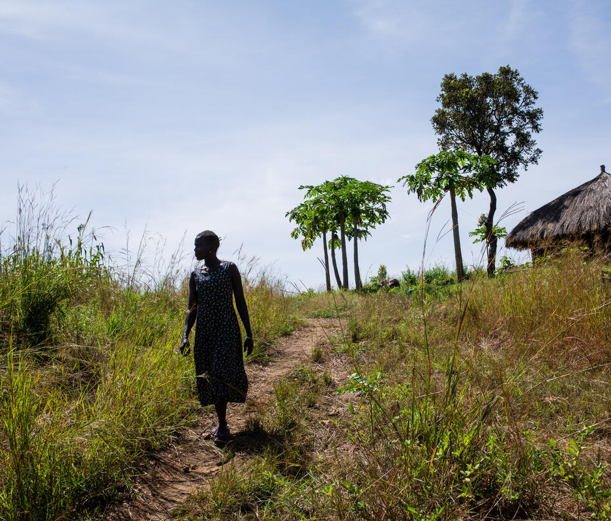
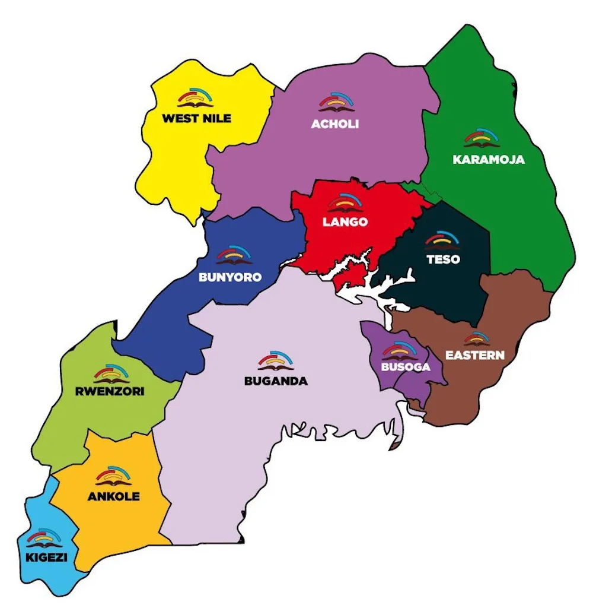
The Problem
Dependency on Rain
Prolonged dry season
Poor access to agro inputs and Training
Unreliable Markets
Off-grid, can-not afford fuel pumps
Dependency on Aid, >1.9M refugees in Uganda
Result: Low yields, unstable income

Slide 3
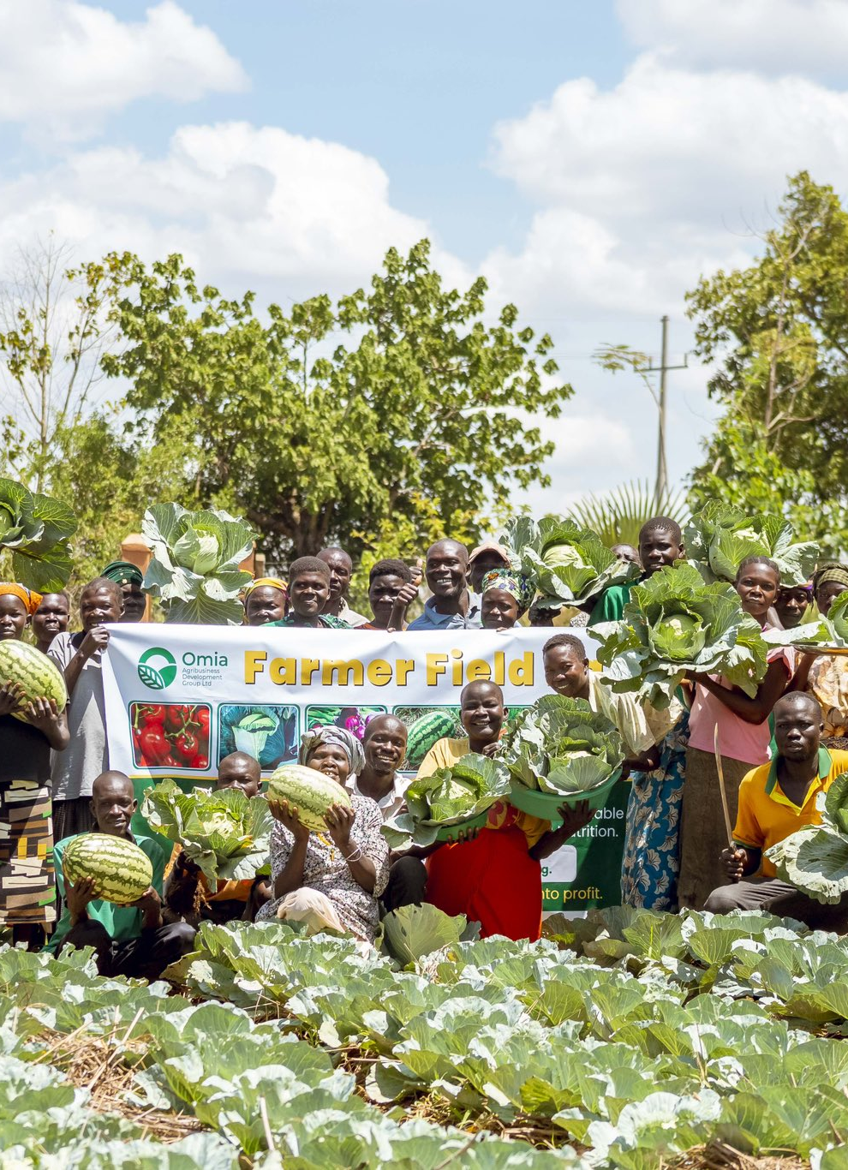
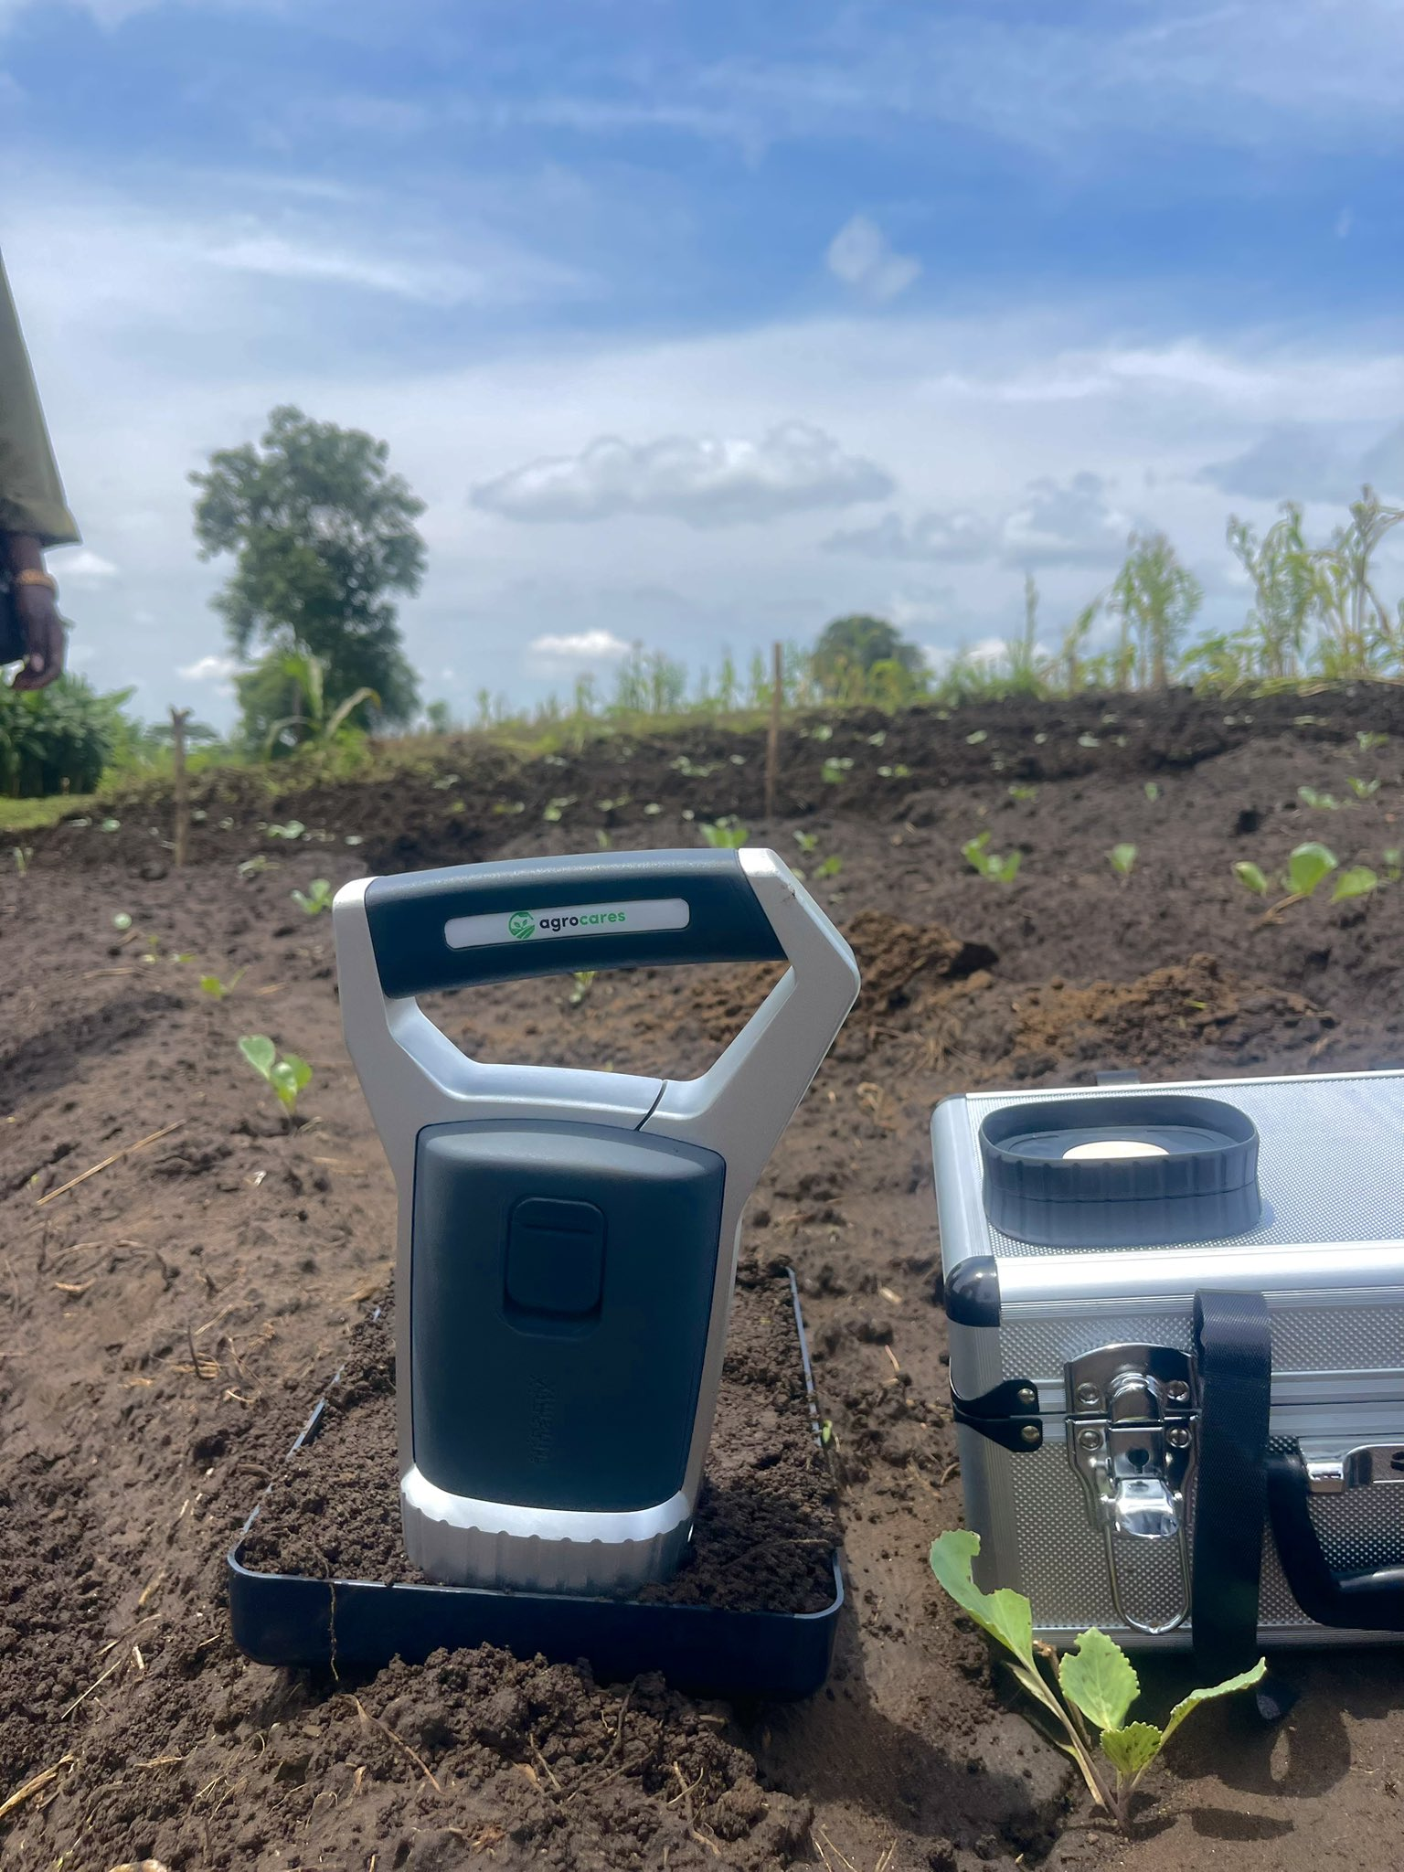
Our Solution
Integrated Solution
Soil testing
Agro Inputs
Farmer training
Solar Solutions
Linkages to Markets
Higher Yields, Income

Slide 4

Evidence and Traction
Farmer groups supported: 250
Total Number of farmers: 6,081
Refugees: 47% (2,840) Host community farmers: 53% (3,241)
Women Farmers: 67% and Male Farmers: 33%
Yield: 5,107 to 45,246 (9x per group)
Income: $4,193 to $30,673 (6x per group)
Average Profit: $93 to $296 (3x per group)
Returning Customers: 86,593 in 2025 for Omia and Over 200 for Tulima Solar

Slide 5
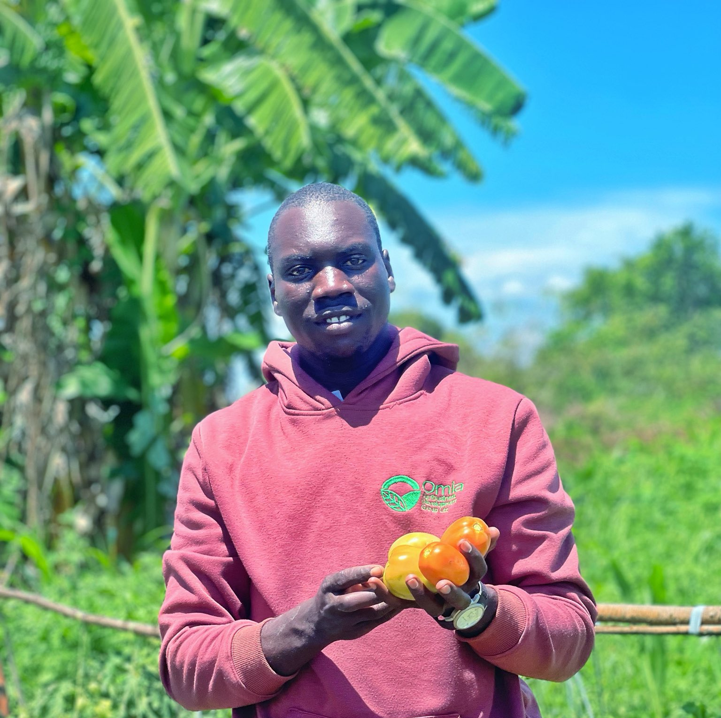
What we have learnt!
Solar solutions are an enabler, not the THING!
Follow on support is as important as the project activities
Adoption takes time
Market certainty changes farmer behavior
Partners matter more than the technology
Not all technologies are a right fit for the communities

Slide 6
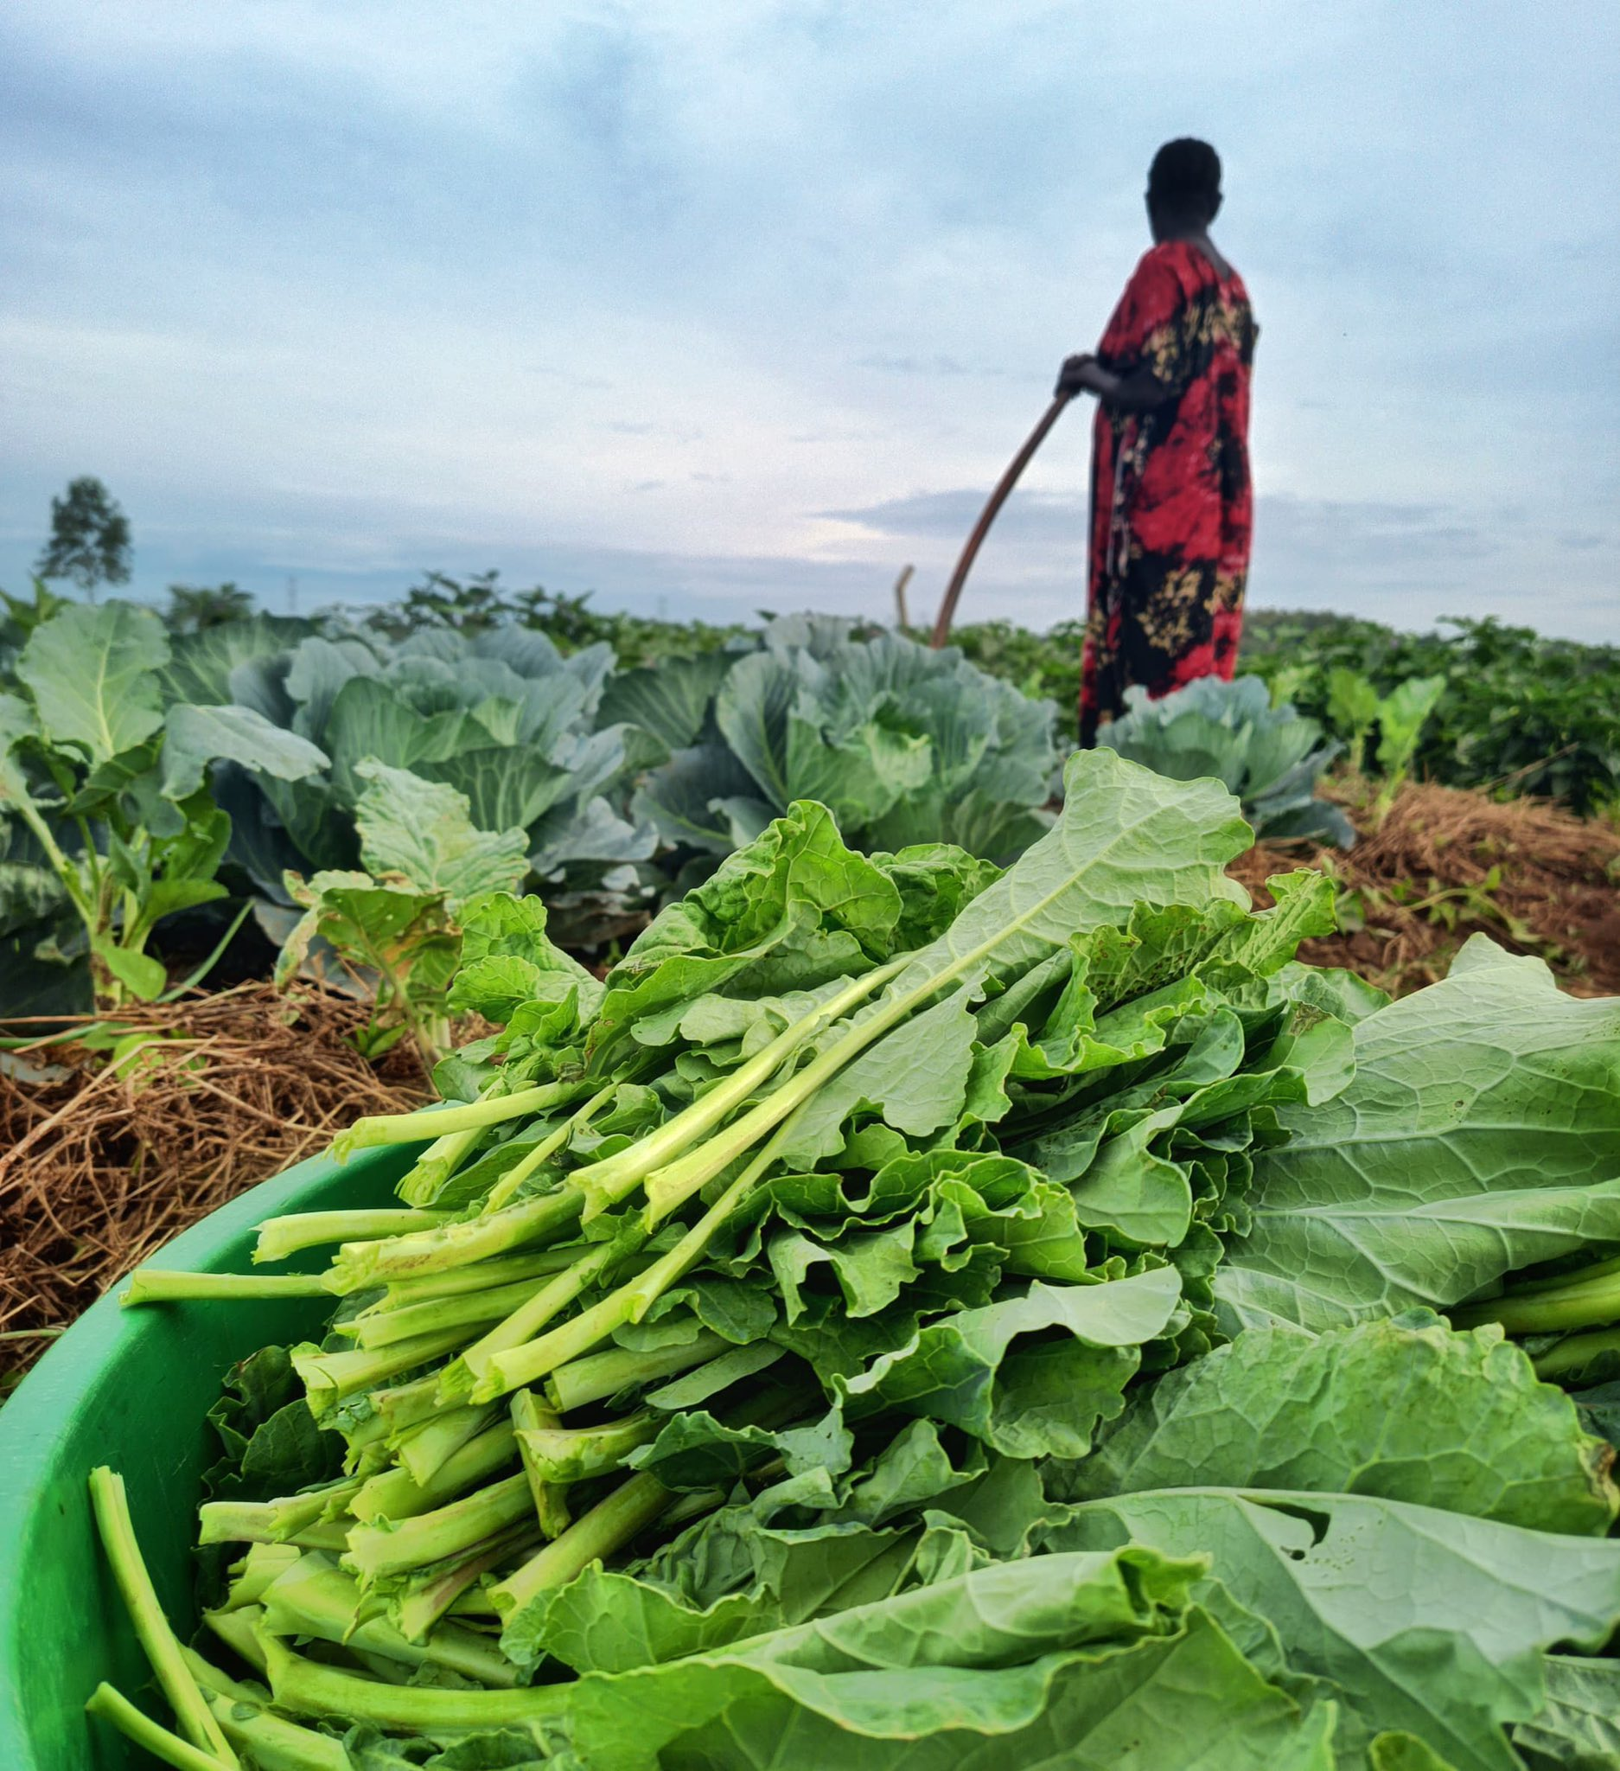
Pathway to Scale/sustainability
Farmer contribution
Group ownership-Pumps
Block Farms-Refugees
Pay as you go Models
Structure aggregation and off-take markets
Align and work with local actors
Train local agents, working closely with Tulima
Scale as a bundle not a product

Slide 7

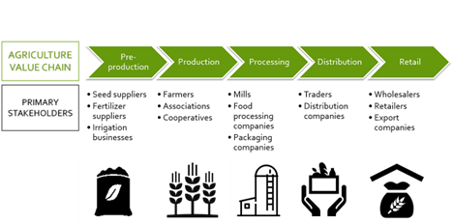
Ecosystem Fit

Slide 8
The challenges and solutions
Low adoption rates of the promoted practices
Water sources-drying up
Working Capital Constraint for private sector partners
Affordability of Solar Solutions
Explore farmer to farmer models. Follow ups
Shallow wells and alternative water sources
Seek for Blended finance
Pay as you go, Group Ownership

Slide 9
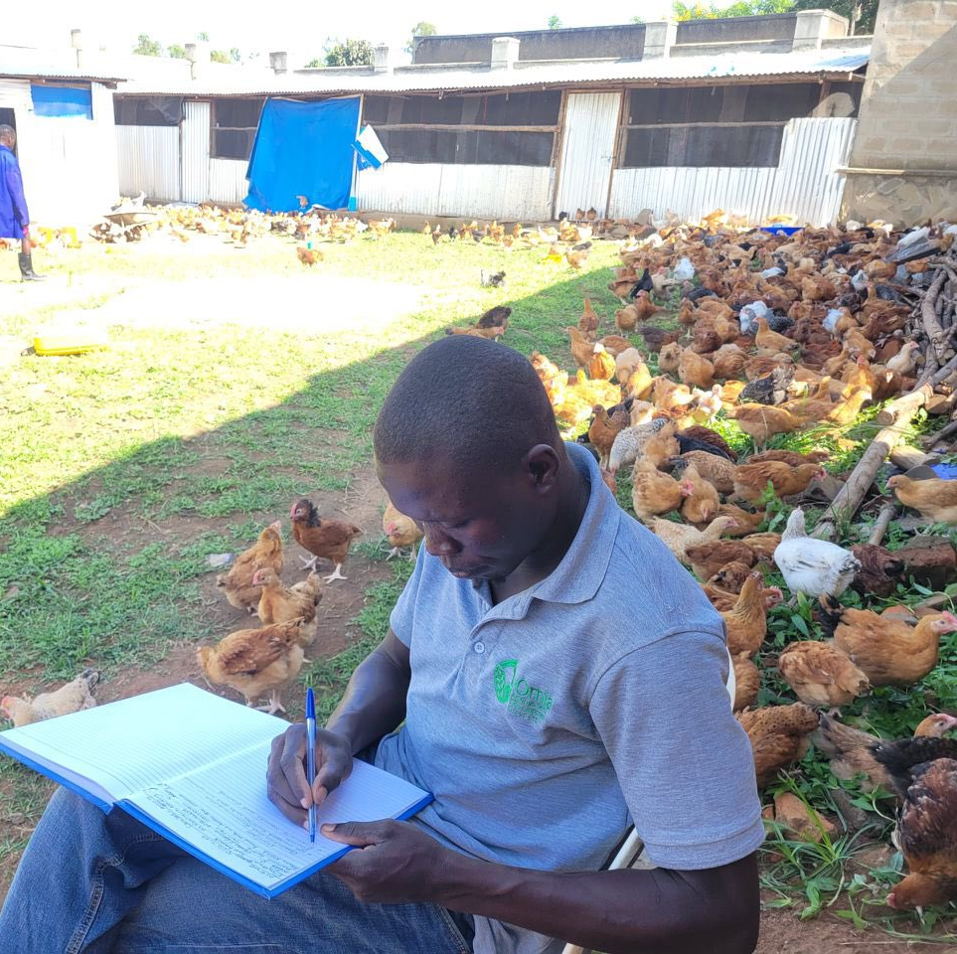
The Ask
Conversation with Impact Investors,
Use of Funds
Working Capital Investment (Debt/Equity)
Water sources for farmers
Land opening equipment
Marketing Infrastructure Investment: Warehouse, Trucks
Seed Processing Facility
Hatchery Facility
Instrument: Debt, Grants and Equity

Slide 10
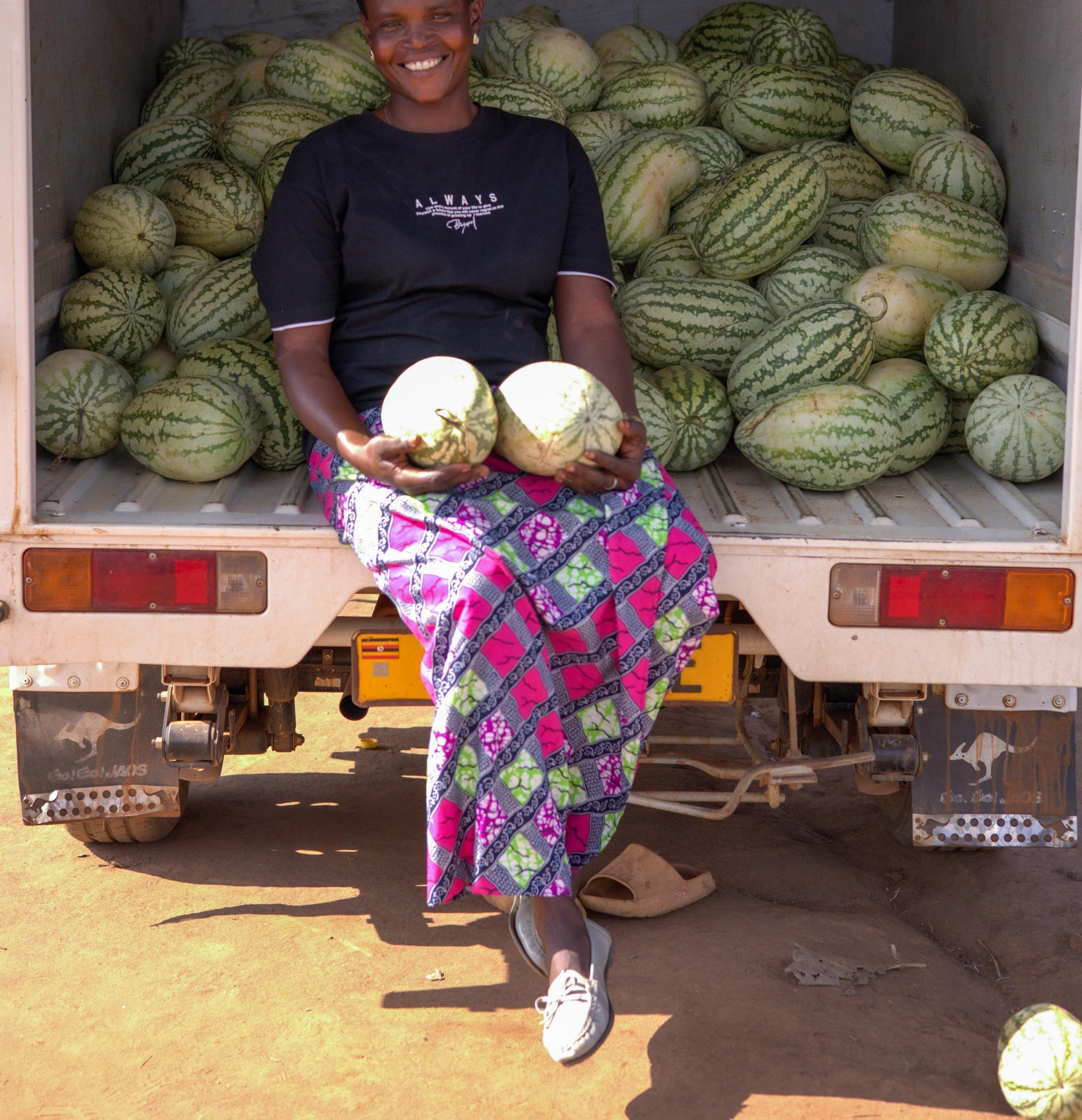
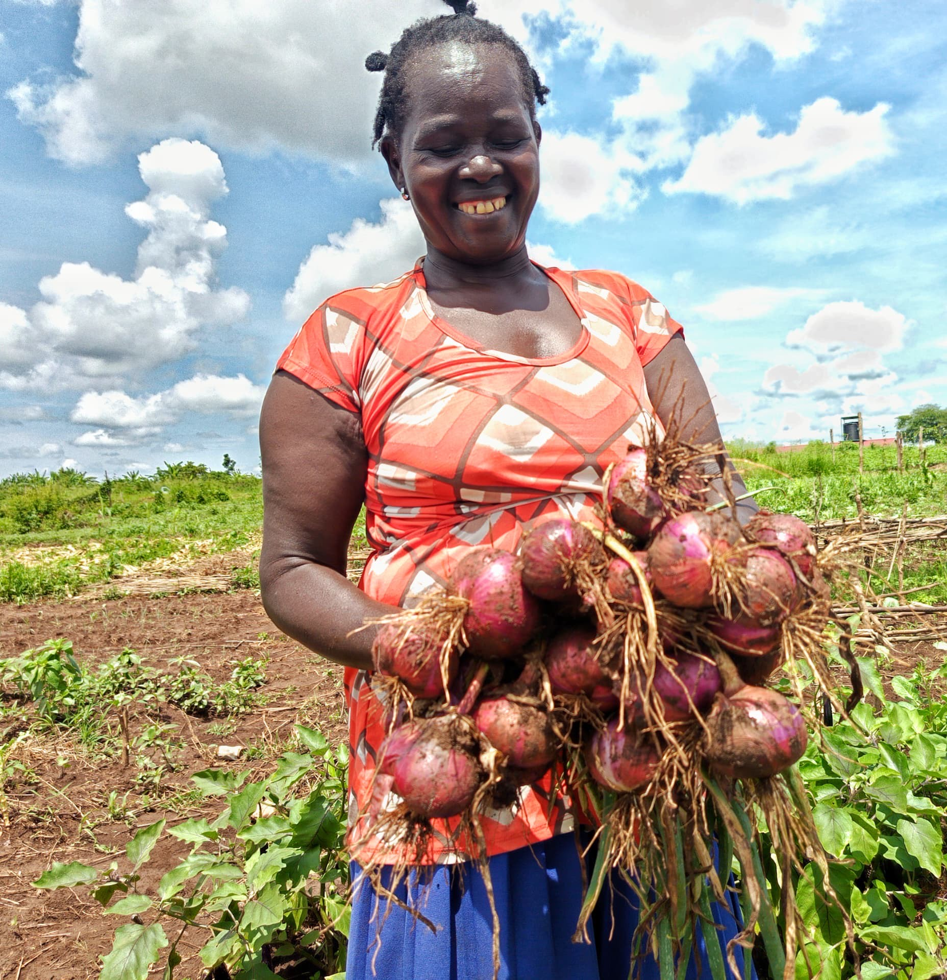
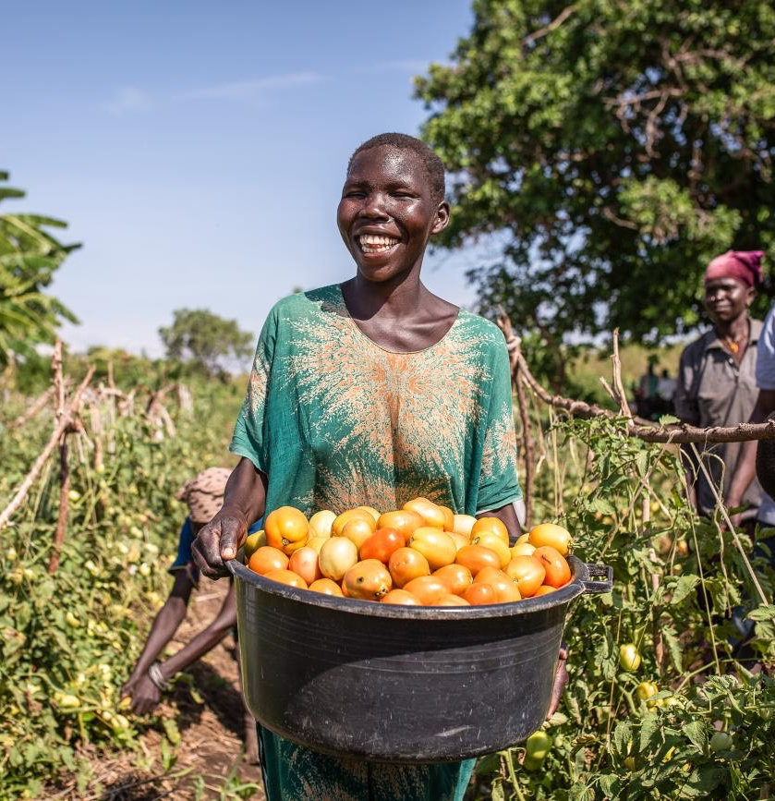
Thank you

