Slide 1

INVESTMENT READINESS
& BLENDED FINANCE
From Humanitarian Innovation to Credible Capital Pathways
The HIPpening - Innovation Norway
Capital Literacy • Sustainability Architecture • Readiness Discipline
GRANT
COMMERCIAL
Notes:
Welcome everyone. Today’s session is about practical capital logic — how capital actually works and how your projects can improve readiness logic. This is not a fundraising workshop. We are focusing on structures that support strategic decision-making across grants, catalytic capital, and commercial pathways.

Slide 2


OPENING ENGAGEMENT
When you hear the word Refugee, what is the first thing that comes to mind?
Notes:
This is the gap we currently need to bridge with many in the private sector
Sometimes even within this sector, we have a negative connotation of refugees - which makes it difficult to think from the position of opportunities.
you can be guaranteed that outside those who work in this field, the word refugees triggers mainly negative connotations.
mention africa tech festival - closed door UNHCR - Nancy Aburi - Chief of private sector Partnerships-Africa: first time view

Slide 3
OPENING ENGAGEMENT
Which statement best reflects your view today?
A
Private capital is essential for scale
B
Blended finance is relevant now
C
Grants remain the right model
D
Unsure
´
Notes:
let’s also check-in to understand the diversity of perspectives in the room. This will set the context for our exploration of investment readiness. There is no “right” answer — we are mapping assumptions, not judging them.
Lets understand the starting assumptions of the room
Most participants in humanitarian innovation come in with strong but different beliefs about capital.
Typically the room will split into three camps:
“Private capital is essential” → usually ecosystem, venture, or tech-oriented participants.
“Grants remain the right model” → often program leaders inside UN or NGOs.
“Blended finance is relevant” → people already thinking about hybrid pathways.
By asking this question immediately, you reveal where the room currently stands ideologically before the session begins.
This is crucial because the workshop is about correcting misconceptions around capital sequencing, not pushing everyone toward private capital.
take a picture so we can compare at the end

Slide 4


PRIVATE CAPITAL IS NOT THE DEFAULT GOAL.
READINESS = CLARITY, NOT AMBITION.
Notes:
Building on our initial engagement, we want to orient expectations early: private capital is not the default endpoint for every humanitarian innovation pathway. True readiness means understanding if, when, and how capital adds value — not pursuing it reflexively. This mindset shift is vital to today’s work. Our focus is on clarity of logic, not just the scale of ambition.

Slide 5






FIRESIDE CONVERSATION
JULIANA ROTICH
TECHNOLOGIST | CO-FOUNDER, USHAHIDI, iHUB
Navigating the tension between mission, capital, and sustainability.
Lived experience in crisis data platforms and mission-driven scaling.
Grounding investment readiness in practical reality, not theory.
"Tapping into lived experience to ground our perspective on investment readiness."
Notes:
It is a real privilege to welcome Juliana Rotich to this conversation. Juliana is a globally recognised technologist and ecosystem builder, best known as co-founder of Ushahidi, the crisis-mapping platform that has been deployed in over 160 countries and fundamentally reshaped how communities use real-time data during elections, disasters, and humanitarian crises. She was also a founding force behind iHub, East Africa’s pioneering innovation hub that became the epicentre of Kenya’s tech ecosystem, nurturing hundreds of startups and positioning Nairobi as a global innovation node.
Beyond founding institutions, Juliana has held executive leadership roles at Safaricom, one of Africa’s largest and most influential telecommunications companies, where she operated at the intersection of technology, governance, and scale within a multi-billion-dollar corporate environment. She understands both grassroots innovation and enterprise-grade systems, and how capital logic changes across those layers.
Today, she is also an active angel investor and ecosystem mentor, backing early-stage ventures and evaluating investment opportunities through a disciplined lens. That combination (builder, executive, and investor) makes her uniquely positioned to speak about investment readiness: not as theory, but as lived experience navigating mission, scale, governance, and capital alignment.
Sustainability & scaling!
first question: What was your biggest challenge in your social entrepreneurial journey?
Juliana - the mindset that guided me *do not run an NGO like an NGO, run it like a tech company - commitment, focus and strategic engagement with the board to drive sustainability and diversify the mix of funding to support the budgets for Ushahidi, iHub and other resulting innovations.
second question: What do private and catalytic capital actually look for?
third question:

Slide 6




WHAT CAPITAL ACTUALLY LOOKS FOR
PROBLEM
CLARITY
UNIT ECONOMICS
LOGIC
SUSTAINABLE
PATHWAY
Deep understanding of the specific challenge and the context in which it exists.
Clear connection between activity and cost, demonstrating financial discipline.
A credible long-term viability plan that moves beyond grant dependency.
PRACTICAL DECISION LEVERS • NOT BUZZWORDS
Notes:
Following Juliana's invaluable insights, let's now consider what capital actually looks for. Capital of any kind — grant, catalytic, debt, or equity — is not interested in ambition alone. It looks for clarity on what problem you solve, how you measure progress, and whether there is a credible pathway to sustainability. Today we treat these as practical decision levers, not buzzwords. This includes deep understanding of the problem, clear unit economics, and a sustainable pathway.
add the notes from here also https://docs.google.com/document/d/1amuQ6gjqHXwofJZFRfgN6fXKObYEFZe5k6ecL-ALgs4/edit?tab=t.0

Slide 7



NORTH STAR VS. VANITY METRICS
VANITY METRICS
DECISION METRICS
Good for Headlines
Drive Capital Judgments
Metrics that look impressive on paper but don't correlate with long-term sustainability or impact.
Hard data that investors and partners use to evaluate the credibility of your capital logic.
Low Strategic Impact
Inform Strategic Choices
Data points that fail to inform internal calibration or critical capital judgments.
Actionable insights that guide resource allocation and sustainability architecture.
DECISION METRICS = CAPITAL LOGIC
Notes:
Distinguishing between vanity and actionable metrics is a core skill in investment readiness. Vanity metrics create good headlines; decision metrics drive capital judgments. We'll use this slide to ground the difference and begin internal calibration. This focus on clear, actionable data directly relates to what capital actually looks for. Next, we'll explore how different types of funding can either support or hinder this clarity.

Slide 8


STRATEGIC GRANT VS. DISTRACTION GRANT
STRATEGIC GRANT
DISTRACTION GRANT
Amplifies Core Logic: Supports what you are already building well.
Pulls Away from Essentials: Creates activity drift and resource strain.
Protects mission integrity and improves readiness logic.
Dilutes focus and weakens structural readiness.
GOAL: SELECTING THE RIGHT FUNDING TO PROTECT MISSION INTEGRITY.
Notes:
Not all funding supports clarity. Some grants help you build what you are already building well; others pull you into activity drift. Understanding that distinction protects mission integrity and improves readiness logic. This is a critical follow-on to our discussion on decision metrics, as the right funding reinforces those metrics. Now, let's look at the current state of our portfolio in this context.

Slide 9




HIP BLENDED FINANCE & INVESTMENT READINESS INITIATIVE
TINKR
THINKPLACE KENYA
REMODE
Humanitarian innovation & scaling maturity lens.
Human-centred systems design & community integrity lens.
Investment readiness, blended finance & sequencing architecture.
TIME-BOUND, DATA-BACKED PORTFOLIO DIAGNOSTIC ACROSS 7 HIP PROJECTS
(NOT A FUNDRAISING INSTRUMENT. NOT A TRANSACTION READINESS CERTIFICATION.)
Notes:
This is the snapshot of the HIP Blended Finance & Investment Readiness portfolio analysis we did in our consortium of Tinkr (Norway) brings expertise in humanitarian innovation and scaling maturity. ThinkPlace Kenya - co-creator of this event - provides human-centered systems design and community integrity. and us -Remode focuses on investment readiness, blended finance, and sequencing architecture. Our approach was a time-bound, data-backed diagnostic across seven HIP projects. It was not a fundraising instrument or a transaction readiness certification. We focused on understanding of strategic funding and set the stage for identifying specific constraints. Here are the results of what we found:

Slide 10
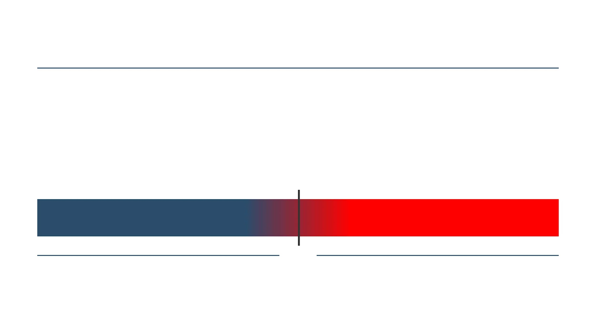
THE HIP PORTFOLIO REALITY
Portfolio Readiness is Transitional
CURRENT STATE
OPERATIONALLY CREDIBLE
STRUCTURALLY TRANSITIONAL
Strong innovation teams, program leads, and project champions. High execution capability.
Moving from humanitarian logic to investment readiness. Identifying systematic improvement areas.
Notes:
Current HIP assessments indicate that portfolio projects are strong in operational credibility but transitional in investment readiness. This transition indicates real opportunity, not failure — it means improvement areas exist that can be systematically addressed.

Slide 11

THE BINDING CONSTRAINT
SUSTAINABILITY ARCHITECTURE IS THE DOMINANT GAP
COST LAYER RIGOR
REVENUE POSSIBILITIES
Deep discipline around separating core operational costs from project-specific expenditures.
Mapping credible pathways for cost recovery and identifying potential revenue streams.
DEPENDENCY MAPPING
SCENARIO STRESS TESTING
Understanding structural dependencies on grants and identifying risks to long-term viability.
Applying structural discipline to test the model against various capital and operational scenarios.
Notes:
Across the portfolio, the most consistent readiness bottleneck is sustainability architecture —
the rigor around cost layers (unit economics - CAPEX OPEX),
revenue possibilities,
dependency mapping, and scenario stress testing. Today’s exercise will confront that directly.

Slide 12
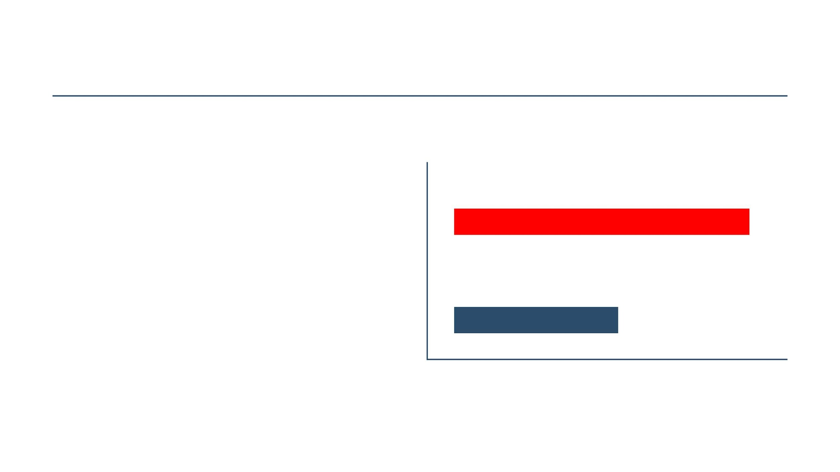

THE CALIBRATION GAP
Optimism Skew in Sustainability
SELF-ASSESSMENT
OPTIMISM
GAP
Projects tend to overestimate readiness, particularly around business and financial sustainability.
INDEPENDENT REALITY
Recognizing this gap is a calibration moment, not a failure. It is core to improving capital judgment.

Slide 13





STRUCTURAL RISK TYPOLOGY
CAPITAL MISALIGNMENT
OVER-SCALING RISK
Securing the wrong type of funding for the current stage of innovation, leading to structural tension and inefficiency.
Expanding operations before the underlying economic model or sustainability architecture is fully validated.
GOVERNANCE FRAGILITY
MANDATE DISTORTION
Weak decision-making structures that cannot support the complexity of blended finance or commercial pathways.
Mission drift caused by adapting core activities to meet the specific requirements of misaligned capital sources.
IDENTIFYING VULNERABILITIES TO FOCUS READINESS WORK

Slide 14

PART 2
PRACTICAL READINESS
DISCIPLINE
The HIPpening - Innovation Norway
From Portfolio Reality to Practical Action
Investment Readiness & Blended Finance
Exercise Framing • Structural Triage • Readiness Moves

Slide 15





LEVERS OF HIGHER-SCORING PROJECTS
CLEAR COST LAYERS
GOVERNANCE CLARITY
Disciplined separation of core operational costs from project-specific expenditures.
Strong decision-making mechanisms that support capital logic and sustainability.
ONE PATHWAY DISCIPLINE
BOUNDED MECHANISMS
Focused economic logic that prioritizes the most credible route to sustainability.
Well-defined operational scopes that prevent activity drift and resource strain.
DISCIPLINED ARCHITECTURE • PATTERNS, NOT PRESCRIPTIONS
Notes:
q1 - for juliana = 12 -
q2 - quasi commercial - 10
q3 - philanthropic - 5

Slide 16




EXERCISE FRAMING: CAPITAL TRIAGE
A process for mapping how different parts of a humanitarian program should be financed
SUSTAINABLE
SUBSIDY
PHILANTHROPIC
Activities that can recover costs through revenue streams and move toward financial independence.
Components that require ongoing support to maximize impact while maintaining operational logic.
Purely grant-funded elements that remain essential but cannot recovery costs commercially.
PREPARATION FOR JUDGMENT • NOT PITCHING
Notes:
Second you should understand how VC looks at the term and why
Outside the humanitarian sector, capital triage is not a formally standardized financial term like capital allocation or portfolio optimization, but it is used conceptually in venture, private equity, corporate strategy, and restructuring to mean:
The rapid prioritization of where capital should be deployed, preserved, or withdrawn based on strategic importance, risk, and return potential.
The word “triage” comes from medicine (sorting patients based on urgency and survivability). In finance or strategy, the idea is similar: not everything can be funded equally, so resources must be classified and prioritized.

Slide 17

PHASE 1 — INDIVIDUAL WORK
01
MAP FUNDING SOURCES
Identify all current and projected capital inflows for your project components.
20
MINUTES
02
DEFINE SUSTAINABILITY LOGIC
Articulate the underlying economic rationale for each core activity.
03
MAPPING YOUR LOGIC
TRIAGE INTO BUCKETS
Classify activities into Sustainable, Subsidy, or Philanthropic categories.
BE PRECISE • BE HONEST • FOCUS ON COST LAYERS
Notes:
“Before we move into the next discussion, we want to pause and do a short exercise called capital triage.
In humanitarian innovation, we often talk about sustainability or scaling, but we rarely stop to examine how different parts of our work are actually financed.
The reality is that not everything we do should — or even can — be funded in the same way. Some activities may eventually sustain themselves. Some require ongoing subsidy to reach vulnerable populations. And some are fundamentally mission-driven and should remain fully grant-funded.
This exercise is simply about creating clarity around that structure.
For the next 20 minutes, you’ll map your current funding logic and then classify different components of your work into three categories:
sustainable, subsidised, or philanthropic.
This is not about getting the “right answer,” and it’s not about pitching.
It’s about understanding the real financial architecture of your solution.”

Slide 18


WHAT SURPRISED YOU?
FIVE SECONDS OF SILENCE • LET INSIGHTS INCUBATE

Slide 19





PHASE 2 — GROUP DISCUSSION
SHARE TENSIONS,
ASSUMPTIONS,
& SACRED COWS
Discuss findings in small groups
Identify common tension patterns
Challenge your own assumptions
CHALLENGE TO CLARIFY • NOT TO WIN

Slide 20



PLENARY SYNTHESIS
WHAT PATTERNS ARE
EMERGING?
TABLE REPORTING
STRUCTURAL GAPS
[ Capture recurring tensions and insights from group discussions here ]
[ Map shared vulnerabilities across the portfolio here ]
MAPPING SHARED STRUCTURAL GAPS • NOT INDIVIDUAL WEAKNESSES

Slide 21

WHAT GOOD READINESS LOOKS LIKE
CLARITY > PITCH QUALITY
SUBSIDIZED
COST RECOVERY
NON-COMMERCIAL
Knowing exactly what must be subsidized and why, maintaining mission integrity.
Identifying components that can recover costs through sustainable revenue logic.
Understanding what cannot be served with commercial capital and requires philanthropic support.
THAT CLARITY IS READINESS.

Slide 22
MENTIMETER CLOSING ENGAGEMENT
After this session, your position is:
A
Pursue private capital
B
Do structural work first
C
Grants remain appropriate
D
Need clearer boundaries
Scan to Participate
CLOSING THE LOOP • MEASURING MINDSET SHIFTS

Slide 23


YOUR NEXT READINESS MOVE
WRITE ONE TANGIBLE ACTION
NEXT 6 – 12 MONTHS
Define your structural improvement here...
STRUCTURAL, NOT TRANSACTIONAL
SPECIFIC IMPROVEMENT AREA

Slide 24



ARCHITECTURAL CLARITY
BEFORE CAPITAL VELOCITY
NOT A RANKING
NOT A PITCH
NOT AN INVESTOR PANEL
The HIPpening —
Innovasjon Norge

