Slide 1

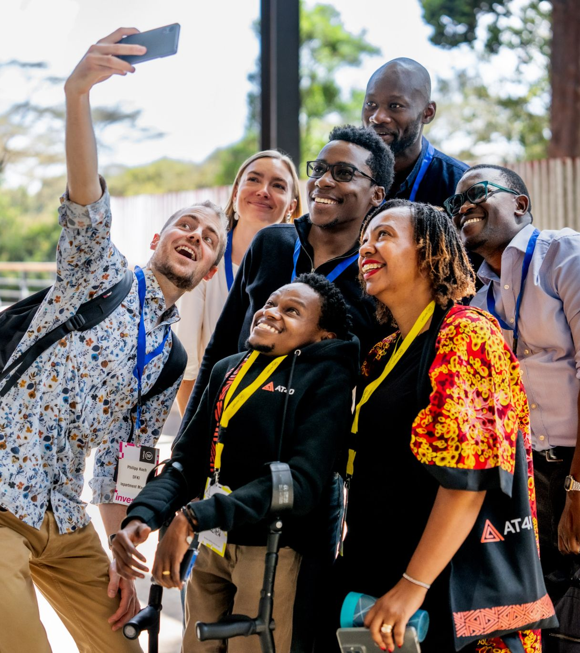



Photo:Intro Africa

Slide 2
Workshop
Humanitarian business modelling: Mapping the value chain for sustained humanitarian impact

Slide 3
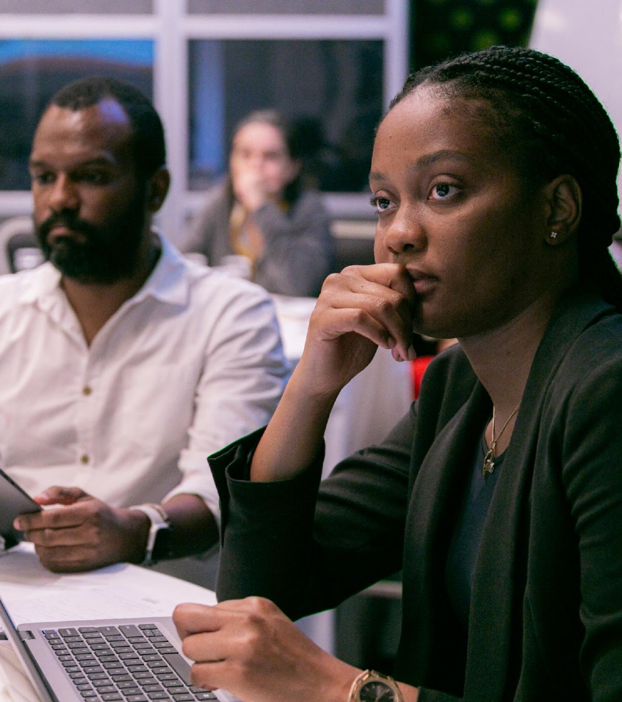
Agenda
Introduction
Agenda
What is a humanitarian value creation model and why is it relevant?
The core components
Value map: Introduce framework for mapping your system
Learnings shared by Abubaker Mayemba, IOM E-waste Initiative in Uganda
Workshop
Map your humanitarian business model + identify key gaps
Deeper dive on topic of choice: Financial sustainability model -OR- Partner model
Summary and next steps
Photo: Save the Children

Slide 4
Plenary question
Expectations
What do you wish to get out of this session?

Slide 5
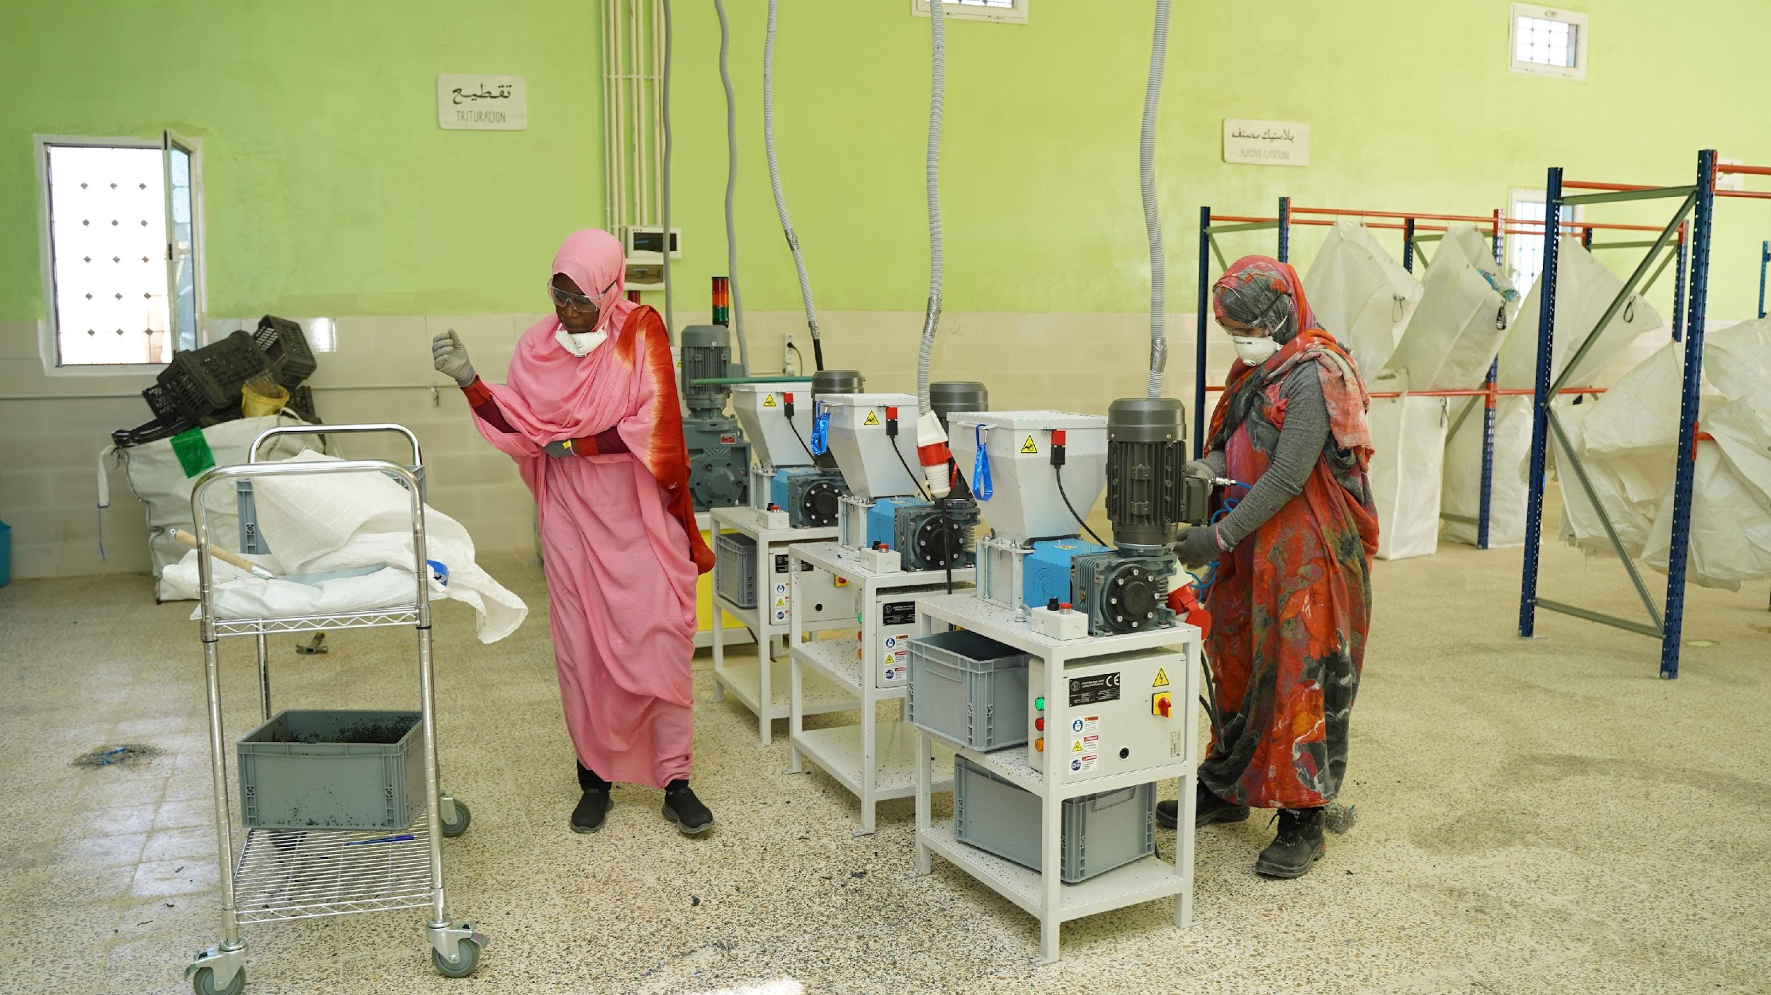

What is a humanitarian business model?
Megan Lee

Slide 6
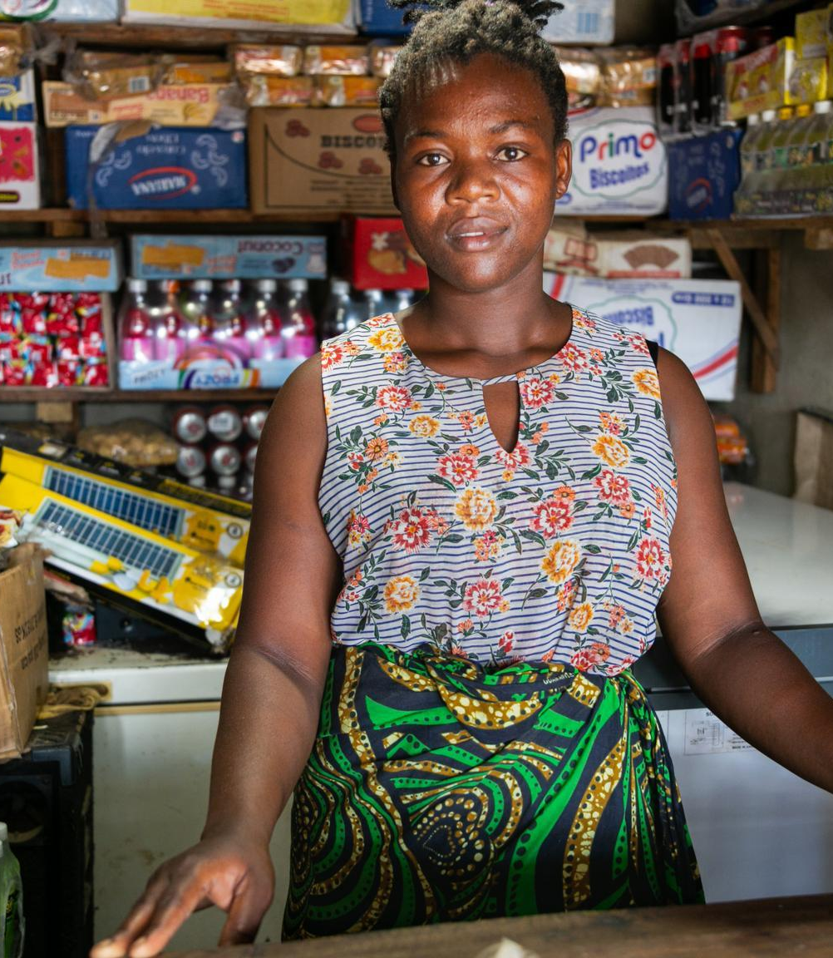
Humanitarian Business Models are the systems you use to operate sustainably in the real world, so that you can create impact and do no harm - socially or environmentally - over time.
Source: Making Circular Economy Business Models Work in Humanitarian Action by Dan McClure, Hannah Reichardt and adjustments by Tinkr
Notes:
It is the complete system that enables your innovation to create impact, operate sustainably, and do no harm — socially or environmentally — over time

Slide 7
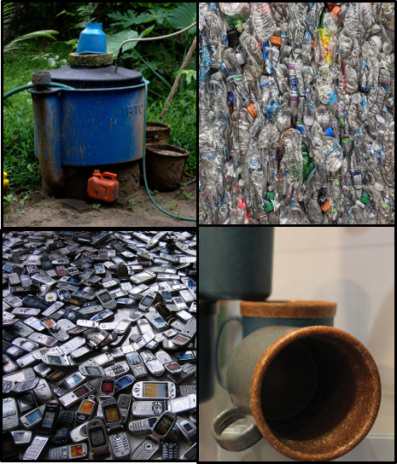
Why are humanitarian business models relevant for you?
It helps you align all moving parts (solution, activities, production, team, resources, partners, users, channels, finances etc) needed to create the intended value.
It provides a practical framework for you to ask critical questions, clearly map, visualise, test, and refine each part of your system - together and in-depth - that secures value creation.
Source: Making Circular Economy Business Models Work in Humanitarian Action by Dan McClure, Hannah Reichardt and Tinkr
Notes:
Circular Economy (CE) strategies seek to reduce the environmental impact of things we produce and use (minimizing waste and pollution, keeping materials and products in use and helping to regenerate natural systems).

Slide 8
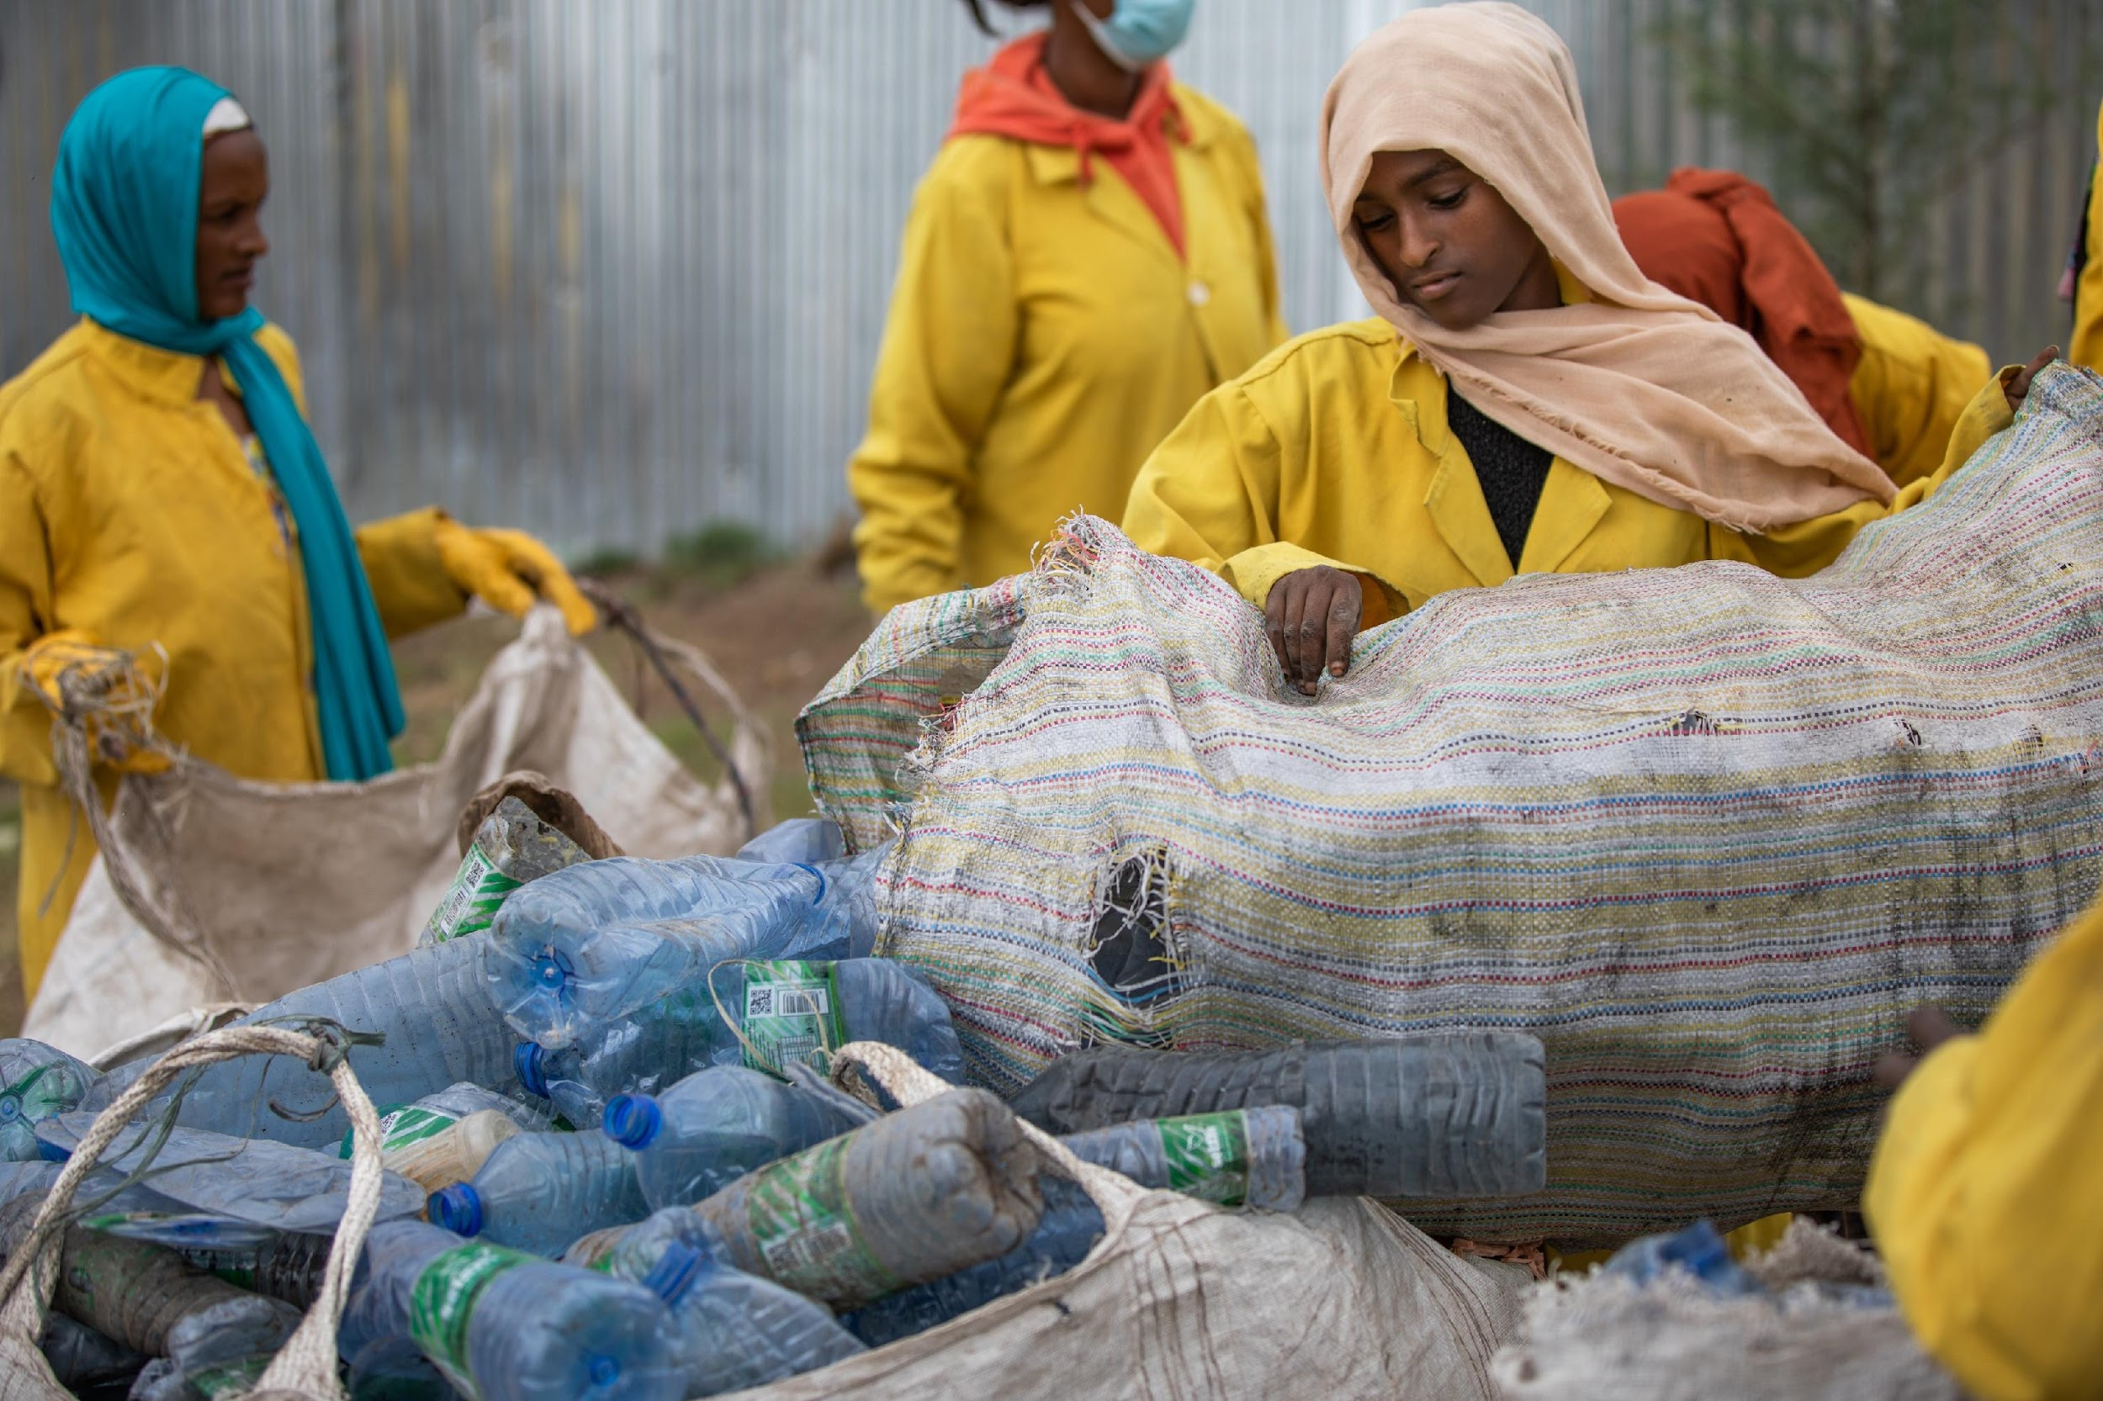
Its core components
IOM
Precious Plastic
Norwegian Church Aid
Notes:
The main building blocks of a humanitarian business model: What you need to think about to make your solution work, create impact, and be financially, operationally, socially and environmentally sustainable within a real-world ecosystem and humanitarian realities.
The main building blocks of a humanitarian business model: What you need to think about to make your solution work, create impact, and be financially, operationally, socially and environmentally sustainable within a real-world ecosystem and humanitarian realities.
What you offer (the solution and activities)
How you operate to deliver value (resources, partners, and operations)
Who you create value for (users, payers, and affected groups)
What impact you create (social and environmental effects)
How it is financially sustainable (costs, revenue, and funding)
The context you work in (humanitarian setting, policies, competitors, trends)

Slide 9
What you offer to create value
What is your solution (or system of solutions)?
What key activities are needed to deliver it?
Who you create value for and how
Who benefits? Who pays? Who owns the problem?
What is your value proposition?
How do you reach and deliver value to users, adopters and partners?
The impact and value you intend to create
What problem are you solving?
What value do you create?
What potential +/- social and environmental effects might your solution create?
Outside of your model but affecting it
The context you operate in: influencing and being influenced by
What ecosystem and context do you work within?
What external factors influence you or do you influence (policy, competition, trends, fragility)?
Financial model: How you make it financially sustainable
What does it cost to run?
How do you generate revenue or funding? From what sources?
How you maximize the effect of our existing resources?
Operational model: How you operate to create and deliver value sustainably
What kind of operational capacity and expertise? (e.g. plant operator, development team)
What other key resources you need over time? (People, places, processes, and access).
Partners you depend on to deliver the value?
What is the physical aspect of your model? (e.g. factory)
Source: Business Model Canvas for Humanitarian Innovation by Paula Gil Baizan and Tinkr value creation model
Notes:
Source: Business Model Canvas for Humanitarian Innovation by Paula Gil Baizan and Tinkr value creation model

Slide 10
Impact and value you create
What functional, emotional, or social value does the solution create and for whom?
The magnitude of the problem
Social and environmental effects and costs
How you create value
What you offer to create value
The innovation(s): What is the solution(s) you are offering? System innovation – what are the interdependent solutions?
Activities: The main activities needed to create and deliver the solution?
How you operate to create and deliver value
Physical: What is the physical aspect of your model? (e.g. factory, software lab)
Operation: What kind of operational capacity does it require? (e.g. plant operator, development team)
Key resources: What other resources you need to deliver the solution over time? People, places, ideas, finances, and access.
Partners you depend on to deliver the value? Is there another key component of your operating model played by a different actor?
Who you create value for and how you deliver it
To whom you deliver value direct and indirectly: Who are the people who experience the problem? Who are the people who are willing to pay to solve the problem? Who owns the problem? Who affects the problem?
Value proposition: What is the value you are offering to the people who are willing and able to pay to address the problem? What is the value you are offering to the people who are experiencing the problem?
Channels: How are you reaching your users and adopters?
Customer Interaction: What is the type of interaction between you/ key partner and the paying or non-paying end-user or adopter?
Distribution Model: How will your end product be distributed to users? (e.g. Fuel for Community Centre; Software as a Service with Multi-Tenant Architecture)
How you make it financially sustainable
Cost: What are the costs associated with the solution, including both direct and indirect costs? How can we reduce costs while strengthening value creation?
Revenue streams: What are the potential income sources for the solution? What resources are customers willing to pay for? What do we charge for today, and how? Identify funding sources such as grants, investments, contracts, subscriptions, donations, or partnerships.
Resource optimization: How can we strategically invest and maximize the effect of our existing resources? Including people, infrastructure, and technology — to ensure efficiency, cost-effectiveness, and long-term success? And how do we balance financial sustainability with accessibility, affordability, and quality for those who need the solution most?
The context you operate in – influencing and being influenced by
Ecosystems
Humanitarian context and fragility
Competitors
Interests
Policy
Global trends

Slide 11
Humanitarian business models
Support and adjust to different phases of the innovation journey: Explore → Develop & Test → Transition to scale → Scale → Implement & operate
Diversification: Often integrate multiple sources, mechanisms, actors and incentives
Balancing sustainability, impact, while remaining grounded in humanitarian realities, contexts and goals.
Source: Making Circular Economy Business Models Work in Humanitarian Action by Dan McClure and Hannah Reichardt, Business Model Canvas for Humanitarian Innovation by Paula Gil Baizan and Tinkr value creation model
Notes:
Humanitarian business models must:
Work as complete systems (not isolated projects)
Align impact, capacity and financial viability Support different phases of innovation (Explore → Develop → Transition to scale → Scale → Implement and operate) Diversification: Integrate multiple actors and incentives

Slide 12
Some examples focus on financial sustainability
IOM
Precious Plastic
Norwegian Church Aid

Slide 13
Common funding stream patterns for Humanitarian Innovation
Grant portfolio model
(InnoLab/ Explore Stage)
Coordinated donor grants fund multiple pilots addressing a systemic challenge.
Journey-to-Scale Grant Model
(Develop Stage)
Multi-year grants + additional and coaching support to move from pilot to fully operational solution.
Impact Bond
(Outcomes-Based Financing)
Private investors fund upfront delivery; donors/ governments repay based on verified results.
Aligns impact with financial returns.
Guarantee / blended funding model (before self-sustained or public goods)
Donors use grants or guarantees to take on part of the financial risk, making it safer for private investors to contribute or invest. Guarantees protect against losses, while blended finance combines grants and investment capital. Both approaches help attract private funding to scale humanitarian solutions in fragile or high-risk contexts.
Trash-to-Cash / Circular Economy Model
Waste becomes feedstock or new products; revenue from e-waste resources like metal or recycled materials funds operations and reduces environmental harm.
Pay-Per-Use / Service Model
Users or agencies pay per usage (e.g., energy, water, digital services), lowering entry barriers and increasing sustainability.

Slide 14
Partnership and market-based models
Two-sided platform model
Platform connects two user groups (e.g., communities + service providers), generating value from interactions.
Kiva connects individual lenders with low-income borrowers, enabling direct peer-to-peer financing for underserved communities.
Ecosystem / orchestrator model
NGO coordinates multiple actors (private firms, local suppliers, donors) into one functioning system. Value is co-created.
Gavi coordinates governments, vaccine manufacturers, donors, and NGOs to deliver immunisation at scale.
Social enterprise hybrid model
Commercial sales (B2B/B2C) cross-subsidise humanitarian delivery (Robin Hood logic).
Aravind Eye Care uses fees from paying patients to subsidise free or low-cost surgeries for the poor.
Risk financing / insurance model
Insurance or catastrophe bonds provide rapid funding during shocks — shifting risk to capital markets.
African Risk Capacity (ARC) provides drought insurance to governments, triggering rapid humanitarian payouts when crises hit.
Franchise Model
A standardized solution is replicated through local partners who operate under a shared brand, model, and support system.
Living Goods scales community health delivery through a micro-franchise network of local health entrepreneurs using a standardized model, brand, and supply chain.

Slide 15
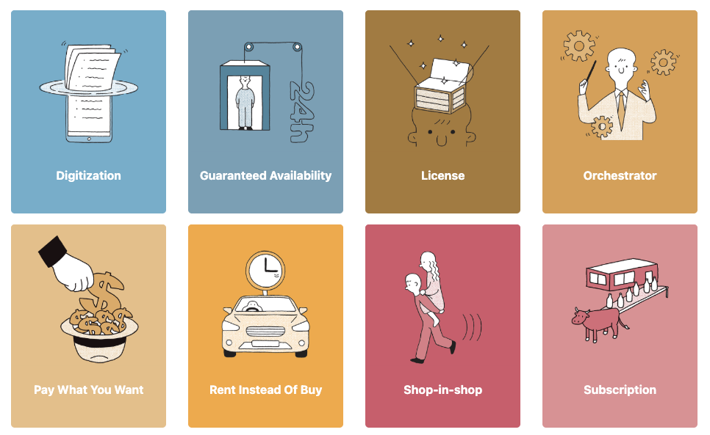
Source: HTTPS://BUSINESSMODELNAVIGATOR.COM/

Slide 16
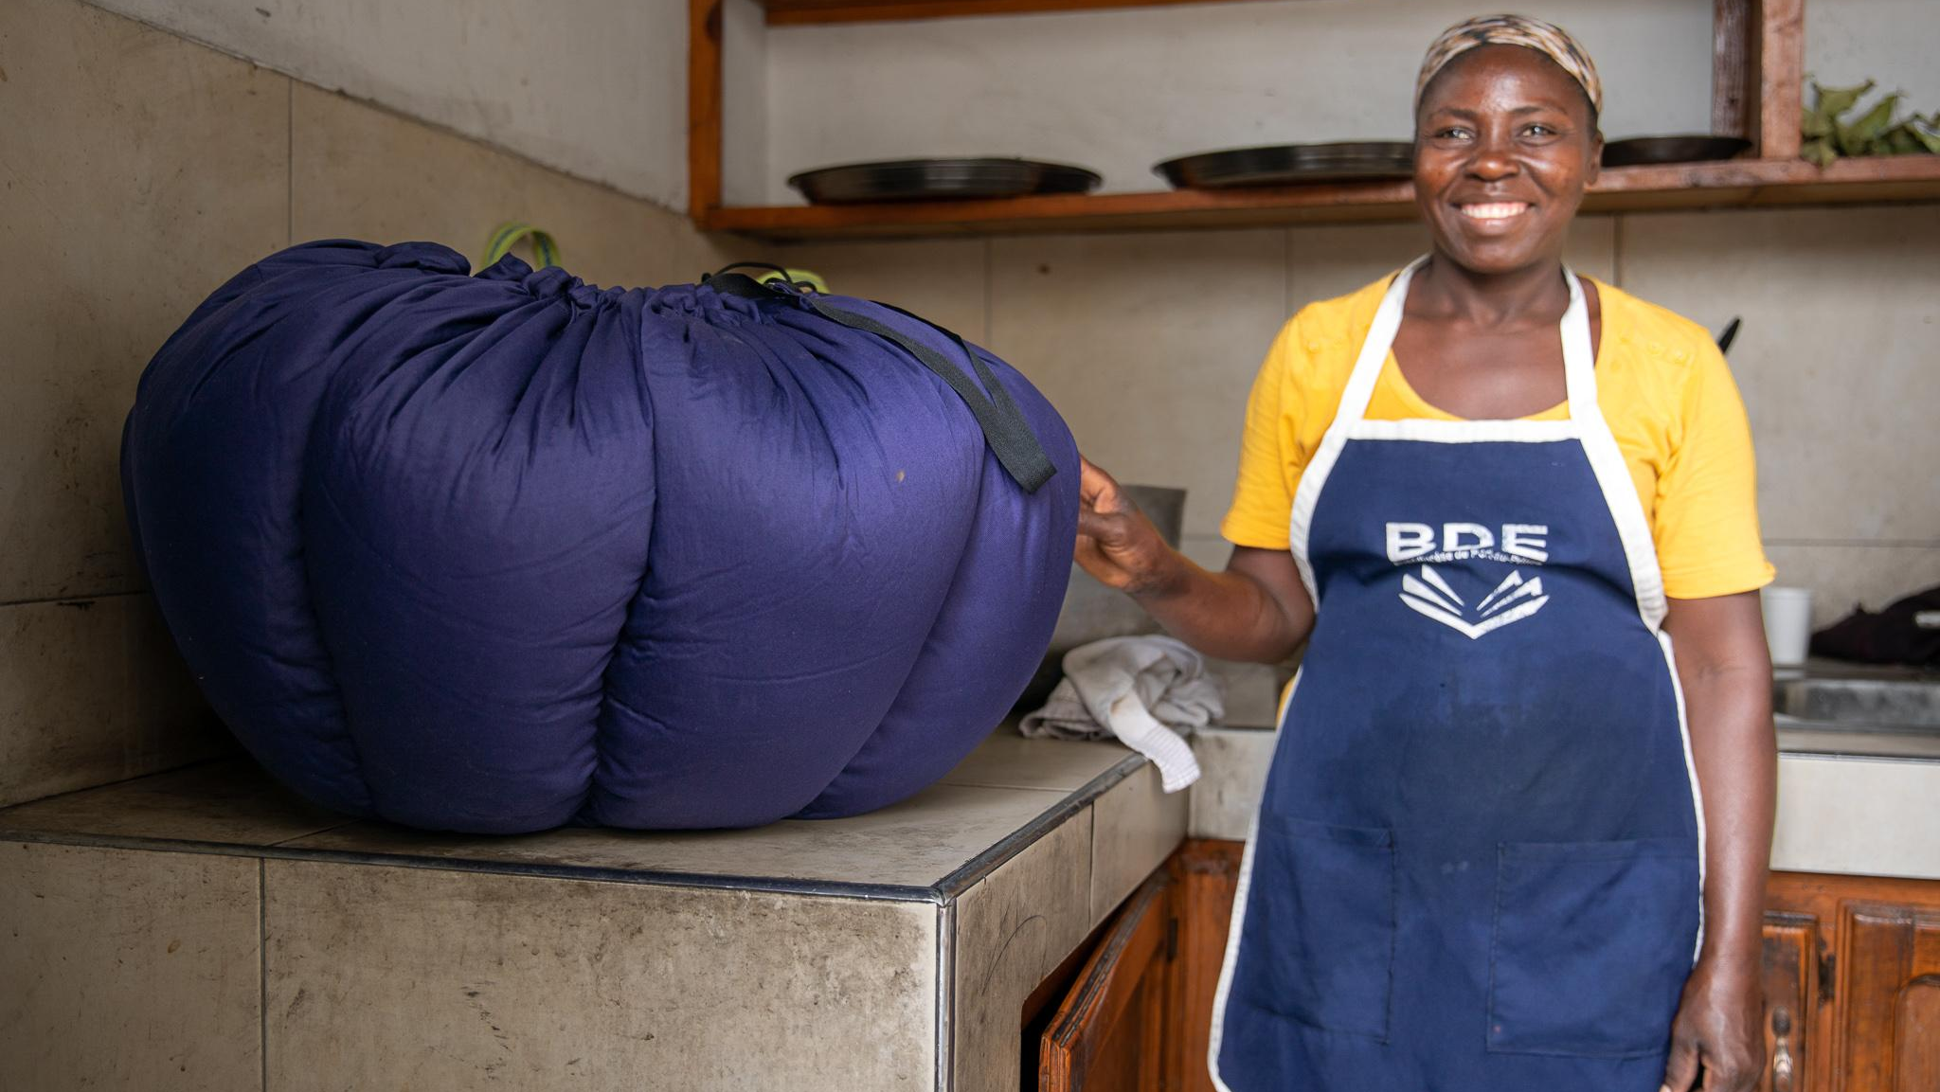
Workshop session
Introduction to today’s value chain framework
Haiti

Slide 17
Outside of your model but affecting it
The context you operate in: influencing and being influenced by
What ecosystem and context do you work within?
What external factors influence you or do you influence (policy, competition, trends, fragility)?
What you offer to create value
What is your solution (or system of solutions)?
What key activities are needed to deliver it?
Who you create value for and how
Who benefits? Who pays? Who owns the problem?
What is your value proposition?
How do you reach and deliver value to users, adopters and partners?
The impact and value you intend to create
What problem are you solving?
What value do you create and for whom?
What social and environmental effects does your solution have? Circularity / regeneration
Financial model: How you make it financially sustainable
What does it cost to run?
How do you generate revenue or funding? From what sources?
How you maximize the effect of our existing resources?
Operational model: How you operate to create and deliver value sustainably
What kind of operational capacity and expertise? (e.g. plant operator, development team)
What other key resources you need over time? (People, places, processes, and access).
Partners you depend on to deliver the value?
What is the physical aspect of your model? (e.g. factory)

Slide 18
An [innovation type] business model optimized for [Factor 1] , [Factor 2] , and [Factor 3]
This business develops [product concept] with a [key innovation] and [key market value].
PART ONE
Value Creation (How does the business generate value?)
Value Delivery (How does the business distribute value?)
Custom Category
Innovation
Constraints
Unit of Replication
[Physical]
Model
[Operating]
Model
[Partner]
Model
Payer + User Interaction
[Distribution] Model
Payer + User
Model
X
Factor
Innovation
Options
Neighborhood
Settlement
Challenge(s)

Slide 19
Value Map
Examples
IOM
Precious Plastic
Norwegian Church Aid

Slide 20
A [pyrolysis] business model optimized for [affordability] , [environment] , and [participation]
This business develops [settlement scale pyrolysis] with a [collaborative collection network] and [provides power to a large-scale community centre].
PART ONE
Value Creation (Pyrolysis Operations)
Value Delivery (Energy Distribution)
Custom Category
Innovation
Constraints
Unit of Replication
[Physical]
Model
[Operator]
Model
[Partner]
Model
Payer + User Interaction
Distribution Model
Payer + User
Model
X
Factor
Innovation
Constraints
Unit of Replication
Plant Operation
Operator
Model
Collector
Model
Payer + User Interaction
Distribution Model
Payer + User Model
Environment Protection
Pyrolysis
10T per day processing only plastic
Clean feedstock for high uptime
Settlement
Zone
(50,000 users)
Co-locate with existing intermediate dumpsites
Small Private
Utilities + Dumpsite Operators
CBOs operate daily pushcart routes for all waste & sort at source
Households bring waste to compound-
level bins
Powers community centres
Households pay nominal fee (80% recovery) + Public subsidy (20% recovery)
Community Centre Clean Up Days
Innovation
Pyrolysis 100T per day processing all waste
Total waste manage-
ment for continuous volume
Settlement
(200,000 Users)
Start a new sustainable dumpsite
Large
Public Benefit Utility
Utility operates a network of electric tuk tuks
Utility manages individual customers, with dynamic routing
Outputs power utility plant and fleet
Households pay fully loaded price (100%), made affordable through centralized operations
Utility operates under a SLA for 100% waste collection
Options
Options can be used to explore different approaches
Financing the assets
Which model leads to lower end user pricing?
Challenge(s)

Slide 21
An [early warning] business model optimized for [accuracy] , [response] , and [inclusion]
This business develops [a digital early warning platform] with a [hybrid, inclusive, localized datasets] and [enables the most accurate response ].
PART ONE
Value Creation (Warning Platform)
Value Delivery (Response Operations)
Custom Category
Technical Innovation
Innovation
Technical
Constraints
Constraints
Unit of Replication
Unit of Replication
[Physical]
Model
Physical
Model
[Operator]
Model
Operator
Model
[Partner]
Model
Responder
Model
Payer + User Interaction
Payer + User Interaction
Distribution Model
Distribution Model
Payer + User
Model
Payer + User Model
X
Factor
Response Assurance
Digital platform combining local insights with AI models
Diverse Training / High Accuracy
Conflict
Zone (National / Transborder)
Collaborative Deployment with Response Teams
Non-Profit Tech Developer
Multi-tenant Architecture
Virtual Community
Software-as-a-Service (SAAS)
Customer Fees (80% recovery)
Community Validators enhance inclusion
Innovation
Here’s an example of how a different type of business model fits into the framework
Options
Challenge(s)

Slide 22
An [energy access] business model optimized for [affordability] , [recycling] , and [sustainability]
This business develops [circular waste-to-energy platform] with a [focus on solar and mobile e-waste] and [minimizes access costs to end users].
PART ONE
Value Creation (E-Waste Collection)
Value Delivery (Energy Access)
Custom Category
Technical Innovation
Innovation
Technical
Constraints
Constraints
Unit of Replication
Unit of Replication
[Physical]
Model
Physical
Model
[Operator]
Model
Operator
Model
[Partner]
Model
Partner
Model
Payer + User Interaction
Payer + User Interaction
Distribution Model
Distribution Model
Payer + User
Model
Payer + User Model
X
Factor
Environment
Protection
National e-waste collection and processing network in displacement settings
Balancing repair, refurbish- ment, and recycling for optimal aggregation and value
National displacement settings (refugee settlements
Collection, sorting, processing, sales, and service of select devices. Assembly of second-life battery packs
Community-led enterprises (IOM
plays oversight and technical support role)
CBOs: Waste Collection, Repair and 2nd life product assembly. IOM & Private sector: Technical and operational oversight
Collect devices at disposal/repair points. Community outreaches. Informal collectors to be linked
Micro-
enterprises create models for sales and service of refurbished devices
User fees (100% of repairs and refurbished products);
E-waste Export to be further explored
Safe storage sites, awareness creation to avoid pollution
Innovation
Private social enterprise who can organize a successful national and settlement level model
For IOM, piloting revealed the need for a new high-level operating partner
Options
CBO Umbrella Organization is formed to strengthen high-level coordination
Which model is most sustainable, allowing IOM to exit?
Challenge(s)

Slide 23
Q&A
Clarifications?
Any questions before moving into the workshop?

Slide 24
Lets start working
IOM
Precious Plastic
Norwegian Church Aid

Slide 25
Workshop exercise (20 min)
Map your system
Map your system
You map your humanitarian system/ business model using the provided framework
Q&A and peer input are encouraged throughout the session
Those with an existing business model should focus particularly on the area that is least developed or needs further strengthening.

Slide 26
Summarize your strategic goals
What 3 criteria best define your business aims?
Consider what’s DESIRABLE to customers
Consider what’s FEASIBLE for the business
Consider what’s SUSTAINABLE for people + planet
Describe your concept in 3 components
What is your innovation + target scale of replication or improvement?
Innovation can describe technologies or capabilities
Scale of replication (diffusion or improvement) is the scale you work to create impact
What is the Value Creation model?
Capture what is distinct about how your business generates value in one phrase
What is your Value Delivery model?
Capture what is distinct about how your business distributes value in one phrase
Define your value creation and delivery models
How do you create value?
Summarize in 5 Components
Consider ‘Top Level’ Framing that bundles smaller components
How do you deliver value?
Summarize in 5 Components
Consider ‘Top Level’ Framing that bundles smaller components
Map your detailed value chain
What business, partnership, and funding options define your business model?
Consider and select one or more distinct options for fulfilling each component
Consider ‘Top Level’ Framing, or highlight distinct options separately
Consider the biggest key challenge(s) with the model you have selected
Reflect
How can you work toward articulating a simplified value chain over time?
Value Map Categories
Innovation - Define the technical aspect of your innovation (this can be a technology or a capability).
Constraints - Get specific about the biggest challenge your model needs to help solve in order to work effectively (this may influence later choices).
Unit of Replication - Define at what level your model should work with distinct operating partners and/or a formula that can scale to new areas (e.g. settlement, conflict zone).
Physical Model - What is the physical aspect of your model? (e.g. pyrolysis factory, software lab)
Operating Model - What kind of operating system does it require? (e.g. plant operator, development team)
Partner Model - Is there another key component of your operating model played by a different actor? (e.g. waste collection, coordinating body of incident responders)
User + Payer Interaction - What is the type of interaction between the lead commercial partner and the users + payers? (e.g. users support waste collection to communal bins, subscriber organizations first responders monitor emergencies)
Distribution Model - How will your end product be distributed to users? (e.g. Fuel for Community Centre; Software as a Service with Multi-Tenant Architecture)
User + Payer Model - To what extent will you get paid by users and/or other payers? (e.g. User fees cover 100% of operational expenses, and Other funders required for capital expenditures)
X Factor - Is there a unique aspect of your model to ensure social, environmental, and commercial sustainability and protection? (e.g. Community Clean Up Days ensure total waste collection; Community Validators ensures AI model accuracy and inclusivity)
Exercise Guide | Part One

Slide 27
An [innovation type] business model optimized for ____________________ ____________________ ____________________
This business develops _____________________ with a _____________________ and _____________________
PART ONE
Value Creation _______________________________________
Value Delivery _______________________________________
Custom Category
Innovation
Constraints
Unit of Replication
[Physical]
Model
[Operating]
Model
[Partner]
Model
Payer + User Interaction
[Distribution] Model
Payer + User
Model
X
Factor
Innovation
Options
Neighborhood
Settlement
Challenge(s)

Slide 28
Plenary reflection (5 min)
Bottlenecks & weaknesses
Identify gaps & next step action
What are the most important and pressing bottlenecks or weaknesses in your system right now?

Slide 29
Exercise: Deep dive (15 min)
Finance OR Partners
Choose one focus area:
Financial sustainability model OR Partner model
Using the framework, deepen your analysis of the chosen focus area
Map to clarify strengths, gaps, risks, and opportunities
Define some key action points to continue working with

Slide 30
Choose one area to model in depth
Partners vs. Funders
Partners
Consider partners that are relevant to your model and how to collaborate with them
Type of Partner - What type of organization? E.g. CBO, Private Company, NGO, Government
Partner Examples - What examples do you know of? E.g. Uganda Ministry of Environment
Contributions to Validate - What are your desired contributions from them to test? E.g. Leverage existing e-waste campaigns
Value & Incentives - What’s in it for your partner? E.g. Reach their campaign targets for public education
How to Sustain - Are there any other ways to enhance the relationship? E.g. Offering to help co-design the next campaign
Funders
Consider funders that are relevant to your model and how to attract them
Funding Need - What type of funding do you need? E.g. Startup capital for National E-Waste Aggregator
Type of Funder - What type of funder provides such financing? E.g. Angel investor, Existing Entrepreneur, Innovation Challenge, Climate CSR
Funder Examples - What examples do you know of? E.g. Innovation Village, IKEA Foundation PowerUp! Program, I&M Bank CSR
Funder Requirements - What does the funder expect? E.g. Proof-of-Concept, 1,000 beneficiaries reached, Attend an incubation program
How to Attract - What actions can you take to strengthen your position? E.g. Prioritize environmental evidence, Create beneficiary stories
Reflect
Insights + Challenges - Did mapping partners or funders relative to your value chain reveal anything new to you?
Closing the Loop - Might pursuing different value chain options better position you with partners or funders?
Exercise Guide | Part Two

Slide 31
Partner Canvas Mapping key partners to your value chain
PART TWO
Value Creation
Value Delivery
Type of Partner
Partner Examples
Contributions to Develop
Value & Incentives (for partners)
Neighborhood
How to Sustain
Settlement

Slide 32
Funder Canvas Mapping key funders to your value chain
PART TWO
Value Creation
Value Delivery
Funding Need
Typer of Funder
Funder Examples
Funder Requirements
Neighborhood
How to Attract
Settlement

Slide 33
Plenary sharing (5 min)
Finance OR partners
2–3 participants who briefly want to share key reflections?
One insight gained
One challenge identified
One action or shift you will consider moving forward

Slide 34
Our best advice
Identify gaps & next step action
Take a few minutes to reflect individually and share:
What are the most important and pressing bottlenecks or weaknesses in your system right now?
(What are the 1-3 most important things you can do to address them going forward?)

Slide 35
Summary &
next steps
IOM
Precious Plastic
Norwegian Church Aid

Slide 36
Resources
HIP resources: Innovative Business Models in Humanitarian Contexts: https://hip.innovationnorway.com/article/business-models
Humanitarian Innovation Guide by Elrha on business modelling: https://higuide.elrha.org/toolkits/invention/ideation/explore-business-models/ There are 55 and Elhra estimates that at least 30 of them are relevant to the humanitarian sector: https://businessmodelnavigator.com/explore There is a whole book that is the background for the website https://www.saxo.com/dk/the-business-model-navigator_bog_9781292480701?srsltid=AfmBOoqtItU1YUPdFnHa…
A Business Model Canvas for Humanitarian Innovation by Paula Gil Baizan https://medium.com/@paulagilb/a-business-model-canvas-for-humanitarian-innovation-cf7c1d474775
Tandemic’s Social Business Model Canvas: https://www.socialbusinessmodelcanvas.com/
Impact Business model Canvas https://www.impactbusinessmodelcanvas.com/
The Business Model Canvas by Strategyzer: https://www.strategyzer.com/library/the-business-model-canvas
Tandemic’s Social Business Model Canvas
Notes:
Social Business Model Canvas by Tandemic

Slide 37
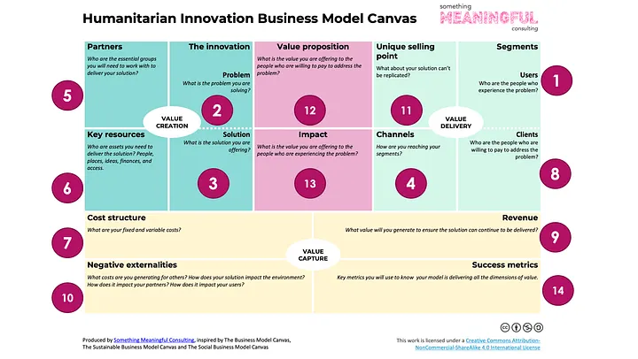

Slide 38
Value creation model
Financially viable and sustainable model

Slide 39

Value creation (business) model
The value creation model can be a platform to optimize a specific project or solution or a tool that helps you to understanding and create a sustainable model both from organisational, social, environmental and financial aspects.
The model is meant to be iterative, so you might need to go back to the previous steps to adjust key components, cost structures or sustainability as you identify and define aspects of the other steps to ensure a both feasible and sustainable value creation model.
The value creation model is a framework that allows you to quickly and easily break down the model for value creation of your solution or organisation into various defined factors, and uncertainties.
It can help you...​
Get an overview of all the critical elements in your project / solution or organisation
Challenge your assumptions to ensure you are not basing your project/solution on misconceptions
Gain a clearer understanding of which areas you do not need to focus your efforts on because they are either too resource-intensive to do anything with, or because they are not of great importance to your project​
Get an overview of what are the biggest and most critical uncertainties in your project, which enables you to
  Know which activities you should prioritize
  Which other people or organizations would you benefit from having on the team?
  Create a clear work plan with defined tasks
  It is easier to distribute tasks to a project team and be sure that you do not do double work and spend your time in important areas.​
A framework for the development of a sustainable value creation model of a new solution or your organisation

Slide 40

1.
Map the key aspects and uncertainties on core components of the value creation model
Begin by filling out step 1 of the model outlining key aspects of each components of the value creation model and key uncertainties or assumptions related to each of the components. It's important to emphasise that in this table we are not evaluating costs or potential revenues, this will be done in step 2. This is to ensure that we distinguish between whether the solution is feasible (can we create the value we aim and how?) and whether it is financially sustainable or profitable as well as socially and environmentally sustainable that will be assessed in step 1.1.
When discussion the key uncertainties or assumptions these question can be valuable to consider:
  Is there uncertainty about which resources you need or whether the necessary resources are available?
  Is there uncertainty about which activities need to be carried out or whether the activities will lead to the desired solution?
  Is there uncertainty about how the service should function, what it should look like, or what features it should have?
  Is there uncertainty about how to communicate the service to users?
  Is there uncertainty about whether the service will deliver the desired value to the user or whether users will adopt the solution?
Map key aspects and uncertainties related to environmental and social sustainability
In step 1.1 you will map the environmental and social sustainability – positive impact or potential negative consequences - of your solution and value creation model related to key components of the value creation model. You should also map key uncertainties or assumptions you would need to explore further.
Map key aspects and uncertainties related to costs, revenue and use of resources
Map the costs, revenue streams and how you could maximize the use of the resources that you have to enhance the financial viability or profitability of your solution or organisation. Same as in the previous steps, map key uncertainties or assumptions you would need to explore further.
Identify and select key uncertainties and assumptions to be addressed
In step 3 we focus on identifying and prioritizing the key uncertainties and assumptions that we have mapped in the previous steps. You should select the uncertainties or assumptions that needs to be tested and addressed going forward to secure we are creating a sustainable value creation model.
Review the list of uncertainties in the project. Choose the uncertainties you think are most critical to resolve first (probability x impact).
How important is this point to the project, and how significant is the uncertainty?
How could it be tested and addressed?
How to use the value creation model tool
1.1
2.
3.

Slide 41
The value creation model
Step 1.
Key components of your value creation
(business)
model
1
2
3
4
5
6
Key resources
Activities
Solution
Channels
Value
Key partners
Describe the resources needed e.g. expertise, human, time, material resources, financial resources etc.
Do we know:
what resources we need?
if they exist?
that can get hold of them?
If we can use existing resources in new ways?
Can we start from what we have?
Describe the main activities need to create and deliver the solution?
Do we know that the activities
can be executed?
can be executed by us?
will result in the desired outcome?
Describe the solution we deliver (often a main solution with various adaptations tailored to different users and contexts)
Do we know
all the details we want the solution to satisfy?
which adaptations we want/ need to secure its scalable?
to what extent we should emphasize standardization vs. flexibility in the solution?
What in the design or features could ensure that the solution is used in the right way to secure intended quality and the highest possible value?
List main channels or activities that connect, create awareness and engagement for the solution among the target group(s)/user(s), or other crucial stakeholders such as
Relationships we need to build with users and other crucial partners to ensure use?
Ways to market the solution to build awareness, desire and emotional value among the users.
Logistics – how do we distribute the solution?
What complementary s​upport, guidance or user manual(s) can help secure maximum value and usability for the users.
What functional, emotional, or social value (including potential negative impacts) does the solution create for users, other individuals, and the environment?"
How can we ensure that the solution is used in a way that delivers the highest value?
Do we know:
If the solution truly provides value to the user and what aspects of the solution the user finds most valuable?
How will the user interact with and utilize the solution?
To what extent the user want to customize or adjust the solution?
What could be potential risks or negative consequences of the solution?
Describe the key partners
Who are our key partners?
Which are our suppliers?
Which are our ambassadors?
How can we effectively engage or communicate with them?​
What are the potential barriers, risks or challenges and mitigation efforts?​
What are their willingness, ability or incentives to use, buy, invest or promote your solution?
Note the key elements of the value creation model and potential uncertainties or assumptions that you need to explore further
Notes...
Notes...
Notes...
Notes...
Notes...
Notes...

Slide 42
Step 1.1: Sustainability deep-dive - What positive and negative impact does your value creation model entail?
Key
resources
Key
activities
Solution
Channels
Use & value
Disposal & recycling
What kinds of impacts are linked to our resource use and
how can we manage them?
Environment:
What is the environmental impact of our key resources?
Do we rely materials with a high footprint and are there ways to reduce it?
Social:
Are there risks or issues regarding working conditions and human rights related to the extraction of resources or to the expertise we use?
Who do we buy from?
Who do we hire (diversity?)
What kind of impacts are linked to the activities and how can we manage them?
Environment: Can we use less resources in production, e.g. less energy and emissions?
Can we use or sell byproducts?
How can we reduce waste?
Is there pollution or risk of pollution?
Social:
Are there risks or issues regarding working conditions related to processing and development?
Are there ripple effects for the local community?
Training
What kind of impacts are linked to the solution and how can we manage them?
Environment: How to secure solutions that promote circularity, e.g. through:
Increased durability
Reparability
Sharing
Solves several needs (makes other products redundant)
Regeneration of resources through recyclability or upcycling
Social:
Ensure availability, affordability for different groups
Inclusive and accessible design
Create customized variants
What kinds of influences are linked to dissemination and distribution and how do we manage them?
Environment:
Can we increase/decrease the positive/negative impacts on the environment linked to the distribution of the product, e.g. by reducing energy, transport or packaging?
Social:
Can we reduce negative social impacts or increase positive social impacts through
availability in different locations?
use of subcontractors?
the attitudes/behaviours we enable or create?
What environmental or social value do we deliver with our solution, and how can we maximize it?
Environment: Can we reduce the environmental footprint by making sure the solution is used
by several
more often
longer
more broadly
Social:
Can we increase positive societal impact by making sure the solution
Is used by more more people though availability and affordability for different user groups
Ise used correctly, reducing negative side effects
What happens to the solution when it is no longer in use?
Environment: Can the solution or parts of it be re-used, re-purposed or recycled?
Social:
Can we make the products available to other groups?
Could we secure jobs through repurposing or recycling?
Notes of the key sustainability related elements linked to resources and potential uncertainties that you need to explore further…
Notes of the key sustainability related elements linked to activities and potential uncertainties that you need to explore further…
Notes of the key sustainability related elements linked to the solution and potential uncertainties that you need to explore further…
Notes of the key sustainability related elements linked to Channels and potential uncertainties that you need to explore further…
Notes of the key sustainability related elements linked to use & value and potential uncertainties that you need to explore further…
Notes of the key sustainability related elements linked to Disposal and recycling and potential uncertainties that you need to explore further…
Notes:
Se på om vi bør inkludere dette: Bærekraftige forretningsmodeller.pptx

Slide 43
Step 2. How make it a financially viable solution and value creation model?
Financial viability focuses on identifying sustainable revenue streams and cost structures that enable the long-term delivery and development of the solution.
Development, production or distribution costs
Revenue streams
Maximize the use of our resources
Describe the key revenue streams
What are the potential income streams for the solution?
Which resources can we charge for (willingness to pay)
What do we charge for today?
How do we charge?
Identify potential sources of funding such as
Grants, investments, contracts, subscriptions, donations or partnerships, to support the testing, implementation and potential scaling of the solution?
Select and describe how you could use it in the most relevant way to secure financial sustainability: Could some be project-based, revenuew based on sales of the solution, would we need some revenue from fundraising or investmens?
How can we strategically invest our resources to ensure success?
How can we optimize the use of our resources, including personnel, infrastructure, and technology, to achieve maximum efficiency and cost-effectiveness in both the short and long term?
How can we remove or reduce costs and maximize our existing resources to ensure value creation?
How can the organization balance the need for financial sustainability with the need to ensure that the solution remains accessible, affordable and of necessary quality for those who need it most?
Describe the key costs in the value creation model.
What are the costs associated with the solution, including both direct and indirect costs?
Notes of the key elements related to costs and potential uncertainties that you need to explore further…
Notes of the key elements related to revenue streams and potential uncertainties that you need to explore further…
Notes of the key elements related to maximizing use of resources and potential uncertainties that you need to explore further…
The value creation model

Slide 44

Step 3. Mapping central uncertainties and assumptions
Once the model is completed, you can proceed to systematically describe and categorize the uncertainties in the project. This can be done by distinguishing between different levels of knowledge and uncertainty:
What we know we know (no uncertainty): These are areas where you have solid facts and data. E.g., "We know which resources are already available.
What we think we know (some uncertainty): These are assumptions or beliefs based on experience or incomplete information. E.g., "We believe the proposed solution will meet the user's needs."
What we know we don’t know (high uncertainty): These are identified gaps in knowledge where further exploration or testing is needed. E.g., "We know we don’t fully understand how users will adopt the service.”
The there is also, what we don’t know we don’t know. By nature, these cannot yet be added to the model but may emerge as the project progresses.
Step 3
Map and categorize project uncertainties
Balancing complexity and uncertainty
Remember to write down the uncertainties at a level that ensures you don’t spend too much time on it, and that the table doesn’t become overly complex and unmanageable. This will vary from project to project.
For instance, if your idea is to develop a global training program to increase women’s workforce participation, you’re dealing with a different level of complexity than if you aim to develop fish cake production for a local market. When selecting an uncertainty to work on, that’s when you delve into the details of that specific area of uncertainty.

Slide 45
Prioritize uncertainties and define suitable measures
When deciding which areas to focus on and test first, three main factors should be emphasized:
How critical is the uncertainty or assumption to the project?
How significant is the level of uncertainty associated with this point?
How resource-intensive do you expect it will be to reduce the uncertainty on this point?
Step 3 (and 4)
How to test and reduce the project uncertainties?
Step 4
Action to reduce uncertainty and securing sustainable value creation
Next step is to identify and start carrying out activities and measures you can undertake to test or reduce the uncertainties related to the prioritized areas. What actions can you take to resolve or mitigate the uncertainties?
The content of the test plan should be updated and adjusted along the way, serving as a useful tool for checking what has been done, what has been successful, and which specific and important steps need to be taken moving forward.
The model should continuously be updated throughout the project. Among other things, the following changes will occur:
Uncertainties will be reduced.
New uncertainties will emerge.
During the process, some of the points we have outlined may need adjustments, and we will then identify alternatives that must be incorporated into the model.

Slide 46
There are a number of great toolboxes you can use
Board of Innovation toolkit: https://www.boardofinnovation.com/tools/
Nesta, innovation foundation toolkit: https://www.nesta.org.uk/toolkit/ and their DIY toolkit: https://www.nesta.org.uk/toolkit/diy-toolkit/
IDEO designkit: https://www.designkit.org/methods
A curated list of the best business, design, and organisational change toolboxes built by some of the most influential companies, institutions and thinkers: https://www.toolboxtoolbox.com/
OPSI (OECD's commitment to innovation in the public sector): https://oecd-opsi.org/ and they have developed a toolbox with various tools adapted to innovation work in the public sector: https://oecd-opsi.org/toolkit-navigator/ Innovation leaders mentioned that their tools were good and especially because they focus on anchoring in a political structure.
Hyper Island toolkit for creativity and innovation: The Hyper Island toolkit is a resource kit you can use to find and apply creative collaboration and unleash potential in your team or organization. https://toolbox.hyperisland.com/
IBM design thinking toolkit: https://www.ibm.com/design/thinking/
Response Innovation Lab https://www.responseinnovationlab.com/innovation-evidence-toolkit Tools for prototyping and testing https://www.responseinnovationlab.com/toolkit-innovation-evidence-prototype

