Slide 1
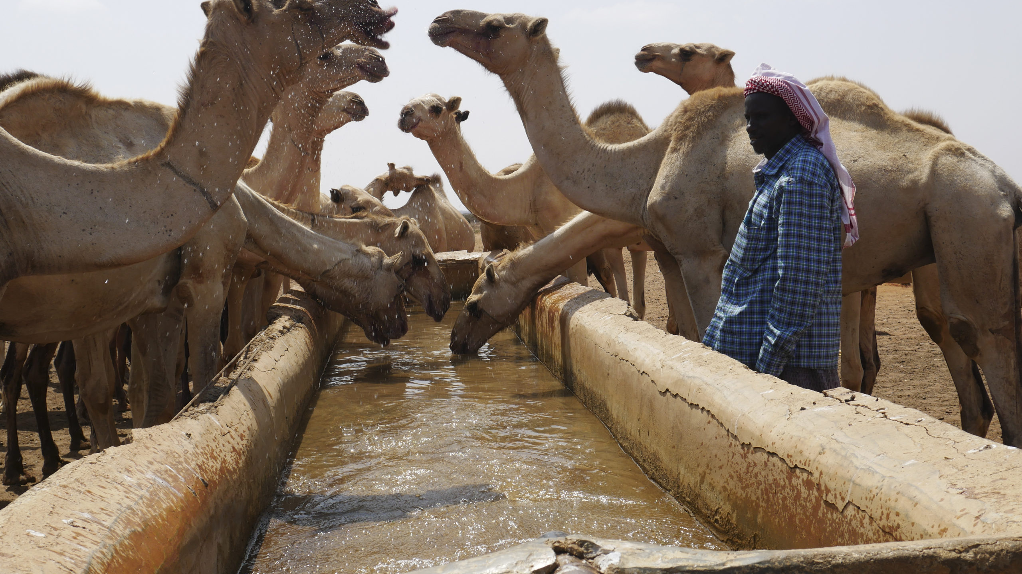





FIRM II
Financial Innovation & Resource Mobilization Project – Index Insurance
Transition to Scale
ADRA,
Notes:
ADD LOGOS OF ALL PARTNERS

Slide 2
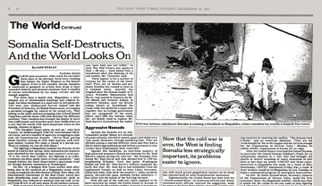
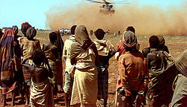
Collapse of the Somali State
For many Somalis, the government collapse and famine of 1991 felt like the end of the world.
A Beacon of Hope: In this time of chaos and profound uncertainty, their livestock became their ultimate safety net.
The Power of Livestock: The camels, goats, and sheep were more than just animals; they were the force that carried communities through the storm and allowed the country to be reborn.
Notes:
Ragnarök / Somalia 1991

Slide 3
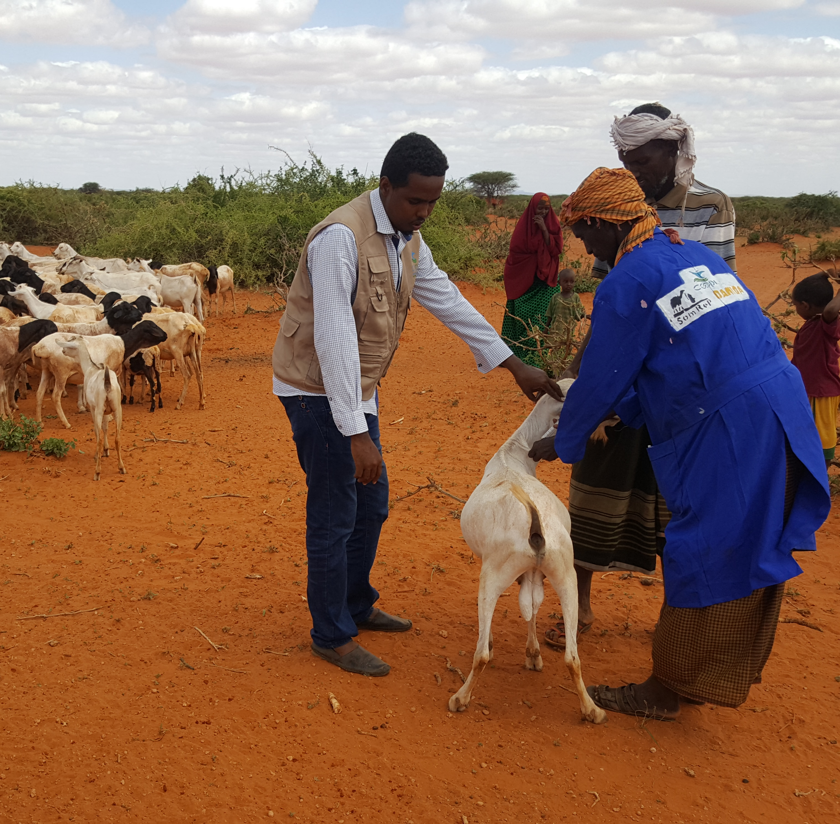
The Challenge:
A Vicious Cycle
Disasters like drought are becoming more frequent and intense due to climate change, leading to water scarcity, the rapid depletion of pastureland, and mass livestock deaths
Humanitarian funding is reducing, and more sustainable resilience tools and long-term solutions are needed.
An estimated 80% of Somalia's population raise livestock. Strengthening this sector is the key to building national resilience and moving from temporary fixes to permanent empowerment.
Notes:
Droughts - push communities into poverty and increase their reliance on humanitarian aid, threatening their traditional way of life.
The Challenge:
A Vicious Cycle

Slide 4
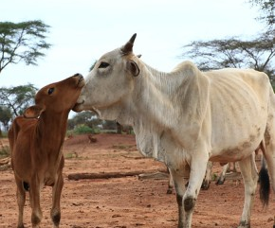
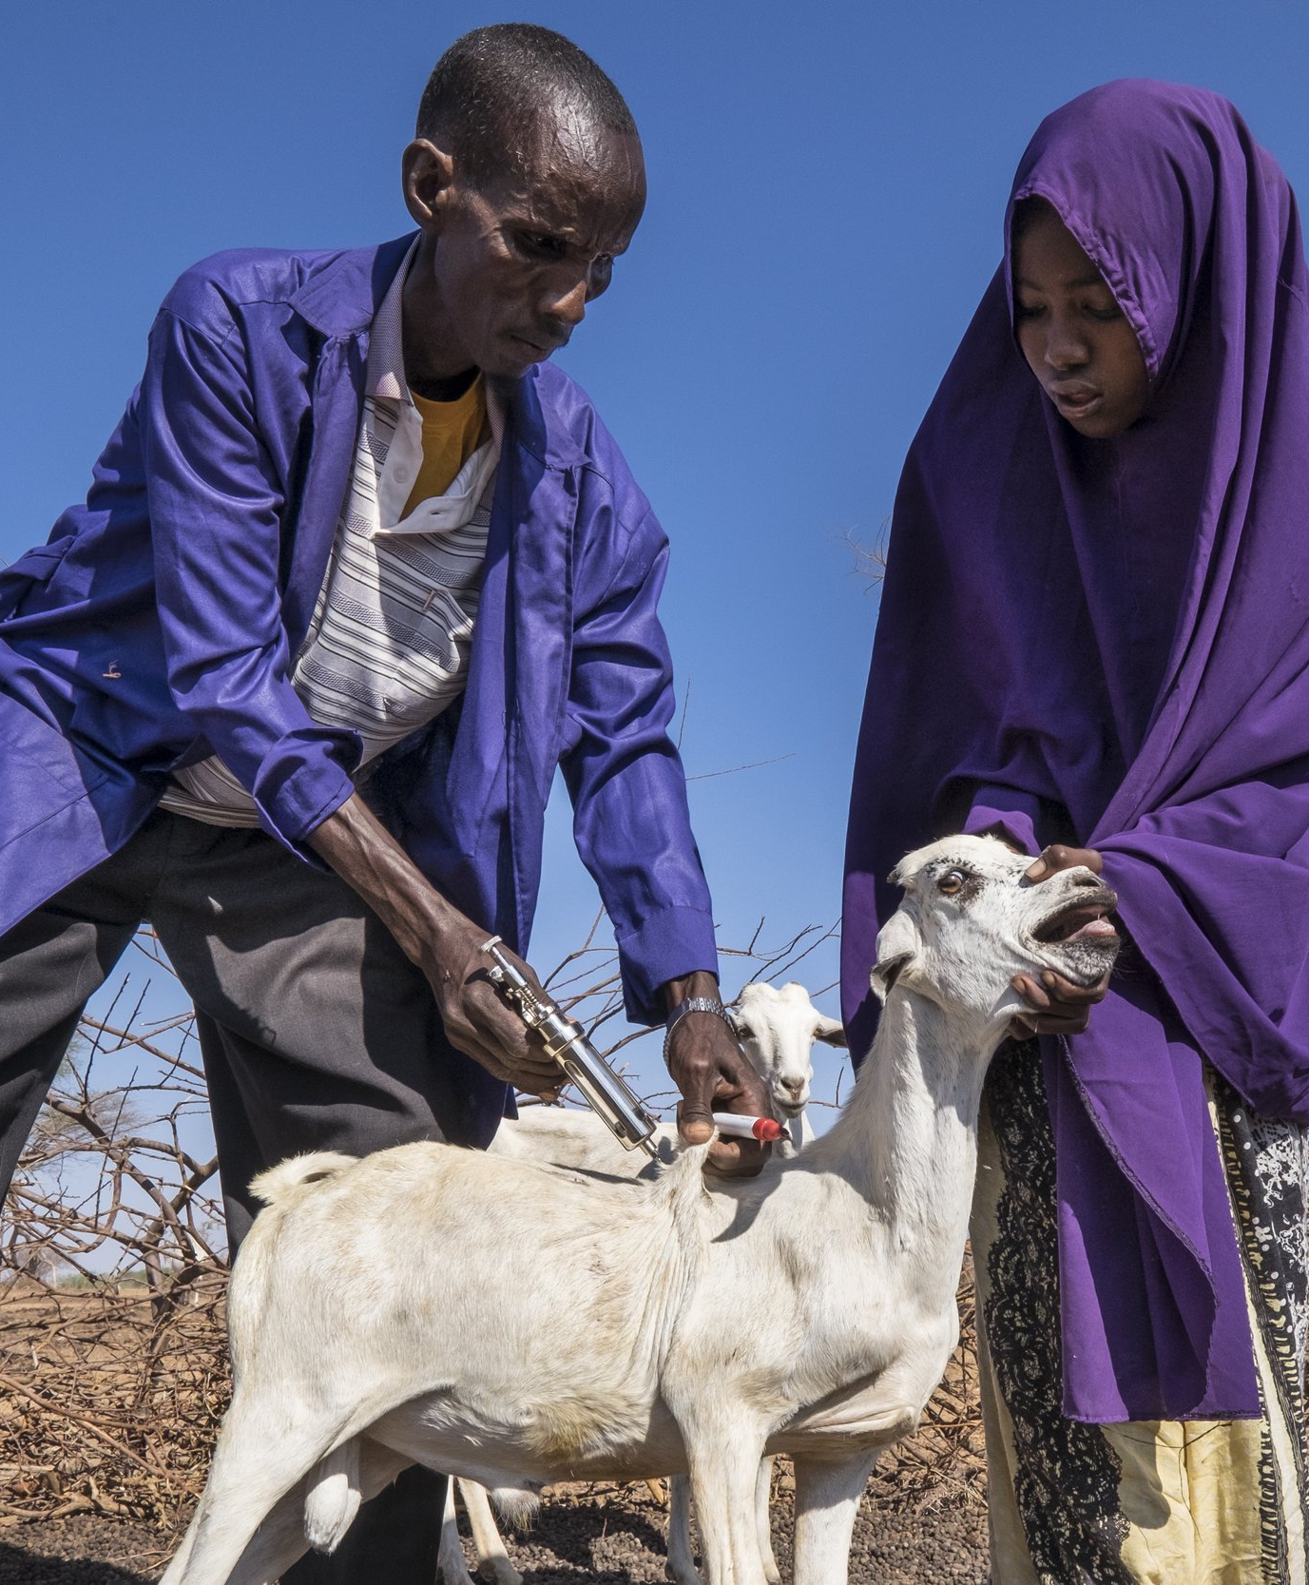
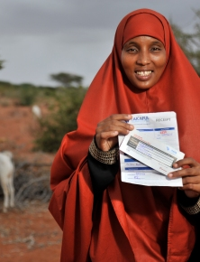
Bundling of Index-Based Livestock Insurance (IBLI)
Moving from response to anticipatory action
Empowering local actors to be agents of change
Bundling: combining IBLI with other services or interventions to enhance its effectiveness and uptake
Protecting livestock, providing access to capital for other needs, and lowering the cost of vital resources.
Notes:
We do this by moving from a reactive response to an anticipatory action model using a bundled approach to Index-Based Livestock Insurance (IBLI).
IBLI allows for funds to be released before a crisis fully unfolds, enabling pastoralists to take proactive steps to prevent or lessen the impact of a drought, and ultimately reduce losses.

Slide 5
Evidence & Traction
Federal Mandate: The Federal Government of Somalia (FGS) has formally integrated IBLI into its national resilience strategy. The Minister of Livestock, Forestry and Range (MoLFR) reaffirmed this as a "national imperative" for food security and economic growth.
Established Task Forces: A Federal-level IBLI task force and Federal Member State-level technical working groups have been created to oversee implementation.
Regulatory Frameworks: There is an ongoing transition from pilot-phase to formal policy. This includes the development of a National Feed Policy and a National Fodder Development and Management Strategy, which are being enhanced to include sector-internal financing mechanisms.
The Ecosystem Fit
The DRIVE Project: Backed by a $40 million IDA grant from the World Bank, the "De-Risking, Inclusion and Value Enhancement of Pastoral Economies" (DRIVE) project provides the primary institutional vehicle for IBLI in Somalia. This has set the foundation for:
  Engagement with clan leaders & traditional leaders to help ensure community buy in
  Partnerships with local institutions and private sector, such as Salaam Somali Bank
Notes:
Project Overview - visualization

Slide 6
What We Have Learned
The Barrier | The Innovation (The Pivot) | The Impact
High Basis Risk: Satellite data alone sometimes misses localized droughts, leading to "false negatives" where herders suffer but get no payout. In arid & semi-arid regions, the data shows an eternal drought. | Nuru’s Multi-Index Triangulation: Cross-references satellite data with ground observations to ensure payouts match the actual forage scarcity. | Increased Accuracy: Payouts are more reliable, reducing community frustration and building long-term market trust.
Low Perceived Value: In "good years" without a drought, herders feel they are "wasting" money on premiums with no tangible return. | ILRI’s Bundled Services: Even if no payout occurs, herders access credit for trade and vet services to keep animals healthy. | Continuous Value: Provides a reason to stay in the system every year, creating a sustainable, "sticky" product.
Slow Response: Traditional aid and single-index models can take months to process. | Anticipatory Triggers: Data signals allow for payouts within 4 weeks, before animals start dying. | Asset Preservation: Herders get cash in time to buy feed/water, preventing the total collapse of their livelihoods.
Notes:
Evolving bottneck’s and challenges
Arid & semi-arid
Now its policy and regulatory
Choose a format:
Option A – One Major Pivot
What you changed and why.
Option B – Hard Truth Slide
A constraint you underestimated.
Option C – Emerging Insight
What the ecosystem is teaching you.
This is where your authenticity differentiates you
Evolving bottneck’s and challenges
Arid & semi-arid
Now its policy and regulatory

Slide 7
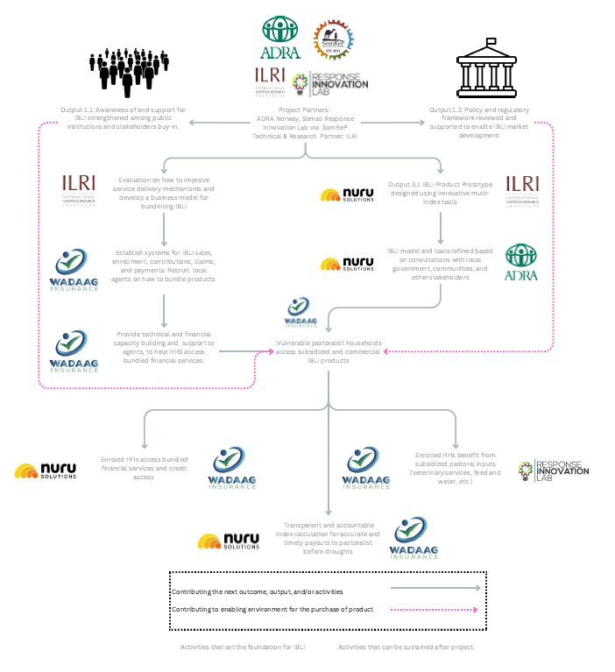
Building a sustainable future: Our core pillars
Strengthened regulatory environment
Bundled financial service package
  A comprehensives and dignified package of subsidized IBLI products, credit, and access to other vital pastoral inputs based off the want's needs of pastoral communities
New multi-index model to enable accurate & timely payouts for arid & semi-arid regions
  Standardized Precipitation Evapotranspiration Index (SPEI) & Leaf Area Index (LAI)
Notes:
This approach is designed around 3 core pillars where we aim to ensure the development of an equitable, affordable, and sustainable solution that can last far beyond this project and empower pastoralist to protect themselves, their assets, and their futures
If we are able to achieve these 3 pillars, we hope to prevent negative coping mechanisms such as the premature sale of livestock, the depletion of other household assets, and displacement.
The first pillar focuses on strengthening the regulatory environment at both the federal and local level to ensure the smooth rollout and management of the product.
Our second goal is to create a bundled financial services package for pastoralists that combines insurance, credit, and subsidized inputs to meet their needs more effectively.
This will help by:
Protecting their livestock.
Giving them access to capital.
And lowering the cost of vital resources while increasing access to them.
To reduce risk and ensure uptake, We will leverage lessons from ILRI's work in Kenya and federal Somalia, to embed real-time "willingness-to-pay" research, choice experiments, and real-time uptake monitoring to learn the needs and wants of pastoralists
We will also explore innovative lending terms and embed our insurance product into existing group credit and savings schemes
Lastly, we will work to design & develop a new multi-index model built on real-time data, combining 2 indices’: SPEI and Leaf Area Index (LAI) to:
better capture the challenges pastoralists face
and significantly reduce basis risk,
providing us the ability to build more reliable triggers for payouts.
With this new approach, we aim to reduce payout timelines, and get funds to herders within a maximum of 4 weeks from a trigger.

Slide 8
Pathway to Scale or Sustainability
The Capital Stack
Catalytic Capital: Grants from partners like Innovation Norway fund the technical setup, multi-index calibration, and initial "smart subsidies" for premiums.
Local insurers (e.g., Wadaag Group) and international reinsurers provide the risk-carrying capacity, shifting the burden away from the public sector.
Pastoralist, through graduated premium payments, moving from 100% subsidy to a market-rate contribution over 3–5 years.
Revenue & Sustainability Pathway
The "Bundle" Value Proposition: By integrating insurance with Group Credit and Veterinary Services, the product generates multiple revenue streams for local partners, making the "insurance" component an anchor for broader financial inclusion.
Data Monetization: The high-resolution forage and weather data generated by the project creates a secondary value loop for government planning and livestock value-chain actors.
The Exit Strategy: Market Graduation
Year 1-2: High grant support to build "Informed Demand" and prove the payout reliability.
Year 3-4: Subsidies decrease as insurance is bundled with productive loans; the increased productivity of the livestock pays for the insurance premium.
Year 5+: A fully functional, private-sector-led market where IBLI is a standard financial tool for Somali herders, backed by regional reinsurance.

Slide 9
Collaboration
Opportunities
Link with linking livestock to sales
Now
Data resources (satellite data, historical risk data, etc.)
Policy Development – taking federal level frameworks and helping adopt at the local level
Future
Help scale and layer onto other livestock initiatives to build resilience
Help scale to new regions once we prove the new index works
Notes:
Areas for Collaboration – data resources, policy development – localized from federal level, linking to existing other livestock initiatives. Integration into cultural and religious structures to give legitimacy
Strategic Partners to help look at linking livestock to sales

Slide 10
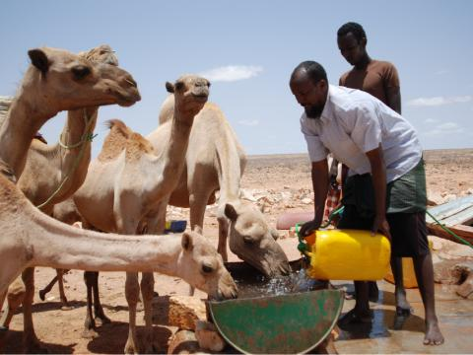
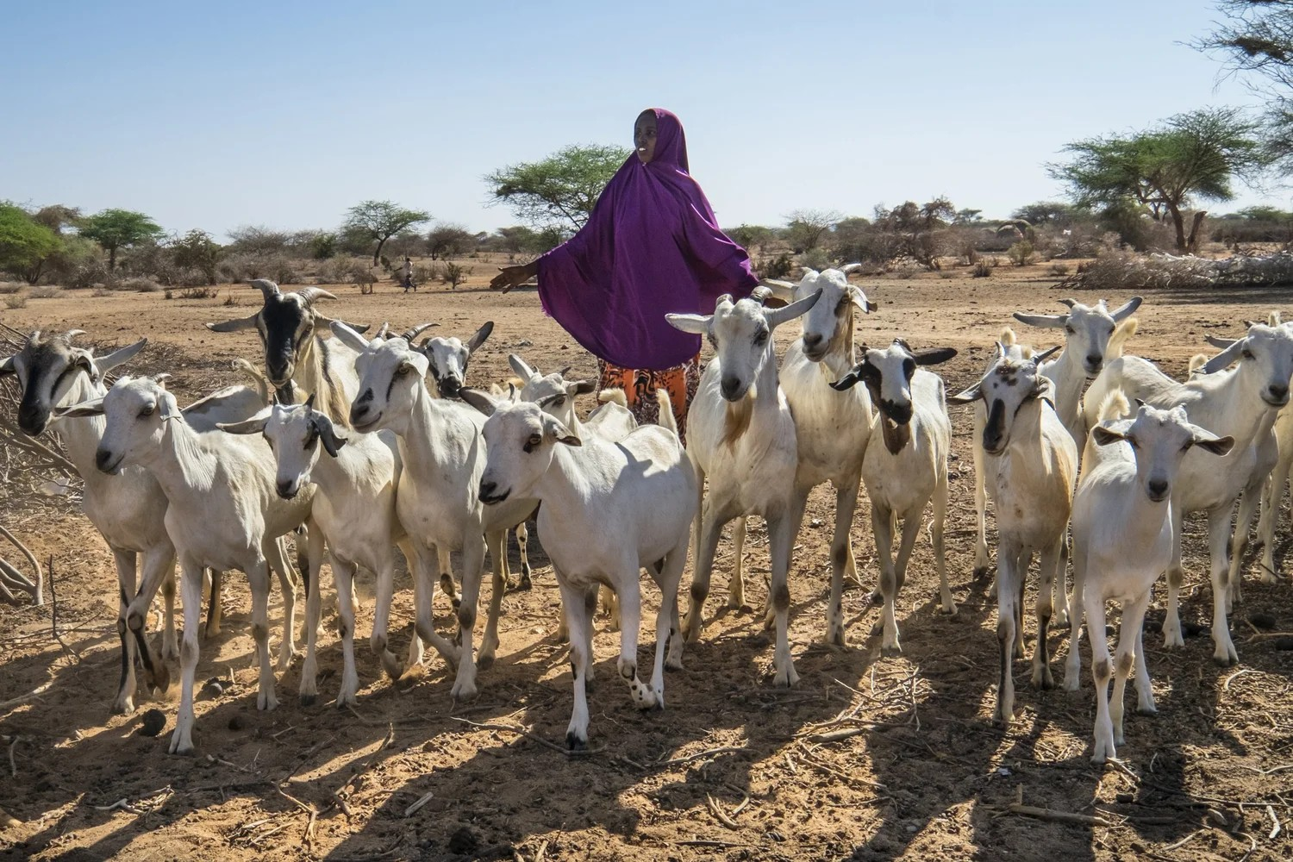
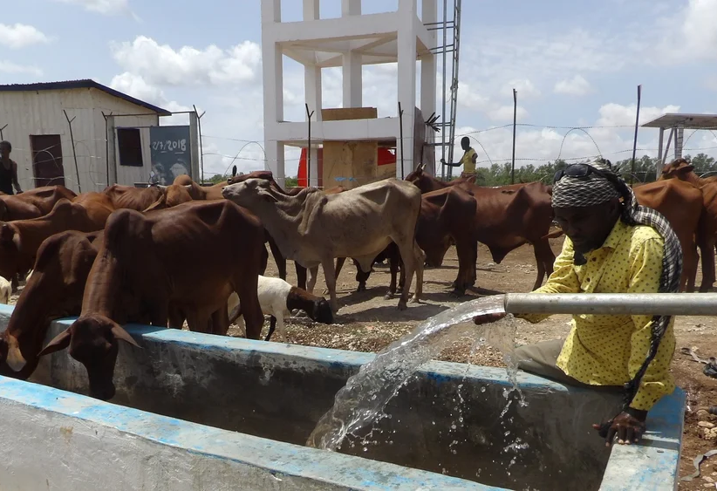
Rewriting the Story of Resilience in Somalia
Notes:
Future

