Slide 1


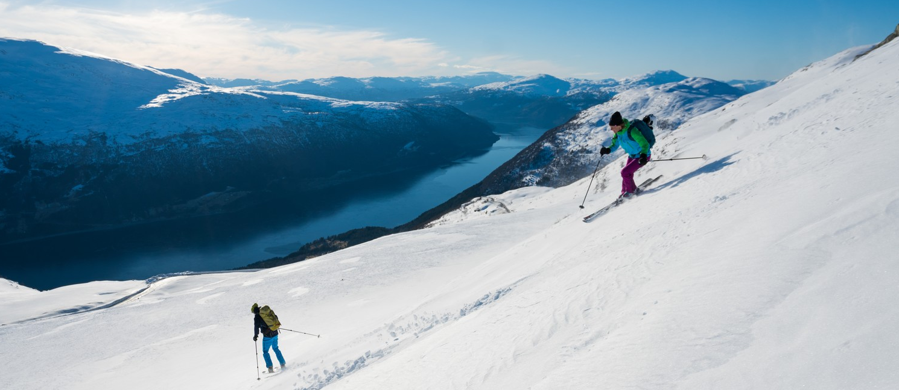
DANISH SKIERS
NORWAYS MARKET POSITION AMONG DANISH SKIERS
INNOVATION NORWAY
© Bård Basberg - Loen Skylift

Slide 2
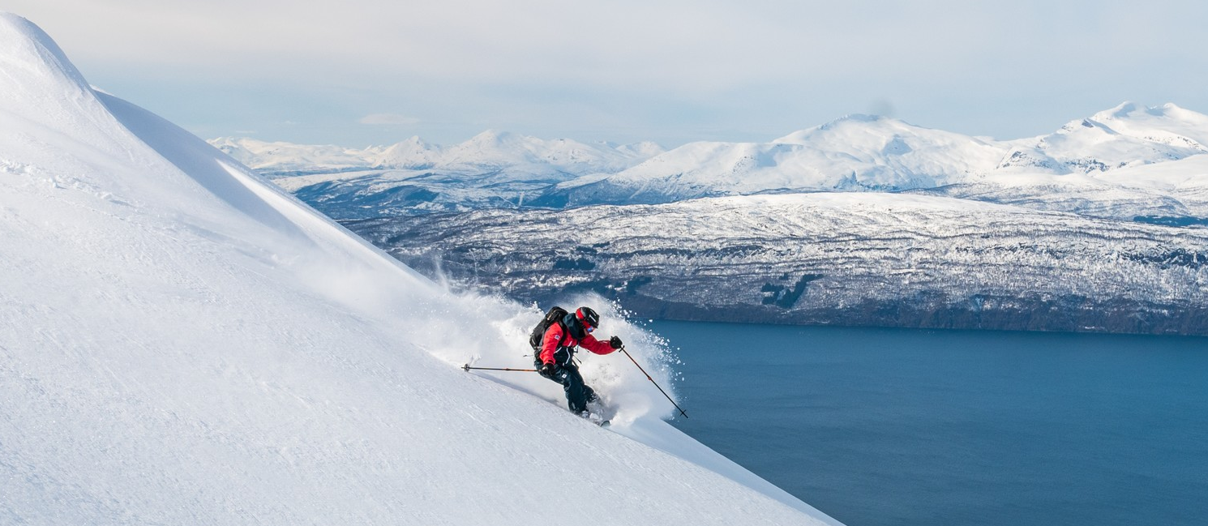
Purpose and data | 3
Method | 4
Theme 1: Market share | 5
Theme 2: Previous and futuristic visitor intention | 11
Theme 3: What characterises the Danish skiers? | 15
© Sophie Stevens - Visitnorway.com

Slide 3
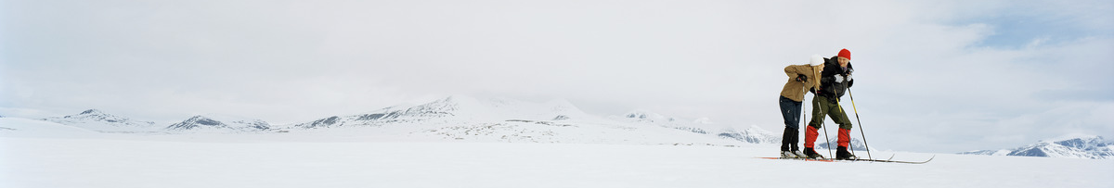
PURPOSE AND DATA
© CH - Visitnorway.com
Purpose
Innovation Norway is strategically working on attracting skiers from Denmark to Norway. A key element in this task is to have updated information on the skiing market in Denmark. This includes information about Norway’s position on the Danish ski market as well as knowledge about how Danish ski tourists travel and what they do on their ski holiday. This knowledge is essential when developing campaigns aimed at attracting Danish skiers.
This report provides updated information about Norway’s position on the Danish ski market compared to the major competing destinations in Europe as well as information about preferences and behavior of the Danish ski tourists.
Analogous reports are made for the ski markets in Germany, South Eastern United Kingdom and Sweden.
Data
This report is based on 5.568 online interviews with Danish respondents aged 18 years or older. 511 of them have been on at least one ski holiday in the past season (October 2018 to April 2019).
All interviews are conducted between May 16th and July 7th, 2019.
The number of interviews in each region are:
Region Hovedstaden: 1.897 (180 skiers)
Region Sjælland: 816 (71 skiers)
Region Syddanmark: 1.126 (103 skiers)
Region Midtjylland: 1.155 (112 skiers)
Region Nordjylland: 573 (45 skiers)

Slide 4
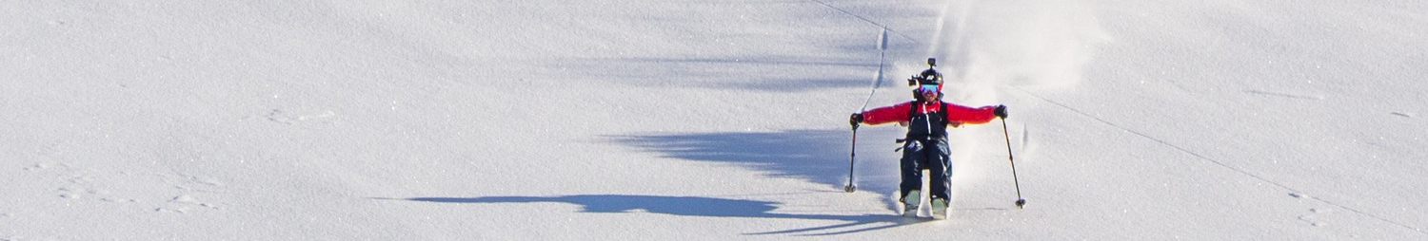
method
© Sophie Stevens - Visitnorway.com
Design
The study is designed to display the distribution of travels rather than respondents, i.e. if a respondent went on more than one ski holiday during the past season, each of his/her holidays are included in the distributions.
All respondents are asked how many ski holidays they went on in the past season. Respondents who state that they were on one ski holiday are asked which country they went to, with whom they traveled, the size of their travels party, the number of nights they spent and if they went alpine skiing, snowboard, cross country skiing and/or off-piste skiing.
Respondents stating that they went on more than one ski holiday in the past season were asked the same questions for each of their holidays separately. Thus, each holiday accounts for a separate holiday in the data analysis.
Measured market share
The share of the market is measured in three different ways:
Travels: The market share for each country is calculated by looking at the number of travels that have gone to a specific country as a percentage of all travels.
Travellers: The market share for the specific country is calculated by looking at the size of the travel group that the respondent travelled with to the country. For each country, the market share is the sum of the size of the travel group to this country divided by the sum of all travel groups.
Nights spent: The market share is calculated as the number of nights spent in a country as a percentage of the total number of nights spend in all countries.
Data processing
The collected data has been weighted and processed to make the best possible estimates of the real population distributions. The data processing has been conducted analogously to the previous reports to ensure consistency.
Comparison with previous seasons
In selected charts, results are compared with results from previous seasons. However, due to statistical uncertainty, any developments over time should be interpreted with caution, especially on the Danish market, as the sample sized has been reduced by approximately 50% compared to last year’s analysis.

Slide 5
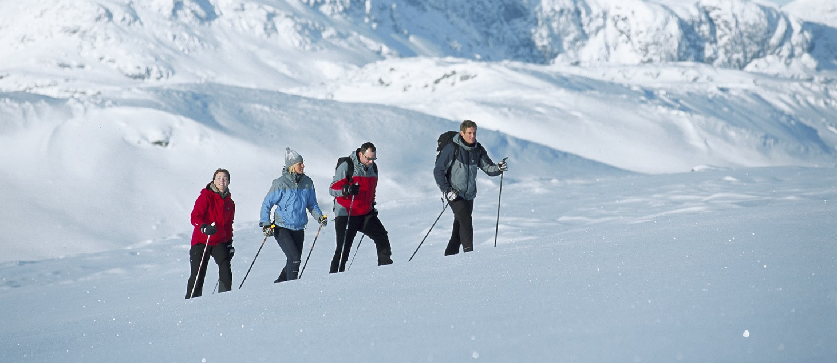
Theme 1: market share
© Terje Rakke/Nordic life - Visitnorway.com

Slide 6

Norway’s market share has decreased slightly
KEY FINDINGS:
In the last skiing season, Norway had a market share of 27% on the Danish market, which is a small decrease compared to the previous seasons.
In contrast, Sweden’s market share has increased steadily. Austria’s market share on the Danish market seemingly decreased remarkably in the 2017/2018 season, but is now on the same level as the year before that.
Market share as percentages of travels
2016/2017 (n=1.602); 2017/2018 (n=1.114); 2018/2019 (n=511)

Slide 7
Norway’s market share has decreased slightly
KEY FINDINGS:
A similar pattern appears when looking at the distribution of travellers: Norway’s market share seems to have decreased, while Sweden and Austria have gained market shares.
Market share as percentages of travellers
2016/2017 (n=1.602); 2017/2018 (n=1.114); 2018/2019 (n=511)

Slide 8
Norway’s market share has decreased slightly
KEY FINDINGS:
Also when looking at the distribution of the total number of nights spent on ski holidays at the different destinations, Norway’s market share decreased from 2017/2018 to 2018/2019, while Sweden’s market share increased.
Market share as percentages of nights spent
2016/2017 (n=1.602); 2017/2018 (n=1.114); 2018/2019 (n=511)

Slide 9
Norway holds the largest market share on cross country skiing
KEY FINDINGS:
When looking at the market shares for the three types of skiing separately, a very clear image emerges: Norway is – by far – the most popular destination for cross country skiing among Danish ski tourists, holding a market share of no less than 56%. Sweden comes second with a market share of just 24%.
Among alpine and off-piste skiers, Norway is the second most popular ski destination, overtaken by only Austria.
Market share of different skiing types as percentages of travels
(n=511)

Slide 10
Norway holds the largest market share among Danish families with young children
KEY FINDINGS:
Norway holds the largest market share among Danish ski tourists traveling with at least one child under the age of 12 years. When looking at the skiers travelling with older children, Austria takes the first place. This is also the case among the skiers travelling with no children.
Unlike the skiers traveling with children, France is also a rather popular skiing destinations among the skiers with no children.
Market share of among different travel groups (share of travels)
(n=511)

Slide 11
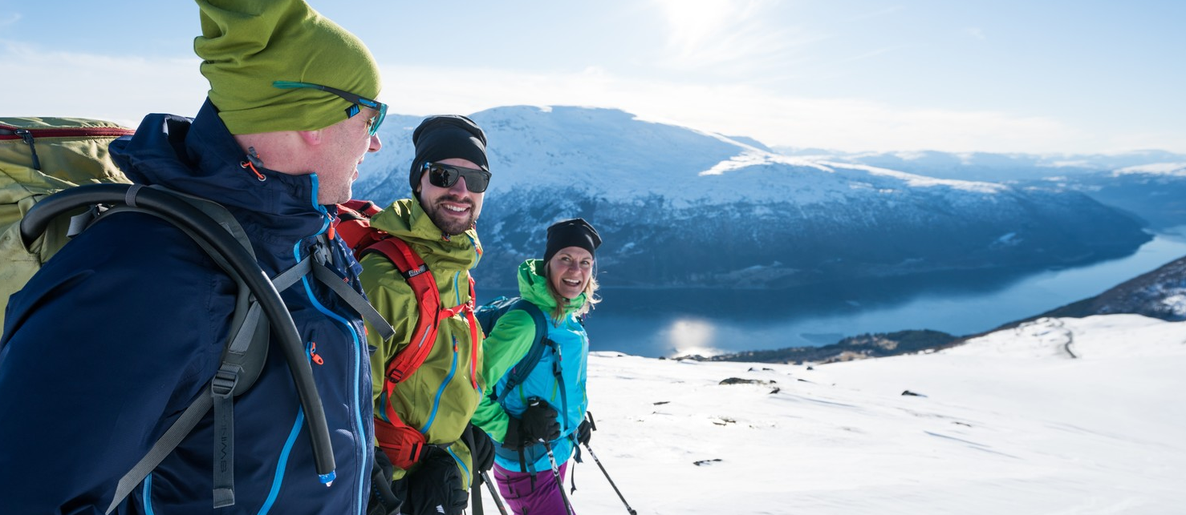
Theme 2: previous and futuristic visitor intention
© Bård Basberg - Loen Skylift

Slide 12
The Danish ski tourist’s likeliness to visit Norway remains largely unchanged
KEY FINDINGS:
The Danish ski tourists find it rather likely that they will go skiing in Norway in the future. The only destination with a higher score is Austria.
Average probability that Danish ski tourists visit each country next season
Average probability that Danish ski tourists visit each country in the future

Slide 13
Almost 100.000 Danes visited Norway on a ski holiday in the last season
KEY FINDINGS:
It is estimated that just about 95.000 Danes above 18 years went skiing in Norway in the last season, which is a decrease of about 23.000 compared to the previous season. In contrast, the number of Danes who went skiing in Austria increased by about 15.000 in the same time period.
Number of ski tourists from Denmark visiting the country last season

Slide 14
About 16% of the danes have been on a ski holiday within the last five years
KEY FINDINGS:
It is estimated that 7% of the Danes went skiing in the last season, and that a total of 16% have been on at least one ski holiday during the past five years.
35% have been skiing at least once (but more than five years ago). About half of the population have never been on a ski holiday.
Share of Danes who have been on a ski holiday

Slide 15
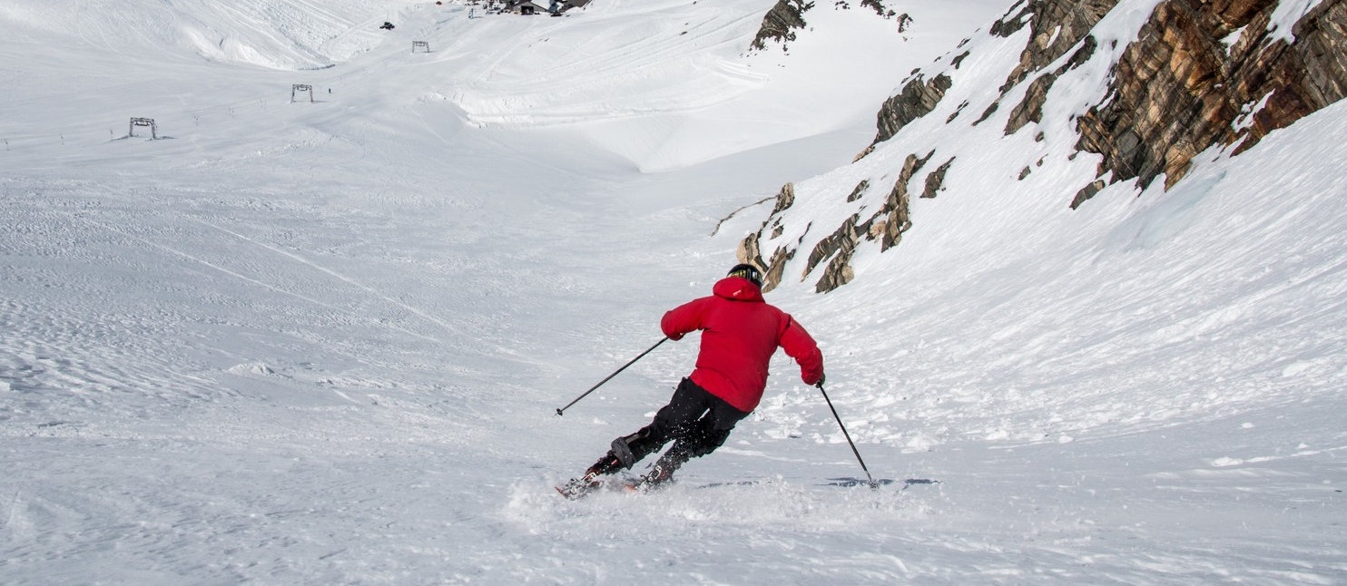
Theme 3: tourist characteristic
© Skiinformarmatie.nl

Slide 16





Characteristics of a Danish ski tourist
The average Danish ski tourist is 39 years old, and 41% have at least one child under the age of 18.
Just 13% went skiing more than once in the past season, while the vast majority went on just one ski holiday.
77% travel in groups of 4 persons or more, and most go on rather long ski holidays: Only 25% of the ski tourists went on a short ski holiday of 1-4 nights.
81% of the Danish skiers went alpine skiing or snowboarding, while just 21% went cross country skiing.
39 years
13%
41%
Average years of age
Have been on 2 ski holidays or more in the last season
Have at least one child at home under the age of 18
26%
77%
25%
Travel with at least one child under the age of 12
Travel in groups of 4 persons or more
Are on short trips (1-4 overnight stays)
81%
21%
18%
Go alpine skiing or snowboarding
Go cross country skiing
Go off-piste skiing
Note: The percentages display the shares of the Danish ski tourists, who met the statement on at least one of their ski holidays in the last season.
(n=511)

Slide 17
Characteristics of a Danish ski tourist in Norway
In general, the Danish ski tourists going to Norway are similar to the Danish ski tourists travelling to other ski destinations.
However, a significantly larger share of the Danish skiers going to Norway do cross country skiing.
Also, a larger share of the skiers visiting Norway travel with kids.
44 years
20%
47%
Average years of age
Have been on 2 ski holidays or more in the last season
Have at least one child at home under the age of 18
34%
79%
27%
Travel with at least one child under the age of 12
Travel in groups of 4 persons or more
Are on short trips (1-4 overnight stays)
71%
41%
16%
Go alpine skiing or snowboarding
Go cross country skiing
Go off-piste skiing
Note: The percentages display the shares of the Danish ski tourists, who met the statement on at least one of their ski holidays in the last season.
(n=159)

Slide 18
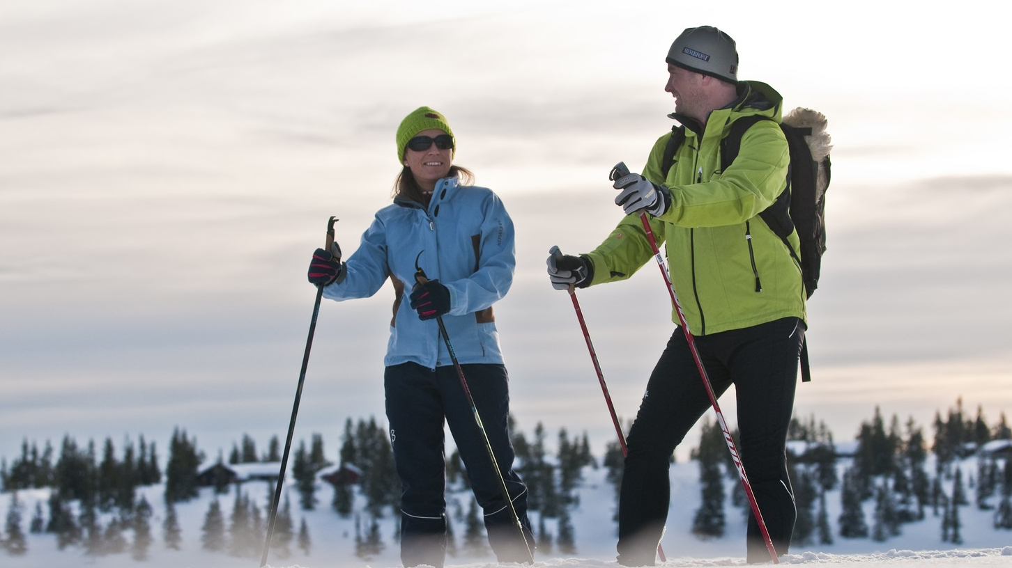
EPINION OSLO
BISKOP GUNNERUS GATE 14
0185 OSLO - NORWAY
T: +47 90 17 18 99
E: SM@EPINION.NO
W: WWW.EPINION.NO
EPINION STAVANGER
KLUBBGATEN 4
4006 STAVANGER - NORWAY
T: +47 90 17 18 99
E: SM@EPINION.NO
W: WWW.EPINION.NO
AUSTRIA|DENMARK|GERMANY|GREENLAND|INDONESIA|NORWAY|PHILLIPINES|THAILAND|SWEDEN|UNITED KINGDOM| VIETNAM
© CH - Visitnorway.com

