Slide 1


Discussion Time
Chapter 1 : Number Systems
Page 2

Slide 2

Question posed:
1. Decide which of the options given is the correct answer to the following sum:
7 + 6 × 2² + 3
A: 55 B: 64 C: 34 D: 22
2. Enter the sum into your calculator. Did you get the same answer?
3. Does the order in which you do a sum matter?

Slide 3
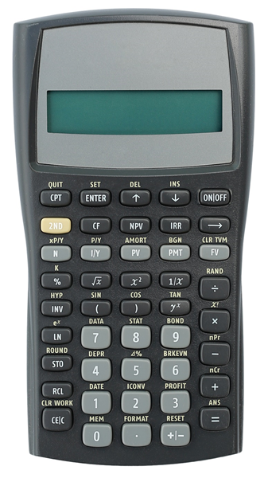









Suggested solution:
1. Decide which of the options given is the correct answer to the following sum:
7 + 6 × 2² + 3
A: 55 B: 64 C: 34 D: 22
Do all the addition first:
1. Do the calculation in the order you see it:
7 + 6 $×$ 2² + 3
7 + 6 $×$ 2² + 3
13
$×$ 2² + 3
16 $×$ 2²
13 $×4$
+ 3
16 $×4$
52 + 3
6$4$
55
Do the calculation in the order of the strength of operations:
7 + 6 $×$ 2² + 3
7 + 6 $×$ 4 + 3
7 + 24 + 3
34

Slide 4
2. Enter the sum into your calculator. Did you get the same answer?
When you enter the sum into the calculator you get 34.
3. Does the order in which you do a sum matter?
Yes. We must do the sum in the order of the strength of the operations. We use BIMDAS.

