Slide 1
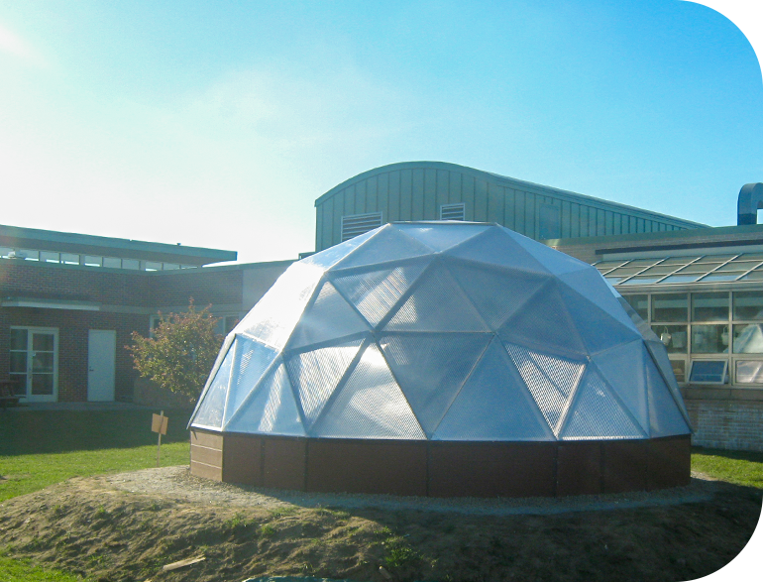
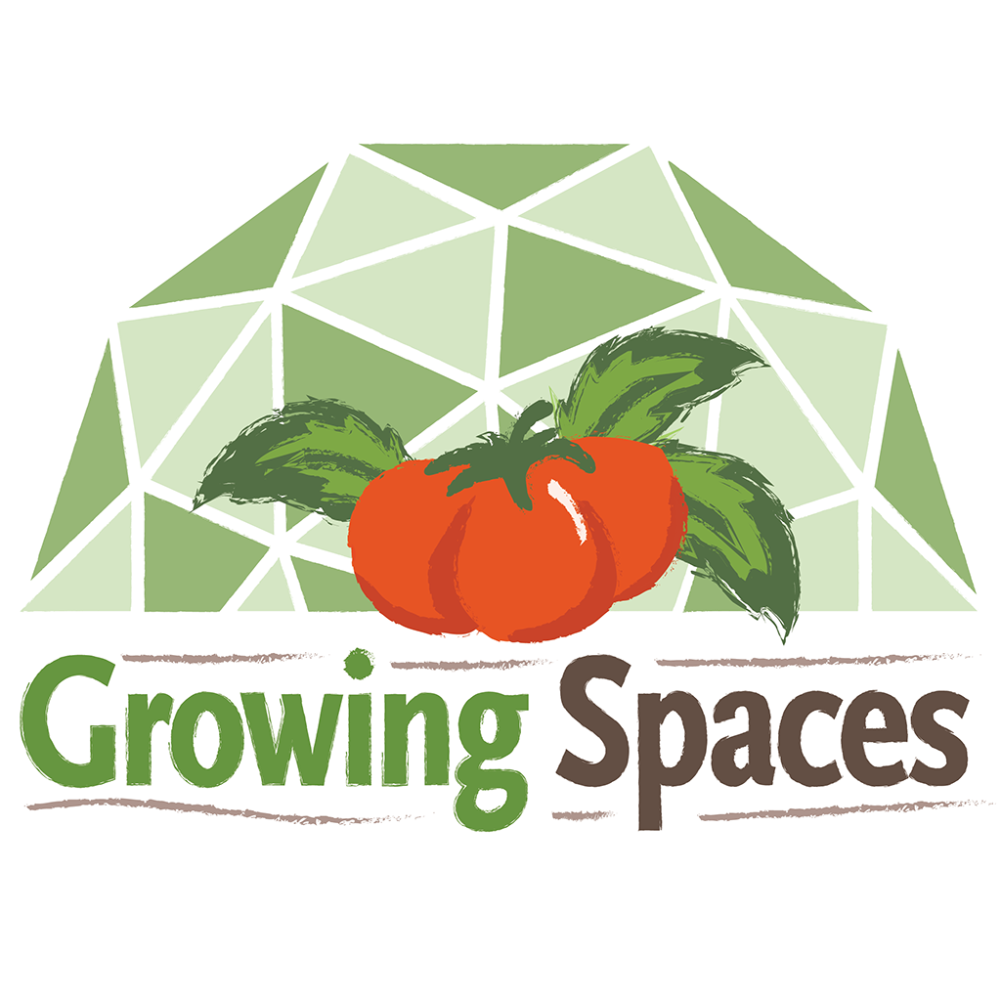
A Living
Classroom
for Every
Season
A Growing Dome® greenhouse proposal for hands-on learning, food education, and community impact
GrowingSpaces.com
Notes:
Opening: frame the project as a school program and community asset, not only a greenhouse purchase.

Slide 2
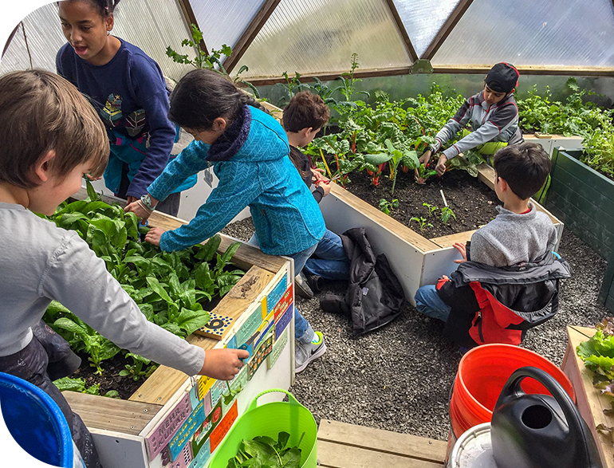
Why This Project Matters
Students learn differently when they can step into a living system.
A year-round setting for hands-on learning
A Growing Dome greenhouse can turn science, food, ecology, climate, engineering, and nutrition into experiences students can observe, measure, grow, harvest, and share.
It gives a school a visible, practical gardening project that can support learning during more of the year.
Notes:
Presenter: connect the proposal to learning outcomes, student engagement, and the school mission.

Slide 3
The Request Is Practical and Phased
The first decision does not have to approve every detail. It can authorize planning, site review, and funding work.
Size Consideration
Request a Quote
Site Plan
Program Launch
Recommended 26–42 foot diameter
Base kiit, climate options, freight,
and installation considerations
Location, access, utilities, foundation,
and regulation compliance
Curriculum, stewardship, harvest use,
and measurable outcomes
What is being requested
What is not being requested yet
Permission to explore an educational Growing Dome project
Support for site review, quote, budget, and funding research
Approval to pursue grants, fundraising, donations, and/or
the Growing Dome Award
A return to the board with refined cost, timeline, and operations plan
No assumption that one grant covers all project costs
No construction before site, facilities, and compliance review
No program launch without an operations and stewardship plan
No single-person project without staff and partner support

Slide 4
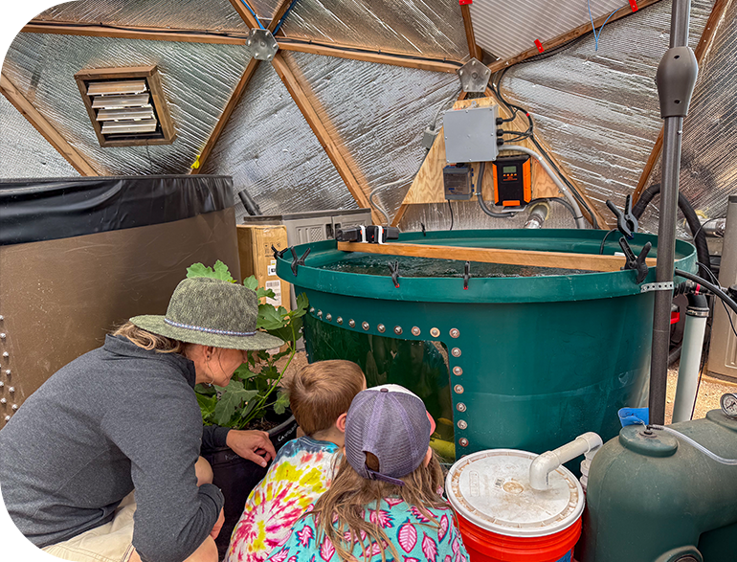
A Living Lab for Science, Engineering, and Food Systems
The dome can become a real-world system students study, improve, and maintain.
Students Can Work With Real Systems
Plant life cycles, soil, compost, pollinators, and ecology
Passive solar design, thermal mass, ventilation,
and seasonal climate control
Sensors, automation, irrigation, data collection,
and student-led design improvements
Cultivation, nutrition, culinary arts, food access,
and community sharing

Slide 5
The Opportunity for Our School
A Growing Dome project can support classroom learning, student wellness, and community partnerships.
Educational Pathways
Student Wellbeing
Community Partnerships
Hands-on STEM and environmental education
Engineering, design thinking, and data collection
Nutrition, food literacy, and culinary connections
Nature-connected
and outdoor learning
Student responsibility
and garden stewardship
Fresh food connection
and harvest participation
Family and volunteer engagement
Partnerships with local growers, food pantries, extension offices,
or colleges
A visible project that can attract donors and grants

Slide 6
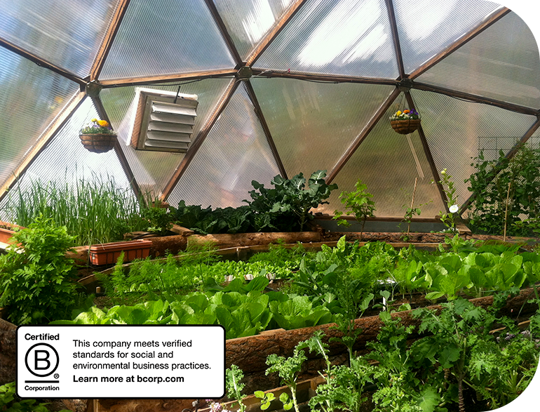
What Is a Growing Dome Greenhouse?
A durable geodesic greenhouse kit designed for long-term, year-round growing and learning.
How It Differs from Other Greenhouse Options
Geodesic framing inspired by Buckminster Fuller’s design principles, using interconnected triangles for strength
and efficient material use
Rigid polycarbonate glazing rather
than temporary plastic film
Passive solar features, automatic ventilation, insulation, and thermal mass
A finished educational structure
intended for long-term program use

Slide 7
Curriculum Connections
A Growing Dome can support instruction across subjects and grade levels.
Science
Engineering
Math
Botany and ecosystems
Weather, water, soil, and energy
Observation and experimentation
Structure and material efficiency
Ventilation and climate controls
Automation and systems design
Measurement and graphing
Harvest logs and data
Budgeting and estimating
Health & Nutrition
Career Pathways
Community
Food literacy and preparation
Fresh produce experience
Wellness and stewardship
Agriculture and sustainability
Engineering and design
Culinary arts and nutrition
Service-learning
Family engagement
Partner-led workshops

Slide 8
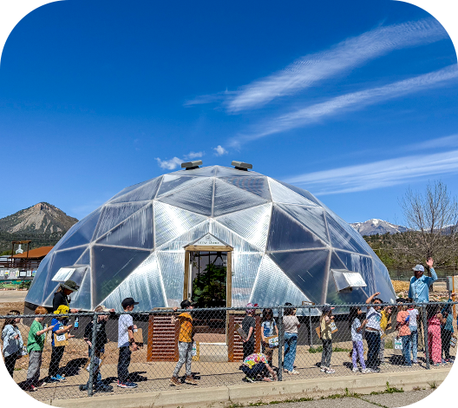
Appropriate School-Sized Dome Options
The 26’, 33’, and 42’ models are the most relevant sizes for school and community learning projects.
Size
Approx. Sq. Ft.
Typical School Use Cases
26 ft
530 ft²
Pilot program, small class groups, trades or aquaponics lab
33 ft
855 ft²
Dedicated learning greenhouse with room for group instruction
42 ft
1,385 ft²
Large program, community garden, food access, or multi-use learning hub
Decision lens: Choose the size that fits the educational program, site, budget, and student group.
Smaller domes can still work for pilot programs or limited spaces,
but the larger domes better support school-scale instruction and shared use.

Slide 9
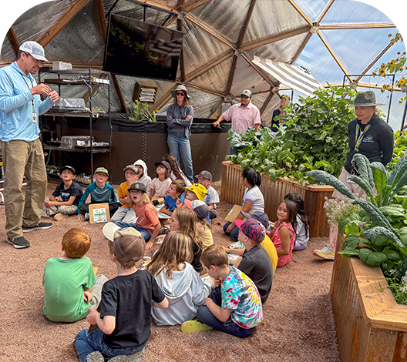
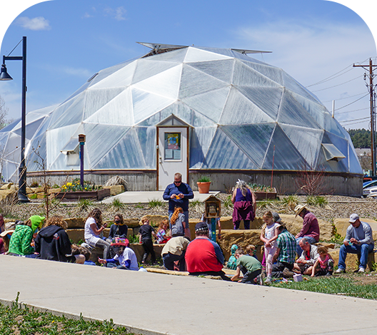
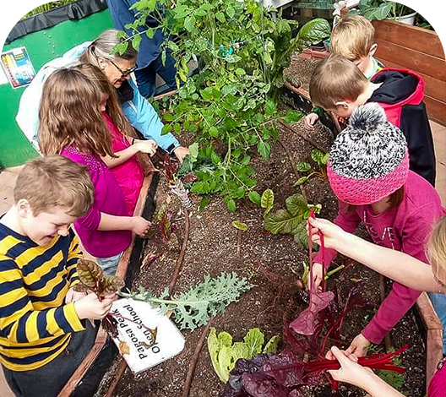
Year-Round Learning and Community Use
A school greenhouse can extend learning beyond a short outdoor garden season.
During The School Day
Beyond The Classroom
Across The Year
Classroom instruction
Lab activities and experiments
Student stewardship teams
Career and technical education
After-school garden clubs
Family learning nights
Community workshops
Partner and volunteer programs
Seed starting and planting
Data tracking and seasonal observations
Harvest and food distribution

Slide 10
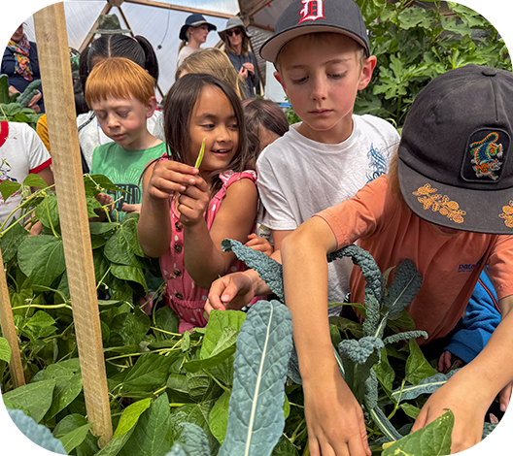
A Sustainable Example: SOIL Outdoor Learning Lab
A K-12 example of a Growing Dome supporting hands-on education and community engagement.
Students don’t just learn about ecosystems.
They step into one.
The SOIL Lab shows how a Growing Dome can become part of a larger outdoor education program. They have created a resource for a whole community, not just one classroom. Students can rotate through hands-on stations and connect sunlight, plant growth, food, aquaponics, ecology, and stewardship through direct experience.
Imagine …
… tracking temperature, sunlight, and plant growth through the seasons.
… seeing plants, soil, insects, fish, and food webs in action.
… harvesting fresh fish and garden ingredients to cook a complete meal.
… growing produce to support local families and school cafeterias.

Slide 11
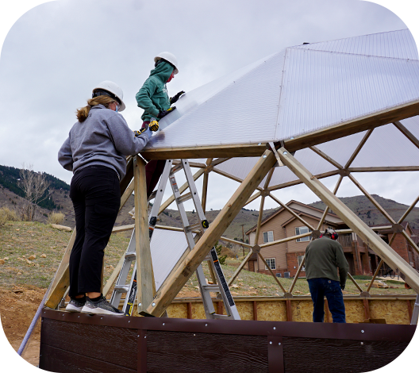
Student Innovation in Action: Colorado School of Mines
A Growing Dome can support engineering, automation, and student-led design projects.
How The Project Began
The Mines project began as a senior Capstone Design Project focused on creating a campus greenhouse to supply local organic produce to students and commercial markets. Students fundraised, built a 22’ Growing Dome, and used the project as a campus garden and food production space.
Engineering Opportunities
Hydroponics and aeroponic tower design
Climate-control thinking around temperature, light, and humidity
Raspberry Pi automation and greenhouse systems
Modular geodesic construction, thermal mass,
and temperature regulation

Slide 12
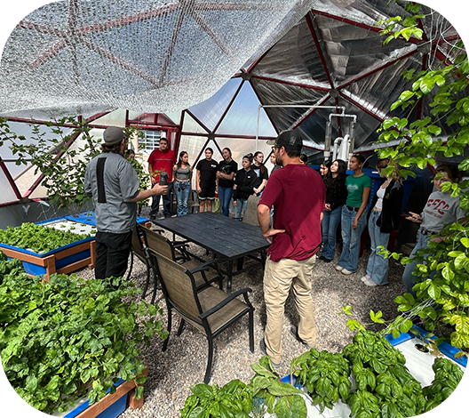
Applied Learning: SFCC Aquaponics Lab
A 26’ Growing Dome can support trades, aquaponics, culinary arts, and food systems education.
A Living Laboratory
Students work with an aquaponics system where fish waste feeds plants and plants help clean recirculating water
The greenhouse supports agriculture, environmental stewardship, and controlled environment growing
Students gain experience with crop production, greenhouse
management, water systems, pest management, and plant care
Produce connects to the culinary arts programs, campus food access, and community support
A Model for Career-Connected Learning
SFCC demonstrates how a Growing Dome can support a broader academic program in controlled environment agriculture. It is especially relevant for schools exploring Career and Technical Education, sustainability, agriculture, culinary arts, aquaponics, and hydroponics.

Slide 13
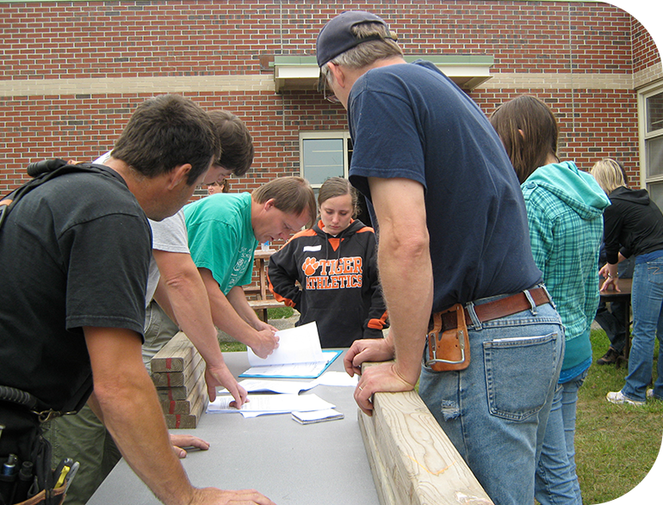
Planning for Long-Term Success
Growing Spaces offers a toolkit designed to surface planning gaps before the project is funded or built.
What a Strong Project Includes
A site the school owns, controls, or can use long term
A teacher, program lead, or garden coordinator
who owns the project after installation
A student group, grade level, course,
or community served
A realistic budget that includes more than
the dome quote
A timeline that accounts for approvals, site work, delivery, installation, and first use

Slide 14
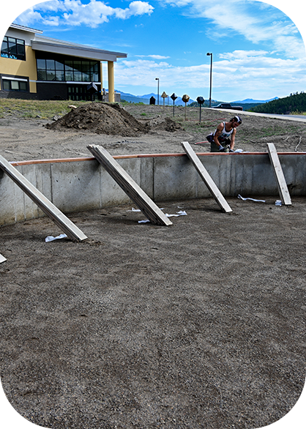
Site and Compliance Questions to Answer Early
Facilities, access, utilities, permitting, and foundation details can affect cost and schedule.
Site map or wide-angle photo of the proposed location
Access path for delivery, contractors, and materials
Setbacks from property lines, buildings, utilities, and easements
Water, power, drainage, fencing,
and winter access
Known permitting or inspection requirements
Facilities or operations lead
Authority Having Jurisdiction, such as town, city, county, fire, or health officials as applicable
Contractor or foundation provider
Administration and finance lead
Program lead and safety/contact person
Site Readiness Checklist
Recommended Review Partners

Slide 15
Budget and Long-Term Project Costs
A complete project budget includes more than the greenhouse kit.
Capital Costs
Ongoing Costs and Capacity
Growing Dome kit and options
Freight and delivery
Foundation and site work
Utilities, water, drainage, fencing, or access
Installation labor or contractor costs
Garden beds, soil, irrigation, tools, and supplies
Program supplies and curriculum materials
Seeds, soil amendments, pest control,
and replacement parts
Staff, volunteer, or partner time
Maintenance and future replacement reserve
Reporting, harvest logs, and evaluation
Summer care and school break coverage

Slide 16
Growing Dome Award Opportunity
Schools can use the toolkit to apply for Growing Spaces’ annual award program.
Program Fit
Application Timeline and Planning
Application cycle runs from Jun 1 through Sept 30
Review occurs in Oct
Award is announced Nov 1
Installation should occur within 12 months of awarding
Strong applicants identify site readiness, funding gaps, outcomes, and Year 1 capacity
Designed for schools, nonprofits, tribal organizations, public agencies, and community groups
Supports projects connected to education, food security, therapeutic use, or community impact
Applicants submit a focused packet rather than every document in the full toolkit
Note: Schools and nonprofits are eligible for Growing Spaces’ 6% discount whether or not they apply for the Growing Dome Award.

Slide 17
Requested Board Action
Approve the next step so the project team can refine the site, budget, timeline, and funding plan.
Decision Options
Proposed Standards for Moving Forward
Prioritizing educational purpose and student benefit
Identified site and compliance path
Realistic funding and Total Cost of Ownership plan
Clear operations and stewardship plan
Define measurable Year 1 outcomes
Approve project exploration and site review
Authorize a project team to gather quotes
and facilities input
Support a Growing Dome Award
or external grant application
Approve fundraising, donor outreach,
or partner development
Request a refined proposal with final budget, timeline, and operations plan

Slide 18
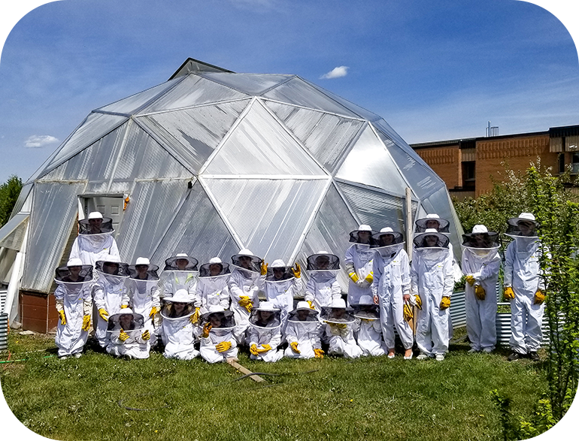
Appendix
Resources and supporting information for review
Photo courtesy of Steven Schultz, Lacombe Composite High School

Slide 19
Appendix A: Seven Design Features
Design features that support durability, climate moderation, and year-round growing.
Geodesic Shape
Polycarbonate Glazing
The geodesic dome shape is naturally wind-resistant & strong.
16mm multi-wall panels provide diffused light and insulation value.
Above-Ground Pond
North Wall Insulation
Thermal mass helps regulate interior temperature.
Reflects light and helps reduce winter heat loss.
Automatic Vents
Undersoil System
Heat-activated vents open and close without electricity.
Circulates air throughout the greenhouse.
Foundation Wall
24-inch insulated wall raises the structure and adds stability.
Appendix

Slide 20
Appendix B: Planning Timeline Template
Start with the desired first-use date and work backward.
Phase
Key tasks
Date
First use
Planting, lessons, harvest logs, safety routines, reporting
Installation
Order, manufacturing, freight, delivery, build, inspection if required
Site preparation
Permits, foundation, utilities, access, contractor schedule
Funding
Grant applications, donor outreach, letters, match or in-kind documentation
Planning
Project lead, student group, site review, quote, outcomes, board discussion
Add buffer for school breaks, weather, permitting, contractor availability, and institutional approvals.
Appendix

Slide 21
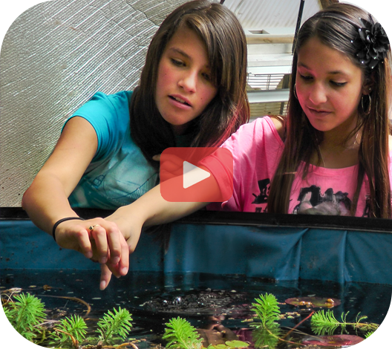
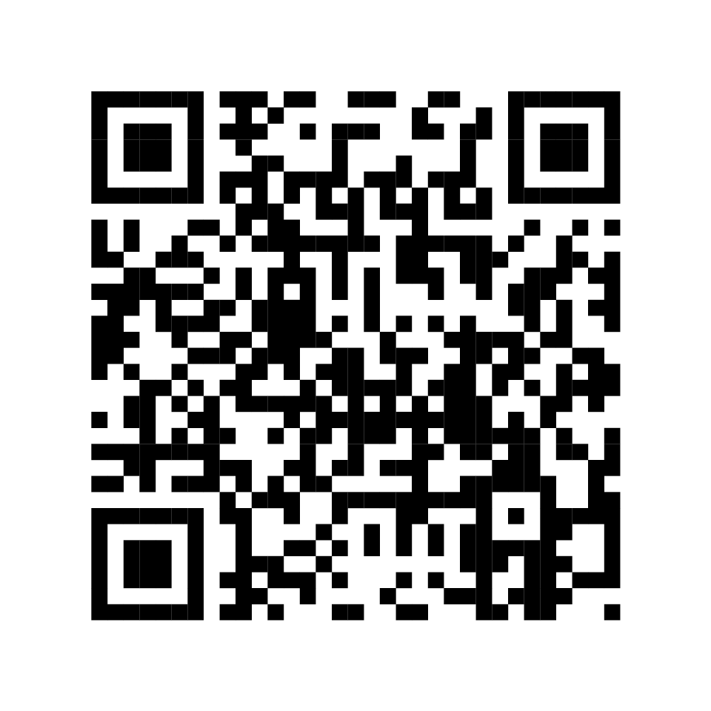
Appendix C: Source Links for Board Review
Reference pages and planning tools used to support this proposal.
Growing Dome 7 Unique Features:
https://growingspaces.com/geodesic-dome-greenhouse
Growing Dome Greenhouse Guide:
https://growingspaces.com/greenhouse-guide
SOIL Outdoor Learning Lab:
https://growingspaces.com/blog/hands-on-discovery-in-the-soil-lab-growing-dome
Colorado School of Mines Growing Dome:
https://growingspaces.com/blog/mines-tiny-greenhouse
SFCC Aquaponics in a 26’ Dome:
https://growingspaces.com/blog/aquaponics-in-a-26-dome
Growing Spaces Grants and Funding:
https://growingspaces.com/gardening-grants
School and Garden Grant Toolkit:
https://growingspaces.com/gardening-grants/garden-grant-toolkit
Hear from educators using Growing Dome greenhouses as hands-on learning environments for science,
food education, sustainability, and student engagement.
Scan the QR Code to watch the YouTube video.
Appendix

