Slide 1
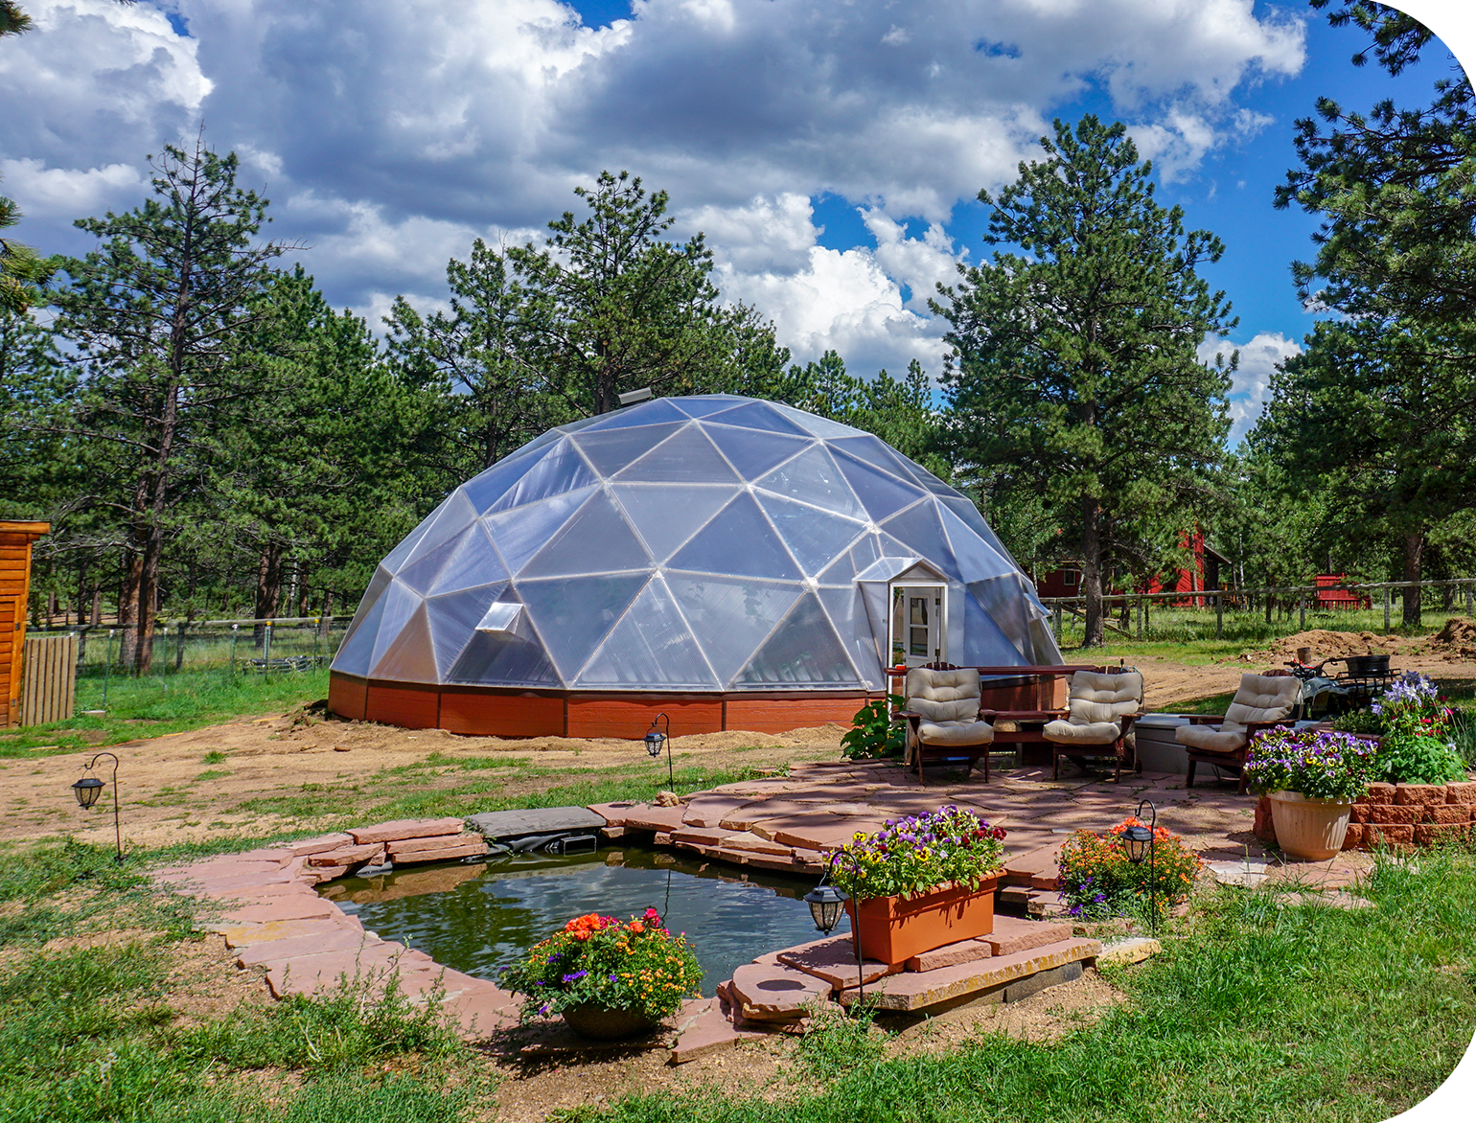
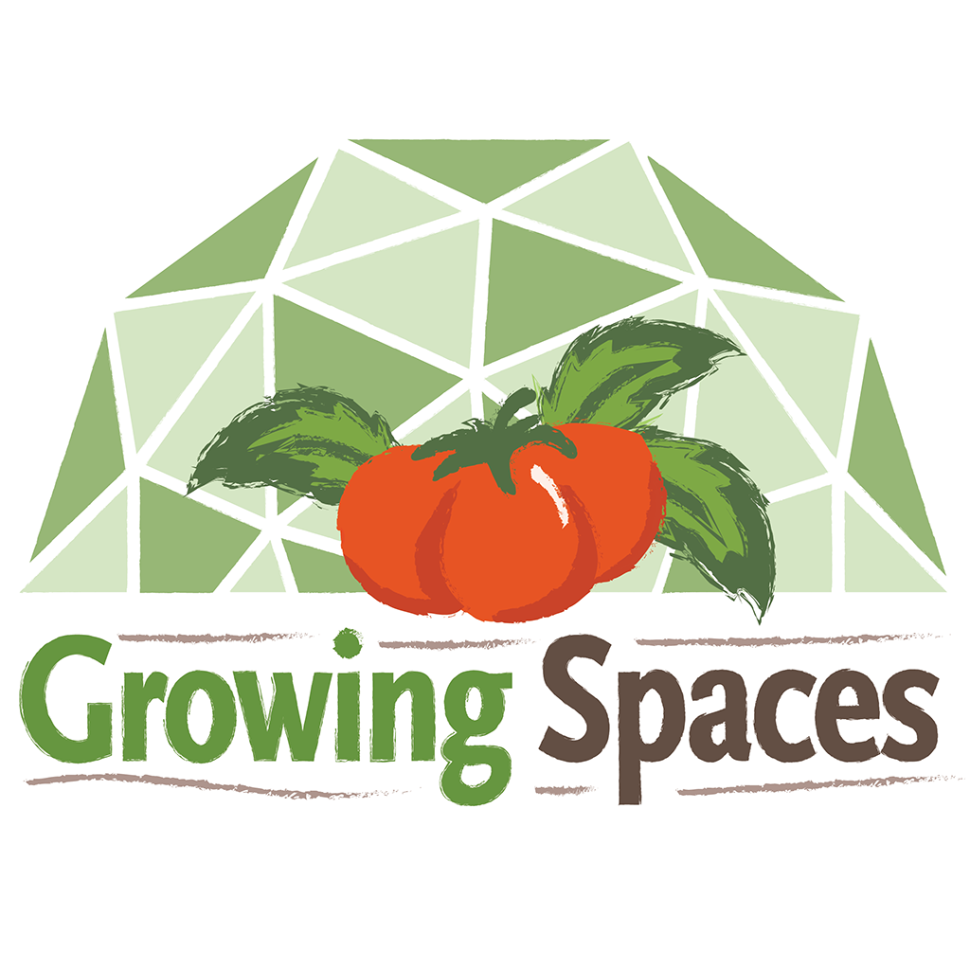
A Responsible Backyard Greenhouse Proposal
For HOA communities considering residential Growing Dome® greenhouses
GrowingSpaces.com
Notes:
Suggested image: a small Growing Dome in a tidy landscaped backyard with a home visible nearby.

Slide 2
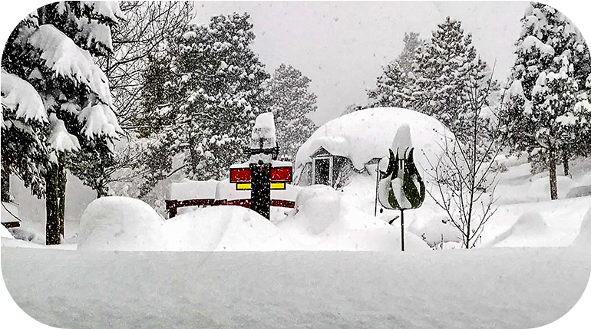
A Solid Alternative to Temporary Greenhouse Structures
The design is intended for weather resistance and long-term use.
65 PSF
115 MPH
200 X
20+ Yrs
Snow load*
Wind resistance*
Polycarbonate stronger than glass
Life expectancy
Designed for Snow, Wind, Hail, Heat,
Cold, and Wildlife Pressure
Why The Shape Matters
Triangular geodesic framing distributes
stress through the structure
Rounded form helps wind move
around the greenhouse
Rigid polycarbonate panels
are more durable than plastic film
*Potentially more depending on dome size, foundation, or additional engineering modifications
Notes:
Source facts: Growing Spaces HOA page states 75 PSF snow load, 115 MPH winds depending on foundation, polycarbonate 250 times stronger than glass, 20+ year life expectancy, and 10-year pro-rated warranty against yellowing and hail damage.

Slide 3

Why This Request Matters
A backyard greenhouse supports practical, personal gardening while remaining contained, attractive, and privately maintained.
Many homeowners are looking for responsible ways to grow fresh food, garden year-round, and make better use of their backyard space. A Growing Dome greenhouse provides a durable, enclosed structure for personal gardening without creating commercial activity, public access, or neighborhood disruption.
Supports fresh food, year-round gardening,
and homeowner wellness
Keeps gardening activity contained
within a finished backyard structure
Can be sited to respect setbacks,
views, and neighboring properties
Remains privately owned, maintained,
and used for residential purposes

Slide 4
The Request Is Limited and Residential
This is a personal-use backyard garden structure, not a commercial operation.
15–26 ft Diameter
Discrete Signage
Backyard
Site Plan
Residential sizes in focus
No commercial presence, subtle branded Growing Spaces logo above the door
Sited away from public view when feasible
Submitted for board review
What Is Being Requested
What Is Not Being Requested
Permission to install a Growing Dome greenhouse on a residential lot
Review under existing accessory structure, greenhouse, garden,
or landscape rules
A guideline update only if current bylaws do not clearly address greenhouses
No commercial growing,
customer visits, or retail activity
No outdoor storage or visible accumulation of materials
No exception to setback, height, drainage, or neighbor impact standards

Slide 5
Common HOA Questions This Proposal Answers
Aesthetics
Views & Setbacks
Durability
Will it look intentional
and compatible with the home?
Can it be placed without
affecting neighbors?
Is it built for wind, snow, hail,
and long-term use?
Maintenance
Precedent
Documentation
Will it stay tidy and cared for?
Can the board approve it
with clear guardrails?
Are dimensions, materials,
and site details provided?
Approval can be made predictable through site planning, size limits,
appearance standards, and maintenance conditions.

Slide 6
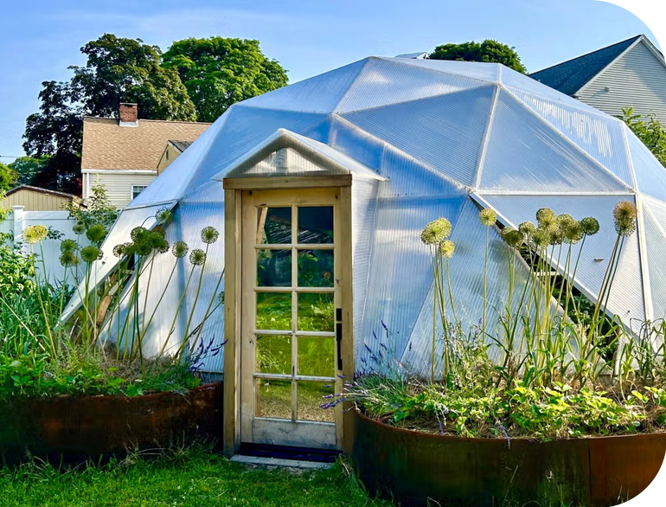
What Is a Growing Dome® Greenhouse?
A durable geodesic greenhouse kit designed for long-term, year-round gardening.
Geodesic framing inspired by Buckminster Fuller’s design principles, using interconnected triangles
for strength and efficient material use
Rigid polycarbonate glazing rather than temporary plastic film, with a 10-year pro-rated manufacturer warranty that covers yellowing and hail damage
Integrated passive solar features, ventilation, insulation, and thermal mass
A finished garden structure intended for long-term residential use
How It Differs from Temporary Greenhouses

Slide 7
Small Domes Fit Backyard-Scale Gardening
The 15’, 18’, 22’, and 26’ models are the most relevant sizes for HOA review.
Size
Approx. Sq. Ft.
Height
Best-Fit for a HOA
15 ft
175 ft²
9 ft 5 in
Most compact backyard option
18 ft
255 ft²
10 ft 8 in
Small-family / urban-garden scale
22 ft
380 ft²
10 ft 10 in
Dedicated residential garden space
26 ft
530 ft²
12 ft 7 in
Larger-lot residential option
Decision lens: choose the size that meets the homeowner’s gardening goals
while fitting the HOA’s height, setback, view, and accessory-structure guidelines.

Slide 8
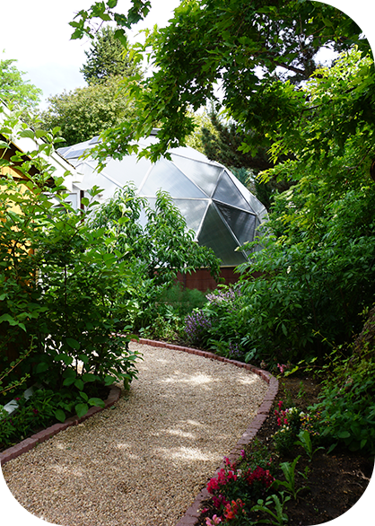
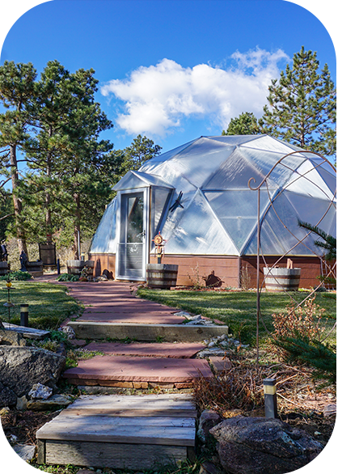
Aesthetic Integration Can Be Addressed
A Growing Dome can be finished and landscaped by the owner to feel intentional, not temporary.
How Concerns Are Addressed
Exterior siding or door color
could match the home
Landscape screening softens visibility from neighboring lots
or common areas
Greenhouse shading paint or exterior shade cloth can help reduce glare if needed
No exterior clutter, storage,
or unfinished materials
Structure remains maintained and in good repair

Slide 9
Site Planning Protects Neighbors and The Community
Approval can require the same practical documentation used for other accessory structures.
Reviewed HOA bylaws,
covenants, and design standards
Confirmed local building
department requirements
Identified setback, drainage,
height, and view considerations
Prepared a site plan with
dimensions and placement
Location on lot relative to home
and property lines
View impacts from adjacent lots
Visibility from street or common areas
Proposed landscaping or screening
Foundation and anchoring approach
Before Installation I Have…
Recommend Board Review:
SITE PLAN / AERIAL PHOTO

Slide 10
Why a Growing Dome Instead of a Basic Greenhouse?
The proposal is for a durable, finished greenhouse, not a temporary structure.
Concern
Conventional Greenhouse
Growing Dome Greenhouse
Appearance
May look seasonal, improvised, or utilitarian
Finished architectural structure with ability to coordinate trim/door finishings with the home
Durability
Often shorter lifespan and more weather vulnerability
Geodesic frame, polycarbonate glazing, long-term use
Weather
Limited wind/snow resistance in many basic structures
Designed for high wind, snow, hail, and harsh climates
Maintenance
Plastic film coverings may require frequent replacement
Quality components and replaceable parts support long-term upkeep
Growing Spaces®
HOA Approval Template

Slide 11
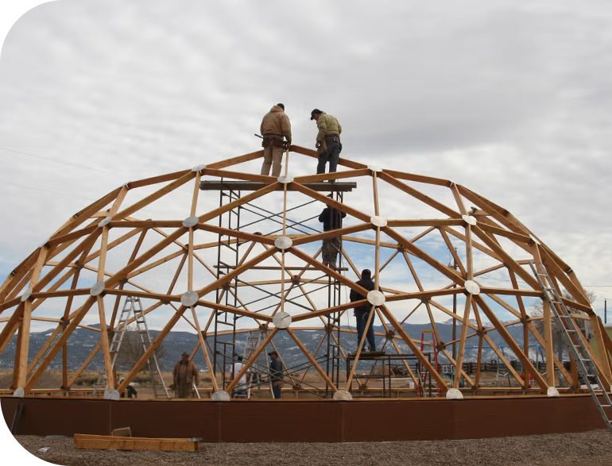
Installation Can Be Planned and Contained
A Growing Dome® is a prefabricated kit with a defined installation process, helping limit the duration and disruption during the project.
Installation options include homeowner self-install, supervised installation,
or a full Growing Spaces crew
Components are pre-cut, color-coded,
and labeled for an organized build process
Growing Domes 26' and smaller
are typically estimated at 4 to 7 days
for self-installation
Certified crew installations are generally estimated at 2 to 5 days, depending on weather, dome size, and crew expertise
Work can be scheduled to follow
HOA rules, local noise ordinances,
and reasonable construction hours

Slide 12
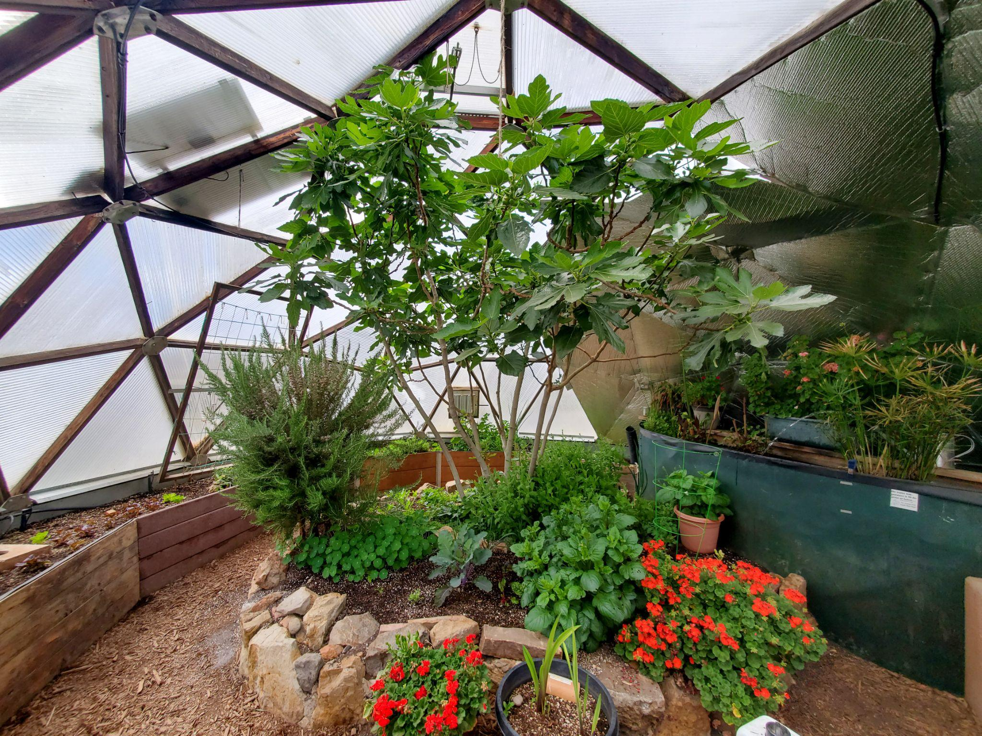
Low-impact Residential Operation
Personal gardening only
No customer visits
or commercial activity
No signage (small branded Growing Spaces logo above
the door), no retail display,
or business parking
No outdoor material storage
or visible equipment clutter
Passive solar design
supports energy efficiency
Automatic heat-activated vents help regulate temperature
Thermal mass from the above-ground pond helps
stabilize interior conditions
Enclosed structure protects
plants from animals and pests
Use Limits
Operational Features

Slide 13
A Clear Approval Path for The Board
1
2
3
4
Confirm Rules
Review Site Plan
Set Conditions
Document Decision
Review greenhouse/accessory structure language, size limits, setbacks, and height requirements.
Verify location, visibility,
views, drainage, and adjacent-neighbor impacts.
Approve with size,
appearance, maintenance,
and personal-use conditions.
Apply the same criteria to future residential greenhouse requests.
Growing Spaces®
HOA Approval Template

Slide 14
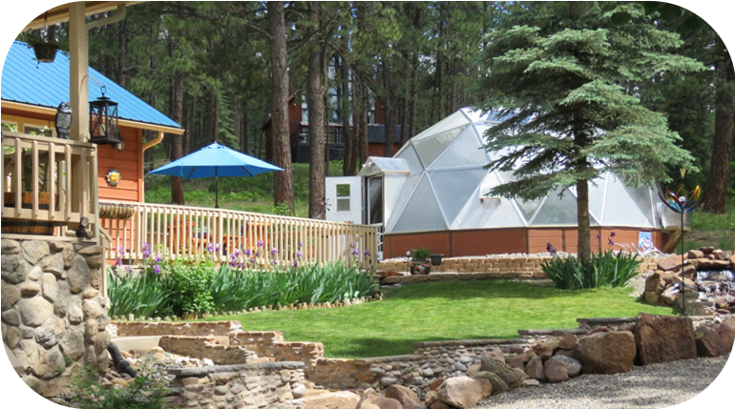
Recommended Approval Conditions
These guardrails help the board say yes while protecting community standards.
Dome size limited to approved residential footprint
Must comply with setback, height, drainage,
and building department requirements
Placed in rear yard or other board-approved location
Must not materially obstruct neighboring views
Exterior colors/materials should complement the home
Applicant provides site plan, dimensions,
materials, and visual examples
Structure maintained in good condition with no outdoor clutter
No commercial use unless separately approved by the association

Slide 15
Sample Guideline Language for Discussion
Residential greenhouse structures may be approved when they are located in the rear yard or another approved location, comply with all setback and height requirements, are maintained in good condition, and are designed or finished in a way that is compatible with the home and surrounding landscape. Geodesic greenhouse structures may be considered when the applicant provides a site plan, dimensions, materials, and visual examples for architectural review.
Note: This is example language for board discussion only.
The association should adapt any final wording to its governing documents and legal requirements.

Slide 16
Requested Board Action
Approve a small backyard Growing Dome greenhouse under clear, reasonable conditions that protect neighborhood standards while allowing responsible residential gardening.
Decision Options
Proposed Standard
Approve the submitted application
Approve with conditions listed in this proposal
Update guidelines to allow small
backyard greenhouses
Form a short-term review group to finalize criteria
Small residential use
Compatible appearance
Thoughtful backyard placement
Technical documentation
Ongoing maintenance and upkeep
Growing Spaces®
HOA Approval Template

Slide 17
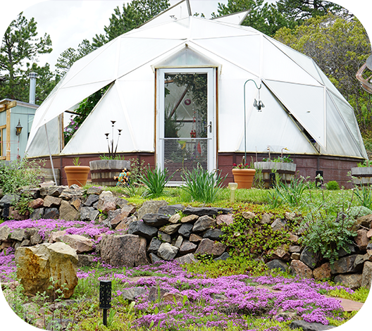
Appendix
Technical details and supporting information for HOA review

Slide 18
Appendix A: Growing Dome Size Specifications
Spec
15 ft
18 ft
22 ft
26 ft
Approx. diameter
15 ft
18 ft
22 ft
26 ft
Approx. square footage
175 ft²
255 ft²
380 ft²
530 ft²
Height
9 ft 5 in
10 ft 8 in
10 ft 10 in
12 ft 7 in
Source: Growing Dome Greenhouse Guide
Growing Spaces®
Appendix
Notes:
Specs from Growing Dome Greenhouse Guide. Verify current specs before final use.

Slide 19
Appendix B: Seven Design Features
Geodesic Shape
Polycarbonate Glazing
The geodesic dome shape is naturally wind-resistant & strong.
16mm multi-wall panels provide diffused light and insulation value.
Above-Ground Pond
North Wall Insulation
Thermal mass helps regulate interior temperature.
Reflects light and helps reduce winter heat loss.
Automatic Vents
Undersoil System
Heat-activated vents open and close without electricity.
Circulates air throughout the greenhouse.
Foundation Wall
24-inch insulated wall raises the structure and adds stability.
Growing Spaces®
Appendix
Notes:
Feature descriptions summarized from Growing Spaces 7 Unique Features page.

Slide 20
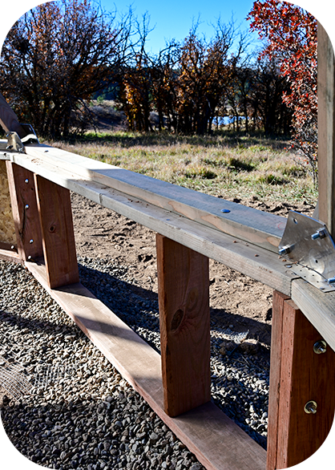
Appendix C: Foundation and Anchoring Options
Securely anchors the greenhouse to the ground
Supports long-term
durability and stability
Helps address site-specific
soil, drainage, frost,
and wind conditions
Can be reviewed as part
of the board’s technical documentation
Compacted gravel ring
Concrete piers/Sonotubes at foundation vertices with landscape timbers or compacted gravel between
Full insulated concrete form (ICF) foundation
Insulated wood foundation wall included in the dome design
Purpose of The Foundation
Foundation Options
Growing Spaces®
Appendix
Notes:
Foundation notes summarized from Growing Spaces foundation/options resources and installation guidance.

Slide 21
Appendix D: Weather Resistance and Long-Term Maintenance
Geodesic design remains stable
in high winds and sheds snow
65 PSF snow and 115 MPH wind resistance, potentially more depending on foundation, dome size, or engineering modifications
Hail-resistant 16mm, 5-wall polycarbonate glazing is cited by the manufacturer as 200 times stronger than glass
Weather-ready kit for wind, snow,
hail, heat, cold, and wildlife pressure
The Growing Dome includes a five year warranty from Growing Spaces against structural failure of the struts and hubs.
The polycarbonate glazing comes
with a 10-year pro-rated manufacturer warranty that covers yellowing and hail damage.
A Growing Dome is a long-term structure
with 20+ year life expectancy with proper maintenance.
Growing Spaces offers ongoing support, replacement parts, and resources.
Weather-Resistant Features
Maintenance & Support
Growing Spaces®
Appendix

Slide 22
Appendix E: Greenhouse Comparison Details
Greenhouse type
Longevity
Structural Strength
Snow Load
Wind Resistance
Notes for HOA Review
Hoop House
3–5 yrs
Low-Moderate
Low
Low
Inexpensive, plastic-covered and often more temporary
Traditional
5–10 yrs
Moderate-Good
Moderate
Low-Moderate
Classic appearance, but strength varies widely
Growing Dome®
20+ yrs
Excellent
High
High
Finished long-term structure with premium polycarbonate glazing
Fabric Dome
3–5 yrs
Moderate
Moderate
Moderate
Lightweight and quick to assemble, but shorter lifespan
Growing Spaces®
Appendix

Slide 23
Appendix F: Source Links for Board Review
Growing Dome 7 Unique Features: https://growingspaces.com/geodesic-dome-greenhouse
Greenhouse Types Comparison: https://growingspaces.com/compare-greenhouses/types-of-greenhouses
Growing Dome Greenhouse Guide: https://growingspaces.com/greenhouse-guide
Foundation Options: https://growingspaces.com/greenhouse-building/greenhouse-foundation
Weather-Resistant Kit (standard snow loads & wind resistance): https://growingspaces.com/weather-resistant-greenhouse-kit
Growing Dome Installation Options: https://growingspaces.com/greenhouse-building/greenhouse-installation-options
Appendix

