Slide 1
PRIMARY YEARS SLIDESHOW
Notes:
This PowerPoint slide show is suitable for primary teachers to use in the classroom or during a self-guided tour of the exhibition in the Gallery of Modern Art (GoMA). It has been designed for use with data projectors, school interactive whiteboards, or as a colour print-out.
The slideshow explores how artists in the exhibition have chosen to use colour and light in different ways to communicate optimistic moods and messages.
Light and colour are inextricably linked. We can only see objects and colours when there is light. Just as sunny days help brighten our mood, so do vibrant colours such as red, orange and yellow.
The notes sections provide background reading for teachers, and include questions (in italics) which can be read aloud when discussing each of the art works. Additional information about ‘Contemporary Australia: Optimism’ can be found in the exhibition catalogue, including essays on each of the artists featured.
The curriculum information included in this resource has been developed from the:
Assessment and Reporting Framework for The Arts, focusing on learning and assessmentt around the Essential Learnings and Standards for Visual Art and Media (© The State of Queensland, Queensland Studies Authority, 2007).
1

Slide 2
Colour and light
Notes:
CURRICULUM INFORMATION
(NB: Relevant artists for specific curriculum areas are noted in brackets.)
Artists use and combine colour in many ways and for many reasons. They may choose colours that are reminders of specific things or ideas, or they may choose colours purely for the effect they have on your eye.
This slideshow presentation will provide primary students with an understanding of:
the decision-making processes artists engage in, in terms of their placement of colour
colour choices, including the absence of colour.
ESSENTIAL LEARNINGS BY THE END OF YEAR 5
Visual Art
Visual Art involves selecting visual arts elements, concepts, processes and forms (both 2-D and 3-D) to express ideas, considering different audiences and purposes, through images and objects.
Students will explore the ways:
colour shades (adding black to a colour) and tints (adding colour to white) are used to create balance, contrast and patterns (e.g. Robert MacPherson and Vernon Ah Kee)
curved, angular, symmetrical, asymmetrical and overlapping shapes are used to create balance, contrast and patterns (e.g. Robert Owen, Gemma Smith and Sally Gabori).
Media
Media involves selecting media languages and technologies to create representations and construct meaning, considering different audiences and purposes.
Students will explore the ways:
still and moving images, sounds and words are selected to construct media texts (e.g. Tarryn Gill and Pilar Mata Dupont, Vernon Ah Kee and Tim Maguire)
representations in media texts are selected from different settings, including time and place, and for different audiences and purposes (e.g. Tarryn Gill and Pilar Mata Dupont, and Christian de Vietri).
2

Slide 3
Colour and light
continued
Notes:
ESSENTIAL LEARNINGS BY THE END OF YEAR 7
Visual Art
Visual Art involves modifying visual arts elements, concepts, processes and forms (both 2-D and 3-D) to express ideas, considering intended audiences and purposes, through images and objects.
Students are able to:
respond by analysing and evaluating arts works in social, cultural, historical and spiritual contexts, using arts elements and languages (e.g. Sally Gabori, Vernon Ah Kee)
reflect on learning, apply new understandings and identify future applications (e.g. Tim Maguire).
Media
Media involves constructing meaning, considering intended audiences and purposes, by modifying media languages and technologies to create representations.
Students will explore the ways:
still and moving images, sounds and words are applied and modified, using genre conventions, to construct media texts (e.g. Tim Maguire; Vernon Ah Kee)
representations in media texts have specific purposes and are modified to maximise audience impact (e.g. Tarryn Gill and Pilar Mata Dupont, and Vernon Ah Kee).
3

Slide 4
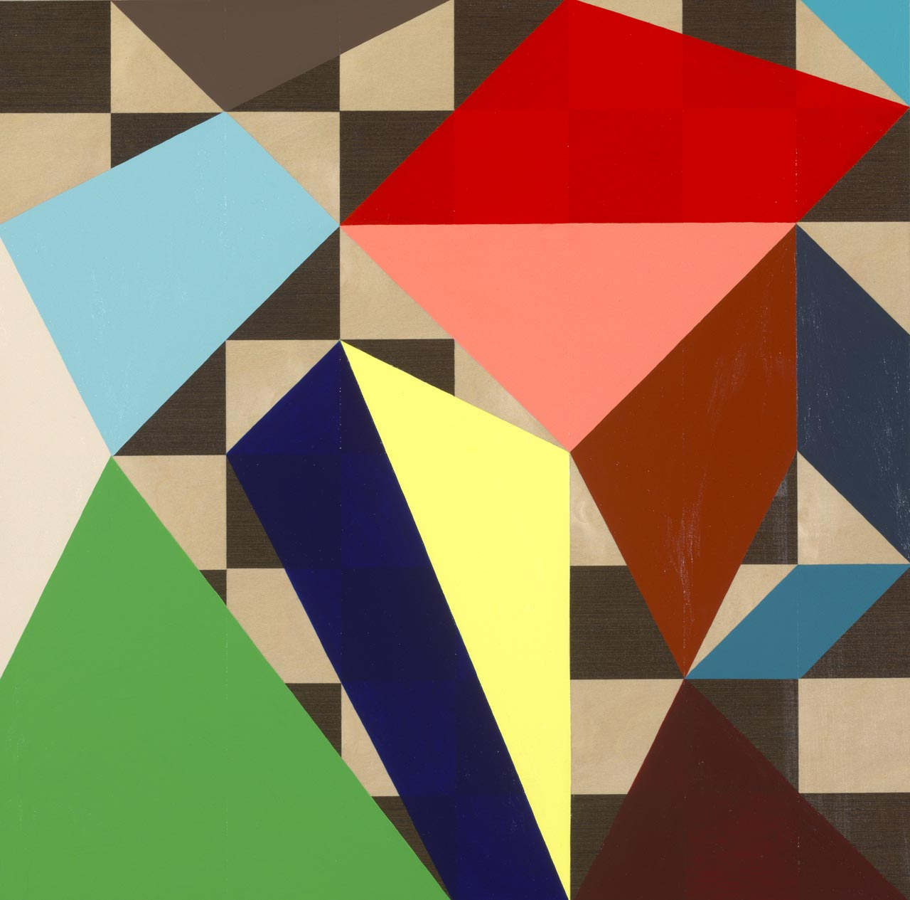
Both Gemma Smith and Sally Gabori combine colours in adventurous and unexpected ways.
How is their use of colour similar or different?
Sally Gabori
Dibirdibi Country 2008
Gemma Smith, Chessboard painting #6 2008
Notes:
Sally Gabori
Sally Gabori’s application of paint, in various states of drying, creates striking and interesting clashes of colour and transition and, although produced quickly, her works are carefully planned. Her paintings convey a combination of vitality, immediacy and supreme confidence. The working of paints into and over each other at different stages of the drying process has created differing visual effects — colour fields meet, with wet paints blending together to create soft transitions; and painting over dry sections has created harder and bolder transitions.
(Bruce McLean, ‘Sally Gabori: Intimate country’, in Contemporary Australia: Optimism [exhibition catalogue], Queensland Art Gallery, Brisbane, 2008, pp.94−7.)
Gemma Smith
In the same way that each move of a chess piece affects the entire board, each colour Gemma Smith adds to the board reflects on and reacts with all the other colours. This necessitates the re-evaluation of the pre-existing colour relationships. Therefore, every addition, like each move in a chess game, must take into account the ever-changing conditions of the board. These seemingly old-fashioned interests in the grid, colour theory and the painterly qualities of the works could easily slip into cliché. But, rather than slipping into the repetitive realm, Smith’s works seem to paint a rainbow of colour over the volumes of literature on the death of painting.
(Ellie Buttrose, ‘Gemma Smith: One step ahead’, in Contemporary Australia: Optimism [exhibition catalogue], Queensland Art Gallery, Brisbane, 2008, pp.208−11.)
Questions for discussion
Look at the way colours are overlapped and combined in paintings by Sally Gabori and Gemma Smith and compare the colour relationships to those on a colour wheel. As a class, how many words can you think of to describe the use of colour?
Do you think the colours have been selected carefully or at random? Both artists’ use of colour is carefully considered. Can you see any evidence of this in Smith’s painting? (Hint: Look at the title.)
What sorts of things do you think the artists considered when choosing the colours?
How do the pictures make you feel? Bright colours are often associated with happiness. Would you describe these artists’ use of colour as ‘optimistic’? Why or why not?

Slide 5
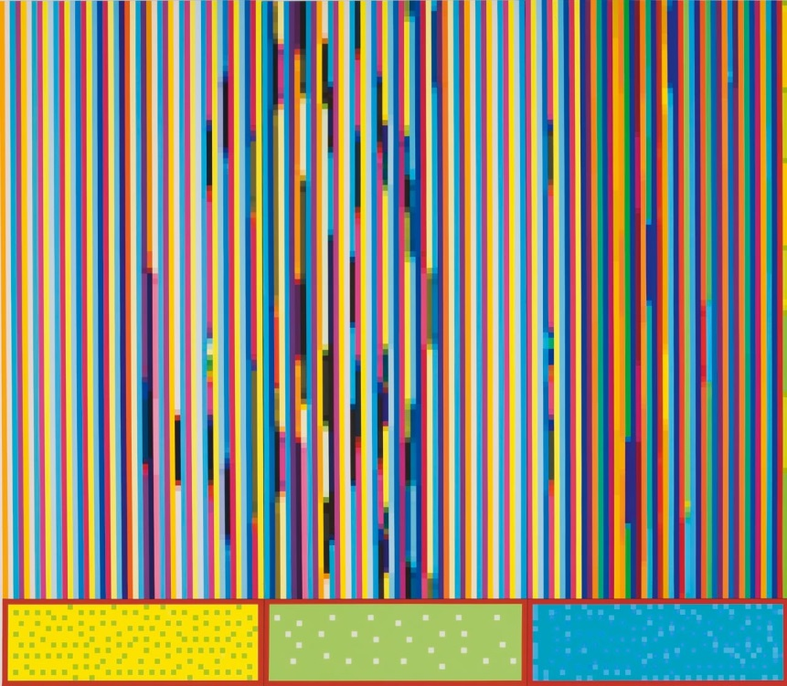
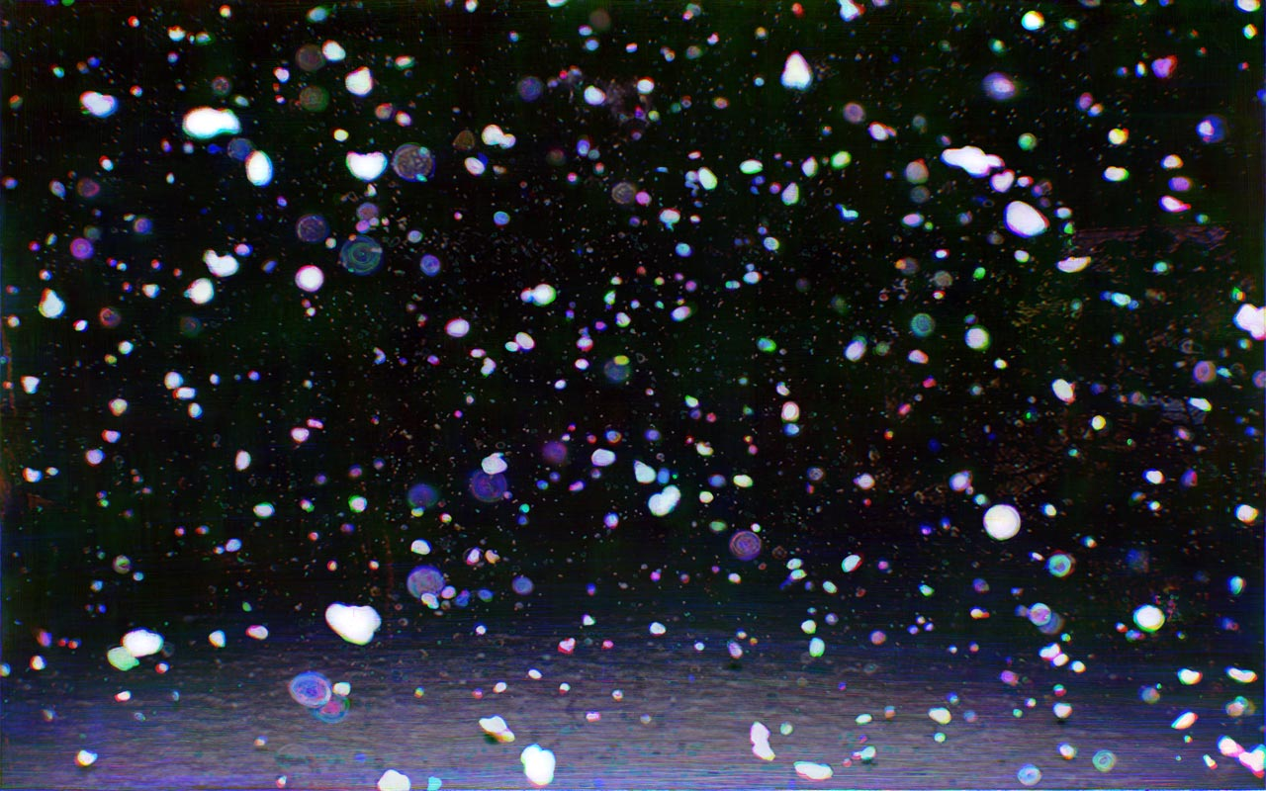
Compare the use of light and colour in each of these art works:
Robert Owen
Aura (Ten eye colours) (from ‘The text of light’ series) (detail) 2003–08
Tim Maguire
Falling snow I 2007
Notes:
Robert Owen
Robert Owen plots his feelings and sensations into a graphic system of colours, each band representing approximately 24 hours in his life. This work was made in direct response to the invitation to participate in ‘Contemporary Australia: Optimism’. Owen does not reveal exact correspondences between the colours and different states in his emotional register. He does, however, indicate that although pigments are subject to the laws of physics, the emotional affect of colour defies definition: its impact on individuals is essentially unclassifiable.
(Angela Goddard, ‘Robert Owen: How the light gets in’, in Contemporary Australia: Optimism [exhibition catalogue], Queensland Art Gallery, Brisbane, 2008, pp.174−7.)
Questions for discussion
Do you think colours have emotional effects on people? If so, are these emotions universal or specific to the individual?
Do colours signify different meanings depending on where you are in the world?
Examine the following pigments and think about what they symbolise in Western society: black
white
red and green
purple and gold
red, white and blue.
Do any of these colours symbolise something else in another culture?

Slide 6
Tim Maguire
Falling snow I 2007
Notes:
Tim Maguire
For his Falling snow prints, Tim Maguire begins with a found photograph that he then puts through a computer program, separating the image into three colour components: cyan, magenta and yellow. He paints each of these images with black oil paint onto a separate piece of film, removing areas with solvent to create the white of the snow. Scanned back into the computer, re-treated with their respective colours and then digitally overlaid, these painted layers of the old photograph form a new composition, becoming the large digital prints we see.
The photographic image is pulled apart, ‘handled’ and put back together again. However, the pieces do not quite fit. Maguire’s slightly imprecise painting of the photograph onto film often results in a mis-registration of the white snow particles, allowing the colour of each of the three sheets to seep into the next layer. The effect is at once familiar and strange, and fingerprints and brushstrokes create additional diversions.
(Ruth McDougall, ‘Tim Maguire: An uncertain place’, in Contemporary Australia: Optimism [exhibition catalogue], Queensland Art Gallery, Brisbane, 2008, pp.142−5.)
Questions for discussion
Do the white snow particles in this work look familiar or strange to you?
Do the particles appear to be still or moving across the surface of the work?
Which of these words best sums up the way Maguire’s work makes you feel? Compare your response with that of your neighbour (eg. peaceful, optimistic, afraid, uncertain, lost, free).

Slide 7
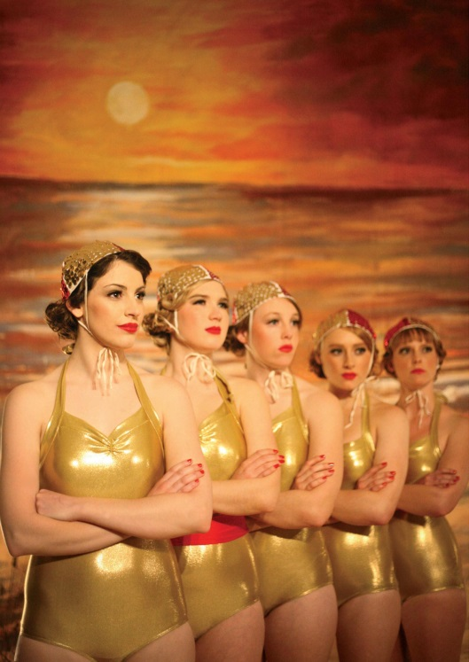
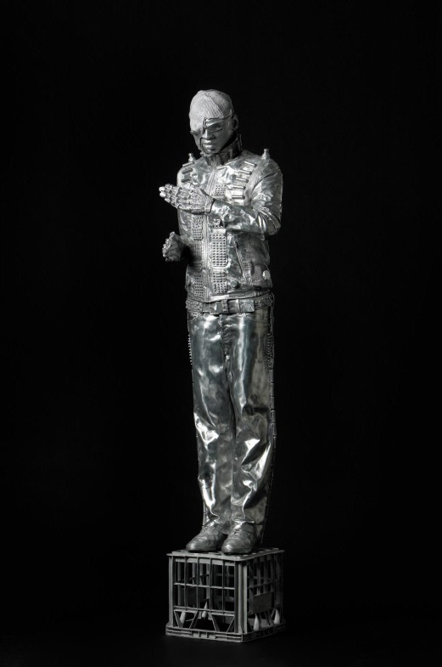
What are metallic colours? Can you see any in these art works?
Tarryn Gill
Pilar Mata Dupont
A Gladiator Class, Envied By All The Men, Adored By All The Women (from ‘Heart of Gold Project 5: the All Australian Surf Lifesaver’ series) 2008
Christian de Vietri
Tim 2006
Notes:
Tarryn Gill and Pilar Mata Dupont
Tarryn Gill and Pilar Mata Dupont hybridise the glorious technicolour of the well-loved world of Hollywood musicals with Australian surf lifesaving carnivals in to question Aussie nationalism and standard gender roles. The female lifeguards wearing sequined caps and gold swimsuits resemble a chorus line from a 1940s Esther Williams water ballet, rather than the bronzed surf lifesavers we are used to seeing on our shores. All of the moments captured in ‘Heart of Gold Project 5’ are synonymous with action, physical strength and heroism, which are not the sort of qualities that we expect from glamorous young women with ruby red lips and halter-neck swimsuits. Our expectations are constantly thwarted.
(Kate Ravenswood, ‘Tarryn Gill and Pilar Mata Dupont: Into the heart of nationhood’, in Contemporary Australia: Optimism [exhibition catalogue], Queensland Art Gallery, Brisbane, 2008, pp.102−5.)
Questions for discussion
Do these look like typical lifesavers you would see at the beach? What time period do the women look like they’re from?
If you were to apply sound and words to this photograph to tell us about Australian identity, what would it say?
What does it mean to be Australian? Is there more than one type of Australian?
How do people overseas view Australians (i.e. the type of people that we are)? How do they get these ideas?

Slide 8
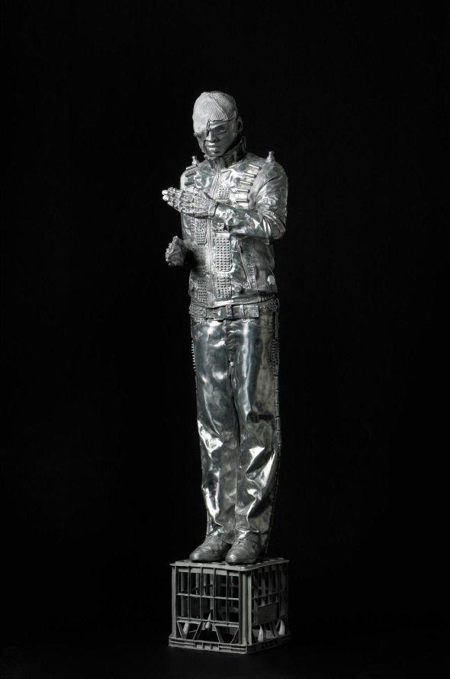
Christian de Vietri
Tim 2006
Notes:
Christian de Vietri
Which character from film or television do you think this statue is meant to resemble?
Tim 2006 is a statue of the ‘archetypal’ street performer — the kind that attempts to convince its audience that it really is a statue. There is an elegant visual pun inherent in a statue of a person pretending to be a statue. Tim is the name of one of the artist’s models who posed in this costume for the art work. One of the prominent prototypes for Tim 2006 is the Terminator — the cyborg assassin from the future. The sunglasses, the eyepiece, the metallic silver of aluminium all point unmistakably to this pop culture reference.
(Emma Cain, ‘Christian de Vietri: How many statues does it take to change an archetype?’, in Contemporary Australia: Optimism [exhibition catalogue], Queensland Art Gallery, Brisbane, 2008, pp.70−3.)
Questions for discussion
Have you ever seen a street performer? Where?
Why do performers choose to act like statues? Why do the statues amuse us, and make us laugh?
Tim is quite large in scale. When you look at the statue in the Gallery space, it seems like it is watching us in the same way that we watch it (i.e. we feel like we’re an object being stared at). Why do you think the artist wanted to create this feeling?
How do you think the sculpture was made? What materials do you think were used? What do you associate with these materials?
Think about some of the silver things you might have at home. Shiny, metallic objects reflect images back to us. What ideas might Tim reflect back about who we are?
If a friend was to describe who you are, what would they say about you?
What aspects of your life reveal who you are (e.g. what you wear, where you live, what hobbies you enjoy)?
In summary
These art works draw our attention to the various identities we perform as individuals and as Australians. We come to understand that our sense of who we are, both individually and collectively, is something that we have learned to ‘act out’, and that it does not necessarily stem from some innate place within ourselves.

Slide 9
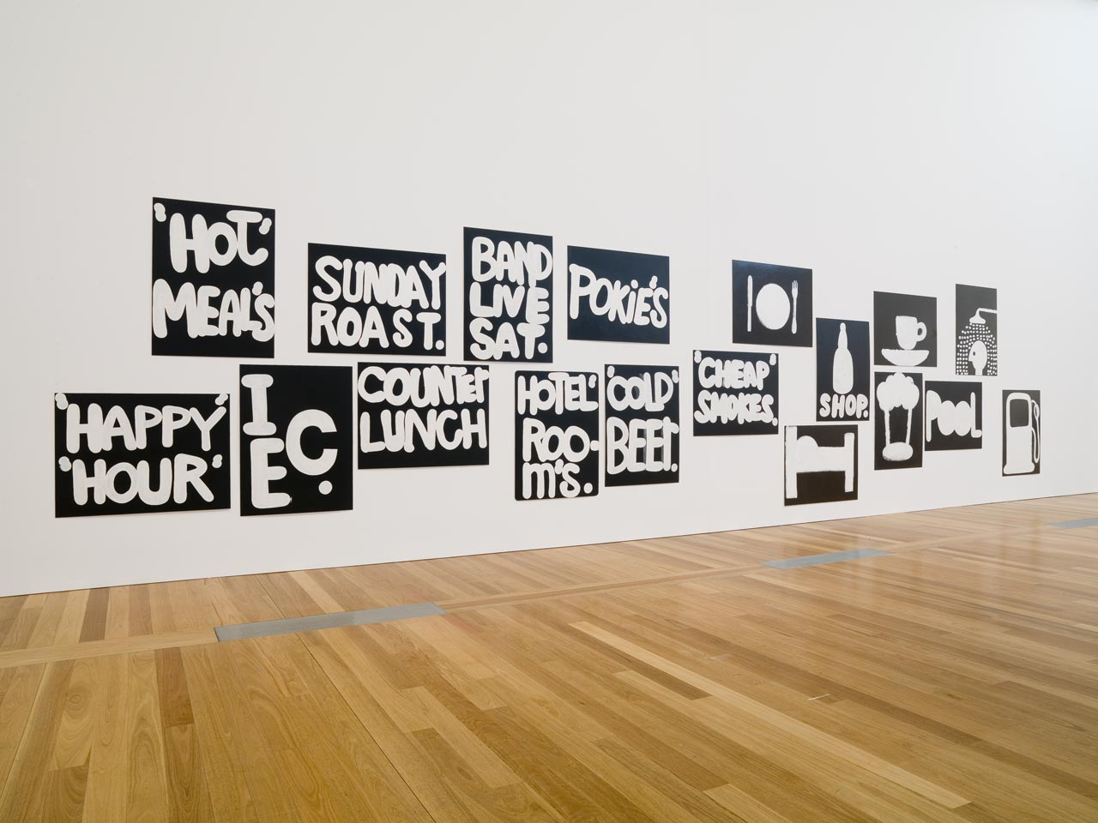
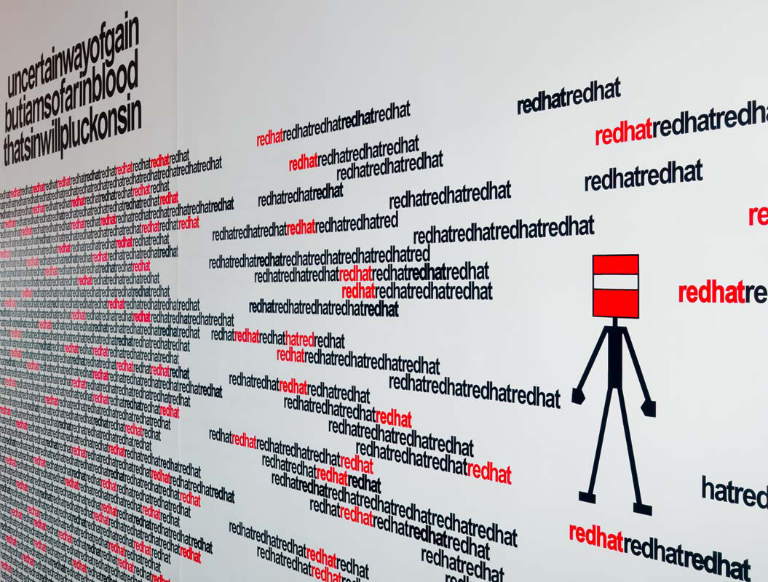
How can artists’ use of black and white create as much impact as colour?
Robert MacPherson
Mayfair: 18 signs, 18 paintings, "green lizard", "Double sars" + "Maiden's blush” for D.R.M. 1997–2005
Vernon Ah Kee
Who let the dogs out 2008
Notes:
Robert MacPherson
Robert MacPherson’s Mayfair paintings and installations are based on road signs. Named after his favourite sandwich bar in Brisbane, the works are inspired by the amateur signage relating to food, travel and various forms of community that is ubiquitous in the Australian countryside. Mayfair: 18 signs, 18 paintings, "green lizard", "Double sars" + "Maiden's blush” for D.R.M. 1997–2005 has its origins in signs that are meant to be read while moving past in a vehicle. For many travellers, signs evoke a nostalgia for those journeys through rural areas signposted by small handpainted notices announcing items for sale. MacPherson is drawn less to the exact connotations of words than to the way in which language can conjure images. He utilises the slick painted lettering and erotic wordplay of advertising sign-writing to create a work that is humorous, elegant and provocative. MacPherson highlights the disjunction between the ordered system of language and the world’s chaotic plethora of things that language describes.
Vernon Ah Kee
Vernon Ah Kee takes statements from books, songs, quotes and everyday life and creates slogans which confront and encourage dialogue about contemporary Aboriginal experience. In Who let the dogs out 2008 Ah Kee introduces us to a character or alter-ego that speaks his slogans. ‘Red Hat’ alters, chops up and runs-on words to dilute their negative connotations and to change their meaning. Red Hat is an anagram of the word ‘hatred’ and Ah Kee bases his character on iconic bushranger Ned Kelly, using a red hat or helmet, to personify the new concept. To Ah Kee, Red Hat has become an Aboriginal spirit in much the same way. The introduction of this mischievous spirit figure brings a different reading to Ah Kee’s otherwise black-and-white texts. Red Hat also speaks in Shakespearian verse, reciting lines from his favourite plays and recontextualising their ambiguous meanings. Red Hat’s slogans ooze boisterous, boyish appeal.
(Bruce McLean, ‘Vernon Ah Kee: Keeping them in line’, in Contemporary Australia: Optimism [exhibition catalogue], Queensland Art Gallery, Brisbane, 2008, pp.38−41.)
Questions for discussion
Compare some of the words that each artist includes in their works. How are the types of words used different, or similar, in both? What statements or stories are the artists representing?
What personal experiences do you think MacPherson and Ah Kee were thinking about when they created their works?
What is the impact of black and white? Do you think the art works have more or less impact if they were in colour?
Reading can sometimes conjure images in our minds. What kind of images do you imagine when you read the words in these art works? Do you think these artists are interested in images as much as text?
Do you think that each person reading the text in these art works would experience a different feeling? Why?
In-Gallery questions: Can you read the words all at once, or are the art works too large? How big or small do you feel when looking at the art works? Why do you think the artists chose to work on this kind of scale?

Slide 10
How do artists use colour and contrast to portray a message, feeling or experience?
Notes:
Reflection exercise
List the key points on a blackboard for the students to reflect upon and consider.

Slide 11
Classroom activity suggestions
Notes:
Knowledge and understanding
Examine colour combinations on a colour wheel. What happens when you put certain colours alongside each other? Talk about the colours in rainbow and the order of the colours.
Discuss different colour classifications, e.g. metallic, warm, cool or bright. How do we classify and describe colours? What colours would you select as optimistic colours?
Creating
Assemble a range of coloured items, including: paper, plastic, textiles, water, jelly and string. Encourage the students to construct colour combinations by folding, twisting, bending, tearing, ripping, making holes and projecting light through these objects. Discuss the comparisons.
Using cellophane, old film strips, transparencies, wrappers and chip packets, make three or four colour transparencies and place them onto a projector in a very dark room. Use this as a backdrop for a play or story. Invite the students to try various distances and surfaces, and to vary the size by controlling the focus.
Presenting
When you think of the word ‘red’ what kind of red do you see? How would you describe it? Is this the same colour your friend sees when they think of red? Conduct a group survey in the class and evaluate which shade of red the students thought of the most.
Responding
Respond to colour by words. Ask students to paint a sheet of colour and stare at it for three minutes, and without looking away, jot down their responses. What can you find in the sheet? These might be memories, images, dreams, fantasies, surreal references. Then link your words up to write a poem.
Reflecting
In a very dark room, use coloured sheets and explore how the colours appear to change when you project different colours onto them. You might like to project red, green and blue onto a multi-coloured sheet and see if the students can remember what the colours were like in normal daylight. Do colours change under different lighting conditions?
Can you think of an experience that you’ve had which made you feel hopeful about the future? If you were creating a work of art, what colours would you choose (from the colour wheel) to depict this?
11

Slide 12
a
List of art works
The art work captions are listed below in the order they appear in the PowerPoint.
Sally Gabori
Australia b.c.1924
Kaiadilt people
Dibirdibi Country (detail) 2008
Synthetic polymer paint on linen
200 x 600cm
Purchased 2008 with funds from Margaret Mittelheuser, am, and Cathryn Mittelheuser, am, through the Queensland Art Gallery Foundation
Collection: Queensland Art Gallery
© Sally Gabori 2008. Licensed by Viscopy, Sydney, 2008
Gemma Smith
Australia b.1978
Chessboard painting #6 2008
Synthetic polymer paint on inlaid wooden chessboard
50 x 50cm
Collection: The artist
Robert Owen
Australia b.1937
Aura (Ten eye colours) (from ‘The text of light’ series) 2003–08
Synthetic polymer paint on canvas
10 panels: 315 x 120 cm (each); 315 x 1200cm (overall)
Collection: The artist
© Robert Owen 2003–08. Licensed by Viscopy, Sydney, 2008
Tim Maguire
United Kingdom/Australia b.1958
Falling snow I 2007
Digital pigment ink on Berger photograph paper, ed.1/3
249 x 400cm
Collection: The artist
Tarryn Gill
Australia b.1981 Pilar Mata Dupont Australia b.1981 A Gladiator Class, Envied By All The Men, Adored By All The Women (from ‘Heart of Gold Project 5: the All Australian Surf Lifesaver’ series) 2008
Giclée print on paper
75 x 50cm
Collection: The artists
Christian de Vietri
Australia/United States b.1981
Tim 2006
Aluminium
225 x 60 x 60cm
Purchased 2008. Queensland Art Gallery Foundation Grant
Collection: Queensland Art Gallery
Robert MacPherson Australia b.1937 Mayfair: 18 signs, 18 paintings, "green lizard", "Double sars" + "Maiden's blush” for D.R.M. 1997–2005 Acrylic on masonite 18 panels: 122 x 90cm (each)‏ Collection: The artist
Vernon Ah Kee
Australia b.1967 Kuku Yalanji/Waanyo/Yidinyji/Guugu Yimithirr people Who let the dogs out 2008 Applied vinyl / Dimensions variable / Site-specific work for ‘Contemporary Australia: Optimism’ Courtesy: The artist
Notes:
12

Slide 13
Sponsors
Notes:
13

