Slide 1
Preparation Notes
Please review and customize this deck to prepare it for use. Some notes:
These professional learning (PL) materials (slide deck and accompanying handout) are being offered in editable forms so that you may make adjustments to better support the specific work happening in your school or district.
These PL materials are designed to easily accommodate remote delivery:
  A Jamboard template is provided to facilitate discussion of student work; the facilitator will need to make a copy of this and be ready to share the link with participants as noted in the deck.
  Text that can be readily pasted (marked with “—”) into a video call chat feature is included when participants need to reference the handout.
  There are placeholders for handout links to be shared with participants in the notes field of selected slides; the facilitator will need to add a link to the handout where indicated by “[insert link].”

Slide 2

M104 Overview
XQ Badge Project PL Series Baseline Session
Month XX, XXXX
Notes:
Baseline timeframe: 2 hours

Slide 3
Welcome!
Community Builder:
Write a “tweet” in 140 characters or less to describe a moment/interaction that pushed your teaching practice. Get ready to share!
Notes:
Facilitation Note
Give time to consider this joining question and invite folks to share.

Slide 4


Outcomes and Agenda
Participants will be able to:
Agenda:
Explain the content and practice expectations for the M104 badge
Analyze tasks through the lenses of (1) content and practice expectations and (2) learning principles
Analyze student work for evidence of learning
Exploring the Content
Task 1: Expectations and Learning Principles
Task 1: Student Work
Task 2: Expectations and Learning Principles
Task 2: Student Work
Closing
Notes:
Facilitation Note
Give overview of session goals and agenda.

Slide 5
Learning Principles
Engage with cognitively demanding tasks in heterogeneous settings.
Engage in social activities.
Build conceptual understanding through reasoning.
Have agency in their learning.
View mathematics as a human endeavor across centuries.
See mathematics as relevant.
Employ technology as a tool for problem-solving and understanding.
Which learning principle would you like to focus on today?
Notes:
Facilitation Note
This slide serves to remind participants about the learning principles that undergird the bading system.
Give time to consider this question and invite folks to share with a partner and the whole group.

Slide 6
01
Exploring the Content
Notes:
Facilitation Note
Estimated time for this section is about 25 minutes.

Slide 7
M104 Modeling with Exponential Functions
What comes to mind?
What knowledge and skills should students learn to earn this badge?
Come off mute or put your thoughts in the chat!
Notes:
Facilitation Note
Give participants time to consider the questions on this slide; they should generate responses based only on the title of the badge. Invite volunteers to share responses with the group.

Slide 8
What’s the Story of these Standards?
Interpret functions that arise in applications in terms of the context
For a function that models a relationship between two qualities, interpret key features of graphs and tables in terms of the quantities, and sketch graphs showing key features given a verbal description of the relationship. Key features include: intercepts; intervals where the function is increasing, decreasing, positive, or negative; relative maximums and minimums; symmetries; and behavior; and periodicity
Relate the domain of a function to its graph and, where applicable, to the quantitative relationship it describes. For example, if the function h(n) gives the number of person-hours it takes to assemble n engines in a factory, then the positive integers would be an appropriate domain for the function.
Calculate and interpret the average rate of change of a function (presented symbolically or as a table) over a specified interval. Estimate the rate of change from a graph.
Selected Common Core Standards for Mathematics High School - Functions
Understand the concept of a function and use function notation
Understand that a function from one set (called the domain) to another set (called the range) assigns to each element of the domain exactly one element of the range. If f is a function and x is an element of its domain, then f(x) denotes the output of f corresponding to the input x. The graph of f is the graph of the equation y = f(x)
Use function notation, evaluate functions for inputs in their domains, and interpret statements that use function notation in terms of a context.
How would you synthesize these?
What are the key takeaways
for students?
Notes:
Facilitation Note
Share that our process began by grounding in the standards and identifying the story of the standards.
Invite participants to read through the standards associated with this badge in the handout. (The slide image shows only a partial list.)
Frame this by asking participants to consider how they would synthesize this set of standards.
Share link to document in chat:
—-
Link to Handout: [insert link]
Feel free to download a copy.
Please see pages 2-5 in your handout.
—-

Slide 9
What’s the Story of these Standards?
Interpret functions that arise in applications in terms of the context
For a function that models a relationship between two qualities, interpret key features of graphs and tables in terms of the quantities, and sketch graphs showing key features given a verbal description of the relationship. Key features include: intercepts; intervals where the function is increasing, decreasing, positive, or negative; relative maximums and minimums; symmetries; and behavior; and periodicity
Relate the domain of a function to its graph and, where applicable, to the quantitative relationship it describes. For example, if the function h(n) gives the number of person-hours it takes to assemble n engines in a factory, then the positive integers would be an appropriate domain for the function.
Calculate and interpret the average rate of change of a function (presented symbolically or as a table) over a specified interval. Estimate the rate of change from a graph.
Selected Common Core Standards for Mathematics High School - Functions
Understand the concept of a function and use function notation
Understand that a function from one set (called the domain) to another set (called the range) assigns to each element of the domain exactly one element of the range. If f is a function and x is an element of its domain, then f(x) denotes the output of f corresponding to the input x. The graph of f is the graph of the equation y = f(x)
Use function notation, evaluate functions for inputs in their domains, and interpret statements that use function notation in terms of a context.
Share your thinking!
Notes:
Facilitation Note
Invite volunteers to share responses with the group.
Share in chat:
—
What are the are the key takeaways for students?
—

Slide 10
M104 Content and Practice Expectations (CPE)
104.a | Engage in the modeling cycle.
104.b | Interpret exponential functions that arise in applications in terms of the context.
104.c | Analyze exponential functions using different representations.
104.d | Build an exponential function that models a relationship between two quantities.
104.e | Construct and compare linear and exponential models and solve problems to draw conclusions.
104.f | Interpret expressions for exponential functions in terms of the situation they model.
104.g | Summarize, represent, and interpret data on two quantitative variables for linear and exponential model fits. In this badge, students are encouraged to investigate patterns of association in bivariate data, which includes the informal description of the fit of the curve and addresses the usefulness of the model for the particular context.
104.h | Understand the relevance of modeling with exponential functions.
104.i | Use a functions of exponential type model to determine values of interest in a real-world problem.
Notes:
Facilitation Note
Share these are the Content and Practice Expectations (CPE) we landed on.
Give participants some time to read and consider: What in our list of Content Practice Expectations resonates with you? What surprises you?
Share in chat:
—
Link to Handout: [insert link]
Feel free to download a copy.
Please see page 5 in your handout.
—

Slide 11
M104 Content and Practice Expectations (CPE)
104.a | Engage in the modeling cycle.
104.b | Interpret exponential functions that arise in applications in terms of the context.
104.c | Analyze exponential functions using different representations.
104.d | Build an exponential function that models a relationship between two quantities.
104.e | Construct and compare linear and exponential models and solve problems to draw conclusions.
104.f | Interpret expressions for exponential functions in terms of the situation they model.
104.g | Summarize, represent, and interpret data on two quantitative variables for linear and exponential model fits. In this badge, students are encouraged to investigate patterns of association in bivariate data, which includes the informal description of the fit of the curve and addresses the usefulness of the model for the particular context.
104.h | Understand the relevance of modeling with exponential functions.
104.i | Use a functions of exponential type model to determine values of interest in a real-world problem.
What
resonates with you?
Notes:
Facilitation Note
Invite participants to share with the group.

Slide 12
M104 Content and Practice Expectations and Indicators
Content and Practice Expectations | Indicators Choose an artifact where you…
104.a: Engage in the modeling cycle (performance assessment). | i. engage with the full modeling cycle (problem, formulate, compute, interpret, validate, revise as necessary, report).
104.b: Interpret exponential functions that arise in applications in terms of the context. | i. select two different data points that illustrate something interesting or important about the context you are modeling and describe what these points tell you about the topic.
 | ii. use a model to compute output values and then interpret the values in the context of the problem.
 | iii. describe the domain of the exponential function, including anything noticed about values that are not part of the domain or why the shape of the model might change for particular values of the domain.
 | iv. describe the contextual meaning of the average rate of change between two points for an exponential function.
What new insights do you have?
Notes:
Facilitation Note
Invite participants to examine the indicators that are associated with each content and practice expectation.
Pose the question: “What new insights do you have?”
Invite participants to share with the group.
Share that we will continue to build a shared understanding of these through sample prompts.
Share in chat:
—
Please see page 6 in your handout.
—

Slide 13
Let’s Investigate
Choose at least one task to explore:
Lake Algae
Interesting Interest Rates
Which content and practice expectations are evident in each one?
Notes:
Facilitation Note
Invite participants to select a task and look for connections to badge CPEs.
Offer enough time for everyone to engage with at least one task; participants do not need to look at both.
Consider use of self-select breakout rooms to give participants time to discuss with small group.
Encourage participants to stay focused at the content and practice expectation (CPE) level, using the indicators to support their thinking.
Share in chat:
—
Please see pages 7 and 8 in your handout.
—

Slide 14
Let’s Investigate
Choose at least one task to explore:
Lake Algae
Interesting Interest Rates
Which content and practice expectations are evident in each one?
Come off mute or put your thoughts in the chat! What did you find?
Notes:
Facilitation Note
Invite volunteers to share connections they see to each of the tasks.
Highlight responses where participants have identified one or more CPEs, using the indicators as part of their rationale.

Slide 15
What’s the Same? What’s Different?
How do these content and practice expectations align to ways you’ve taught this topic before?
How are they different?
Come off mute or put your thoughts in the chat!
Notes:
Facilitation Note
Give participants some time to consider their responses to these questions then invite volunteers to share with whole group.

Slide 16

Inequity
Is our
Reality
About
60%
of community college students and 40 percent of four-year students are placed into non-credit bearing developmental mathematics (Ganga et al., 2018)
Only
33%
of community college students complete the developmental math sequence. Only 20 percent complete a college-level math course over three years (Bailey, Jeong, & Cho, 2010).
Notes:
Facilitation Note
Share these quotes with group as a way to give insight into the why of this badging project.

Slide 17
We Must Lead the Movement
Is math...?
Or could be math...?
About getting one right answer, the teacher’s way
Irrelevant
About doing procedures
Independent work
Something my teacher made up
Formulaic
About using multiple strategies flexibly
Connected to the real-world in ways that make sense
About understanding and applying
Collaborative work
Lived across continents and centuries
Novel, challenging problems
How can this approach give space for what math can be?
Notes:
Facilitation Note
Give participants time to reflect on the HS Badging System, the quote and this list.
Invite participants to consider how can this approach give students space for what math can be?
Consider inviting 1-2 voices to share thoughts with the group before transitioning to the next section.

Slide 18
02
Task 1: Expectations
and Learning Principles
Notes:
Facilitation Note
Estimated time for this section is about 15 minutes.

Slide 19
Let’s Do Some Math!
The original Superman movie came out in 1978 and made about $300 million at the box office. If the yearly inflation rate is about 4%, how much money would this be equivalent to in 2022?
Do the task as a student would. Jot down any reflections that you have as you do the math!
Notes:
Facilitation Note
Give participants time to read through prompt and consider how students might approach this. Invite to try it out for themselves.
Share in chat:
—
Please see page 9 in your handout.
—

Slide 20
Content and Practice Expectations
The original Superman movie came out in 1978 and made about $300 million at the box office. If the yearly inflation rate is about 4%, how much money would this be equivalent to in 2022?
Choose 1-2 Content and Practice Expectations that student work could give evidence of.
Notes:
Facilitation Note
Give time to read and connect.
Consider use of breakout rooms to give participants time to discuss with a small group.

Slide 21
Content and Practice Expectations
The original Superman movie came out in 1978 and made about $300 million at the box office. If the yearly inflation rate is about 4%, how much money would this be equivalent to in 2022?
104.i: Use a function
of exponential type l to determine values of interest in a real-world problem.
Notes:
Facilitation Note
Encourage participants to stay focused at the content and practice expectation (CPE) level, using the indicators to support their thinking.
A good CPE to focus on for this task is 104.i: Use a function of exponential type to determine values of interest in a real-world problem.

Slide 22
Learning
Principles
In M104 Modeling with Functions of Exponential Type, students will employ the following learning principles:
Engage with cognitively demanding tasks in heterogeneous settings (LP 1).
Engage in social activities (LP 2).
Build conceptual understanding through reasoning (LP 3).
Have agency in their learning (LP 4).
View mathematics as a human endeavor across centuries (LP 5).
See mathematics as relevant (LP 6).
Employ technology as a tool for problem-solving and understanding (LP 7).
Notes:
Facilitation Note
Share that we will now be reflecting on the learning principles in relation to this task.
Give participants time to read them over again in the handout.
Share in chat:
—
Please see page 10 in your handout.
—

Slide 23
Learning
Principles
In M104 Modeling with Functions of Exponential Type, students will employ the following learning principles:
Engage with cognitively demanding tasks in heterogeneous settings (LP 1).
Engage in social activities (LP 2).
Build conceptual understanding through reasoning (LP 3).
Have agency in their learning (LP 4).
View mathematics as a human endeavor across centuries (LP 5).
See mathematics as relevant (LP 6).
Employ technology as a tool for problem-solving and understanding (LP 7).
Which of these principles does this task lend itself to? Which ones can the task be easily adapted to accommodate?
Notes:
Facilitation Note
Give time for participants to consider these questions, reflecting on the student experience associated with this task and consider how the 7 learning principles are evident.
Consider use of breakout rooms for small group conversation.

Slide 24
Learning
Principles
In M104 Modeling with Functions of Exponential Type, students will employ the following learning principles:
Engage with cognitively demanding tasks in heterogeneous settings (LP 1).
Engage in social activities (LP 2).
Build conceptual understanding through reasoning (LP 3).
Have agency in their learning (LP 4).
View mathematics as a human endeavor across centuries (LP 5).
See mathematics as relevant (LP 6).
Employ technology as a tool for problem-solving and understanding (LP 7).
Share what
you came up with!
Notes:
Facilitation Note
Invite participants to share with the whole group.

Slide 25
03
Task 1: Student Work
Notes:
Facilitation Note
Estimated time for this section is about 30 minutes.

Slide 26
What is the impact of our labels?
“Undoing the harms of ability labeling is not just an issue of changing our language or implementing a standardized set of “best practices” or policies. It requires sustained action and ongoing learning at every level of our educational system, from individual classrooms to schools, school districts, universities, regions, states/provinces, and the nation. Many curricula, assessments, and instructional practices reproduce stratification—labeling students, their problem-solving strategies, and the learning opportunities they should receive on a scale from “remedial” to “sophisticated” (e.g., test score categories, systems for grouping students based on perceived ability, and strategies for sequencing student work for mathematical discussions). “
-National Council of Teachers of Mathematics
Notes:
Facilitation Note
Let participants know that since we will be looking at student work, it is important to maintain an asset orientation and avoid deficit labels.
Ask a participant to read the quote out loud.
Ask the group to reflect on (a) the types of labels they have heard used in math contexts; (b) the potential impact of these labels.
From: NCTM position paper Ability Labels: Disrupting “High,” “Medium,” and “Low” in Mathematics Education November 2023
Read the quote and ask participants to reflect on (a) the types of labels they have heard used in math contexts; (b) the potential impact of these labels.

Slide 27
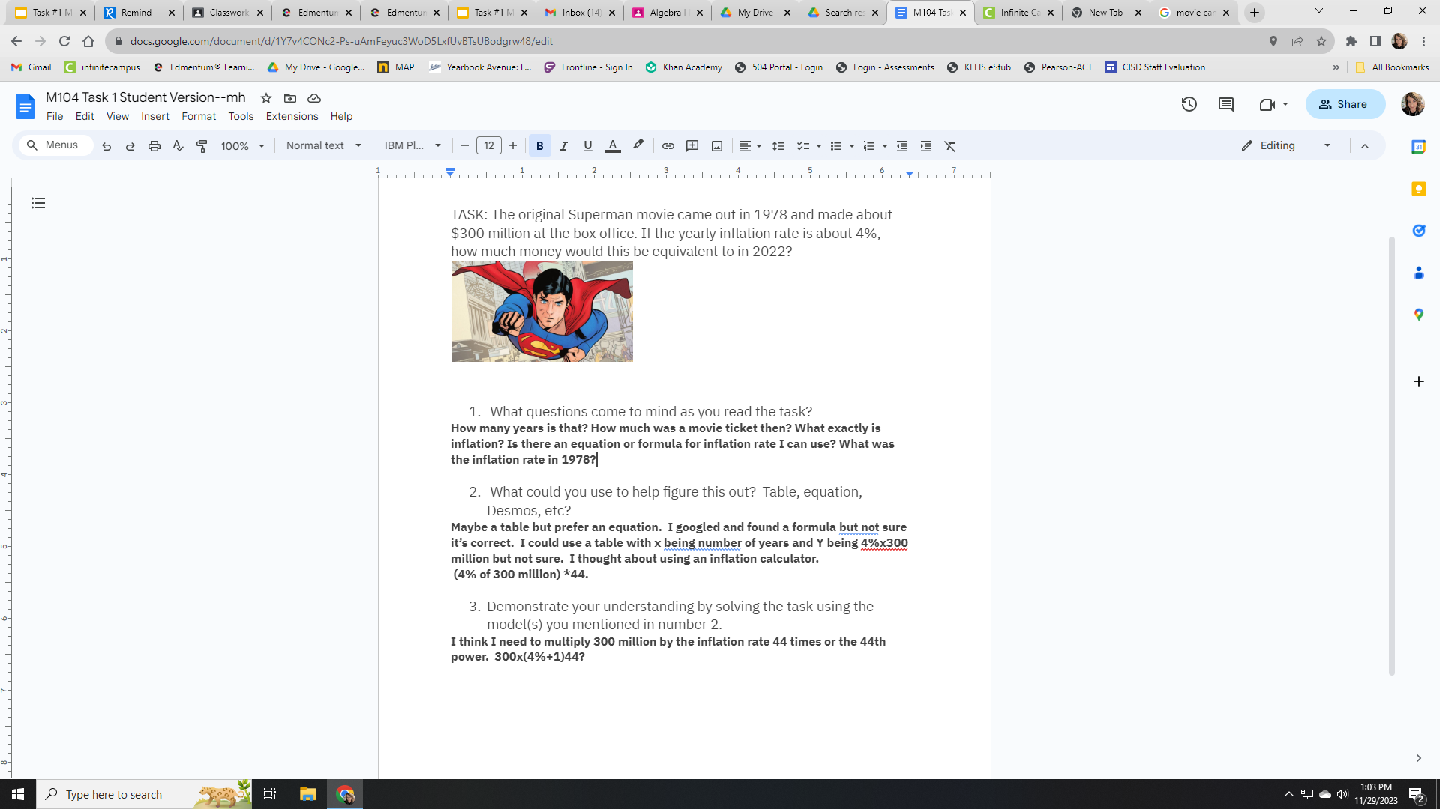
Round 1:What
do you notice?
Jot down
One thing you notice about each piece of student work.
Notes:
Facilitation Note
Give participants time to study student work associated with Task 1.
Share in chat:
—
Please see pages 11 and 12 in your handout
—

Slide 28
Round 1:What
do you notice?
Jot down
One thing you notice about each piece of student work.
Come off mute and share what you saw!
Notes:
Facilitation Note
Invite participants to share what they noticed.
Look for trends in responses, especially as connected to CPE 104.i: Use a function of exponential type model to determine values of interest in a real-world problem.

Slide 29
Criteria for Success
Conference and Provide Revision Support | Accept with Revision | Accept
The student’s artifact shows an emerging understanding of the expectations of the indicator(s). After conferencing and additional instruction/learning, the student may provide a revised or different artifact as evidence of the indicator(s). | The student’s artifact is approaching a full understanding of the expectations of the indicator(s). The artifact may contain execution errors that should be corrected in revision. The student may revise the selected artifact or submit a different artifact. | The student’s artifact demonstrates evidence that they have met the expectations of the indicator(s).
What resonates with you? What questions surace for you?
Notes:
Facilitation Note
Introduce criteria for success.
Ask: “What resonates with you? What questions surface for you?”
Consider use of breakout groups.
Share the following in chat:
—
Please see page 16 in your handout.
—

Slide 30
Humanizing Assessment
Project-based learning, performance assessment, and discussion-based classrooms, on the other hand, create an infrastructure for students to explore, construct, reflect on, and publicly demonstrate knowledge. Students become agents in their own learning rather than consumers of curriculum. (Safir and Dugan, 2021, p. 102)
Source: Safir, Shane, and Jamila Dugan. Street Data: A Next-Generation Model for Equity, Pedagogy, and School Transformation. Corwin, 2021.
Notes:
Facilitation Note:
Share the quote. Ask participants to reflect on how the criteria and the ideas in the quote require rethinking something in their current practice.

Slide 31
Round 2:
What evidence of learning is there?
Let’s examine some work together:
Conference and Provide Revision Support
The student’s artifact shows evidence of an emerging understanding of the expectations of the indicator(s). After conferencing and additional instruction/learning, the student may provide a revised or different artifact as evidence of the indicator(s).
Accept with Revision
The student’s artifact shows evidence of approaching a full understanding of the expectations of the indicator(s). The artifact may contain execution errors that should be corrected in revision. The student may revise the selected artifact or submit a different artifact.
Accept
The student’s artifact demonstrates evidence
that they have met the expectations of the indicator(s).
104.i: Use a function of exponential type to determine values of interest in a real-world problem.
Notes:
Facilitation Note
Use this slide to set up what folks will do- next slide illustrate space to capture thinking.
They will examine the student work.
Determine where that work falls along the criteria for success spectrum.
And add a post it sharing what evidence of success is present.
We will focus our lens on the indicator displayed on the slide.
Note, a similar process can be done for each indicator that applies to this task.

Slide 32
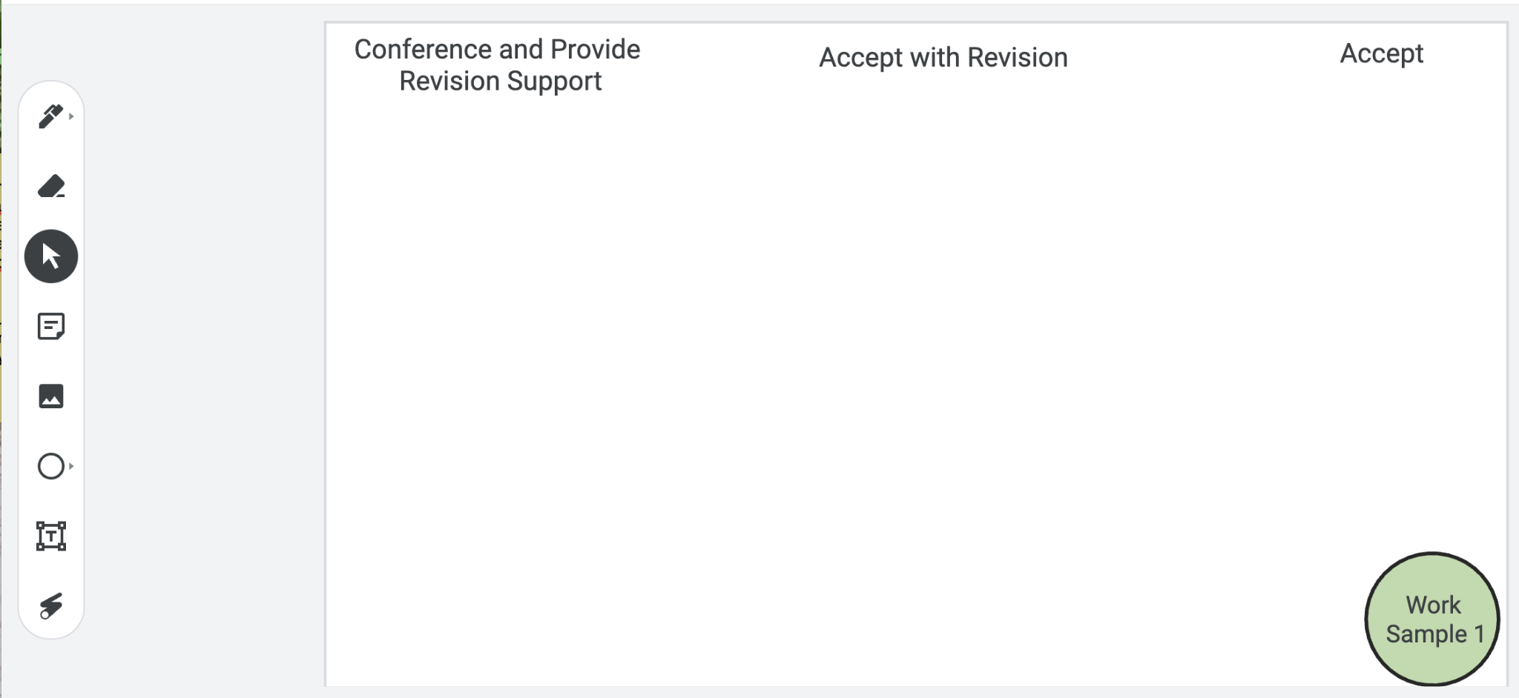
Examining Student Work
Put your
thoughts on the Jamboard!
Notes:
Facilitation Note
Facilitator will need to make a copy of the Jamboard file- Baseline PL Looking at Student Work and share that link with participants.
Invite participants to add a post it to the jamboard sharing:
Where they think the evidence of learning is along the Criteria for Success spectrum.
If the student was here, what question(s) would you pose to understand what they know?
Remind participants to focus at the CPE level, using the indicators to help guide decision-making.
If they find the student work falls within the first two categories, consider inviting folks to consider and share what “conferring and additional instruction/learning” might look like for that student, as time permits.
Share that directions are on the first slide and the pink circle on the bottom indicates which work sample is in focus for that slide.
Navigate to Jamboard file to illustrate use of tools as needed.

Slide 33
Example #1
Let’s compare notes.
Notes:
Facilitation Note
Use this slide to discuss how folks thought about the student work, in terms of the Criteria for Success chart.
This is meant to give time for group to build shared understanding of how to use the CPEs and indicators alongside the rubric to share ways of partnering with students to support all students reaching.

Slide 34
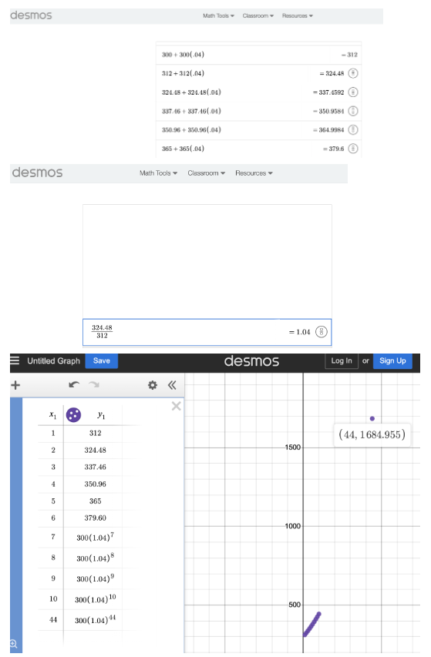
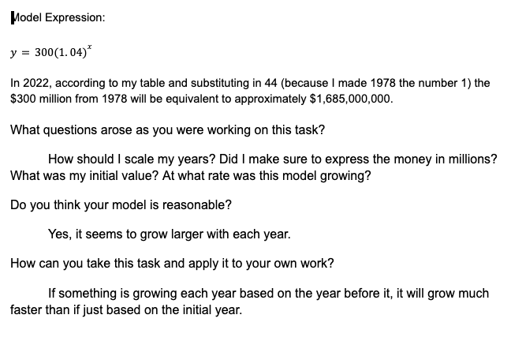
Example #2
Let’s compare notes.
Notes:
Facilitation Note
Use this slide to discuss how folks thought about the student work, in terms of the Criteria for Success chart.
This is meant to give time for group to build shared understanding of how to use the CPEs and indicators alongside the rubric to share ways of partnering with students to support all students reaching.

Slide 35
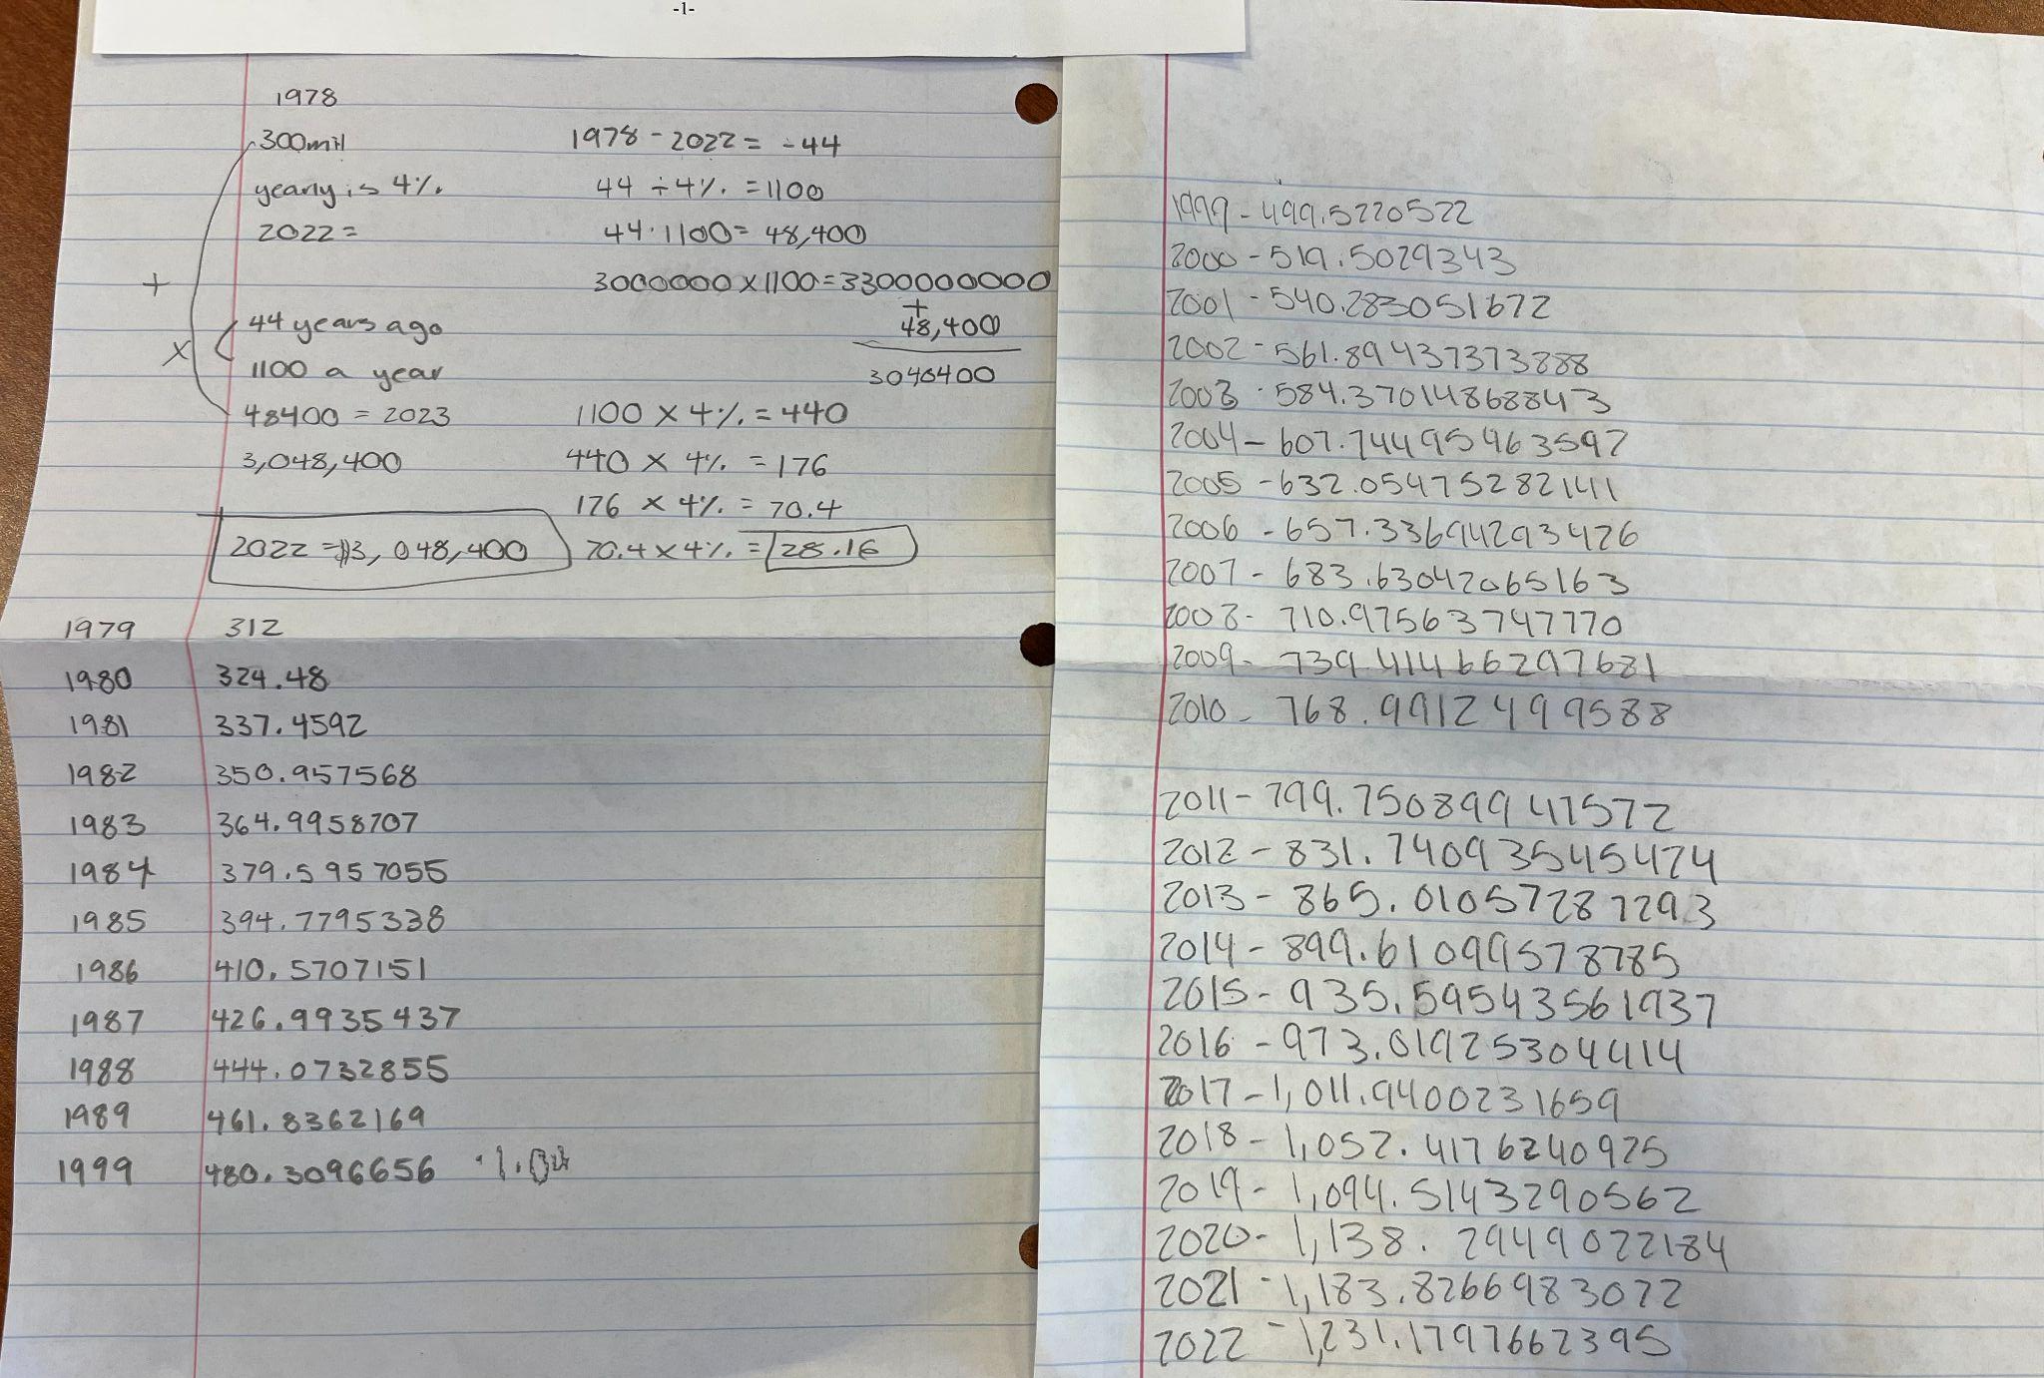
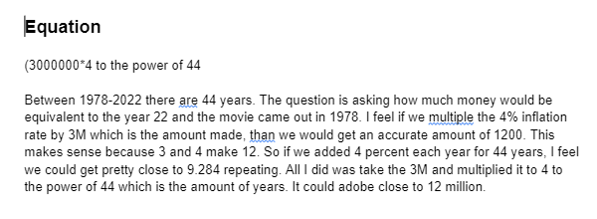
Example #3
Let’s compare notes.
Notes:
Facilitation Note
Use this slide to discuss how folks thought about the student work, in terms of the Criteria for Success chart.
This is meant to give time for group to build shared understanding of how to use the CPEs and indicators alongside the rubric to share ways of partnering with students to support all students reaching.

Slide 36
Three Key Components of the Math Badging System
Content and Practice Expectations
Learning Principles
Criteria for Success
Which one excites you the most?
What one will have the greatest impact on students?
What questions surface for you?
Come off
mute or share in the chat!
Notes:
Facilitation Note
Give participants time to reflect. If time permits, consider using breakout rooms to have folks connect in smaller pairings or groups.
Invite to share with whole group.

Slide 37
04
Task 2: Expectations and Learning Principles
Notes:
Facilitation Note
Estimated time for this section is about 15 minutes.

Slide 38
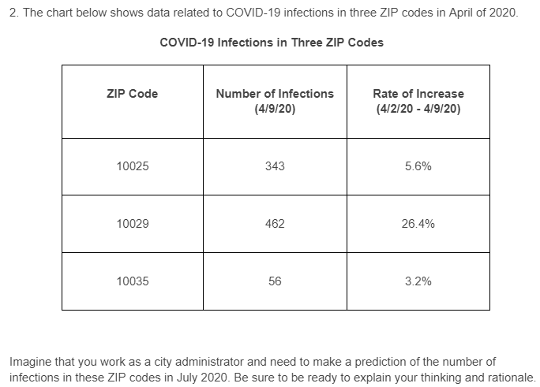
Let’s Do Some Math!
Do the task as a student would. Jot down any reflections that you have as you do the math!
Notes:
Facilitation Note
Give participants time to read through prompt and consider how students might approach this. Invite to try it out for themselves.
Share in chat:
—
Please see page 13 in your handout.
—

Slide 39
Content and Practice Expectations
Choose 1-2 Content and Practice Expectations that student work could give evidence of.
Notes:
Facilitation Note
Give time to read and connect.
Consider use of breakout rooms to give participants time to discuss with small group.

Slide 40
Content and Practice Expectations
104.i: Use a functions of exponential type model to determine values of interest in a real-world problem.
Notes:
Facilitation Note
Encourage participants to stay focused at the content and practice expectation (CPE) level, using the indicators to support their thinking.
A good CPE to focus on for this task is 104.i: Use a function of exponential type to determine values of interest in a real-world problem.

Slide 41
Learning
Principles
In M104 Modeling with Functions of Exponential Type, students will employ the following learning principles:
Engage with cognitively demanding tasks in heterogeneous settings (LP 1).
Engage in social activities (LP 2).
Build conceptual understanding through reasoning (LP 3).
Have agency in their learning (LP 4).
View mathematics as a human endeavor across centuries (LP 5).
See mathematics as relevant (LP 6).
Employ technology as a tool for problem-solving and understanding (LP 7).
Notes:
Facilitation Note
Share that we will now be reflecting on the learning principles in relation to this task.
Give participants time to read them over again in the handout.
Share in chat:
—
Please see page 10 in your handout.
—

Slide 42
Learning
Principles
In M104 Modeling with Functions of Exponential Type, students will employ the following learning principles:
Engage with cognitively demanding tasks in heterogeneous settings (LP 1).
Engage in social activities (LP 2).
Build conceptual understanding through reasoning (LP 3).
Have agency in their learning (LP 4).
View mathematics as a human endeavor across centuries (LP 5).
See mathematics as relevant (LP 6).
Employ technology as a tool for problem-solving and understanding (LP 7).
Which of these principles does this task lend itself to?
Which ones can the task be easily adapted to accommodate?
Notes:
Facilitation Note
Give time for participants to consider these questions, reflecting on the student experience associated with this task and consider how the 7 learning principles are evident.
Consider use of breakout rooms for small group conversation.

Slide 43
Learning
Principles
In M104 Modeling with Functions of Exponential Type, students will employ the following learning principles:
Engage with cognitively demanding tasks in heterogeneous settings (LP 1).
Engage in social activities (LP 2).
Build conceptual understanding through reasoning (LP 3).
Have agency in their learning (LP 4).
View mathematics as a human endeavor across centuries (LP 5).
See mathematics as relevant (LP 6).
Employ technology as a tool for problem-solving and understanding (LP 7).
Share what
you came up with!
Notes:
Facilitation Note
Invite participants to share with the whole group.

Slide 44
05
Task 2: Student Work
Notes:
Facilitation Note
Estimated time for this section is about 30 minutes.

Slide 45
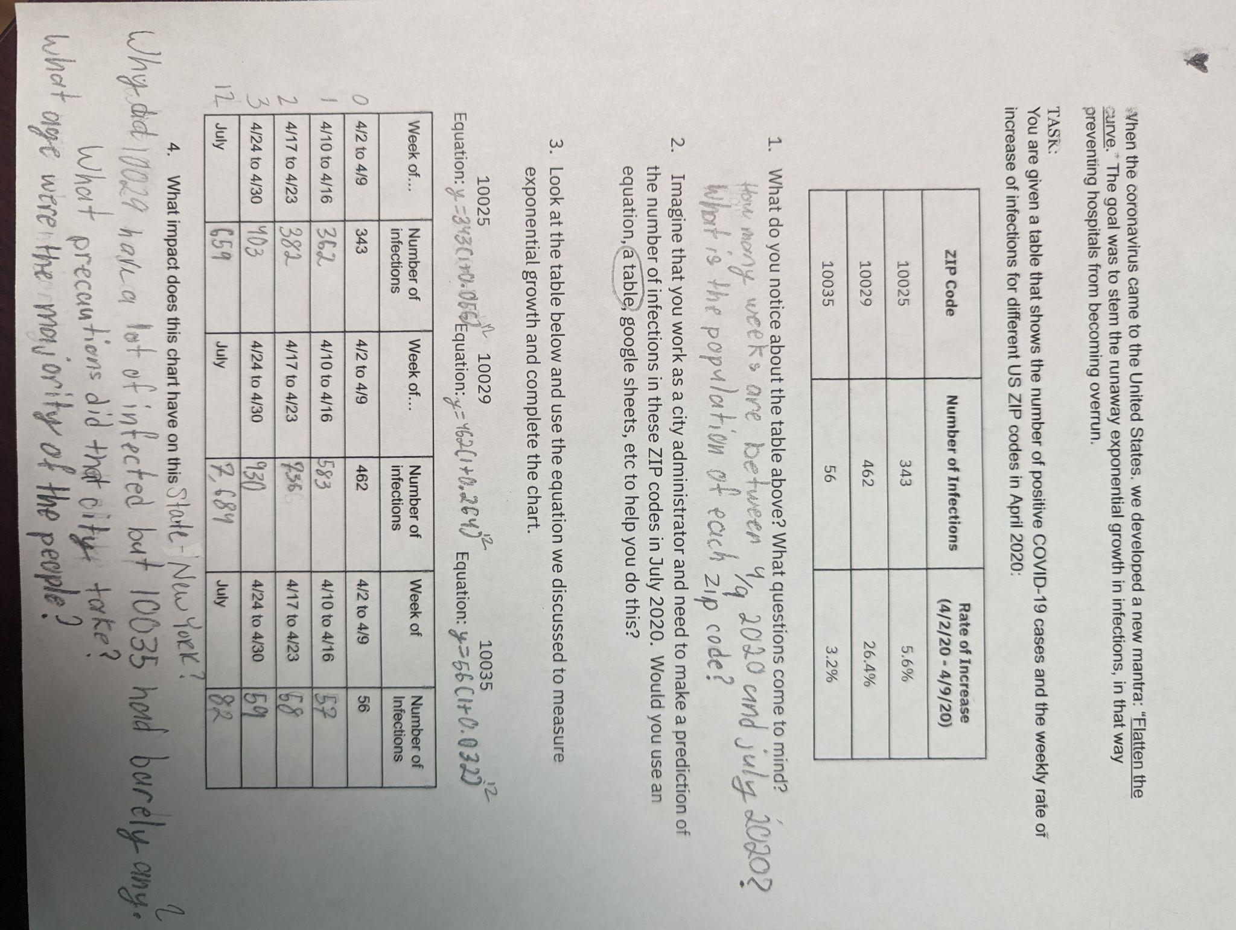
Round 1:What
do you notice?
Jot down
One thing you notice about each piece of student work.
Notes:
Facilitation Note
Give participants time to study student work.

Slide 46
Round 1:What
do you notice?
Jot down
One thing you notice about each piece of student work.
Come off mute and share what you saw!
Notes:
Facilitation Note
Invite participants to share what they noticed.
Look for trends in responses, especially as connected to CPE 104.d: Build an exponential function that models a relationship between two quantities.
Share in chat:
—
Please see pages 14 and 15 in your handout.
—

Slide 47
Round 2:
What evidence of learning is there?
Let’s examine some work together:
Conference and Provide Revision Support
The student’s artifact shows evidence of an emerging understanding of the expectations of the indicator(s). After conferencing and additional instruction/learning, the student may provide a revised or different artifact as evidence of the indicator(s).
Accept with Revision
The student’s artifact shows evidence of approaching a full understanding of the expectations of the indicator(s). The artifact may contain execution errors that should be corrected in revision. The student may revise the selected artifact or submit a different artifact.
Accept
The student’s artifact demonstrates evidence
that they have met the expectations of the indicator(s).
104.i: Use a functions of exponential type model to determine values of interest in a real-world problem.
Notes:
Facilitation Note
Remind participants of the criteria of success.
Use this slide to set up what folks will do on the next slide.
They will examine the student work.
Determine where that work falls along the criteria for success spectrum.
And add a post it sharing what evidence of success is present.
We will focus our lens on the indicator displayed on the slide: 104.d.Build an exponential function that models a relationship between two quantities.
Note, a similar process can be done for each indicator that applies to this task.

Slide 48
Examining Student Work
Put your
thoughts on the Jamboard!
Notes:
Facilitation Note
Facilitator will need to make a copy of the Jamboard file- Baseline PL Looking at Student Work and share that link with participants.
Invite participants to add a post it to the jamboard sharing:
Where they think the evidence of learning is along the Criteria for Success spectrum.
If the student was here, what question(s) would you pose to understand what they know?
Remind participants to focus at the CPE level, using the indicators to help guide decision-making.
If they find the student work falls within the first two categories, consider inviting folks to consider and share what “conferring and additional instruction/learning” might look like for that student, as time permits.
Share that directions are on the first slide and the pink circle on the bottom indicates which work sample is in focus for that slide.
Navigate to Jamboard file to illustrate use of tools as needed.

Slide 49
Example #1
Let’s norm our feedback
Notes:
Facilitation Note
Use this slide to discuss how folks thought about the student work, in terms of the Criteria for Success chart.
This is meant to give time for group to build shared understanding of how to use the CPEs and indicators alongside the rubric to share ways of partnering with students to support all students reaching.

Slide 50
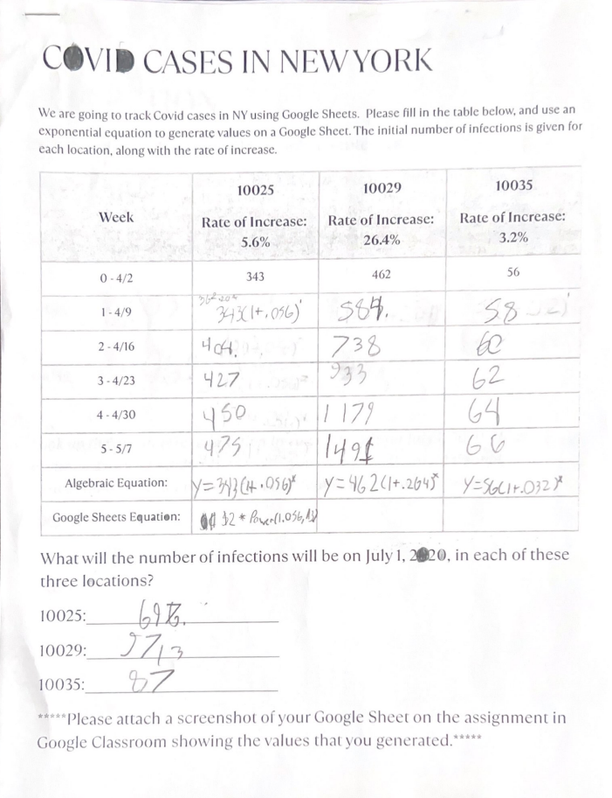
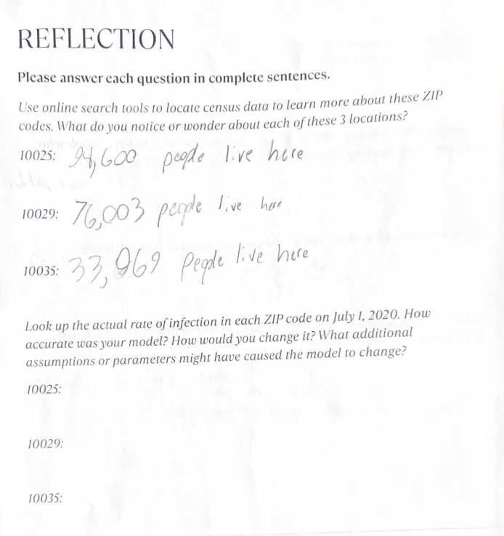
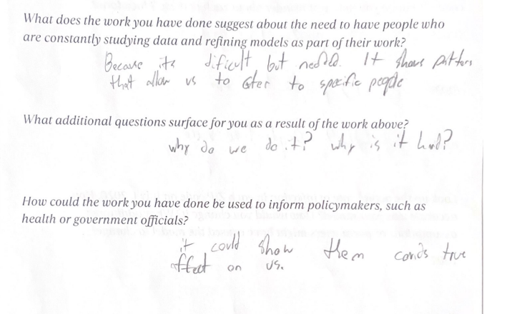
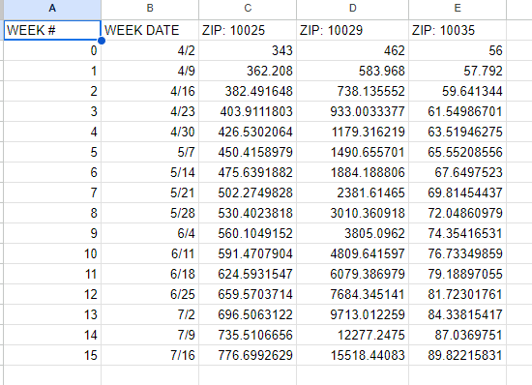
Example #2
Let’s norm our feedback
Notes:
Facilitation Note
Use this slide to discuss how folks thought about the student work, in terms of the Criteria for Success chart.
This is meant to give time for group to build shared understanding of how to use the CPEs and indicators alongside the rubric to share ways of partnering with students to support all students reaching.

Slide 51
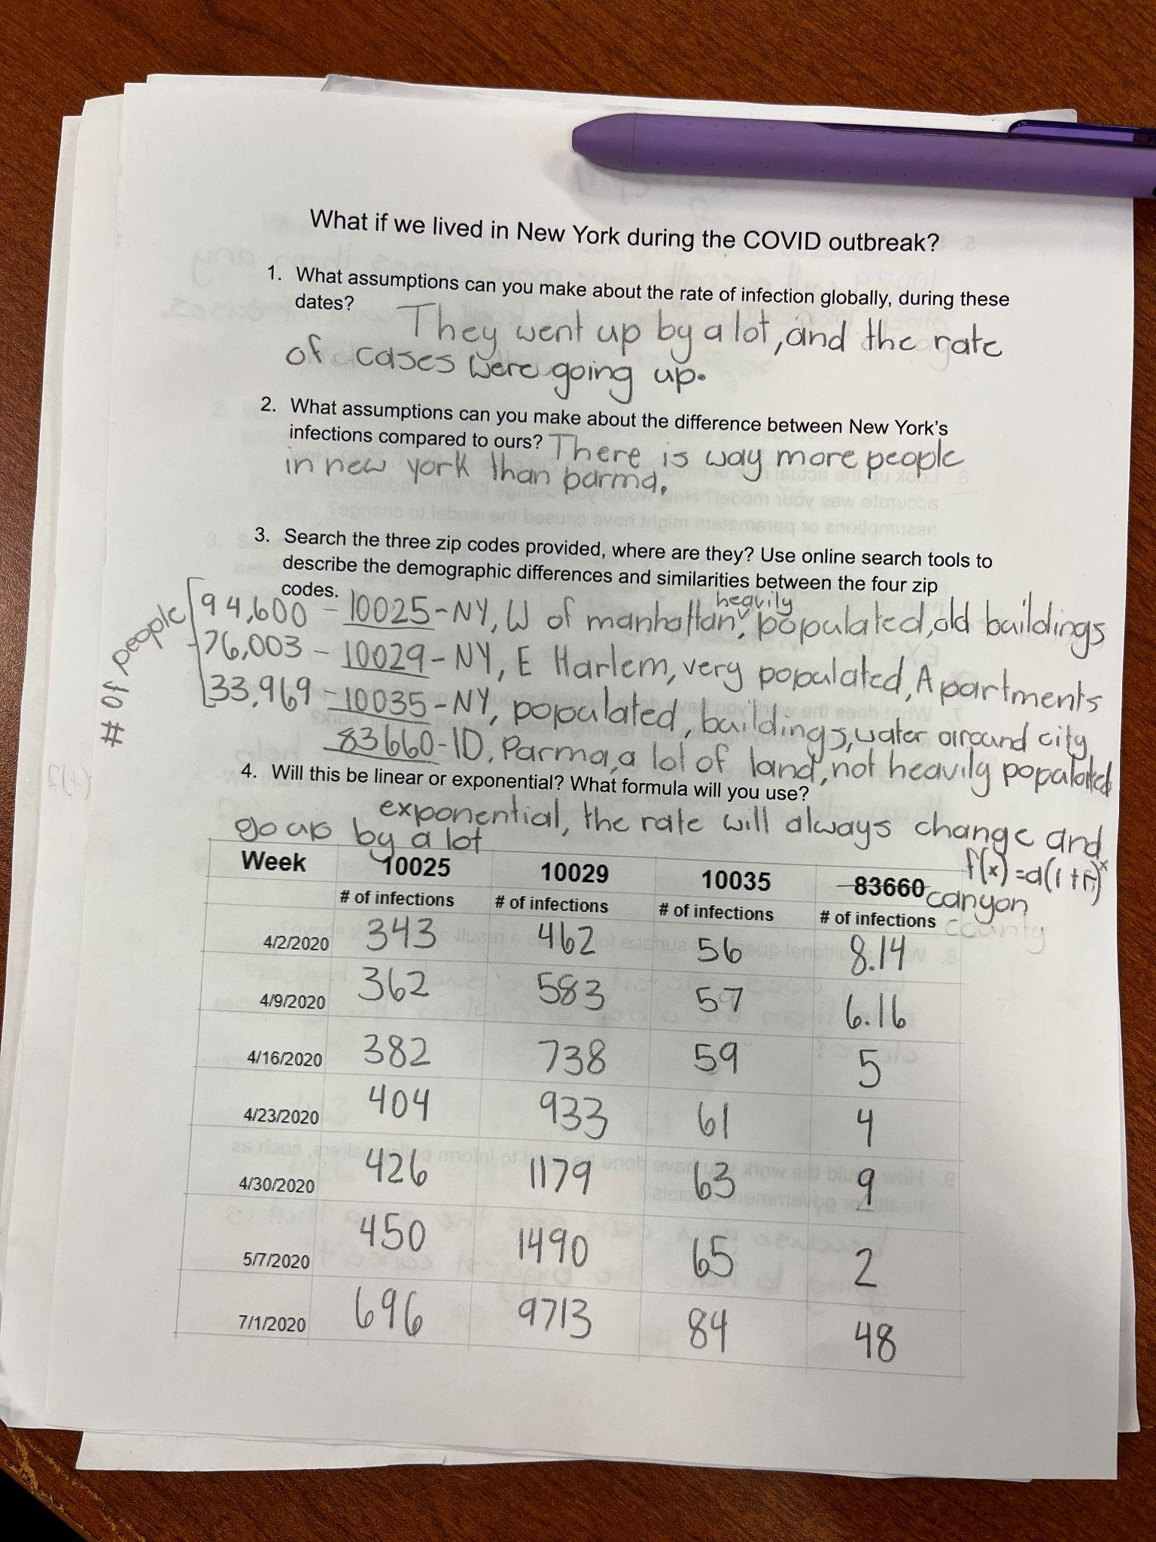
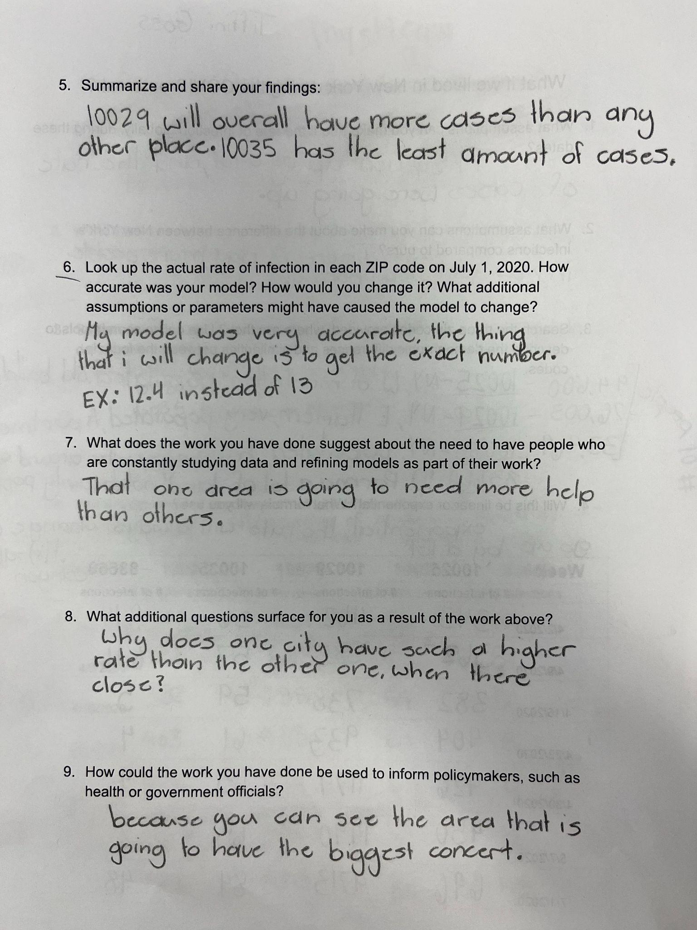
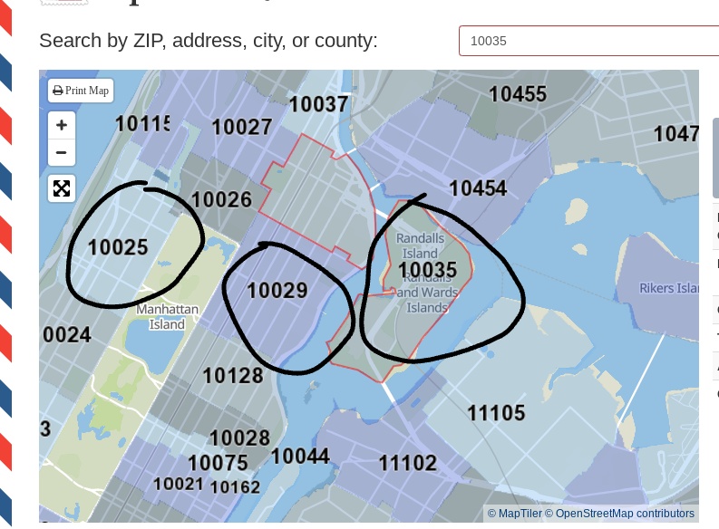
Example #3
Let’s norm our feedback
Notes:
Facilitation Note
Use this slide to discuss how folks thought about the student work, in terms of the Criteria for Success chart.
This is meant to give time for group to build shared understanding of how to use the CPEs and indicators alongside the rubric to share ways of partnering with students to support all students reaching.

Slide 52
Let’s Hear Some Reflections
What kinds of support will students need to demonstrate evidence of learning?
Has your thinking changed at all on how to implement this task? If so, how?
Come off
mute or share in the chat!
Notes:
Facilitation Note
Give participants time to reflect. If time permits, consider using breakout rooms to have folks connect in smaller pairings or groups.
Invite to share with whole group.

Slide 53
06
Closing
Notes:
Facilitation Note
Estimated time for this section is about 5 minutes.

Slide 54
What Are Your Takeaways?
Choose one question to respond to:
Which content and practice expectation are you most excited about? Why?
Which learning principle are you most excited about connecting to M104 content? Why?
What impact do you think using a portfolio system will have on your students? Why?
Notes:
Facilitation Note
Give participants time to reflect. If time permits, consider using breakout rooms to have folks connect in smaller pairings or groups.
Invite to share with whole group.

