Slide 1
Preparation Notes
Please review and customize this deck to prepare it for use. Some notes:
These professional learning (PL) materials (slide deck and accompanying handout) are being offered in editable forms so that you may make adjustments to better support the specific work happening in your school or district.
For the 2024-25 school year, student work samples are not provided for most sessions. The facilitator will need to collect or create student work samples when implementing these materials during 2024-25.
These PL materials are designed to easily accommodate remote delivery:
  A Jamboard template is provided to facilitate discussion of student work; the facilitator will need to make a copy of this and be ready to share the link with participants as noted in the deck.
  Text that can be readily pasted (marked with “—”) into a video call chat feature is included when participants need to reference the handout.
  There are placeholders for handout links to be shared with participants in the notes field of selected slides; the facilitator will need to add a link to the handout where indicated by “[insert link].”

Slide 2

M215 Overview
XQ Badge Project PL Series Baseline Session
Insert date
Notes:
Baseline timeframe: 2 hours

Slide 3
Community Building
Create a slide with pictures, photos, and/or words that describe you as an educator.
Notes:
Facilitation Note
Give 3-5 minutes for folks to complete activity, and up to 10 for share out

Slide 4


Outcomes and Agenda
Explo
Participants will be able to:
Agenda:
Explain the content and practice expectations for the M215 badge
Analyze tasks through the lenses of (1) content and practice expectations and (2) learning principles
Analyze student work for evidence of learning
Exploring the Content
Task 1: Expectations and Learning Principles
Task 1: Student Work
Task 2: Expectations and Learning Principles
Task 2: Student Work
Closing
Notes:
Facilitation Note
Give overview of session goals and agenda.

Slide 5
Learning Principles
Engage with cognitively demanding tasks in heterogeneous settings.
Engage in social activities.
Build conceptual understanding through reasoning.
Have agency in their learning.
View mathematics as a human endeavor across centuries.
See mathematics as relevant.
Employ technology as a tool for problem-solving and understanding.
Which learning principle would you like to focus on today?
Notes:
Facilitation Note
This slide serves to remind participants about the learning principles that undergird the bading system.
Give time to consider this question and invite folks to share with a partner and the whole group.

Slide 6
01
Exploring the Content
Notes:
Facilitation Note
Estimated time for this section is about 25 minutes.

Slide 7
M215 Inference and Making Conclusions
What comes to mind?
What knowledge and skills should students learn to earn this badge?
Come off mute or put your thoughts in the chat!
Notes:
Facilitation Note
Give participants time to consider the questions on this slide; they should generate responses based only on the title of the badge. Invite volunteers to share responses with the group.

Slide 8
Make inferences and justify conclusions from sample surveys, experiments, and observational studies
What’s the Story of these Standards?
3. Recognize the purposes of and differences among sample surveys, experiments, and observational studies; explain how randomization relates to each.
4. Use data from a sample survey to estimate a population mean or proportion; develop a margin of error through the use of simulation models for random sampling.
6. Use data from a randomized experiment to compare two treatments; use simulations to decide if differences between parameters are significant.
Selected Common Core Standards for Mathematics - Making Inferences and Making Conclusions
Understand and evaluate random processes underlying statistical experiments
Understand statistics as a process for making inferences about population parameters based on a random sample from that population.
Decide if a specified model is consistent with results from a given data-generating process, e.g., using simulation. For example, a model says a spinning coin falls heads up with probability 0.5. Would a result of 5 tails in a row cause you to question the model?
How would you synthesize these?
What are the key takeaways
for students in 2-3 sentences?
Notes:
Facilitation Note
Share that our process began by grounding in the standards and identifying the story of the standards.
Invite participants to read through the standards associated with this badge in the handout. (The slide image shows only a partial list.)
Frame this by asking participants to consider how they would synthesize these set of standards.
Share link to document in chat:
—-
Link to Handout: [insert link]
Feel free to download a copy.
Please see page 2 in your handout.
—-

Slide 9
Make inferences and justify conclusions from sample surveys, experiments, and observational studies
What’s the Story of these Standards?
3. Recognize the purposes of and differences among sample surveys, experiments, and observational studies; explain how randomization relates to each.
4. Use data from a sample survey to estimate a population mean or proportion; develop a margin of error through the use of simulation models for random sampling.
6. Use data from a randomized experiment to compare two treatments; use simulations to decide if differences between parameters are significant.
Selected Common Core Standards for Mathematics - Making Inferences and Making Conclusions
Understand and evaluate random processes underlying statistical experiments
Understand statistics as a process for making inferences about population parameters based on a random sample from that population.
Decide if a specified model is consistent with results from a given data-generating process, e.g., using simulation. For example, a model says a spinning coin falls heads up with probability 0.5. Would a result of 5 tails in a row cause you to question the model?
Share your thinking!
Notes:
Facilitation Note
Share that our process began by grounding in the standards and identifying the story of the standards.
Invite participants to read through the standards associated with this badge in the handout. (The slide image shows only a partial list.)
Frame this by asking participants to consider how they would synthesize these set of standards.
Share link to document in chat:
—-
Link to Handout: [insert link]
Feel free to download a copy.
Please see page 2 in your handout.
—-

Slide 10
M215 Content and Practice Expectations (CPE)
215.a | Use probability distributions to calculate p-values and interpret these p-values in context.
215.b | Use probability distributions to calculate confidence intervals in order to estimate population parameters and interpret these confidence intervals in context.
215.c | Conduct informal inference testing for quantitative and categorical data.
215.d | Use bootstrapping to estimate population parameters.
215.e | Make appropriate conclusions about study results using aspects of the study design.
Notes:
Facilitation Note
Share these are the Content and Practice Expectations (CPE) we landed on.
Give participants some time to read and consider: what in our list of Content and Practice Expectations resonates with you? What surprises you?
Share in chat:
—
Link to Handout: https://docs.google.com/document/d/1R1YlVPbptTB8nTf_D-Js6OTefEGyMTeQcNh6iiQCXjQ/edit?usp=sharing
Feel free to download a copy.
Please see page 7 in your handout.
—

Slide 11
M215 Content and Practice Expectations (CPE)
215.a | Use probability distributions to calculate p-values and interpret these p-values in context.
215.b | Use probability distributions to calculate confidence intervals in order to estimate population parameters and interpret these confidence intervals in context.
215.c | Conduct informal inference testing for quantitative and categorical data.
215.d | Use bootstrapping to estimate population parameters.
215.e | Make appropriate conclusions about study results using aspects of the study design.
Put in the chat: Which ideas connect to what your group came up with?
Notes:
Facilitation Note
Invite participants to share with the group.
Share that we will continue to build a shared understanding of these through sample prompts.

Slide 12
M215 Content and Practice Expectations and Indicators
215.a | Use probability distributions to calculate p-values and interpret these p-values in context.
215.b | Use probability distributions to calculate confidence intervals in order to estimate population parameters and interpret these confidence intervals in context.
215.c | Conduct informal inference testing for quantitative and categorical data.
215.d | Use bootstrapping to estimate population parameters.
215.e | Make appropriate conclusions about study results using aspects of the study design.
What new insights do you have?
Notes:
Facilitation Note
Invite participants to examine the indicators that are associated with each content and practice expectation.
Pose the question: “What new insights do you have?”
Invite participants to share with the group.
Share that we will continue to build a shared understanding of these through sample prompts.
Share in chat:
—
Please see page 8 in your handout.
—

Slide 13
Let’s Investigate
Choose at least one task to explore:
EPA Regulations
Political Polling
Which content and practice expectations are evident in each one?
Notes:
Facilitation Note
Invite participants to select a task and look for connections to badge CPEs.
Offer enough time for everyone to engage with at least one task; participants do not need to look at both.
Consider use of self-select breakout rooms to give participants time to discuss with small group.
Encourage participants to stay focused at the content and practice expectation (CPE) level, using the indicators to support their thinking.
Share in chat:
—
Please see page 10 in your handout.
—
Thunder and Lightning:
100.b: Reason with units in problems, formulas, and data displays to solve problems. ,
100.f: Solve real-world problems involving distances, intervals of time, liquid volume, mass, money, and other situations where operations with fractions and decimals are appropriate.
Traffic Jam:
100.b: Reason with units in problems, formulas, and data displays to solve problems. ,
100.f: Solve real-world problems involving distances, intervals of time, liquid volume, mass, money, and other situations where operations with fractions and decimals are appropriate.
100.c: Interpret simple numeric and algebraic expressions that arise in applications in terms of the context.

Slide 14
Let’s Investigate
Choose at least one task to explore:
EPA Regulations
Political Polling
Which content and practice expectations are evident in each one?
Come off mute or put your thoughts in the chat! What did you find?
Notes:
Facilitation Note
Invite volunteers to share connections they see to each of the tasks.
Highlight responses where participants have identified one or more CPEs, using the indicators as part of their rationale.

Slide 15
What’s the Same? What’s Different?
How do these content and practice expectations align to ways you’ve taught this topic before?
How are they different?
Come off mute or put your thoughts in the chat!
Notes:
Facilitation Note
Give participants some time to consider their responses to these questions then invite volunteers to share with whole group.

Slide 16

Inequity
Is our
Reality
About
60%
of community college students and 40 percent of four-year students are placed into non-credit bearing developmental mathematics (Ganga et al., 2018)
Only
33%
of community college students complete the developmental math sequence. Only 20 percent complete a college-level math course over three years (Bailey, Jeong, & Cho, 2010).
Notes:
Facilitation Note
Share these quotes with group as a way to give insight into the why of this badging project.

Slide 17
We Must Lead the Movement
Is math...?
Or could math be...?
About getting one right answer, the teacher’s way
Irrelevant
About doing procedures
Independent work
Something my teacher made up
Formulaic
About using multiple strategies flexibly
Connected to the real-world in ways that make sense
About understanding and applying
Collaborative work
Lived across continents and centuries
Novel, challenging problems
How can this approach give space for what math can be?
Notes:
Facilitation Note
Give participants time to reflect on the HS Badging System, the quote and this list.
Invite participants to consider how can this approach give students space for what math can be?
Consider inviting 1-2 voices to share thoughts with the group before transitioning to the next section.

Slide 18
02
Task 1: Expectations
and Learning Principles
Notes:
Facilitation Note
Estimated time for this section is about 15 minutes.

Slide 19
Let’s Do Some Math!
In this activity, you will use the applet at www.tinyurl.com/appletCI to learn what it means to say we are “95% confident” that our confidence interval captures the true proportion. Set the population proportion to 0.5, the confidence level to 95%, and the sample size to 75. Click “Sample” to choose a simple random sample and display the resulting confidence interval. The confidence interval is displayed as a horizontal line segment with a dot representing the sample proportion in the middle of the interval. The true proportion (p) is the green vertical line.
Did the first confidence interval capture the true proportion?
Repeat this 10 times. How many of the intervals capture the true proportion?
With a partner, explore this applet by generating many confidence intervals for different confidence levels, then again for different sample sizes. Use the “Sample 25” button to generate many confidence intervals at once.
Do the task as a student would. Jot down any reflections that you have as you do the math!
Notes:
Facilitation Note
Give participants time to read through prompt and consider how students might approach this. Invite to try it out for themselves.
Share in chat:
—
Please see page 11 in your handout.
—

Slide 20
Content and Practice Expectations
In this activity, you will use the applet at www.tinyurl.com/appletCI to learn what it means to say we are “95% confident” that our confidence interval captures the true proportion. Set the population proportion to 0.5, the confidence level to 95%, and the sample size to 75. Click “Sample” to choose a simple random sample and display the resulting confidence interval. The confidence interval is displayed as a horizontal line segment with a dot representing the sample proportion in the middle of the interval. The true proportion (p) is the green vertical line.
Did the first confidence interval capture the true proportion?
Repeat this 10 times. How many of the intervals capture the true proportion?
With a partner, explore this applet by generating many confidence intervals for different confidence levels, then again for different sample sizes. Use the “Sample 25” button to generate many confidence intervals at once.
Choose 1-2 Content and Practice Expectations that student work could give evidence of.
Notes:
Facilitation Note
Give time to read and connect.
Consider use of breakout rooms to give participants time to discuss with small group.

Slide 21
Content and Practice Expectations
In this activity, you will use the applet at www.tinyurl.com/appletCI to learn what it means to say we are “95% confident” that our confidence interval captures the true proportion. Set the population proportion to 0.5, the confidence level to 95%, and the sample size to 75. Click “Sample” to choose a simple random sample and display the resulting confidence interval. The confidence interval is displayed as a horizontal line segment with a dot representing the sample proportion in the middle of the interval. The true proportion (p) is the green vertical line.
Did the first confidence interval capture the true proportion?
Repeat this 10 times. How many of the intervals capture the true proportion?
With a partner, explore this applet by generating many confidence intervals for different confidence levels, then again for different sample sizes. Use the “Sample 25” button to generate many confidence intervals at once.
215.b: Use probability distributions to calculate confidence intervals in order to estimate population parameters and interpret these confidence intervals in context.
Notes:
Facilitation Note
Encourage participants to stay focused at the content and practice expectation (CPE) level, using the indicators to support their thinking.
A good CPE to focus on for this task is 100.g: Solve real-world problems involving area and perimeter of polygons, as well as surface area and volume of prisms and pyramids.
100.b Reason with units in problems, formulas, and data displays to solve problems.

Slide 22
Learning
Principles
In M215 Inference and Making Conclusions, students will employ the following learning principles:
Engage with cognitively demanding tasks in heterogeneous settings (LP 1).
Engage in social activities (LP 2).
Build conceptual understanding through reasoning (LP 3).
Have agency in their learning (LP 4).
View mathematics as a human endeavor across centuries (LP 5).
See mathematics as relevant (LP 6).
Employ technology as a tool for problem-solving and understanding (LP 7).
Notes:
Facilitation Note
Share that we will now be reflecting on the learning principles in relation to this task.
Give participants time to read and access the copy.
Share in chat:
—
Please see page 12 in your handout.
—

Slide 23
Learning
Principles
In M215 Inference and Making Conclusions, students will employ the following learning principles:
Engage with cognitively demanding tasks in heterogeneous settings (LP 1).
Engage in social activities (LP 2).
Build conceptual understanding through reasoning (LP 3).
Have agency in their learning (LP 4).
View mathematics as a human endeavor across centuries (LP 5).
See mathematics as relevant (LP 6).
Employ technology as a tool for problem-solving and understanding (LP 7).
Which of these principles does this task lend itself to? Which ones can the task be easily adapted to accommodate?
Notes:
Facilitation Note
Give time for participants to consider these questions, reflecting on the student experience associated with this task and consider how the 7 learning principles are evident.
Consider use of breakout rooms for small group conversation.

Slide 24
Learning
Principles
M215 Inference and Making Conclusions, students will employ the following learning principles:
Engage with cognitively demanding tasks in heterogeneous settings (LP 1).
Engage in social activities (LP 2).
Build conceptual understanding through reasoning (LP 3).
Have agency in their learning (LP 4).
View mathematics as a human endeavor across centuries (LP 5).
See mathematics as relevant (LP 6).
Employ technology as a tool for problem-solving and understanding (LP 7).
Share what
you came up with!
Notes:
Facilitation Note
Invite participants to share with the whole group.

Slide 25
03
Task 1: Student Work
Notes:
Facilitation Note
Estimated time for this section is about 30 minutes.

Slide 26
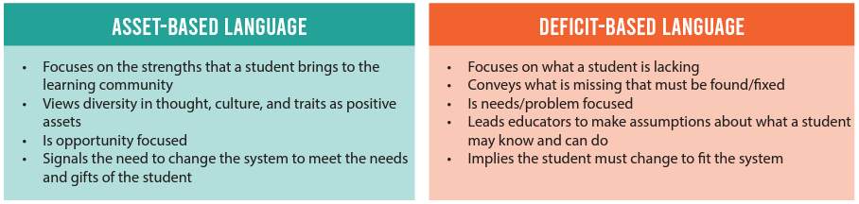
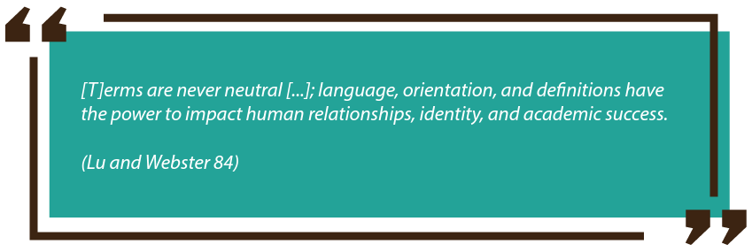
Notes:
Facilitation Note
Give participants time to review each definition
Ask participants:
“What resonates abouts asset based? Deficit based?”
“How do these differences show up in your space”
“What specifics shifts have you made around this work?”
https://resources.finalsite.net/images/v1631049397/psesdorg/sa6sbwvd6ddw1mskedu1/RecommendationsforAsset-BasedLanguage082021FINAL.pdf

Slide 27
Round 1:What
do you notice?
What do you notice?
Jot down at least one thing you notice about this piece of student work.
Come off mute or share in the chat.
Notes:
Facilitation Note
Give participants time to study student work associated with Task 1.
Try to avoid making inferences.
This is from Grace. Slide 17
Share in chat:
—
Please see page 13 in your handout
—

Slide 28
Round 1:What
do you notice?
What do you notice?
Jot down at least one thing you notice about this piece of student work.
Come off mute or share in the chat.
Notes:
Facilitation Note
Give participants time to study student work associated with Task 1.
Try to avoid making inferences.
This is from Grace. Slide 17
Share in chat:
—
Please see page 13 in your handout
—

Slide 29
Humanizing Assessment
Grading echoes the economic framework of testing, presuming that we can encapsulate learning in a number or a letter. Street data reminds us that our primary task as educators is to provide regular feedback to students so they can grow, not to evaluate them in order to anoint them academically capable or not. (Safir and Dugan, 2021, p. 135)
Source: Safir, Shane, and Jamila Dugan. Street Data: A Next-Generation Model for Equity, Pedagogy, and School Transformation. Corwin, 2021.
Notes:
Facilitation Note:
Share the quote. Ask participants to reflect on how the criteria and the ideas in the quote require rethinking something in their current practice.

Slide 30
Criteria for Success
Conference and Provide Revision Support | Accept with Revision | Accept
The student’s artifact shows an emerging understanding of the expectations of the indicator(s). After conferencing and additional instruction/learning, the student may provide a revised or different artifact as evidence of the indicator(s). | The student’s artifact is approaching a full understanding of the expectations of the indicator(s). The artifact may contain execution errors that should be corrected in revision. The student may revise the selected artifact or submit a different artifact. | The student’s artifact demonstrates evidence that they have met the expectations of the indicator(s).
What resonates with you? What questions surface for you?
Notes:
Facilitation Note
Introduce criteria for success.
Ask: “what resonates with you? What questions surface for you?”
Consider use of breakout groups.
Share the following in chat:
—
Please see page 17 in your handout.
—

Slide 31
M215 Content and Practice Expectations (CPE)
215.a | Use probability distributions to calculate p-values and interpret these p-values in context.
215.b | Use probability distributions to calculate confidence intervals in order to estimate population parameters and interpret these confidence intervals in context.
215.c | Conduct informal inference testing for quantitative and categorical data.
215.d | Use bootstrapping to estimate population parameters.
215.e | Make appropriate conclusions about study results using aspects of the study design.
Notes:
Facilitation Note
Share these are the Content and Practice Expectations (CPE) we landed on.
Give participants some time to read and consider: what in our list of Content and Practice Expectations resonates with you? What surprises you?
Share in chat:
—
Link to Handout: [insert link]
Feel free to download a copy.
Please see page 7 in your handout.
—

Slide 32
Round 2:
What evidence of learning is there?
Let’s examine some work together:
Conference and Provide Revision Support
The student’s artifact shows evidence of an emerging understanding of the expectations of the indicator(s). After conferencing and additional instruction/learning, the student may provide a revised or different artifact as evidence of the indicator(s).
Accept with Revision
The student’s artifact shows evidence of approaching a full understanding of the expectations of the indicator(s). The artifact may contain execution errors that should be corrected in revision. The student may revise the selected artifact or submit a different artifact.
Accept
The student’s artifact demonstrates evidence
that they have met the expectations of the indicator(s).
215.b: Use probability distributions to calculate confidence intervals in order to estimate population parameters and interpret these confidence intervals in context.
Notes:
Facilitation Note
Use this slide to set up what folks will do on the next slide:
They will examine the student work.
Determine where that work falls along the criteria for success spectrum.
And add a post it sharing what evidence of success is present.
We will focus our lens on the indicator displayed on the slide: 100.g
Note, a similar process can be done for each indicator that applies to this task.

Slide 33
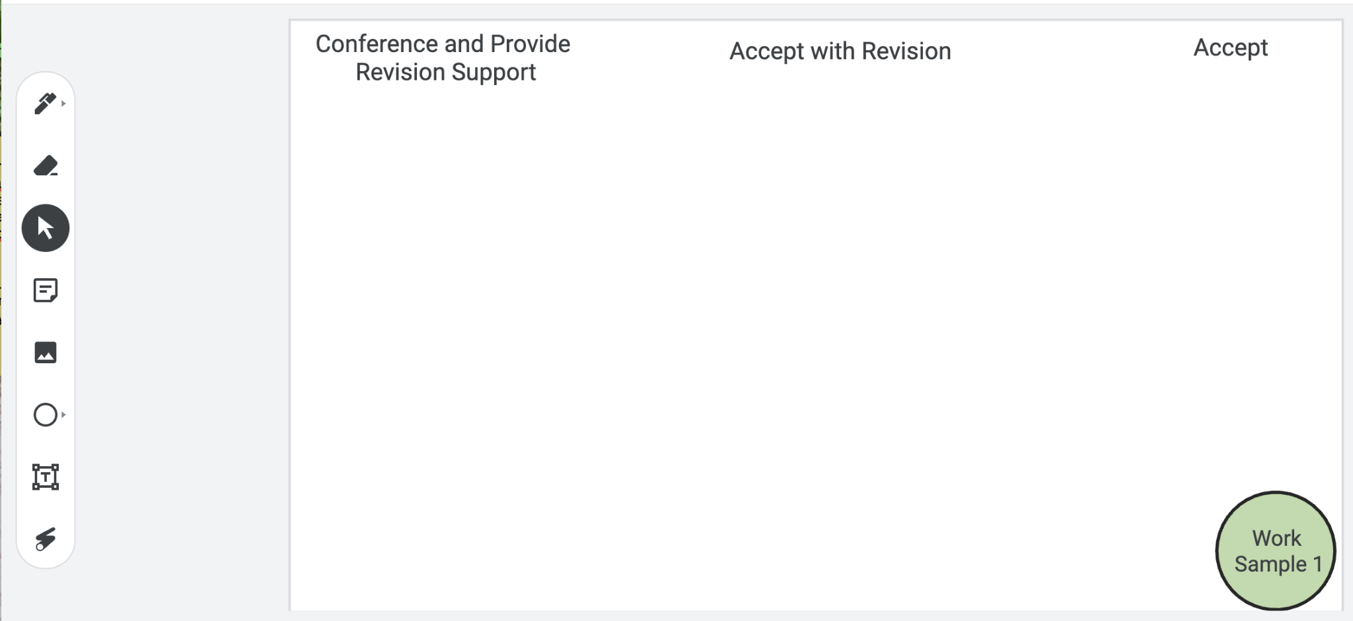
Examining Student Work
Put your
thoughts on the Jamboard!
Notes:
Facilitation Note
Facilitator will need to make a copy of the Jamboard file- Baseline PL Looking at Student Work and share that link with participants.
Invite participants to add a post it to the jamboard sharing:
Where they think the evidence of learning is along the Criteria for Success spectrum.
If the student was here, what question(s) would you pose to understand what they know?
Remind participants to focus at the CPE level, using the indicators to help guide decision-making.
If they find the student work falls within the first two categories, consider inviting folks to consider and share what “conferring and additional instruction/learning” might look like for that student, as time permits.
Share that directions are on the first slide and the pink circle on the bottom indicates which work sample is in focus for that slide.
Navigate to Jamboard file to illustrate use of tools as needed.

Slide 34
Example #1
Let’s compare notes.
Notes:
Facilitation Note
Slide 9 - Kristen #1c
Use this slide to discuss how folks thought about the student work, in terms of the Criteria for Success chart.
This is meant to give time for group to build shared understanding of how to use the CPEs and indicators alongside the rubric to share ways of partnering with students to support all students reaching.

Slide 35
Example #2
Let’s compare notes.
Notes:
Facilitation Note
Slide 4: Jenny #3
Use this slide to discuss how folks thought about the student work, in terms of the Criteria for Success chart.
This is meant to give time for group to build shared understanding of how to use the CPEs and indicators alongside the rubric to share ways of partnering with students to support all students reaching.

Slide 36
Example #3
Let’s compare notes.
Notes:
Facilitation Note
Slide 17 - Grace #4
Use this slide to discuss how folks thought about the student work, in terms of the Criteria for Success chart.
This is meant to give time for group to build shared understanding of how to use the CPEs and indicators alongside the rubric to share ways of partnering with students to support all students reaching.

Slide 37
04
Task 2: Expectations and Learning Principles
Notes:
Facilitation Note
Estimated time for this section is about 15 minutes.

Slide 38
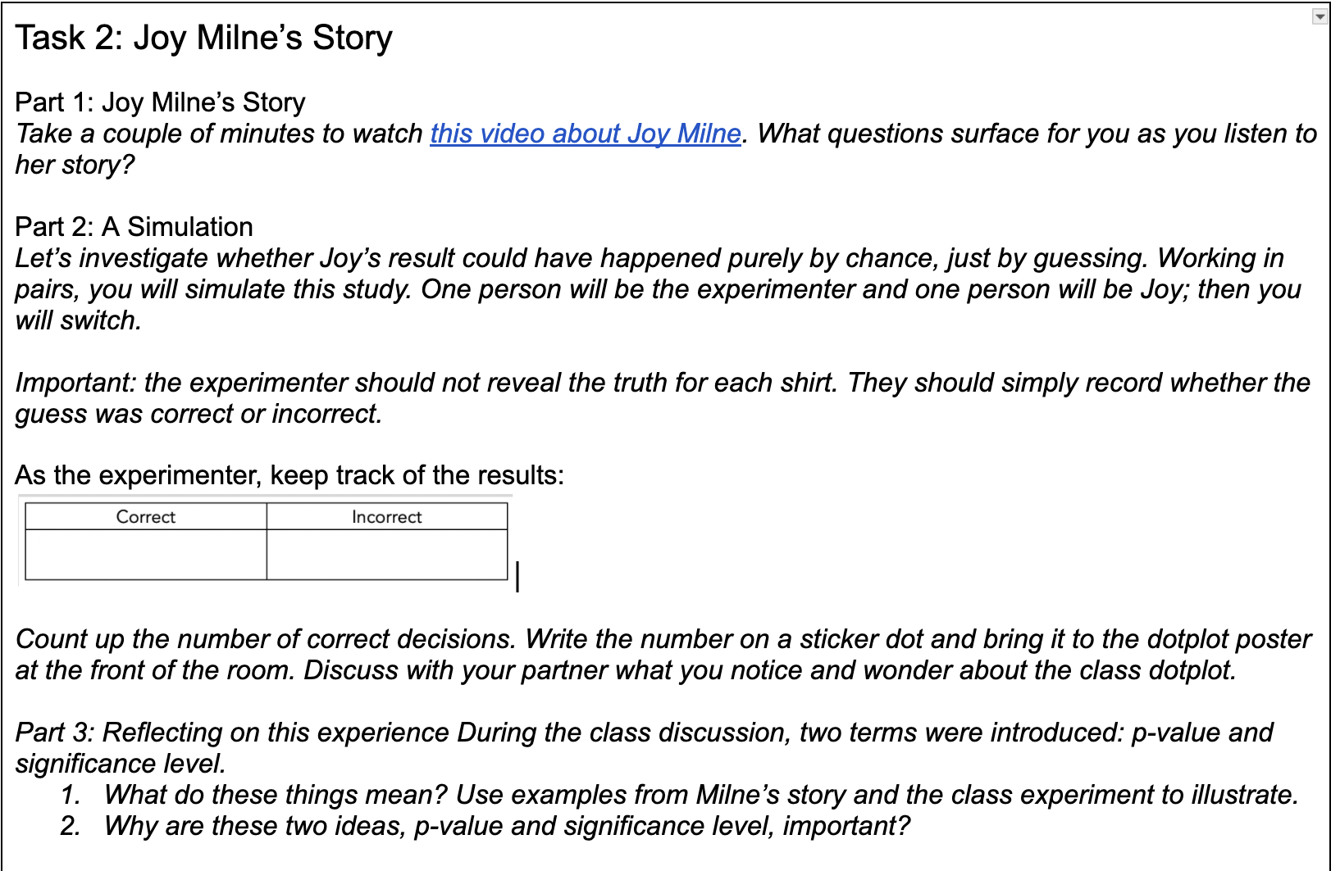
Let’s Do Some Math!
Do the task as a student would. Jot down any reflections that you have as you do the math!
Notes:
Facilitation Note
Give participants time to read through prompt and consider how students might approach this. Invite to try it out for themselves.
Share in chat:
—
Please see page 14 in your handout.
—

Slide 39
Content and Practice Expectations
Choose 1-2 Content and Practice Expectations that student work could give evidence of.
Notes:
Facilitation Note
Give time to read and connect.
Consider use of breakout rooms to give participants time to discuss with small group.

Slide 40
Content and Practice Expectations
215.c: Conduct informal inference testing for quantitative and categorical data.
Notes:
Facilitation Note
Encourage participants to stay focused at the content and practice expectation (CPE) level, using the indicators to support their thinking.
A good CPE to focus on for this task is 100.a: Identify quantities of interest for modeling purposes.

Slide 41
Learning
Principles
In M215 Inference and Making Conclusions, students will employ the following learning principles:
Engage with cognitively demanding tasks in heterogeneous settings (LP 1).
Engage in social activities (LP 2).
Build conceptual understanding through reasoning (LP 3).
Have agency in their learning (LP 4).
View mathematics as a human endeavor across centuries (LP 5).
See mathematics as relevant (LP 6).
Employ technology as a tool for problem-solving and understanding (LP 7).
Notes:
Facilitation Note
Share that we will now be reflecting on the learning principles in relation to this task.
Give participants time to read and access the copy.
Share in chat:
—
Please see page 12 in your handout.
—

Slide 42
Learning
Principles
In M215 Inference and Making Conclusions, students will employ the following learning principles:
Engage with cognitively demanding tasks in heterogeneous settings (LP 1).
Engage in social activities (LP 2).
Build conceptual understanding through reasoning (LP 3).
Have agency in their learning (LP 4).
View mathematics as a human endeavor across centuries (LP 5).
See mathematics as relevant (LP 6).
Employ technology as a tool for problem-solving and understanding (LP 7).
Which of these principles does this task lend itself to?
Which ones can the task be easily adapted to accommodate?
Notes:
Facilitation Note
Give time for participants to consider these questions, reflecting on the student experience associated with this task and consider how the 7 learning principles are evident.
Consider use of breakout rooms for small group conversation.

Slide 43
05
Task 2: Student Work
Notes:
Facilitation Note
Estimated time for this section is about 30 minutes.

Slide 44
Round 1:What
do you notice?
What do you notice?
Jot down at least one thing you notice about this piece of student work.
Come off mute or share in the chat.
Notes:
Facilitation Note
Give participants time to study student work associated with Task 1.
Try to avoid making inferences.
This is from Grace. Slide 14
Share in chat:
—
Please see page 13 in your handout
—

Slide 45
Criteria for Success
Conference and Provide Revision Support | Accept with Revision | Accept
The student’s artifact shows an emerging understanding of the expectations of the indicator(s). After conferencing and additional instruction/learning, the student may provide a revised or different artifact as evidence of the indicator(s). | The student’s artifact is approaching a full understanding of the expectations of the indicator(s). The artifact may contain execution errors that should be corrected in revision. The student may revise the selected artifact or submit a different artifact. | The student’s artifact demonstrates evidence that they have met the expectations of the indicator(s).
Our goal: understand student thinking so we can help to move it forward!
Notes:
Facilitation Note
Introduce criteria for success.
Ask: “what resonates with you? What questions surface for you?”
Consider use of breakout groups.
Share the following in chat:
—
Please see page 17 in your handout.
—

Slide 46
M215 Content and Practice Expectations (CPE)
215.a | Use probability distributions to calculate p-values and interpret these p-values in context.
215.b | Use probability distributions to calculate confidence intervals in order to estimate population parameters and interpret these confidence intervals in context.
215.c | Conduct informal inference testing for quantitative and categorical data.
215.d | Use bootstrapping to estimate population parameters.
215.e | Make appropriate conclusions about study results using aspects of the study design.
Notes:
Facilitation Note
Share these are the Content and Practice Expectations (CPE) we landed on.
Give participants some time to read and consider: what in our list of Content and Practice Expectations resonates with you? What surprises you?
Share in chat:
—
Link to Handout: [insert link]
Feel free to download a copy.
Please see page 7 in your handout.
—

Slide 47
Round 2:
What evidence of learning is there?
Let’s examine some work together:
Conference and Provide Revision Support
The student’s artifact shows evidence of an emerging understanding of the expectations of the indicator(s). After conferencing and additional instruction/learning, the student may provide a revised or different artifact as evidence of the indicator(s).
Accept with Revision
The student’s artifact shows evidence of approaching a full understanding of the expectations of the indicator(s). The artifact may contain execution errors that should be corrected in revision. The student may revise the selected artifact or submit a different artifact.
Accept
The student’s artifact demonstrates evidence
that they have met the expectations of the indicator(s).
215.c: Conduct informal inference testing for quantitative and categorical data.
Notes:
Facilitation Note
Use this slide to set up what folks will do on the next slide:
They will examine the student work.
Determine where that work falls along the criteria for success spectrum.
And add a post it sharing what evidence of success is present.
We will focus our lens on the indicator displayed on the slide: 100.g
Note, a similar process can be done for each indicator that applies to this task.

Slide 48
Examining Student Work
Put your
thoughts on the Jamboard!
Notes:
Facilitation Note
Facilitator will need to make a copy of the Jamboard file- Baseline PL Looking at Student Work and share that link with participants.
Invite participants to add a post it to the jamboard sharing:
Where they think the evidence of learning is along the Criteria for Success spectrum.
If the student was here, what question(s) would you pose to understand what they know?
Remind participants to focus at the CPE level, using the indicators to help guide decision-making.
If they find the student work falls within the first two categories, consider inviting folks to consider and share what “conferring and additional instruction/learning” might look like for that student, as time permits.
Share that directions are on the first slide and the pink circle on the bottom indicates which work sample is in focus for that slide.
Navigate to Jamboard file to illustrate use of tools as needed.

Slide 49
Example #1
Let’s Compare Notes
Notes:
Facilitation Note
Slide 18 - Grace #4
Use this slide to discuss how folks thought about the student work, in terms of the Criteria for Success chart.
This is meant to give time for group to build shared understanding of how to use the CPEs and indicators alongside the rubric to share ways of partnering with students to support all students reaching.

Slide 50
Example #2
Let’s Compare Notes
Notes:
Facilitation Note
Slide 14: Grace #1
Use this slide to discuss how folks thought about the student work, in terms of the Criteria for Success chart.
This is meant to give time for group to build shared understanding of how to use the CPEs and indicators alongside the rubric to share ways of partnering with students to support all students reaching.

Slide 51
Example #3
Let’s Compare Notes
Notes:
Facilitation Note
Slide 15 - Grace #2
Use this slide to discuss how folks thought about the student work, in terms of the Criteria for Success chart.
This is meant to give time for group to build shared understanding of how to use the CPEs and indicators alongside the rubric to share ways of partnering with students to support all students reaching.

Slide 52
06
Closing
Notes:
Facilitation Note
Estimated time for this section is about 5 minutes.

Slide 53
Closing Discussion
Consider:
  What is next for you with M215 or other badges?
  What questions linger for you?
  What further support would you like to see?
Notes:
Facilitation Note
Give participants time to read through prompt and consider how students might approach this. Invite to try it out for themselves.
Share in chat:
—
Please see page 11 in your handout.
—

