Slide 1
Preparation Notes
Please review and customize this deck to prepare it for use. Some notes:
These professional learning (PL) materials (slide deck and accompanying handout) are being offered in editable forms so that you may make adjustments to better support the specific work happening in your school or district.
These PL materials are designed to easily accommodate remote delivery:
  A Jamboard template is provided to facilitate discussion of student work; the facilitator will need to make a copy of this and be ready to share the link with participants as noted in the deck.
  Text that can be readily pasted (marked with “—”) into a video call’s chat feature is included when participants need to reference the handout.
  There are placeholders for handout links to be shared with participants in the notes field of selected slides; the facilitator will need to add a link to the handout where indicated by “[insert link].”

Slide 2

M111 Overview
XQ Badge Project PL Series Baseline Session
Month XX, XXXX
Notes:
Baseline timeframe: 2 hours

Slide 3
Welcome!
Community Builder:
Write a “tweet” in 140 characters or less that describes your first year of teaching. Get ready to share!
Notes:
Facilitation Note
Encourage participants to write their “tweet” on their own device. Participants can share their tweets by reading them out loud, sharing via their device, or pasting into the chat.

Slide 4


Outcomes and Agenda
Participants will be able to:
Agenda:
Explain the content and practice expectations for the M111 badge
Analyze tasks through the lenses of (1) content and practice expectations and (2) learning principles
Analyze student work for evidence of learning
Task 1: Expectations and Learning Principles
Task 1: Student Work
Task 2: Expectations and Learning Principles
Task 2: Student Work
Closing
Notes:
Facilitation Note
Give overview of session goals and agenda.

Slide 5
Learning Principles
Engage with cognitively demanding tasks in heterogeneous settings.
Engage in social activities.
Build conceptual understanding through reasoning.
Have agency in their learning.
View mathematics as a human endeavor across centuries.
See mathematics as relevant.
Employ technology as a tool for problem-solving and understanding.
Which learning principle would you like to focus on today?
Notes:
Facilitation Note
This slide serves to remind participants about the learning principles that undergird the bading system.
Give time to consider this question and invite folks to share with a partner and the whole group.

Slide 6
01
Exploring the Content
Notes:
Facilitation Note
Estimated time for this section is about 25 minutes.

Slide 7
M111 Modeling with Data: One-Variable Measurement Data
What comes to mind?
What knowledge and skills should students learn to earn this badge?
Come off mute or put your thoughts in the chat!
Notes:
Facilitation Note
Give participants time to consider the questions on this slide; they should generate responses based only on the title of the badge. Invite volunteers to share responses with the group.

Slide 8
What’s the Story of these Standards?
Develop understanding of statistical variability.
Recognize a statistical question as one that anticipates variability in the data related to the question and accounts for it in the answers. For example, “How old am I?” is not a statistical question, but “How old are the students in my school?” is a statistical question because one anticipates variability in students’ ages.
Understand that a set of data collected to answer a statistical question has a distribution which can be described by its center, spread, and overall shape.
Recognize that a measure of center for a numerical data set summarizes all of its values with a single number, while a measure of variation describes how its values vary with a single number.
Selected Common Core Standards for Mathematics - Statistics and Probability
Summarize, represent, and interpret data on a single count or measurement variable.
Represent data with plots on the real number line (dot plots, histograms, and box plots).
Use statistics appropriate to the shape of the data distribution to compare center (median, mean) and spread (interquartile range, standard deviation) of two or more different data sets.
Interpret differences in shape, center, and spread in the context of the data sets, accounting for possible effects of extreme data points (outliers).
Use the mean and standard deviation of a data set to fit it to a normal distribution and to estimate population percentages. Recognize that there are data sets for which such a procedure is not appropriate. Use calculators, spreadsheets, and tables to estimate areas under the normal curve.
How would you synthesize these?
What are the key takeaways
for students?
Notes:
Facilitation Note
Share that our process began by grounding in the standards and identifying the story of the standards.
Invite participants to read through the standards associated with this badge in the handout. (The slide image shows only a partial list.)
Frame this by asking participants to consider how they would synthesize these set of standards.
Share link to document in chat:
—-
Link to Handout: [insert link]
Feel free to download a copy.
Please see page 2 in your handout.
—-

Slide 9
What’s the Story of these Standards?
Develop understanding of statistical variability.
Recognize a statistical question as one that anticipates variability in the data related to the question and accounts for it in the answers. For example, “How old am I?” is not a statistical question, but “How old are the students in my school?” is a statistical question because one anticipates variability in students’ ages.
Understand that a set of data collected to answer a statistical question has a distribution which can be described by its center, spread, and overall shape.
Recognize that a measure of center for a numerical data set summarizes all of its values with a single number, while a measure of variation describes how its values vary with a single number.
Selected Common Core Standards for Mathematics - Statistics and Probability
Summarize, represent, and interpret data on a single count or measurement variable.
Represent data with plots on the real number line (dot plots, histograms, and box plots).
Use statistics appropriate to the shape of the data distribution to compare center (median, mean) and spread (interquartile range, standard deviation) of two or more different data sets.
Interpret differences in shape, center, and spread in the context of the data sets, accounting for possible effects of extreme data points (outliers).
Use the mean and standard deviation of a data set to fit it to a normal distribution and to estimate population percentages. Recognize that there are data sets for which such a procedure is not appropriate. Use calculators, spreadsheets, and tables to estimate areas under the normal curve.
Share your thinking!
Notes:
Facilitation Note
Invite volunteers to share responses with the group.
Share in chat:
—
What are the are the key takeaways for students?
—

Slide 10
M111 Content and Practice Expectations (CPE)
111.a | Engage in the modeling cycle.
111.b | Develop statistical questions in the course of modeling with one-variable measurement data.
111.c | Interpret differences in shape, center, and spread in the context of data sets, accounting for the possible effects of extreme data points (outliers).
111.d | Use measures of center and variability to describe one-variable measurement data.
111.e | Generate a random sample in the course of modeling with one-variable measurement data.
111.f | Use statistics appropriate to the shape of the data distribution to compare center (median, mean) and spread (interquartile range, standard deviation) of two or more different data sets.
111.g | Estimate population percentages by using a normal curve to approximate a data distribution.
Notes:
Facilitation Note
Share these are the Content and Practice Expectations (CPE) we landed on.
Give participants some time to read and consider: what in our list of Content Practice Expectations resonates with you? What surprises you?
Share in chat:
—
Link to Handout: [insert link]
Feel free to download a copy.
Please see page 6 in your handout.
—

Slide 11
M111 Content and Practice Expectations (CPE)
111.a | Engage in the modeling cycle.
111.b | Develop statistical questions in the course of modeling with one-variable measurement data.
111.c | Interpret differences in shape, center, and spread in the context of data sets, accounting for the possible effects of extreme data points (outliers).
111.d | Use measures of center and variability to describe one-variable measurement data.
111.e | Generate a random sample in the course of modeling with one-variable measurement data.
111.f | Use statistics appropriate to the shape of the data distribution to compare center (median, mean) and spread (interquartile range, standard deviation) of two or more different data sets.
111.g | Estimate population percentages by using a normal curve to approximate a data distribution.
What
resonates with you?
Notes:
Facilitation Note
Invite participants to share with the group.
Share that we will continue to build a shared understanding of these through sample prompts.

Slide 12
M111 Content and Practice Expectations and Indicators
Content and Practice Expectations | Indicators Choose an artifact where you…
111.a: Engage in the modeling cycle. | i. engage with the full modeling cycle (problem, formulate, compute, interpret, validate, revise as necessary, report).
111.b: Develop statistical questions in the course of modeling with one-variable measurement data. | i. develop a statistical question to investigate.
 | ii. explain or justify why your question is statistical.
111.c: Interpret differences in shape, center, and spread in the context of data sets, accounting for the possible effects of extreme data points (outliers). | i. determine and construct an appropriate graphical representation of collected data, such as box plot, line plot, histogram, or other data display.
 | ii. describe the shape, center, and spread of a data set.
 | iii. interpret the real-world meaning of the shape, center, and spread of a data set.
 | iv. identify and explain the effect of an outlier on the shape, center, and spread of a data set.
What new insights do you have?
Notes:
Facilitation Note
Invite participants to examine the indicators that are associated with each content and practice expectation.
Pose the question: “What new insights do you have?”
Invite participants to share with the group.
Share that we will continue to build a shared understanding of these through sample prompts.
Share in chat:
—
Please see page 7 in your handout.
—

Slide 13
Let’s Investigate
Choose at least one task to explore:
Speed Trap
Do You Fit in this Car?
Which content and practice expectations are evident in each one?
Notes:
Facilitation Note
Invite participants to select a task and look for connections to badge CPEs.
Offer enough time for everyone to engage with at least one task; participants do not need to look at both.
Consider use of self-select breakout rooms to give participants time to discuss with small group.
Encourage participants to stay focused at the content and practice expectation (CPE) level, using the indicators to support their thinking.
Share in chat:
—
Please see pages 9 and 10 in your handout.
—

Slide 14
Let’s Investigate
Choose at least one task to explore:
Speed Trap
Do You Fit in this Car?
Which content and practice expectations are evident in each one?
Come off mute or put your thoughts in the chat! What did you find?
Notes:
Facilitation Note
Invite volunteers to share connections they see to each of the tasks.
Highlight responses where participants have identified one or more CPEs, using the indicators as part of their rationale.

Slide 15
What’s the Same? What’s Different?
How do these content and practice expectations align to ways you’ve taught this topic before?
How are they different?
Come off mute or put your thoughts in the chat!
Notes:
Facilitation Note
Give participants some time to consider their responses to these questions then invite volunteers to share with whole group.

Slide 16
Inequity
Is our
Reality
“And by 2018, problems with the pipeline through math courses and tests were persisting. Despite the implementation of new state standards and tests, just 31 percent of students were meeting or exceeding standards in math, compared with 56 percent in English.” (Daro & Asturias, 2019)
Notes:
Facilitation Note
Share this quote with group as a way to give insight into the why of this badging project.
Source: https://justequations.org/resource/branching-out-designing-high-school-math-pathways-for-equity

Slide 17
We Must Lead the Movement
Is math...?
Or could math be...?
About getting one right answer, the teacher’s way
Irrelevant
About doing procedures
Independent work
Something my teacher made up
Formulaic
About using multiple strategies flexibly
Connected to the real-world in ways that make sense
About understanding and applying
Collaborative work
Lived across continents and centuries
Novel, challenging problems
How can this approach give space for what math can be?
Notes:
Facilitation Note
Give participants time to reflect on the HS Badging System, the quote and this list.
Invite participants to consider how can this approach give students space for what math can be?
Consider inviting 1-2 voices to share thoughts with the group before transitioning to the next section.

Slide 18
02
Task 1: Expectations
and Learning Principles
Notes:
Facilitation Note
Estimated time for this section is about 15 minutes.

Slide 19
Let’s Do Some Math!
Data can be used to gain insights about communities and help us understand issues.
Framing Questions
What are some questions you have about your community that could be answered by collecting data?
Why are these questions/issues important?
Why should we care about this question/issue?
Who else might care about these questions/issues?
Why might it be important to them?
For this task you will prepare a presentation in any form (slideshow, report, song, artwork) delivering a message you want to share on a topic of your choice, supported by the evidence you collect.
Do the task as a student would. Jot down any reflections that you have as you do the math!
Notes:
Facilitation Note
Give participants time to read through prompt and consider how students might approach this. Invite to try it out for themselves.
Share in chat:
—
Please see page 11 in your handout.
—

Slide 20
Content and Practice Expectations
Data can be used to gain insights about communities and help us understand issues.
Framing Questions
What are some questions you have about your community that could be answered by collecting data?
Why are these questions/issues important?
Why should we care about this question/issue?
Who else might care about these questions/issues?
Why might it be important to them?
For this task you will prepare a presentation in any form (slideshow, report, song, artwork) delivering a message you want to share on a topic of your choice, supported by the evidence you collect.
Choose 1-2 Content and Practice Expectations that student work could give evidence of.
Notes:
Facilitation Note
Give time to read and connect.
Consider use of breakout rooms to give participants time to discuss with small group.

Slide 21
Content and Practice Expectations
Data can be used to gain insights about communities and help us understand issues.
Framing Questions
What are some questions you have about your community that could be answered by collecting data?
Why are these questions/issues important?
Why should we care about this question/issue?
Who else might care about these questions/issues?
Why might it be important to them?
For this task you will prepare a presentation in any form (slideshow, report, song, artwork) delivering a message you want to share on a topic of your choice, supported by the evidence you collect.
111.b: Develop statistical questions in the course of modeling with one-variable measurement data.
Notes:
Facilitation Note
Encourage participants to stay focused at the content and practice expectation (CPE) level, using the indicators to support their thinking.
A good CPE to focus on for this task is 111.b: Develop statistical questions in the course of modeling with one-variable measurement data.

Slide 22
Learning
Principles
In M111 Modeling with Data: One-Variable Measurement Data, students will employ the following learning principles:
Engage with cognitively demanding tasks in heterogeneous settings (LP 1).
Engage in social activities (LP 2).
Build conceptual understanding through reasoning (LP 3).
Have agency in their learning (LP 4).
View mathematics as a human endeavor across centuries (LP 5).
See mathematics as relevant (LP 6).
Employ technology as a tool for problem-solving and understanding (LP 7).
Notes:
Facilitation Note
Share that we will now be reflecting on the learning principles in relation to this task.
Give participants time to read and access the copy.
Share in chat:
—
Please see page 13 in your handout.
—

Slide 23
Learning
Principles
In M111 Modeling with Data: One-Variable Measurement Data, students will employ the following learning principles:
Engage with cognitively demanding tasks in heterogeneous settings (LP 1).
Engage in social activities (LP 2).
Build conceptual understanding through reasoning (LP 3).
Have agency in their learning (LP 4).
View mathematics as a human endeavor across centuries (LP 5).
See mathematics as relevant (LP 6).
Employ technology as a tool for problem-solving and understanding (LP 7).
Which of these principles does this task lend itself to? Which ones can the task be easily adapted to accommodate?
Notes:
Facilitation Note
Give time for participants to consider these questions, reflecting on the student experience associated with this task and consider how the 7 learning principles are evident.
Consider use of breakout rooms for small group conversation.

Slide 24
Learning
Principles
In M111 Modeling with Data: One-Variable Measurement Data, students will employ the following learning principles:
Engage with cognitively demanding tasks in heterogeneous settings (LP 1).
Engage in social activities (LP 2).
Build conceptual understanding through reasoning (LP 3).
Have agency in their learning (LP 4).
View mathematics as a human endeavor across centuries (LP 5).
See mathematics as relevant (LP 6).
Employ technology as a tool for problem-solving and understanding (LP 7).
Share what
you came up with!
Notes:
Facilitation Note
Invite participants to share with the whole group.

Slide 25
03
Task 1: Student Work
Notes:
Facilitation Note
Estimated time for this section is about 30 minutes.

Slide 26
What is the impact of our labels?
“Any kind of qualifier can be harmful because who we are is not static. Our abilities are constantly changing…I know if I was raised in this day and age, I would have been labeled a struggling reader. But what I know now is I was actually reading like a writer. I was reading slowly and deliberately and deconstructing language, not in the sense of looking up words in the dictionary, but understanding from context. I was constantly being compared to my sister who excelled, and it made me feel insecure. What gets translated is 'you are not as good,' and that gets translated into our whole bodies. That's where the danger lies.” - Jacqueline Woodson
Notes:
Facilitation Note
Let participants know that since we will be looking at student work, it is important to maintain an asset orientation and avoid deficit labels.
Ask a participant to read the quote out loud.
Ask the group to reflect on (a) the types of labels they have heard used in math contexts; (b) the potential impact of these labels.
From: EdWeek https://www.edweek.org/education/opinion-are-labels-preventing-students-from-succeeding/2018/05 (Jacqueline Woodson bio)

Slide 27
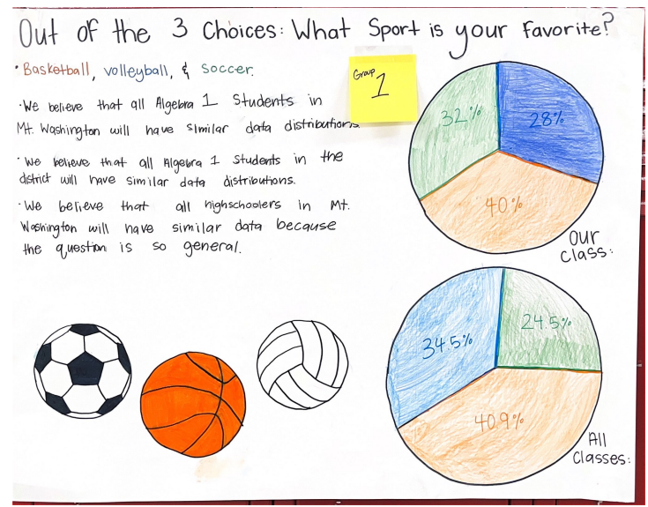
Round 1:What
do you notice?
Jot down
One thing you notice about each piece of student work.
Notes:
Facilitation Note
Give participants time to study student work associated with Task 1.
Share in chat:
—
Please see page 14 in your handout
—

Slide 28
Round 1:What
do you notice?
Jot down
One thing you notice about each piece of student work.
Come off mute and share what you saw!
Notes:
Facilitation Note
Invite participants to share what they noticed.
Look for trends in responses, especially as connected to 111.b: Develop statistical questions in the course of modeling with one-variable measurement data.

Slide 29
Criteria for Success
Conference and Provide Revision Support | Accept with Revision | Accept
The student’s artifact shows an emerging understanding of the expectations of the indicator(s). After conferencing and additional instruction/learning, the student may provide a revised or different artifact as evidence of the indicator(s). | The student’s artifact is approaching a full understanding of the expectations of the indicator(s). The artifact may contain execution errors that should be corrected in revision. The student may revise the selected artifact or submit a different artifact. | The student’s artifact demonstrates evidence that they have met the expectations of the indicator(s).
What resonates with you? What questions surace for you?
Notes:
Facilitation Note
Introduce criteria for success.
Ask: “what resonates with you? What questions surface for you?”
Consider use of breakout groups.
Share the following in chat:
—
Please see page 23 in your handout.
—

Slide 30
Humanizing Assessment
When it comes to cognition, performance assessments epitomize high-quality street data. Each task offers its own rich landscape of insight into a learner’s cognitive processes, values, misconceptions, academic identity, and more. (Safir and Dugan, 2021, p. 135-136)
Source: Safir, Shane, and Jamila Dugan. Street Data: A Next-Generation Model for Equity, Pedagogy, and School Transformation. Corwin, 2021.
104.i: Use a function
of exponential type l to determine values of interest in a real-world problem.
Notes:
Facilitation Note:
Share the quote. Ask participants to reflect on how the criteria and the ideas in the quote require rethinking something in their current practice.

Slide 31
Round 2:
What evidence of learning is there?
Let’s examine some work together:
Conference and Provide Revision Support
The student’s artifact shows evidence of an emerging understanding of the expectations of the indicator(s). After conferencing and additional instruction/learning, the student may provide a revised or different artifact as evidence of the indicator(s).
Accept with Revision
The student’s artifact shows evidence of approaching a full understanding of the expectations of the indicator(s). The artifact may contain execution errors that should be corrected in revision. The student may revise the selected artifact or submit a different artifact.
Accept
The student’s artifact demonstrates evidence
that they have met the expectations of the indicator(s).
111.b: Develop statistical questions in the course of modeling with one-variable measurement data.
Notes:
Facilitation Note
Use this slide to set up what folks will do on the next slide:
They will examine the student work.
Determine where that work falls along the criteria for success spectrum.
And add a post it sharing what evidence of success is present.
We will focus our lens on the indicator displayed on the slide: 111.b
Note, a similar process can be done for each indicator that applies to this task.

Slide 32
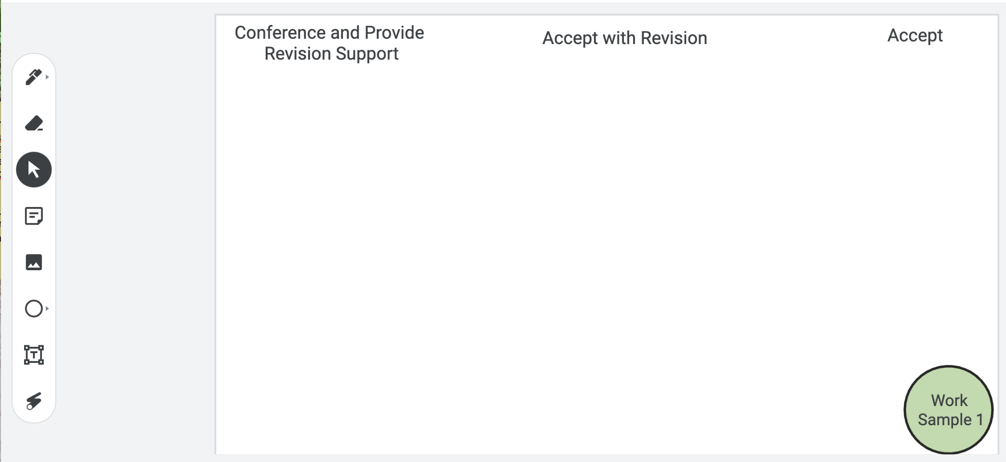
Examining Student Work
Put your
thoughts on the Jamboard!
Notes:
Facilitation Note
Facilitator will need to make a copy of the Jamboard file- Baseline PL Looking at Student Work and share that link with participants.
Invite participants to add a post it to the jamboard sharing:
Where they think the evidence of learning is along the Criteria for Success spectrum.
If the student was here, what question(s) would you pose to understand what they know?
Remind participants to focus at the CPE level, using the indicators to help guide decision-making.
If they find the student work falls within the first two categories, consider inviting folks to consider and share what “conferring and additional instruction/learning” might look like for that student, as time permits.
Share that directions are on the first slide and the pink circle on the bottom indicates which work sample is in focus for that slide.
Navigate to Jamboard file to illustrate use of tools as needed.

Slide 33
Example #1
Let’s compare notes.
Notes:
Facilitation Note
Use this slide to discuss how folks thought about the student work, in terms of the Criteria for Success chart.
This is meant to give time for group to build shared understanding of how to use the CPEs and indicators alongside the rubric to share ways of partnering with students to support all students reaching.

Slide 34
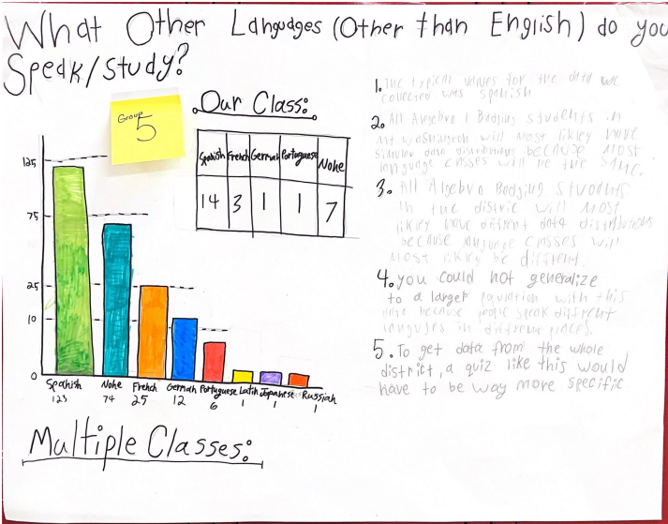
Example #2
Let’s compare notes.
Notes:
Facilitation Note
Use this slide to discuss how folks thought about the student work, in terms of the Criteria for Success chart.
This is meant to give time for group to build shared understanding of how to use the CPEs and indicators alongside the rubric to share ways of partnering with students to support all students reaching.

Slide 35
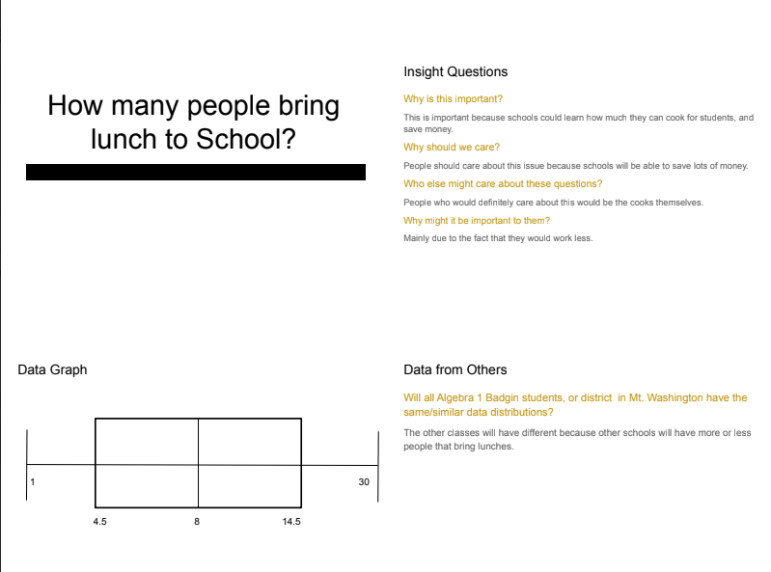
Example #3
Let’s compare notes.
Notes:
Facilitation Note
Use this slide to discuss how folks thought about the student work, in terms of the Criteria for Success chart.
This is meant to give time for group to build shared understanding of how to use the CPEs and indicators alongside the rubric to share ways of partnering with students to support all students reaching.

Slide 36
Three Key Components of the Math Badging System
Content and Practice Expectations
Learning Principles
Criteria for Success
Which one excites you the most?
What one will have the greatest impact on students?
What questions surface for you?
Come off
mute or share in the chat!
Notes:
Facilitation Note
Give participants time to reflect. If time permits, consider using breakout rooms to have folks connect in smaller pairings or groups.
Invite to share with whole group.

Slide 37
04
Task 2: Expectations and Learning Principles
Notes:
Facilitation Note
Estimated time for this section is about 15 minutes.

Slide 38
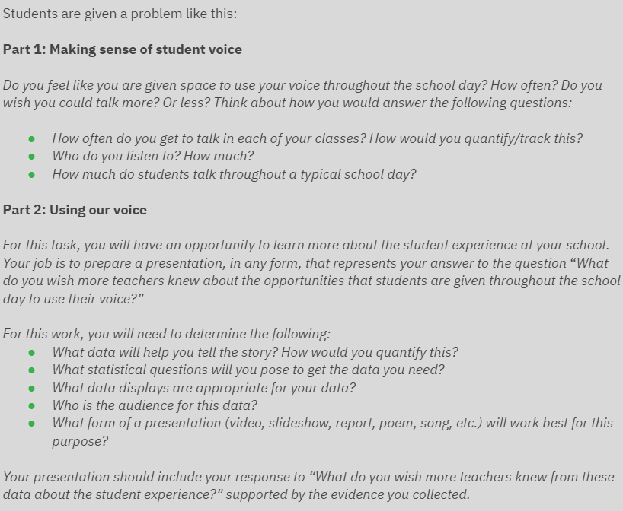
Let’s Do Some Math!
Do the task as a student would. Jot down any reflections that you have as you do the math!
Notes:
Facilitation Note
Give participants time to read through prompt and consider how students might approach this. Invite to try it out for themselves.
Share in chat:
—
Please see page 17 in your handout.
—

Slide 39
Content and Practice Expectations
Choose 1-2 Content and Practice Expectations that student work could give evidence of.
Notes:
Facilitation Note
Give time to read and connect.
Consider use of breakout rooms to give participants time to discuss with small group.

Slide 40
Content and Practice Expectations
111.a: Engage in the modeling cycle.
Notes:
Facilitation Note
Encourage participants to stay focused at the content and practice expectation (CPE) level, using the indicators to support their thinking.
A good CPE to focus on for this task is 111.a: Engage in the modeling cycle.

Slide 41
Learning
Principles
In M111 Modeling with Data: One-Variable Measurement Data, students will employ the following learning principles:
Engage with cognitively demanding tasks in heterogeneous settings (LP 1).
Engage in social activities (LP 2).
Build conceptual understanding through reasoning (LP 3).
Have agency in their learning (LP 4).
View mathematics as a human endeavor across centuries (LP 5).
See mathematics as relevant (LP 6).
Employ technology as a tool for problem-solving and understanding (LP 7).
Notes:
Facilitation Note
Share that we will now be reflecting on the learning principles in relation to this task.
Give participants time to read and access the copy.
Share in chat:
—
Please see page 13 in your handout.
—

Slide 42
Learning
Principles
In M111 Modeling with Data: One-Variable Measurement Data, students will employ the following learning principles:
Engage with cognitively demanding tasks in heterogeneous settings (LP 1).
Engage in social activities (LP 2).
Build conceptual understanding through reasoning (LP 3).
Have agency in their learning (LP 4).
View mathematics as a human endeavor across centuries (LP 5).
See mathematics as relevant (LP 6).
Employ technology as a tool for problem-solving and understanding (LP 7).
Which of these principles does this task lend itself to?
Which ones can the task be easily adapted to accommodate?
Notes:
Facilitation Note
Give time for participants to consider these questions, reflecting on the student experience associated with this task and consider how the 7 learning principles are evident.
Consider use of breakout rooms for small group conversation.

Slide 43
Learning
Principles
In M111 Modeling with Data: One-Variable Measurement Data, students will employ the following learning principles:
Engage with cognitively demanding tasks in heterogeneous settings (LP 1).
Engage in social activities (LP 2).
Build conceptual understanding through reasoning (LP 3).
Have agency in their learning (LP 4).
View mathematics as a human endeavor across centuries (LP 5).
See mathematics as relevant (LP 6).
Employ technology as a tool for problem-solving and understanding (LP 7).
Share what
you came up with!
Notes:
Facilitation Note
Invite participants to share with the whole group.

Slide 44
05
Task 2: Student Work
Notes:
Facilitation Note
Estimated time for this section is about 30 minutes.

Slide 45
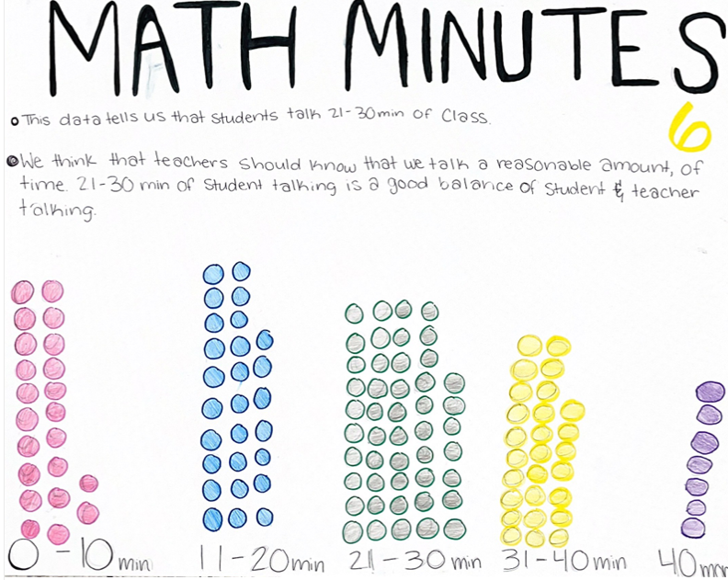
Round 1:What
do you notice?
Jot down
One thing you notice about each piece of student work.
Notes:
Facilitation Note
Give participants time to study student work.

Slide 46
Round 1:What
do you notice?
Jot down
One thing you notice about each piece of student work.
Come off mute and share what you saw!
Notes:
Facilitation Note
Invite participants to share what they noticed.
Look for trends in responses, especially as connected to 111.a: Engage in the modeling cycle.
Share in chat:
—
Please see page 20 in your handout.
—

Slide 47
Round 2:
What evidence of learning is there?
Let’s examine some work together:
Conference and Provide Revision Support
The student’s artifact shows evidence of an emerging understanding of the expectations of the indicator(s). After conferencing and additional instruction/learning, the student may provide a revised or different artifact as evidence of the indicator(s).
Accept with Revision
The student’s artifact shows evidence of approaching a full understanding of the expectations of the indicator(s). The artifact may contain execution errors that should be corrected in revision. The student may revise the selected artifact or submit a different artifact.
Accept
The student’s artifact demonstrates evidence
that they have met the expectations of the indicator(s).
111.a: Engage in the modeling cycle.
Notes:
Facilitation Note
Remind participants of the criteria of success.
Use this slide to set up what folks will do on the next slide.
They will examine the student work.
Determine where that work falls along the criteria for success spectrum.
And add a post it sharing what evidence of success is present.
We will focus our lens on the indicator displayed on the slide: 111.a.
Note, a similar process can be done for each indicator that applies to this task.

Slide 48
Examining Student Work
Put your
thoughts on the Jamboard!
Notes:
Facilitation Note
Facilitator will need to make a copy of the Jamboard file- Baseline PL Looking at Student Work and share that link with participants.
Invite participants to add a post it to the jamboard sharing:
Where they think the evidence of learning is along the Criteria for Success spectrum.
If the student was here, what question(s) would you pose to understand what they know?
Remind participants to focus at the CPE level, using the indicators to help guide decision-making.
If they find the student work falls within the first two categories, consider inviting folks to consider and share what “conferring and additional instruction/learning” might look like for that student, as time permits.
Share that directions are on the first slide and the pink circle on the bottom indicates which work sample is in focus for that slide.
Navigate to Jamboard file to illustrate use of tools as needed.

Slide 49
Example #1
Let’s compare notes.
Notes:
Facilitation Note
Use this slide to discuss how folks thought about the student work, in terms of the Criteria for Success chart.
This is meant to give time for group to build shared understanding of how to use the CPEs and indicators alongside the rubric to share ways of partnering with students to support all students reaching.

Slide 50
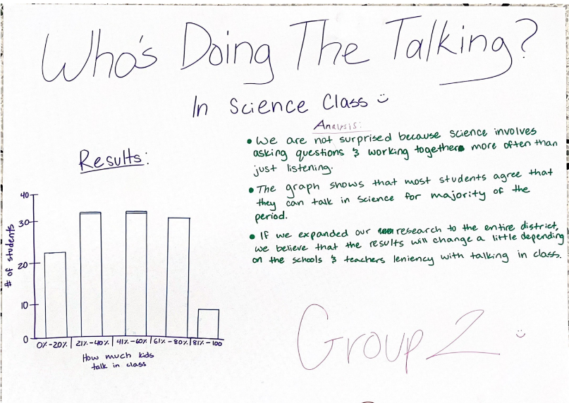
Example #2
Let’s compare notes.
Notes:
Facilitation Note
Use this slide to discuss how folks thought about the student work, in terms of the Criteria for Success chart.
This is meant to give time for group to build shared understanding of how to use the CPEs and indicators alongside the rubric to share ways of partnering with students to support all students reaching.

Slide 51
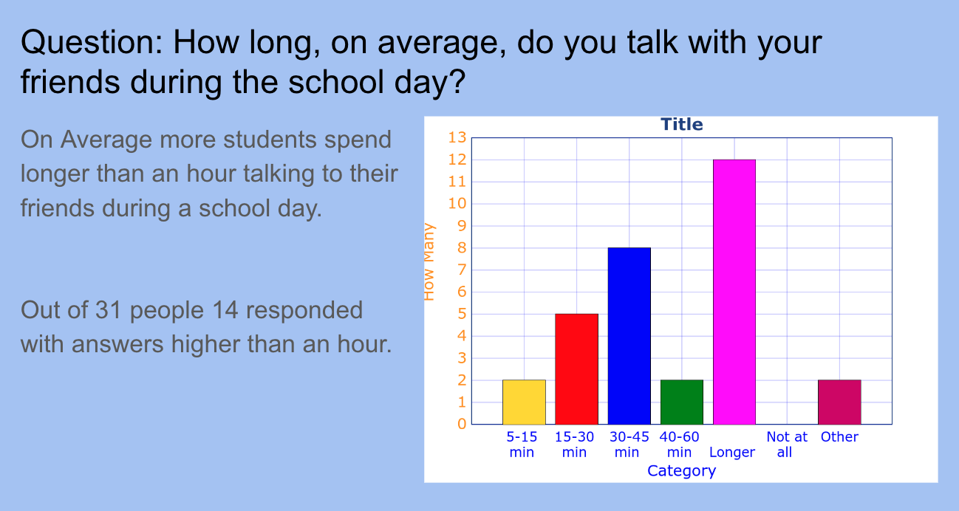
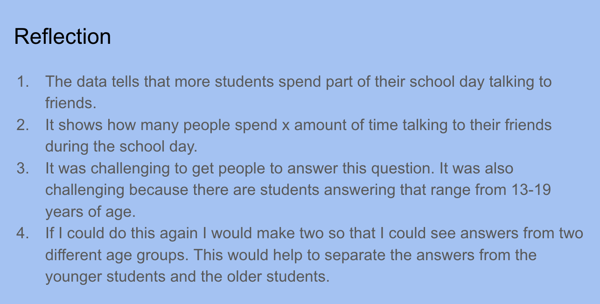
Example #3
Let’s compare notes.
Notes:
Facilitation Note
Use this slide to discuss how folks thought about the student work, in terms of the Criteria for Success chart.
This is meant to give time for group to build shared understanding of how to use the CPEs and indicators alongside the rubric to share ways of partnering with students to support all students reaching.

Slide 52
Let’s Hear Some Reflections
What kinds of support will students need to demonstrate evidence of learning?
Has your thinking changed at all on how to implement this task? If so, how?
Come off
mute or share in the chat!
Notes:
Facilitation Note
Give participants time to reflect. If time permits, consider using breakout rooms to have folks connect in smaller pairings or groups.
Invite to share with whole group.

Slide 53
06
Closing
Notes:
Facilitation Note
Estimated time for this section is about 5 minutes.

Slide 54
What Are Your Takeaways?
Choose one question to respond to:
Which content and practice expectation are you most excited about? Why?
Which learning principle are you most excited about connecting to M111 content? Why?
What impact do you think using a portfolio system will have on your students? Why?
Notes:
Facilitation Note
Give participants time to reflect. If time permits, consider using breakout rooms to have folks connect in smaller pairings or groups.
Invite to share with whole group.

