Slide 1
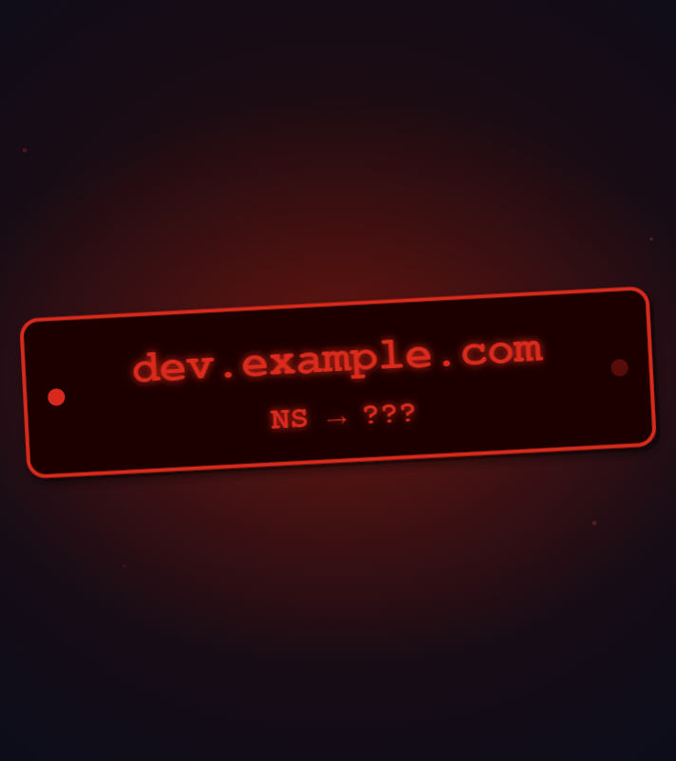
When Infrastructure Disappears but DNS Remains: A Cloud-Native Security Story
Oleksandr Kazymyrov
Cloud Native Days Norway 2026

Slide 2

$ whoami
Security Assurance Manager at Storebrand, ensuring security controls are effective against real-world threats and continuously improved.
Ph.D. in Cryptography and 15+ years in information security
Passionate about building practical, real-world security resilience

Slide 3
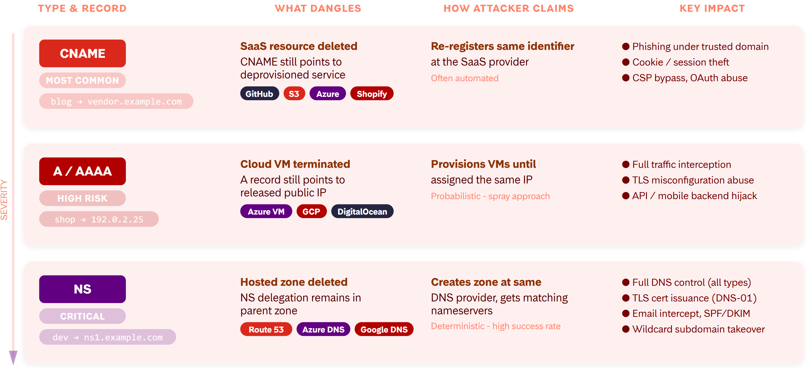
Understanding Danglings

Slide 4
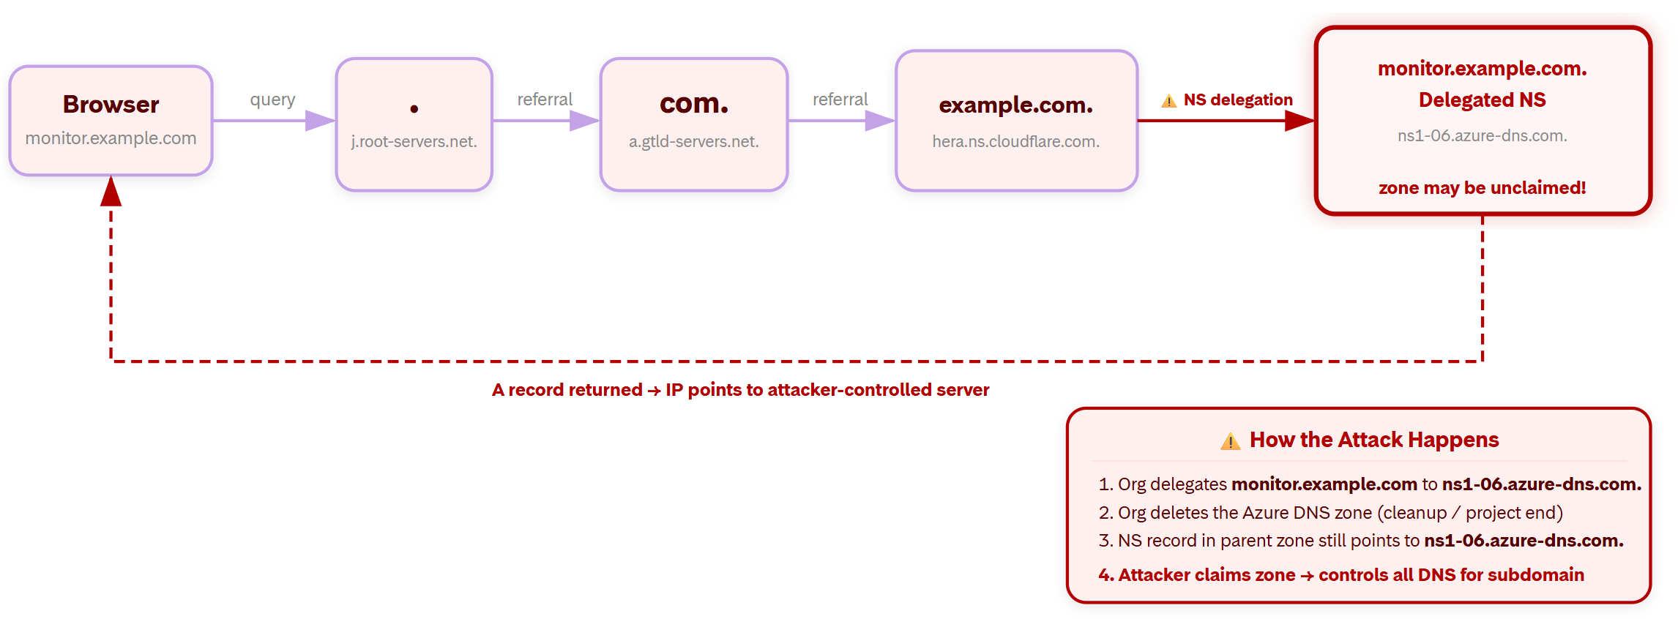
Step-by-Step DNS Resolution Flow

Slide 5
Reconnaissance
TOOL FOR SUBDOMAIN ENUMERATION
TOOL FOR DANGLING NS RECORD DETECTION
TOOL FOR VIBE CODING

Slide 6
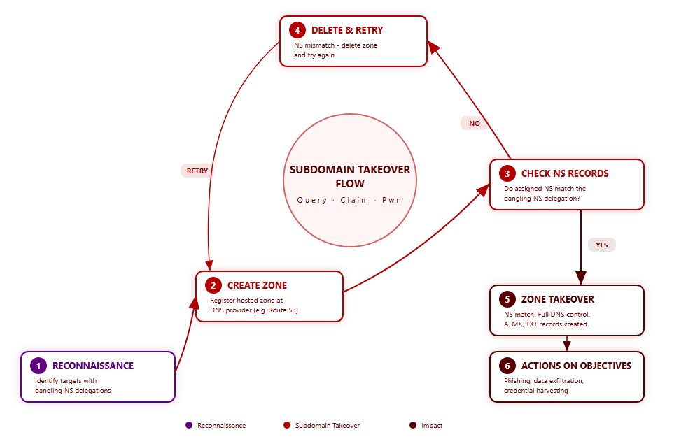
General Flow for Subdomain Takeover

Slide 7
Google Cloud DNS
❝Cloud DNS assigns every public managed zone to one of five name server shards. Shards are the letter before the number in an authoritative name server name, so ns-cloud-e1 through ns-cloud-e4 are the E shard. ❞

Slide 8
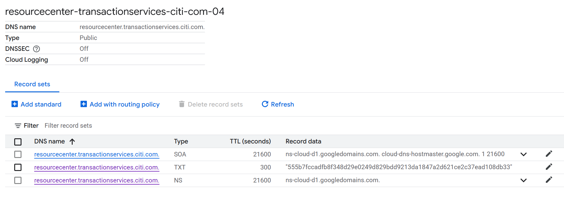
Google Cloud DNS
❝Cloud DNS assigns every public managed zone to one of five name server shards. Shards are the letter before the number in an authoritative name server name, so ns-cloud-e1 through ns-cloud-e4 are the E shard. ❞

Slide 9
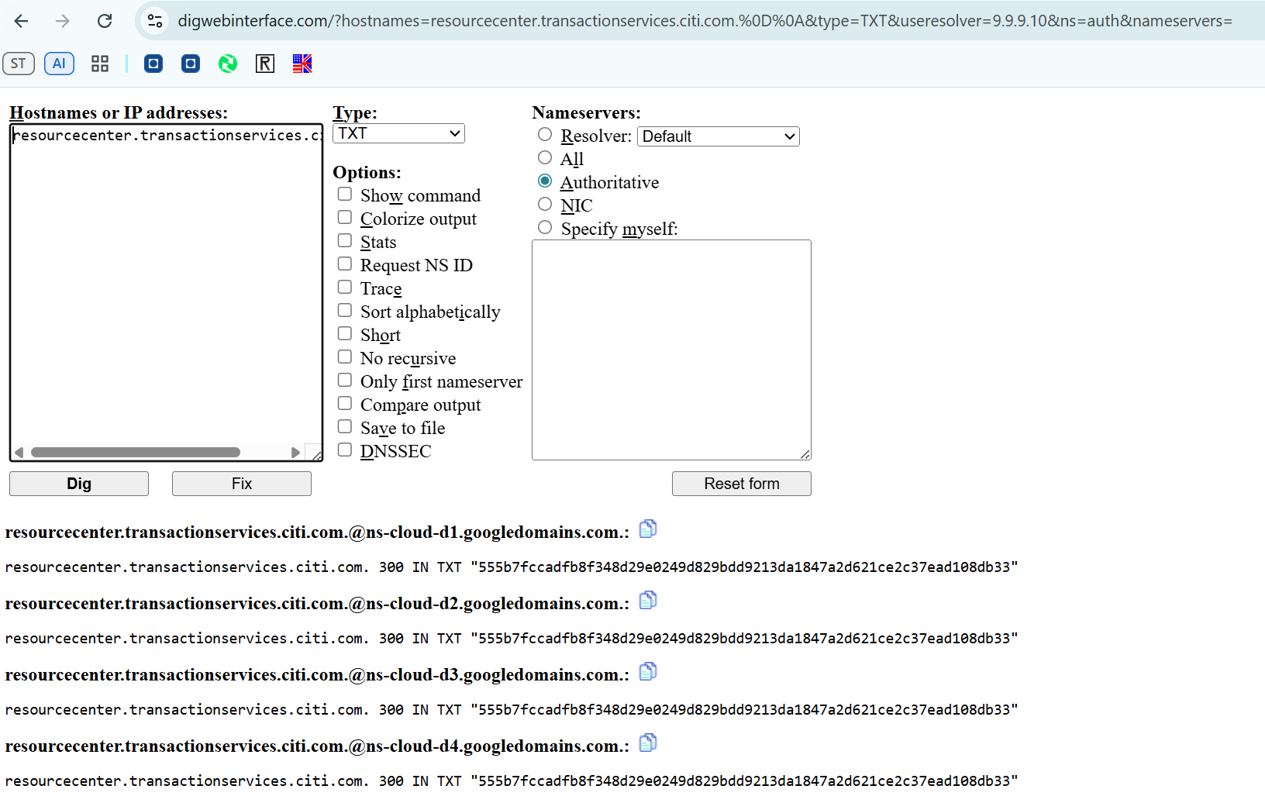
Impact: Domain Verification / TLS Certificate Issuance

Slide 10
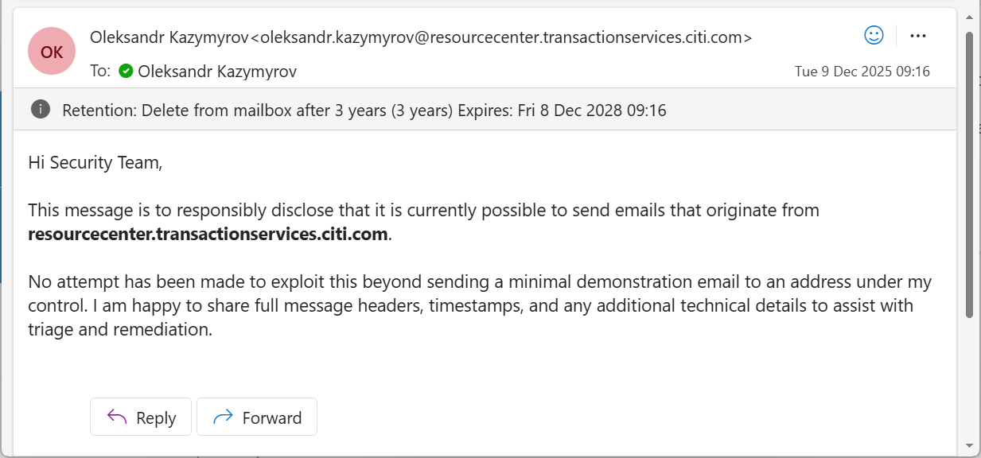
Impact: Business Email Compromise (BEC)

Slide 11
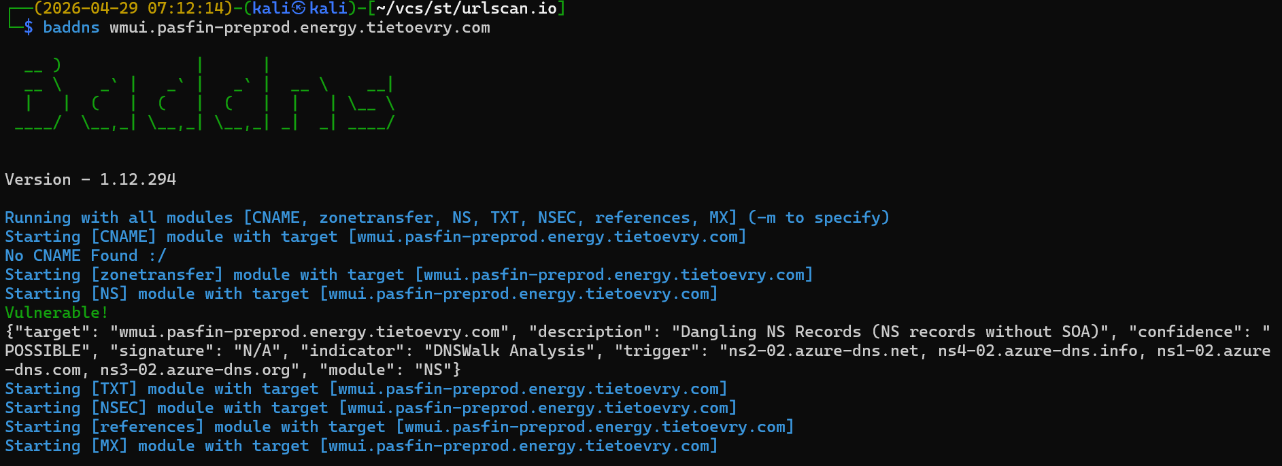
Azure DNS
01-09

Slide 12
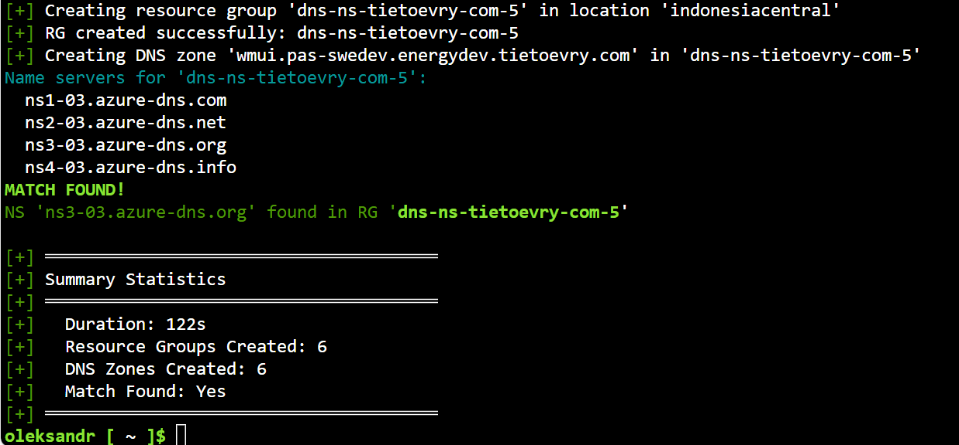
Impact: Supply Chain of IT Service Provider

Slide 13
AWS Route 53: Key Facts About Name Servers
2000+ NAME SERVERS AVAILABLE
EACH ZONE IS ASSIGNED 4 RANDOM NSs
ZONE CREATION IS TIME-CONSUMING PROCESS

Slide 14
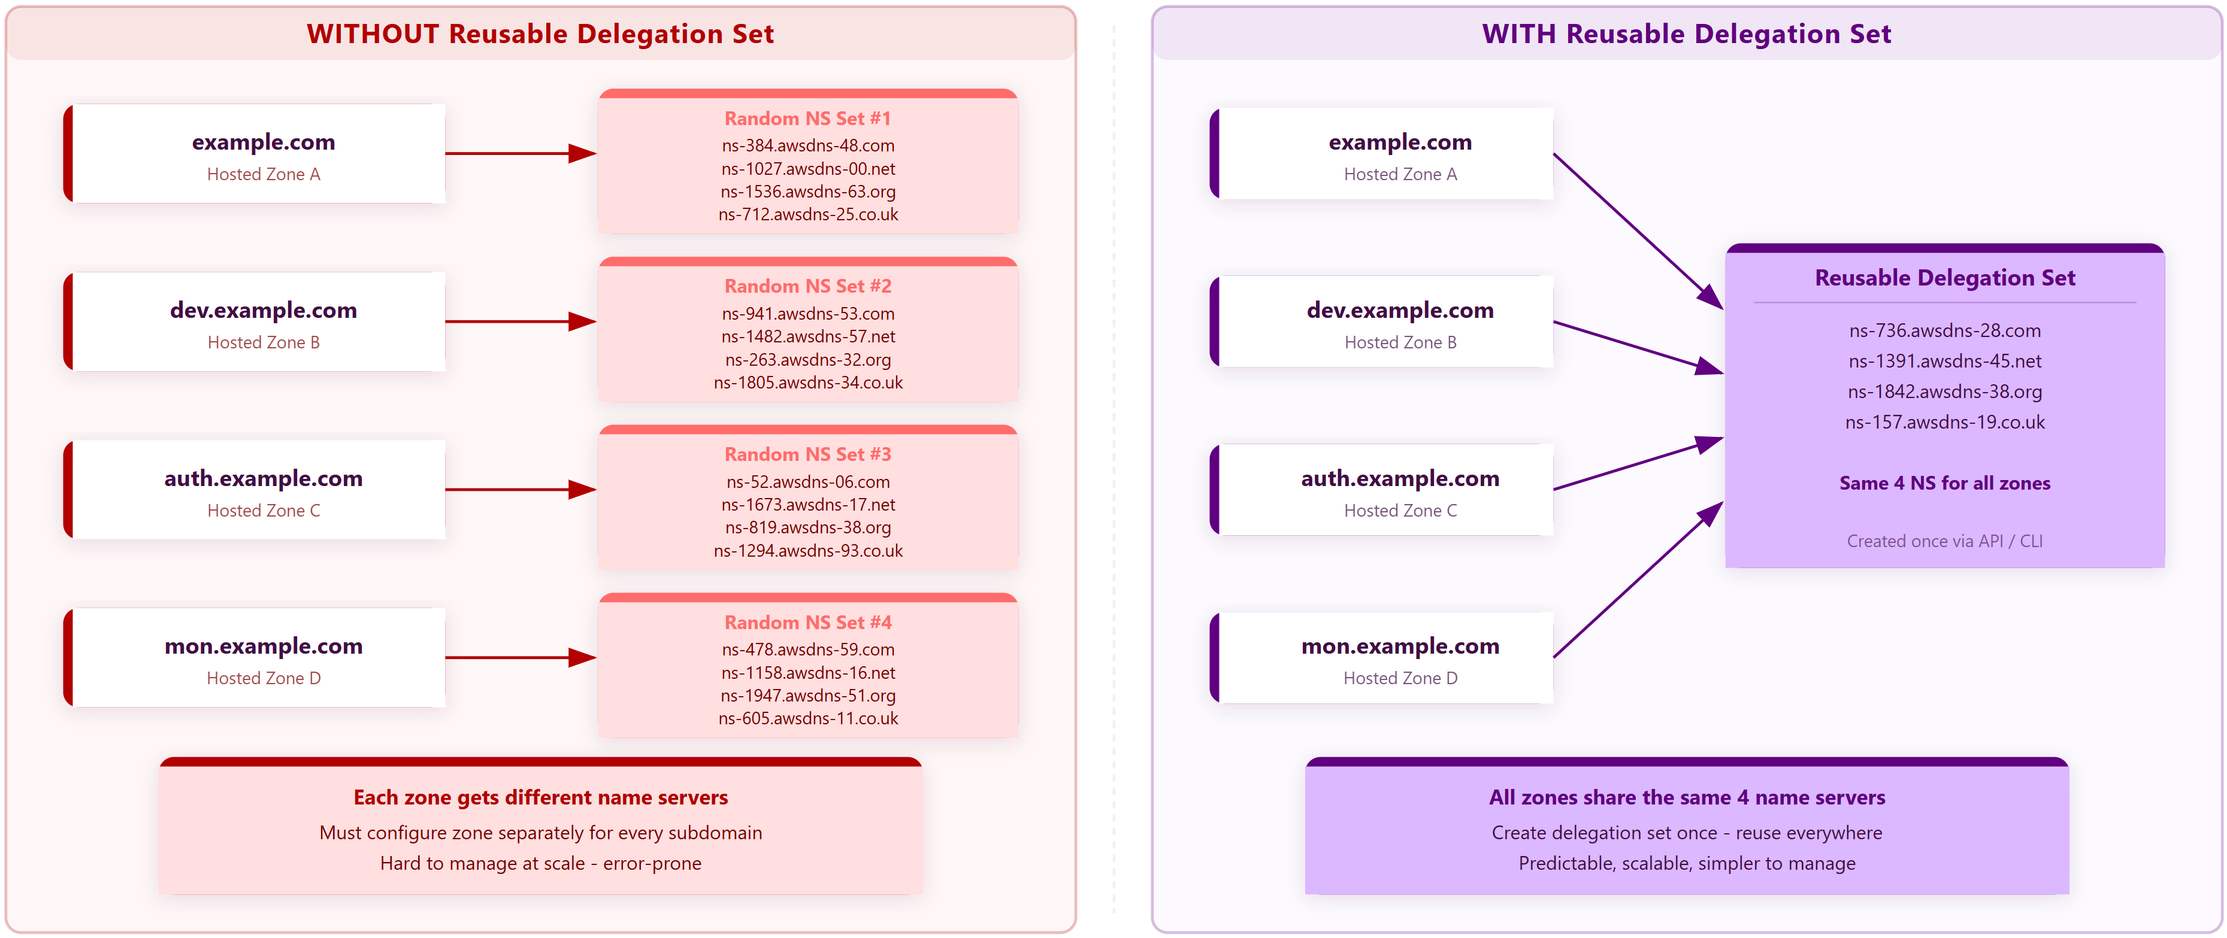
AWS Route 53: Reusable Delegation Set

Slide 15
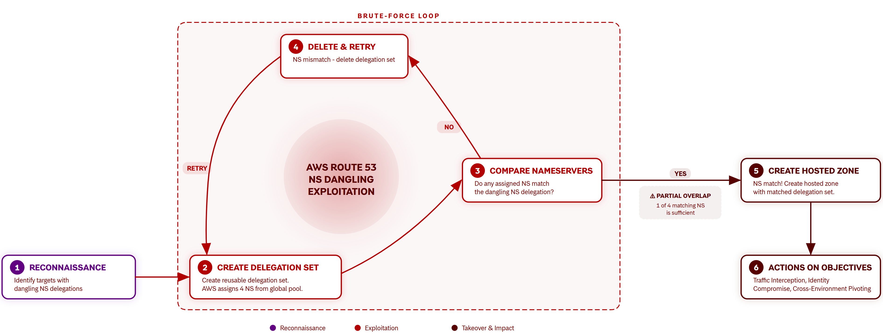
AWS Route 53

Slide 16
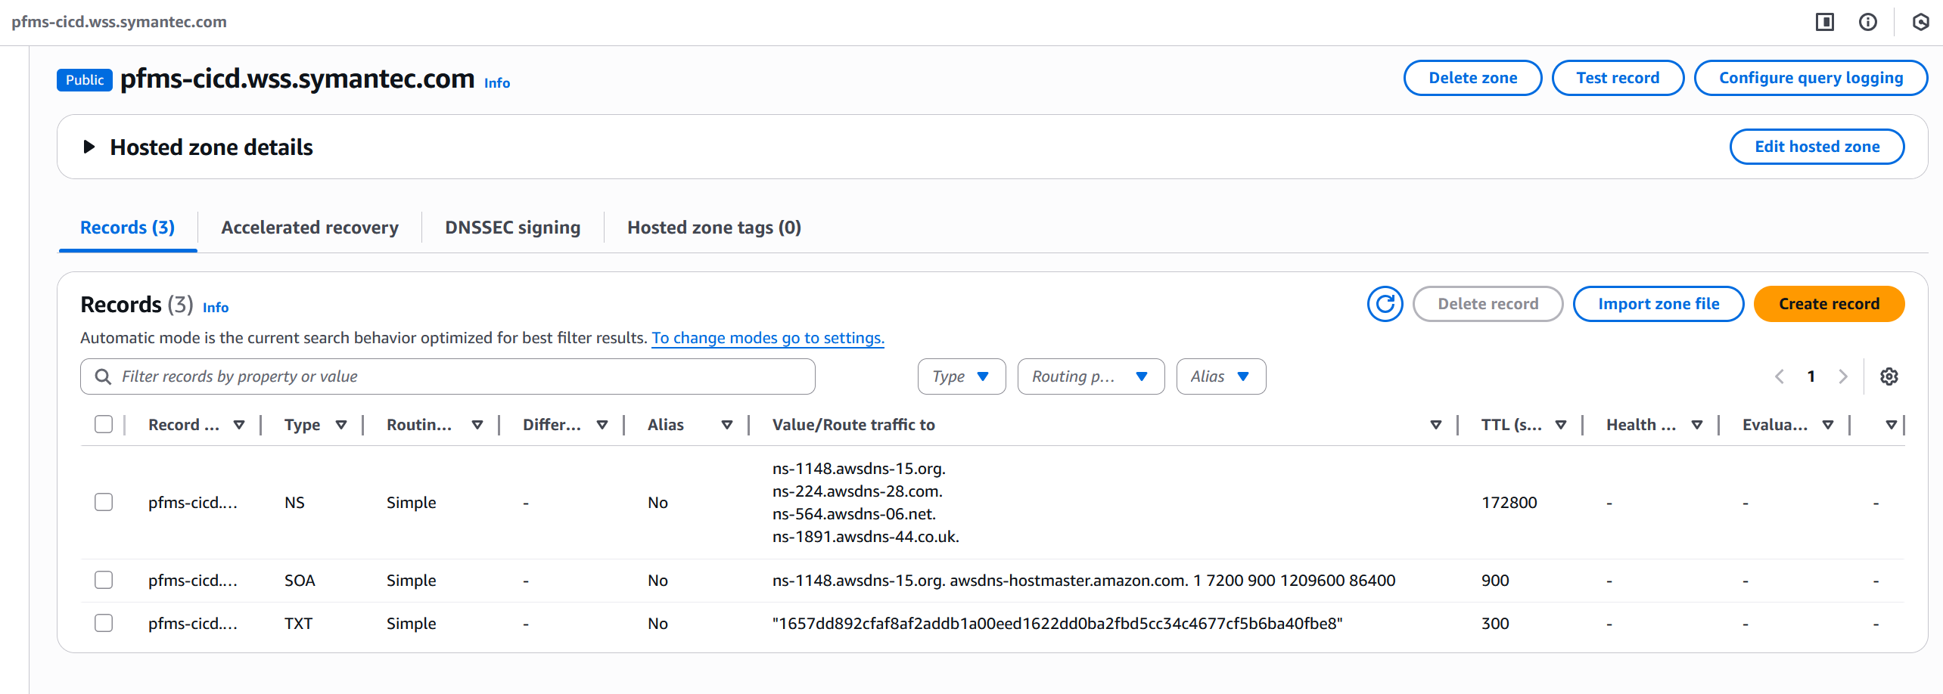
Impact: Security Vendor Supply Chain Exposure

Slide 17
Responses From Vendors
"… decided not to track it as a security bug …"
"… this case has been assessed as moderate severity and does not meet Microsoft's bar for immediate servicing …"
"… does not represent a security vulnerability with AWS products or services …"

Slide 18
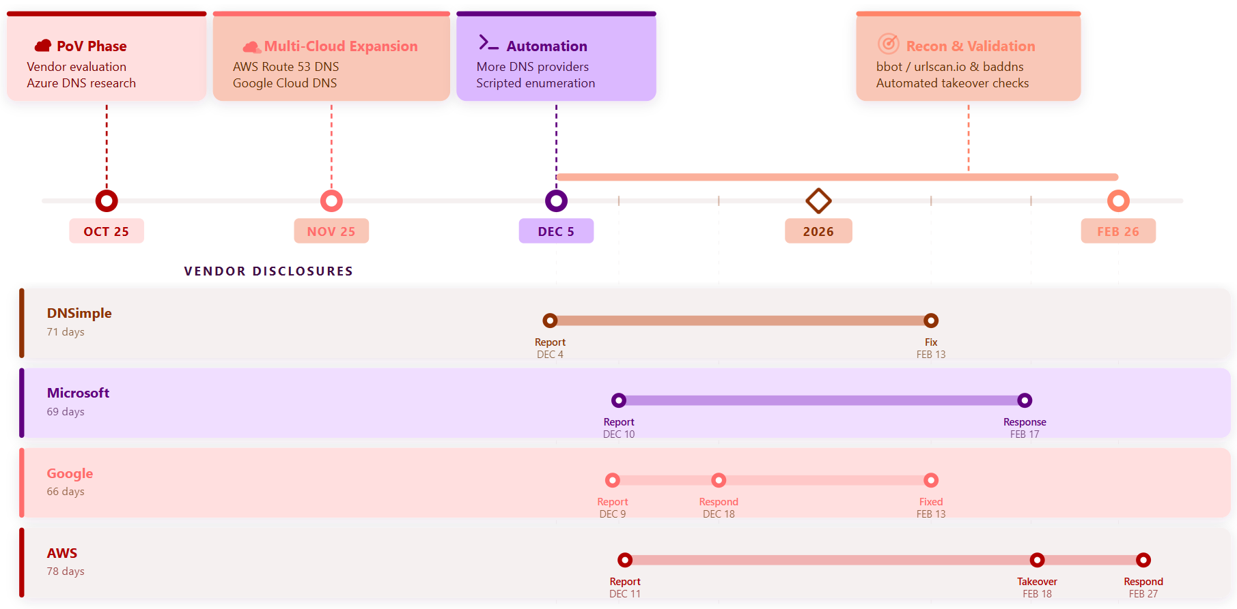
Disclosure Timeline

Slide 19
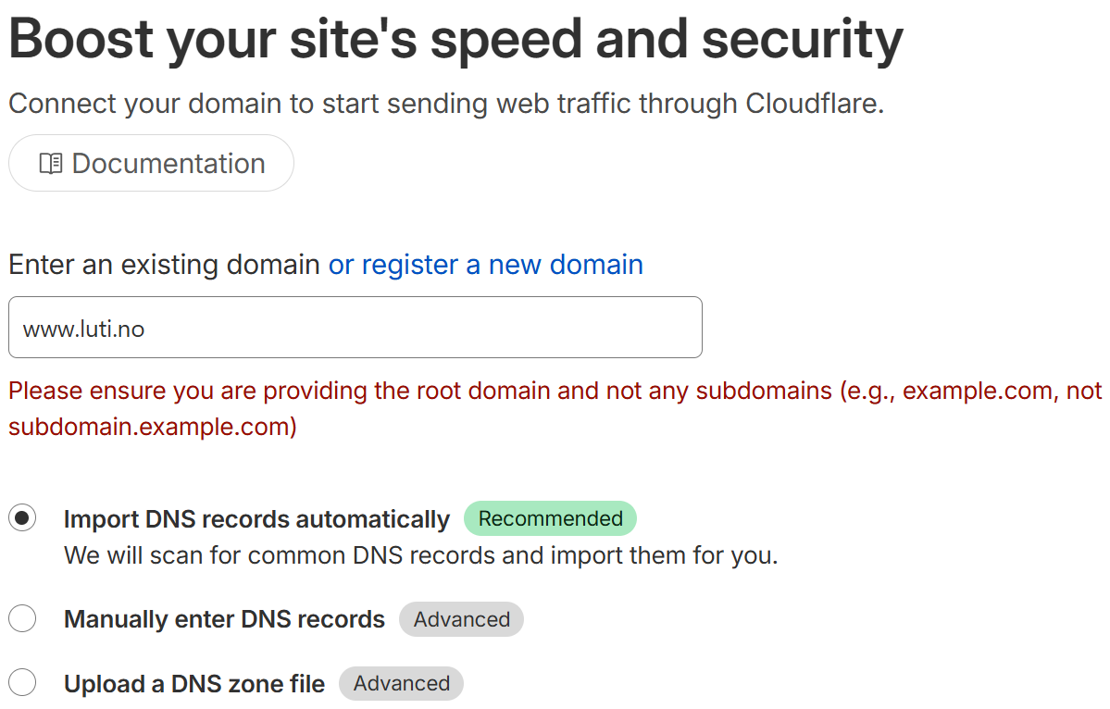

Slide 20
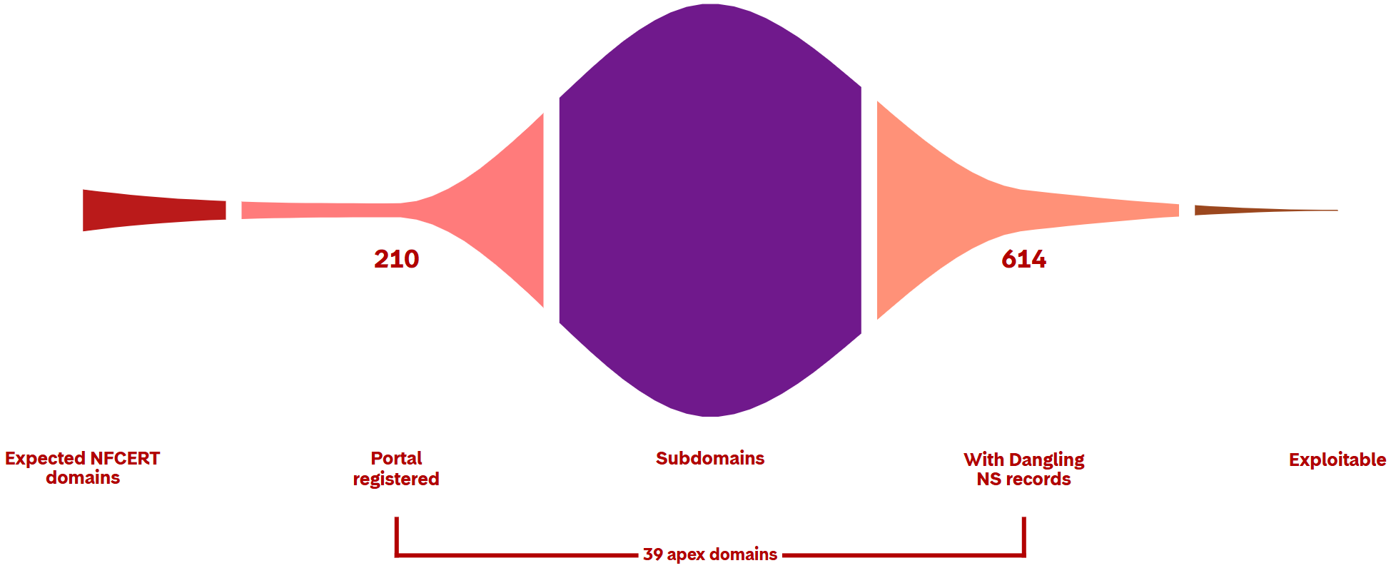
Subdomain Takeover Likelihood via Dangling NS

Slide 21

NS dangling statistic among NFCERT members
614
514
462
451
39
39
37
28

Slide 22
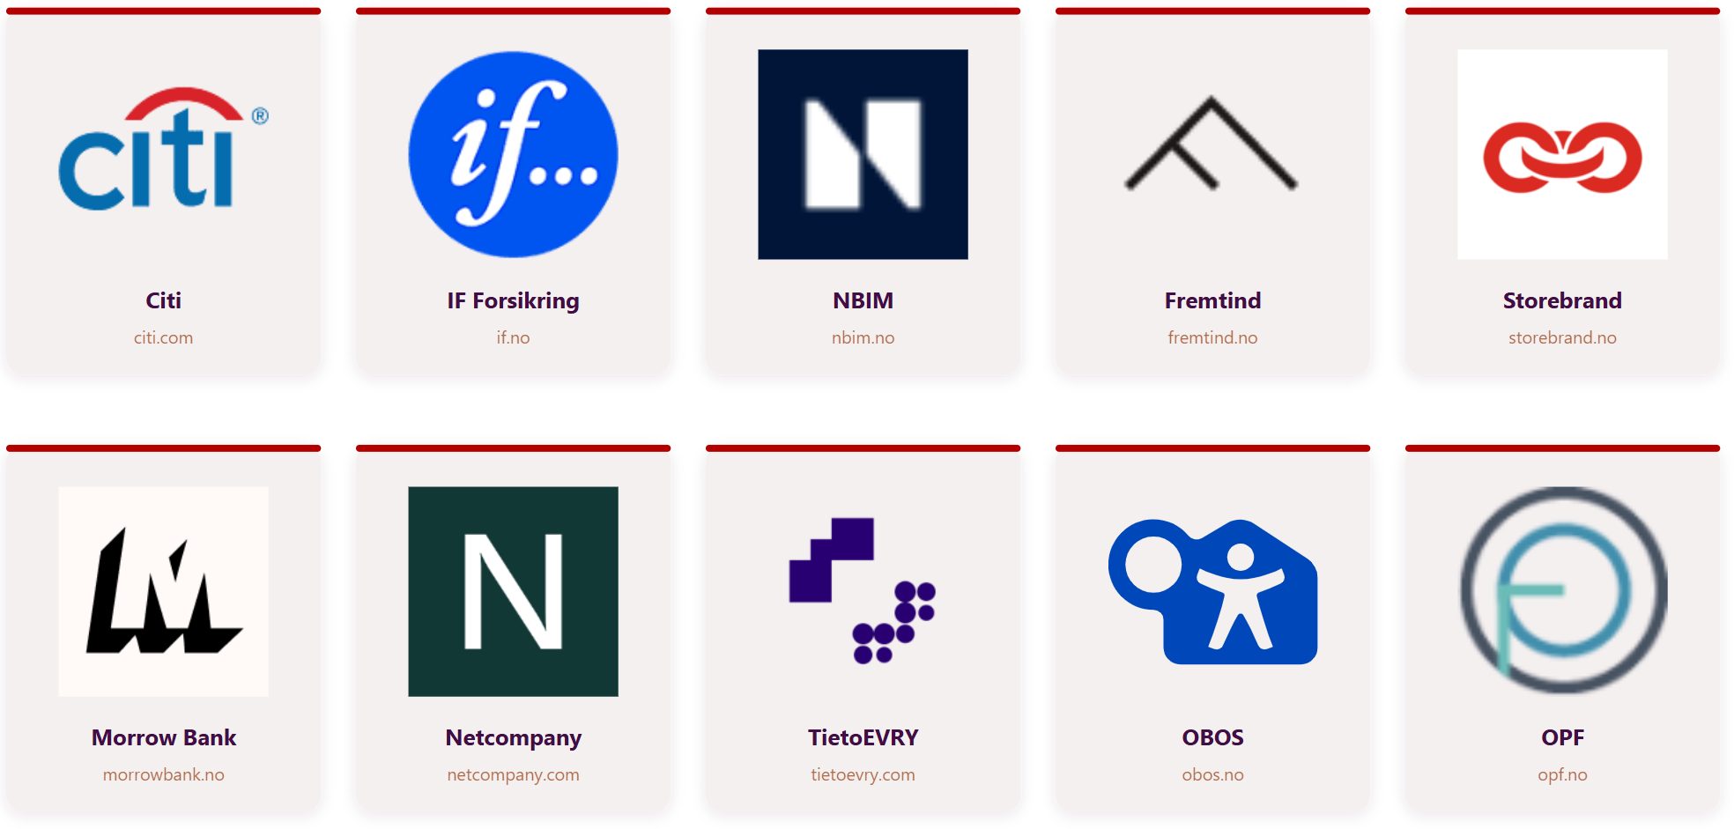
Real-World Examples

Slide 23
Dangling NS Takeover Risk Across DNS Providers
Dangling NS Takeover Risk Across DNS Providers

Slide 24
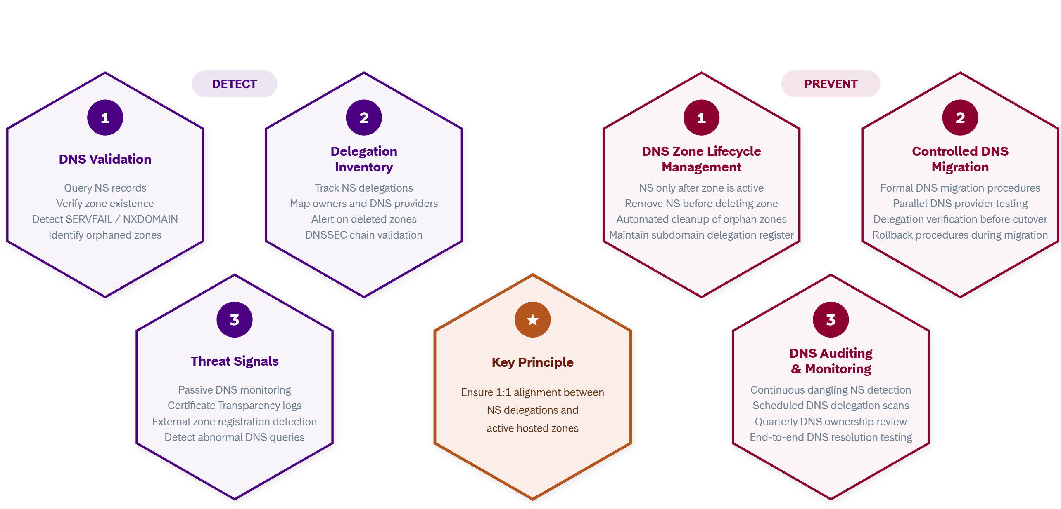
NS Delegation Integrity

Slide 25
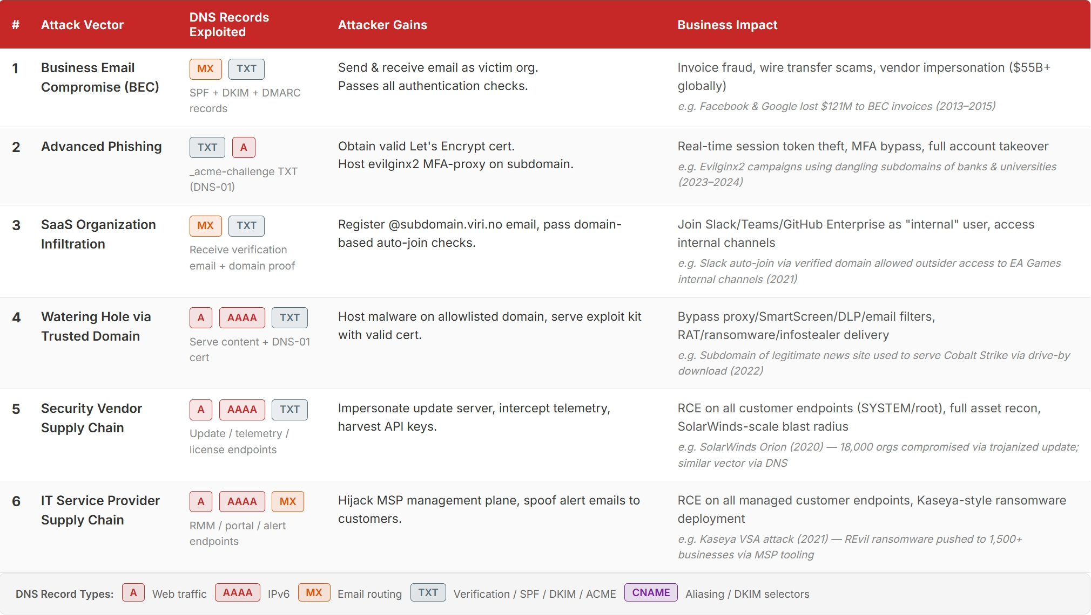
Attack Vectors from a Single DNS Misconfiguration

Slide 26

Q&A

