Slide 1






Scaling LLM access using an AI gateway
Eskedar Kefialew
TEAM PLATFORM
DIGITALISERINGSDIREKTORATET
BERGEN / CLOUD NATIVE DAYS NORWAY

Slide 2
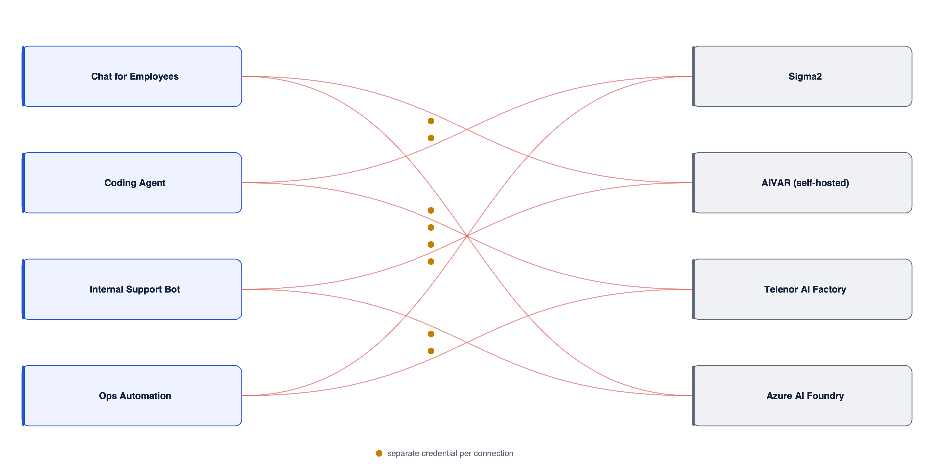

What problem are we solving?
Why AI gateway?
CLOUD NATIVE DAYS / NORWAY
02

Slide 3
What is Agentgateway?
Cloud-native reverse proxy that sits between enterprise applications (or AI agents) and AI model providers
Unified API: one OpenAI compatible endpoint for Azure AI Foundry and Sigma2 models.
Security: TLS at the edge and to providers, JWT (Kiporten/Entra ID) or API key required on every call.
Centralized credentials: provider keys come from Vault and are injected by the gateway, never by clients.
Token based rate limiting: a token budget enforced by a remote rate limit service backed by Redis.
Model routing: backend chosen by the model name in the request body.
Virtual models: weighted routing across providers behind one model name.
MCP proxy: MCP servers published behind the gateway.
No provider lock-in: switch between Azure AI Foundry, Sigma2, or self-hosted models without changing the client integration.
Admin UI: built in, with Entra ID login restricted to the Admin role.
Open source: Apache 2.0 licensed, no license fees, no vendor lock-in.
Kubernetes native: runs on OCP, it is GitOps friendly
AI observability: token counts, model names, provider
CLOUD NATIVE DAYS / NORWAY
03

Slide 4
Agentgateway standalone architecture
Clients
Apps, agents
OpenShift Routes
api.aivar.no
internal · admin UI
Agentgateway
3 replicas
4000 LLM/MCP · 4001 UI
15020 metrics
Model providers
Azure AI Foundry, Sigma2, AIVAR
HTTPS, provider key injected
JWKS, UI OIDC
ArgoCD
4 apps from Git, main
Identity
Kiporten, Entra ID
keys, state
remoteRateLimit
PostgreSQL
CloudNativePG, 3 instances
API keys, state
Rate limit service
envoyproxy/ratelimit
port 8081
Redis HA
3 nodes, Sentinel
token counters
Vault
provider keys, OIDC secret
Prometheus
PodMonitor on 15020
Grafana
CLOUD NATIVE DAYS / NORWAY
04

Slide 5
One gateway, one OpenAI compatible request format
Agentgateway
auth
authorization
token rate limits
model routing
metrics
Azure AI Foundry
DeepSeek-V4-Flash, DeepSeek-V4.1-Flash, gpt-6.1-sol
Application
Sends one OpenAI compatible HTTP request
AIVAR
Self-hosted: borealis
Sigma2
Qwen3.8-27B, Borealis-27B, Borealis2-preview, embeddings
CLOUD NATIVE DAYS / NORWAY
05

Slide 6
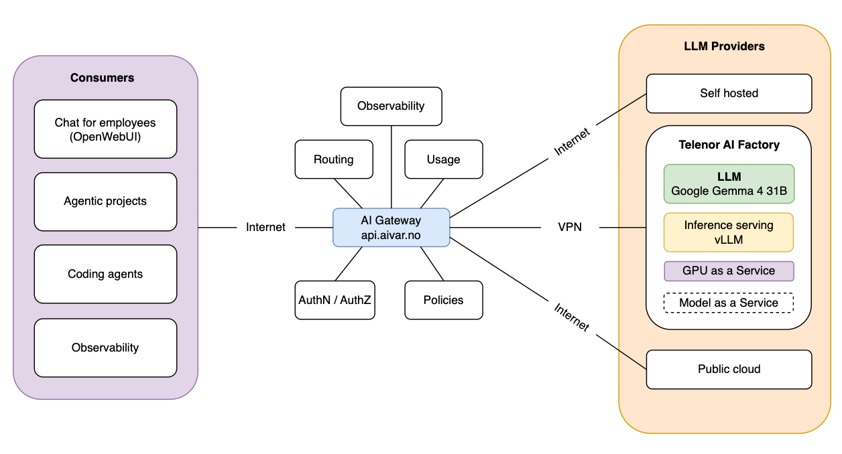
Architecture overview
CLOUD NATIVE DAYS / NORWAY
06

Slide 7
How a request moves through the gateway
$ client request
POST /v1/chat/completions HTTP/1.1
Host: api.aivar.no
Authorization: Bearer <api-key>
{"model": "azure:DeepSeek-V4-Flash-0731", "messages": [{"role": "user", "content": "hi"}]}
$ configs/helm-agentgateway.yaml
llm:
models:
- name: "azure:DeepSeek-V4-Flash-0731"
provider: azure
params:
apiKey: $AZURE_API_KEY
model: DeepSeek-V4-Flash-0731
$ configs/helm-agentgateway.yaml
llm:
policies:
jwtAuth:
providers:
- issuer: https://kiporten.dev
- issuer: https://login.microsoftonline.com/<tenant>/v2.0
apiKey:
keys: []
$ configs/helm-agentgateway.yaml
llm:
policies:
authorization:
rules:
- allow: apiKey != null
- allow: jwt.iss == "https://kiporten.dev"
models:
- name: "azure:DeepSeek-V4-Flash-0731"
authorization:
rules:
- allow: has(jwt.roles) && "Admin" in jwt.roles
- allow: apiKey != null
CLOUD NATIVE DAYS / NORWAY
07

Slide 8
How a request moves through the gateway
$ helm-agentgateway.yaml
remoteRateLimit:
- key: gateway
value: '"agentgateway-standalone"'
$ configmap.yaml
descriptors:
value: agentgateway-standalone
rate_limit:
unit: month
requests_per_unit: 5000000
$ configs/helm-agentgateway.yaml
extraEnv:
- name: AZURE_API_KEY
valueFrom:
secretKeyRef:
name: ai-gw-backend-apikey-azure
key: apiKey
llm:
models:
- name: "azure:DeepSeek-V4-Flash-0731"
params:
apiKey: $AZURE_API_KEY
$ provider dispatch
# client facing
POST https://api.aivar.no/v1/chat/completions
# forwarded by agentgateway
provider: azure (Azure AI Foundry)
model: DeepSeek-V4-Flash-0731
auth: $AZURE_API_KEY
$ configs/helm-agentgateway.yaml
llm:
virtualModels:
- name: borealis2
routing:
weighted:
targets:
- model: "sigma2:Borealis2-preview"
weight: 50
- model: "aivar:borealis"
weight: 50
CLOUD NATIVE DAYS / NORWAY
08

Slide 9
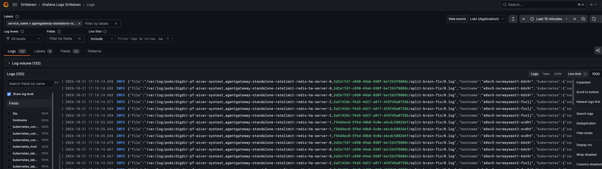
Full stack observability
Prometheus
Loki
Grafana
Scrapes metrics.
Aggregates logs.
Visualizes data.
CLOUD NATIVE DAYS / NORWAY
09

Slide 10
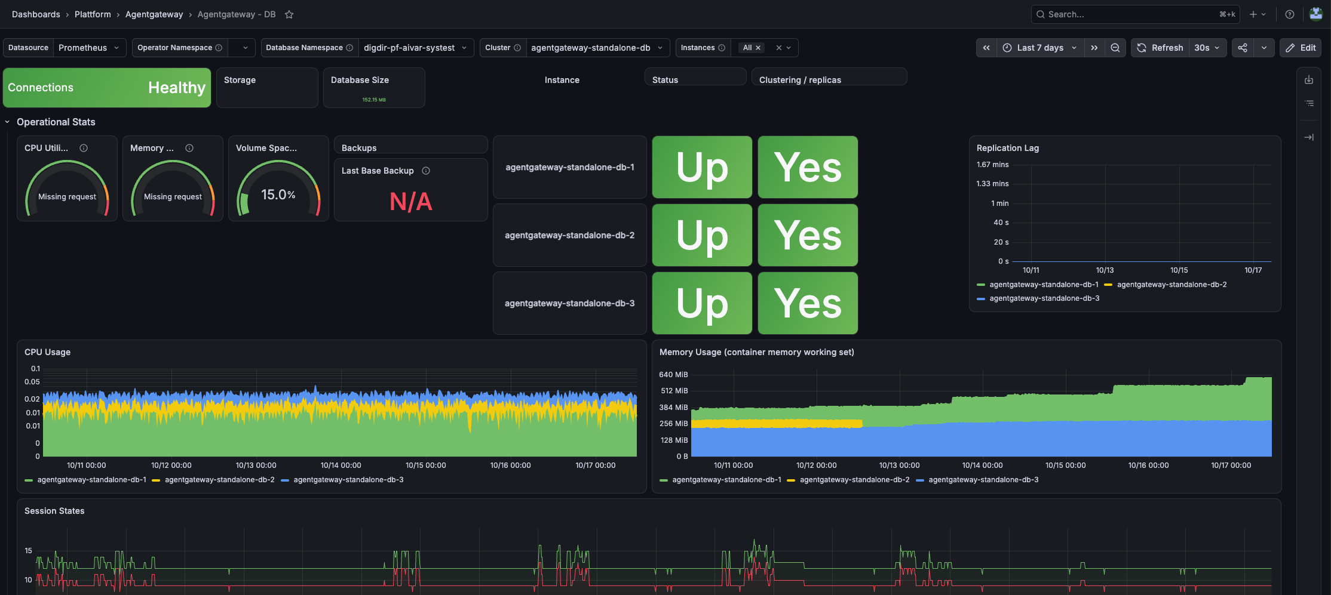
Grafana: PostgreSQL
CLOUD NATIVE DAYS / NORWAY
11

Slide 11
Installing on OpenShift with ArgoCD
1 · ArgoCD Application
2 · Helm chart via kustomize
Points at the environment folder on main.
Kustomize renders the upstream chart with our values.
$ argocd-application.yaml
kind: Application
metadata:
namespace: openshift-gitops
spec:
source:
path: apps/aivar/<env>/agentgateway-standalone
targetRevision: main
$ kustomization.yaml
helmCharts:
- name: agentgateway-standalone
repo: oci://cr.agentgateway.dev/charts
version: v1.5.0
releaseName: agentgateway-standalone
valuesFile: configs/helm-agentgateway.yaml
3 · Database mode
4 · Verify
Three gateway replicas share state in a CloudNativePG cluster.
The four ArgoCD applications, then the pods.
$ configs/helm-agentgateway.yaml
mode: database
replicaCount: 3
database:
postgres:
url: postgresql://...@agentgateway-standalone-db-rw:5432/agentgateway
ArgoCD applications
agentgateway-standalone gateway, routes, UI
agentgateway-standalone-db CNPG cluster x3
agentgateway-standalone-ratelimit ratelimit
agentgateway-standalone-ratelimit-redis Redis HA
CLOUD NATIVE DAYS / NORWAY
12

Slide 12

Key takeaways
a shared entry point for every LLM and MCP server
central control of credentials, authentication and rate limits
model based routing and API translation across providers
full observability of AI traffic
AI access as a platform capability, not a per-team problem
CLOUD NATIVE DAYS / NORWAY
13

Slide 13
THANK YOU
QUESTIONS / DISCUSSION
plattform@digdir.no
Team platform
Digitaliseringsdirektoratet
BERGEN / CLOUD NATIVE DAYS NORWAY

