Slide 1



March 30, 2022

Slide 2
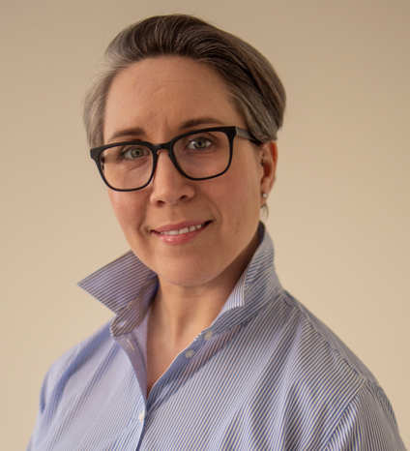
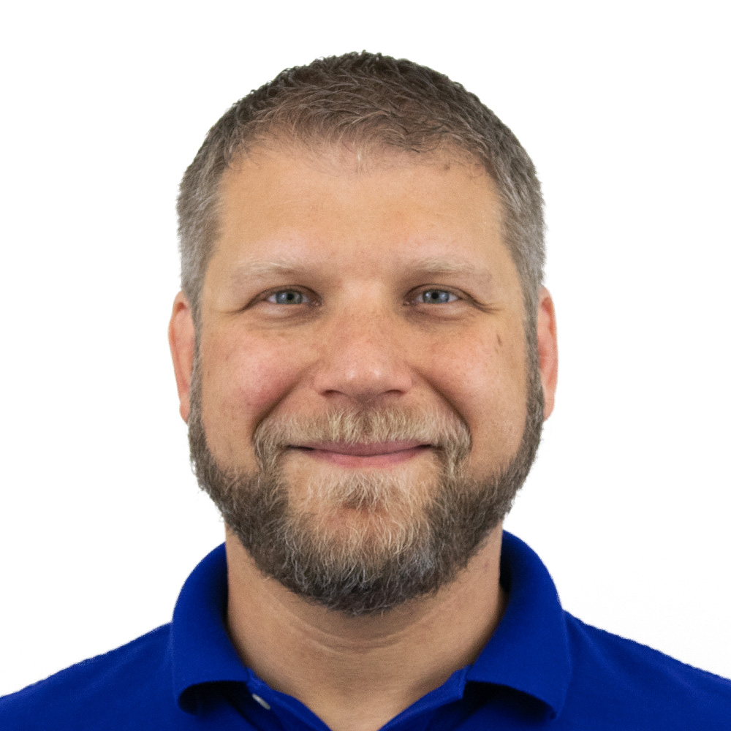
Prescribing Influence Beyond the MD
Cate Evans
SVP Comms Planning
Havas Media
Nick Lapolla
Director of Research
MedSurvey

Slide 3



Healthcare & HCPs Impacted by the Pandemic
33%
76%
Of HCPs said they had considered leaving the medical profession
Of HCPs agree that doctors will eventually become employees of the medical system, without autonomy to make patient-centric decisions
39% for primary care physicians

Slide 4
Why Expand Beyond the MD?
Stress and time constraints imposed on MDs
Increasing corporate involvement in healthcare
Constantly evolving audience & data capabilities
A competitive marketplace that requires looking for every opportunity

Slide 5

The Question we Wanted to Answer:
Who is influential in decision making?

Slide 6
High Level Methodology
Phase 1:
Phase 2:
20 min
60-minute
Phone Interviews
Fielded A 20-minute
Online Survey
From Feb 11th to Feb 22nd , 2022
From Mar 4th to Mar 11th, 2022
Among 6 HCPs:
2 MDs
2 PA/RNs
2 Pharmacists
Among 400
Health Care Providers
High Level Methodology

Slide 7
Sub-Groups Investigated for Statistical Differences
Direct Care Providers (DCPs)
Pharmacists
Nurse
Practitioners
(n=50)
Physician
Assistants
(n=100)
Registered
Nurses
(n=50)
Pharmacists
(n=200)

Slide 8
The Themes That Emerged
TENSIONS
PRESSURE
INFLUENCE
Rx COSTS
Between doctor’s and non-MD HCPs
Feel constrained by outside forces
All say they have it
Are far more “seen” by pharmacists

Slide 9


And a few surprises!
They miss, want, and value sales reps
They value the contributions of pharmaceutical companies

Slide 10

The Non-MDs Talked Influence, Brands, & Patient Involvement
“The pharmacy has a huge role to play in the journey of medication and treatments”
(said by an RN)
“I only get 20 minutes for an appointment, and a lot of that is spent charting. It’s challenging because there’s such emphasis on electronic records now, we have to get those complete and also do preventative medicine.”
“It’s clearly just the patient and myself talking about what is needed, why we would make changes.”
“I do internal medicine, specialty care... A lot of the care that is given now is based off either an integrated health care delivery system, which is where I work, or hospital-based.”
“In becoming an Advance Practice RN, I really wanted to be in a position where I could have more of a say in how I took care of my patients.”
“The pharmacy might try & make a change if it’s not covered or it’s a higher copay, they’re incentivized to try and push cheaper drugs.”
“When it comes to decision makers, I would say the doctor first, then we come in.”
“The pharmacist should not be getting involved, it’s none of their business.”
“We know that certain drugs will not be covered because generics are required, but if they have good insurance I’ll pitch XX brand because I like the medicine.”
“We need to help our patients get the right medicine, at the right price.”
“I feel like there is more awareness to how important we are, how much of an impact we do make on taking care of patients and healthcare as a whole.”

Slide 11
Almost 1/2 Feel They Have High Influence on Rx
Not surprisingly, significantly higher among DCPs w/ Rx privileges
Influence YOU Have on Rx
Extremely Influential
5
46%
82%
85%
14%
25%
4
3
2
℞
High Influence
on Rx (4,5)
(n=183)
Others
(1 to 3)
(n=217)
1
Nurse
Practitioners
(n=50)
Physician
Assistants
(n=100)
Registered
Nurses
(n=50)
Pharmacists
(n=200)
Not at All Influential

Slide 12
About Half Feel Too Little Time is Spent With Patients
Significantly higher among the Pharmacist segment, particularly in Retail
Opinions on Time Spent w/ Pts
Significantly
Too Much Time
5
32%
30%
46%
44%
70%
62%
4
3
2
About
Right
vs
℞
48%
1
Nurse
Practitioners
(n=50)
Physician
Assistants
(n=100)
Registered
Nurses
(n=50)
Hosp/Clinic
(n=68)
Retail
(n=132)
Pharmacists
(n=200)
Significantly
Too Little Time

Slide 13
DCPs Feel Physicians Interact the Least with Patients
Highlighting an underutilized sample pool for marketing
Influence on Pt Rx | PHARM
High (4,5) (n=183) | Others (n=217)
45% | 10%
Who Has Most Interaction w/ Pts During Office Visits?
(% ranked 1st)

Slide 14

Consolidation Has Effected All Aspects of Care
3-in-10 cite Insurance or Administration issues, 1/5 cite issues with Staff or Pts
Perspectives on Large HC Systems Playing Greater Role in Healthcare
(Coded OE response)
29%
29%
22%
19%
Insurance
Administration
Employees
Patients
Lower insurance reimbursement | 7%
Increased difficulty getting prior authorizations | 6%
Insurance companies have too much control over care | 6%
More focus on profit than patient care | 9%
Increased protocols/ metrics/ more hoops | 8%
Decisions made on admin level/ bureaucracy/ corporate feel | 7%
Overworked, understaffed | 11%
Job responsibilities have increased | 7%
Patient needs aren't being met | 9%

Slide 15
HCPs Are Stressed & Feel Overworked
Help w/ staffing issues & more patient focused industry top needed resources
How Has It Impacted You
(Coded OE response)
Resources Industry Could Provide
(Coded OE response)
Experiencing more frustration, stress, burnout | 12%
Unable to spend a good amount of time with patients/ Trying to treat more patients in the same amount or less time | 9%
Decreased professional satisfaction | 7%
Too much paperwork/ More time spent on administrative tasks | 7%
Have experienced an increase in job responsibilities | 7%
Help increase staffing/ Address staffing concerns | 16%
Need to focus more on patient care, less on profits | 10%
Need increased reimbursement amounts/ Easier reimbursement | 7%
More autonomy for providers/ pharmacists/ Involve clinical staff in decision-making | 7%
Lower costs/ Provide information on cost savings | 6%

Slide 16
Stress is Reflected in Organic Conversations
"Personally, the stress levels are dramatically increased, I tend to bring my work home more with me, physically, and emotionally.”
"Some days it’s like a revolving door of people in and out.”
"It has brought me to the point that I am looking to other professions or areas of practice.”
"It takes my time away from direct patient care and providing the best for them.”
"Work is not as much fun any longer. Things are too centralized, non-personal and just based on numbers.”

Slide 17
Physicians Seen As Having Most Influence on Rx
Even significantly more so by Pharmacists compared to Direct Care Providers
HCP Type | PHARM
DCP (n=200) | Pharm (n=200)
36% | 63%
Most Influences on Rx to Patient?
(% ranked 1st)

Slide 18
Opinions Differ Greatly Based on Rx Influence
Those w/ High Rx Influence feel NPs & PAs play a significantly greater role in Rx
Most Influences on Rx to Patient?
(% ranked 1st)
Physician | Patient’s Insurance
Physician Assistant | Nurse Practitioner
39%
14%
℞
High Influence
on Rx (4,5)
(n=183)
21%
12%
58%
25%
Others
(1 to 3)
(n=217)
3%
2%

Slide 19
Efficacy the 1st Choice of Almost Half
Cost a significantly higher factor among Pharmacists as compared to DCPs
Most Important Factors When Deciding What to Rx/Fill
(% ranked 1st)
46%
27%
17%
Efficacy
Cost
Safety
HCP Type | PHARM
DCP (n=200) | Pharm (n=200)
19% | 36%

Slide 20
Overall, Just Under Half Use Telemedicine
Telemedicine is used for 1/5 of their patient visits
For 1/5 of Pt Visits
Mainly for:
78%
General Patient
Health Questions
46%
62%
Ongoing Management
of Chronic Care

Slide 21
PAs Interact Most w/ Pts During Telemedicine
Again, MDs have the least interaction among clinical staff
Most Interaction w/ Pts
(% ranked 1st)
46%

Slide 22
Just Over Half of Practices & Pharmacies Allow Reps
Of those that don’t, about half allow Wallboards
Point of Care Advertising Allowed
49%
48%
14%
14%
13%
51%
41%
17%
17%
12%
Reps
Wallboards
Magazine
Wraps
Digital
Kiosks
EMR/EHR
Ads

Slide 23
Reps Help HCPs Lean & Educate Patients
Nearly 3/4 agree/completely agree reps: Help me learn about new therapies
HCP Type | PHARM
DCPs (n=100) | Pharms (n=100)
76% | 60%
Agreement w/ Statements
(% Top-2-Box, 4&5)
51%
Allow Reps
(n=203)
Help me learn about new therapies & medications | Provide a useful information resource for me to help educate patients/customers | Help me feel confident in speaking about different Tx options w/ patients/customers | Frequently referenced in questions & conversations w/ patients/customer | Adds little to no value & in some cases is a detriment to patient care

Slide 24
Little Difference Seen Between Branded & Generic
Over 2-in-3 feel products are interchangeable based on efficacy & safety
Agreement w/ Statements
Completely
Agree
5
In terms of efficacy,
branded and generic products are essentially interchangeable
4
3
2
In terms of safety, branded and generic products are essentially interchangeable
68%
72%
1
Completely Disagree

Slide 25
6-in-10 Would Always Choose The Generic Option
But some exceptions apply, 1/5 would not choose a generic thyroid medication
Any Products/Product Types You Would NOT Use Generic?
59%
20%
6-in-10 Would Always Choose The Generic Option
But...
No
Thyroid Medications

Slide 26
CME Programs Most Used to Learn About New Tx
Medical Publications & Journals (86%) and Sampling (85%) seen as most useful
CME Programs Most Used to Learn About New Tx
Resources Used to Learn About New Treatments
Usefulness of Resource (Top-2-Box, 4,5)
CME Programs | Conversation w/ colleagues | Print Medical Publications & Journals | Specific Website | Company/ Product Websites | Company/ Product Reps | Digital Medical Publications & Journals | Peer-to-peer Social Sites | Conferences or Medical Congresses | General Internet Searches | In-office Sampling | General Social Media Sites
 |  |  | i.e., Epocrates, Drugs.com, etc. |  |  |  | i.e. Doximity, Medscape, etc. |  | i.e. Google or Safari search |  | i.e. Facebook, LinkedIn, Twitter, etc.

Slide 27
COVID Had the Greatest Impact on ”Burn-Out”
Followed by Hiring & Retention of Medical and Non-medical staff
Avg Level of COVID Impact on Aspects of Practice/Pharmacy
Significantly Impacted
5
4
3
2
4.3
3.9
3.7
3.1
3.1
3.0
3.0
2.9
2.8
1
Not At All Impacted
Staff level of "burn-out" | Hiring and retention of medical staff | Hiring and retention of non-medical staff | Generic product availability | Telehealth Utilization | Branded product availability | Implementation of Telehealth solutions | Hours of operation | Sample availability

Slide 28
In conclusion...
In a post-pandemic, post-disruption world, look to a broader HCP audience to market and educate effectively
AUDIENCE
COMMUNICATIONS
VALUE
Expand your definition of HCP to expand your reach
Think omni-channel and holistic to optimize efforts
Fill specific needs to deliver value and be heard

Slide 29
Thank You
Cate Evans
SVP Comms Planning
Havas Media
Nick Lapolla
Director of Research
MedSurvey

