Slide 1
About this template
This presentation template is designed to help you look great on screen with your content in mmhmm. mmhmm is a video presentation app that makes you more engaging on video calls and recordings by putting you on screen with your ideas.
If you haven’t used mmhmm yet,
get started for free.
Customize
This presentation uses an additional font. For best results, download the Barlow Condensed font for free.
Add content to the slides below.
Slides intentionally have less text
so your audience can focus on you,
the presenter.
You can edit the master slide layout under View > Slide Master.
Import
Once you are finished, save the presentation and upload it into the mmhmm Media Library or drag and drop the presentation into the slide tray.
If you’re new to mmhmm, watch
the mmhmm in 90 seconds video.
For more support, check out our
Help center.

Slide 2


Slide 3
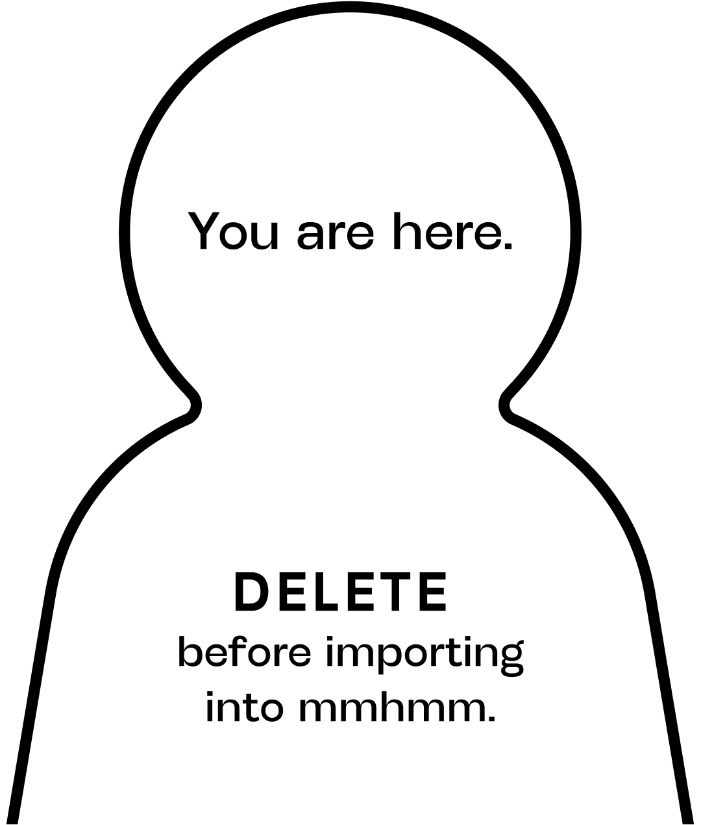

Slide 5
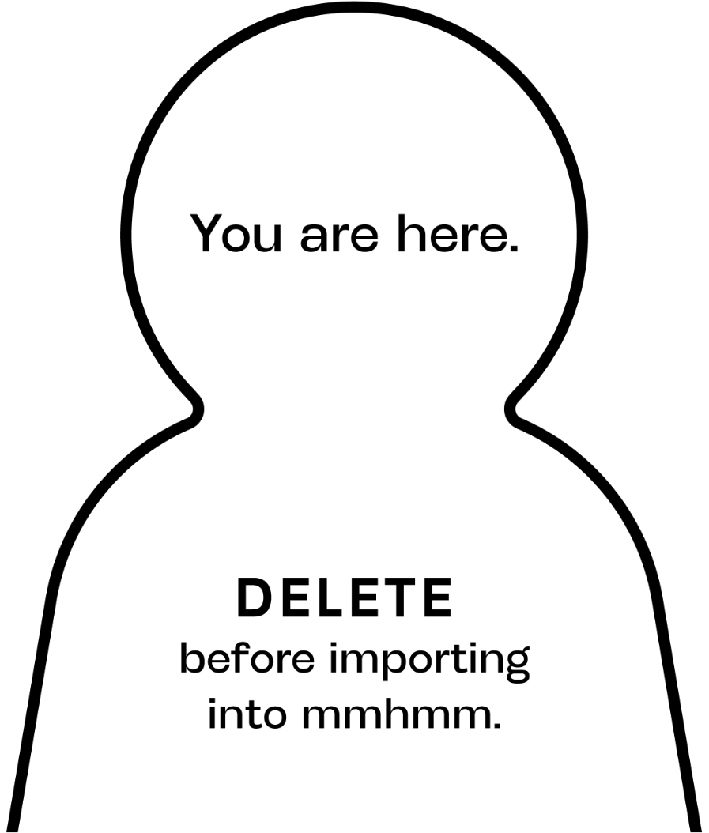

Slide 9


