Slide 1

Is North America Coming of Age as NAFTA Turns 21?
A Mexican Perspective
Pedro Noyola
April, 2015

Slide 2
Index
Openness
Integration and Competitiveness
Competition and Transparency
The Future: A Dual Agenda

Slide 3
Openness

Slide 4
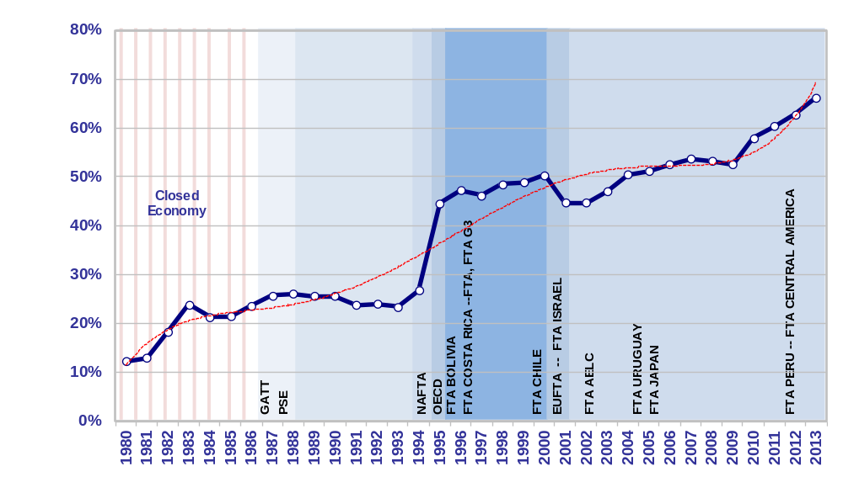
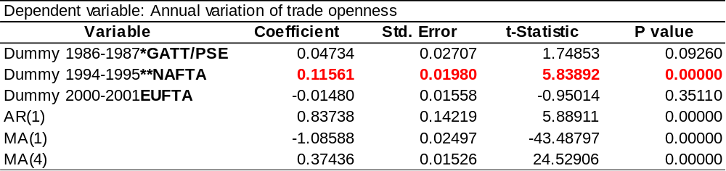
Trade liberalization in Mexico
Degree of trade openness
(X+M/GDP, 1981 - 2012)
Y_{t}= α₁ D_{GATT/PSE} + α₂ D_{NAFTA} + α₃ D_{EUFTA} + AR(1) + MA(1)+MA(4) + u_{t}
Source: SAI Law & Economics with data from INEGI.

Slide 5
B. Integration and Competitiveness

Slide 6
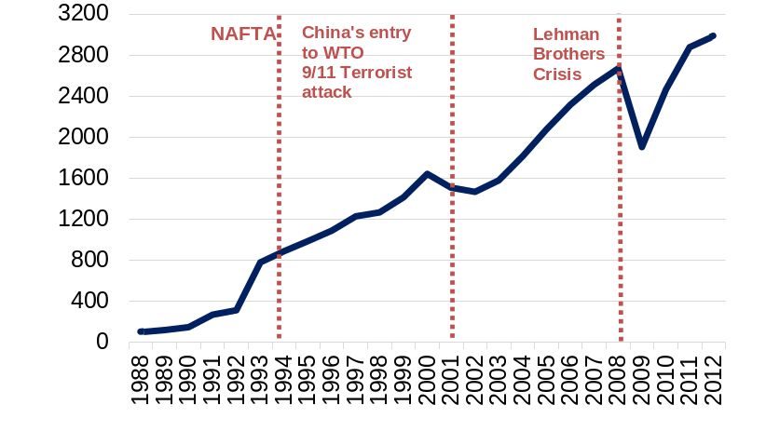
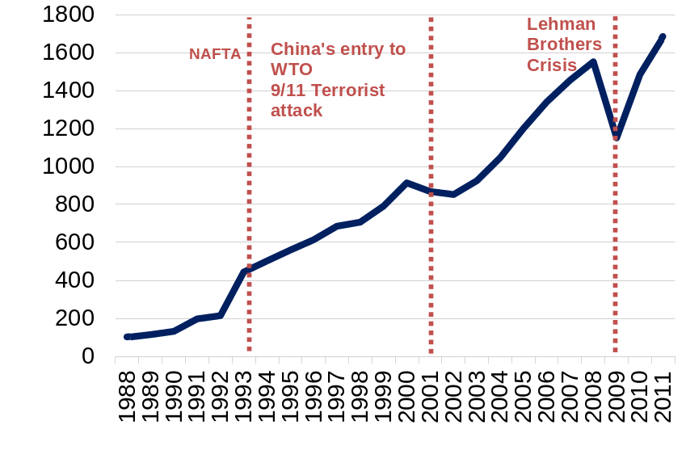
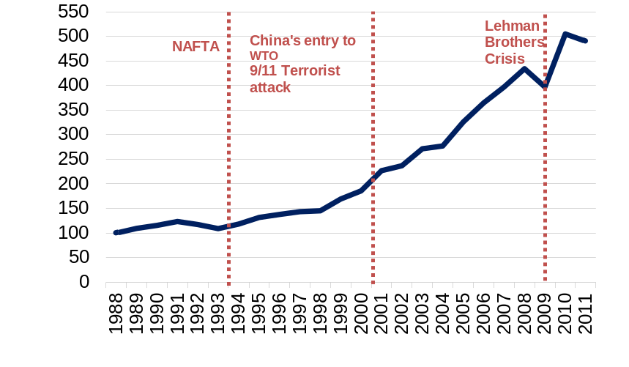
North America’s economic integration
Trade subindex¹
(NAFTA, 1988=100)
Trade & investment integration index
(NAFTA, 1988=100)
FDI subindex²
(NAFTA, 1988=100)
1/ Trade sub index: Weighted average of trade index (imports + exports) between Canada, Mexico and the United States.
2/ Investment sub index: Weighted average of foreign direct investment within NAFTA.
Integration index: Investment and trade sub indexes average
Source: SAI Law & Economics with data from INEGI, Bank of Mexico, Secretaria de Economía, US Census Bureau, US BEA & Statistics of Canada.

Slide 7
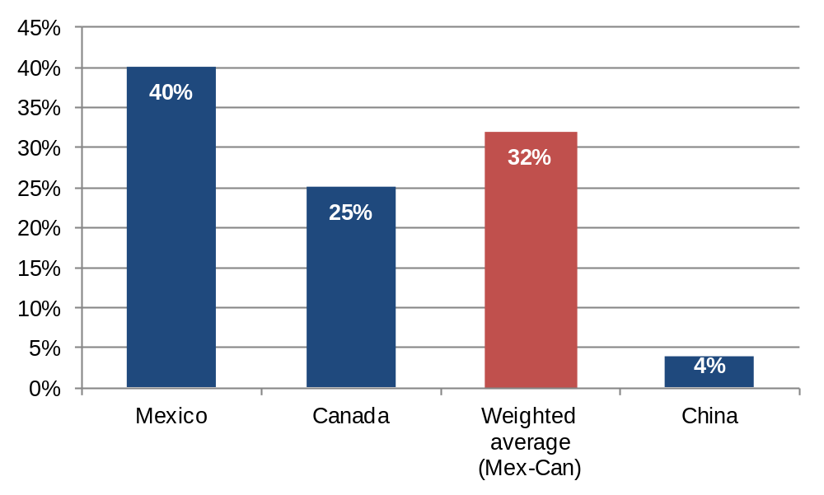
Shared production
U.S. Content in U.S. imports
(percentage)
Production sharing
(intra-industry trade: 40%)
“Pure”
outsourcing
Source: Koopman et. al. (2011) “Give credit where credit is due: tracing value added in global production chains”, U.S. Department of Commerce andAlix Partners, “Costs and Complexity - Will China Remain the Low-Cost Country of Choice?”.

Slide 8
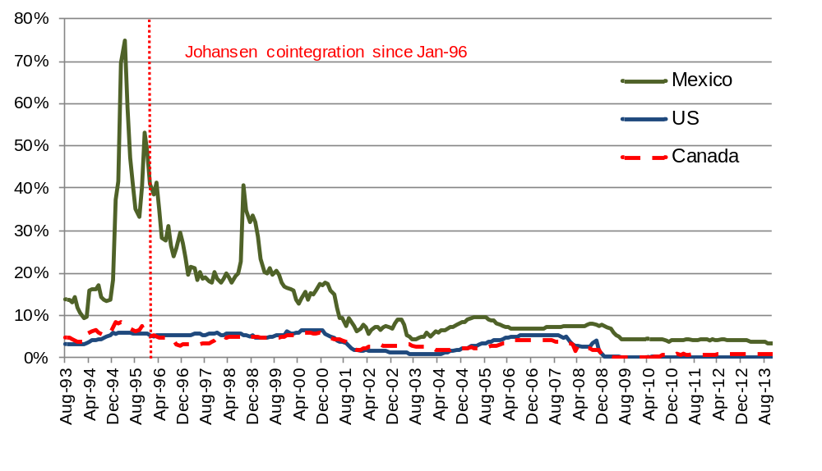
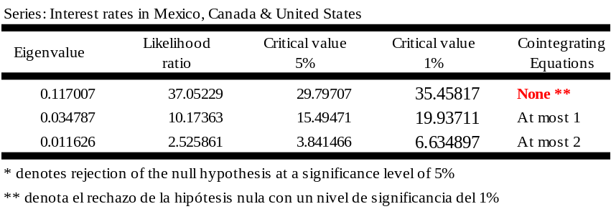
Macroeconomic convergence
Short-term Interest Rates
(percentage, 1993-2013)
Cointegration test
(January 1996 – December 2013)
Source: SAI Law & Economics with data from INEGI.

Slide 9
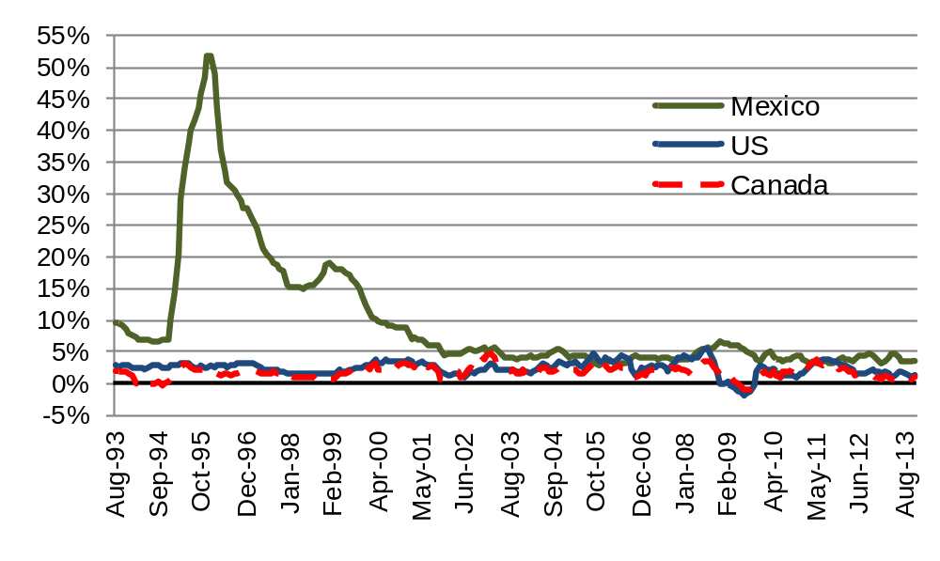
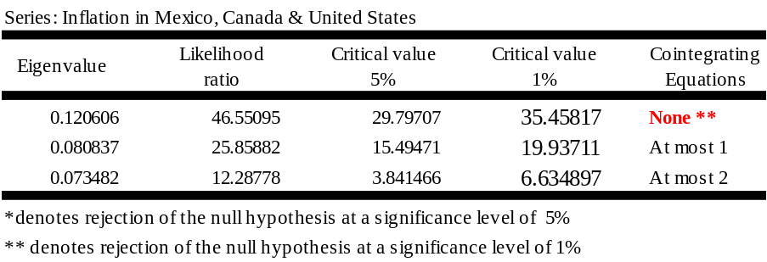
Macroeconomic convergence
Inflation
(annual variation, August 1999 – November 2013)
Cointegration test
(January 2000 – October 2013)
Source: SAI Law & Economics with data from INEGI.

Slide 10
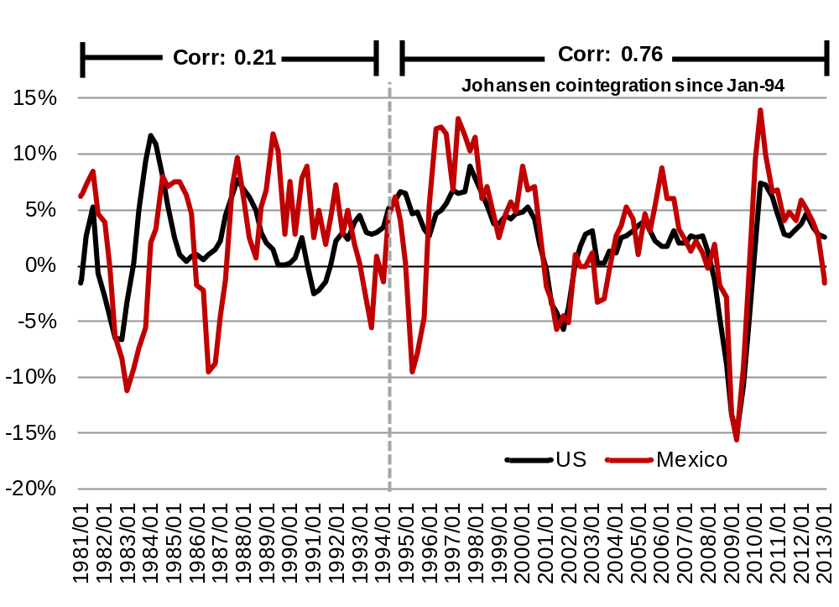
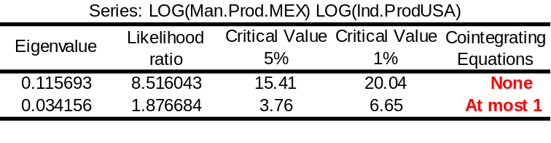
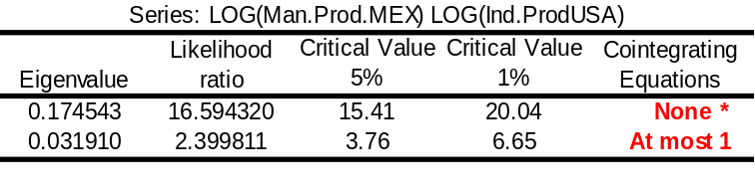
Cycle coordination
Manufacturing production from Mexico and the Unites States (annual growth,1981:T1-2013:T1)
Johansen Cointegration test¹
1980:T1 –1993:T4
1994:T1 – 2012:T2
* Rejects the null hypothesis with a confidence level of 95%. **Rejects the null hypothesis with a confidence level of 99%.
1/ The test supposes a deterministic lineal trend in the data.
Source: Analysis by SAI Law & Economics with data from INEGI and the US Federal Reserve.

Slide 11
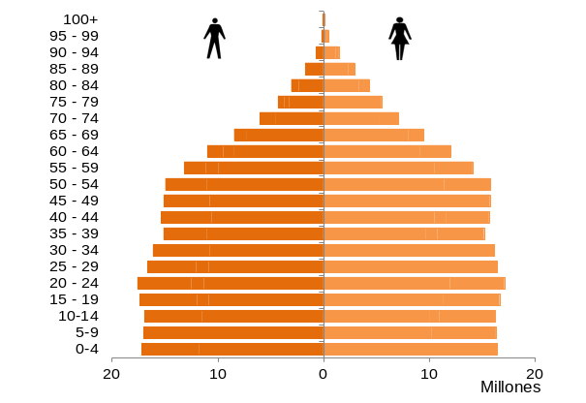
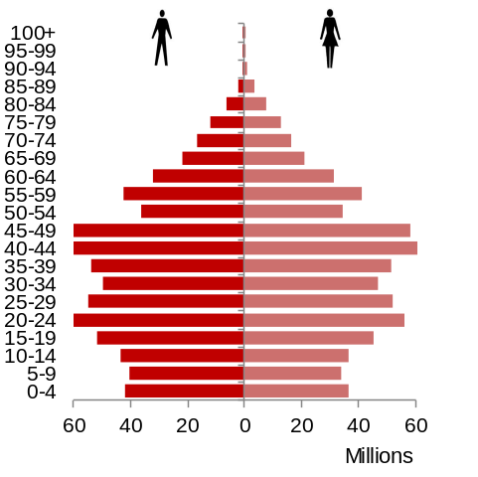
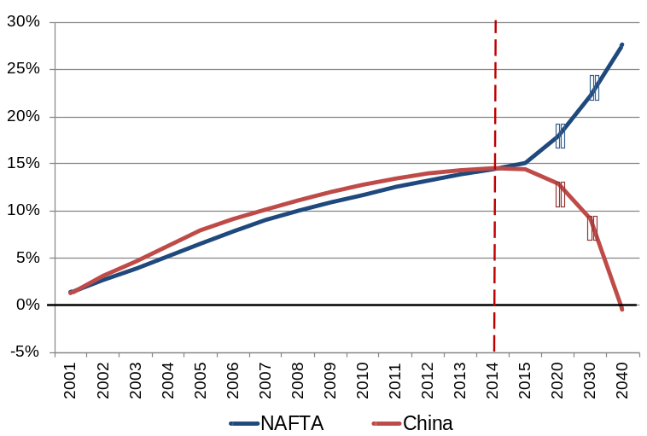
Demographic competitiveness
NAFTA population
(2012)
China population
(2012)
Labor force, from 15 to 64 years
(accumulated annual change)
Source: SAI Law & Economics with data from U.S. Census Bureau and National Bureau of Statistics of China.

Slide 12
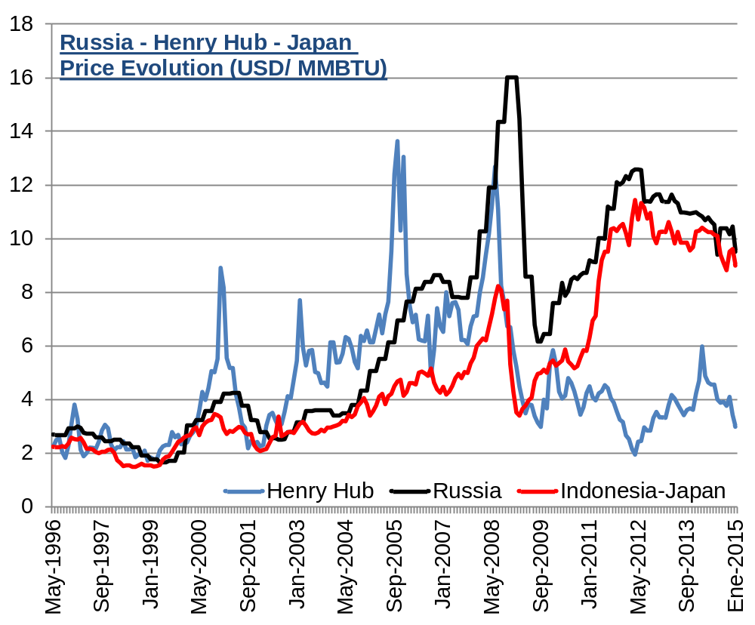
Cost competitiveness
Price of gas
(USD/MMBTU)
Jan-2015
Source: SAI Law & Economics with data from FMI.

Slide 13
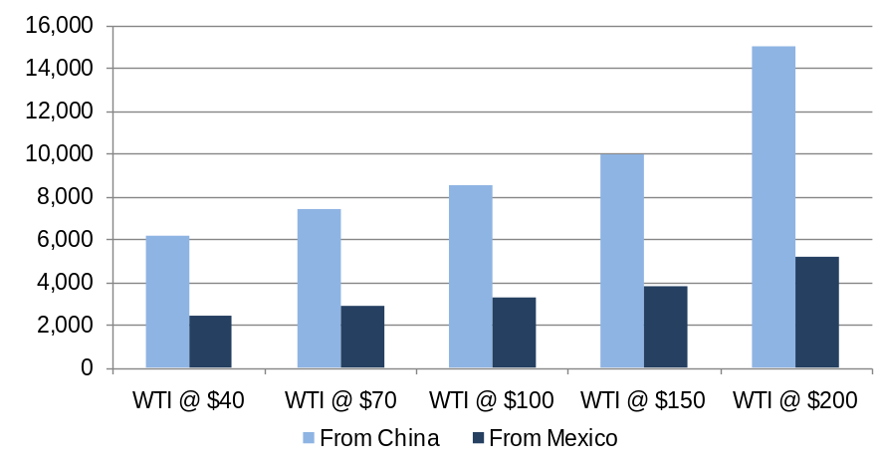
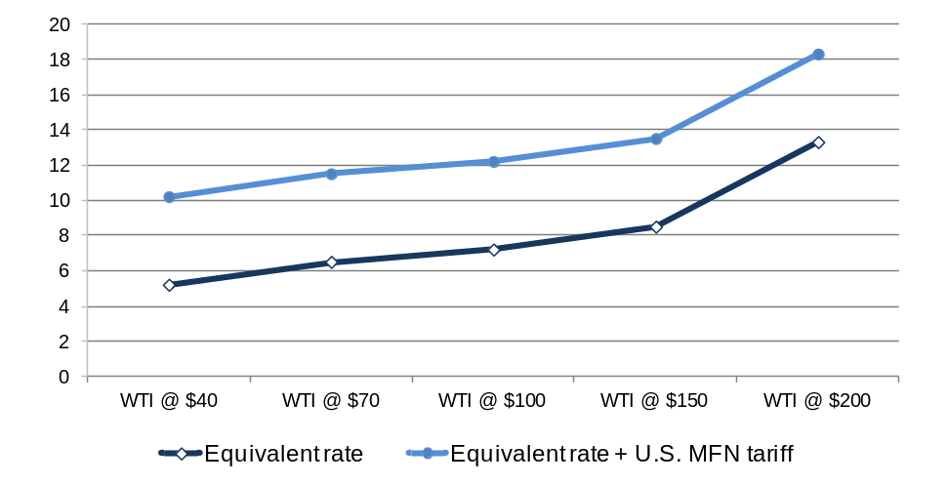
Cost competitiveness
Cost of transporting a 40’ container to the U.S. east coast
(U.S. dollars)
Equivalent tariff
(percentage)
Source: SAI Law & Economics with data from Rubin, Jeff and Benjamin Tal, “Will Soaring Transport Costs Reverse Globalization?”.

Slide 14
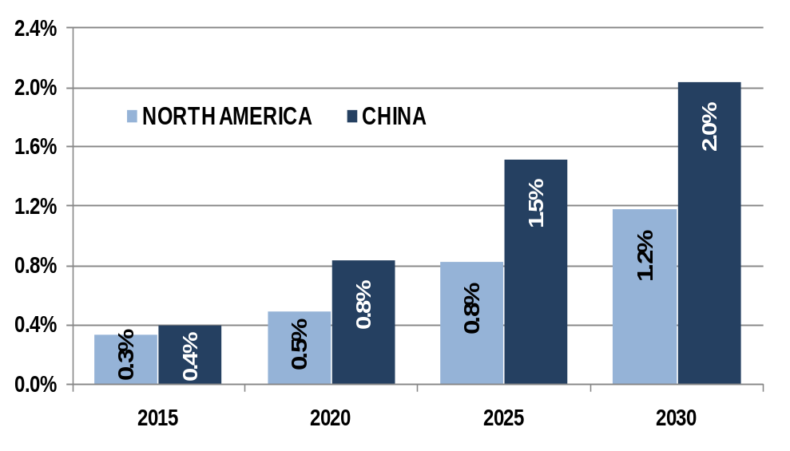
Green competitiveness
Additional investment to reach 450 Scenario
(% of GDP)
The 450 Scenario analyzes different measures to bring energy related CO2 emissions down to a trajectory that would be consistent with ultimately stabilizing the concentration of all greenhouse gases in the atmosphere at 450 particles per million.
Source: SAI Law & Economics with data from The International Energy Agency.

Slide 15
C. Competition and Transparency

Slide 16
Concentration

Slide 17
Concentration

Slide 18
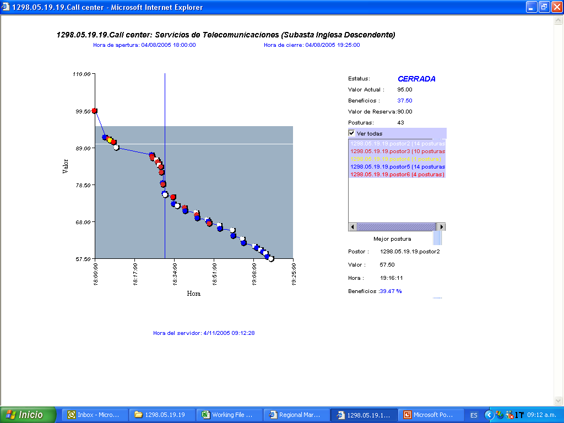
Auction theory at work
Reverse English
Dutch
Partial Lots
Vickrey
Ranking

Slide 19
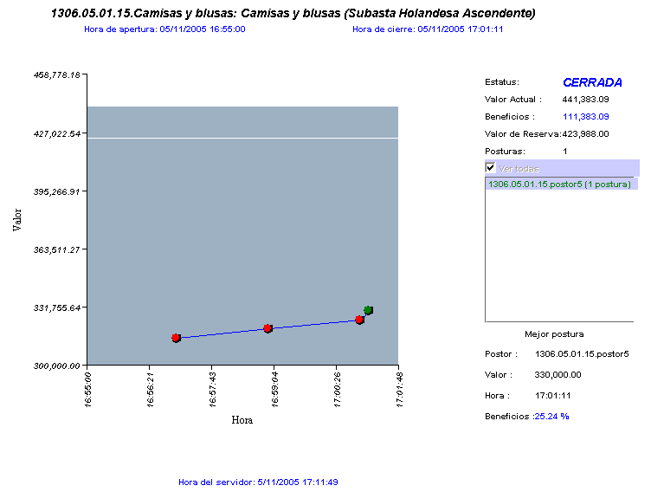
Auction theory at work
Reverse English
Dutch
Partial Lots
Vickrey
Ranking

Slide 20
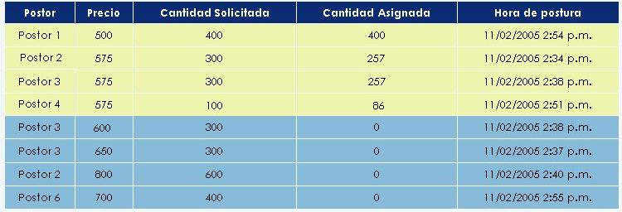
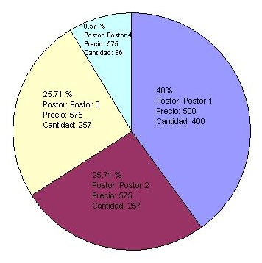
Auction theory at work
Reverse English
Dutch
Partial Lots
Vickrey
Ranking

Slide 21
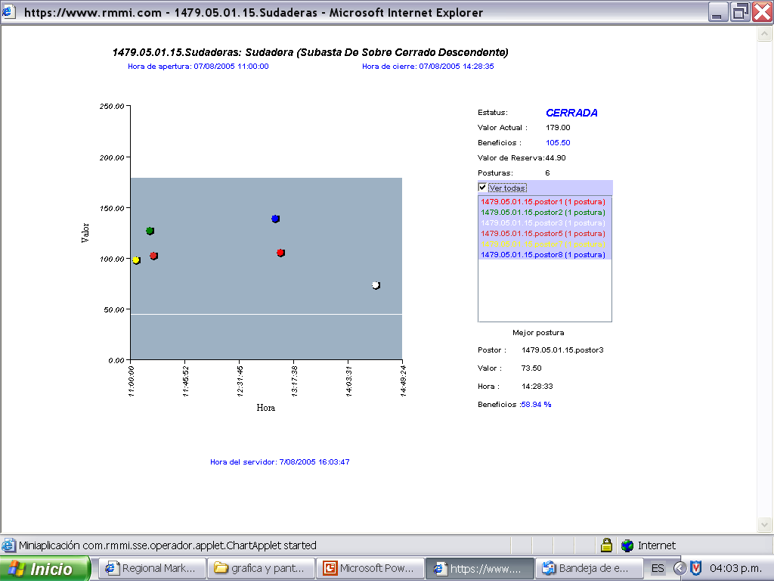
Auction theory at work
Reverse English
Dutch
Partial Lots
Vickrey
Ranking

Slide 22
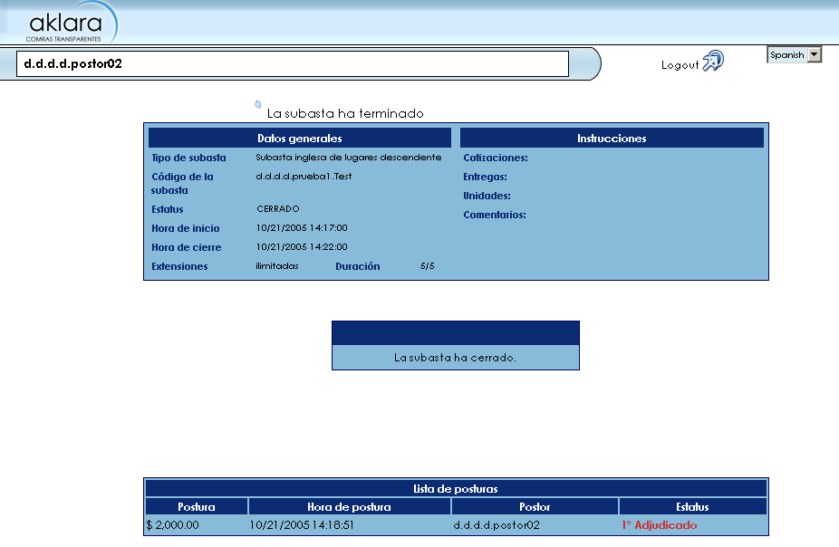
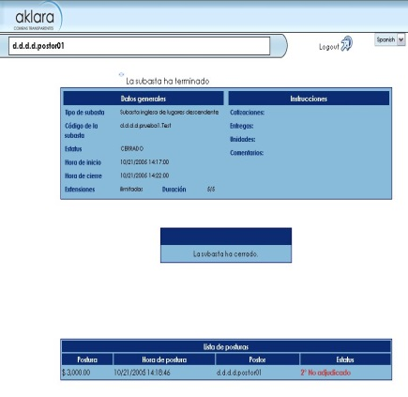
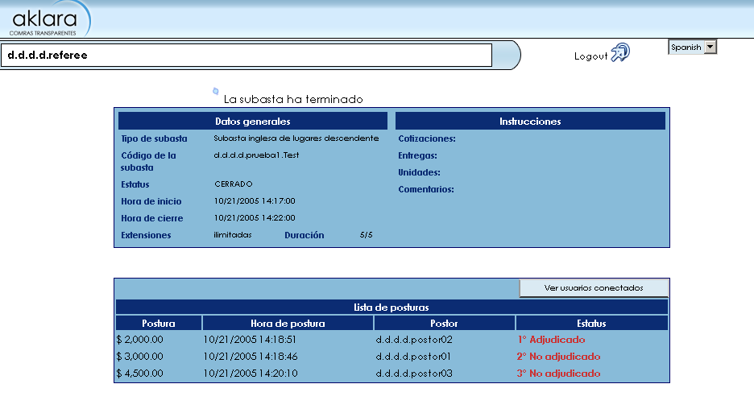
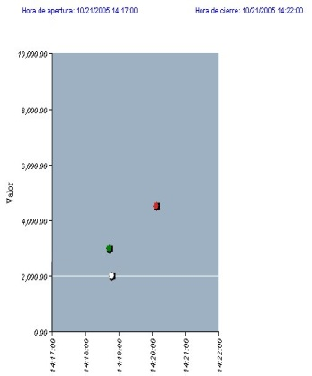
Auction theory at work
Reverse English
Dutch
Ranking:
Ranking:
1°
2°
Partial Lots
Vickrey
Ranking

Slide 23
Government procurement auctions
Through February 2015 | Total | CFE | IMSS | PEMEX | SEP
Processes | 64 | 6 | 49 | 6 | 3
Line Items | 673 | 25 | 523 | 110 | 15
Auctions | 995 | 25 | 876* | 79 | 15
Spend (Million USD) | 8,412 | 4,306 | 3,515 | 339 | 252
Benefits (Million USD) | 879 | 453 | 271 | 155 | 76
Average Savings (%) | 10% | 11% | 7% | 46% | 23%
Adjudication Rate (%) | 94% | 96% | 91% | 99% | 100%
Average Number of Bidders | 5 | 7 | 3 | 7 | 8
ROI | 271 | 453 | 54 | 298 | 139

Slide 24
Government procurement auctions

Slide 25
D. The Future: A Dual Agenda

Slide 26
Intra-regional affairs
Intra-regional
Market access Dumping + ITEC¹ vs. common competition policy (Chapter 15)
Seamless borders and transportation North America Logistics Program
Energy synergies North American Energy Program
Labor mobility vs. migration North American Labor Agreement
2012 Dependency
ratio
2030e/ Dependency
ratio
Country | Ratio²
Mexico | 10.06
US | 19.76
Canada | 23.17
NAFTA | 17.66
Country | Ratio²
Mexico | 17.45
US | 32.10
Canada | 41.40
NAFTA | 28.85
  Dependency ratios
  2012: NAFTA 11% smaller than that of the United States
  2030e: NAFTA 10% smaller than that of the United States
1/ Interagency Trade Enforcement Center.
2/ 64+ age population/ labor force population (15-64 age).
e/ Estimated.
Source: SAI Law & Economics with data from U.S. Census Bureau and National Bureau of Statistics of China..

Slide 27
Extra-regional affairs
Extra-regional
TPP Preservation of NAFTA for trade and investment flows from North America
TTIP Regional negotiation v.s. convergence

