Slide 1
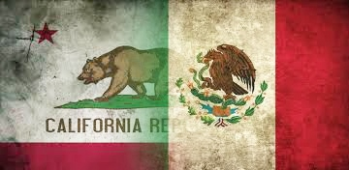
California and Mexico Trade and Investment
2015 Mexico Advocacy Day
May 5, 2015
Notes:
https://www.youtube.com/watch?v=ArKk5hbixEw

Slide 2

Expanding Hispanic Population
Notes:
https://www.youtube.com/watch?v=ArKk5hbixEw

Slide 3
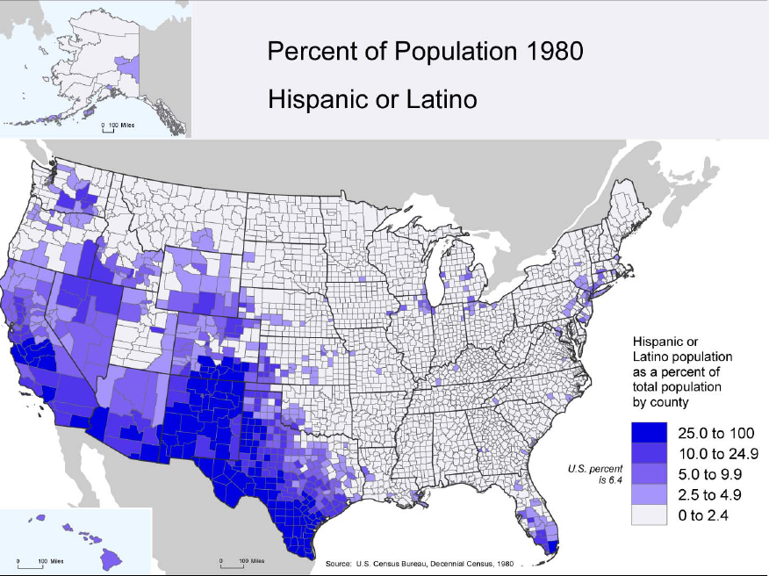
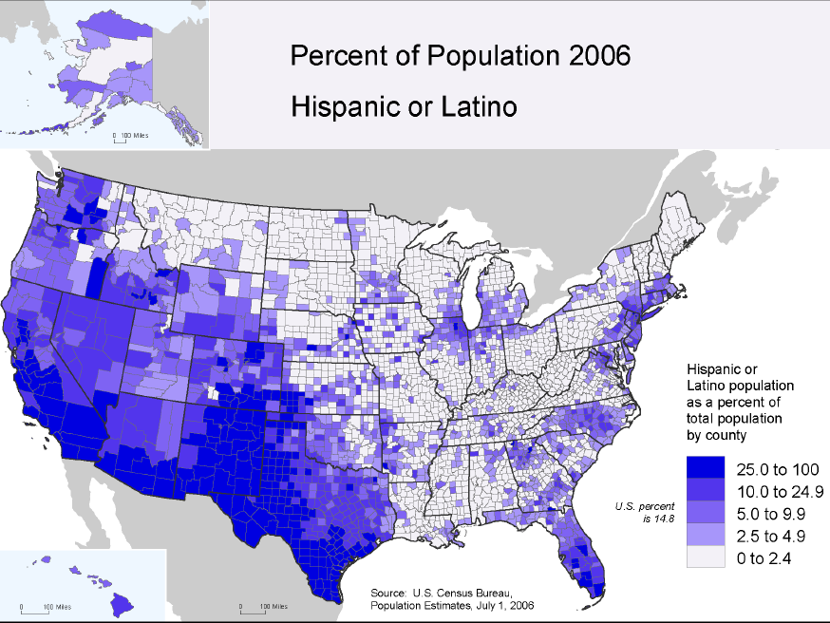
Hispanic Population Expansion in the Western US
Source: US Census Bureau - Estimate 1980 and 2006

Slide 4
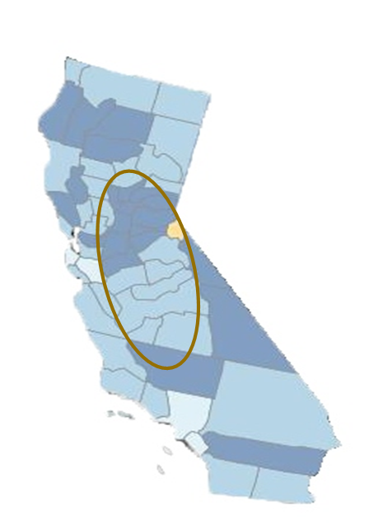
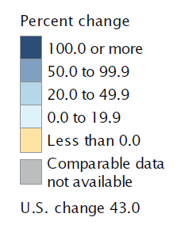
Hispanic Growth Rate in the Central Valley
Percent Change in Hispanic or Latino Population by County: 2000 to 2010
The Central Valley has experienced one of the highest Hispanic population growth rates in California
Sacramento Valley:
50.0 - 99.9 %
San Joaquin Valley:
20 - 49.9 %
Source: U.S. Census Bureau, Census 2000 Summary File 1 and 2010 Census Summary File 1.

Slide 5
California and Central Valley Population Growth
Population growth in California and its Central Valley has and will be driven by robust Hispanic growth
 | Hisp Pop | % Hispanic | Hisp Pop | % Hispanic
Region | 2011 | 2011 | 2030E | 2030E
California (H) | 14,359,500 | 38.10% | 22,000,197 | 47.37%
U.S. (H) | 51,939,916 | 16.70% | 73,080,471 | 20.10%
 | Tot Pop | % Hispanic | Tot Pop | % Hispanic
San Joaquin Valley | 3,971,569 | 48.61% | 5,381,971 | 62.27%
Sacramento Valley | 3,091,049 | 20.01% | 4,045,086 | 32.10%
Central Valley | 7,062,618 | 36.09% | 9,427,057 | 49.32%
Source: U.S. Census H = Hispanic
Notes:
http://www.dof.ca.gov/research/demographic/reports/projections/P-1/documents/Projections_Press_Release_2010-2060.pdf

Slide 6
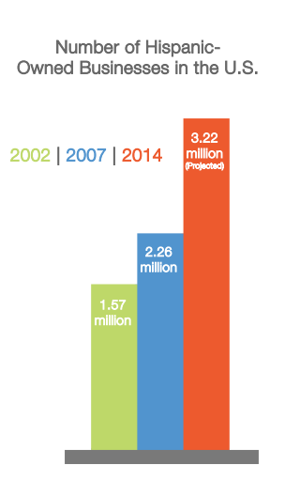
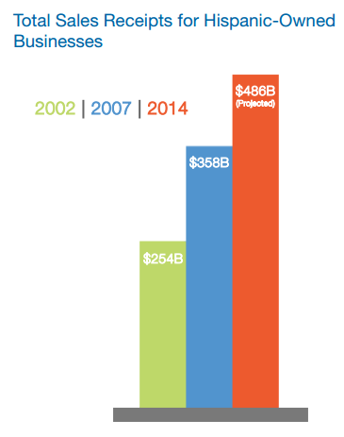
Hispanic Business Trends
75% of all Hispanic firms are concentrated in 4 states, led by California and Texas
California has 500k Hispanic owned businesses who were expected to generate $100B in sales in 2012
Source: Geoscape – “Hispanic Businesses & Entrepreneurs Drive Growth in the New Economy”
Notes:
Stats for next Survey of Business owners, summary of findings to come out July 2015 (Census)
http://www.geoscape.com/HBR/pdf/Geoscape_HispanicBusinessOwners_FINAL.pdf

Slide 7
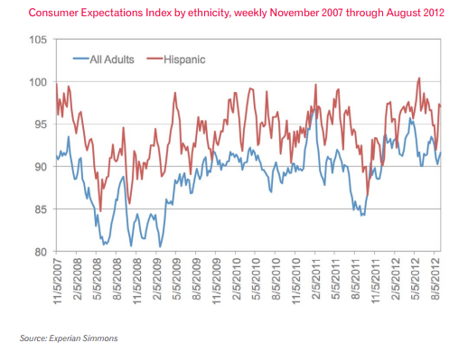
Hispanic Consumer Trends
Hispanic households accounted for $164.2B of discretionary spending in 2012, up 14% YOY
Remittances to Mexico reached $2B in July 2014, rising 8.4% YOY and marking 12 months of consecutive growth
Hispanic consumers, on average, are more optimistic concerning their personal spending outlook

Slide 8
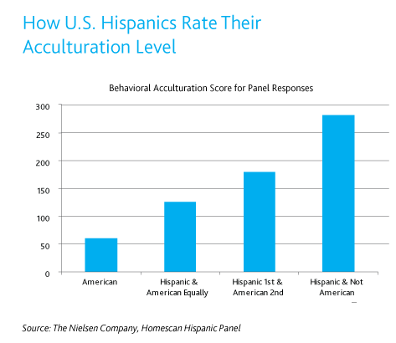
Hispanic Consumer Trends cont.
Over 60% of U.S. Hispanics are below the age of 35, with a median age of 28
  Hispanics will represent an increasingly important buying segment
Acculturation level of Mexican-Americans influence purchasing patterns and product preferences.
  Generational Acculturation – Second and Third generation Mexican-Americans are more acculturated than previous generation
  Language spoken at home and education also affect acculturation
Product | Less Acculturated | More Acculturated
Beer | Corona, Modelo Especial | Imported (various)
Cereal | Cheerios, Corn Flakes | Raisin Bran, Cap'n Crunch
Condiments | Goya, Chili | Ketchup, Lawry's
Toothpaste | Colgate | Crest, Aquafresh
Soap | Zest, Shower to Shower | Bath & Body Works
Cosmetics | Avon, Mary Kay | Lancôme

Slide 9
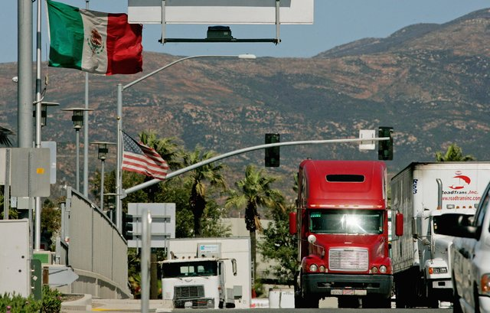
Increased Economic Integration between California and Mexico

Slide 10
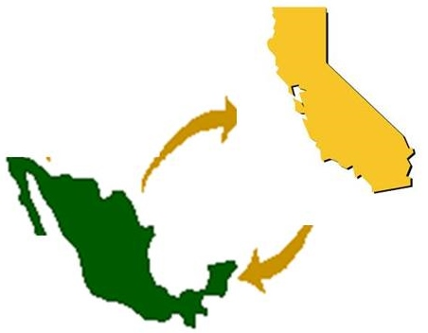
Growing Economic Integration
Mexico is California’s #1 export partner with $25.4B, up 6% YOY.
California trade with Mexico has grown 341% in the last 20 years and is expected to grow 7-10% annually.
Mexican Exports to the California increased $5.0B in 2014, representing a 14% increase.
692,240 jobs in California rely on trade with Mexico
Mexico and California’s Economy and Commerce
(USD$ Billions)
 | GDP |  | Commercial Flow between California and Mexico
Country | Mexico | California | Exports | Imports
2000 | $865.2 | $1,320.0 | $17.5 | $20.3
2014 | $1,296.6 | $2,287.0 | $25.4 | $41.3
% Change | 49.86% | 73.26% | 45.14% | 104.43%
Notes:
https://beaconecon.com/images/uploads/beacon_buzz/California555.png

Slide 11
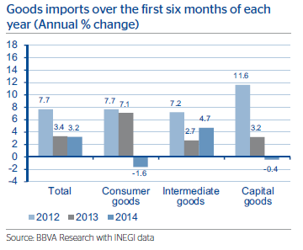
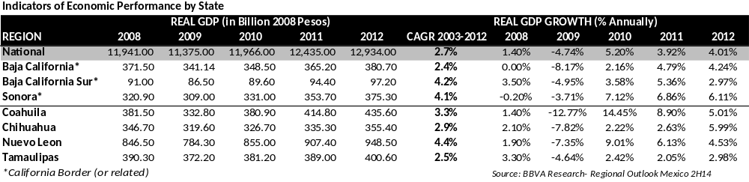
The State of Mexican Trade
Strong US exportation of Intermediate Goods to Mexico
  Top Exports from California include: computers and electronics, transportation, machinery, chemicals, agriculture
Consumer and capital goods backed up in early 2014, but have grown historically
Above average economic performance for Mexican border states

Slide 12
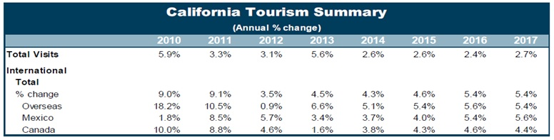
California - Mexico Tourism
California is the #1 Tourism destination for Mexican citizens,
  Mexicans represented 50% of all international tourists to California
  2013: 7.5M Mexican tourists, up 3.4% YOY, with $3B in total spending, up 7.6% YOY
Tourism is Mexico’s 5th largest source of revenue, generating $13.8B in foreign exchange inflows, up 8.5% YOY
  Accounts for 12.5% of GDP and 13.9% of total employment
2013-Received 24M international tourists and 54M “day trippers”
  20.3M trips by American, an increase of 9% year over year
Notes:
http://www.desertsun.com/story/news/2014/09/16/tourism-mexico-california/15719609/
http://www.deanrunyan.com/CATravelImpacts/CATravelImpacts.html
http://industry.visitcalifornia.com/media/uploads/files/editor/California%20-%20Mexico%20TTB%202013%20S3.pdf
http://industry.visitcalifornia.com/media/uploads/files/editor/CAIntlReport2012(1).pdf
http://industry.visitcalifornia.com/media/uploads/files/editor/2013%20CA%20International%20Visitation%20and%20Spending%20Estimates-VCA%20Fin
http://industry.visitcalifornia.com/media/uploads/files/editor/CA%20Forecast%20August%2019%202014%20-%20client.pdfal(1).pdf

Slide 13
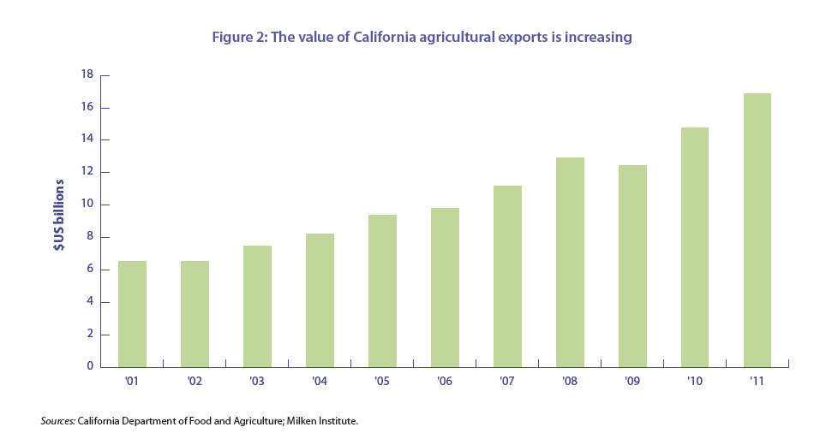
Central Valley and the Mexican Economy
In 2014, California exported over $664M in agricultural products to Mexico
Despite the drought, Agricultural exports to Mexico rose 2.6% in 2014
In 2010, it is estimated that California food processors imported over $5.5B in fresh fruit and vegetables
U.S. farmers cultivate about 200,000 acres of Mexican soil for off-season fresh produce
California Agricultural Exports ($ Millions)
PARTNER | 2008 | 2009 | 2010 | 2011 | 2012 | 2013 | 2014
México | $ 474.24 | $ 372.34 | $ 407.60 | $ 432.53 | $ 577.84 | $ 647.41 | $ 664.11
NAFTA | $ 2,428.85 | $ 2,331.87 | $ 2,625.53 | $ 2,793.95 | $ 2,985.45 | $ 3,254.54 | $ 3,260.65
World | $ 7,678.59 | $ 7,847.39 | $ 9,354.25 | $ 10,612.76 | $ 11,976.21 | $ 13,782.28 | $ 13,598.33
Source: International Trade Administration (US Dept. of Commerce)
Notes:
http://www.organic-world.net/fileadmin/documents/yearbook/2012/fibl-ifoam-2012-summary.pdf organic producers stat

Slide 14
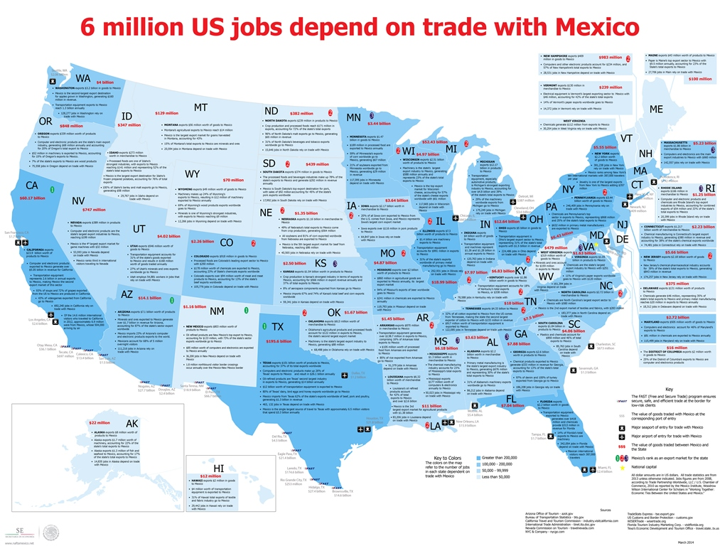
NAFTA – Benefits of U.S. and Mexico’s Trade Partnership
Notes:
https://www.youtube.com/watch?v=ArKk5hbixEw
https://www.youtube.com/watch?v=ArKk5hbixEw

Slide 15













Mexico - U.S. Institutions

