Slide 1
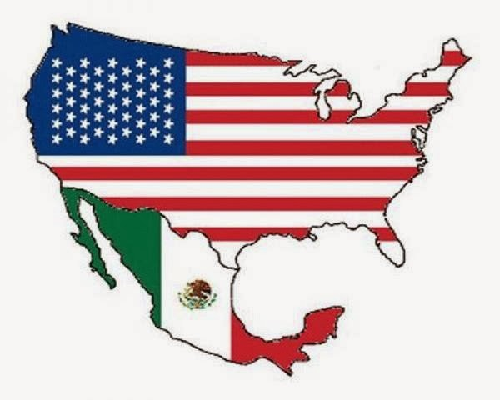
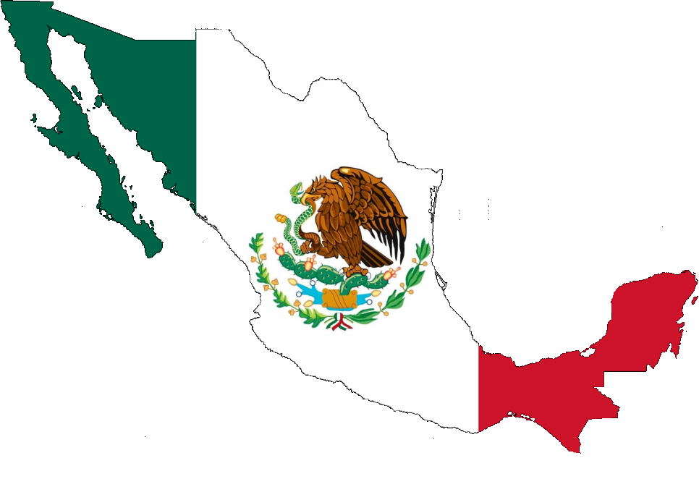
MEXICO/ FROM CLOSED TO OPEN

Slide 2


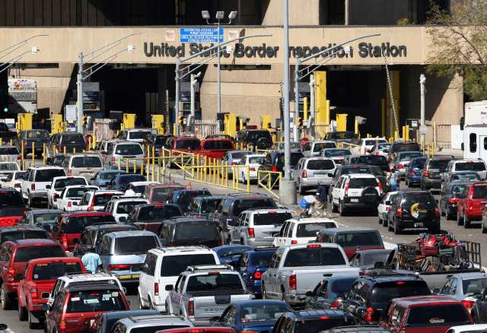


TRADE BEFORE NAFTA

Slide 3

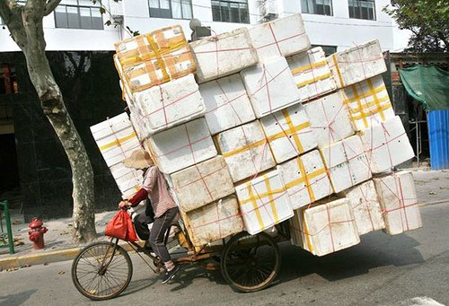


TRADE AFTER NAFTA

Slide 4
NAFTA FOR MEXICO
13th EXPORTER AND 15TH ECONOMY IN THE WORLD.
TURN ITS EXPORT MIX FROM 60% OF EXPORTS BEING OIL RELATED BEFORE NAFTA TO 83% MANUFACTURED GOODS BY 2015.

Slide 5
NAFTA FOR THE USA
5 MILLION JOBS DEPEND ON THE TRADE WITH MEXICO
200,000 JOBS PER YEAR CREATED BY NAFTA
40% OF MEXICAN EXPORTS HAVE US CONTENT
US EXPORTS TO MEXICO DOUBLE OF THOSE FROM CHINA
MEXICO IMPORTS MORE FROM THE US, THAN GERMANY, SPAIN, ITALY, FRANCE, JAPAN AND UK COMBINED
MEXICO THE #1 MARKET FOR EXPORTS FROM CALIFORNIA, AZ, NM AND TX; AND #2 FOR 23 OTHER US STATES.

Slide 6
NAFTA FOR BOTH
* 40% OF MEXICO’S EXPORTS HAVE US CONTENT
* EXAMPLE OF TRADE: AUTOPARTS 8 TIMES CROSSES THE BORDER
* 500 BILLION TRADE A YEAR
* 1.5 BILLION TRADE PER DAY
* 62 MILLION PER HOUR
* WHAT IS GOOD FOR MEXICO IS GOOD FOR THE US; US NEEDS A STRONGER NEIGHBOUR AND PARTNER

Slide 7
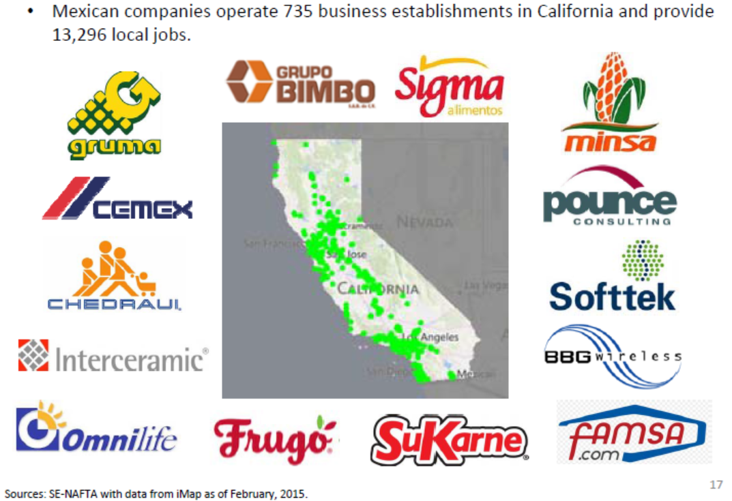
Mexican investment supports jobs in CA

