Slide 1
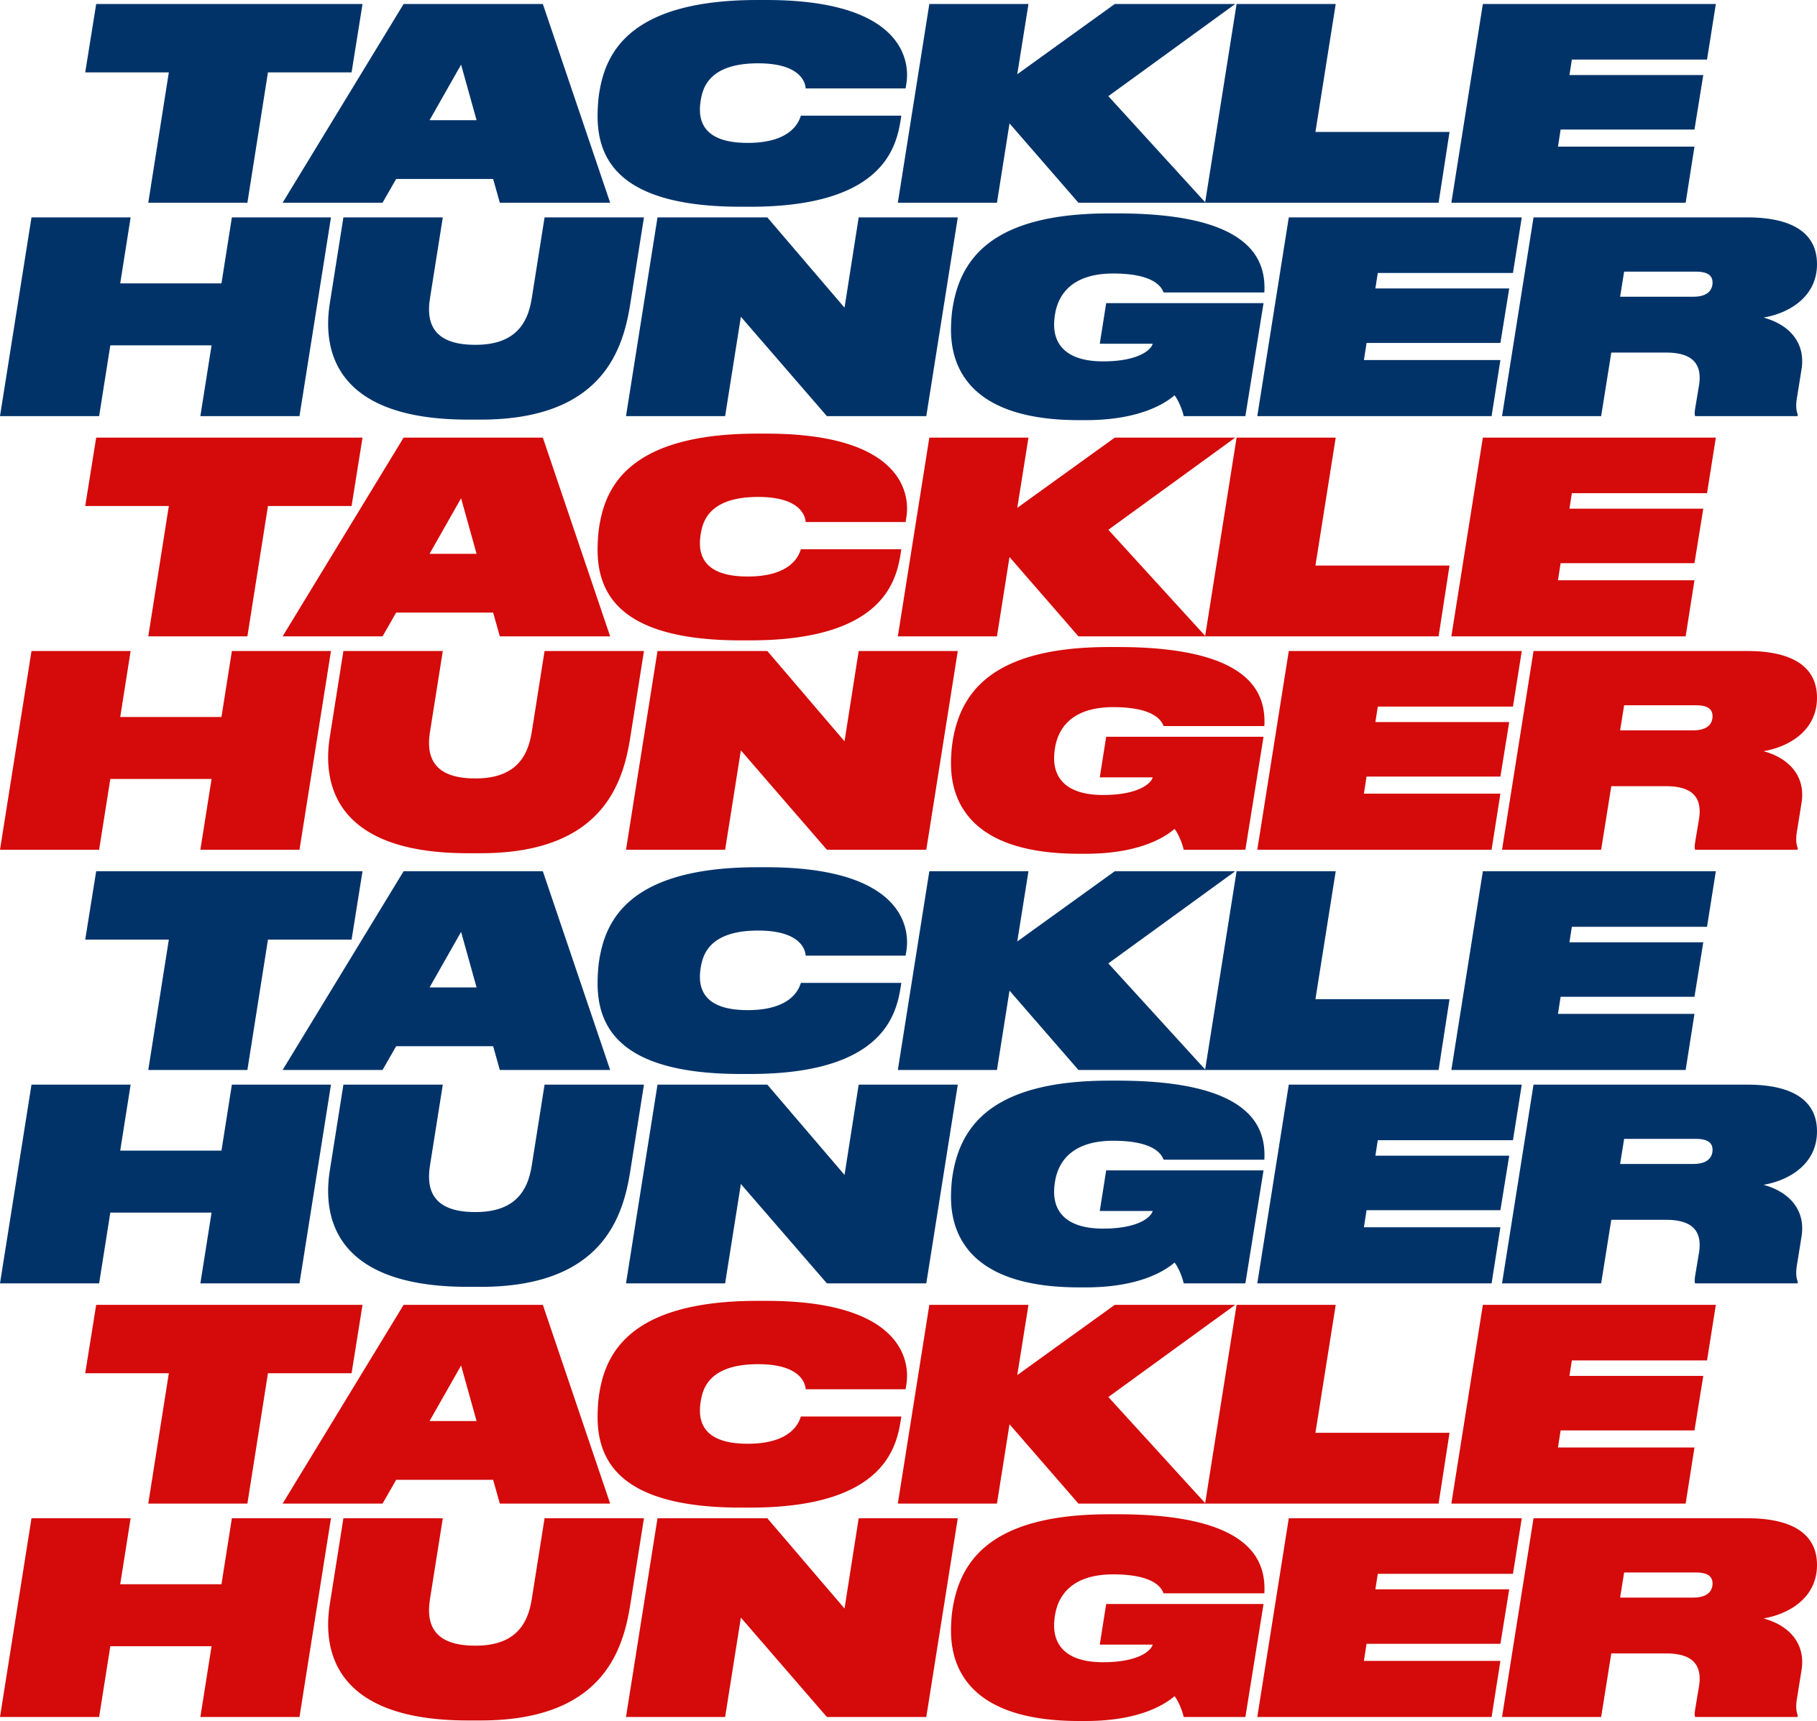
Supporting Programs that Feed Our Food Charities

Slide 2
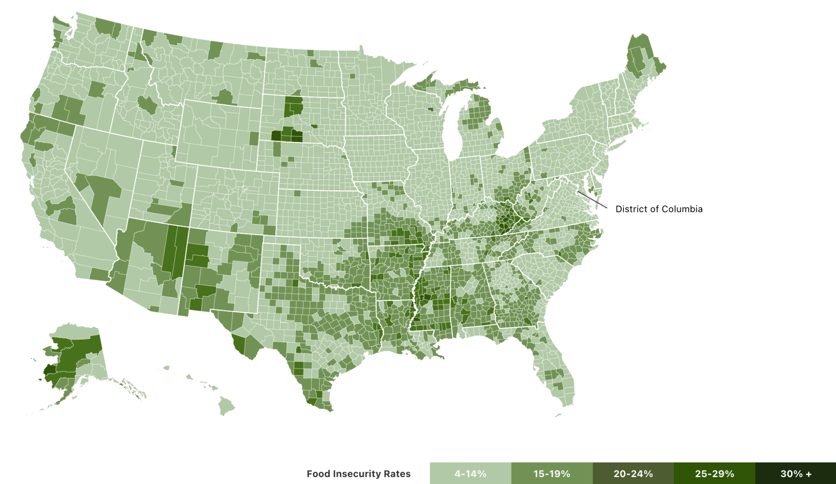
At least 80K food charities large and small *independent and part of Feeding America Network More than 800 college and university campuses have food pantries operating Thousands of school food pantries feed families everyday
Hunger & Food in the US
40M food insecure people in the US

Slide 3
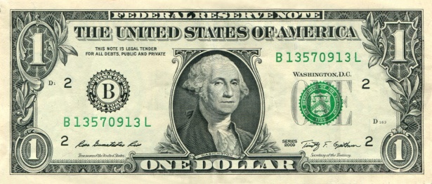
What if? 110M Super Bowl viewers gave just $1. (aka about 3 wings or 1 slice of pizza)
That is? 330M meals for those in need. Close to eight meals for each food insecure American.
During our Annual Souper Bowl of Caring Event, We Ask:
Just this one event has created over $175 million for food charities in all fifty states using the energy of the Big Game.

Slide 4
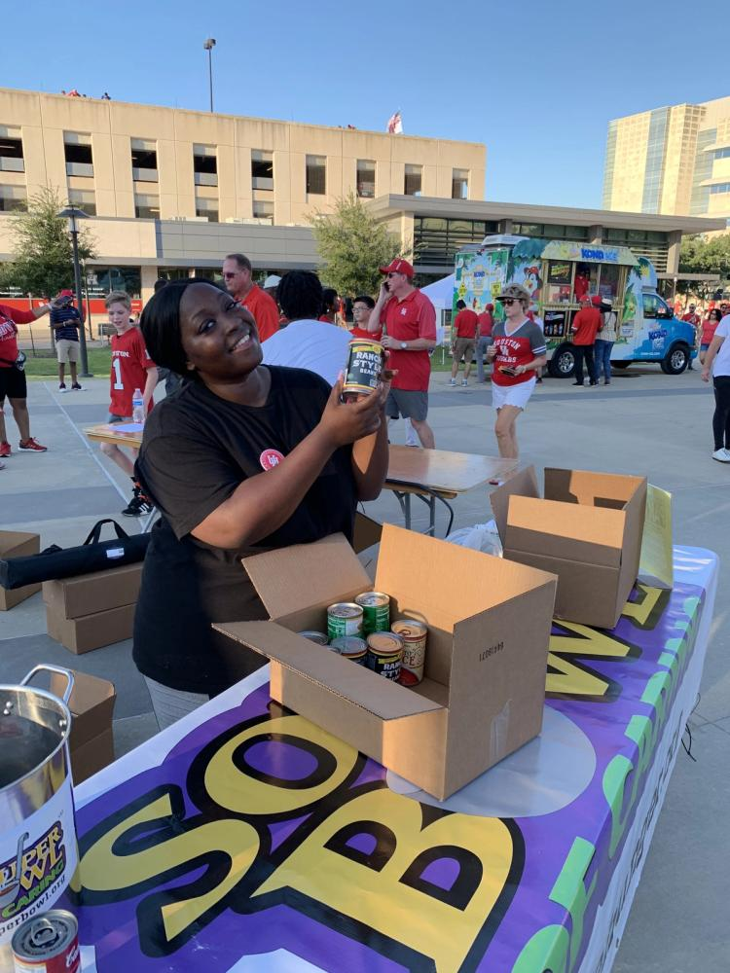
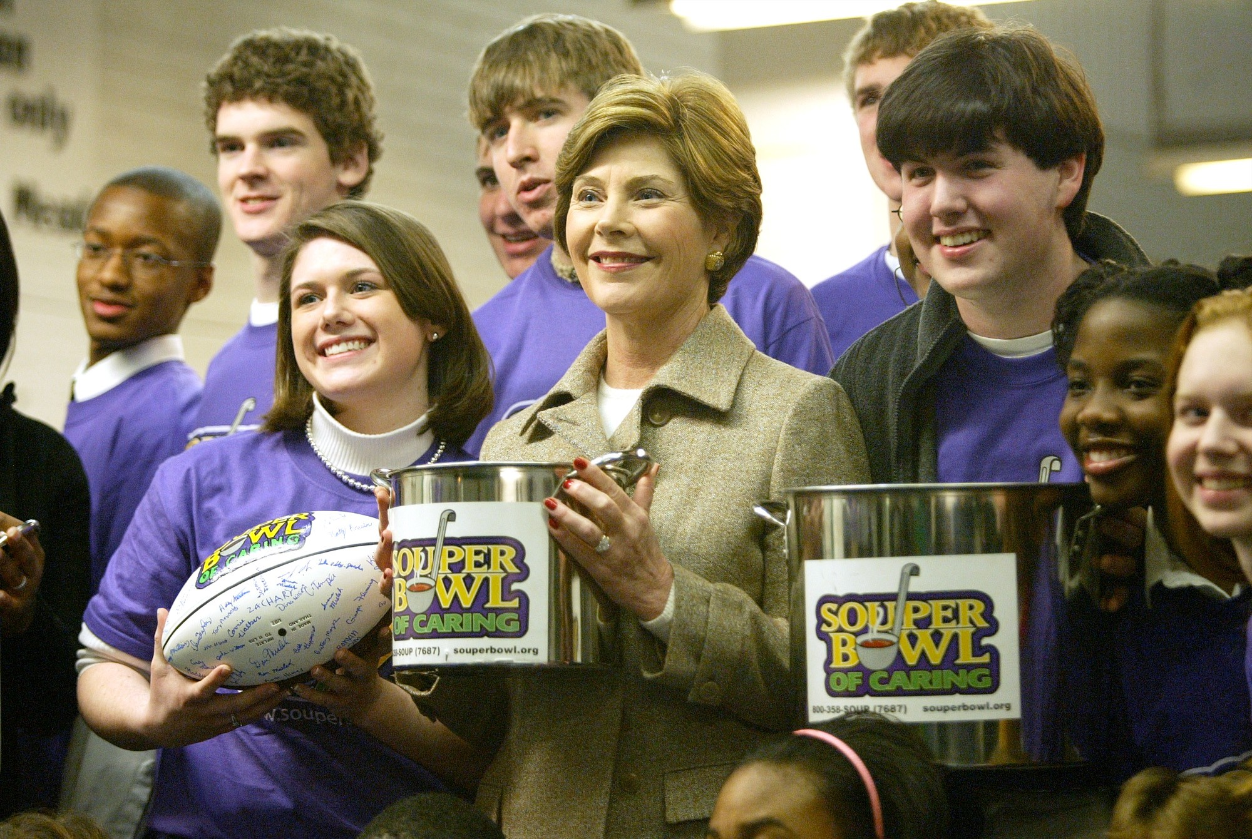
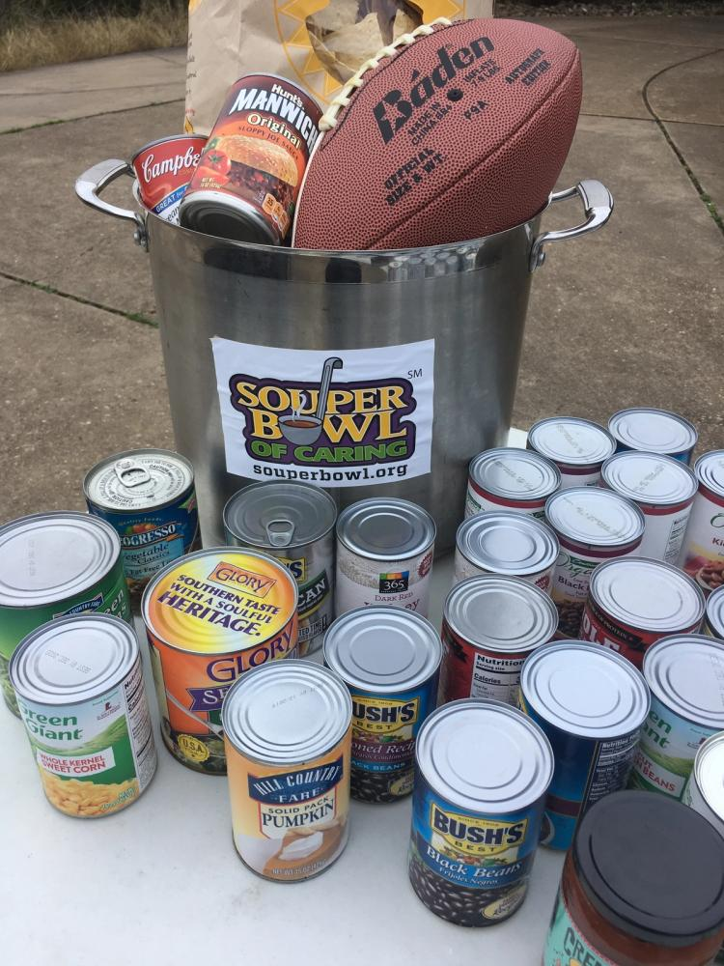
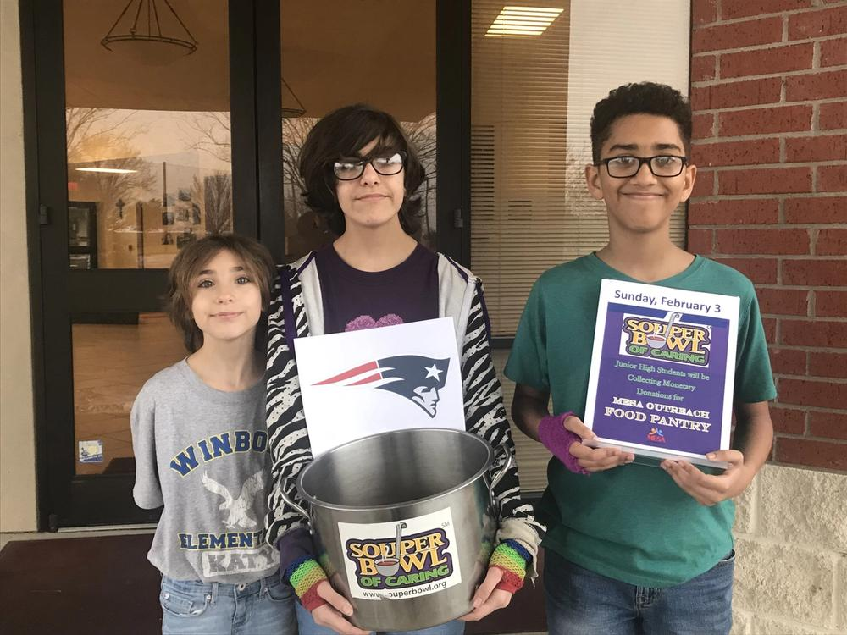
Thousands of groups every year participate in programs of Tackle Hunger, especially our signature event, the Souper Bowl of Caring.

Slide 5
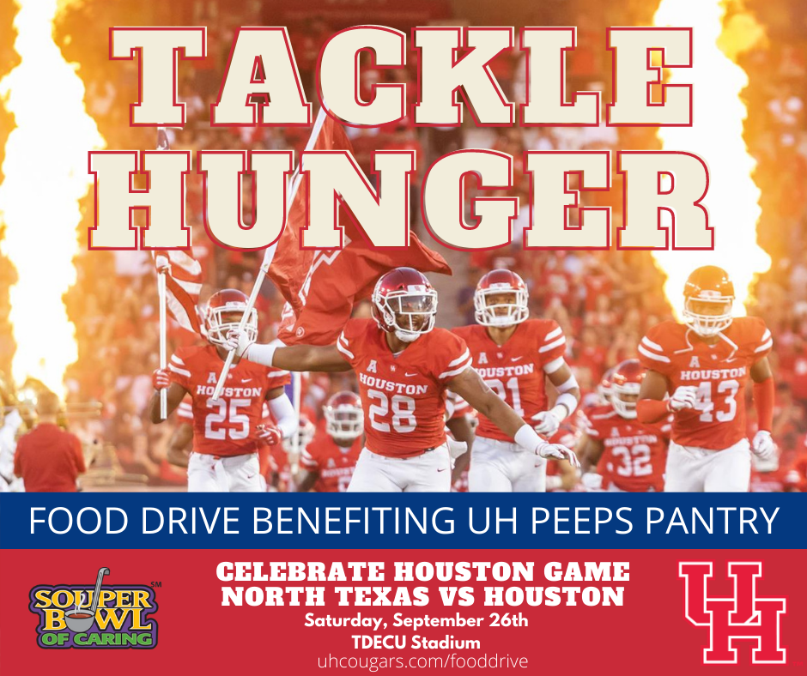
The Tackle Hunger Challenge
Harness the energy of K-12 and college athletic events to support school food programs. What if everyone gave just $1 to help tackle hunger?
Through Tackle Hunger, school pantries fill their shelves and get students fed.

Slide 6
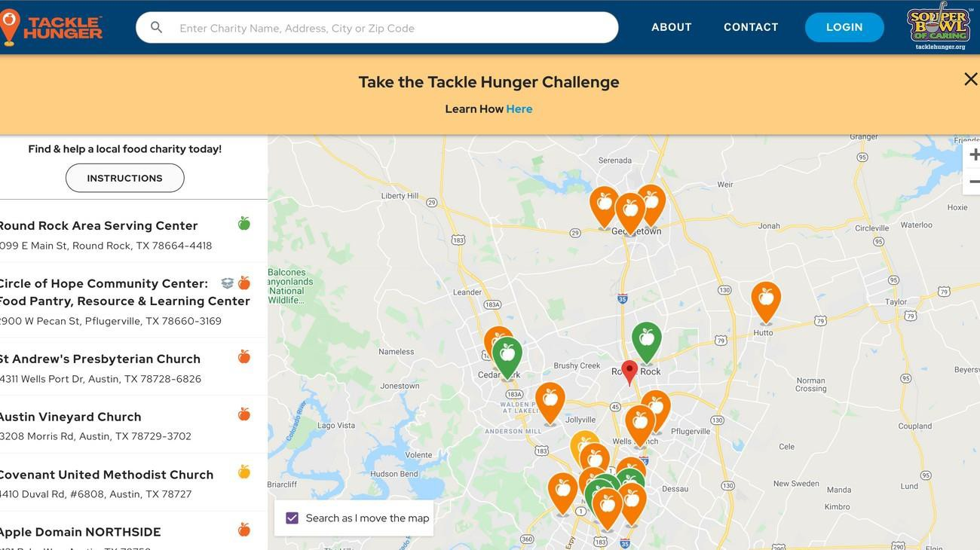
The Tackle Hunger Map
Creates and improves efficiencies among food charities, people in need and those looking for ways to make a difference and tackle hunger in their own community.
Interactive map that pinpoints food charities and their needs in real time to funnel community resources to where they are needed most.
Successfully used in programs built for the Department of Defense to get FEMA resources to where they are needed most in emergency events.

Slide 7
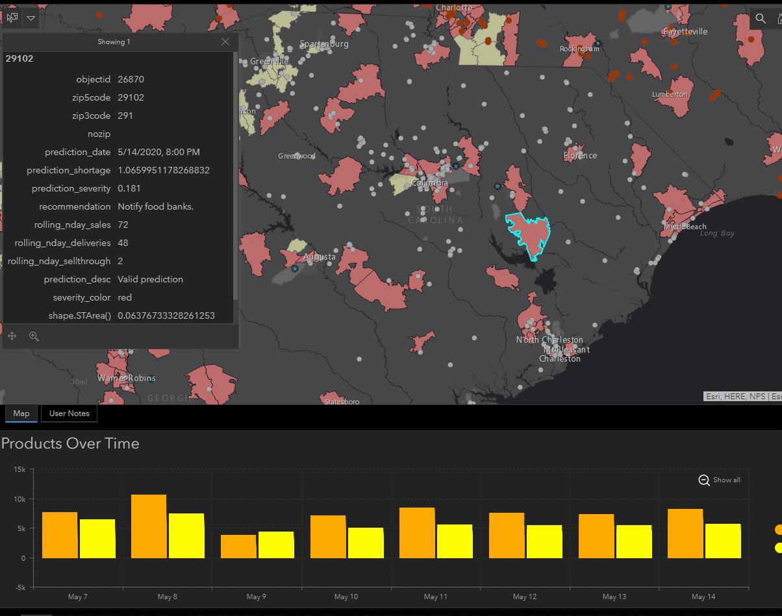
The Tackle Hunger Map
It is currently helping:
Clients in need to find where charities can help them.
Volunteers who might be able to help in their own neighborhood.
Donors to directly help their neighbors in need.
Mapping is being used to help us understand areas of vulnerability where we need to find new ways to support those in need.

Slide 8
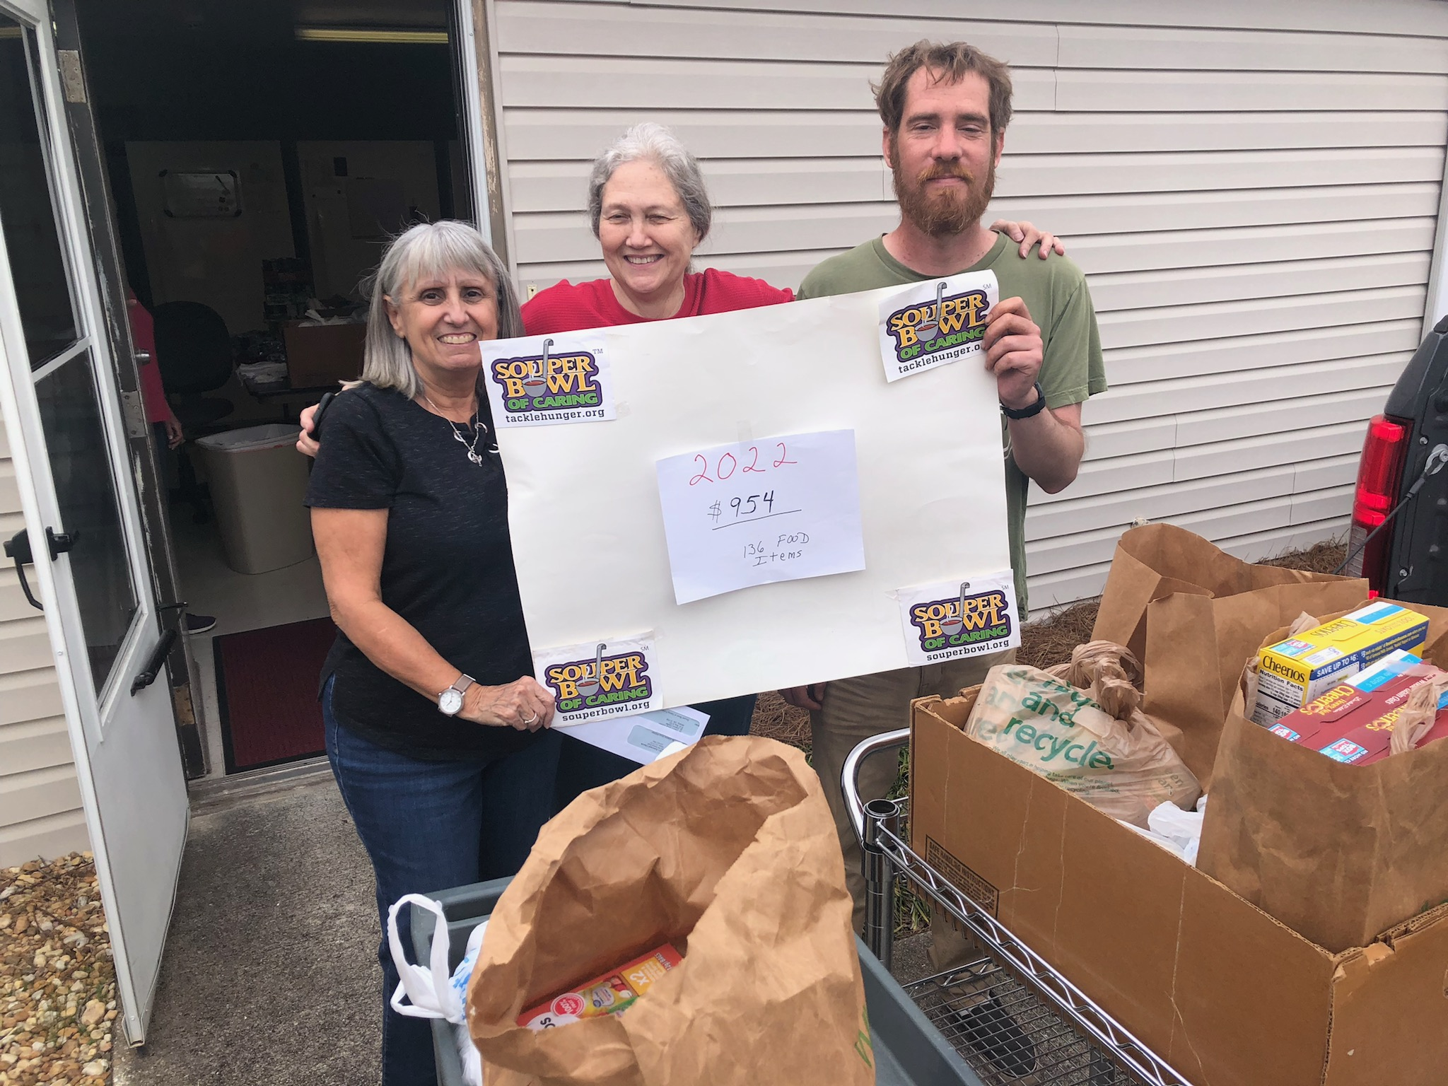
Our Work:
Building our map to increase collaboration AND donations to SPECIFIC food charities in need.
Offering fundraising programs that can freely be used to support feeding people in need.
A network of charities, grassroots organizations and schools to support local food charities.

Slide 9
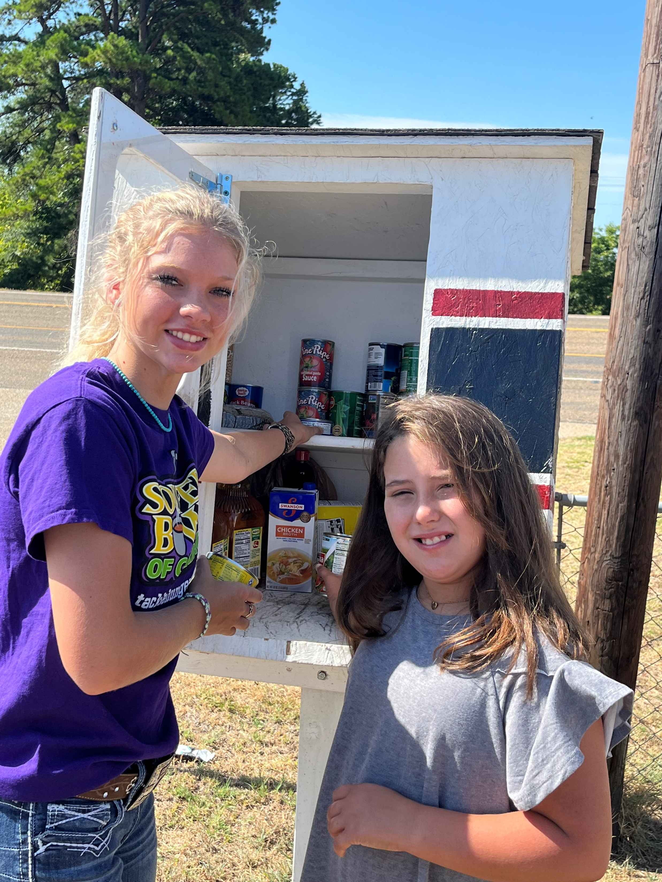
Just over the past 5 years, Souper Bowl of Caring and the Tackle Hunger Movement has created over $37M for thousands of local food charities. Join us! Let’s together!
Go to www.tacklehunger.org to learn more about our campaigns that YOU can use to fundraise for your charity, to learn about the Tackle Hunger Map, or to donate to our work.

