Slide 1
Assessing practical skills in GCSE Science
Lisa Mooney
Scan here to download today’s materials
Notes:
QR code to open electronic pdf versions of booklet & powerpoint? (paper copies of booklet & slides (without notes) available for delegates) – do I ask molly to do this?

Slide 2
What this session is about
Practical questions in the exams:
What kinds of questions are asked to assess students’ understanding of practical work?
What are the most common challenges students encounter with practical questions?
Designing effective practical lessons:
Taking a holistic approach
Planning
Modelling the approach
Notes:
This is a relevant area of assessment to look at as we identified that practical skills presented an area of challenge for students across the 2024 GCSE series. WS are for development for few years
We identified that students found:
Writing valid methods, recalling the names of some practical procedures, applying knowledge to unfamiliar contexts amongst the challenging areas.

Slide 3
Ofqual requirements for assessment of practical work
Apparatus and techniques criteria (ATs): list of apparatus students need to be able to use or techniques they need to be able to carry out.
Required practicals (RPs) which cover all the ATs. These are used to assess the ATs assigned to a particular RP.
Working scientifically (WS) is assessed through practical questions.
For each specification, 15% of the marks will cover different aspects of practical work through the RPs.
Notes:
This is what we have to assess in the context of practical work: the rules from Ofqual.
First, Ofqual set out for each subject a list of apparatus that students need to be know, and be able to use appropriately and experimental techniques they should be able to understand and apply. These are called the Apparatus and techniques; and are listed in a table in the section on practical assessment in the specification (section 8 in the separates, 10 in Trilogy). We assess the ATs in a practical context (not always a RP).
See booklet pages 5-7
We also assess the Working Scientifically criteria (section 3 of the specification both separates & trilogy), often in a practical context: the experimental skills and strategies listed in WS2 and the analysis and evaluative skills in WS3.
See booklet pages 8-12
We then devised the Required practicals, which, when you carry these out, you will ensure that your students have the opportunity to access all of the ATs listed in the specification. See booklet pages 16-18
About 15% of the marks for each exam cover different aspects of practical work, usually (but not always) in the context of a RP.

Slide 4
How practical skills are assessed
Assessment of practical skills in GCSE Science consists of three components:
Apparatus and techniques (set by the DfE)
Required practicals (designed to deliver the ATs)
Working scientifically
These components are assessed at all levels of demand, using our full range of question types, across all three assessment objectives (AOs).
Any question will often cover more than one AO and will assess content as well as practical skills and maths skills.
So, few questions focus solely on a required practical; rather, whole questions assess a number of different aspects.
Notes:
So, these are the three components of practical skills that we assess in our written exams:
The ATs,
knowledge gained by doing the required practicals and
working scientifically.
We assess all of these at all levels of demand, using a range of question types from MCQ to extended response, and across all three AOs.
A question is made up of different items – the individual questions within (eg 1.1, 1.2 are items of Question 1).
Each item may target a
different part of the specification content,
a particular skill and
a particular AO.
So any one question could cover a lot of skills and content.
Let’s have a look at some from the 2024 series.

Slide 5
Examples from 2024

Slide 6
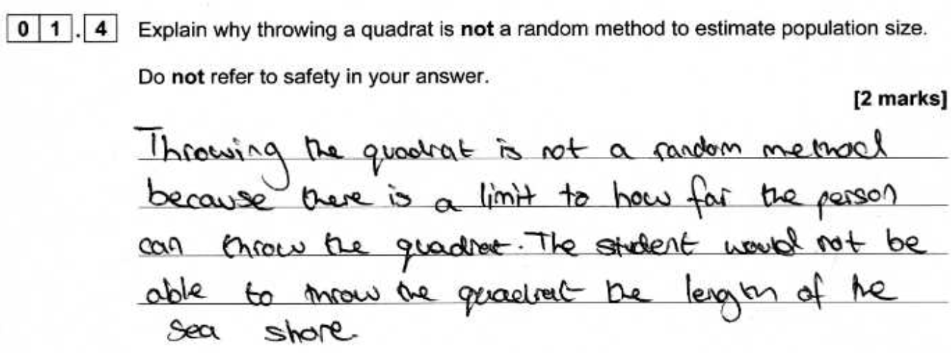
Biology
Example 1: B2, Questions 1.4, 1.5 [H]/ Questions 5.4, 5.5 [F]
Discussion point 1 (page 19)
What do you think the barriers were to success here?
Discussion point 2
How many marks would these responses gain?
1 mark as no reference to population size.
0 marks as there’s no correct description of how to use the tape measure or placement of the quadrat.
Notes:
Page 19-25 show selected practical context items from the 2024 series.
All of these examples have been chosen as they proved difficult for students.
On average, 80% of foundation tier and 43% of higher tier students got 0 marks or did not attempt these 2 items.
Discussion point 1
Example 1 page 19-20.
What do you think the barriers were for a significant number of students not accessing these 2 items?
Give delegates thinking time – take responses
Feedback
lack of practical work
Misconceptions
misunderstanding of the terms random, population
Discussion point 2
On click
show student responses for delegates to mark. Page 19 in booklet
On click
1.4 – 1 mark for the limit to how far student can throw, but no reference to population size
1.5 – 0 marks as they did not correctly describe how to use the tape measure or describe correct placement of quadrat
See examiners report P20
01.4 Most students could give a reason for not throwing the quadrat and gain the first mark. Usually, students stated throwing could be biased. Very few could explain why this was a problem. References to the effect it would have on the population estimate were rare. Some students demonstrated the misconception that throwing quadrats is an appropriate sampling method. Others stated that the issue is that the quadrat could sample the same area twice, which was not correct, because that could also occur with a random method.
01.5 Some students had knowledge of using a random number generator on their calculator or phone and could describe the use of coordinates on the shore. Many students incorrectly referred to throwing in random directions or being blindfolded. These are never appropriate methods for sampling. Others demonstrated the misconception that choosing locations with the most limpets would be appropriate. Some confusion between quadrats and transects was seen.

Slide 7
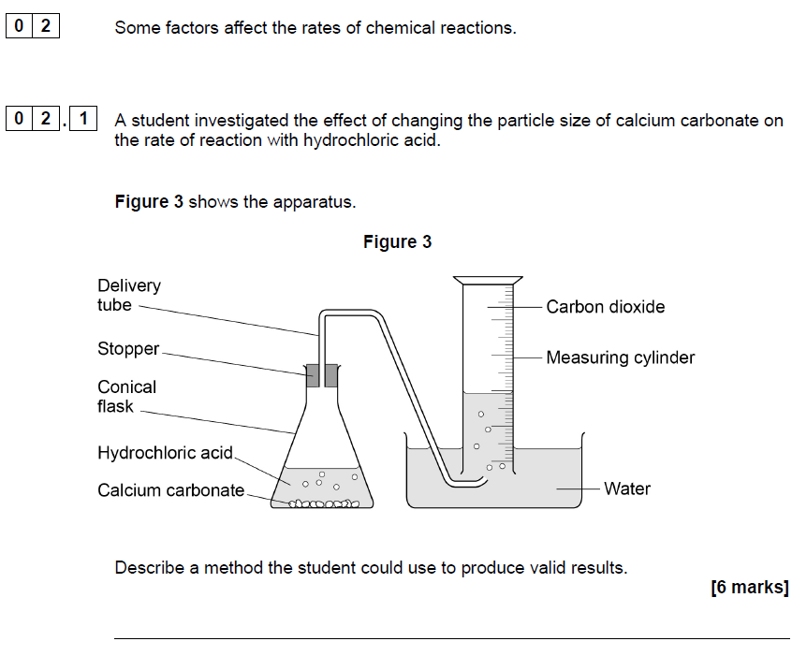
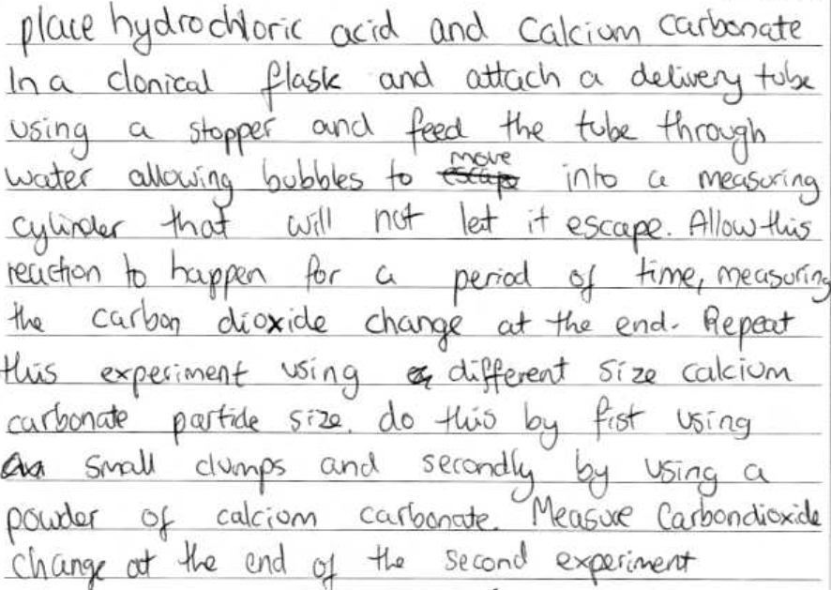
Chemistry
Example 2: C2, Question 2.1 [H]/ Question 7.1 [F]
Discussion point 1 (page 21)
Which AOs do you think are being assessed here? What is a valid method?
Discussion point 2
How many marks would this response gain?
4 marks awarded.
The student hasn’t achieved Level 3 as they haven’t identified the period of time/volume of gas. The mass of calcium carbonate hasn’t been controlled.
Notes:
Example 2 page 21-23.
70% of foundation tier and 20% of higher tier students did not write a credit worthy response or they did not attempt this question.
Discussion Point 1
What AOs are being assessed in this item? What is a valid method?
Feedback
See markscheme on page 23 – AO2 (applying knowledge & understanding of scientific enquiry, techniques & procedures) AO3 (analyse information & ideas to develop & improve experimental procedures) are being assessed.
A valid method must be written to access level 3 which is sequenced logically. Validity includes a method which allows the affect of independent variable to be observed in dependent variable; varying only the independent variable & measurement of the dependent variable; range of independent variable; controlling other variables which might affect the dependent variable. Allows a conclusion to be made which meets the aim of the experiment.
Discussion point 2
On click show student response for delegates to mark.
See Page 22 in booklet 7 mark scheme on page 23
Feedback
On click 4 marks. Response does reach level 3 as time intervals or fixed volume of gas have not been specified. The mass of calcium carbonate has not been controlled.
See examiners report P23
To reach Level 2, three key steps, or two with control variables, were required. To achieve Level 3 marks, all key steps and control variables were needed. The two most common steps identified were adding the hydrochloric acid to the calcium carbonate in the conical flask and attaching the stopper and delivery tube. Many students could not then access Level 3 as they often referred to ‘counting the bubbles of gas’ or to ‘reading the volume when the reaction had finished’, both of which would not allow a valid result to be obtained. Another common response was to ‘repeat the experiment changing the mass of calcium carbonate’ instead of using different-sized pieces with the same mass. This once again limited the response to Level 2, even if control variables were identified.
A significant number of students did identify one or more control variables, but only listed one or two key steps, again limiting their responses to Level 2. Only a minority of students were able to obtain 6 marks.

Slide 8
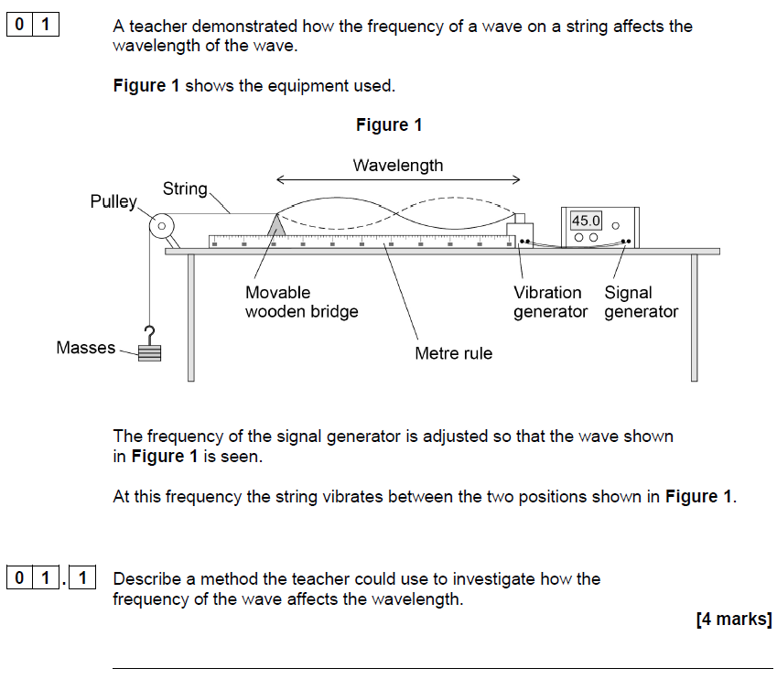
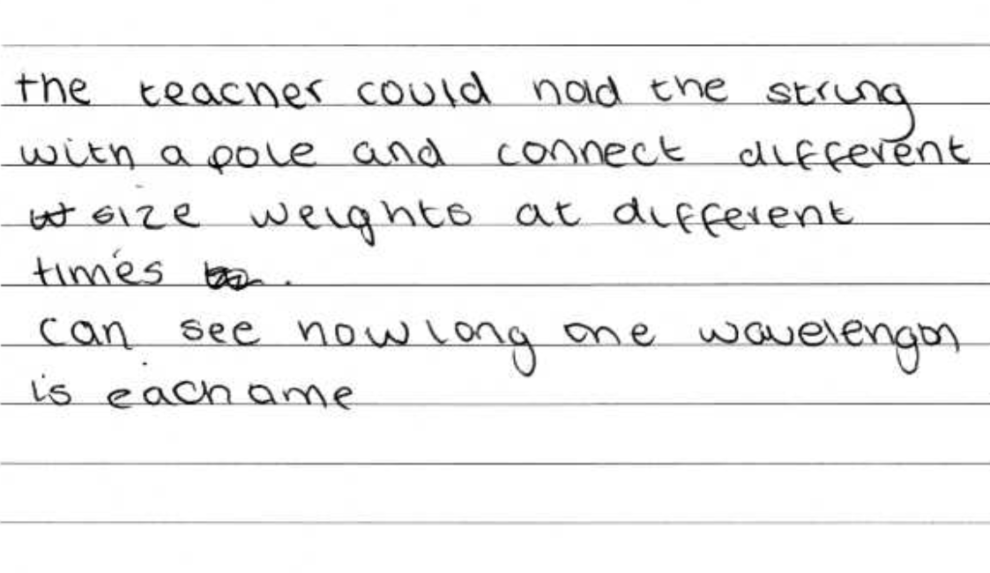
Physics
Example 3: P2, Question 1.1 [H]/ Question 6.1 [F]
Discussion point 1 (page 24)
What approaches do you take to teach students to apply their learning to other contexts?
Discussion point 2
How many marks would this response gain?
0 marks as the method would not lead to valid outcome.
Notes:
Example 3 page 24-25
Students on both F & H tier found this question difficult. 77% of F tier and 41% of H tier students did not write a credit worthy response or did not attempt this question.
Discussion Point 1
Which RP is this based on? What approaches do you take?
Feedback
Give delegates thinking time – take responses –
RP 20 (trilogy) or RP 8 (separate physics) – waves in a solid/ ripple tank.
RP are opportunities to address skills & not just the task in hand. You could:
discuss variables
alternative methods
give students lots follow up exam questions which address associated skills
Discussion Point 2
On click show student response for delegates to mark.
Response is on Page 25 in booklet, mark scheme is also on page 25
Feedback
This response scored 0 marks as the method written would not lead to a valid outcome. (it does not link the variables or measure outcomes)
See examiners report P25
[The majority of] students found this question difficult with 10% gaining more than 2 marks. Although based on Required Practical Activity 20, for most students this appeared to be an unfamiliar experiment and they were unable to answer the question. To access Level 2, the method needed to lead to a valid outcome: most students just described what was shown to them in Figure 11 and did not add anything of value. Most of the students that did score marks were able to describe changing the frequency with the signal generator or measuring the wavelength with a ruler.

Slide 9
The variety of practical assessment

Slide 10
The variety of assessment in a practical context
All areas of the specification – content, maths, WS, ATs.
The method of a required practical.
A method for something that isn’t a required practical but covers the content in the specification.
Practical context that isn’t a required practical.
Questions in a practical context but with no questions about practical – all about knowledge from the specification.
Different levels of demand using the same source materials.
Notes:
These examples can be found on pages 26- 42 the booklet.
BP1: Example 4 (pages 26-29) and Example 5 (pages 30-33) show the variety of questions we could ask in a practical context –
The items in these 2 examples cover
all AOs,
a lot of content,
maths skills etc
Slide 11 looks at this in more detail
BP2: slide 12 gives some examples of method questions we might ask – Biology, Chemistry and Physics. booklet example 11 (P49)
BP3: quick look at example 6 – page 34)
BP4 – quick look at example 7 pages 34-36 – WS in 6.3; maths 6.4; content 6.5, 6.7; AO3 – adapt to investigate something else 6.6
BP5: example 8 (pages 36-39)
BP6: example 9 (pages 40-46)

Slide 11
Breadth of skills
Example 4: 2022, C2 [H] Discussion points: Can you identify:
the ATs being assessed
the maths skills
WS area
which AOs?
Notes:
Example 4 Page 26-29 from the 2022 Trilogy Chemistry 2H paper.
Discussion Points
What ATs do you think are being addressed here?
Are Maths skills being assessed?
What areas of Working scientifically?
What Assessment objectives? 2.
Feedback
In this question students are assessed on subject content, WS, maths and practical skills in the context of a variant on Chemistry RPA5 (Trilogy RPA11), where the investigation is on the effect of temperature on the rate of reaction rather than concentration.
ATs: 1 (recording), 3 (monitoring chem reactions), 5 (making obs)
Maths skills: 3.3 is assessing graph plotting (4a, 4c); 3.4 drawing and using the tangent to a curve (4e)
WS: understanding of variables in 3.2 is WS 2.2
AOs: According to the mark scheme, 3.1 is AO3 and AO2; 3.2 is AO2; 3.3 is AO2 for the plotting and AO3 for the lobf; 3.4 is AO2; 3.5 is also AO

Slide 12
Extended response: Plan a method
Notes:
Example 11 P49 (All of these are in the context of a required practical that students should have had experience of.)
Food tests RPA4 (Trilogy RPA 3); preparation of a salt (Chemistry and Trilogy RPA 1); Use of a ripple tank (Physics RPA 8; Trilogy RPA 20)

Slide 13
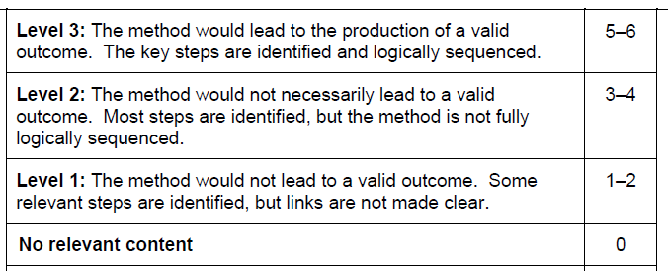
Extended response: Plan a method
Notes:
This is the mark scheme for the chemistry example (p49). The levels descriptors are the same regardless of subject, so they would apply to either of the other examples. Key steps are shown in the indicative content. Students don’t need to give every single step to get full marks – as long as most are identified and would lead to a valid outcome.
However, there is one essential piece of information here. And there often is in such mark schemes so that you can see what is needed to get into that top level.
For the method to give valid results, (highlight on click) must react copper oxide and hydrochloric acid – so a student could give every step in a logical way, but if they react anything but these two compounds they will not end up with copper chloride!

Slide 14
Practicals in a context not required practical
Notes:
This is the question from Example 6 (p34), along with the indicative content from the mark scheme. On click Again, you can see what is needed to get into Level 3 so that results would be valid.

Slide 15
Challenges
Notes:
I’m now going to talk briefly about what we see every year students find challenging in answering practical based questions

Slide 16
Challenges – the how and the why
Disciplinary language – accuracy/precision, variables, controls, resolution.
Methods that give a valid outcome – extended response (4 or 6 marks) – use bullet points and annotated diagrams.
Errors – common errors in that experiment; general reason(s) why common errors occur.
Anomalous results – why they occur, actions to correct them: ‘repeat the experiment and calculate the mean ignoring anomalous results’.
Improvements – to the method; accuracy of measuring equipment; resolution; why do repeats; why increase range.
Understanding and explaining the science behind an unfamiliar practical context.
Notes:
Many students can simply recall a method from a required practical, but that’s rarely what we’re going to ask in exam papers
What does cause many students problems is knowing the ‘how’ and the ‘why’ behind the practical – that’s really what we’re going to examine. For instance:
Understanding and being able to use correctly the disciplinary language of practicals – accuracy, precision, resolution, variables, the difference between a control and a control variable.
As mentioned earlier students often don’t get into the top level of an extended response method question because the method they’ve written won’t give a valid outcome.
Along with other disciplinary language students don’t seem to understand about common errors – what could cause them, how to correct them. ‘Human error’ is rarely an acceptable answer.
Tied in with this is what to do about anomalous results and exactly why we calculate a mean.
AO3 questions are asked where students need to either suggest an improvement to a method – usually to get more accurate or valid outcomes – so would need understanding of appropriateness of equipment (AT1 for all subjects) or do repeats. Also we could ask for an adaptation to a method to investigate something different – so need to really understand what they’re doing in a practical and why so they can apply it. See booklet page 46
Students also need to be able to identify the science behind a practical context (especially if it’s an unfamiliar one) so that they don’t get thrown by the context and duck out of the question. There is a resource on this that you could use if you like, from the Virtual Communities meeting of Autumn 2021

Slide 17
Understanding disciplinary language
Notes:
This is just one of the pages from the Working Scientifically booklet from the Focus on Success pack on Disciplinary language – do share this booklet with your teams & students as it explains what we’re looking for in exam questions. This page is just on errors …
There is a link to where you can find this FoS pack on slide 25 – these are on our website in the teacher training materials for each science qualification

Slide 18
Effective practical lessons
Notes:
So, what might you be doing in your practical lessons to help with these challenges?

Slide 19
Effective practical lessons: A holistic approach
In order to make the most of the lesson time available, a number of elements need to be brought together and taught during the practical lesson.
These include:
the names of each piece of apparatus and how they’re used (the ATs)
elements of WS
correct use of scientific language and terminology
understanding of what students are doing (AO1) and why they’re doing it (AO2)
use of appropriate maths skills (AO2)
applying scientific knowledge from the specification to explain phenomena, observations and results – the science behind the practical (AO2)
concluding, explaining, evaluating and suggesting improvements (AO3).
Notes:
The main thing to think of is you can’t cover everything every time.
I’m not here to tell you how to teach a required practical, but this might assist you in planning for using practical time effectively
Different RPs will lend themselves more to certain aspects of these elements than others. So think of what aspects you might focus on in each practical rather than trying to cover everything.
Map coverage of key elements across the RPs to ensure effective coverage across the specification.
It’s important to work with colleagues to ensure consistent use of subject specific language in lessons to embed understanding of terms.
There are examples of how you might want to consider doing this in the FoS pack on practicals – see next slide

Slide 20
Required practicals planning summary
Notes:
This is an example from the Focus on Success on Practicals, the planning summary designed to model a teaching approach that includes AT, WS, subject-specific language, linking the science behind the practical and application of maths skills.

Slide 21
RP 4 (Separate Science Chemistry)/RP10 (Combined Science Trilogy Chemistry)
Investigate the variables that affect temperature changes in reacting solutions such as, e.g. acid plus metals, acid plus carbonates, neutralisations, displacement of metals
Disciplinary language
Valid method
Science
Exothermic; endothermic; combustion; oxidation; neutralisation; thermal decompositions
Thermometer, beaker, measuring cylinder, balance
Measure start temp, finish temp, work out change in temp
Names of different acids and metals not used in class (AO2)
Independent variable – e.g. type of metals
Dependent variable – temperature change
Controls – volumes, mass, type of acid
Energy is conserved in chemical reactions
Definition of exothermic and endothermic
Examples of these reactions and everyday examples (AO2)
Evaluate/compare uses and applications of exo/endothermic reactions (AO3)
Errors and improvements
Add a lid
Stir the solution
Resolution of thermometer
Accurate balance
If repeating, remove anomalous results and calculate the mean
Notes:
This is an example of what you might want to cover in a particular required practical – this is one of the Chemistry RPs (Trilogy RP10)
Break it down under various headings – as well as teaching a valid method and relevant WS terms, what disciplinary language are you going to cover, science content, information about errors might you be able to cover?
You could share a past question (or parts of it) with students in parts of the practical or as homeworks to emphasise the types of things they’re going to need to know – see example 10 (p46)

Slide 22
Activity: Physics
Can you model the process for the following RP?
Physics RP 7 (Trilogy RP 19): Investigate the effect of varying the force on the acceleration of an object of constant mass and the effect of varying the mass of an object on the acceleration produced by a constant force.
AT 1 – use appropriate apparatus to make and record measurements of length, mass and time accurately.
AT 2 – use appropriate apparatus to measure and observe the effect of force.
AT 3 – use appropriate apparatus for measuring motion, including determination of speed and rate of change of speed (acceleration/deceleration).
Notes:
If time allows, delegates do this. If now, takeaway to centre (planning writing frame on P52)
Suggested activity: have a go, for your subject area at planning a rp. There’s a blank planning page at the back of the booklet.
I’ve emboldened words that you might consider as significant things to think of as important

Slide 23
Activity: Chemistry
Can you model the process for the following RP?
RP 8 (Trilogy RP 13): Analysis and purification of water samples from different sources, including
pH
dissolved solids
Distillation.
AT 2 – safe use of appropriate heating devices and techniques including use of a Bunsen burner.
AT 3 – use of appropriate apparatus and techniques for the measurement of pH in different situations.
AT 4 – safe use of a range of equipment to purify and/or separate chemical mixtures including evaporation, distillation.

Slide 24
Activity: Biology
Can you model the process for the following RP?
RP 3 (Trilogy RP 2): Investigate the effect of a range of concentrations of salt or sugar solutions on the mass of plant tissue.
AT 1 – use appropriate apparatus to record mass and time.
AT 3 – use appropriate apparatus and techniques to observe and measure the process of osmosis.
AT 5 – measure the rate of osmosis by water uptake.

Slide 25
AQA resources
Practical handbooks: Student sheets and teacher/technician sheets
Focus on Success packs: Disciplinary language; Extended response; Practicals
Notes:
These are just some resources on our website that you might not have found, and which might help you in designing your practical lessons.
I’ve included a copy of extracts from the handbooks in the handouts for this session.
The link to the practical handbook is to the GCSE Biology one, but the others can be found in Teaching resources for each specification

Slide 26
Evaluation
We kindly ask you to ​scan the QR code and complete the questions.
Session: Assessing practical skills in GCSE Science

Slide 27
Get in touch
Tel: 01483 477 756
Email: gcsescience@aqa.org.uk
alevelscience@aqa.org.uk
X: @Science_AQA
aqa.org.uk

