Slide 1
Supporting ITT: Understanding GCSE Science assessment
Damian Gent

Slide 2
Session overview
The specification
The assessment objectives
The structure of an exam paper
Applying a mark scheme
Notes:
Overview of what ‘m going to talk to you about

Slide 3
The specification

Slide 4
Combined Science: Trilogy (8464)
You can download all of our specifications from our website: www.aqa.org.uk
Notes:
Each of our qualifications has its own landing page and for GCSE you will see two combined and three separate sciences (separate science currently accessed by subject name eg biology)
This session focus is the combined Trilogy spec 8464 which is the most common GCSE taken, but the layout and principles are the same for all of our GCSE qualifications.
Starting with the landing page, this is a really useful place to come if you are looking for support documents. It is divided into a number of Tabs: the specification, planning, teaching and assessment. Towards the end of this section, we’ll look at resources in a bit more detail.
For now, we are focusing on the specification itself and how you should be using it in your teaching

Slide 5
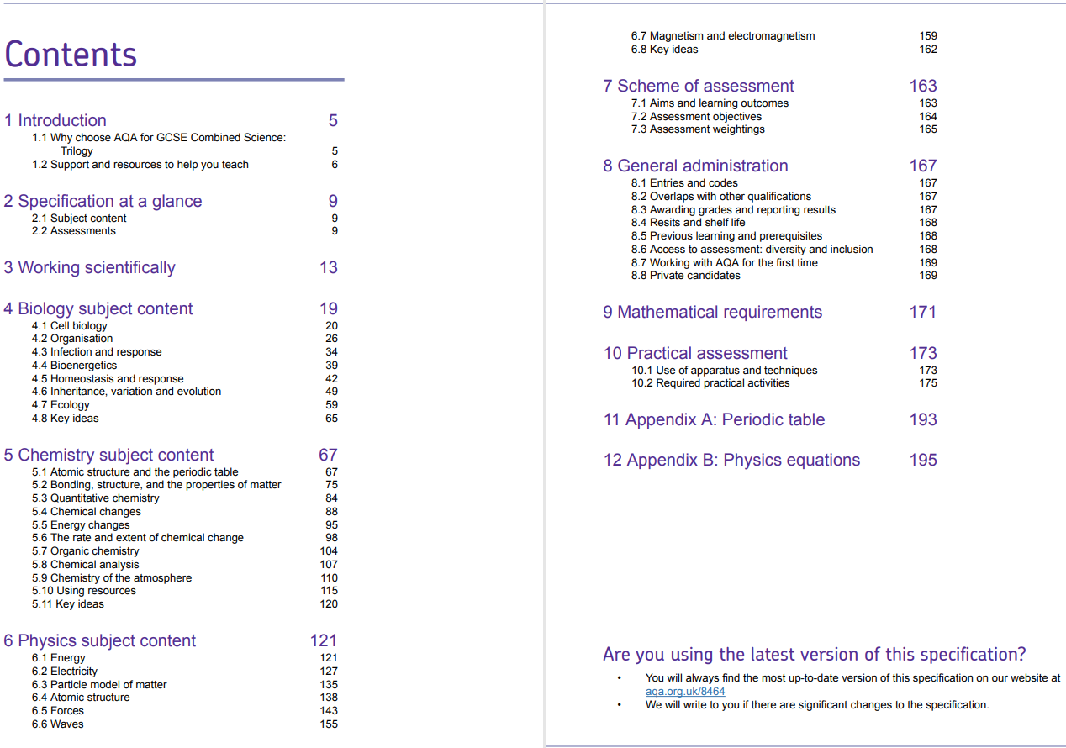
Discussion point: What is a specification used for?
Notes:
Discussion Point
What are specifications used for?
Feedback
The specification lists the content that can be assessed, the skills that students need in assessment and, importantly, HOW the content and skills are assessed.
Depending on the school or trust that you work for you may be given a scheme of work to follow, possibly sets of PowerPoints to teach from and worksheets for the students to do.
All of these resources would have been developed using the specification so if ever you want to drill down to the core content, you can align the scheme of work with the spec to see where it is listed.
Many SOWs list the spec point adjacent to the learning objective for easy cross referencing.
The point of showing the contents page here is to highlight what is contained
Highlight on click the subject content makes up the bulk of the document, and this is, of course, the main focus “what do they need to know?”
The following Highlight on click are also referenced within the content & looked at on the next couple slides
working scientifically
maths skills on next slide is where relevant
Practical assessments are identified
Scheme of assessment

Slide 6
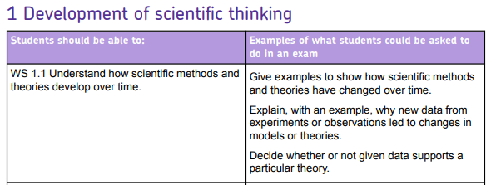
Working scientifically
Four sections:
Notes:
The WS criteria were set out by the DfE along with the subject content.
The WS criteria are the same for all the GCSE sciences.
There are main WS skill areas that naturally come out of teaching science, and in this section of the spec we set them out and give examples of what students may be asked to do in an exam.
WS1 is all about development of scientific thinking and covers understanding of how theories and methods develop over time, using models, ethical considerations etc
WS2 covers a lot of practical, hands-on skills – hypotheses, planning and carrying out experiments, recording data, sampling, using apparatus correctly
WS3 is all about analysing and evaluating data – which includes presenting data appropriately (eg selecting the right type of graph to use), mathematical analysis such as rearranging equations and using graphical data, and using data to draw conclusions
WS4 covers the language scientists need to know and use correctly, and includes understanding of SI units, prefixes and scientific quantities.
We feel WS is so important that we have woven it throughout our specification, and its examination is not a ‘bolt-on’: aspects of WS are embedded in pretty much every question.
If you have a SOW, it may be worthwhile looking at the activities in it and mapping them onto it so that you can see where in the course students are getting opportunities to develop these skills

Slide 7
Working scientifically
Discussion point:
Example 1 (page 9)
Can you identify the working scientifically (WS) areas in the question items?
Notes:
Example 1 Page 9
Discussion Point:
Can you identify the WS areas?
Feedback
This question features aspects of WS 2 & 3

Slide 8
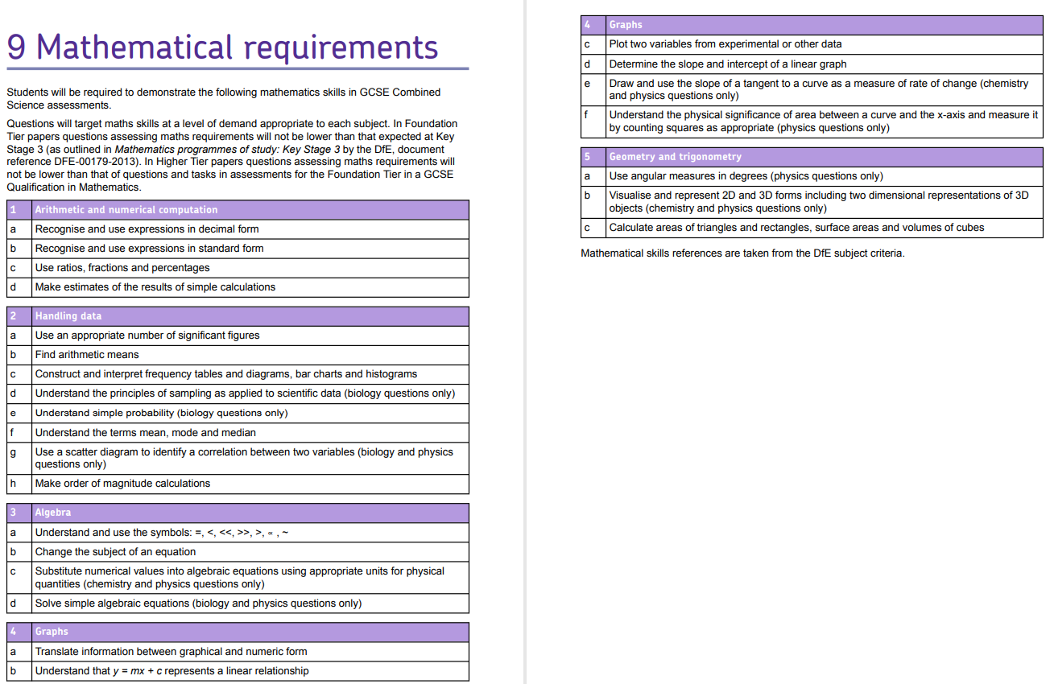
Assessment of maths skills
Notes:
Maths skills are of course key in science with physics having the highest maths requirement, then chemistry followed by biology. (30:20:10)
On a Foundation tier paper, maths skills will not be lower than KS3 expectations and, on a higher tier paper, will not be lower than Foundation tier maths. Note common questions will be higher than KS3 on a F paper because to count as maths on the H paper they must be @ F tier maths – which explains why some questions at the end of a paper may be quite hard for F tier students.
If you look at our papers, you will see certain skills that are assessed every year (e.g. graphing questions for 4 marks are not uncommon) so it is just as important to prepare your students in maths skills as subject knowledge

Slide 9
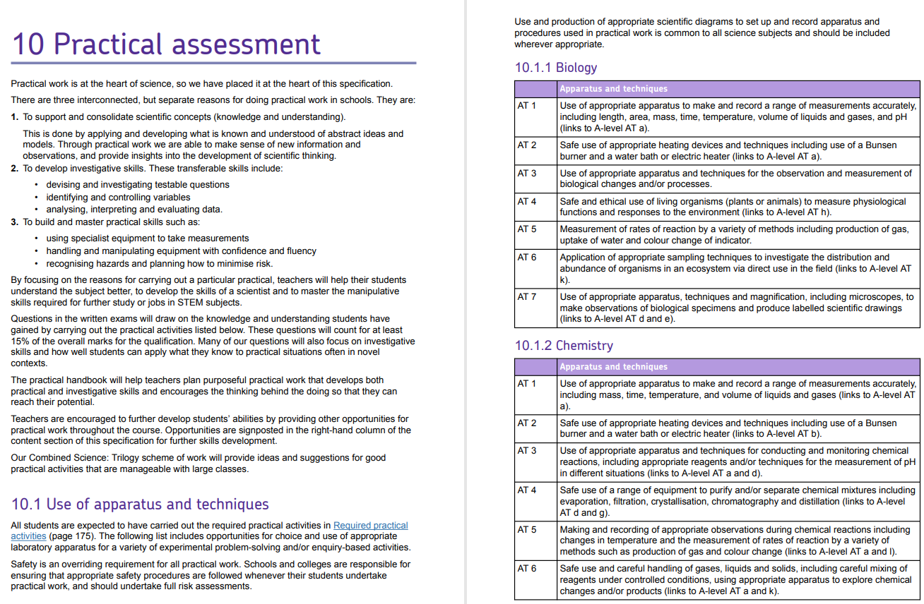
Assessment of practical skills
Notes:
Questions on Practical skills count for 15% of the papers.
Students are required to carry out the 21 RPs (7 each subject BCP) over the course and, although the practicals are not assessed directly in the classroom, they are indirectly assessed in the exams. Your headteacher will sign a centre declaration form at the end of the course stating that all students were offered the opportunity to carry out the practicals.
If you look at our papers you will see that we don’t always ask directly about a RP – what we are assessing is the student’s knowledge of the described apparatus and techniques. Sometimes the RP is set in a slightly different context to that carried out in the classroom so it is important to remember that you are teaching the skill NOT the specifics of the RP. For example, if a student is taught chemistry AT5 “measurement of rates of reaction by a variety of methods” they can apply the skill to a question on any practical involving rates, RP or not.
We also ask practical questions that are not based on the RP but on unfamiliar investigations so students should be equipped to recognise the Ats in exam questions and apply their knowledge of the skill to the new context.

Slide 10
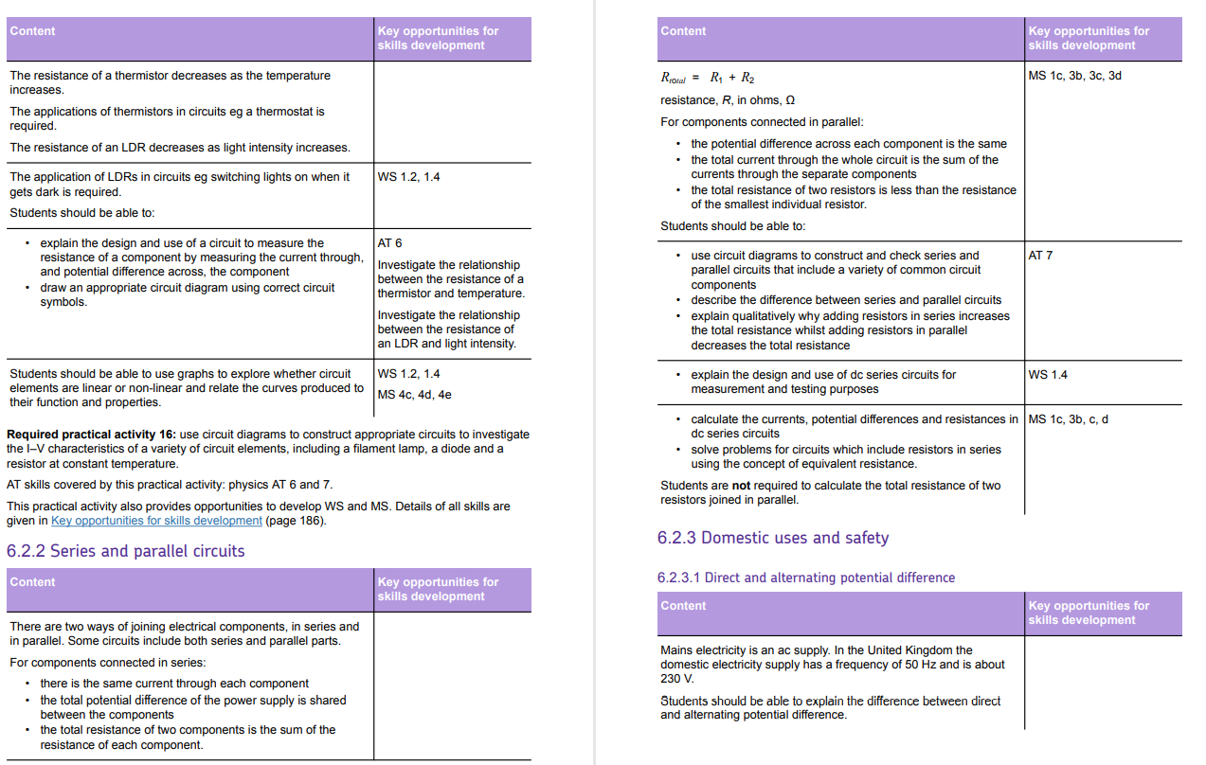
Specification – at a glance
Notes:
You can turn to any page in the specification for examples of WS, AT, MS and RPs. The content is presented in two columns, the first is Subject Knowledge and the 2nd is key opportunities for skills development.
The content is organised into a series of sub-headings with specification point numbering.

Slide 11
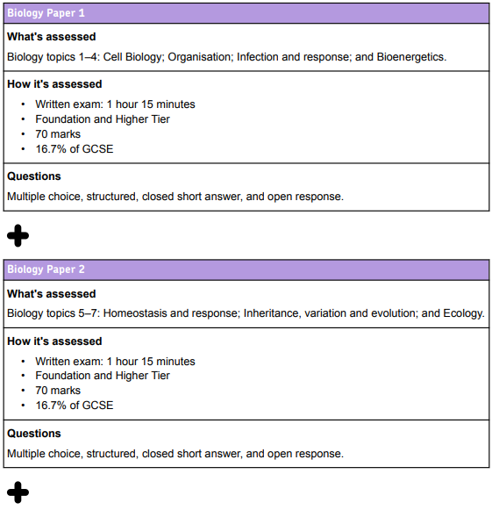
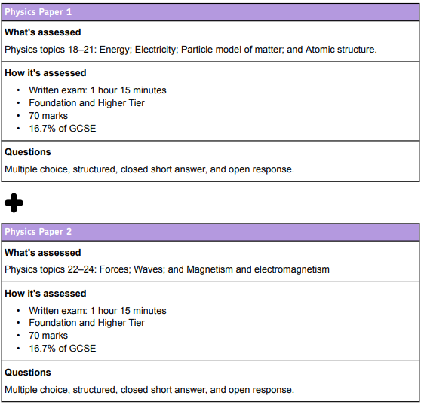
Exam papers
Notes:
There are 6 papers for Trilogy. Papers are available at two tiers – Foundation tier covers grades 1 to 5, and Higher tier covers grades 4 to 9. Students must sit all the papers for a qualification at the same tier.
Content can be taught in any order as exams are terminal. Some schools teach all of P1 in year 10 to be able to use the previous years papers as mocks but, if a department have a preferred sequence, that is also fine.
Mocks can be adapted or made with ExamPro to suit your teaching order.
Scheduling mock exams is usually done at a whole school level.

Slide 12
The assessment objectives

Slide 13
Assessment objectives in GCSE Science
Discussion point:
How many assessment objectives (AOs) are there are for GCSE Science?
What does each AO cover?
What percentage of the award is assigned to each AO?
Why are AOs important to teachers?
Notes:
Discussion Point
Questions On slide
Feedback on next couple slides

Slide 14
The GCSE Science assessment objectives
Notes:
Feedback
How many: For GCSE Science we have three AOs – listed here.
What they cover: These are the skills students have to demonstrate and which we assess in our exam papers
What percentage: the percentage of marks for each AO for the qualification is given in the right hand column
Why important: You’ll see, if you look at the GCSE mark schemes, that every marking point is associated with a particular AO.
They are important to teachers as they indicate what a student needs to do in order to access the marks for a question

Slide 15
Discussion point: Can you identify the AO?
Look at the items (parts of questions) in Example 2 on pages 12 and 13 of the booklet. Can you identify the AO each item covers?
3.1
3.2
3.3
3.4
3.5
AO2
AO3
AO1
AO1
AO2
Notes:
Discussion Point
Page 12-13 of booklet
Have a couple of minutes here for delegates to have a go.
Feedback
Go briefly through each item and discuss which AO is being covered, and why.
3.1 – AO2 – students need to apply their knowledge and understanding of maths to calculate (most maths is AO2)
3.2 – AO3 – Students are looking at the experimental procedure and evaluating it, making a judgement
3.3 – AO1 – stating information straight from the specification content 5.10.1.2
3.4 – AO1 – also information from the specification – knowledge 5.10.1.2
3.5 – AO2 – calculation, applying maths skills to this particular situation

Slide 16
Command words
Notes:
Listed on p14/15

Slide 17
Command words
Discussion point
What are the command words in these examples?
Notes:
Command words tell students what to do in an assessment question. It’s a good idea to use them regularly in your teaching & to check students understanding throughout
Discussion Point
Booklet pages 14 and 15 – What are the command words in these items?
show 3 examples
Feedback
Highlight on Click
Command words are on page 14/15

Slide 18
The structure of an exam paper

Slide 19
Structure of the papers
There are approximately seven questions on a GCSE Combined Science Trilogy paper, and ten for each separate science paper.
Questions are made up of several ‘items’.
Each question covers an area of science, which is introduced in the stem of the question.
Papers are tiered and the demand ramped through the paper.
Common questions make up 30% of the marks.
Demand | Target grades | % marks | Tier
Low | 1–3 | 60% | Foundation
Standard | 4–5 | 40% | Foundation
Standard | 4–5 | 40% | Higher
High | 6–9 | 60% | Higher
Notes:
Look at the question on pages 16-18 (example 3) of the booklet.
This is a typical type of question you’d see on any of our GCSE science papers.
(I’m going to concentrate on Trilogy for ease of reference),
7 questions per paper– this varies slightly each exam series, but not by much.
70 marks per paper
A ‘question’ is broken down into a number of smaller questions, called ‘items’. In this example, you can see that question 7 is worth a total of 12 marks, and is made up of 6 items worth between 1 and 4 marks each.
Each question covers part of the specification, a particular area of science. The example here is based on the knowledge and understanding students will have gained by doing one of the required practicals, in the section on forces and motion.
The stem of this question (the part that comes before 7.1) introduces the context and gives important information, but there might be little stems for individual items too, to help students understand what they’re being asked.
GCSE Science papers are tiered. Foundation tier papers cover grades 1 to 5 and Higher tier papers grades 4 to 9.
Demand ramps up through a question and also across the paper. So, for instance, on the Foundation tier paper, the first few questions will be set at quite low demand, and later questions will be more difficult (Standard demand).
Ramping is intended to help students get into a question and have a go to get some marks even if they can’t answer all of it. In the Higher tier papers, early questions are set at Standard demand, and then ramp up to High demand to stretch the really able students.
The question in the example is a common question – it appears on both the foundation (towards the end) and higher papers (near the start) – and is set at standard demand
30% of the marks on the Foundation tier paper and the Higher tier paper are for what we call Common questions
The table shows the percentages of the marks for each paper that are set to target each level of demand.

Slide 20
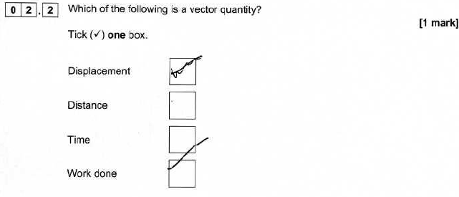
Types of questions
Different question types
Multiple-choice, link boxes, sentence completion: 1 or 2 marks
Short-answer: 1–3 marks
Notes:
These can be found within the examples throughout the booklet
Shown on next 4 slides
MCQ example 4
Short answer

Slide 21
Types of questions
Different question types
Longer answer questions: 4–6 marks
Extended response: 4 or 6 marks
Marked using ‘levels of response’ mark schemes.
When a student writes their answer, they can:
write in paragraphs
use short sentences in bullet points
use labelled diagrams
use tables with headings for compare and evaluate questions.
Notes:
Longer answer & Extended response
Students Don't need to fill all the space.
More guidance given in commentary later

Slide 22
Types of questions
Different question types
Calculations: 1–4 marks
Multistep calculations: 4–6 marks
Notes:
Calculations & Multistep calculations

Slide 23
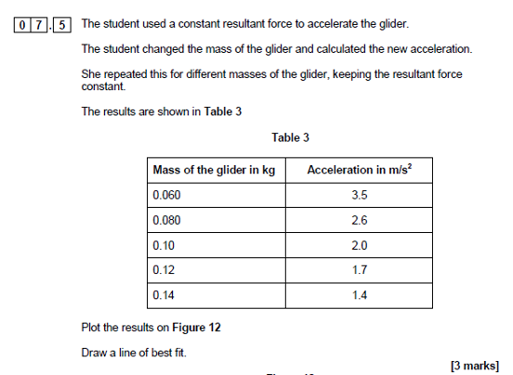
Types of questions
Different question types
Graphs: 3 or 4 marks (plots, axis, scales, line of best fit)
Students may be asked to:
plot the data from a table
label the axis – use the headings in the data table
draw the scale – use most of the graph paper given
draw a line of best fit. Lines of best fit can be straight or curved – look at the pattern in the data first to decide.
Notes:
Graph plotting example 3 page 18 (7.5) & example 21 page 38
Graphs are marked for accuracy (divisions of scales depend on demand).
Ideally they should use a sharp pencil
Crosses (x) or dots can be used for plotting, but crosses (x) are easier to see.

Slide 24
Applying a mark scheme

Slide 25
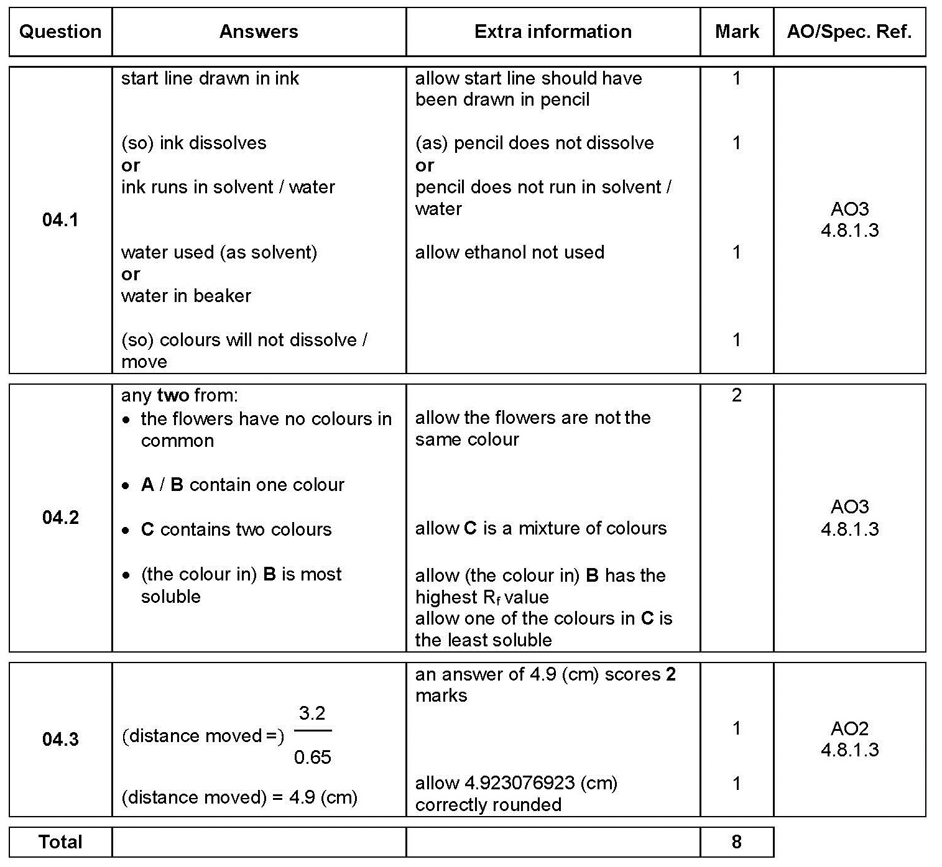
Features of a mark scheme
Discussion point
What do you think needs to be included in a mark scheme?
Notes:
Discussion Point
What needs to feature in a mark scheme?
Feedback
Sample mark scheme appears on click
Questions are points marked or levels marked.
Most questions are what we call ‘points marked’ – that is there is one mark for each specific correct response.
Click highlight The Question/ item in column 1.
Click to highlight The Answers column shows what we want to see as the answer. But as we all know, students rarely use this exact wording, so examiners need to use professional judgement as to whether what the student has written sufficiently covers the marking point to gain the mark.
Note in some answers there are responses in brackets: at the beginning of the mark scheme is a section called ‘Information for examiners’ , which has explanations of some of these features such as what bracketed answers mean.
Sometimes a word will be underlined – this word must be included to gain the mark
Click to highlight The Extra information column gives further guidance (if needed) on what we would allow as an alternative response, answers that would not be allowed (and which might negate a previous response), and answers that are neutral and should be ignored. The Information to examiners section gives clear guidance on how to apply information in this column.
Click to highlight Every marking point is aligned with a mark in the fourth column, so you can see exactly where the marks are awarded.
Click to highlight The last column shows the assessment objectives, the area(s) of the specification the question covers. Not all marking points in a question necessarily cover the same assessment objective

Slide 26
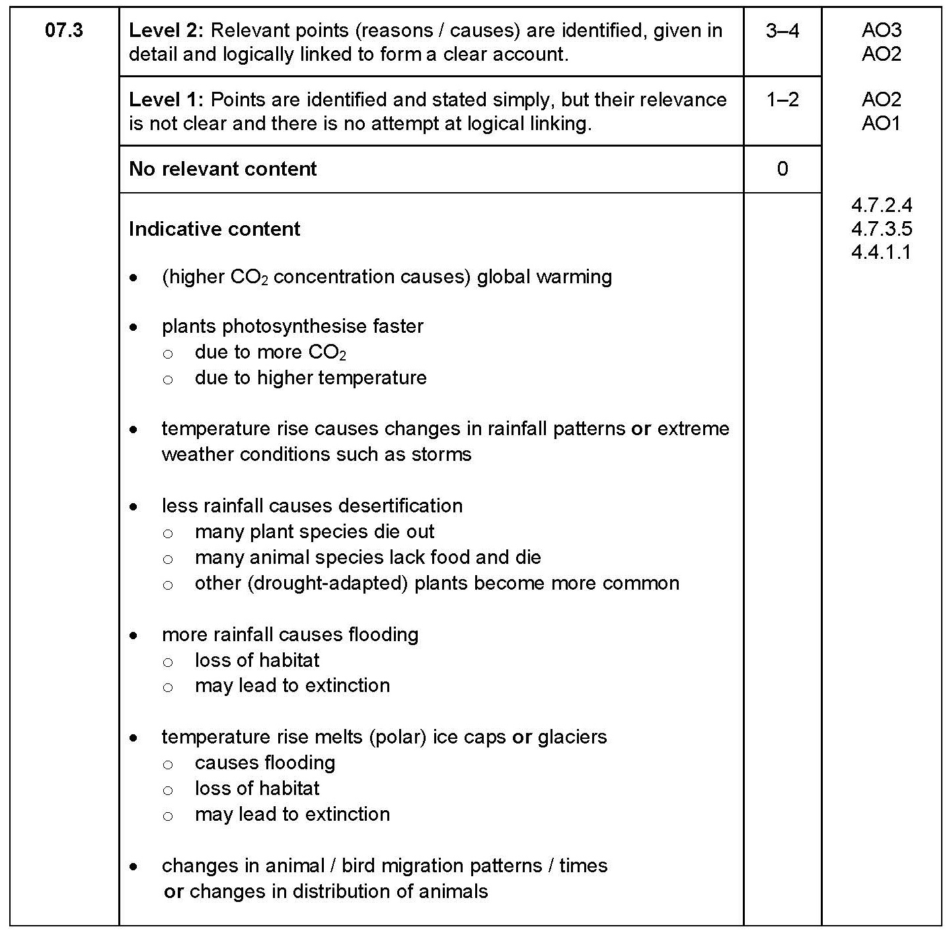
The levels of response mark scheme
Discussion point
How does this levels of response mark scheme differ from the previous mark scheme?
Notes:
Discussion Point:
How does this differ from a points marked mark scheme?
Feedback
This kind of mark scheme is for open response questions (the ‘extended response’ questions). For these open questions there are almost as many possible ways of writing the answer as there are students, so a points-based mark scheme is not the fairest way of marking it as it can be very restrictive. Instead we use a levels of response mark scheme, in which student work is marked holistically.
On click The LoR mark scheme marks performance on a continuum​ by dividing performance into 3 sets of marks (levels) on the continuum​. Level descriptors describe the performance at each level​.
As well as the levels descriptors, which are generic for the command word used (eg every Explain LoR mark scheme has the same levels descriptors), there is some indicative content on click for that specific question, which lists major relevant points that need to be made in the answer.

Slide 27
Applying a mark scheme
Activity: Look at some of the examples in the booklet.
Examples 4–17 (pages 19–33)
How many marks would you give to each response?
Notes:
Activity: Look at a few examples – don’t need to do all
Could split the delegates into groups eg 5 groups looking at 2 examples each/ or taking feedback from 2 per group if looking at all
Feedback (commentary booklet too)
0 – 2 boxes ticked, not clearly crossed out
0 – not clear which metal is more malleable or has higher melting point
0 – answer needs to show that student understands the need to extend range
1 – washing hands is too vague
2 - LOR mark scheme. Apply holistic judgment after reading whole answer. Turn magnet on is credited. No linking of answers, student has simply repeated information from question
2 - 2 correct statements but no explanations
0 – 2 lines drawn from each method which negates correct answer
2 – correct answer & working out but not to 3 sig figs
1 – anomaly not removed, but correct working of a mean so 1 mark awarded
3 – all 3 marks awarded as answer is correct
0 – student did not use supplied equation, incorrect substitution/ rearrangement (multiplied rather than divided)
0/2 – 7. 3 wrong symbol for charge, 7.4 – correct substitution and rearrangement, but final answer not given
0/2 – 0 marks for equation. 2 marks for correct calculation, but have not given answer correct to 2 sf (should be 38000
6 – full marks, correct answer, all working shown

Slide 28
Applying a mark scheme: Graphs
Activity: What marks would you award the example graph questions?
Examples 18–21 (pages 35–39)
Notes:
Discussion point
Examples 18-21 p 35-39 – could do this by going through the examples with delegates or as an activity for them. Refer to the commentaries for these examples
Feedback
Example 18: 1 mark The student has labelled the x axis instead of adding the scale to the y axis so cannot get this marking point. They have correctly drawn 2 of the bars.
Example 19: 2 marks The student has correctly plotted all the points from the table of data, although the crosses could have been clearer. They have attempted to draw a curved line of best fit, but it has not been drawn through all the points and is quite rough. As such, the mark for lobf cannot be awarded.
Example 20: 1 mark The student has plotted five of the six points correctly, within the tolerance allowed, so gains 1 mark for the plotting. The line of best fit is incorrect, so the marks for this cannot be awarded.
Example 21: 2 marks Points plotted correctly, but 3 points lie below lobf so 3rd mark not awarded

Slide 29
Marking extended response questions
Extended response questions are marked on level of response mark schemes
Level of response mark schemes are broken down into levels, each of which has a descriptor.
The descriptor for the level shows the average performance for the level.
There are 2 marks in each level.
Before you apply the mark scheme to a student’s answer, read through the answer and, if necessary, annotate it (as instructed) to show the qualities that are being looked for. You can then apply the mark scheme.
Step 1: Determine a level
Step 2: Determine a mark
For a detailed description of these steps, see the Information for examiners at the beginning of any mark scheme.
Notes:
There are a number of examples of extended response questions with commentaries in the booklet
Go through one or two examples 22–25 p41 - 44

Slide 30
Implications for teaching

Slide 31
Areas of challenge
Applying knowledge and understanding (AO2) in unfamiliar contexts
Required practicals and practical skills
Maths skills

Slide 32
Area of challenge: AO2 in unfamiliar contexts
Copyright © 2024 AQA and its licensors. All rights reserved.
Notes:
This is a physics example, which examines understanding of kinetic theory in the context of a scuba diver – which will be very unfamiliar to most students
Reference diving brick example from 2024

Slide 33
Supporting assessment in class
Explain to students that they need to expect these types of questions.
You could introduce context-based questions or scenarios to solve by the end of the lesson.
Use examples in your lessons:
Start with familiar contexts and then follow up with unfamiliar context questions.
Ideas for integrating AO2 into practicals in Activity 4 of AO2 focus on success.
Change names of chemicals used in practicals in homework questions.
Look at examples already used in assessment questions.
Model identifying the science behind the questions.
Notes:
BP2: For example, if you are teaching about autosomal recessive inheritance crosses you could start with a question such as how can you explain the inheritance of maple syrup urine disease? (this was a context that came up in the 2022 biology paper) (could use own example!) and go on to show that by the end of the class they can not only explain this specific inheritance but any autosomal recessive disease we put to them.
Could for example if looking at calculating relative formula mass start with compounds that are in the specification such as sodium chloride, ammonia, methane then go on to more complex and less familiar ones such as that shown in the example or other compounds like carbonic acid (H2CO3). Organic compounds are often good ones to practice with. You could even get students to design their own questions to make the concept more challenging
Modelling is reminding learners to apply what they know by looking through the questions and understanding that they do know the science behind it. Could look back at Example 3 and see what ideas could have to support modelling this question.

Slide 34
Area of challenge: Required practicals
Students don’t fully understand why they carried out each step in the practical.
Lack of understanding about the science underlying the practical.
Identifying control variables and independent and dependent variables.
Difference between a control and a control variable.
Use of vague terms such as ‘same amount’, ‘fair test’, ‘it’ and ‘they’.
Types of errors.
Subject-specific vocabulary.
Notes:
Students particularly struggle with areas of working scientifically in the context of the RPs
repeatable or its significance
identify control variables and other variables term ‘fair test’ is always inadequate unless suitably qualified types of errors how to improve accuracy - improves inaccuracy is insufficient for type of experimental error, human error is insufficient

Slide 35
Supporting assessment in class
Take more than one lesson to cover the practical.
Use a holistic approach covering the following:
Why they’re doing each step
Explaining science behind the practical
Include working scientifically skills, e.g. variables, errors, improvements
Constructing graphs and interpreting them
Setting the practical in a different context
Discussion of errors and improvement using correct scientific language
Use a framework of generic questions to draw from any given method.

Slide 36
Area of challenge: Maths in science
Unit conversions: g to kg, dm³ to cm³
Use of prefixes and powers of 10 for order of magnitude
Significant figures
Selecting numbers in the diagrams that are needed in the calculations
Percentages, e.g. percentage change is challenging
SA:Volume ratio
Not using a calculator
Notes:
Students not showing working presents an issue. It is important in calculations to show working because although just the correct answer on its own will get the marks if they make an error with no working they can’t get any marks at all – whereas they could get marks for intermediate steps in the calculation if they are shown. For example, Examples 11 and 12, the follow on calculations

Slide 37
Supporting assessment in class
Are you familiar with the maths skills assessed in science?
Which ones would you be confident in teaching students if they don’t know how to use them in a calculation?
Where would you go for support?
Do you understand how calculations are marked?
What piece of advice would you give all of your students concerning calculation questions?
Focus on success – maths in science.
Notes:
Student maths checklist for them to rag rate themselves.

Slide 38
Resources

Slide 39
Website – where to find resources

Slide 40
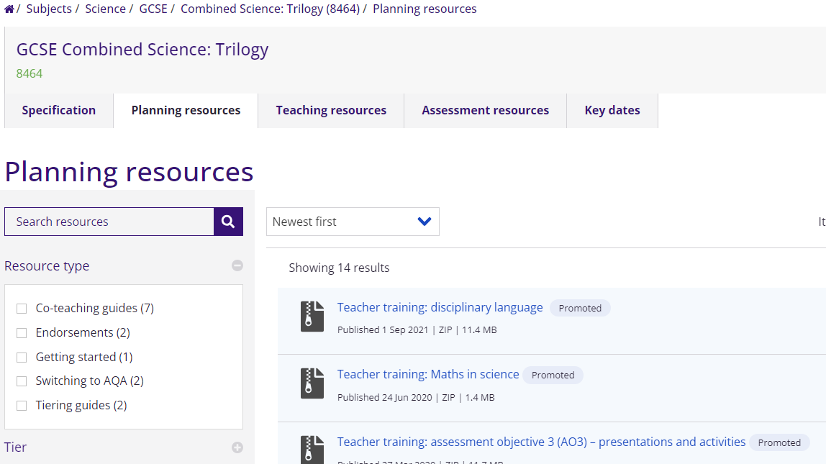
Planning resources

Slide 41
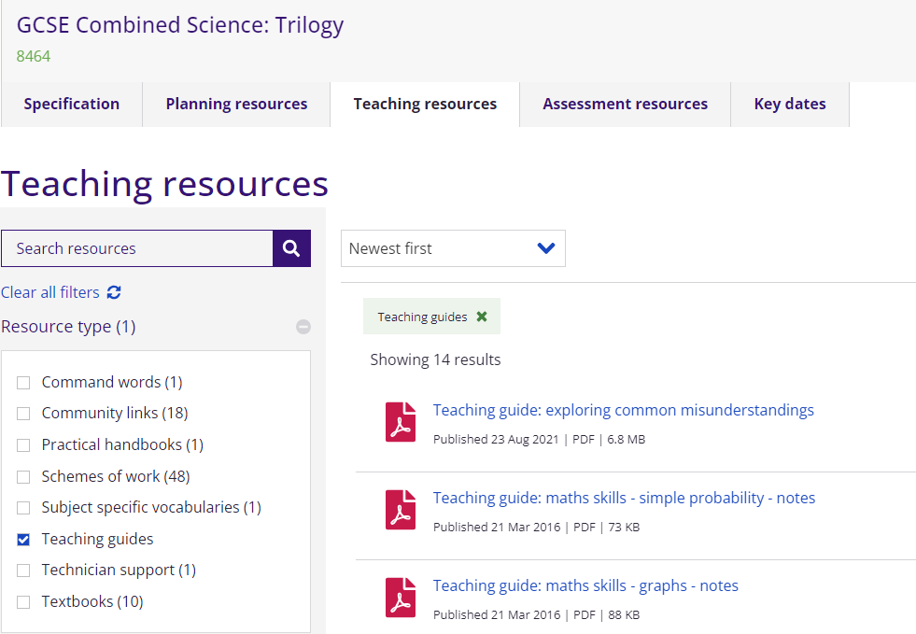
Teaching resources
Notes:
This shows the faceted search to help you find resources on the website. Here I have highlighted the Teaching guides which give information and advice on certain areas
The practical handbook is invaluable for any practical related queries
You might also look at the mandatory CPAC training for lead teachers if you are teaching A-level or want to know more about progression of practical skills from GCSE to A-level

Slide 42
Assessment resources
Notes:
As well as past question papers and mark schemes on this page there are other support documents

Slide 43
Centre Services – secure resources
Notes:
Centre services is the secure area of our website, which teachers can only access by password. It holds all of of our most up to date papers and resources that use the most recent papers – they’re kept on here until the next set of papers are available – this means that teachers can use them as unseen resources with their students without running the risk if your using them as mocks.
More resources here. Worth a look for training and support resources

Slide 44
GCSE science resources
Six self-guided modular training packs –
AQA | GCSE | Combined Science: Trilogy | Planning resources
Helping teachers to better understand the assessment requirements.
Each pack includes notes, ideas for group discussion, an activities booklet and handouts. They cover:
disciplinary language
extended response questions
AO2
practical questions
AO3
maths in science.
Notes:
These are on the planning resources page for all the GCSE sciences, as the issues they cover are common to all the GCSEs. Information can be shared with students – and especially useful are the checklist of Working scientifically language in the Disciplinary Language pack and the Student maths checklist in the Maths in science pack

Slide 45
Get in touch
Our friendly team will be happy to support you between 8am and 5pm, Monday to Friday.
Tel: 01483 477 756
Email: gcsescience@aqa.org.uk
Email: alevelscience@aqa.org.uk
X: @Science_AQA
aqa.org.uk

Slide 46
Evaluation
We kindly ask you to ​scan the QR code and complete the questions

