Slide 1
PRE-VISIT CLASSROOM PRESENTATION
Student & Educator Engagement
Learning & Engagement

Slide 2
Pre-Visit Activities
When students visit the museum, we ask them to share what they see. Slowing down and looking at artworks together, we build connections among the artworks, one another, and the world.
  The following activities offer students the opportunity to practice the kind of slow looking and conversation that takes place during field trips. While we’ve made suggestions based on grade levels, each activity can be used by any age group, with almost any artwork.
Click on the underlined text for more information:
  Notice, Wonder (Grades K–3)
  Elaboration Game (Grades 4–5)
  Looking: Ten Times Two (Grades 6–8)
  See, Think, Me, We (Grades 9–12)

Slide 3
NOTICE, WONDER
At the museum, almost all our looking activities come back to two core thinking dispositions: noticing and wondering.
The practice of noticing details and asking questions is a way to activate artworks no matter what your age or grade level.

Slide 4
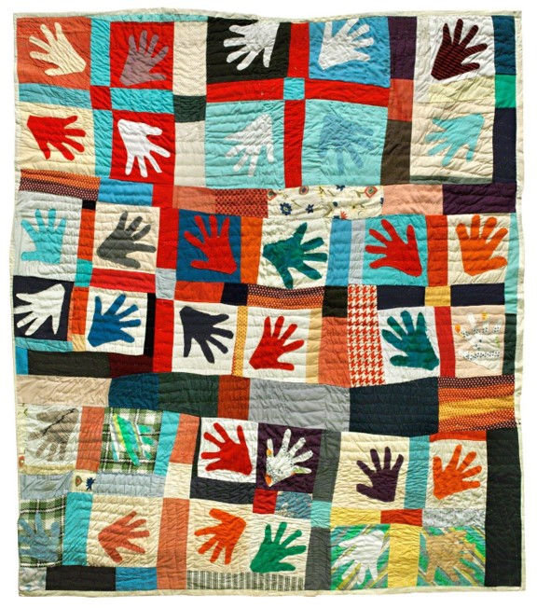
NOTICE
  Spend a few moments quietly looking at this artwork.
  Let your eyes move slowly around the image.

Slide 5
  Now share with the group.
  What details do you notice? Consider colors, patterns, shapes, textures, and anything else.

Slide 6
WONDER
  What questions do you have about this artwork?
  If you could ask the artist about this object, what would you ask?

Slide 7
LEARN
  In creating this quilt, Mississippi-based
  artist Sarah Mary Taylor incorporated bold colors, paying attention to how they interacted with one another.

Slide 8
  She used a process called appliqué, in which smaller shapes are sewn onto larger pieces of fabric.

Slide 9
  For this quilt she traced
  her left hand onto a sheet of brown paper, which she then used as a pattern, cutting hand shapes from old dresses.
  Later, she produced other versions of this quilt, including one made for the 1985 film The Color Purple.

Slide 10
ELABORATION GAME
For this activity, we have divided one artwork into three parts,
inviting students to look closely at each part before
revealing the artwork as a whole.
Learn more about the Elaboration Game, designed by
Project Zero at Harvard Graduate School of Education, here.

Slide 11
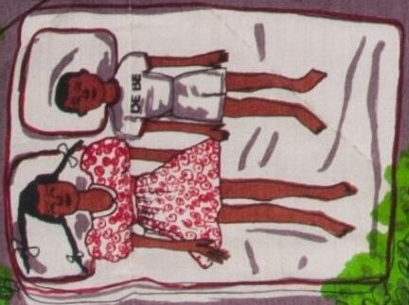
  This is one part of a
  larger artwork.
  Spend a few moments looking at it quietly.

Slide 12
  Now, share with the class. What details do you notice?
  Consider colors, patterns, and anything else.
  Take turns elaborating on (adding onto) what your classmates notice.

Slide 13
  What do you predict you might see in the rest of
  the artwork?
  You will see more on the
  next slide.

Slide 14
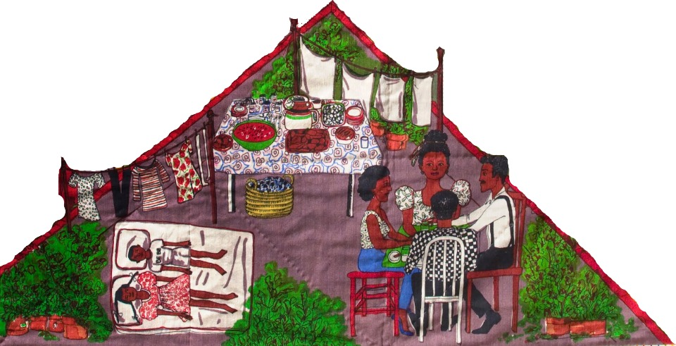
  Now spend a few minutes sharing what you think might be happening here.
  Who might these people be and what are they doing?

Slide 15
  What kind of place might this be?

Slide 16
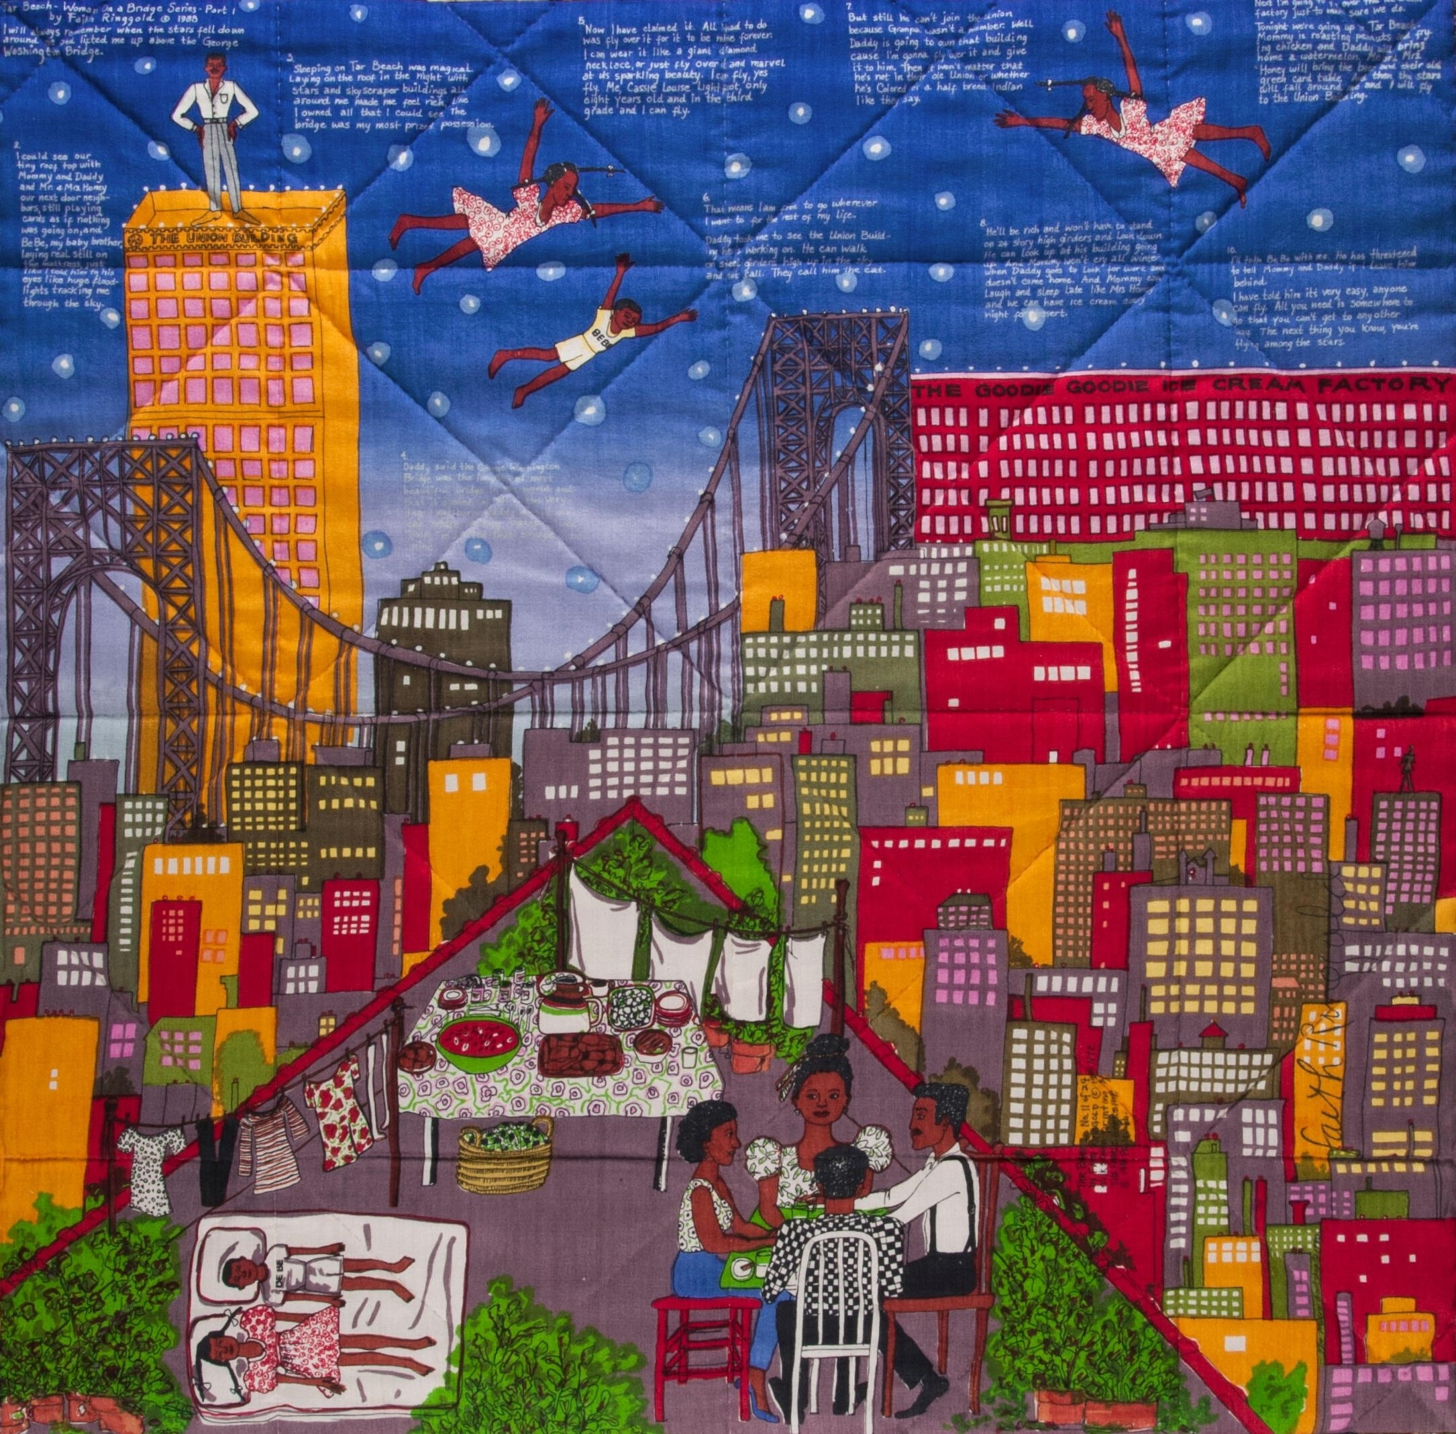
  Here is more of the artwork.
  Does anything surprise you?
  What do you see now?

Slide 17
  What new information
  can you add to your understanding of the artwork?

Slide 18
  Who might these people be?
  Where are they?
  What might they be doing?

Slide 19
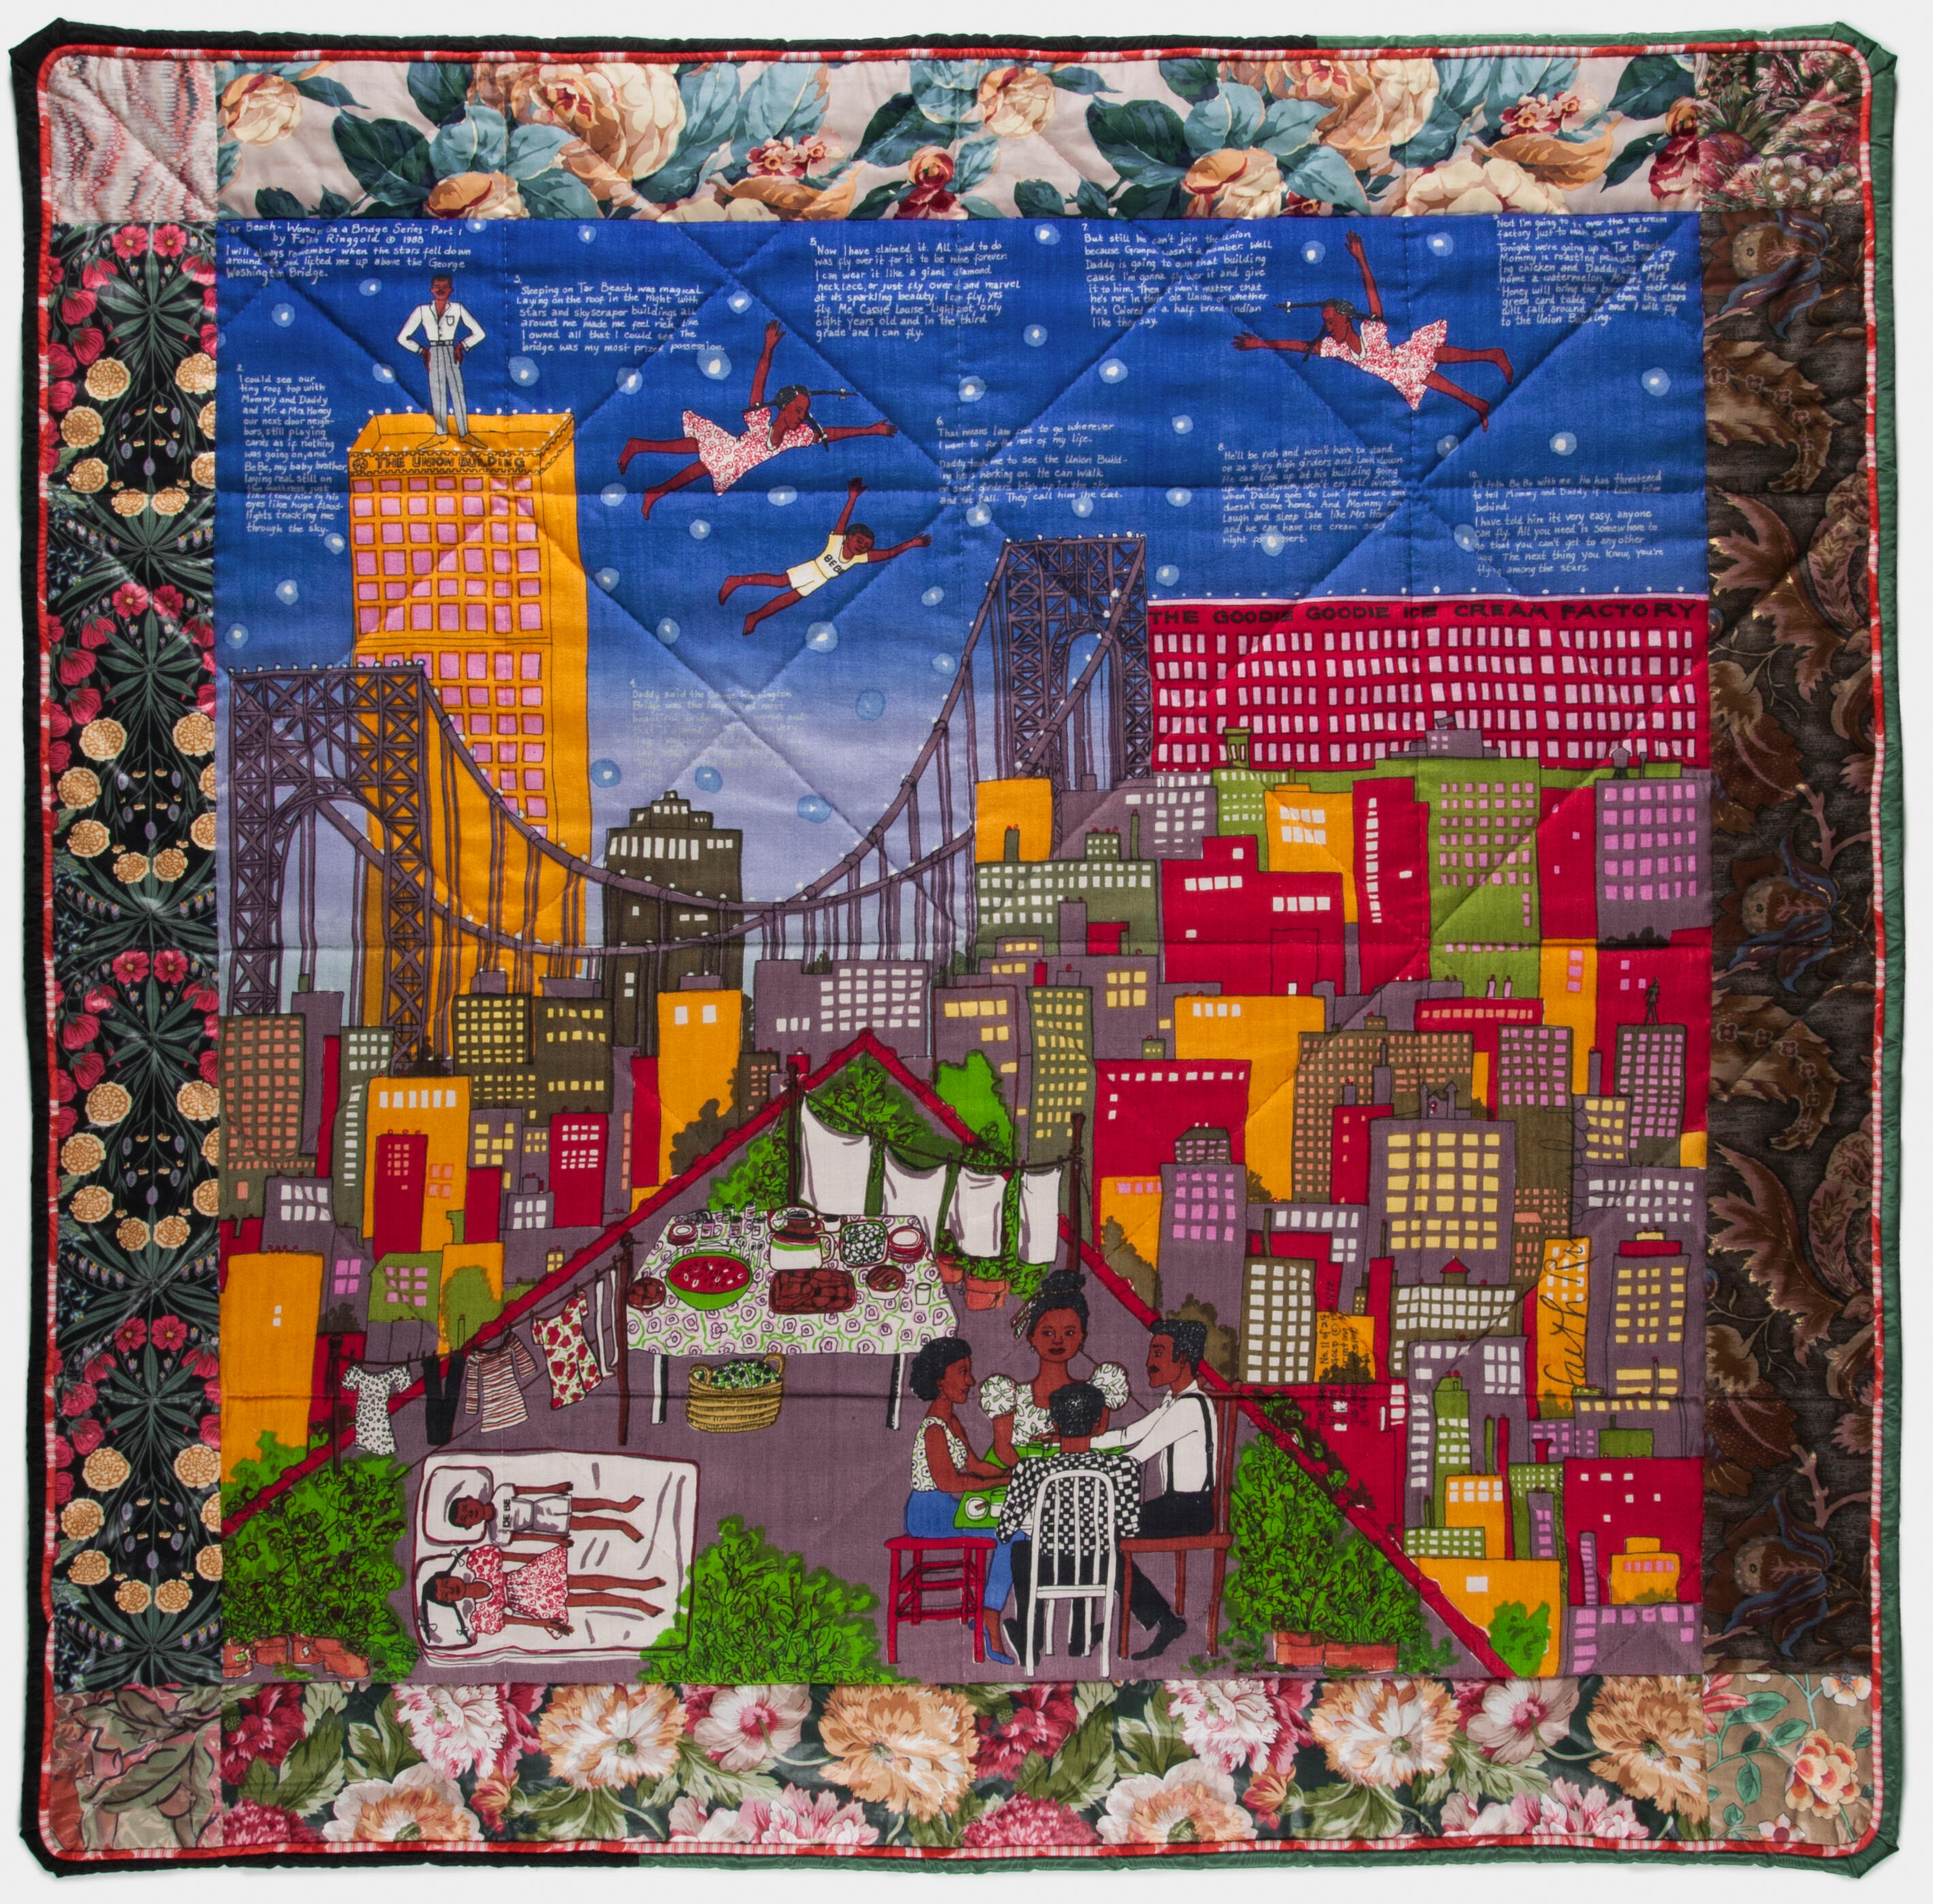
  Here is the entire artwork.
  What new details do you notice?

Slide 20
  In what ways has your understanding of the
  artwork shifted?

Slide 21
REFLECT
  How did it feel to see the artwork in parts before seeing it as a whole?
  What did you learn?

Slide 22
LEARN
  Faith Ringgold’s Tar Beach 2 quilt communicates the dreams and hopes of a young girl, Cassie Louise Lightfoot. Her story is based on the artist’s own memories of growing up in Harlem, New York, but with added fantasy.

Slide 23
  Flying among the stars on
  a hot summer night, Cassie becomes a heroic explorer overcoming obstacles. Ringgold’s combination
  of image and imagination, text and texture, puts a new spin on the traditions of both quilting and storytelling.
  You can read Cassie’s story in the picture book Tar Beach.

Slide 24
LOOKING: TEN TIMES TWO
This activity invites students to compile a list of observations on their own before sharing out as a group. It challenges them to keep looking even if they think there is nothing left to see.
Materials needed: Paper and pencils
Learn more about Looking: Ten Times Two, designed by
Project Zero at Harvard Graduate School of Education, here.

Slide 25
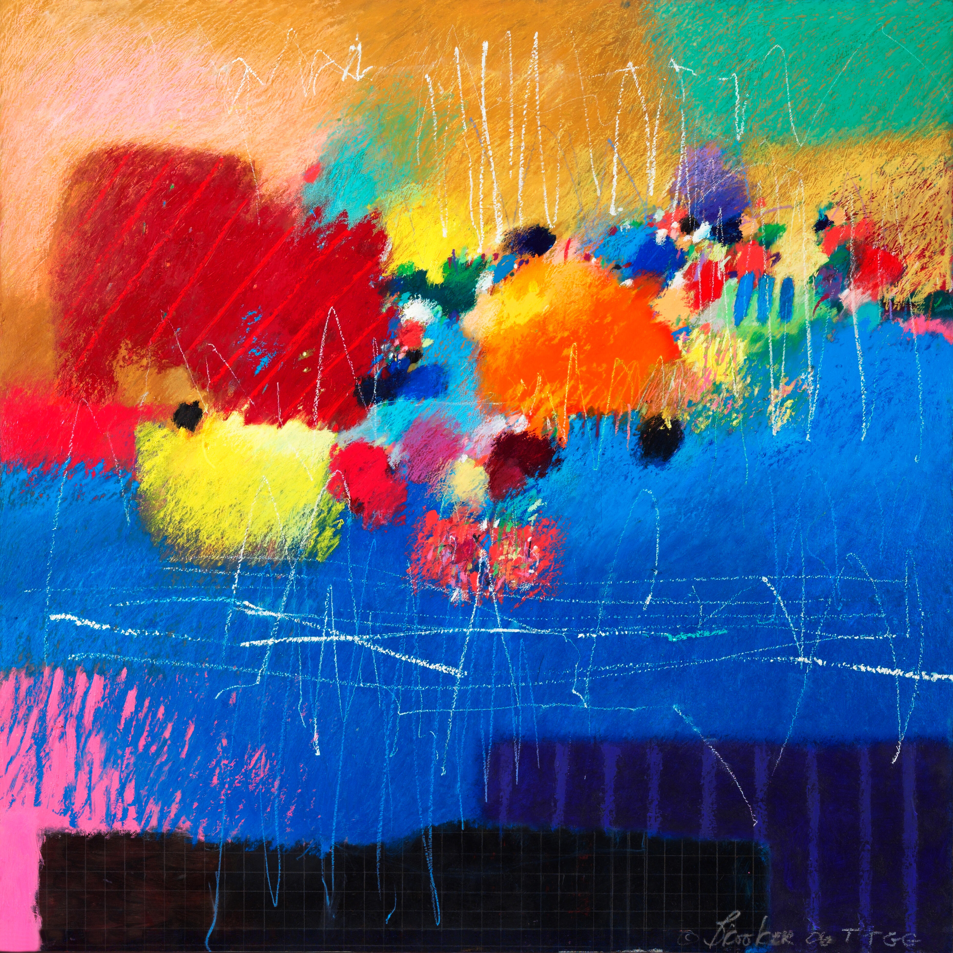
SEE
  Spend a few moments quietly looking at this artwork.

Slide 26
  Now, write down ten things you notice.
  You do not need to write full sentences, a simple list of words is fine.

Slide 27
  The title of this painting
  is Present Futures by the Philadelphia artist Moe Brooker.
  Look again and write down ten new things you notice.
  You could even move to
  a different position in the classroom to see the
  artwork from a different
  point of view before you
  start your second list.

Slide 28
SHARE
  As a class, take turns each sharing one thing you noticed. Challenge yourself to name something that hasn’t already been named.
  Did anyone see something they didn’t see before?

Slide 29
COMPARE
  How is your second list different from your first?
  What does that tell you about how your ideas about the artwork have changed?

Slide 30
REFLECT
  How did it feel to try to
  find so many things in
  the artwork?
  What about repeating
  the activity twice?

Slide 31
SEE, THINK, ME, WE
In this activity, students practice close looking. They then
connect artworks to their own lives and wider communities,
both local and global.
Learn more about See, Think, Me, We, designed by
Project Zero at Harvard Graduate School of Education, here.

Slide 32
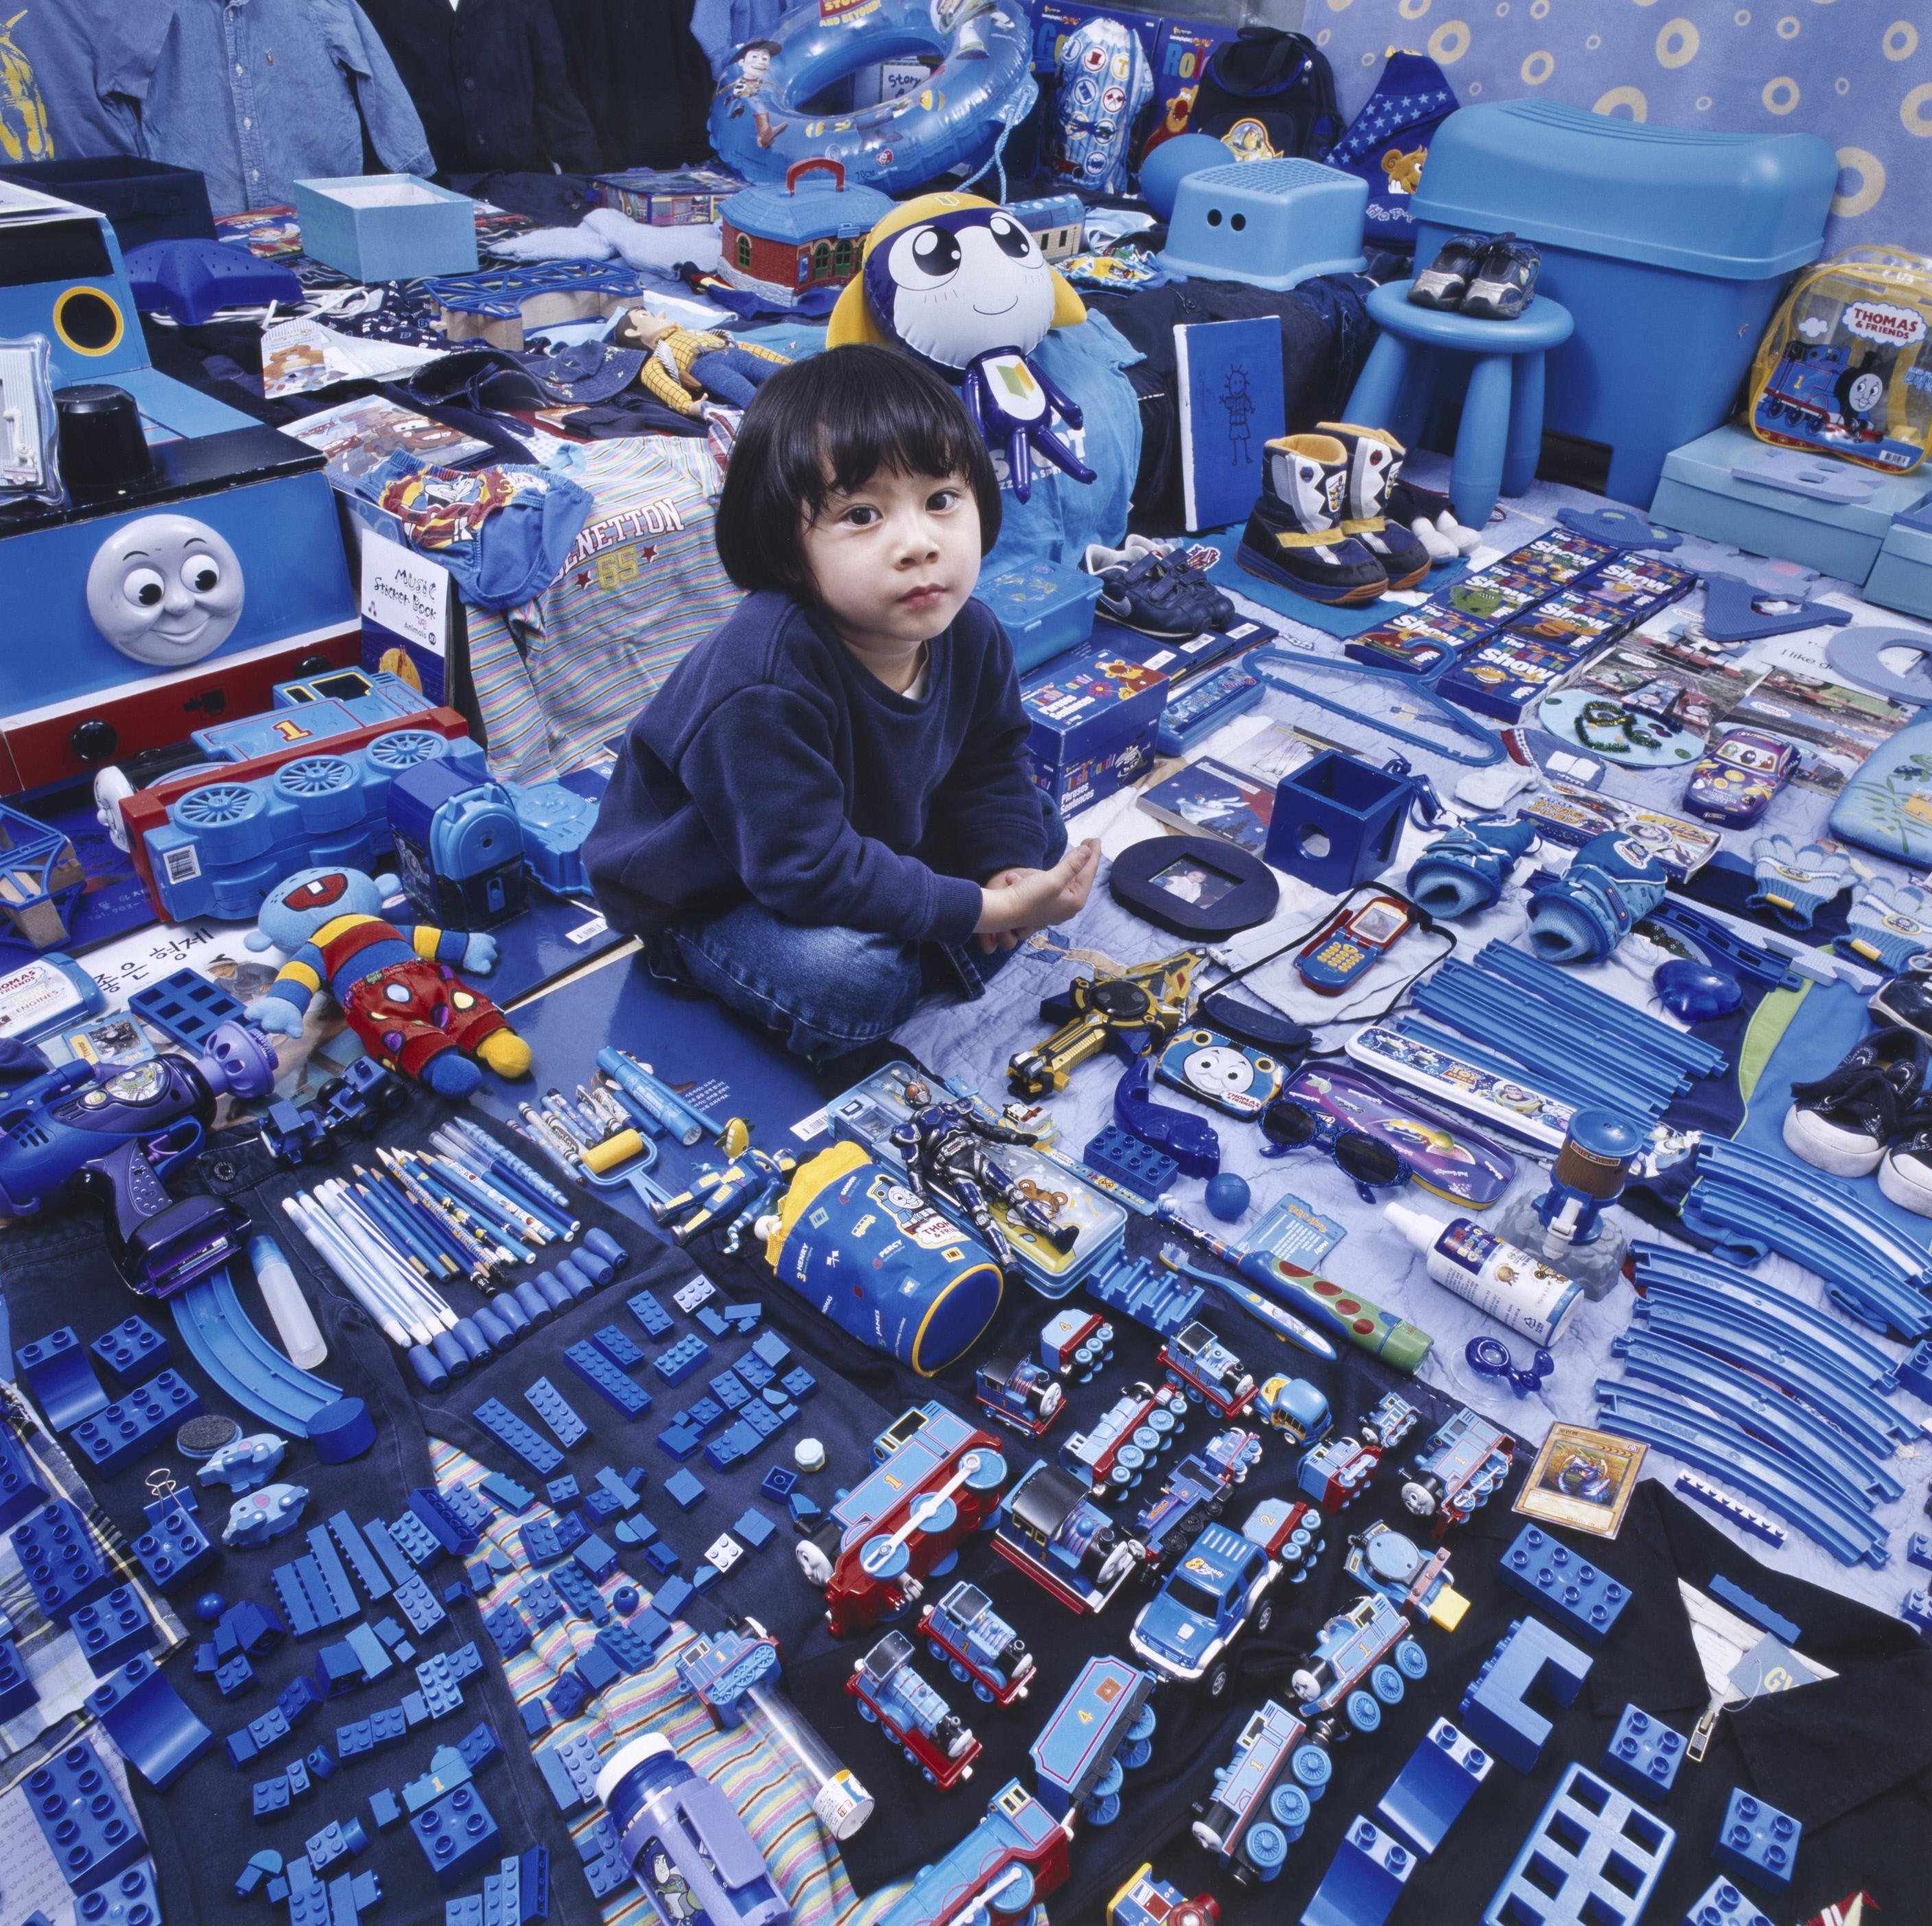
SEE
  Spend a few moments looking quietly at this artwork.

Slide 33
  What do you notice?
  Feel free to turn and talk with a classmate.
  Then share your observations as a class.

Slide 34
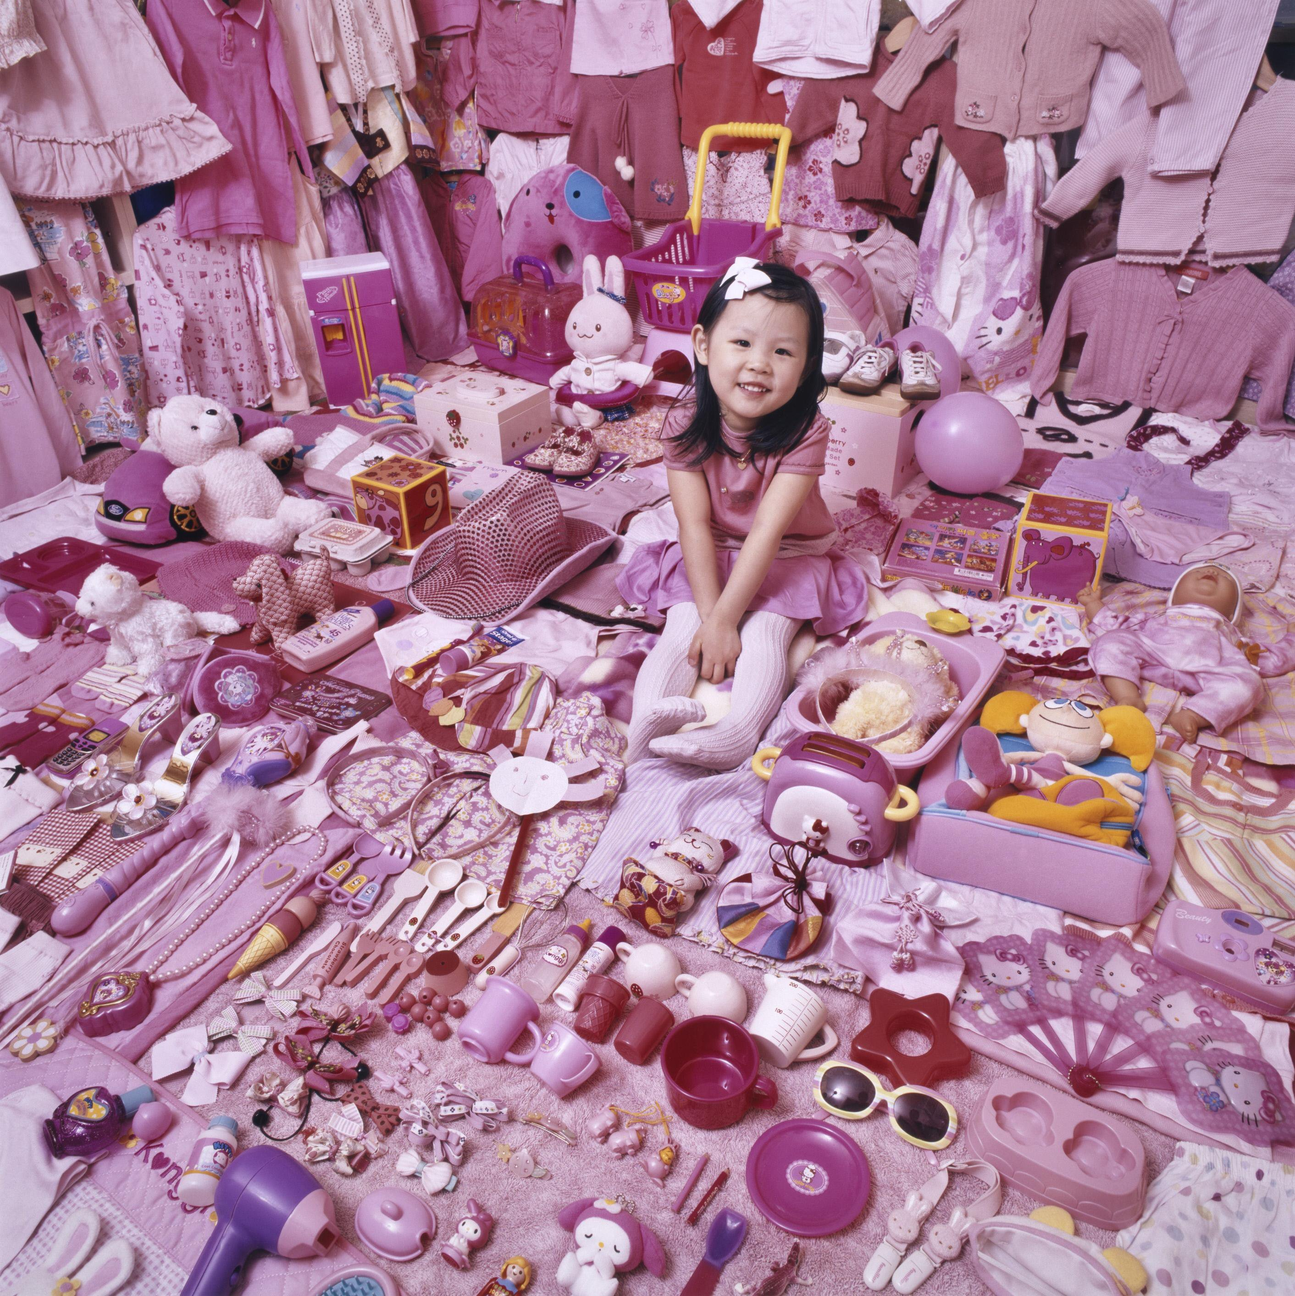
  Now look at this artwork
  from the same series by
  the same artist.
  What do you see here?
  Share your observations
  as a class.

Slide 35
  What similarities and differences do you notice between these two image?

Slide 36
THINK
  What do you think
  is going on in these images?
  What might the relationship be between the children and these objects?

Slide 37
  What might the
  artist be trying to communicate?

Slide 38
ME
  What connections might you make between these artworks and your
  own life?

Slide 39
WE
  What connections might you make between these artworks and society? Think about local and global communities.

Slide 40
ALL ARTWORK IN THIS PRESENTATION IS FROM THE COLLECTION OF THE PHILADELPHIA MUSEUM OF ART UNLESS OTHERWISE NOTED.
CLICK ON THE TITLES FOR MORE INFORMATION ON THE ARTWORKS.
Pages 4–9: “Hands” Quilt, Winter 1980, by Sarah Mary Taylor (The Elle King Torrey Collection of African American Quilts, 2006-163-11)
Pages 11–23: “Tar Beach 2” Quilt, 1990, by Faith Ringgold (Purchased with funds contributed by W. B. Dixon Stroud, 1992-100-1)
© Faith Ringgold / Artists Rights Society (ARS), New York - Courtesy ACA Galleries, New York
Pages 25–30: Present Futures, 2006, by Moe Brooker (Purchased with funds contributed by Marion Boulton Stroud, 2006-149-1)
© Moe Brooker
Pages 32–39: Jimin and His Blue Things, 2007; printed 2008, by JeongMee Yoon (Gift of the Young Friends of the Philadelphia Museum of Art, 2008-108-1) Courtesy of JeongMee Yoon
Pages 34–39: Seohyun and Her Pink Things, 2007; printed 2008, by JeongMee Yoon (Gift of the Young Friends of the Philadelphia Museum of Art, 2008-107-1) Courtesy of JeongMee Yoon

