Slide 1




12, 2916 – 5th Avenue
Calgary, Alberta, T2A 6K4, Canada
Phone: + 1 (403) 243-3285, Fax: + 1 (403) 243-6199
E-mail: cawst@cawst.org, Website: www.cawst.org
CAWST, the Centre for Affordable Water and Sanitation Technology, is a nonprofit organization that provides training and consulting to organizations working directly with populations in developing countries who lack access to clean water and basic sanitation.
One of CAWST’s core strategies is to make knowledge about water common knowledge. This is achieved, in part, by developing and freely distributing education materials with the intent of increasing the availability of information to those who need it most.
This document is open content and licensed under the Creative Commons Attribution Works 3.0 Unported License. To view a copy of this license, visit http://creativecommons.org/licenses/by/3.0 or send a letter to Creative Commons, 171 Second Street, Suite 300, San Francisco, California 94105, USA.
You are free to:
        Share – to copy, distribute and transmit this document
        Remix – to adapt this document
Under the following conditions:
        Attribution. You must give credit to CAWST as the original source of the document. Please include our website: www.cawst.org
CAWST will produce updated versions of this document periodically. For this reason, we do not recommend hosting this document to download from your website.
CAWST and its directors, employees, contractors, and volunteers do not assume any responsibility for and make no warranty with respect to the results that may be obtained from the use of the information provided.
Stay up-to-date and get support:
            Latest updates to this document
            Other workshop & training related resources
            Support on using this document in your work
CAWST provides mentorship and
coaching on the use of its education
and training resources.

Slide 2

This presentation is used with Lesson Plan 8: HWTS Option Selection in the Biosand Filter for Project Implementers Trainer Manual.
Available at www.cawst.org/resources

Slide 3

HWTS Option Selection

Slide 4
Learning Expectations
Identify criteria to select appropriate HWTS options.
Evaluate and select the most appropriate HWTS option for a particular scenario.

Slide 5
HWTS Option Selection
WHO DECIDES?
Decision making and option selection can take place at many levels
  Government
  Independent project implementers
  Individual households.
Many ways to make decisions
Often made based on the information and resources available
Decision making can be done informally or it can be a formal process undertaken by stakeholders
Notes:
Decision making and technology selection can take place at many levels, ranging from central government to independent project implementers to the individual households.
There is no one right way to make decisions and they are often made pragmatically based on the information and resources available. Decision making can be done informally and subconsciously by individuals, or it can be a formal process undertaken by the stakeholders.

Slide 6
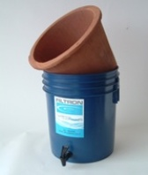


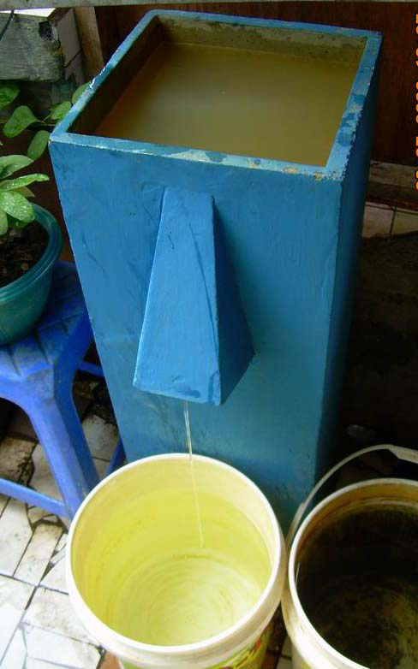

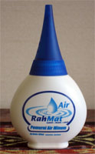
What is the Best Option?
Notes:
Ask participants what they think is the best technology?

Slide 7
There is No Best
Household water treatment is a process and not just a single technology
No easy answer or standard solution
Different factors to consider:
  Treatment effectiveness based on source water quality and local contaminants
  Appropriateness
  Affordability
  Acceptability
Notes:
Many people simply want to be told the “best” technology for household water treatment. Unfortunately, there is no easy formula that will answer this question since there are many factors to consider.
First of all, it is important to remember that household water treatment is a process and not just a single technology. It is not easy to know which combination of technologies is the most appropriate. Many measures have the potential to seriously reduce diarrheal disease; each with its advantages and limitations depending on the local circumstances. Different technologies are better suited for different situations.
The “best process” ought to be driven by a number of factors, including treatment effectiveness based on the source water quality and local contaminants, appropriateness, affordability and acceptability for sustainable use by poor households.

Slide 8
Criteria Influencing Selection
Effectiveness – How well does the technology perform?
Appropriateness – How well does the technology fit into people’s daily lives?
Acceptability – What will people think of the technology?
Cost – What are the costs for the household?
Implementation – What is required to get the technology into people’s homes?

Slide 9
Decision Making
Tools are available to help identify the HWTS process best suited for the local context
  Matrix scoring
  Weighted matrix scoring
  Ranking line
Participatory activities to encourage involvement of different stakeholders
Notes:
However, decision making tools are available to help identify the HWT process that is best suited for the local context. Several decision making tools have been provided in Appendix 3 to compare different HWTS options against criteria which are important to the stakeholders.
The tools are participatory activities which encourage the involvement of different stakeholders in a group process. Participants can actively contribute to decision making, rather than passively receive information from outside experts, who may not have local understanding of the issues.
Participatory activities are designed to build self-esteem and a sense of responsibility for one’s decisions. Experience shows that when everyone contributes to the decision making process, then people feel more ownership of the problem and develop more appropriate solutions for their situation. Participatory decision making can empower communities to implement their own HWTS improvements.

Slide 10
Technology Evaluation
Technology/ Criteria | Cloth Straining | Biosand Filter | Ceramic Pot Filter | Ceramic Candle Filter
Effectiveness
Appropriateness
Acceptability
Cost
Implementation
Notes:
Ask groups to join each other so that there is a total of three groups (if more that 20 participants, make six groups). Give each group a set of HWT options (all options from sedimentation to one group, filtration to another group…) and ask them to evaluate each of the options based on the criteria discussed.
This matrix is an example of how to compare effectiveness for different filtration technologies. Participants should create their own matrix with the criteria they have identified as important.

Slide 11
Review
Which HWT option is the best choice for treating water?
It depends!
Notes:
There is no “best” technology for HWTS. There are lots of HWTS options and they all have advantages and limitations.
A technology should always be evaluated within the context of its implementation. There are many criteria to consider for the local context, including treatment effectiveness for the water source, appropriateness, acceptability, affordability and implementation requirements.
There is no one right way to make decisions about HWTS selection. There are systematic tools to evaluate technologies, but decisions are often made pragmatically based on the information and resources available.
Government should ensure that different HWTS products are available in the marketplace. Rather than promoting only one HWTS option, government should try to develop a market for a range of products at a number of price-points. This provides households and implementers with the freedom to make their own decisions and to choose the options that best suit them.
Review the learning expectations. Ask participants whether or not the expectations have been met. If not, give options for participants to find the information they were looking for or identify next steps for follow up.

Slide 12
Review
List 5 criteria can you use to evaluate different HWT options.
Effectiveness
Appropriateness
Acceptability
Cost
Implementation
Notes:
There is no “best” technology for HWTS. There are lots of HWTS options and they all have advantages and limitations.
A technology should always be evaluated within the context of its implementation. There are many criteria to consider for the local context, including treatment effectiveness for the water source, appropriateness, acceptability, affordability and implementation requirements.
There is no one right way to make decisions about HWTS selection. There are systematic tools to evaluate technologies, but decisions are often made pragmatically based on the information and resources available.
Government should ensure that different HWTS products are available in the marketplace. Rather than promoting only one HWTS option, government should try to develop a market for a range of products at a number of price-points. This provides households and implementers with the freedom to make their own decisions and to choose the options that best suit them.
Review the learning expectations. Ask participants whether or not the expectations have been met. If not, give options for participants to find the information they were looking for or identify next steps for follow up.

