Slide 1

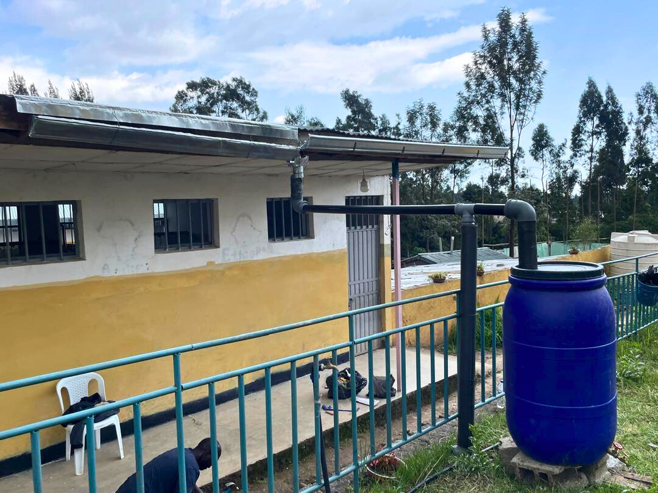



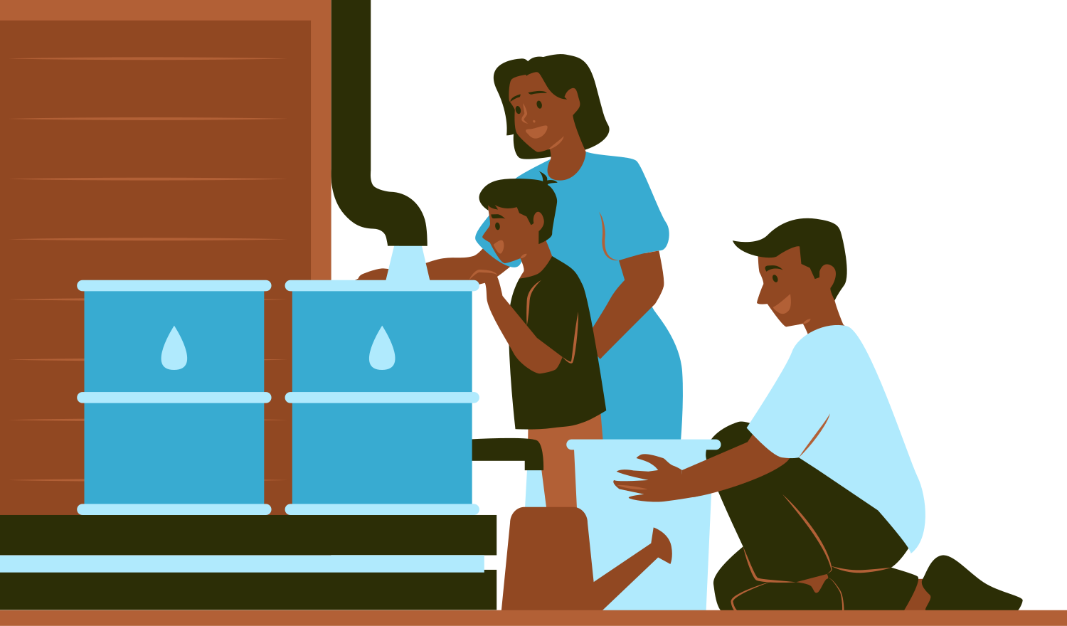


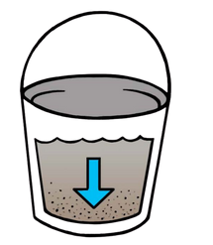
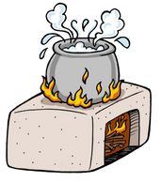
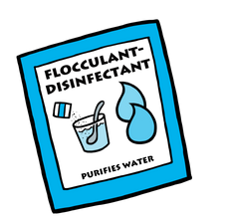
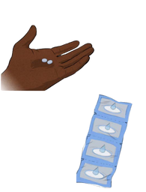
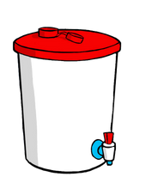
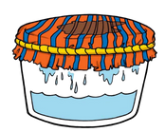

Free Water for Your Family – Just from Rain!
1
Rain Falls: Let’s Catch it!
Rainwater lands on your roof. The cleaner your roof, the cleaner
your water!
1
2
2
Gutters Guide the Flow
Gutters and pipes move the rain into the tank. They help collect
every drop.
3
First Water Out! (It’s Dirty)
The first bit of water is diverted away. It may carry dust, droppings,
or roof dirt.
4
4
Filter the Water: Keep the Good, Throw the Bad
Water flows through a screen or filter. It removes leaves, bugs,
and debris.
5
Store It Safely – Your Tank is a Treasure
Clean water is stored in a sealed container or tank. Covered tanks keep out mosquitoes, dirt, and sunlight. Use the tap! It’ll let you access the water easily.
6
6
Use It for Home Needs
Water is available for washing, cleaning, or even drinking (if treated). It saves money and keeps your family healthy.
5
7
Simple Maintenance = Long-Lasting Water
A little care keeps your system working year after year.
✔️ Clean your gutters
✔️ Check your filter
✔️ Watch for leaks
3
Even clean-looking rainwater can carry tiny germs. Let’s make it safe to use!
For more information:
**Insert Contact Info
Let It Rest – Dirt Sinks Down!
Use a Filter
Kill Any Remaining Germs
Safely Store the Water!
(Boil, use Bishan Gari, or Chlorine)

