Slide 2
This presentation is for use with
“Lesson Plan:
HWTS (What Is It and
When Is It Effective?)”
in the Household Water Treatment and Safe Storage (HWTS)
Trainer Manual
Available at resources.cawst.org

Slide 3
Household Water Treatment and Safe Storage (HWTS)
What Is It and When Is It Effective?
2018
June

Slide 4
Learning Outcomes
Define HWTS
Describe the 3 conditions required for HWTS to have the greatest health benefits
Identify potential barriers to correct, consistent, and continued use of HWTS

Slide 5
What Is Water Treatment?
Any process (physical, chemical, biological)
used to improve water quality

Slide 6

Which Problems Can Water Treatment Solve?
Only water quality issues
Does not address water supply or reliability unless combined with other measures

Slide 7


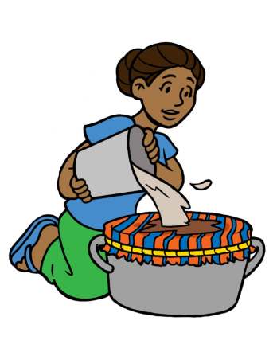
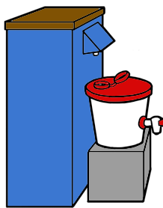
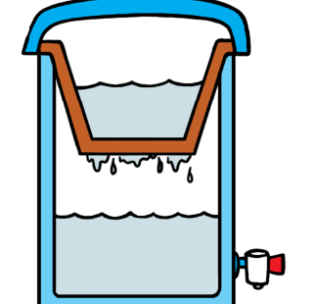
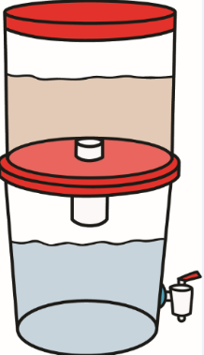
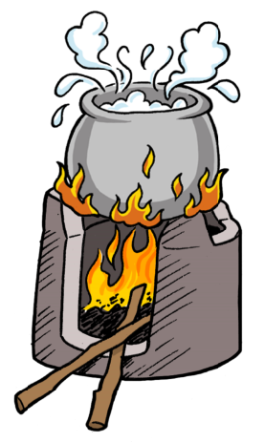
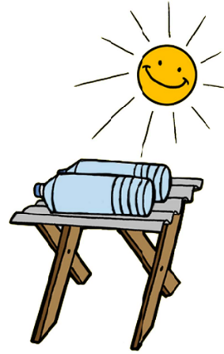
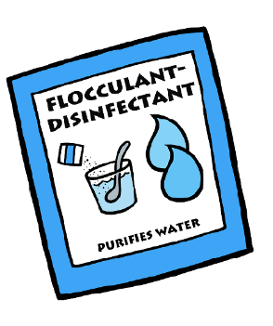
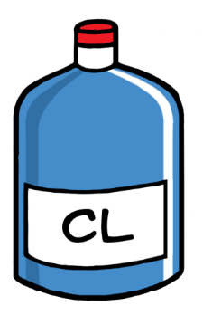
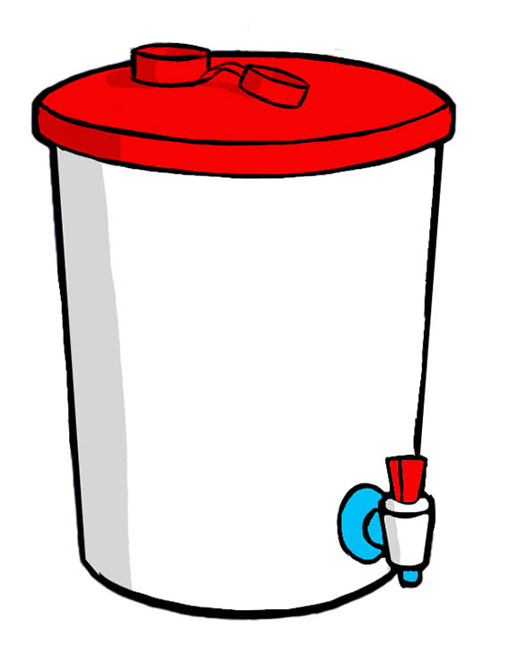
What Is HWTS?
Sedimentation
Filtration
Disinfection
Safe Storage
Any approaches used to treat and safely store water at the household level
or point-of-use (POU)

Slide 8
Is HWTS Effective at Improving Health?
HWTS Intervention Type | Reduction in Diarrhea
Chlorination | 23%
Flocculation – Disinfection | 31%
Ceramic Filters | 61%
Biosand Filters | 53%
Lifestraw Filters | 31%
SODIS | 38%
Reduction in Diarrhea for Different HWTS Interventions (adapted from Clasen et al., 2015)

Slide 9
Health Impacts of HWTS: Diarrheal disease
Unimproved source
Improved source
Piped water on premises
28%
38%
45%
Wolf J, Prüss-Ustün A, Cumming O, et al. Review of the evidence relating drinking-water and sanitation to diarrhoea: a meta-regression.
Tropical Medicine and International Health. 2014.
Notes:
A 2014 systematic review and meta-analysis found that effective household water treatment (boiling or filtration and safe storage) led to a 45% reduction in diarrheal disease when the water source was unimproved. When the source was improved, the addition of household water treatment led to a 38% reduction. And with piped water on premises, a 28% reduction.

Slide 10
When are HWTS Methods Most Likely to Improve People’s Health?
Clasen (2015) found that the HWTS method must be:
Effective against pathogens
Accessible to vulnerable populations
Used correctly, consistently, and continually

Slide 11
The 3 Cs
Correct
Consistent
Continued
100% treated water consumed
Notes:
Correct: The household is using an appropriate HWTS system for their water source(s), following best practices or manufacturer’s instructions
Consistent: All members of the household are only drinking treated water, regardless of time of day or season.
Continued: All members of the household are using treated water for the long term.

Slide 12

Correct
Effective method given the source water quality
User follows instructions and uses correctly

Slide 13

Examples of Incorrect Use
Technology is not appropriate for source water quality
User does not follow instructions (difficult to use, lack of training)
Different users with different knowledge and skills
Broken parts not repaired or maintenance not performed

Slide 14

Consistent
Importance of consistent use when pre-treatment water quality is high risk
Simplified from: Brown J, & Clasen T (2012) High Adherence Is Necessary to Realize Health Gains from Water Quality Interventions. PLOS ONE 7(5): e36735.

Slide 15

Examples of Inconsistent Use
Drink unsafe water at school or work, but safe water at home
Only drink treated water when available
Only treat water when a certain person is home

Slide 16

Continued (Sustained)
Long-term use of treatment
Until household has access to safely managed water in their home
Never return to drinking untreated water

Slide 17

Examples of Discontinued Use
Stop using a filter when it breaks
Stop using when run out of supplies
Forget to use after a while

Slide 18

Imagine you have received a new HWTS product…
What does correct, consistent, and continued use look like for your household?
What challenges might you face in achieving correct, consistent, continued use?

Slide 19

Review: Workbook
Notes:
What is household water treatment and safe storage (HWTS)?
What factors are needed for HWTS to have the greatest health benefits?
Fill in the table describing the 3 Cs.

Slide 20
References
Brown, J., & Clasen, T. (2012). High adherence is necessary to realize health gains from water quality interventions. PLoS One, 7(5), e36735.
Clasen, T. (2015). Household Water Treatment and Safe Storage to Prevent Diarrheal Disease in Developing Countries. Current Environmental Health Reports, 2(1), 69–74. https://doi.org/10.1007/s40572-014-0033-9
Clasen, T., Alexander, K. T., Sinclair, D., Boisson, S., Peletz, R., Chang, H. H., … Cairncross, S. (2015). Interventions to improve water quality for preventing diarrhoea. In The Cochrane Collaboration (Ed.), Cochrane Database of Systematic Reviews. Chichester, UK: John Wiley & Sons, Ltd. Retrieved from http://doi.wiley.com/10.1002/14651858.CD004794.pub3

