Slide 1



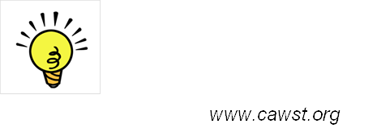
424 Aviation Road NE
Calgary, Alberta, T2E 8H6, Canada
Phone: + 1 (403) 243-3285, Fax: + 1 (403) 243-6199
E-mail: resources@cawst.org, Website: www.cawst.org
CAWST, the Centre for Affordable Water and Sanitation Technology, is a nonprofit organization that provides training and consulting to organizations working directly with populations in developing countries who lack access to clean water and basic sanitation.
One of CAWST’s core strategies is to make knowledge about water common knowledge. This is achieved, in part, by developing and freely distributing education materials with the intent of increasing the availability of information to those who need it most.
This document is open content and licensed under the Creative Commons Attribution Works 3.0 Unported License. To view a copy of this license, visit http://creativecommons.org/licenses/by/3.0 or send a letter to Creative Commons, 171 Second Street, Suite 300, San Francisco, California 94105, USA.
You are free to:
        Share – to copy, distribute and transmit this document
        Remix – to adapt this document
Under the following conditions:
        Attribution. You must give credit to CAWST as the original source of the document. Please include our website: www.cawst.org
CAWST will produce updated versions of this document periodically. For this reason, we do not recommend hosting this document to download from your website.
CAWST and its directors, employees, contractors, and volunteers do not assume any responsibility for and make no warranty with respect to the results that may be obtained from the use of the information provided.
Stay up-to-date and get support:
            Latest updates to this document
            Other workshop & training related resources
            Support on using this document in your work
CAWST provides mentorship and
coaching on the use of its education
and training resources.

Slide 2

This presentation is used with Lesson Plan 9: User-Focused Design in the Latrine Design and Construction Trainer Manual.
Available at: www.cawst.org/resources

Slide 3

User-Focused Design

Slide 4
Learning Outcomes
Explain user-focused design in the context of a sanitation system.
Identify different latrine user groups.
Discuss potential latrine modifications for each user group.
Discuss the importance of latrine access for all people, whatever their abilities or limitations.
Identify different ways to involve users in the latrine design process.

Slide 5
Latrine Access and Use
Everyone should be able to use the latrine comfortably, regardless of their strength, size or physical condition
Important to remove barriers for anyone who may have a difficult time accessing or using a latrine
Access is important for health, but also for human dignity

Slide 6
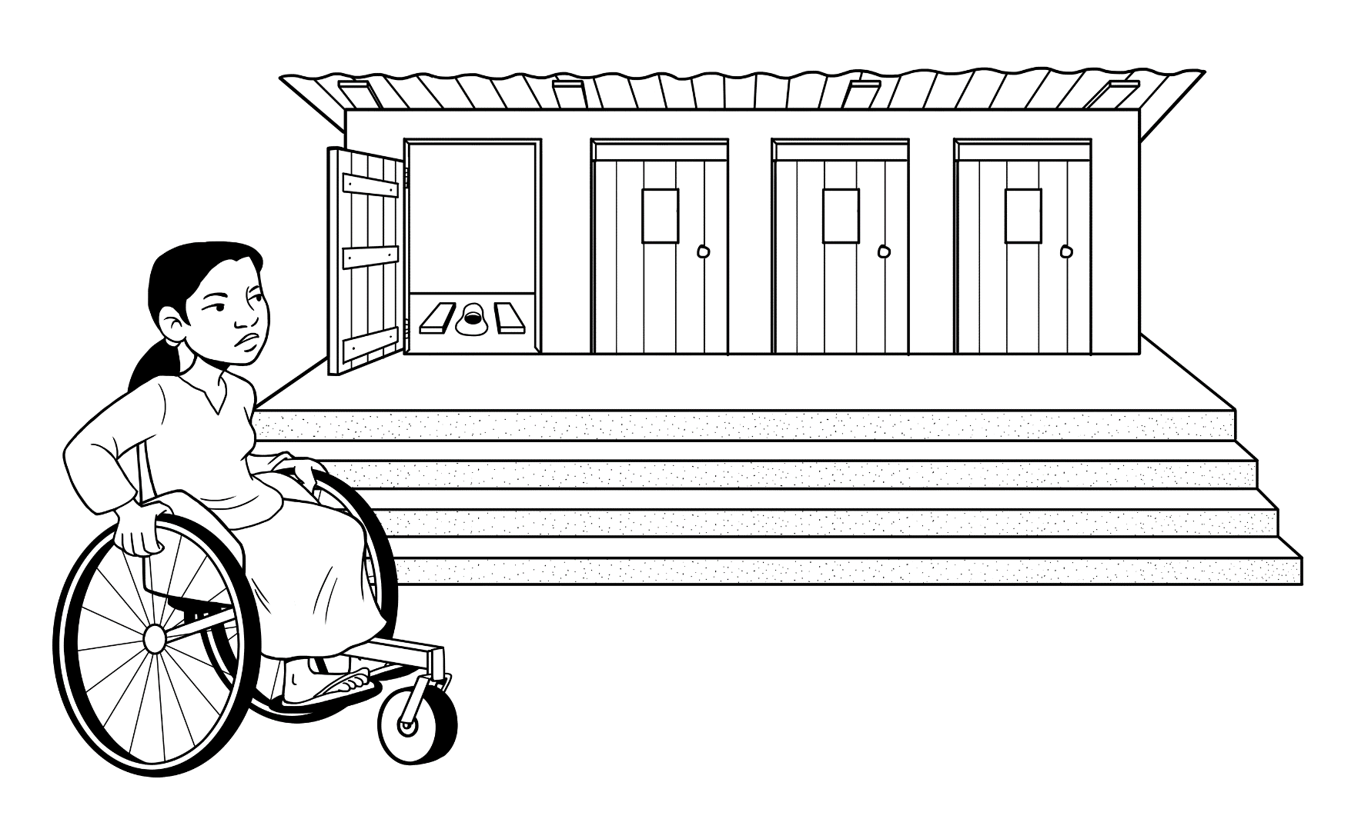
What Modifications?

Slide 7
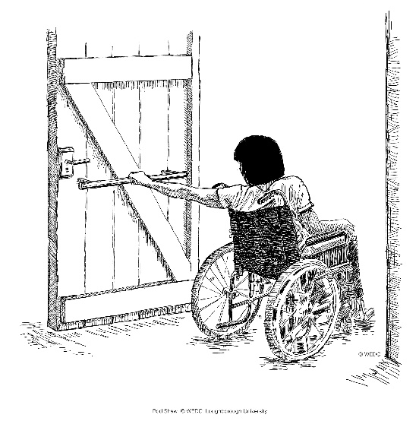
Outward opening door
Handrail on door
Wide entrance, no steps
(Credit: Shaw/WEDC, 2013)
Notes:
With some simple modifications, latrines can be made user-friendly for people with disabilities and other physical vulnerabilities. The following features can be taken into consideration when designing an accessible latrine:
Locate the latrine as near as possible to the user
Provide easy access to the latrine with a wide path (at least 120 cm wide) that is well drained, compacted and non-slip
Construct ramps with a gentle slope using less than a 1:15 (6.6%) gradient
Construct an entrance area large enough to allow a person in a wheelchair to move, entrance doors should be a minimum 80 cm wide to provide clear space
Use outward opening doors to leave more usable space inside the latrine
Door should have easier to reach handles on the outside and inside, and a lock on the inside (and possibly outside)
Ensure that the door can be opened and closed by the user when they are inside the latrine
Portable seat or permanent raised seat for people who have difficulty squatting
Provide additional space inside the latrine to move a wheelchair or for a caregiver to help somebody
Provide support rails for people to hold on to when moving to and from the seat or when squatting
Provide guiding systems (e.g., paint the entrance and footrests) and good lighting for the visually impaired
Ensure that lids, taps and knobs are light and easy to use with one hand or feet for people with missing or paralyzed limbs
Ensure that the latrine, including the floor and seat, is easy to clean

Slide 8
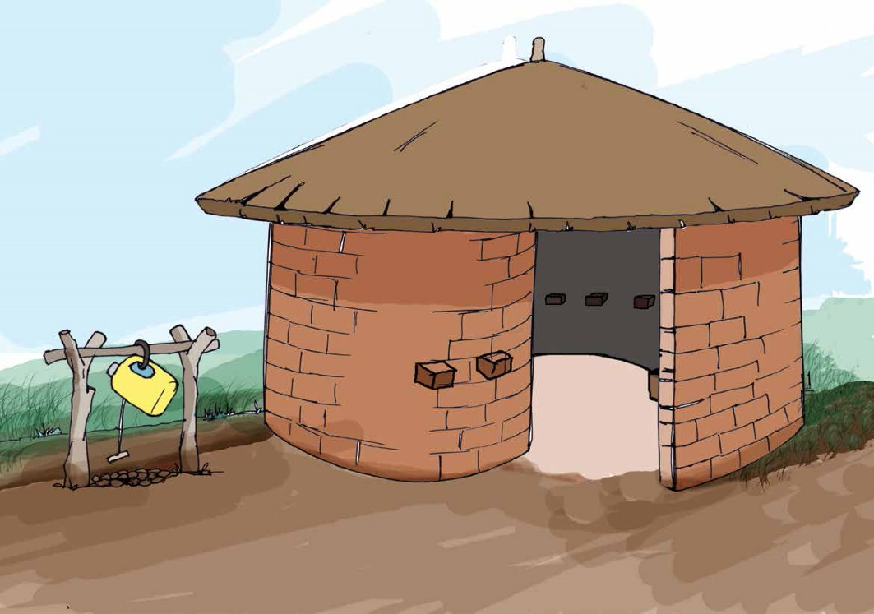
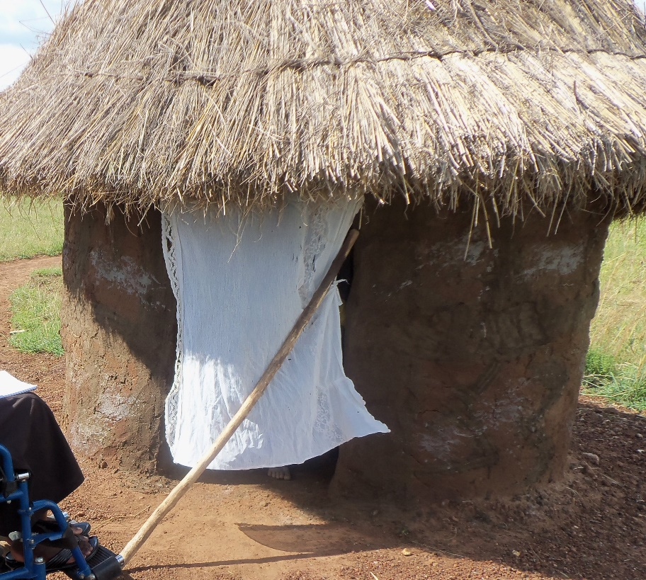
Spiral entrance
Curtain
(Credit: Jones and Wilbur, 2014)
Notes:
A spiral entrance or a curtain may be easier for some users than a door
Reference for illustrations:
Jones, H. and Wilbur, J. 2014. Compendium of Accessible WASH Technologies. WEDC, WaterAid and Share. Retrieved from: http://www.wateraid.org/what-we-do/our-approach/research-and-publications/view-publication?id=aff6d098-00f2-42e5-b9a0-22ec2b264a5e

Slide 9
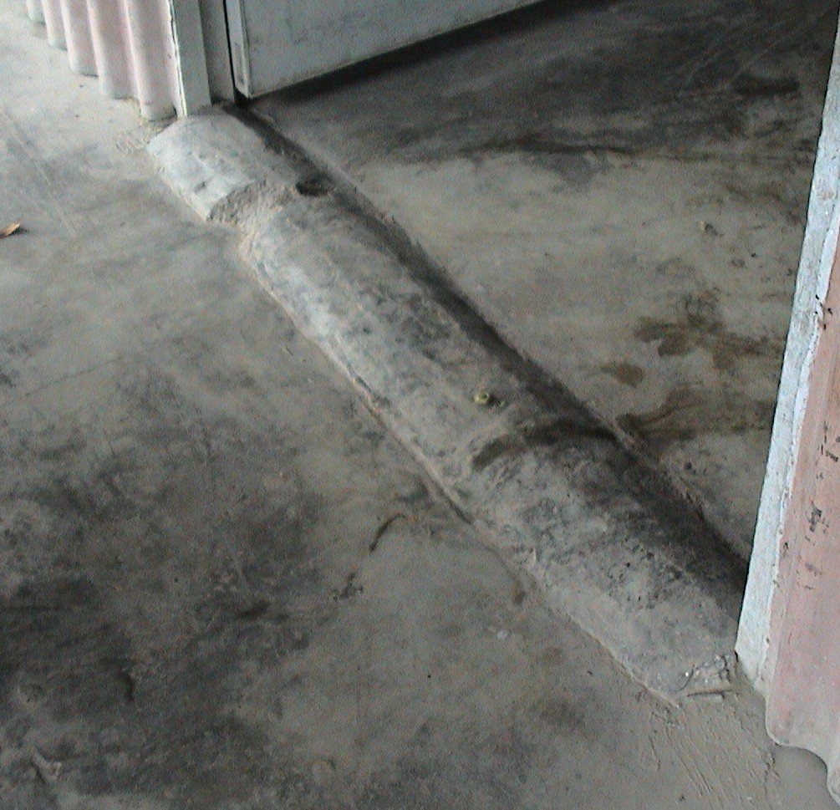
Low rounded bump keeps out rain water but allows wheelchair access
(Credit: Jones and Wilbur, 2014)
Notes:
For wheelchair users, entrances should be:
wide (width of wheelchair + 20cm),
flat and level with the outside. You could use a small rounded bump at the entrance to keep out rain water and minor flooding, but still allow wheelchairs past. A small bump like this will not keep out deeper floods.
Reference for illustration:
Jones, H. and Wilbur, J. 2014. Compendium of Accessible WASH Technologies. WEDC, WaterAid and Share. Retrieved from: http://www.wateraid.org/what-we-do/our-approach/research-and-publications/view-publication?id=aff6d098-00f2-42e5-b9a0-22ec2b264a5e

Slide 10
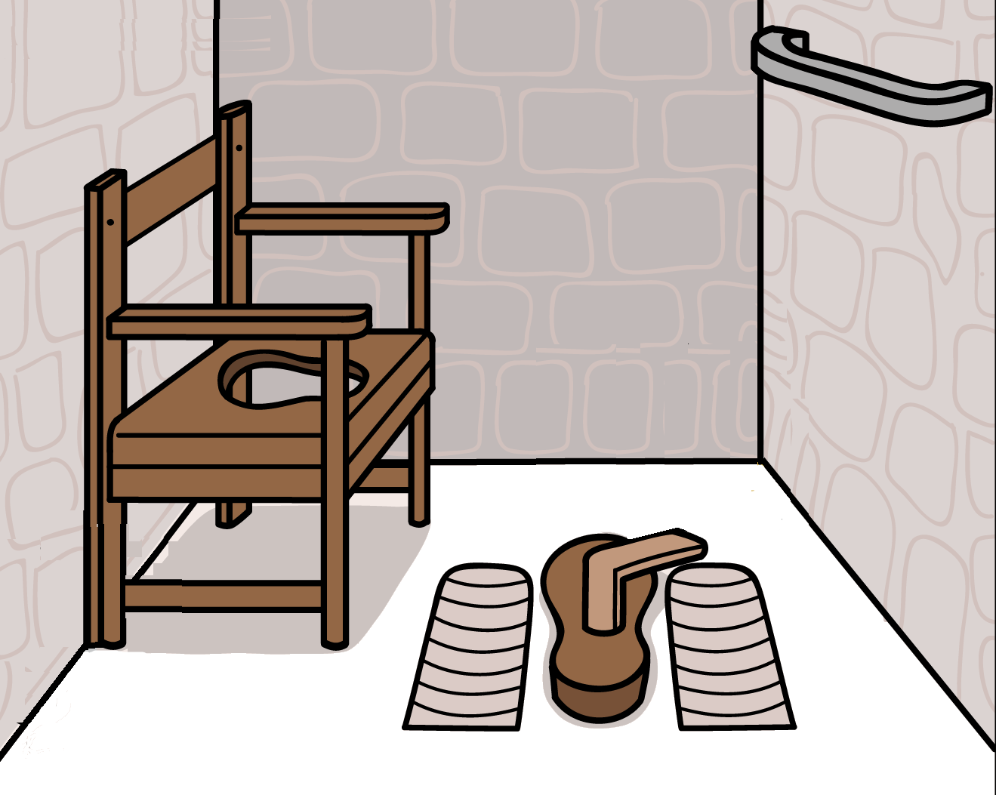
Handrail on wall
Portable chair
Textured footrests
Notes:
In cultures where squatting is the norm, those with reduced mobility may prefer to sit (such as the elderly, pregnant women or people with disabilities). A portable seat or chair can be placed directly over a squat hole or pour flush pan. Hand rails or hold bars can also help people when squatting, sitting down and getting up. Textured footrests are also often put on the slab to help people place their feet and provide grip so that they do not slip.
A permanently raised seat could also be used for those who have difficulty squatting

Slide 11
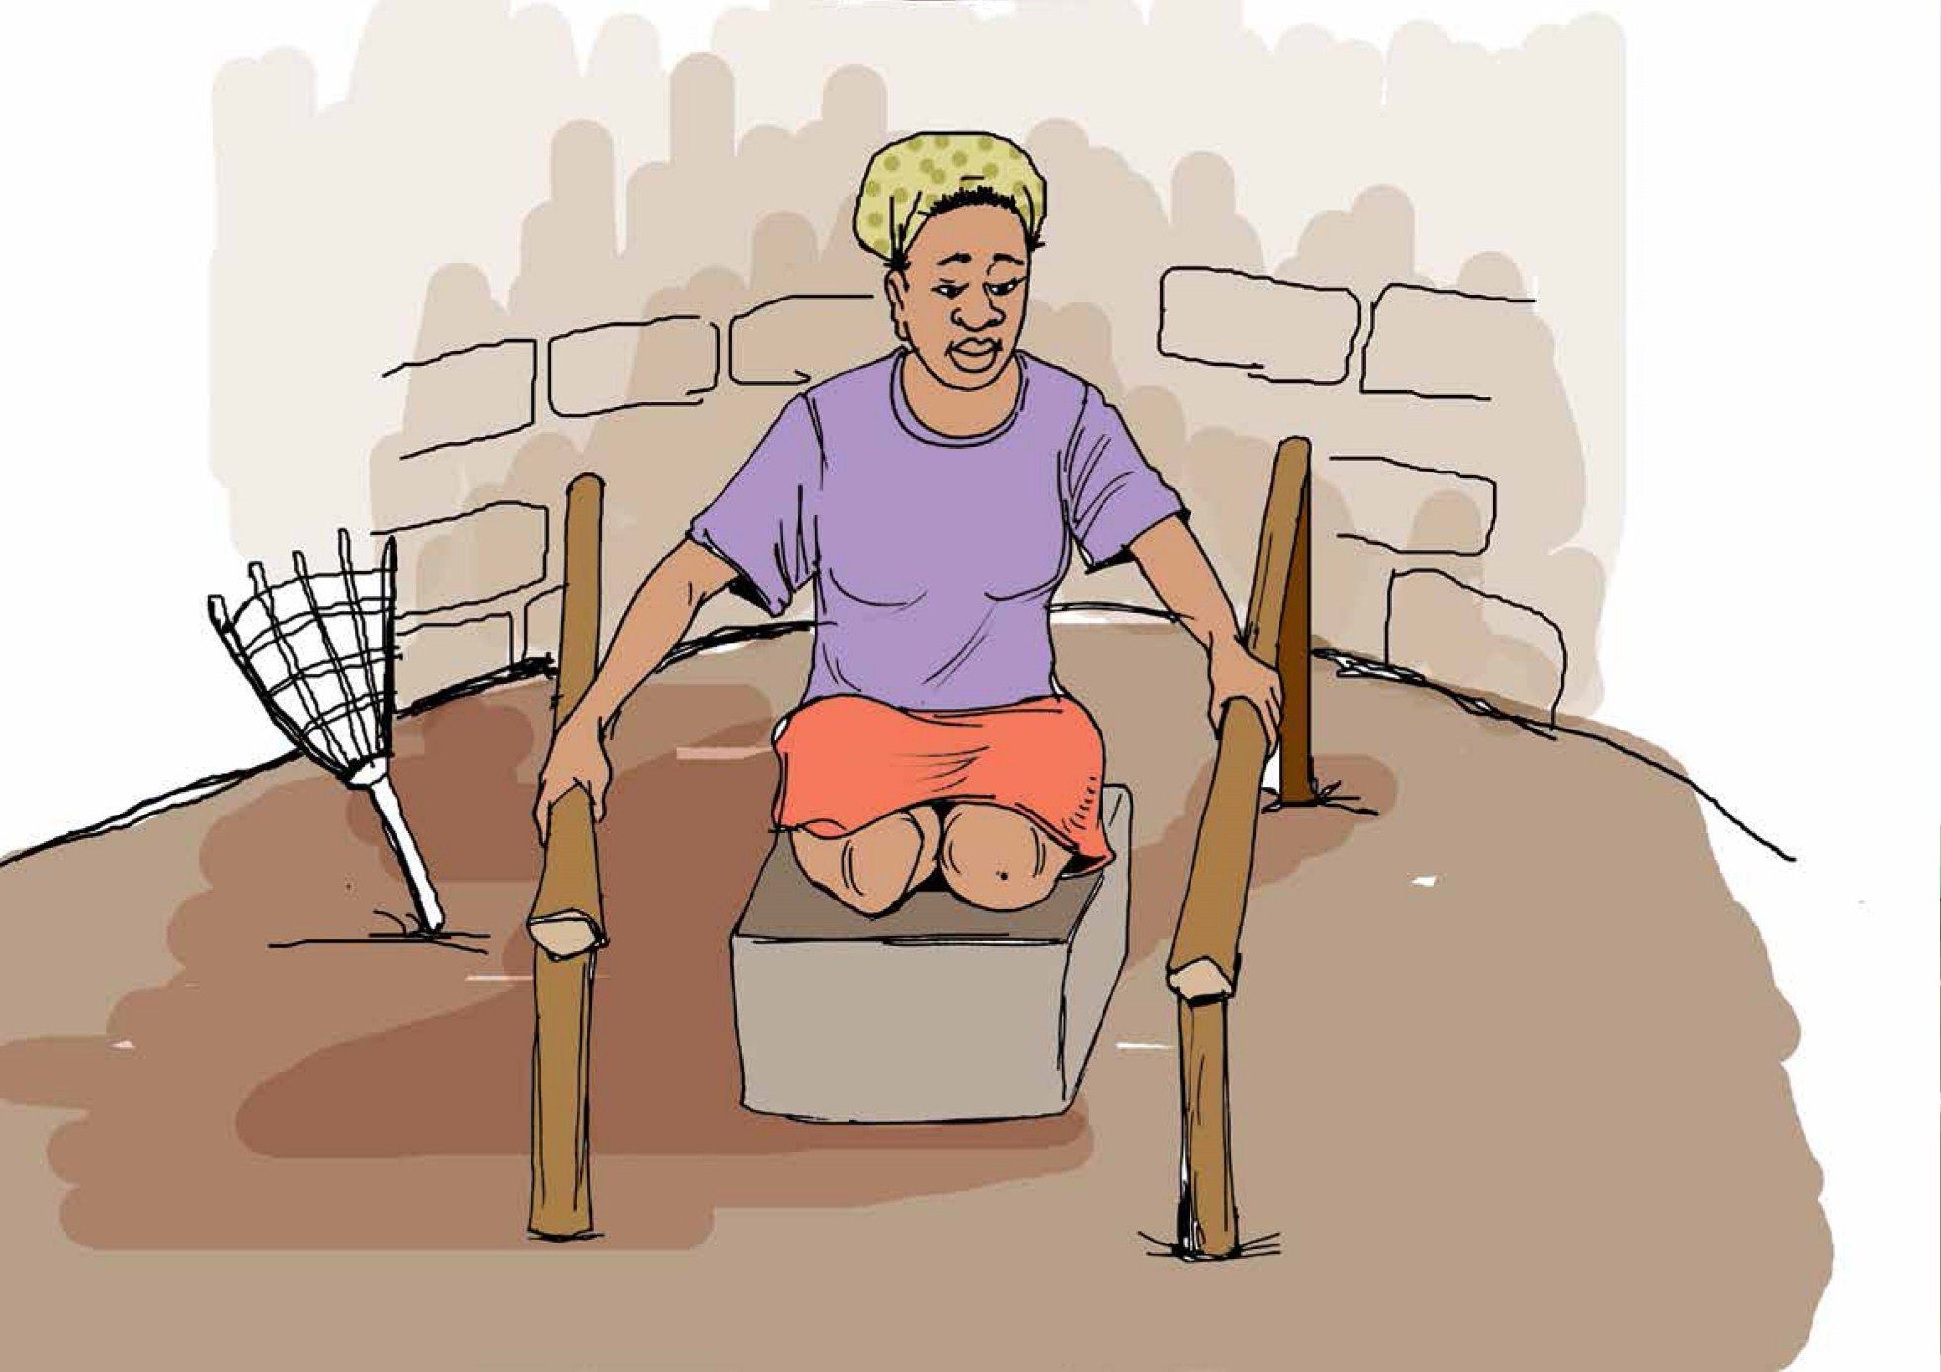
Handrails to help with moving and stability
Raised toilet
(Credit: Jones and Wilbur, 2014)
Notes:
For those who need assistance squatting or getting on/off the toilet, handrails provide support.
Can be made of wood, bamboo or metal
Must be rigid and strong enough to support weight of user
Can be affixed to walls or floor (metal bars can be cast into concrete)
If affixed to walls, the walls must be close enough for user to reach bars (but still have room to move or for a wheelchair or for a support person in the latrine)
Consult user about height of bars. Various bars at different heights may suit more than one user if required, or may help some users lower/lift themselves
A raised seat may also be used (instead of a portable chair) for those who have difficulty squatting
Reference for illustration:
Jones, H. and Wilbur, J. 2014. Compendium of Accessible WASH Technologies. WEDC, WaterAid and Share. Retrieved from: http://www.wateraid.org/what-we-do/our-approach/research-and-publications/view-publication?id=aff6d098-00f2-42e5-b9a0-22ec2b264a5e

Slide 12
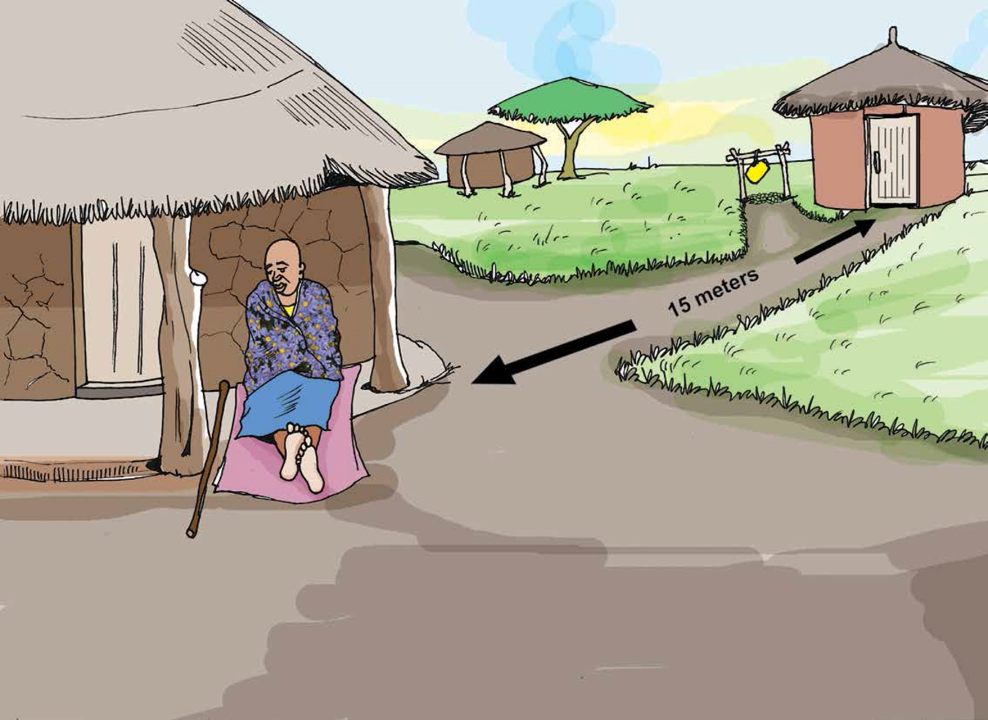
(Credit: Jones and Wilbur, 2014)
Notes:
For people with limited mobility, latrines should be placed as close as possible to their dwelling. 15 metres is recommended (Jones and Wilbur, 2014).
Reference for illustration:
Jones, H. and Wilbur, J. 2014. Compendium of Accessible WASH Technologies. WEDC, WaterAid and Share. Retrieved from: http://www.wateraid.org/what-we-do/our-approach/research-and-publications/view-publication?id=aff6d098-00f2-42e5-b9a0-22ec2b264a5e

Slide 13
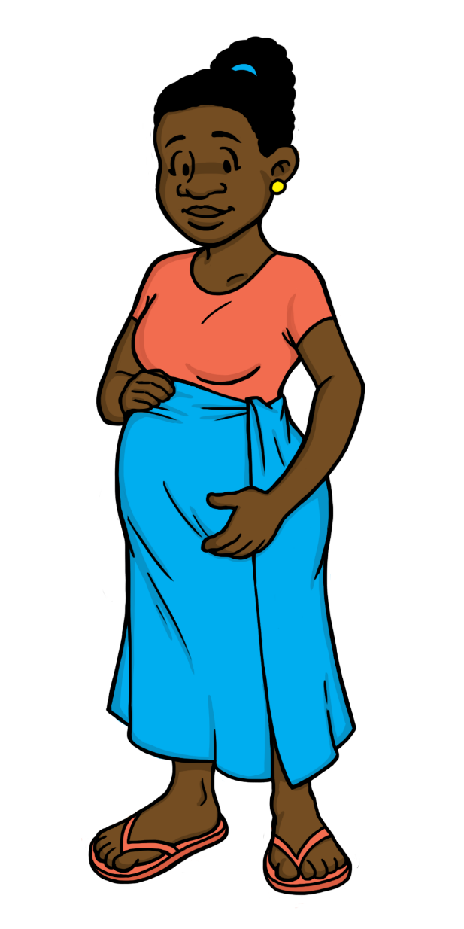
What Modifications?
Notes:
Pregnant women may find it difficult to squat and balance, may be worried about slipping, falling or straining, and may experience urgency or have to use the latrine often.

Slide 14
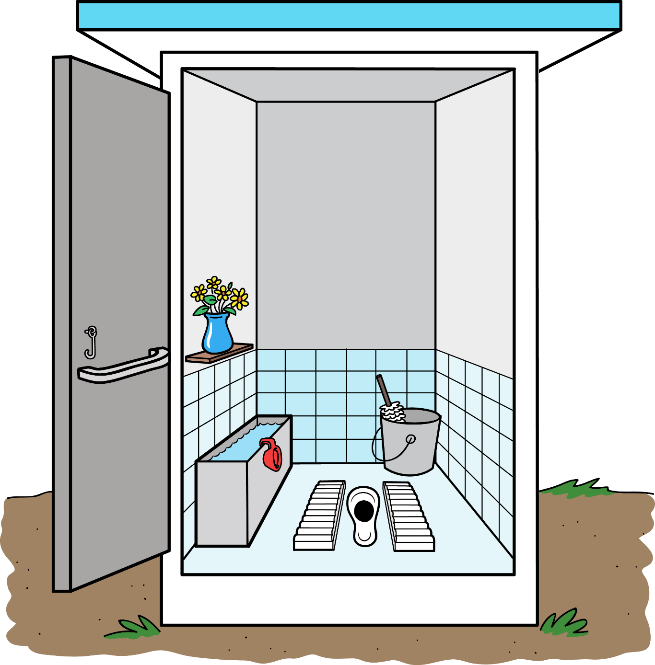
Handrail on door
Textured footrests
Notes:
Handrails or hold bars can also help people when squatting, sitting down and getting up. Textured footrests are also often put on the slab to help people place their feet and provide grip so that they do not slip.
These modifications can also apply to people with physical disabilities, elderly and the sick.

Slide 15
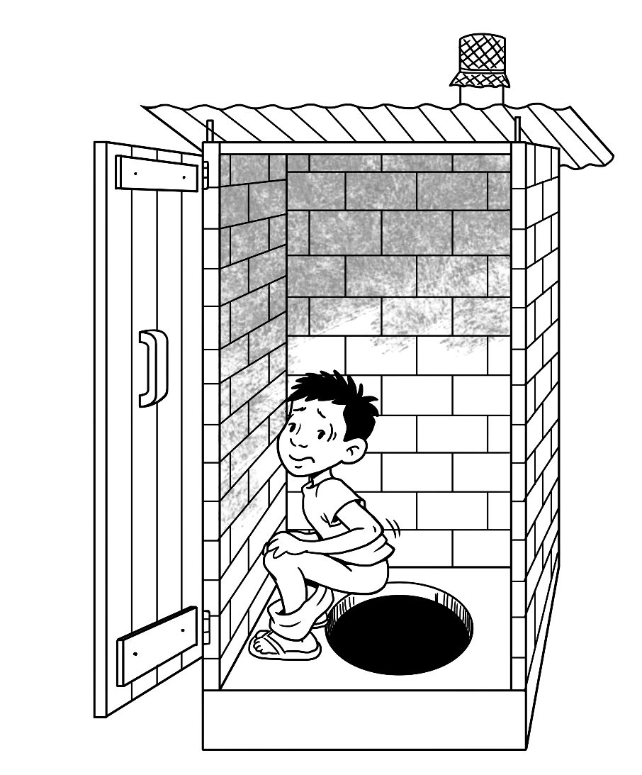
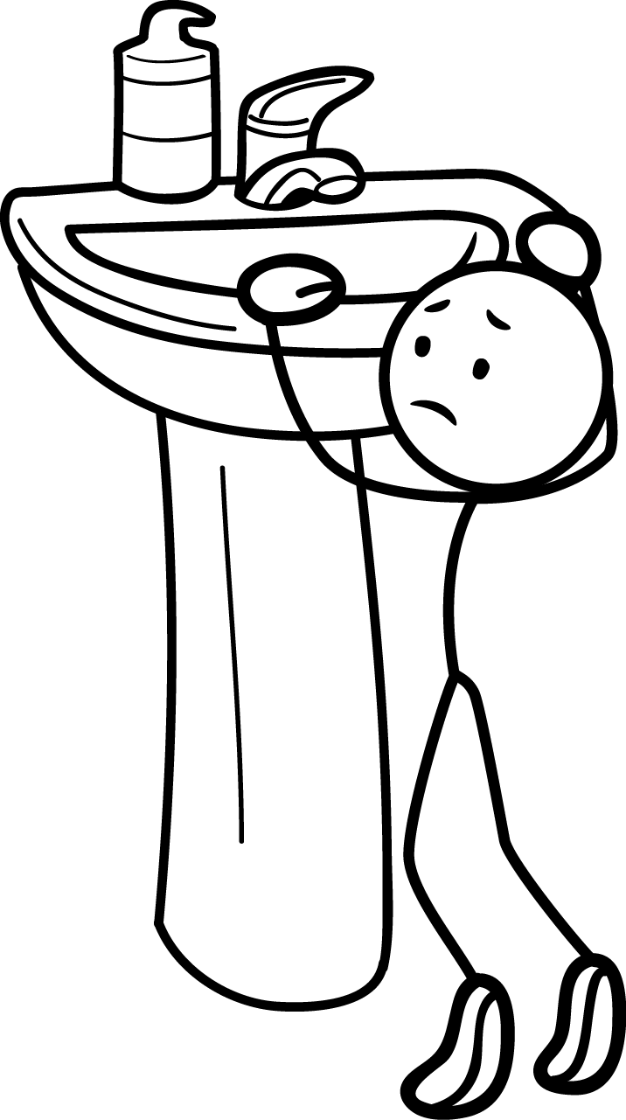
What Modifications?

Slide 16
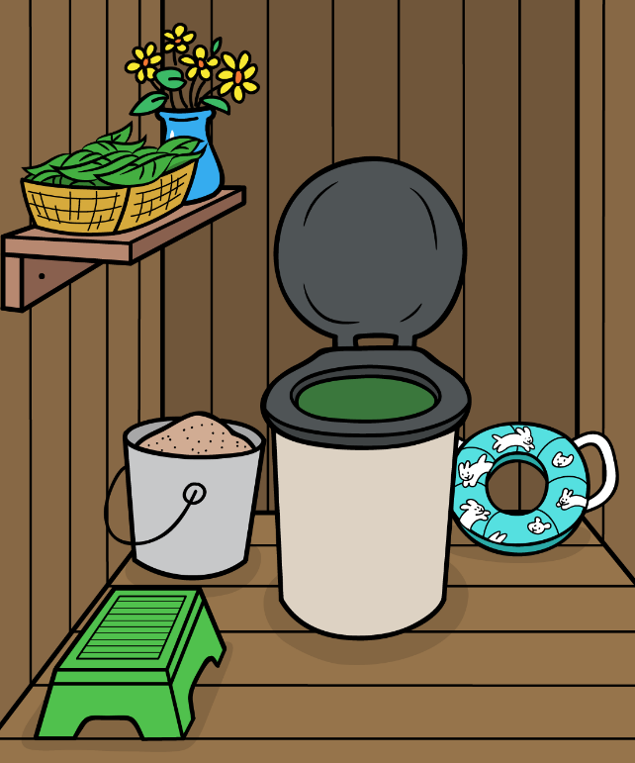
Small removable seat
Foot stool
Notes:
A small stool can help children access the toilet and handwashing sink.
For raised seats, a small portable toddler seat can be placed over the toilet for small children. When using squatting toilets, handrails to hold onto can give children stability and confidence when squatting over an adult-sized drop hole. If possible, smaller squat holes can be built for children.

Slide 17
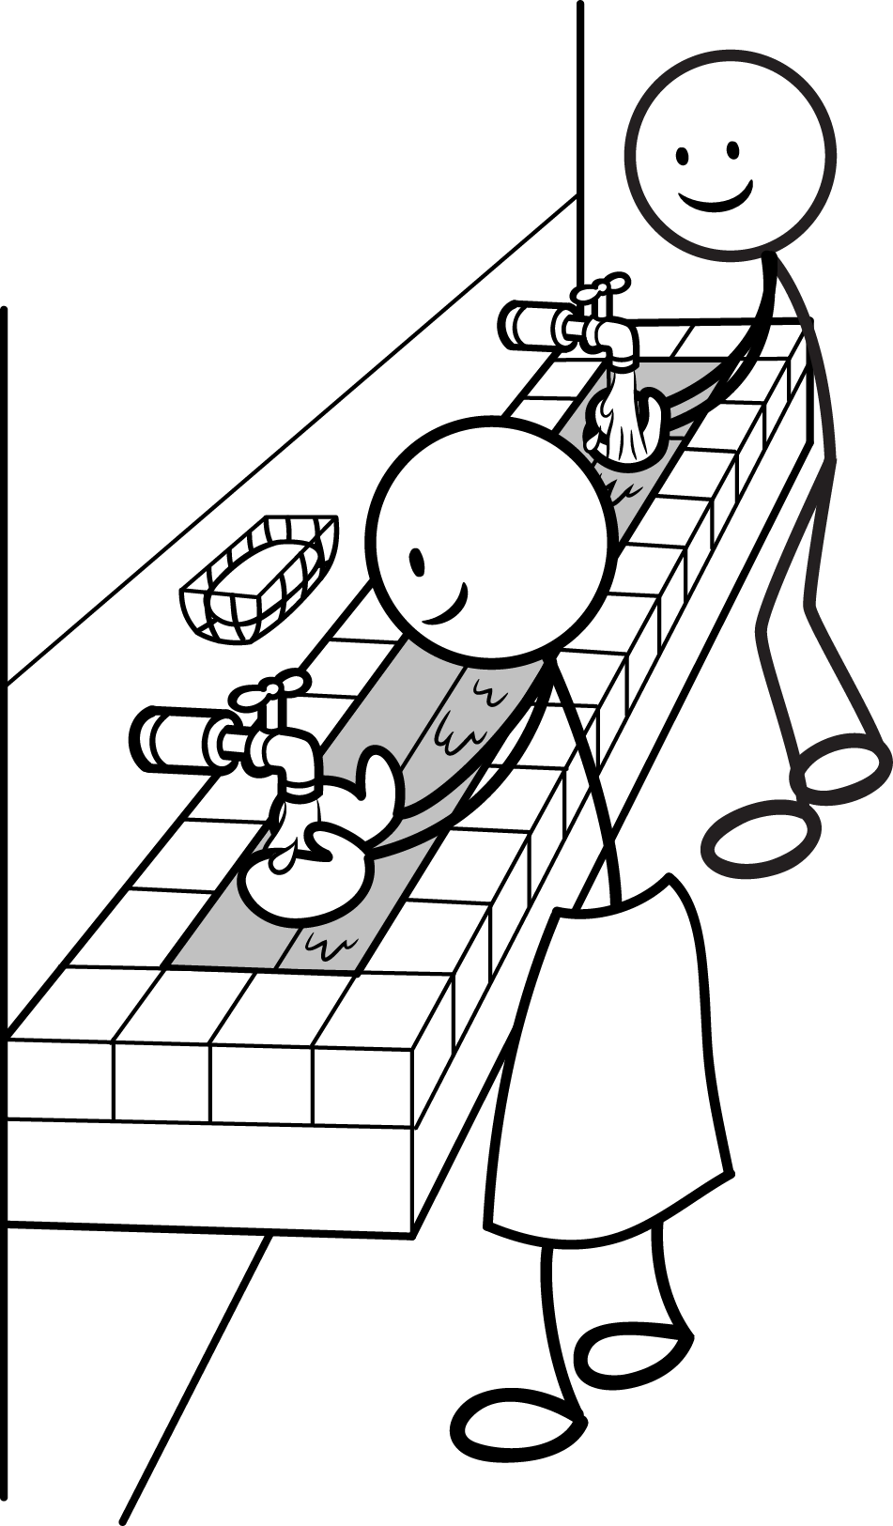
Low sink that children can reach
Notes:
Children must be able to reach the sink and taps (or other handwashing facility) and soap. Facilities designed especially for children (such as in schools) can be built low with easy to use taps. Alternatively, a stool can be used for children to stand on, such as in homes where the same facilities will be used by adults.

Slide 18
What Modifications?

Slide 19
Men and Boys
Taller urinals for men
Low urinals for boys
(Credit: Rieck et al., 2012)
Notes:
Urinals can be used for men, to collect urine.
Some men may prefer to urinate in a urinal.
Urinals can also be used for women (sitting or squatting), but they are not common.
By using a urinal, urine can also be easily collected, stored and used as a fertilizer.
The urine can be piped into a pit, sewer system, a soak pit, into the ground, or it can drain directly into a storage tank such as a jerry can.
A simple funnel, bought or cut from a bucket or large bottle, can be attached to the top of a jerry can to make a basic urinal.
Reference for photo:
Rieck, C., von Münch, E., Hoffmann, H. (2012). Technology review of urine-diverting dry toilets (UDDTs) - Overview on design, management, maintenance and costs. Deutsche Gesellschaft fuer Internationale Zusammenarbeit (GIZ) GmbH, Eschborn, Germany. Retrieved at: http://www.susana.org/_resources/documents/default/2-874-technology-review-of-uddts-18-june-2013.pdf

Slide 20
Women and Girls
Places to change, dispose of or wash and dry menstrual products
(Credit: UNICEF Bangladesh and UNICEF Sierra Leone in WaterAId 2012)
Notes:
All women menstruate, and need a private place to change, dispose of or wash and dry menstrual products. This is also important not only in the home, but in public buildings such as clinics, markets, places of work, and schools. Girls typically start menstruating between the ages of 9 and 14.
Reference for illustrations:
House, S., Mahon, T. and S. Cavill (2012). Menstrual Hygiene Matters: A Resource for Improving Menstrual Hygiene around the World. WaterAid, London, UK. Available at: www.wateraid.org/what-we-do/our-approach/research-and-publications/view-publication?id=02309d73-8e41-4d04-b2ef-6641f6616a4f&sc_lang=en

