Slide 1
Creative Commons
License
This document is open content and licensed under the Creative Commons Attribution Works 4.0 International License. To view a copy of this license, visit http://creativecommons.org/licenses/by/4.0
You are free to: Share – Copy and redistribute the material in any medium or format Remix – Remix, transform, and build upon the material for any purpose, even commercially
Under the following conditions:
Attribution – You must give appropriate credit to CAWST and Eawag-Sandec, provide a link to the license, and indicate if changes were made. You may do so in any reasonable manner, but not in any way that suggests that CAWST and Eawag-Sandec endorses you or your use. Please include our website: www.cawst.org and www.sandec.ch.
CAWST and Eawag-Sandec will produce updated versions of this document periodically. For this reason, we do not recommend hosting this document to download from your website.
CAWST and Eawag-Sandec its directors, employees, contractors, and volunteers do not assume any responsibility for, and make no warranty with respect to, the results that may be obtained from the use of the information provided.

Slide 2
This presentation is used with Lesson Plan Financial Transfers in the Introduction to Faecal Sludge Management Trainer Manual
Available at www.cawst.org/resources and www.sandec.ch

Slide 3
Financial Transfers
2016
JULY

Slide 4
Learning Outcomes
Identify stakeholders involved in financial transfers in faecal sludge management.
List different types of financial transfers that play a role in faecal sludge management.
Identify different financial flow models for faecal sludge management.
Discuss the complexity of stakeholders and financial interactions in faecal sludge management.

Slide 5
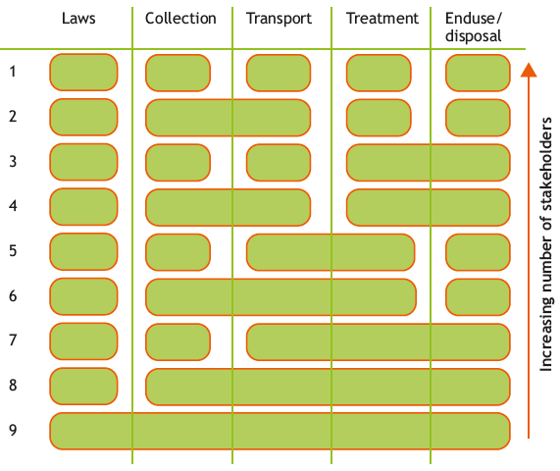
Financial Transfers
Notes:
There are many ways for stakeholders to organize the faecal sludge management service chain.
Systems that have more stakeholders involved will be more complex, regardless of who the stakeholders are.
Since the entire sanitation service chain is interlinked, it is essential that the roles and responsibilities of the stakeholders are clearly defined. One of the main reasons for faecal sludge management failure is the overlapping and unclear responsibilities.
This is different than wastewater management where the wastewater is transported via the sewer and frequently only one stakeholder is in charge of the entire system.

Slide 6
Financial Transfers
Budget supports
Capital investment
Discharge fee
Discharge incentive
Operating license
Emptying fee
Operation and maintenance
Purchase price
Sanitation tax
Notes:
-Budget support: Financial transfer between stakeholders to partly or fully cover a stakeholder’s operating budget.
- Capital investment: One-time financial transfer made at the beginning of a project to cover materials, labor and associated expenses (e.g., for a vacuum truck or a FS treatment plant).
- Discharge fee: Financial transfer made by collection and transport service providers in exchange for permission to discharge FS at some type of facility, like a treatment plant.
- Discharge incentive: The opposite of a discharge fee. A financial transfer to the collection and transport service in exchange for discharging FS at some type of facility.
- Operating license: (also known as a discharge license) Financial transfer made by a stakeholder in exchange for being permitted to operate in a certain area (e.g., collection and transport service).
- Emptying fee: Financial transfer between the household and a service provider in exchange for collecting and transporting FS from an on-site sanitation system.
- Operation and maintenance: Financial transfer that must be paid regularly to operate and maintain equipment like pumps, trucks, hoses, etc.
- Purchase price: Financial transfer between one stakeholder to another in exchange for becoming the sole owner of a good (e.g., a treatment product).
- Sanitation tax: Financial transfer collected once or regularly in exchange for an environmental service such as a sewer or water connection or emptying of FS from an on-site sanitation system.

Slide 7
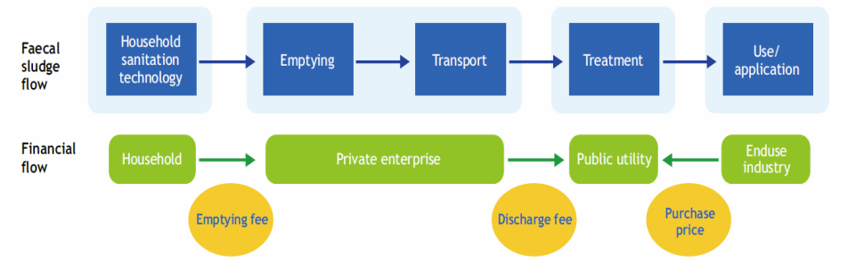
A Financial Flow Diagram
How do you read a financial flow diagram?
Notes:
The different components of the faecal sludge management system are shown on the upper part of the diagram in blue
The associated stakeholder is indicated below in green
The type of transfer is indicated by a yellow oval
The direction of the arrow between the stakeholders indicates the direction of the payment

Slide 8
Example: Model 1
A simple model
Notes:
Model:
The household pays a private enterprise and emptying fee in exchange of removing faecal sludge from their onsite sanitation technology.
The private enterprise pays a discharge fee to the public utility in exchange for the permission to discharge faecal sludge at the public utilities facility.
The public utility is paid a purchase price from a faecal sludge treatment product user.
Potential negative consequences of this model:
Private enterprise charge a high emptying fee to customers in order to pay for the discharge fee, excluding the poorest.
The private enterprise avoids paying the discharge fee and illegally discharges faecal sludge directly into the environment.
The public utility has no support from the government – less administrative supervision and poor quality of treatment and adherence to regulation.

Slide 9
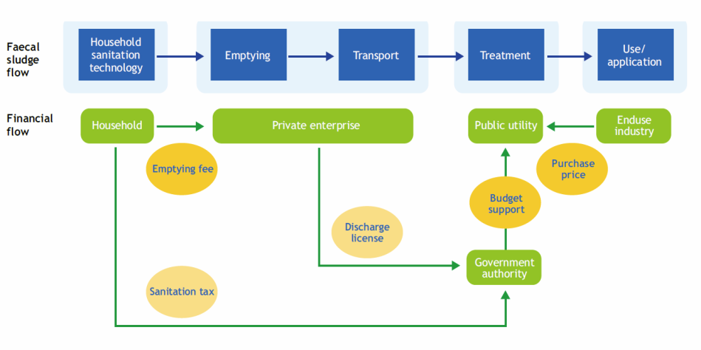
Example: Model 2
A more complex model
Notes:
Model:
The household pays a private service provider an emptying fee for removing faecal sludge from their on-site sanitation technology.
The private service provider pays a discharge license (or operating license) to the government authority for unlimited (or semi-limited) permission to discharge faecal sludge at the public utility.
The government authority is paid a sanitation tax from the household.
The government authority provides budget support to the public utility.
The public utility is paid a purchase price from a faecal sludge treatment product user.
How does this model reduce the negative consequences of the previous model:
The private service provider does not have to pay a discharge fee each time they bring faecal sludge to the public utility. This may reduce the illegal discharge of faecal sludge into the environment.
The public utility receives budget support from the discharge license (or operating license) and sanitation tax. This could be increased revenue compared to the previous discharge fee.
The government authority receives information on faecal sludge management services, such as the number of on-site sanitation systems emptied or vacuum trucks operating in a certain area.
The government authority recognizes and formalizes faecal sludge management services. This is the first step for improving the sector, setting industry standards, and improving working conditions.

Slide 10
How we can support you!
Contact CAWST and Eawag-Sandec for support on using and adapting our education and training resources for your work.
Visit www.cawst.org/resources and www.sandec.ch for:
Latest updates to this document
Other workshop & training related resources
Upper 424 Aviation Rd NE,
Calgary AB T2E 8H6, Canada
+ 1 403 243 3285
support@cawst.org
www.cawst.org
Überlandstrasse 133
CH-8600 Dübendorf, Switzerland
+41 (0)58 765 55 11
info@sandec.ch
www.sandec.ch

