Slide 1
424 Aviation Road NE
Calgary, Alberta, T2E 8H6, Canada
Phone: + 1 (403) 243-3285, Fax: + 1 (403) 243-6199
E-mail: resources@cawst.org, Website: www.cawst.org
CAWST, the Centre for Affordable Water and Sanitation Technology, is a nonprofit organization that provides training and consulting to organizations working directly with populations in developing countries who lack access to clean water and basic sanitation.
One of CAWST’s core strategies is to make knowledge about water common knowledge. This is achieved, in part, by developing and freely distributing education materials with the intent of increasing the availability of information to those who need it most.
This document is open content and licensed under the Creative Commons Attribution Works 4.0 International License. To view a copy of this license, visit http://creativecommons.org/licenses/by/4.0 or send a letter to Creative Commons, 171 Second Street, Suite 300, San Francisco, California 94105, USA.
You are free to:
Share – to copy, distribute and transmit this document
Remix – to adapt this document
Under the following conditions:
Attribution. You must give credit to CAWST as the original source of the document. Please include our website: www.cawst.org
CAWST will produce updated versions of this document periodically. For this reason, we do not recommend hosting this document to download from your website.
CAWST and its directors, employees, contractors, and volunteers do not assume any responsibility for and make no warranty with respect to the results that may be obtained from the use of the information provided.
Stay up-to-date and get support:
Latest updates to this document
Other workshop & training related resources
Support on using this document in your work
CAWST provides mentorship and
coaching on the use of its education
and training resources.

Slide 2
This presentation is used with Lesson Plan: Maternal and Child Health, WASH-Related Diseases and HWTS.
Available at www.cawst.org/resources

Slide 3
Maternal and Child Health: Disease Information Packages

Slide 4
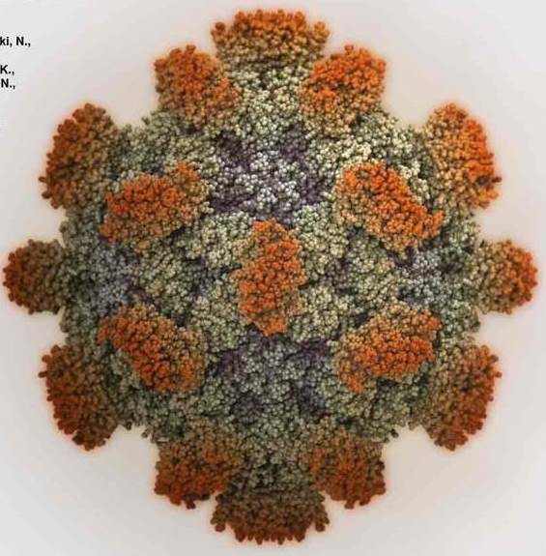
Hepatitis E
Source: Yamashita, et al., 2009
Hepatitis E is caused by the Hepatitis E virus.
It is also called HEV.

Slide 5
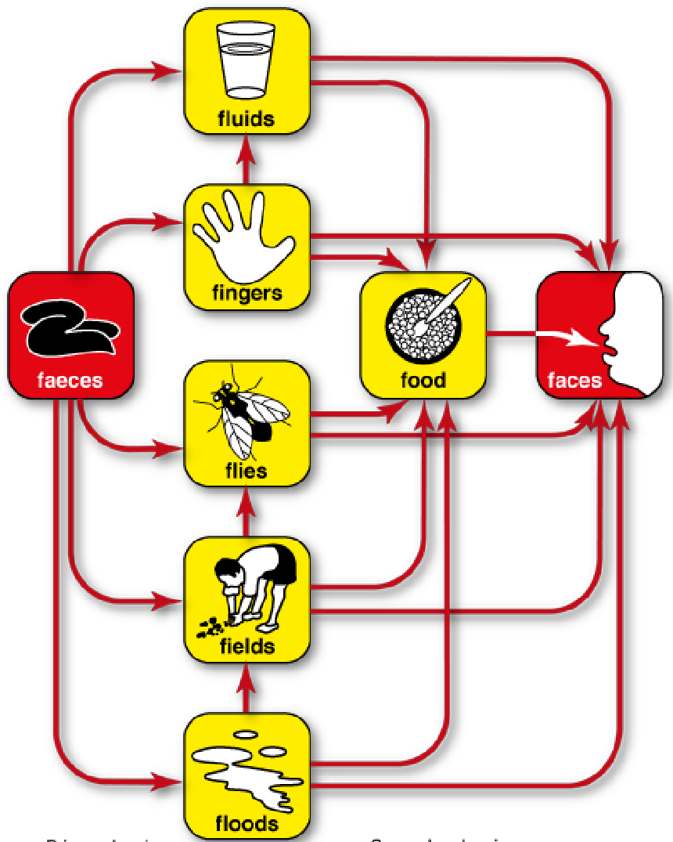
Hepatitis E
WEDC, 2012

Slide 6
Hepatitis E
Source: CDC http://www.cdc.gov/hepatitis/HEV/HEVfaq.htm#section2
Notes:
http://www.cdc.gov/hepatitis/HEV/HEVfaq.htm#section2

Slide 7
Hepatitis E
Hepatitis E is highly waterborne.
It is a fecal-oral disease. Commonly it is spread by fecal contamination of water from people, but certain types can also be spread by animals.
Pregnant women are very susceptible to Hepatitis E and transmit the disease to their fetuses.

Slide 8
Hepatitis E
According to the WHO there are 20 million Hepatitis E infections each year. 56,600 of these infections result in death.
Symptoms of Hepatitis E appear 3 to 8 weeks after infection. These symptoms include jaundice, lack of appetite, enlarged liver, stomach pain and tenderness, nausea, vomiting and fever.
Hepatitis E causes liver disease.

Slide 9
Hepatitis E
Numerous studies have shown that Hepatitis E infection during pregnancy in developing countries results in high maternal death (mortality) rates, increases the risk of premature birth, and death of newborns.
Approximately 30% of pregnant women who are infected with Hepatitis E die.
Approximately 45% of pregnant women with Hepatitis E will have a premature birth.
Approximately 25% of newborns born to women with Hepatitis E will die.

Slide 10
Toxoplasmosis
Source: CDC
Toxoplasmosis is caused by the protozoa Toxoplasma gondii.

Slide 11
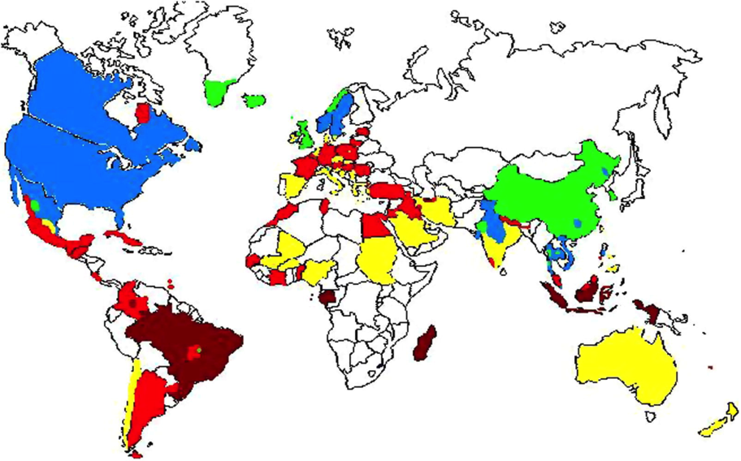
Toxoplasmosis
Global status of Toxoplasma gondii prevalence. Dark red equals prevalence above 60%, light red equals 40–60%, yellow 20–40%, blue 10–20% and green equals prevalence <10%. White equals absence of data.
Source: Pappas et al. 2009

Slide 12
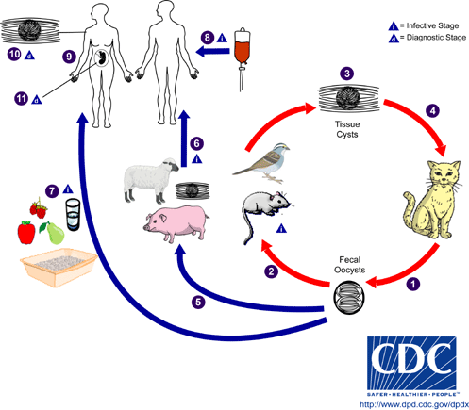
Toxoplasmosis
Source: CDC, 2014 http://www.cdc.gov/parasites/toxoplasmosis/biology.html

Slide 13
Toxoplasmosis
Toxoplasmosis is one of the most common human infections in the world – it is found everywhere other than Antarctica. It is most common in areas that have hot, humid climates and are at a lower altitude.
Toxoplasmosis can be transmitted by
Eating undercooked meat (e.g., lamb, venison, pork)
Lack of proper hygiene when preparing raw meat (e.g., handwashing)
Drinking water contaminated by feces
Passed from a pregnant mother who gets infected to her fetus.
Notes:
CDC

Slide 14
Toxoplasmosis
Healthy adults do not usually show symptoms because their immune systems are able to fight the disease. If they do have symptoms, they are similar to the flu, including fever and muscle aches. The parasite remains in the body and can become reactivated if the person’s immune system is very weak.
For adult with a very weak immune system, (e.g., people living with HIV / AIDS), the symptoms are worse. Symptoms are headache, seizures, poor coordination and blurred vision.

Slide 15
Toxoplasmosis
The impacts on a fetus can be severe. The child can appear healthy at birth, however, toxoplasmosis infection of a fetus can result in the following impacts on the child: severe eye infections, seizures, and mental disability.
The impact on the fetus is more severe the earlier in pregnancy the woman becomes infected. This may result in miscarriage or stillbirth.
More than 6 times the risk of miscarriage than a non-infected, pregnant woman
More than 3 times the risk of premature birth than a non-infected, pregnant woman
Almost 6 times the risk of fetal abnormality (e.g., severe eye infections, seizures, and mental disability)

Slide 16
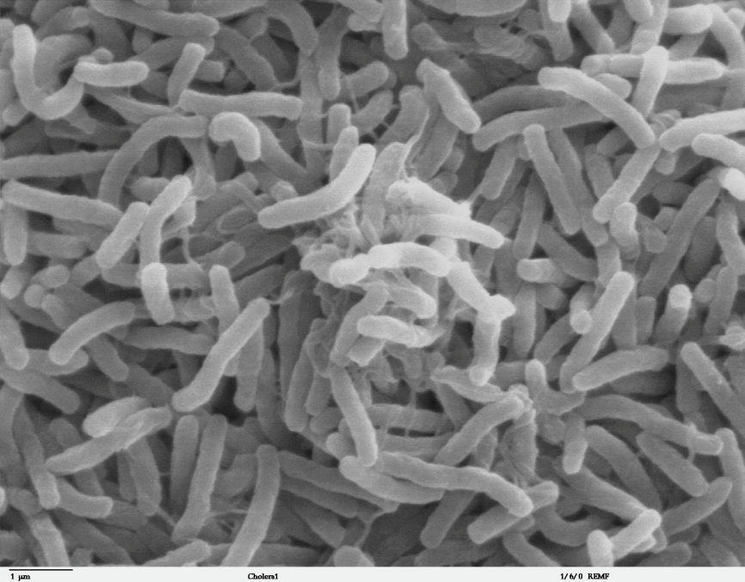
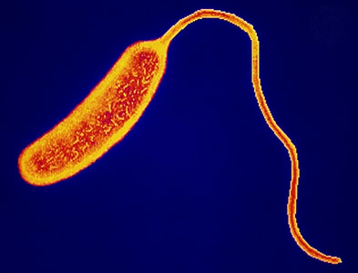
Cholera
kirstyne.wordpress.com
Wikipedia.com
Cholera is caused by the bacteria Vibrio cholerae.

Slide 17
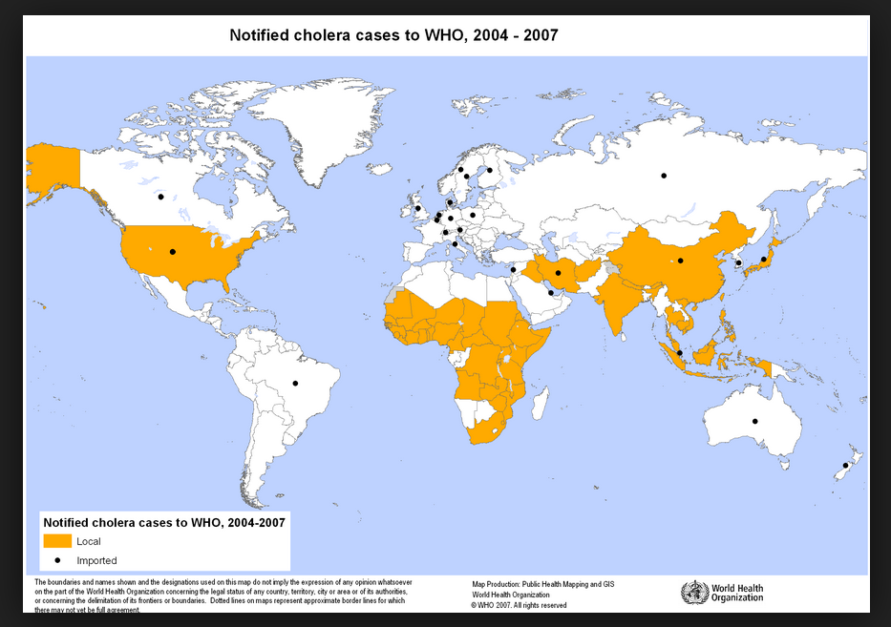
Cholera

Slide 18
Cholera
WEDC, 2012

Slide 19
Cholera
Cholera is a serious diarrheal disease that can result in death if it is not treated quickly. According to the WHO, there are 3 to 5 million cholera cases every year and approximately 100,000 to 120,000 result in death.
Cholera is found worldwide, but is commonly found in the Middle East, Africa, Central and South America, parts of Asia and the Gulf Coast of the United States.

Slide 20
Cholera
Cholera can cause severe dehydration which can have severe impacts on pregnant mothers and children.
Pregnant mothers have an increased chance of death. In fact, pregnant mothers are two times more likely to die from cholera as non-pregnant women.
When a pregnant woman dehydrates, not enough blood, oxygen, and / or nutrients pass to the fetus. About 30% of fetuses will die either from miscarriage or stillbirth.
Pregnant women have an increased risk of premature birth.
Newborns and young children are more than eight times more likely to die than adults.

Slide 21
Cholera
Cholera is highly contagious, dose dependent, and is transmitted by ingesting contaminated water or food. The transmission route is fecal-oral. Most infections become apparent within two or three days.
The most common symptom of cholera is watery diarrhea. Other symptoms include nausea and vomiting.
In places where cholera is common each year, “children, who are less likely than adults to have been exposed, are the most vulnerable to symptomatic infection and severe illness and death.” (UNICEF, 2013)

Slide 22
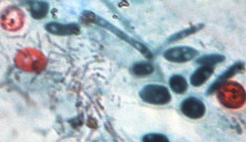
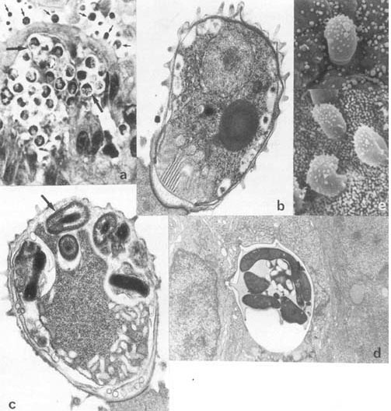
Cryptosporidiosis
ecdc.europa.eu
Cyrptosporidiosis is caused by a protozoa, most commonly Cryptosporidium hominis and C. parvum.
examiner.com

Slide 23
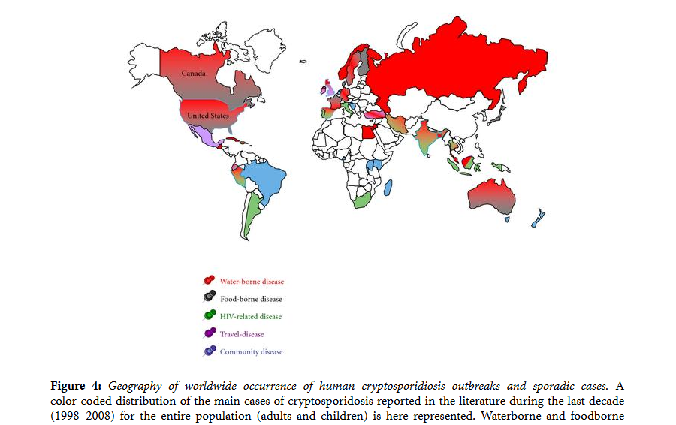
Cryptosporidiosis
Taken from Putignani, L., & Menichella, D. (2010). Global Distribution, Public Health and Clinical Impact of the Protozoan Pathogen Cryptosporoidium. Interdisciplinary Perspectives on infectious Diseases. doi:10.1155/2010/753512

Slide 24
Cryptosporidiosis
North America | Caribbean | Central/ South America | Africa | Europe
Canada | Cuba | Argentina | Algeria | Austria
Mexico | Haiti | Brazil | Burundi | Belgium
United States | Jamaica | Colombia | Cameroon | Czechoslovakia
 | Puerto Rico | Chile | Ethiopia | Denmark
Pacific | St. Lucia | Costa Rica | Gabon | England
Australia | Tobago | Ecuador | Ghana | Finland
Malaysia | Trinidad | El Salvador | Guinea | France
New Zealand | Virgin Islands | Guatemala | Guinea-Bissau | Germany
Papua-New Guinea |  | Panama | Ivory Coast | Greece
Philippines | Asia | Peru | Kenya | Hungary
Singapore | Bangladesh | Uruguay | Liberia | Ireland
 | Belarus | Venezuela | Mauritania | Italy
Middle East | Cambodia |  | Mauritius | Lithuania
Egypt | China |  | Morocco | Netherlands
Iran | India |  | Nigeria | Poland
Israel | Japan |  | Rwanda | Portugal
Kuwait | Korea |  | South Africa | Romania
Saudi Arabia | Myanmar Republic |  | Sudan | Serbia
 | Pakistan |  | Togo | Spain
 | Russia |  | Tunisia | Sweden
 | Sri Lanka |  | Uganda | Switzerland
 | Taiwan |  | Zaire | Turkey
 | Thailand |  | Zambia | Wales
 |  |  | Zimbabwe
Countries that have reported cryptosporidiosis (Source: USEPA, 2011)

Slide 25
Cryptosporidiosis
WEDC, 2012

Slide 26
Cryptosporidiosis
Cryptosporidiosis is a diarrheal disease that is found worldwide. Estimates are that the prevalence is 1-4.5% in developed countries and 3-20% in developing countries.
Transmitted by the fecal-oral route. Drinking water and recreational water are the two most common methods of transmission. Cryptosporidium oocysts are shed in the feces of contaminated people and animals (especially cows). The Cryptosporidium oocysts are immediately able to infect a new host.

Slide 27
Cryptosporidiosis
Cryptosporidiosis symptoms begin 2 to 10 days after infection. The most common symptom is watery diarrhea. Other symptoms include stomach pain or cramps, dehydration, nausea, vomiting, fever, and weight loss.
In young children and people with weak immune systems, cryptosporidiosis can cause diarrhea that is persistent (lasts more than 14 days).
This disease (with or without symptoms) can result in poor nutrient absorption, malnutrition, stunting, poor cognitive development, and death.

Slide 28
Cryptosporidiosis
Children are particularly susceptible to Cryptosporidium infections, especially children less than 2 years old.
Many studies show that young children are more likely to die with a Cryptosporidium infection.
Persistent diarrhea at a young age can cause poor cognitive development – the process of developing intelligence and problem-solving ability.
People living with HIV/AIDS, especially pregnant women and children, have a higher risk of death.

Slide 29
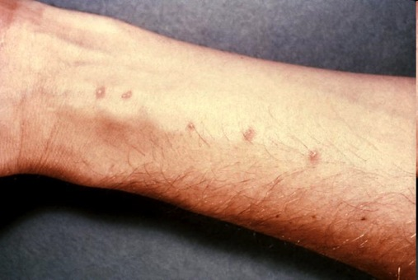
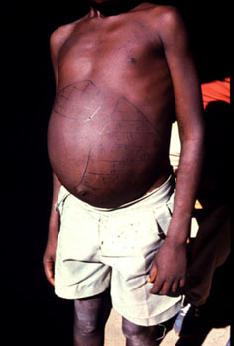
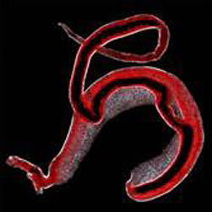
Schistosomiasis
www.asb.wchsgis.net
Schistosomiasis is caused by helminths, or worms, called schistosomes of the type Schistosoma. They are also known as blood flukes or bilharziasis.
www.path.cam.ac.uk
© Natural History Museum, London

Slide 30
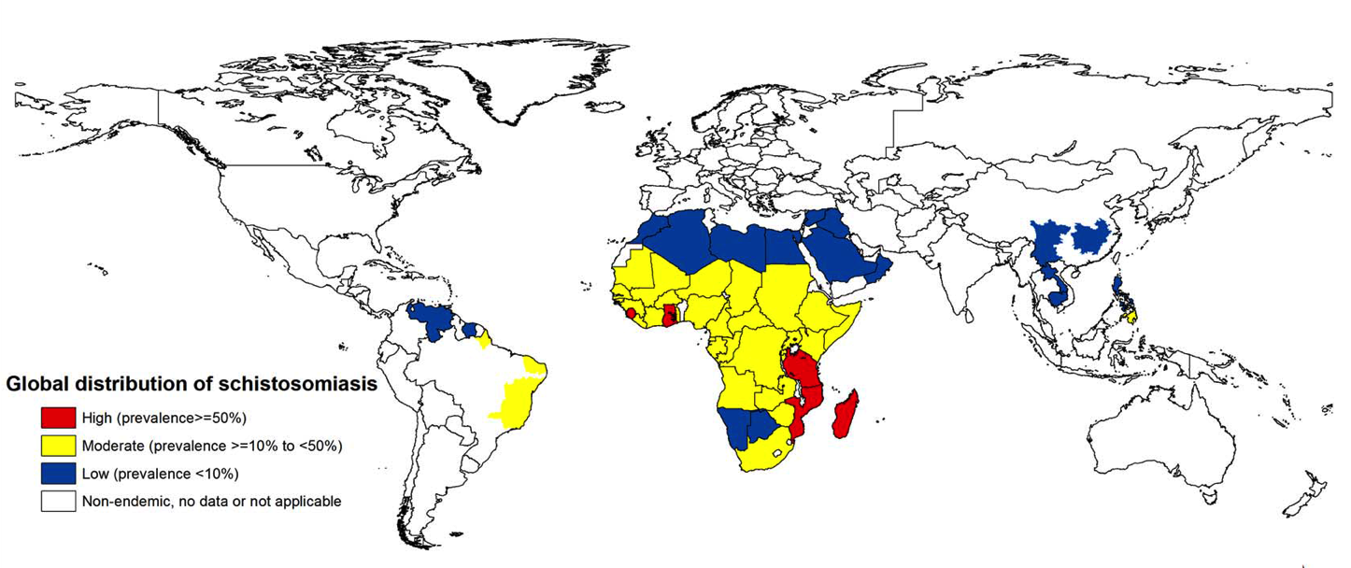
Schistosomiasis
Source: Campbell, et al. 2014

Slide 31
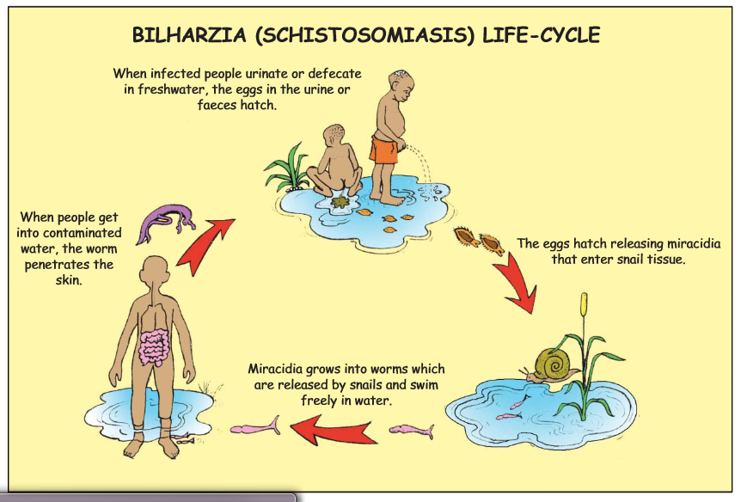
Schistosomiasis
From http://apps.who.int/iris/bitstream/10665/44636/1/9789241501903_eng.pdf

Slide 32
Schistosomiasis
“In terms of impact, this disease (schistosomiasis) is second only to malaria as the most devastating parasitic disease.” – CDC
Schistosomiasis affects 74 countries, 200 million people (approximately 20 million with severe disease), and causes 280,000 deaths every year.
Approximately 10 million women in Africa have schistosomiasis in pregnancy.
An estimated 85% of the world’s cases of schistosomiasis are in Africa, where prevalence can exceed 50% in some local populations.
Notes:
CDC quotation http://www.cdc.gov/parasites/schistosomiasis/

Slide 33
Schistosomiasis
Schistosomiasis is transmitted when a person’s skin comes into contact with contaminated water. Water is contaminated when infected humans or animals defecate or urinate in water, as schistosome eggs are shed with feces and urine. Eggs in contaminated water attach to and enter a person’s body through their skin.
When the eggs first enter the body through the skin, rashes may appear and skin may itch. As the parasite matures, symptoms include fever, chills, cough and muscle aches. Other symptoms include stomach pain, diarrhea and bloody stool. The liver and spleen can enlarge in serious cases.

Slide 34
Schistosomiasis
In children, schistosomiasis:
Causes anemia - newborns and children have a 40% higher rate of anemia
Contributes to difficulty learning
Pregnant women infected with schistosomiasis:
Develop severe anemia - 65% of pregnant women with schistosomiasis have anemia
Have low birth weight infants - 45% of newborns will be born with low birth weight
Increased infant / maternal mortality rates
Higher rates of miscarriage

