Slide 1
12, 2916 – 5th Avenue
Calgary, Alberta, T2A 6K4, Canada
Phone: + 1 (403) 243-3285, Fax: + 1 (403) 243-6199
E-mail: cawst@cawst.org, Website: www.cawst.org
CAWST is a Canadian non-profit organization focused on the principle that clean water changes lives. Safe water and basic sanitation are fundamentals necessary to empower the world’s poorest people and break the cycle of poverty. CAWST believes that the place to start is to teach people the skills they need to have safe water in their homes.
CAWST transfers knowledge and skills to organizations and individuals in developing countries through education, training and consulting services. This ever expanding network can motivate individual households to take action to meet their own water and sanitation needs.
One of CAWST’s core strategies is to make knowledge about water common knowledge. This is achieved, in part, by developing and freely distributing education materials with the intent of increasing its availability to those who need it most. You should feel free to copy and distribute this document in any form, printed or electronic. If you wish to use any parts of this document in the creation of your own materials, please ensure that CAWST is properly acknowledged. Please include our website address: www.cawst.org.
Feel free to include a link from your website to the CAWST website. Please do not host this document to download from your website as we will have updated versions from time to time. Please email us if you have any questions or feedback.
This document is open content and licensed under the Creative Commons Attribution Works 3.0 Unported License. To view a copy of this license, visit: http://creativecommons.org/licenses/by/3.0
You are free to:
Share – to copy, distribute and transmit this document
Remix – to adapt this document
Under the following conditions:
Attribution. You must give credit to CAWST as the original source of the document
CAWST and its directors, employees, contractors, and volunteers do not assume any responsibility for and make no warranty with respect to the results that may be obtained from the use of the information provided.

Slide 2
This presentation is used with Lesson Plan 11: Storage Tanks in the Rainwater Harvesting Trainer Manual.
Available at www.cawst.org/resources

Slide 3
Storage Tanks

Slide 4
Learning Expectation

Slide 5
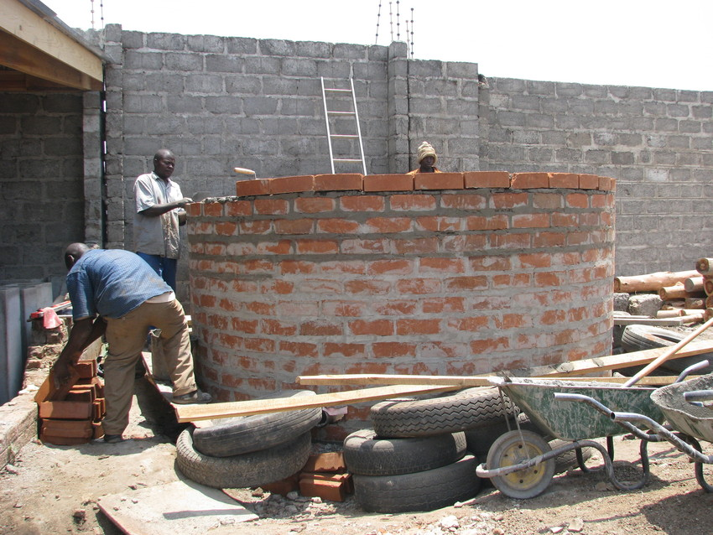
Brick and Block Tanks
Notes:
Simple and cheap to build
Materials found locally
People can make bricks themselves
Tend to have poor strength
Can require more cement
Easier to build than ferrocement.

Slide 6
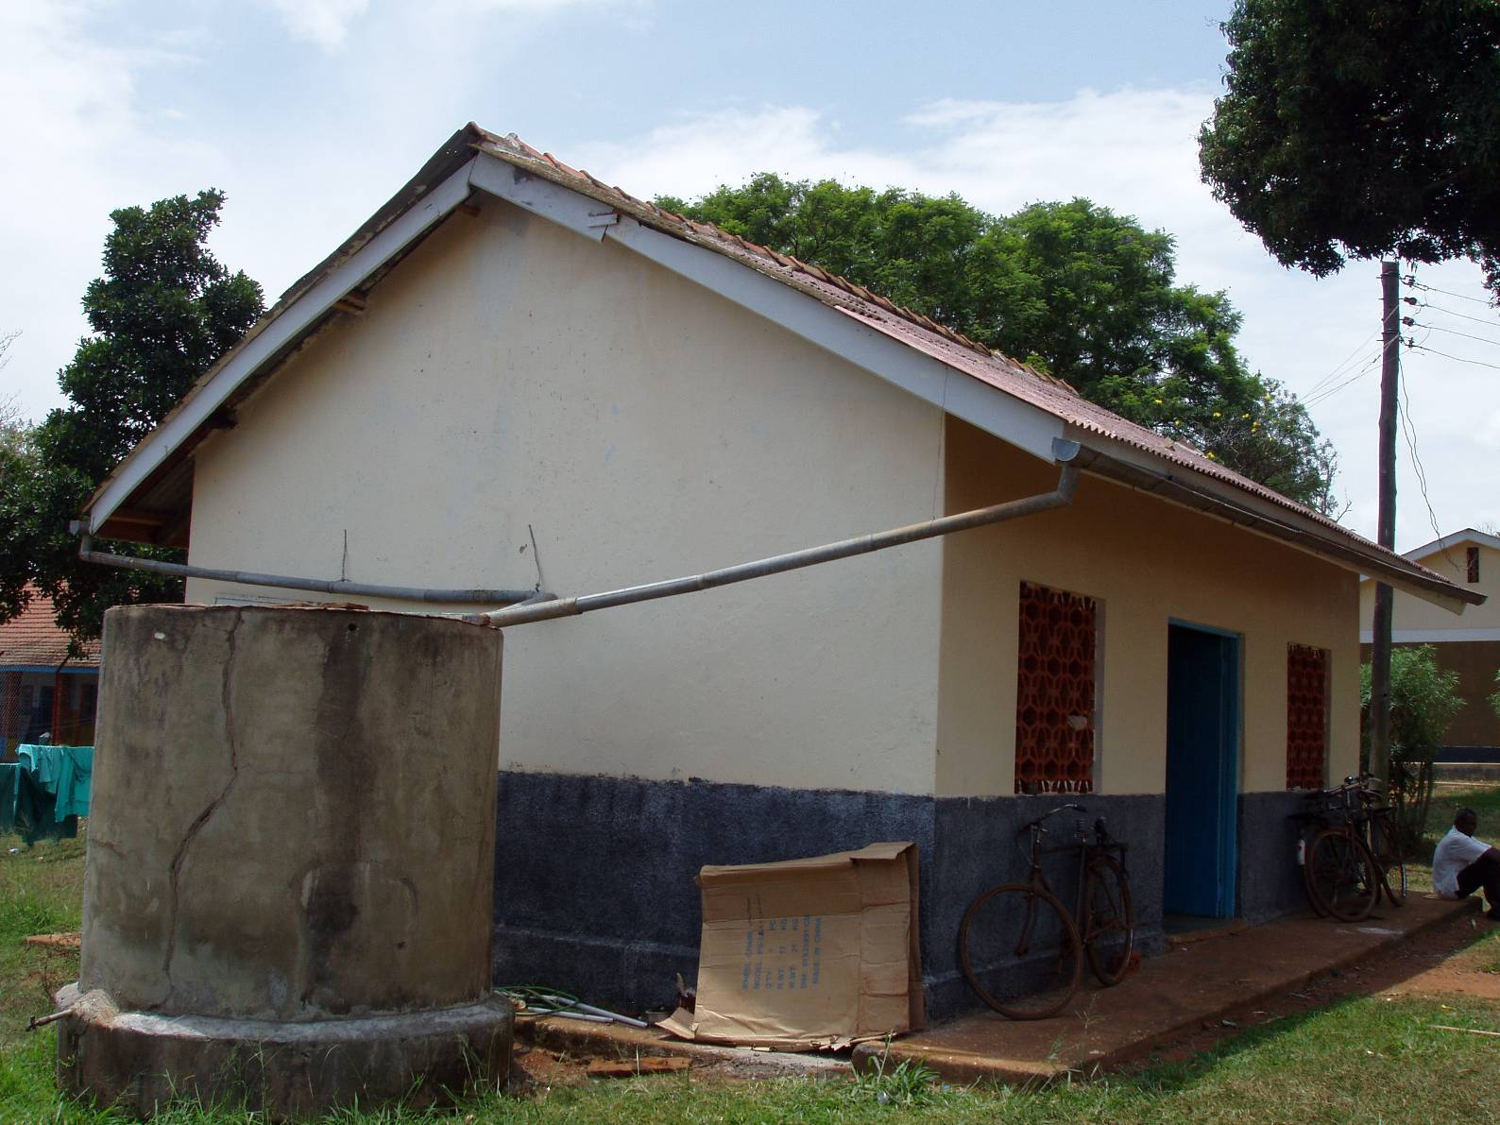
Ferrocement Tank
Notes:
Durable
Inexpensive
Made locally
If not made correctly can be susceptible to cracks

Slide 7
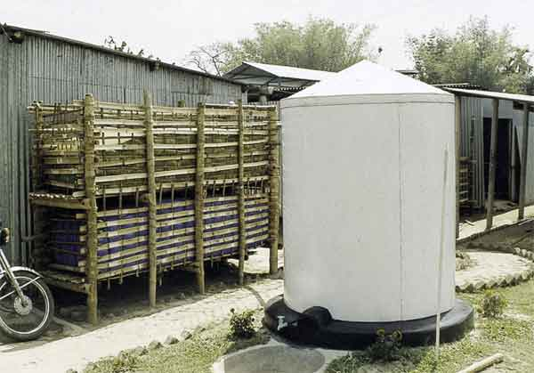
Galvanized Iron
Notes:
Buy prefabricated
Can rust
Light to transport
More expensive than ferrocement

Slide 8
Concrete
Notes:
Durable
Made locally
Need good molds
Local Labour
More expensive – require reinforcement

Slide 9
Plastic
Notes:
Light
Easy to transport
More expensive
No local labour

Slide 10
Tank Roof or Cover
Notes:
Prevents evaporation
Reduces the risk of contamination
Two options:
Flat roof (reinforced concrete) is easier to construct
Dome roof (ferrocement)

Slide 11
Tap
Not a great design!
(Gould and Nissen-Petersen, 1999)
Notes:
There must be a tap for easy access of water
The water at the level of the outlet of the tank is unusable, we call this dead storage
Its best to make a soakpit under the tap to stop water from pooling, creating mud and breeding grounds for mosquitoes.
This is not a great tap design – you will get sludge trapped in your tap!!!
You should put a washout pipe at the bottom of our tank, this way you can clean out the sludge from the bottom and stop it from coming out of your tap.

Slide 12
Tank Design
(Gould and Nissen-Petersen, 1999)

